Slide 1
IBM Cognos TM1 IBM planning Analytics
an ERP software that can remodel your complete planning cycle

Slide 2
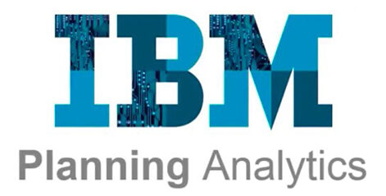
IBM Planning Analytics: Analyze Data and Create Reports
Identify the TM1 position in a performance management system
Describe TM1 components and architecture
Manually create dimensions, import, and edit them
Construct and edit a cube
Identify data sources
Create processes to update and maintain a model
Review, disable, and enable auto-generated rules
Optimize rules using a SKIPCHECK statement
Troubleshoot rules and feeders
Link cubes with different dimensions
Use Planning Analytics as a data source
Push data to a cube
Create a drill process and drill assignment rules
Utilize a lookup cube and attributes in rules
Create rules for currency conversion
Use Planning Analytics to reduce maintenance
Use discreet time dimensions
Implement a continuous time dimension model

Slide 3
Sinper corporation: 1983
Sinper TM/1
Applix: 1996
Applix TM1
Cognos: 2007
IBM: 4 Months later
IBM Cognos TM1
IBM Planning Analytics powered by TM1 is a business performance management software suite designed to implement collaborative planning, budgeting & forecasting solutions, interactive ‘what-if’ analyses, as well as analytical & reporting applications.
The database server component of the software platform retained its historical name TM1.
IBM Cognos TM1 (Table Manager 1) is a multidimensional, in-memory OLAP engine which allows write back to the TM1 database.
TM1 is a client/server platform. It uses Microsoft excel & various web applications on the client side with an in memory, multidimensional data store on the server side.
Notes:
Manny Perez invented Table Manager 1 (TM1) in 1983 to solve complex, forward-looking business modeling problems associated with budgeting, forecasting and financial reporting.
Manuel Perez with his friend Jose Sinai formed the Sinper Corporation in early 1983 and released his initial product, TM/1 (the "TM" in TM1 stands for "Table Manager"). Sinper was purchased by Applix in 1996, which was purchased by Cognos in late 2007, which was in itself acquired mere months later by IBM.
With its flagship TM1 product line, Applix was the purest OLAP vendor among publicly traded independent BI vendors prior to OLAP industry consolidation in 2007.
On December 16, 2016 IBM released a rebranded and expanded version of the software (IBM Planning Analytics Local 2.0 'powered by' IBM TM1) with a 'restarted' version numbering. The data server component is still referred to as TM1 and retains numbering continued from prior versions, so Planning Analytics version 2.x includes TM1 version 11.x.

Slide 4

TM1 belongs to a class of software products which implement the principles of the functional database model.
The IBM Planning Analytics platform, in addition to the TM1 database server, includes an ETL tool, server management and monitoring tools and a number of user front ends which provide capabilities designed for common business planning and budgeting requirements, including workflow, adjustments, commentary, etc.
Notes:
Data is stored in in-memory multidimensional OLAP cubes, at leaf level & consolidated on demand.
In addition to data, cubes can include encoded rules which define any on-demand calculations.
By design, computations on the data are performed in near real-time, without the need to pre-calculate, due to a highly performant database design and calculation engine. These properties also allow the data to be updated frequently and by multiple users.

Slide 5
Development by IBM
Since acquisition, IBM has dramatically improved the performance of the product, added a number of new front ends & integrated it well with Cognos Analytics.
IBM renamed TM1 to Planning Analytics. It can be hosted by IBM in a SAAS environment, or hosted locally or managed in a hybrid configuration.
Additionally, there has been the introduction of Planning Analytics Workspace, a highly visual data exploration & dash boarding tool with write back to the source data.
IBM has also replaced the original excel add-in , perspectives with Planning Analytics for Excel (PAX) ,significantly increasing the usability for the excel user.

Slide 6
is a versatile solution used by organizations ranging from the largest corporations and government agencies to small businesses for budgeting, planning, forecasting, management reporting, analysis and consolidations on demand.
integrates business planning, performance measurement, and operational data to enable companies to optimize business effectiveness and customer interaction regardless of geography or structure.
IBM Planning Analytics Workspace and other Planning Analytics components provide immediate visibility into data, accountability within a collaborative process and a consistent view of information, allowing managers to quickly stabilize operational fluctuations and take advantage of new opportunities.

Slide 7
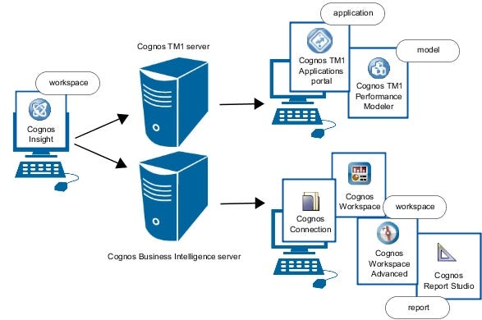
IBM TM1 is now available as a part of IBM Planning Analytics, a next-generation of analysis and planning, available on- cloud, on-premise and in combined environments too.

Slide 8
Components
TM1 Server
Planning Analytics Workspace (a.k.a. PAW) - main web front end and development environment
Planning Analytics for Microsoft Excel (a.k.a. PAfE, formerly PAx) - main Excel front end
TM1 Web - legacy web front end
TM1 Applications - legacy web front end
TM1 Perspectives - legacy Excel front end
TM1 Architect - legacy standalone Windows front end and development environment
TM1 Performance Modeler - legacy development environment

Slide 9
Understanding TM1
Table Manager (TM1) is a multi-dimensional, in-memory OLAP database with a cell-oriented structure.
TM1 was developed from the need to perform ‘spreadsheet’ analysis to large volumes of multidimensional data.
Here data is stored as multidimensional arrays or “cubes”, which can be easily manipulated & analyzed in real-time.
Cell orientation is key aspect of TM1.
Data is stored and processed at the level of individual cells, rather than in predefined structures such as tables or columns which allows for a high degree of flexibility in modeling and analyzing data, as cells can be easily manipulated and combined to create new views and analyses.
Since cells can be easily linked to other cells or data sources, cell-oriented databases are highly dynamic and can be updated in real-time as new information becomes available.
Notes:
TM1 provides the flexibility, interactivity and modeling power of spreadsheets, but retains the control, security and scalability of a database.

Slide 10
Core Components of TM1
Dimensions
Elements (the individual members of a dimension, usually rolled into hierarchies)
Cubes (combining dimensions into a storage repository called a cube)
Rules (the formulae that determine how elements are calculated)
Processes (for loading data & managing the overall environment)
Chores (scheduled jobs)
Security (by cube, dimension, element or even cell)
Excel reports & forms.
Dashboards & visualizations.

Slide 11
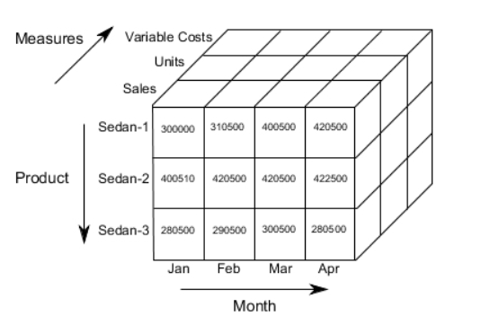
Components of TM1
Cubes, Dimensions, hierarchies & rules are essential components of TM1.
They provide a powerful framework for organizing and analyzing enterprise planning data and can help businesses gain valuable insights into their operations, performance and trends.
Cubes:
Central building blocks of TM1.
Multi-dimensional arrays of data that allow users to analyze & explore data from different perspectives.
Made up of 2 or more dimensions.
Look & feel like a pivot table.
Data is at dimension intersection points.
Ex: A company might wish to summarize financial data by product, time-period & city to compare actual & budget expenses.

Slide 12
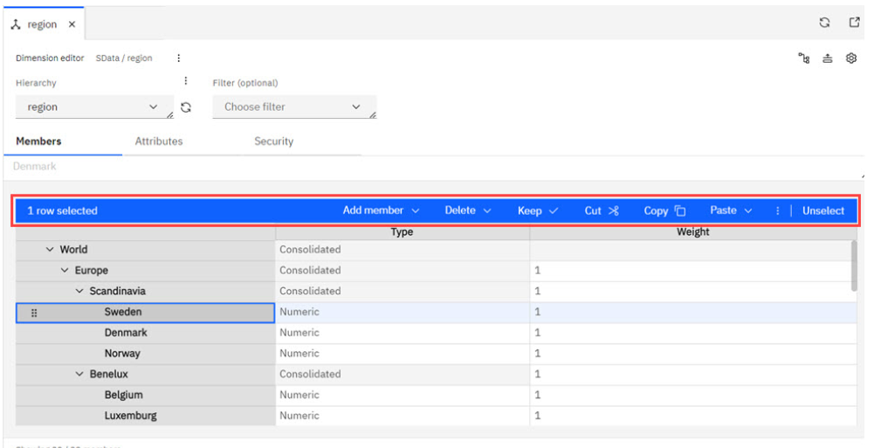
Dimensions:
Are the categories or attributes by which data is organized within a cube.
They provide context & meaning to the data and allow users to slice & dice data along different axes.
Typical dimensions in a cube contain time, versions, regions, products, departments & metrics.

Slide 13
Hierarchies:
Logical organization of dimension members into a parent-child relationship.
They provide a structure or organization to a dimension, allowing users to navigate & analyze KPIs at different levels of granularity or detail.
Ex: A time dimension hierarchy might include levels such as year, quarter, month and day.
Rules:
Statements or instructions that govern the behavior of the database.
Rules define how the database processes and calculates data and how it responds to user queries & requests.
These can be used to calculate purchase costs, exchange rates, inventory levels, inventory depletion and final production costs.
More details later..

Slide 14
Key concepts
In-memory:
The storage of data is in computer memory instead of on disk or other external storage devices. This allows for faster access to the data, which is useful for processing large amounts of data quickly and enables real-time data analysis and reporting. By storing data in memory, TM1 can perform calculations and generate reports faster than traditional databases.
Write-back:
Write-back capability, a feature of cell-oriented databases, enables users to update and save changes made directly to cells in the database, rather than exporting and importing data for editing. In a cell-oriented database, data is stored and processed at the level of individual cells, rather than in predefined structures such as tables or columns.
Real-time calculation:
TM1 optimizes calculations by performing them only on data that has actual values or changes, instead of recalculating everything in the cube. It saves time by reducing the amount of data processed during calculations and identifying only the cells that need to be recalculated based on updated or modified data.

Slide 15
Benefits
This software platform is designed to help businesses with decision-making based on real-time data.
Collaborating seamlessly with multiple stakeholders and forecasting future outcomes by using advanced statistical and predictive algorithms without the need for IT.
Flexibility and scalability
Allows for a high degree of flexibility in data modeling and analysis.
Makes it easier to accommodate changes in business requirements and adapt to evolving business needs.
Can scale to handle large volumes of data, making it suitable for large enterprises and complex businesses.
Speed and Performance
Designed for high-speed, real-time data analysis and modeling.
The in-memory database architecture allows for rapid data retrieval and processing.

Slide 16
Benefits
Data Integration
Using TurboIntegrator, it can integrate data from a variety of data sources, including spreadsheets, leading EPM (such as Oracle, SAP), and other data management systems, making it easy to combine data from different sources for analysis and report authoring.
Real-time collaboration
Provides a platform for collaborative planning, budgeting and forecasting, enabling multiple stakeholders to contribute to the workflows and share insights and feedback in real-time.
Granular security
Provides granular security capabilities, allowing for data access to be restricted to specific end users or user groups, ensuring that sensitive data is only accessible by authorized users, leading to increased trust and confidence in the data.
Prospective analytics
Can perform prospective analytics by using predictive modeling and forecasting techniques to analyze historical data, identify trends and patterns, perform what-if scenario analysis and make predictions about future outcomes.

Slide 17
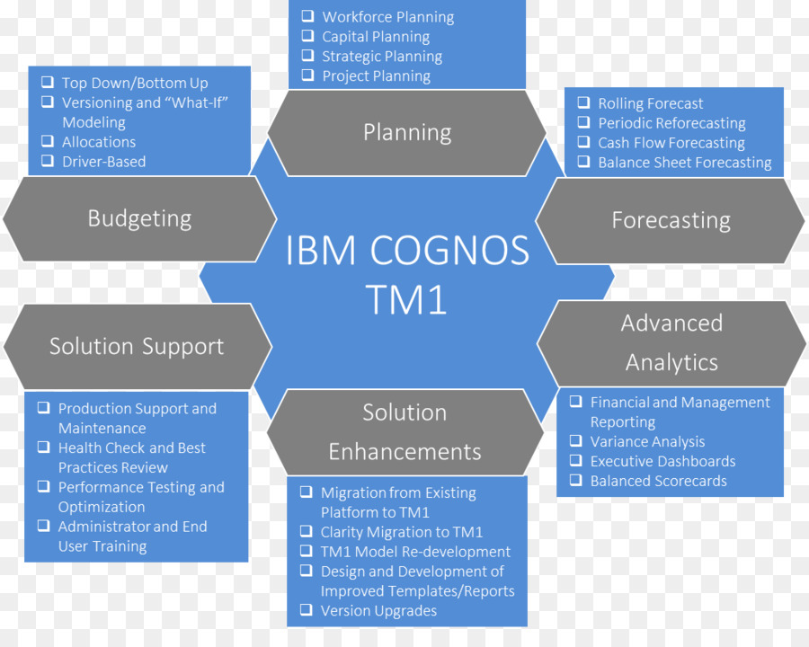

Slide 18
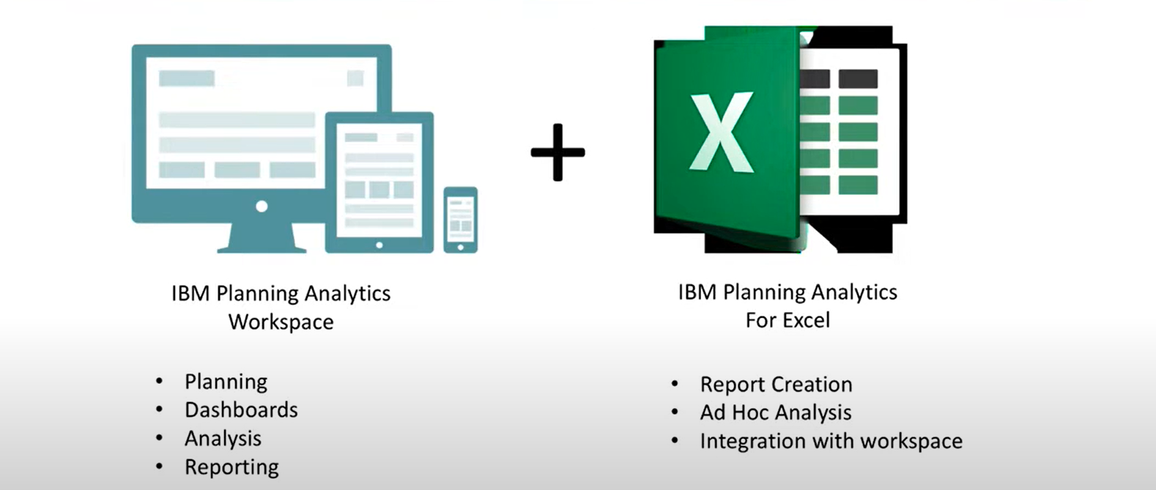
All user roles are served by a single web based workspace available via desktop or mobile browsers.
Users can also have access via excel based interface which is deeply integrated within the solution.

Slide 19
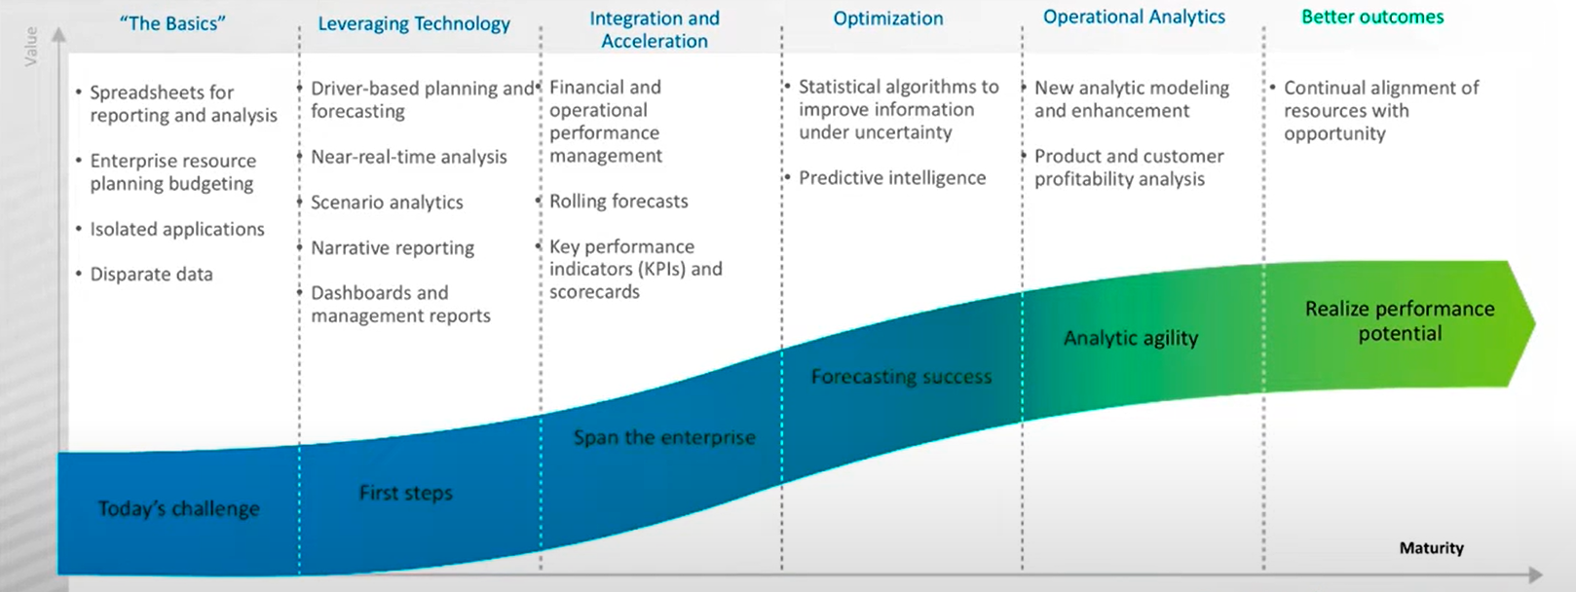
Depending on where we are on our analytics journey, we can start in automation and grow into more advanced capabilities such as BI, where we may need to do reporting across all organization’s data sources.

Slide 20

Understanding & working with TM1

Slide 21
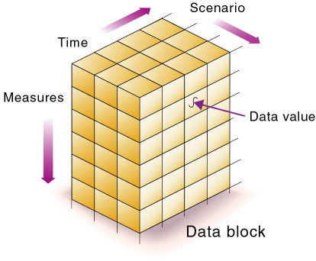
Multidimensional Database
A type of database that is optimized for data warehouse and online analytical processing (OLAP) applications.
MDBs are frequently created using input from existing relational databases.
An OLAP application that accesses data from a multidimensional database is known as a multidimensional OLAP (MOLAP) application.
A multidimensional database provides the ability to rapidly process data and generate answers quickly. MDBs let users ask questions about businesses operations and trends.

Slide 22
Conceptually, a multidimensional database uses the idea of a data cube to represent the dimensions of data available to a user.
MDBs have three or more dimensions to them, labeled as X, Y and Z dimensions.
This is opposed to databases with two dimensions, which have rows and columns and only use X and Y labels.
Example
In an MDB, sales could be viewed in the dimensions of the product model, geography, time or some additional dimension.
In this case, sales is known as the measure attribute of the data cube and the other dimensions are seen as feature attributes. A database creator can define hierarchies and levels within a dimension, such as state and city levels within a geographical hierarchy.

Slide 23
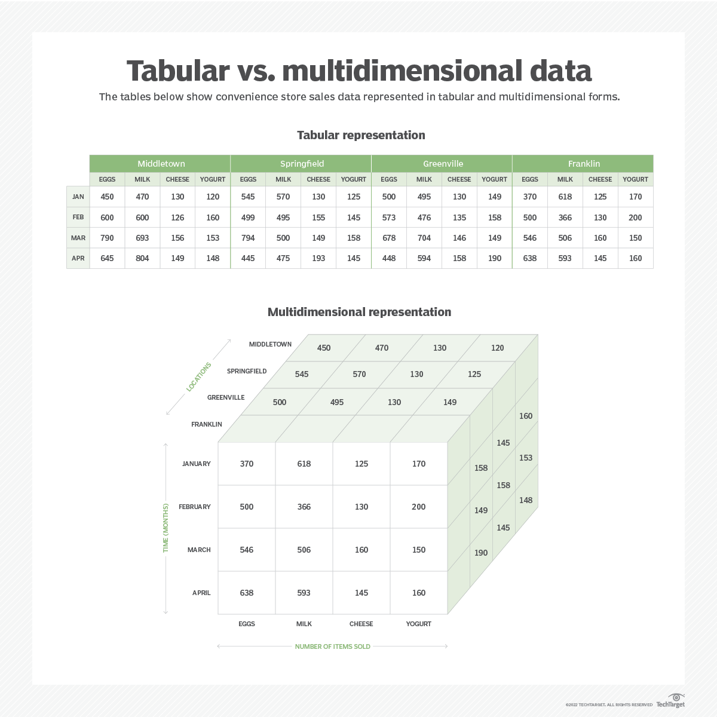

Slide 24
Advantages and disadvantages of a multidimensional database
MDBs come with a number of benefits and challenges when compared to other types of databases.
Benefits
Easy maintenance- Because data is stored the same way it is viewed -- by attribute -- it's easy to keep track of and maintain.
Similar data groupings- Similar data is grouped in single dimensions, which helps with organization and data presentation.
Performance- MDBs are able to process data and answer queries faster than relational databases.
Different views of data sets. Users can analyze relationships between data sets and categories in different visual layouts.
Challenges
Complexity MDBs are more complex than relational databases and may require more training and experience.
Performance issues- Performance can become impaired if the system doesn't cache correctly; for instance, if Google hasn't yet stored a cached view for the page.

Slide 25
OLAP and multidimensional database relationship
Online analytical processing (OLAP) is a multidimensional, multiuser, client-server computing environment for users who need to analyze enterprise data.
OLAP is a computing method that enables users to easily and selectively extract and query data and then analyze it from different points of view.
OLAP often aids in trend analysis, financial reporting, budget planning and forecasting.
Some examples of the leading OLAP vendors include Microsoft, Oracle, IBM and SAP.
Multidimensional databases are important to the functioning of OLAP systems. They consolidate and calculate data and provide for the retrieval and calculation of data subsets.
MOLAP is a type of OLAP that indexes directly into a multidimensional database.

Slide 26
Finance departments use OLAP for applications such as budgeting, activity-based costing (allocations), financial performance analysis, and financial modeling.
Sales departments use OLAP for sales analysis and forecasting.
Marketing departments use OLAP for market research analysis, sales forecasting, promotions analysis, customer analysis, and market/customer segmentation.
Typical manufacturing OLAP applications include production planning and defect analysis.
Important to all of these applications is the ability to provide managers the information that they need to make effective decisions about an organization's strategic directions.
A successful OLAP application provides information as needed; that is, it provides “just-in-time” information for effective decision-making.

Slide 27
Just-in-time information is computed data that usually reflects complex relationships and is often calculated on the fly.
Analyzing and modeling complex relationships are practical only if response times are consistently short.
In addition, because the nature of data relationships may not be known in advance, the data model must be flexible.
A truly flexible data model ensures that OLAP systems can respond to changing business requirements as needed for effective decision making.

Slide 28
OLAP applications all require the following key features:
Multidimensional views of data
Calculation-intensive capabilities
Time intelligence
Key to OLAP systems are multidimensional databases & their functionalities.

Slide 29
To understand multi-dimensionality, consider the example of the Vice President of Sales for a retail company who wants to analyze product sales across a retail chain that operates in the United States and Canada. Each retail store records the unit sales, dollar sales, and discounts for the durable consumer products.
The sales are
analysed by product
scenario (actual versus budget)
Region
measures (units, dollar sales, and discounts)
and week.
The dimensions identify how the data is organized or how the types of data are tracked.
So how many dimensions, x-model is it.??

Slide 30

In TM1, the sales analysis can reside in one or more multidimensional structures called cubes.
A collection of cubes forms a database.
Each data point in a cube is identified by one element in each dimension of the cube.
For example, actual dollar sales of dryers during the second week of January in the Boston store.
TM1 cubes must contain no less than two and no more than 256 dimensions.

Slide 31
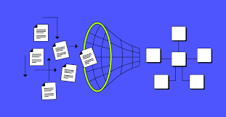
Building a Model
We design a model in response to a business need.
For example, a company wants to plan its expenses for the next 12 months by expense line.
This needs information collected from a number of departments that are spread across a wide geographical area.
A model has the following basic building blocks: dimensions, cubes, and links.
Multidimensional cubes are central to the model.
We then create views (any number) from the cubes so that you can see just the information that we need.
We might want to review data at a consolidated level or we might want to input the detailed data for specific level. Thus same cube but different views.

Slide 32
Building a Model
Dimensions give the cubes structure.
A cube that is viewed by a user should have enough dimensions to define the data, but not so many dimensions that the cube is difficult to navigate.
We can use hierarchies to reduce the number of dimensions in a model, while giving you the option to see alternative rollups of data.
We can quickly add business logic such as links, by creating rules.
We make the data available to other colleagues by creating books and adding views, visualizations, graphics, and videos, and then sharing the book with them.

Slide 33

1. Design dimensions
To make the data available for input and analysis, we must first create dimensions.
Examples : Chart of Accounts, Products, Time, and Versions.
2. Create hierarchies
We use hierarchies to simplify our model design. A hierarchy acts as a virtual dimension, enabling you to see alternative rollups of the same view without creating additional dimensions. This makes a model easier to maintain.
3. Create cubes
Use dimensions to build cubes. A cube is a store of data within a model. It is multidimensional and contains rows, columns, and any number of pages. Examples : sales planning or expense analysis.
4. Create rules and processes
We can create rules for calculations, and processes for managing and maintaining the model. Processes can then be grouped into chores for coordinated and automated execution.

Slide 34
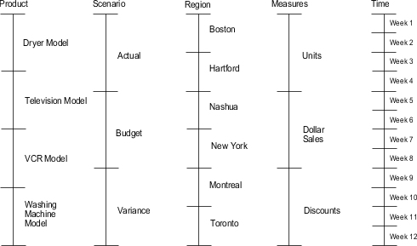
Durable Cubes
Each dimension in the Durables cube is represented by a vertical line segment.
The elements within the dimension are represented by unit intervals.
Notes:
An IBM® Cognos TM1 developer, your responsibilities fall into four major tasks.
Design and create the cubes that hold business analysis.
Decide where to store the cubes so they can be shared across the organization.
Import data into the cubes from transactional systems and other data sources.
Create formulas that do calculations, such as average prices, currency conversions, and price/earning ratios.

Slide 35
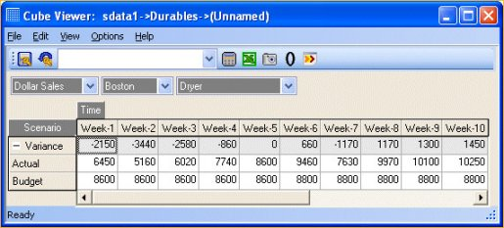
Suppose that you are the Vice President of Sales, and you need to quickly compare the performance of products and stores to identify the winning strategies and trouble spots.
Using TM1 multidimensional views, you can create an unlimited number of ad hoc queries.
Here you can quickly compare actual versus budgeted dollar sales across weeks.
The region is Boston and the product is a dryer model.

Slide 36
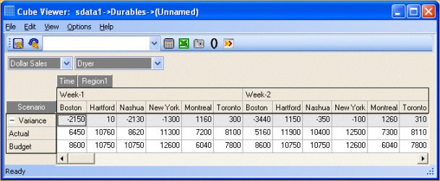
By rearranging the view, you can compare dollar sales for the dryer model across all regions.

Slide 37
Understanding & Designing Cubes
TM1 stores your business analysis in cubes.
Each cell in a cube contains a measure that you are tracking in an analysis.
A cube can store data against one or more measures.
You form a cube with dimensions, which identify how to organize the data or the measures you want to track.
One element in each dimension identifies the location of a cell in a cube.
Here cube contains three dimensions:
Product, Measures, and Month. Each measure, such as Sales, is organized or dimensioned by a product and a month. For example, the cell value 300000 represents the sales of Sedan-1 in the month of January (Jan).

Slide 38

Dimensions
When we create a dimension, we identify the leaf-level elements that comprise the dimension and, optionally, any hierarchies (consolidations) within the dimension.
Dimensions are lists of related members. Typical dimensions a cube might contain are time, versions, regions, products, departments, measures.
A member is an item in a dimension, so in a time dimension, you can have months, years, quarters. Each month, year, and quarter is a member.
Notes:
Dimensions change less frequently than members.

Slide 39
Dimensions
Dimensions can be a simple list with all members at the same level, or a dimension can be structured with members at different levels and with multiple hierarchies.
How a dimension is structured depends on how you want the data to be represented.
A dimension represents the highest consolidation level in the database.
The database presents dimensions and members in a tree structure to indicate a consolidation relationship.
For example, in Figure , Hierarchical Structure, Year is a dimension (of type Time) and Qtr1 is a member.
Notes:
Dimensions change less frequently than members.

Slide 40
Dimensions
Standard dimensions represent the core components of a business plan and often relate to departmental functions. Typical standard dimensions: Time, Accounts, Product Line, Market, and Division.
Attribute dimensions are associated with standard dimensions. Through attribute dimensions, you group and analyze members of standard dimensions based on the member attributes (characteristics).
For example, you can compare the profitability of non-caffeinated products that are packaged in glass to the profitability of non-caffeinated products packaged in cans.
Members are the individual components of a dimension.
For example, Product A, Product B, and Product C might be members of the Product dimension.
Notes:
Dimensions change less frequently than members.

Slide 41
Dimensions, Members & Hierarchies
Each dimension consists of one or more members.
The members, in turn, may consist of other members. When you create a dimension, you tell how to consolidate the values of its individual members. (Hierarchies)
Within the tree structure ,a consolidation is a group of members in a branch of the tree.
For example, many businesses summarize their data monthly, rolling up monthly data to obtain quarterly figures and rolling up quarterly data to obtain annual figures. Businesses may also summarize data by zip code, city, state, and country.
Any dimension can be used to consolidate data for reporting purposes.

Slide 42
Dimensions, Members & Hierarchies
Each dimension consists of one or more members.
For example, the Year dimension may comprise five members: Qtr1, Qtr2, Qtr3, and Qtr4, each storing data for an individual quarter, plus Year, storing summary data for the year.
Qtr1 may comprise four members: Jan, Feb, and Mar, each storing data for a month, plus Qtr1, storing summary data for the quarter.
Similarly, Qtr2, Qtr3, and Qtr4 comprise the members that represent the individual months plus the member that stores the quarterly totals.

Slide 43
2017
Q1-2017
Jan-2017
Feb-2017
Mar-2017
Q2-2017
Apr-2017
May-2017
Jun-2017
Q3-2017
Jul-2017
Aug-2017
Sep-2017
Q4-2017
Oct-2017
Nov-2017
Dec-2017
You might want to have a simple time dimension that just contains a list of the months, or you might want a time dimension that is grouped by years, quarters, and months

Slide 44
Selecting dimensions and number of dimensions
Every cube has at least two dimensions and a maximum of 256 dimensions.
For example, a two-dimensional cube is best suited as a lookup table when you want to calculate values in other cubes that have more dimensions.
For example, you can convert the local currency amounts to a reporting currency by using a two-dimensional cube that stores the exchange rates. You retrieve the rate using the TM1 rule.
The number of dimensions in a cube depends mostly on the dimensionality of your data.
Profit and Loss Statement (in thousands) Year Ending 31 Dec, 2002
Net sales | 200,000
Direct costs | 35,000
Direct labor | 50,000
Gross Profit | 115,000
Salaries | 30,000
Payroll | 3,500
Electricity | 5,000
Rent | 10,000
Depreciation | 6,000
How to examine, how the revenue and expenses vary by their factors??

Slide 45
Accounts above the Gross Profit line, which you can dimension by product, region, scenario (Actual versus Budget), and months.
Accounts below the Gross Profit line, which you can dimension by region, scenario (Actual versus Budget), and months, but not product.
You cannot directly attribute the overheads to products, so you cannot analyze them at the same level of detail.
Net sales | 200,000
Direct costs | 35,000
Payroll | 3,500
Electricity | 5,000
Rent | 10,000

Slide 46
This difference in dimensionality suggests two cubes:
Five-dimensional cube for the accounts above the Gross Profit line
> dimension by product, region, scenario (Actual versus Budget), mesaures & time.
Four-dimensional cube for the accounts below the Gross Profit line
> dimension by measures, region, scenario (Actual versus Budget), and time.
Net sales | 200,000
Direct costs | 35,000
Direct labor | 50,000
Gross Profit | 115,000
Salaries | 30,000
Payroll | 3,500
Electricity | 5,000
Rent | 10,000
Depreciation | 6,000

Slide 47
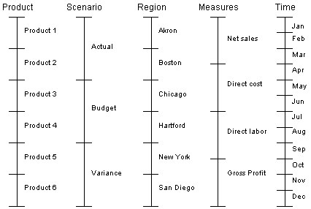
Five-dimensional Cube
Each dimension is represented by a vertical line segment. The elements within the dimension are represented by unit intervals.

Slide 48
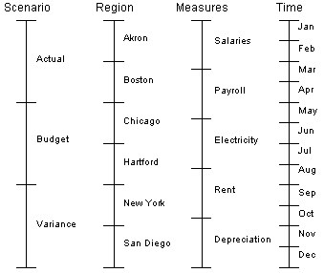
Four-dimensional Cube
Each dimension is represented by a vertical line segment. The elements within the dimension are represented by unit intervals.

Slide 49
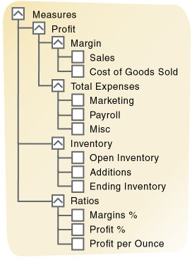
Dimension Hierarchies for consolidation
The data you import into a cube provides a snapshot of your business at a specific level of detail.
For example, you might import the weekly or monthly sales data for products by city.
The dimension elements that identify these data points are simple or leaf-level elements in each dimension: sales for one week, one product, one city.
By using dimension hierarchies, you can easily aggregate numeric data into categories .
Each category corresponds to an aggregation of detail for two or more elements in a dimension.
For example, you can create quarterly elements that sum monthly sales amounts.
In TM1, elements that represent aggregations are called consolidated elements or consolidations.

Slide 50
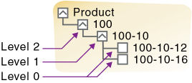
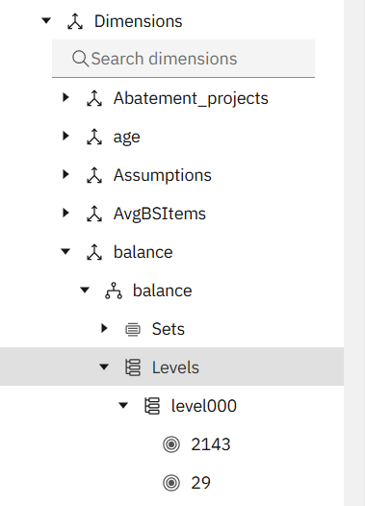
Levels define the way data is grouped in dimensions.
A dimension can have a number of levels relative to their hierarchical structure, and these levels are automatically named Level000, Level001, Level002, Level003 and so on.
If we have a dimension that is structured with multiple levels, we can choose to show the members at a particular level.
For example, we could show the leaf level, which is just the months, or we could show just the quarters, or the years.
To select a level, in a cube view, click the dimension tile and then select the level.

Slide 51
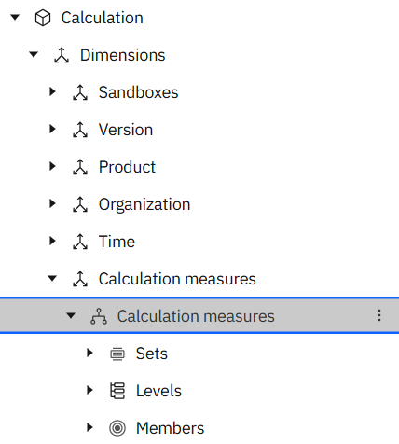
Typically, cubes contain a measures dimension.
A measures dimension contains the measures that we want to track in our business analysis.
Examples : sales amounts, units sold, expenses, acquisition values, and campaign costs.
We can define hierarchies for dimensions.
Every dimension has at least one hierarchy. We can define alternative hierarchies so that we can roll up a hierarchy in different ways without having to add extra dimensions.
We can define attributes for dimension members. Attributes help to explain or describe a dimension member, and could be something like color, size, or type. We can create hierarchies from attributes by right-clicking an attribute in a dimension and clicking Create Hierarchy.

Slide 52
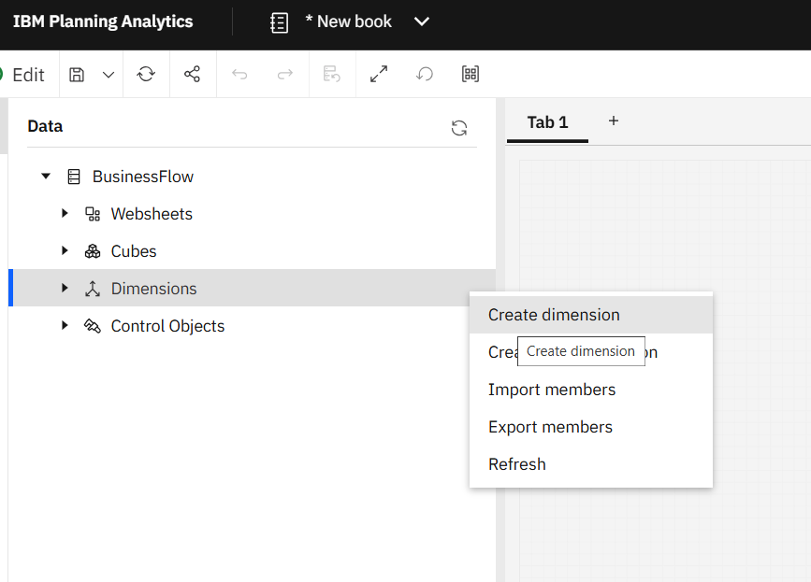
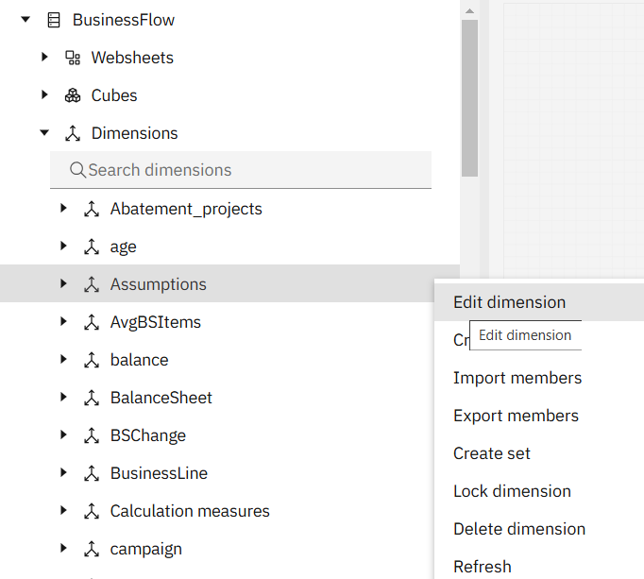
Right-click the Dimensions node in the Databases tree, and then click Create dimension.
To use the dimension editor to edit an existing dimension, right-click the dimension name in the Databases tree, and then click Edit dimension.
To create a new hierarchy for a dimension, right-click the dimension name in the Databases tree, and then click Create hierarchy.
Using Dimension editor we can create dimensions.
More on this later…

Slide 53
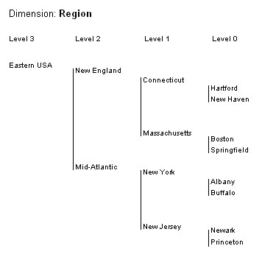
The following diagram shows three levels of consolidation for elements of a Region dimension.
The cities provide the lowest level of detail (Level 0).
The cities roll up into state consolidations (Level 1).
This roll up into regional consolidations, which finally roll up into the Eastern USA consolidation (Level 3).

Slide 54
Navigating through a Dimension Hierarchy
A dimension hierarchy provides a navigation path for analyzing data at different levels of detail.
Drilling down means navigating to greater levels of detail along one dimension. For example, as you drill down from New England in the Region dimension, you access the underlying data for two states and then four cities.
Drilling up means navigating to summary levels in dimensions.

Slide 55
Using Weights to Express Consolidations
Weight factors determine the contribution of an element to a consolidation.
To express that the Connecticut sales total is a sum of Hartford and New Haven, you assign a default weight factor of 1.0 to both Hartford and New Haven.
You can also consolidate elements by subtracting the values associated with the elements.
For example, you can express Net Profit as Market Value - Acquisition Value. You would assign a weight factor of 1.0 to Market Value and -1.0 to Acquisition Value.

Slide 56
Weighting examples of consolidation
Dimension | Consolidated Element | Consolidation Method | Subordinate Elements | Weight Factors
Account | Net Profit | Subtraction | Market Value Acquisition Value | 1.0 -1.0
Month | 1Quarter | Addition | January February March | 1.0 1.0 1.0
Period | Yearly Budget | 4-4-5 Distribution | January February March | .07692 .07692 .09615

Slide 57
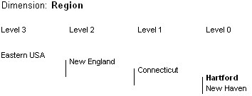
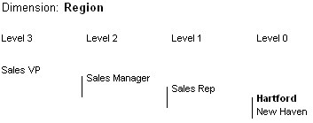
Multiple Roll-ups in a Dimension
You can roll up low-level numeric data, such as sales and units, in several ways by creating multiple hierarchies in a dimension.
By creating multiple roll-ups in a dimension, you can reduce the number of dimensions, and the number of empty cells in a cube.
In the following example, Hartford, a simple element in the Region dimension, rolls up along two paths:
geographic and management.
Geographic roll-up
Management roll-up

Slide 58
Other way of understanding multidimensionality, members & relationships
Parents, Children, and Siblings
A parent is a member that has a branch below it.
For example, Margin is a parent member for Sales and Cost of Goods Sold.
A child is a member that has a parent above it.
For example, Sales and Cost of Goods Sold are children of the parent Margin.
Siblings are child members of the same immediate parent.
For example, Sales and Cost of Goods Sold are siblings (they both have the parent Margin), but Marketing (at the same branch level) is not a sibling, because its parent is Total Expenses.

Slide 59
Other way of understanding multidimensionality, members & relationships
Descendants and Ancestors
Descendants are members in branches below a parent.
For example, Profit, Inventory, and Ratios are descendants of Measures.
The children of Profit, Inventory, and Ratios are also descendants of Measures.
Ancestors are members in branches above a member.
For example, Margin, Profit, and Measures are ancestors of Sales.

Slide 60
Other way of understanding multidimensionality, members & relationships
Roots and Leaves
The root is the top member in a branch. Measures is the root for Profit, Inventory, Ratios, and the children of Profit, Inventory, and Ratios.
Leaf members have no children. They are also referred to as level 0 members. For example, Opening Inventory, Additions, and Ending Inventory are leaf members.

Slide 61
Type of Elements
TM1 supports three types of elements.
Element | Description
Numeric | Identify the lowest-level detail in a dimension. In a cube that contains only numbers, TM1 defines all the lowest-level elements as numeric.
Consolidated | Aggregations of lower-level detail. For example, you could use the 1Quarter element in a time dimension to sum the sales amounts for the first three months of the year.
String | Stores text strings in cells. To include a string in a cell in a cube, the element from the last dimension defining the cell must be a string element. TM1 treats string elements that occur in any dimension other than the last one as numeric elements. The typical use for string elements is in a two-dimensional cube that converts codes in an input file to formal element names. For example, if you want to convert account codes to account names.

Slide 62
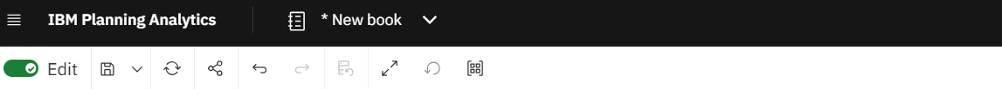
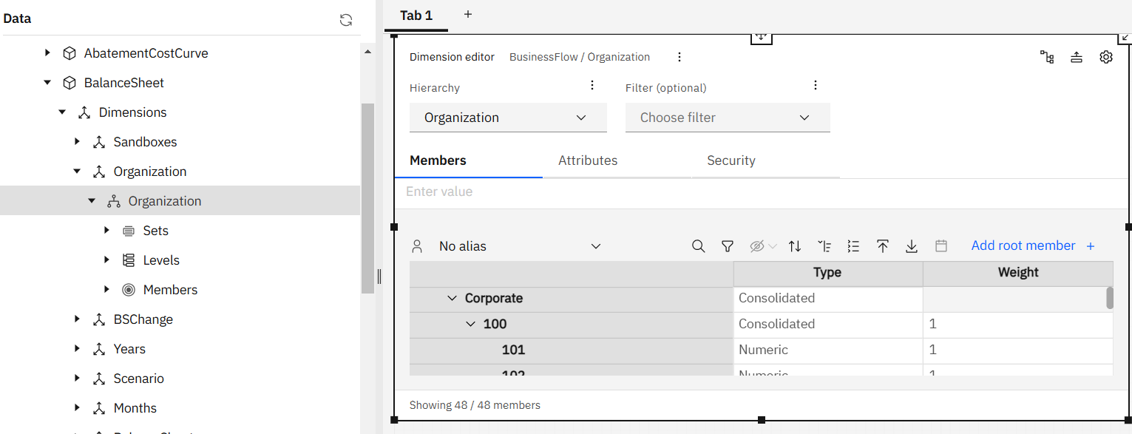
Cube > 1 or more dimensions > Hierarchies > Sets | Levels | Members
> 1 or more views

Slide 63
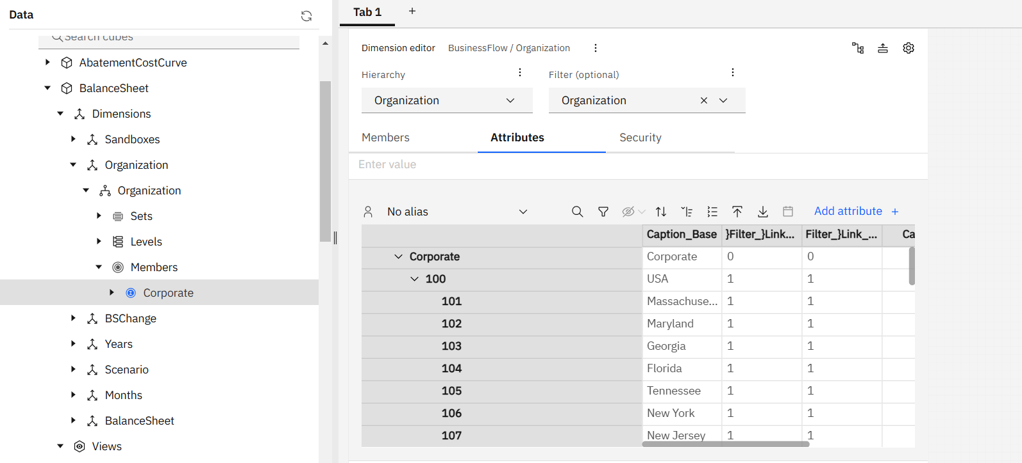

Slide 64
Element Attributes
The elements identify data in a cube, and the element attributes describe the elements themselves.
List features of elements –
For example, the square footage of a store and the engine size of a car model.
Provide alternative names, or aliases. For example, descriptive names of general ledger accounts and the local language versions of product names.
Control the display format for the numeric data. Typically, you select a display format for the measures you track in a cube.
You can select elements by attribute value in the Subset Editor. You can also display element names in TM1 dialog boxes using their aliases.
To create attributes and assign attribute values, use the Attributes Editor.

Slide 65
Descriptive Attributes
elements | Attributes
 | Horsepower (Numeric) | Engine (Text) | Audio (Text)
Sedan 1 | 190 | V-8 | Compact Disc
Sedan 2 | 140 | Inline 4 | Cassette / Radio
Sedan 3 | 120 | Inline 4 | Cassette / Radio
Sedan 4 | 180 | V-8 | Compact Disc
Sedan 5 | 140 | Inline 4 | Cassette / Radio

Slide 66
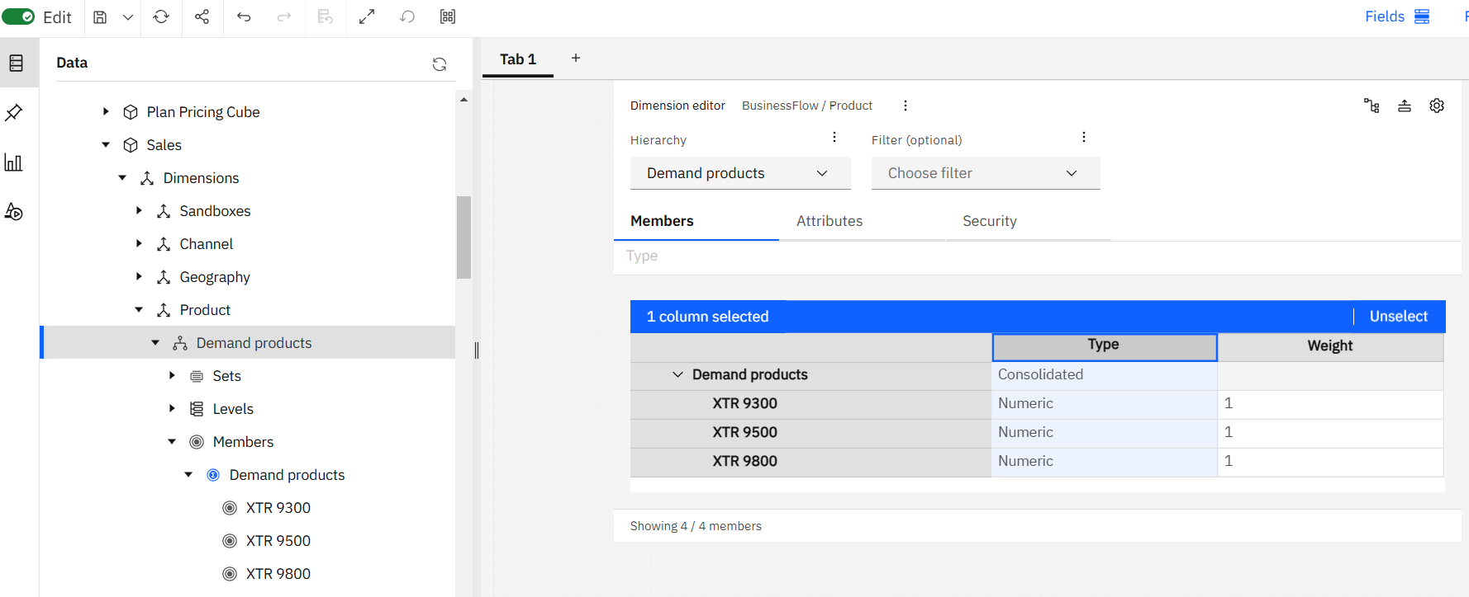

Slide 67
Alias Attributes
Elements | Alias Attributes
 | Deutsche | Español | Français
Chair | Stuhl | Silla | Chaise
Desk | Schreibtisch | Escritorio | Bureau
Lamp | Lampe | Lámpara | Lampe
Table shows German, Spanish, and French versions of English furniture names.

Slide 68
Using the Attributes Editor window, you can select a display format for every element in each dimension in a cube.
TM1 determines which display format to use in the Cube Viewer window, as follows:
TM1 first checks the elements in the column dimension for display formats. If dimensions are stacked, TM1 checks from the bottom upward.
If no format is found, TM1 checks the elements in the row dimension for display formats. If dimensions are stacked, TM1 checks from right to left.
If no format is found, TM1 checks the title elements for display formats. The elements are inspected from right to left.
If no format is found, TM1 applies the format for the current view.
To ensure that TM1 applies the format for the cube measures, position the dimension that contains the measures as the bottommost column dimension.
Notes:
It is recommended that you select display formats only for one dimension, the measures you track in a cube. You can also select a format in the Cube Viewer window that applies to cells whose elements do not have a display format defined.

Slide 69
Attributes VS. Elements
When you want to list multiple attributes values for a single element, consider creating additional elements or additional dimensions.
For example, the exterior color is an attribute of car models. The red models often outsell the other color models. If you create one element per car and another dimension with elements for each color, you can use TM1 to track car sales by color. If you combine sales into a single model, you might lose valuable detail.
Consider another example. In the car models table, there is an attribute category for engine configuration. Each car has a single engine configuration, such as V-8. If any sedans are available in more than one engine configuration, consider creating one element per engine configuration.

Slide 70
Designing cubes : Conclusion
List the measures you want to track in your business analysis.
Examples : sales amounts, units sold, expenses, acquisition values, and campaign costs.
Determine how you want to organize or dimension the measures.
Example : track measures over time.
What is the base time interval: days, weeks, months?
Is there a geographic dimension?
Do the measures vary by customer and product?

Slide 71
Designing cubes : Conclusion
Is there a scenario dimension (actual versus budget)?
Determine how you want to consolidate the dimension elements.
Create a list of attributes you want to associate with the elements of the cube.
Examples : store square footage, customer IDs, and local language versions of element names.
Define the display formats for the measures in your cubes.
Example, define Gross Margin as a percentage and Sales as a currency amount.

Slide 72
Installation/Setup/Cloud SAAS

Slide 73
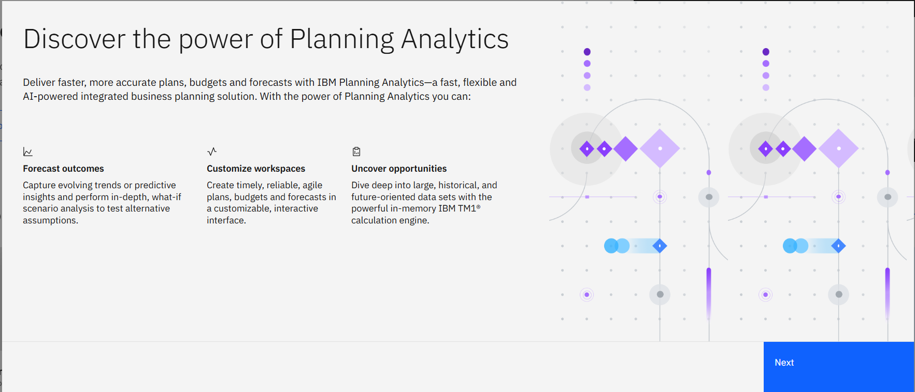
IBM Planning Analytics as SAAS on IBM Cloud

Slide 74
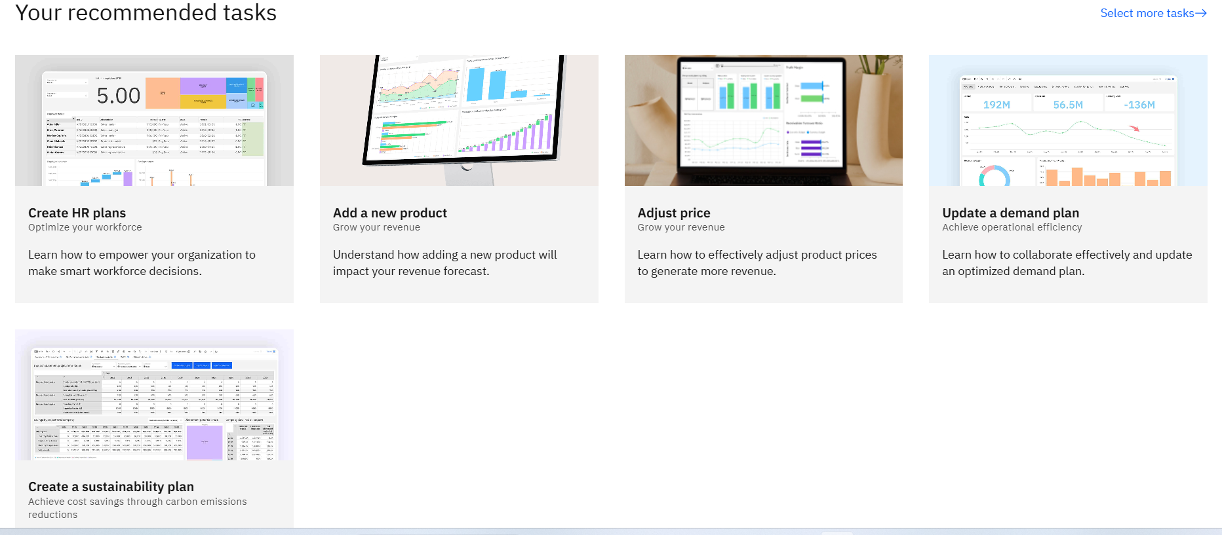

Slide 75
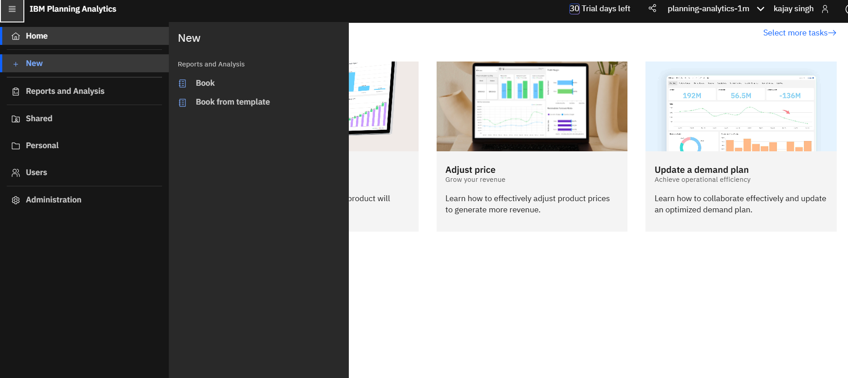

Slide 76
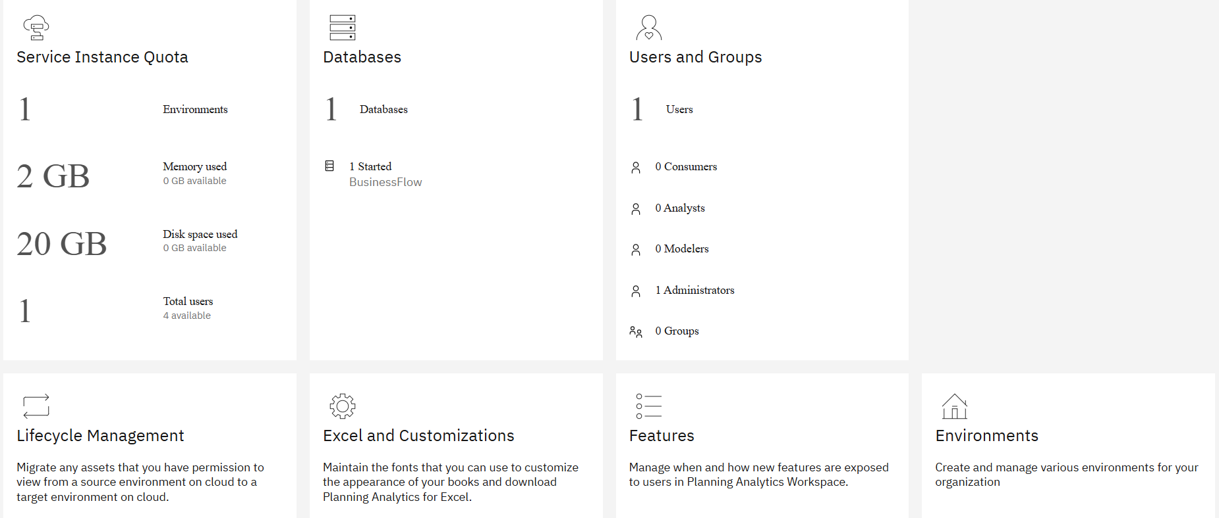
Administration

Slide 77
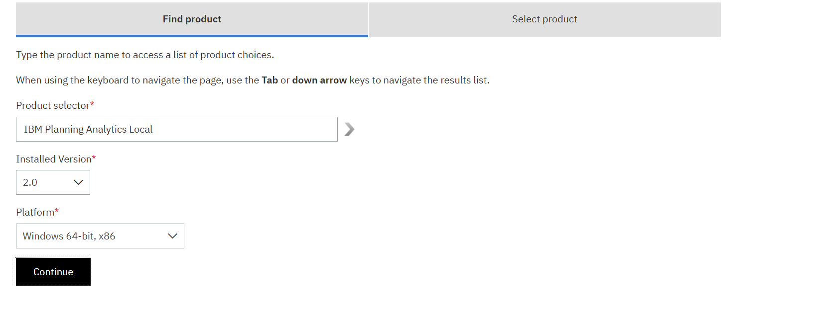

Slide 78
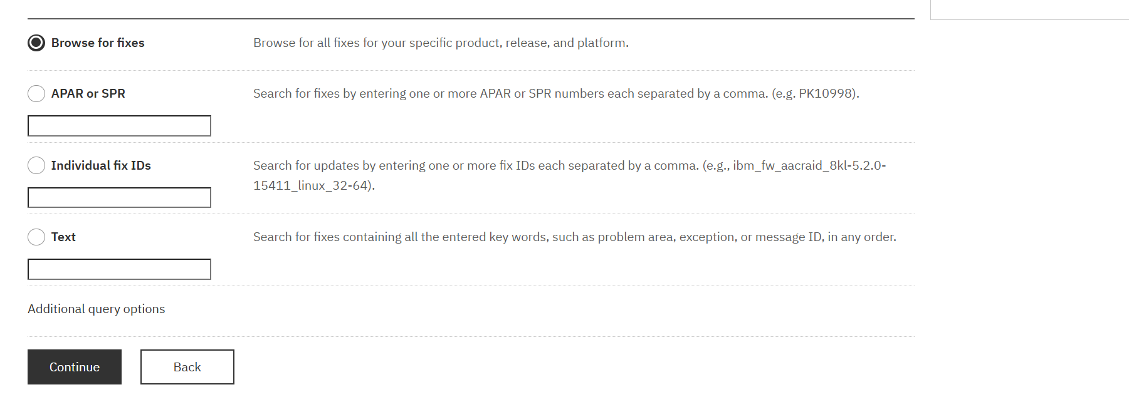

Slide 79
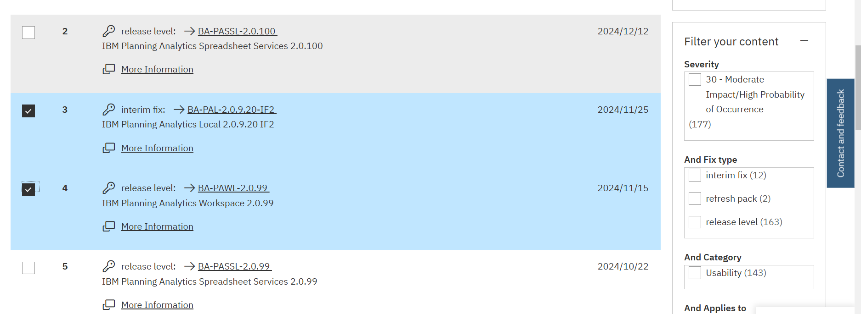

Slide 80
Continued..

