Slide 1
Transfer Learning
IMDB

Slide 2
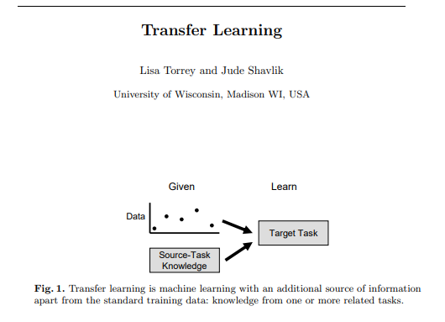

Slide 3
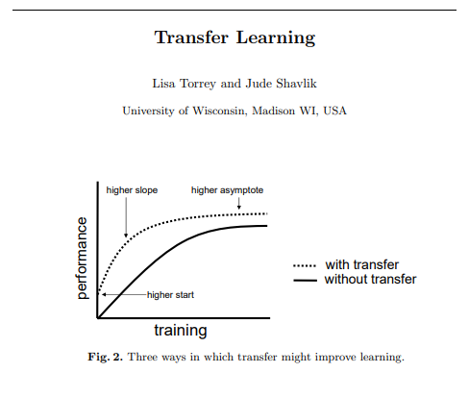

Slide 4
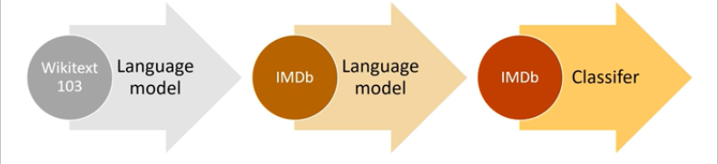

Slide 5
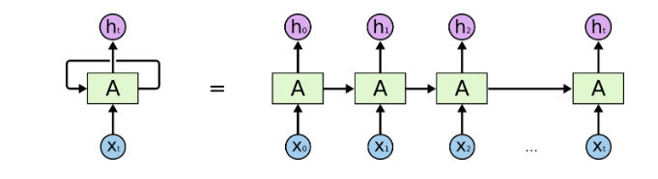
RNN

Slide 6
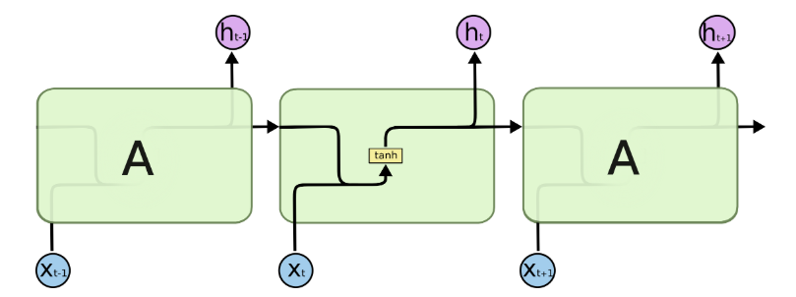
LSTM

Slide 7
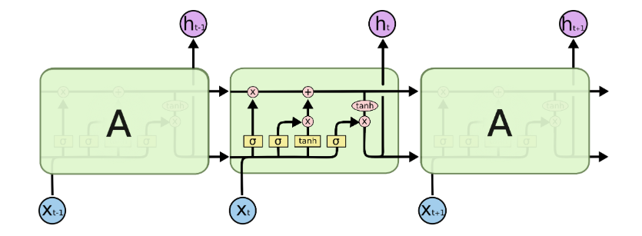
LSTM

Slide 8
AWD-LSTM
LSTM- Long Short Term Memory
AWD- ASGD Weight Dropped
ASGD- Average Stochastic Gradient Descent
Same as SGD but includes the average of previous weights
Using DropConnect instead of using Dropout

Slide 9
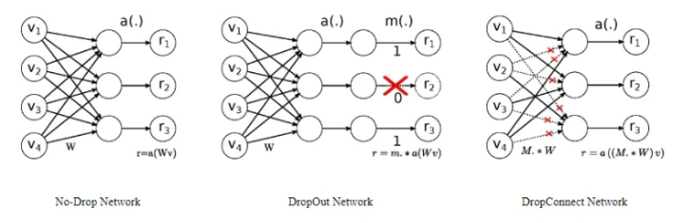
DropConnect

Slide 10
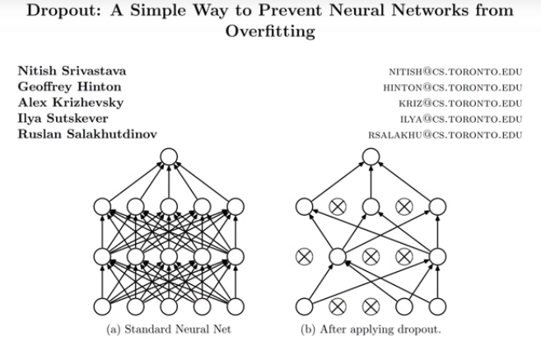

Slide 11
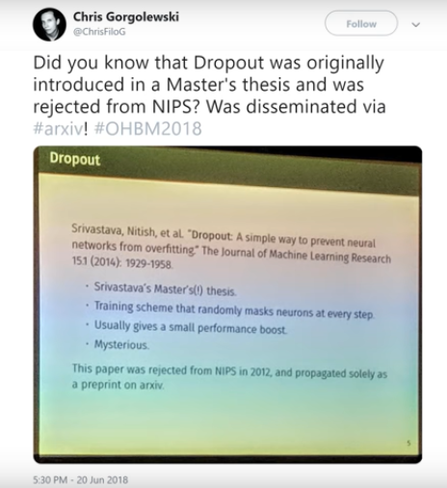

Slide 12
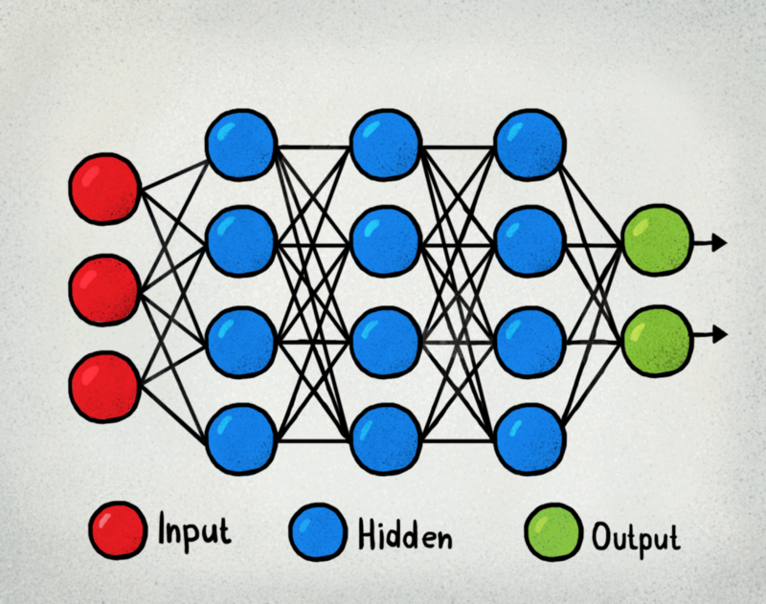
Freeze!

Slide 13
