Slide 1
Compress Offload

Slide 2
System Diagram
Client Proxy
Audio Track
Shared Memory
Audio Flinger
Audio System
Server Proxy
Patch Panel
Thread
Track
Audio Policy Service
Audio HAL
Audio Policy Manager
Data path
Control path
Compress Driver

Slide 3
Call Flow: Create Track

Slide 4
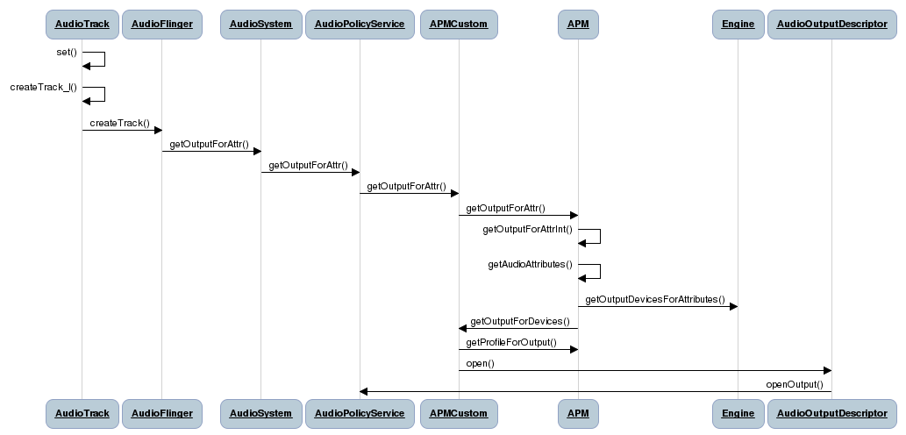

Slide 5
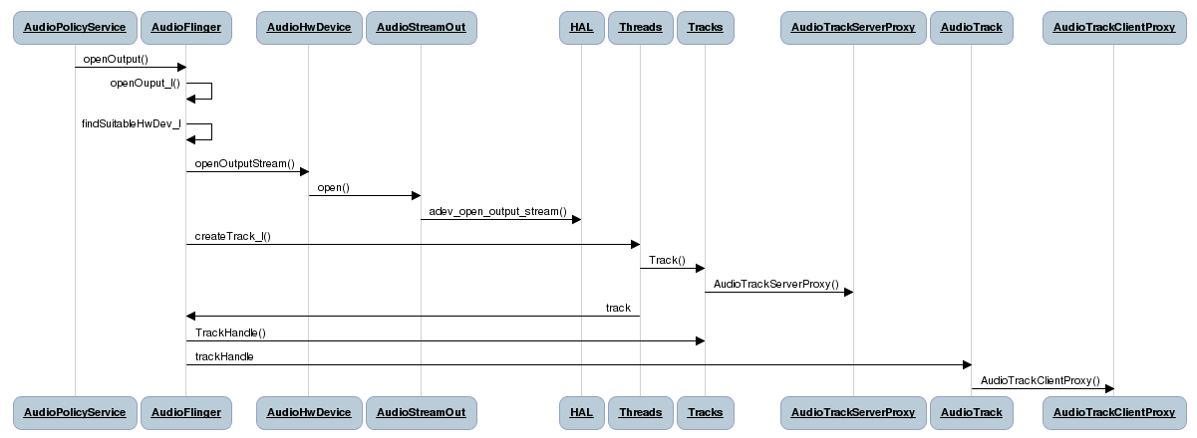

Slide 6
Key API: Create Track
AudioTrack: openOutput_l
Searches for suitable HW device that will match the HW module handle. Typically primary module/audio HAL
Instructs audio HAL to open an output stream for the playback session
Offload thread then gets created in AudioFlinger
AudioFlinger: createTrack_l()
Confirms that the requested flags match the output flags for the stream. If not, force the requested flags to be the same as the output flags.
Checks that the track to be created has the same routing strategy as any other track that is in the same session. If these tracks do not that have the same routing strategy, then it can cause a conflict when AudioPolicyManager moves tracks from output to another.
Tracks: TrackBase()
Allocates the Track’s control block and shared memory buffer
Control block memory is allocated on the client’s heap
Shared buffer is set to be memory location adjacent to the command block

Slide 7
Key API: Create Track
Tracks: Track()
Creates AudioTrackServerProxy which is used to obtain data from the client
AudioTrack: createTrack_l()
Using the control block pointer from the Track returned by AudioFlinger, creates a local control block
Determines the starting address of the shared memory buffer in this way: if a shared buffer already exists, the starting address will be that of the shared buffer. Otherwise, the starting address will be the memory location adjacent to the control block
Creates AudioTrackClientProxy to communicate with the server proxy

Slide 8
Track State Diagram
resumeAck()
RESUMING
TrackBase()
start()
start()
ACTIVE
pause()
PAUSING
setPaused()
PAUSED
IDLE
stop()
flush()
STOPPED
flush()

Slide 9
Call Flow: Play

Slide 10
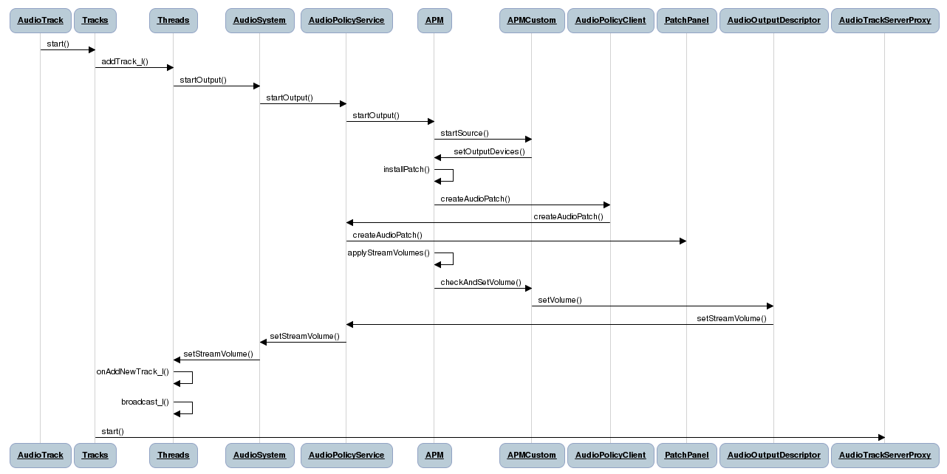

Slide 11
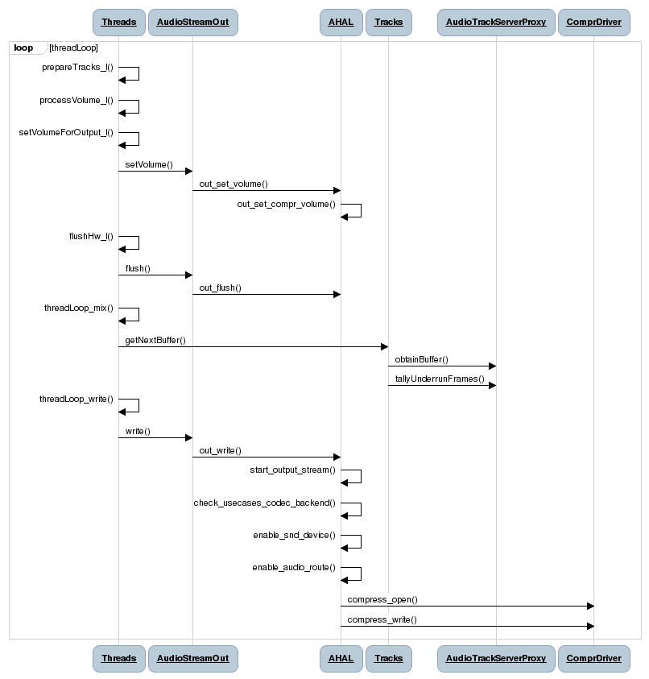

Slide 12
Key API: Play
Threads: prepareTracks_l()
Processes tracks that are in the active list
More details on how each playback state is handled later
Threads: threadLoop() – applicable to all playback states
Constantly running to handle any active Tracks
Calls prepareTracks_l()
While we’re not pending an exit
If there are active tracks that have data available, threadLoop_mix() will be called.
While there is still data to be written, a new buffer will be obtained from the server proxy which is read from the shared buffer of the Track
The buffer obtained from the server proxy will then be copied over to the current buffer
mSleepTimeUs will be set to 0 to indicate that we have data to be written to audio HAL
If there are no active tracks with data available, then threadLoop_sleep() will be called
Once it is indicated that it is time to write to audio HAL (mSleepTimeUs == 0), threadLoop_write() will be called and any pending frames will be written through HIDL calls to out_write()
If it is not time to write to audio HAL and we need to drain, threadLoop_drain() will be called which will communicate to the audio HAL to drain the compress driver
On exit from loop, threadLoop_exit() is called to set the mixer status to drain all and to invalidate all active tracks
If standby hasn’t already been set, threadLoop_standby() is called to put audio HAL into standby

Slide 13
Key API: Play
Tracks: start()
Sets the Track state to be ACTIVE
Track gets added to playback thread addTrack_l() call
AudioServerProxy gets started here
Threads: addTrack_l()
If this is a new track being added, all the Track’s buffer will be filled before playback starts. This is how it is ensured that the client will get its desired latency
Track is added to the active tracks list

Slide 14
Key API: Play
Threads: prepareTracks_l() – processing play
If there are frames ready and the track is ready and isn't paused, terminated or stopping
If the track's filling up status is filled, set the filling up status to active.
Also set the left and right volume to -1 to ensure processVolume_l will apply the new volume
If this previous track is not null and it's not the same as this track
Flush any data still being written from the last track (mBytesRemaining = 0)
If the last track was paused, then we need to flush the saved mix buffer state and invalidate the track so that the client must resubmit the saved data when the track resumes
If we are changing audio sessions, then we should flush any data already sent to DSP because the data now comes from a different source. Also invalidate the track so that a seek will be performed when the track is resumed.
- Set the mixer status to MIXER_TRACKS_READY which means there's at least one active track that has data ready

Slide 15
Call Flow: Pause

Slide 16
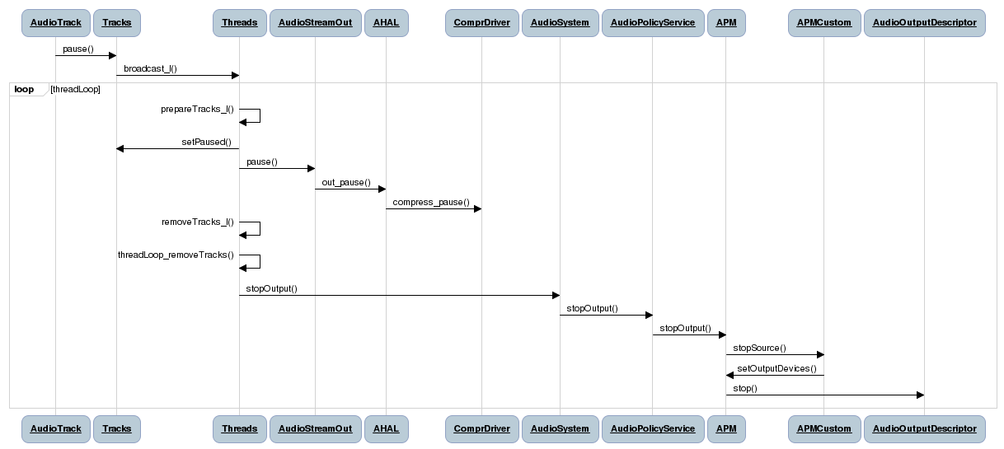

Slide 17
Key API: Pause
Tracks: pause()
Sets the state of the trading to be PAUSING and signals this to the playback thread
Threads: prepareTracks_l() – processing pause
Update the Track’s state to paused
If this is the last track that became active
signal hardware pause if it is supported
In case we were in the middle of writing the mix buffer to the hal, we must save this position for when we resume later. Note however, that this position will become invalid if another track becomes active and so the client will have to be notified to resend this data
- Add the track to tracksToRemove. This just means it will get removed from the active list. It only gets removed from the tracks list entirely if it has been terminated

Slide 18
Call Flow: Resume

Slide 19
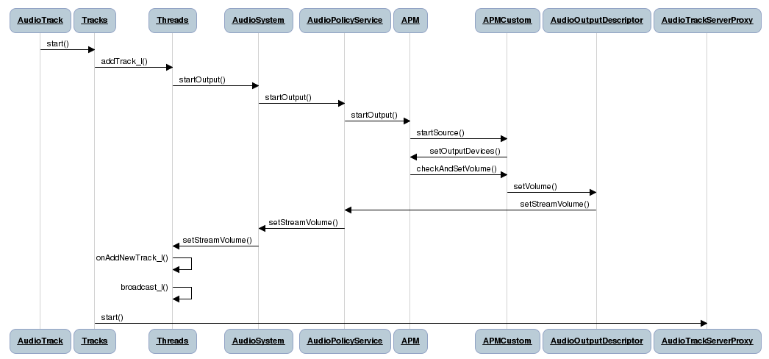

Slide 20
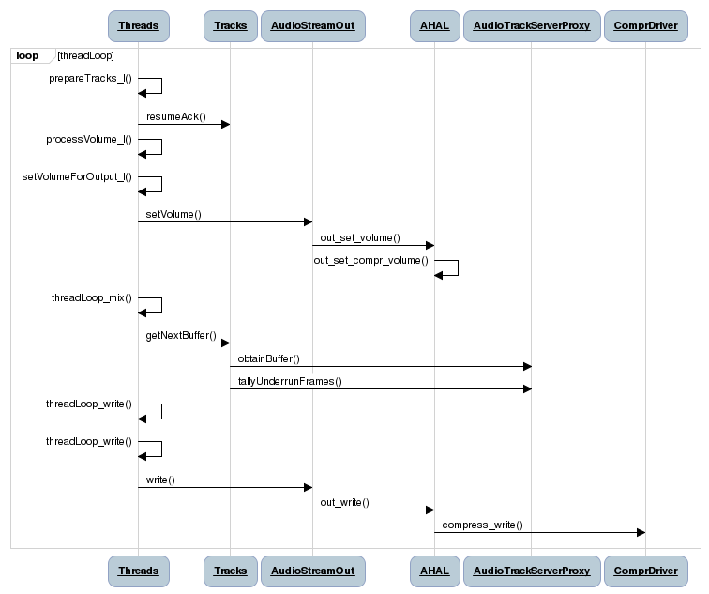

Slide 21
Key API: Resume
Tracks: start()
Same as with Play, except that the state of the track is set to RESUMING
Threads: prepareTracks_l() – processing resume
Calls resumeAck on the track
If the track state is "resuming", update it to "active“
If the track state is "stopping_1", don't change the state because that will prevent drain from getting called
If we need to continue a previous write that interrupted, update the position to that old position where we were interrupted
Resume the hardware if it was paused
Enable write to audio HAL (mSleepTimeUs to 0)
We don't process any new data on this first iteration, even if there are frames ready. Data left over from pause will be written and then we'll handle new data

Slide 22
Call Flow: Pause (> 3 secs)

Slide 23
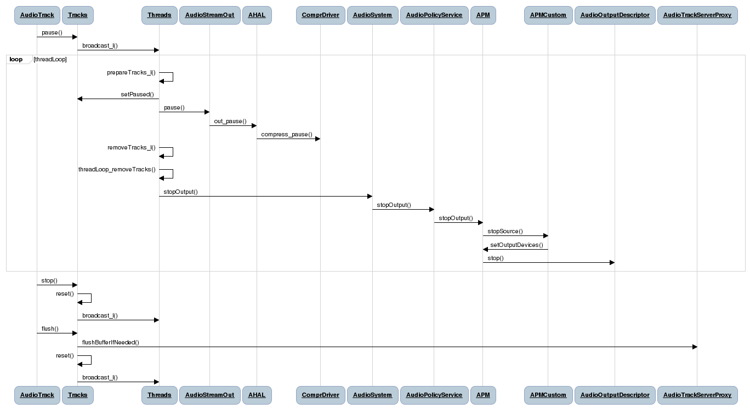

Slide 24
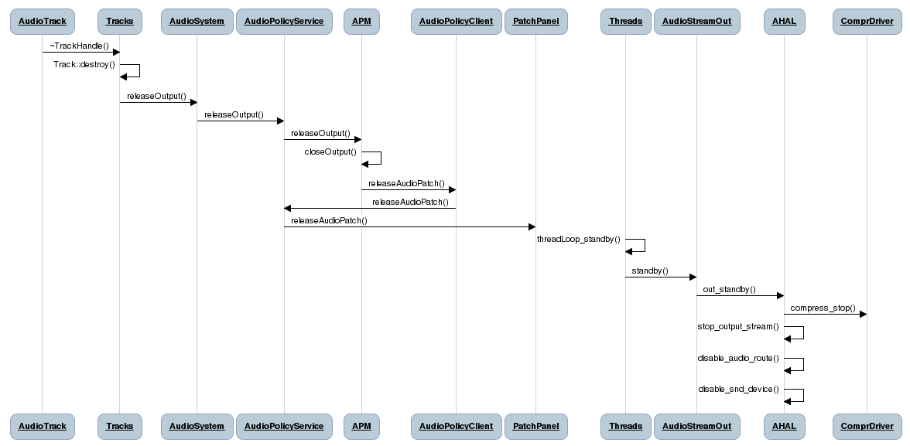

Slide 25
Key API: Pause (> 3 secs)
As we might expect, the logic for pause and prepareTracks_l is the same here as being paused for less than 3 seconds. The difference here is stop being called after 3 seconds.
Tracks: stop()
Since the Track was in PAUSED state, the buffers will have to be flushed
Set the state to STOPPED
Tracks: flush()
- Flush the server proxy buffer if needed
The Track is destroyed in the destructor of AudioTrack and the control block is freed

Slide 26
Call Flow: Seek/Skip
Note: diagrams are stripped down as seek/skip is just a sequence of pause/flush/resume.

Slide 27
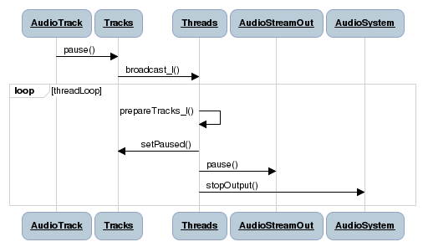

Slide 28
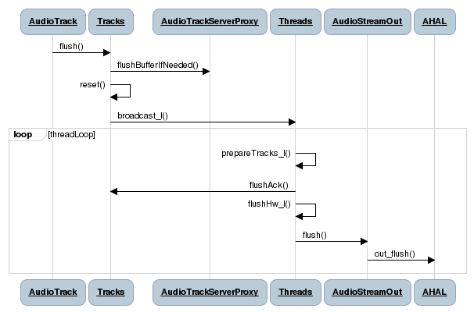

Slide 29
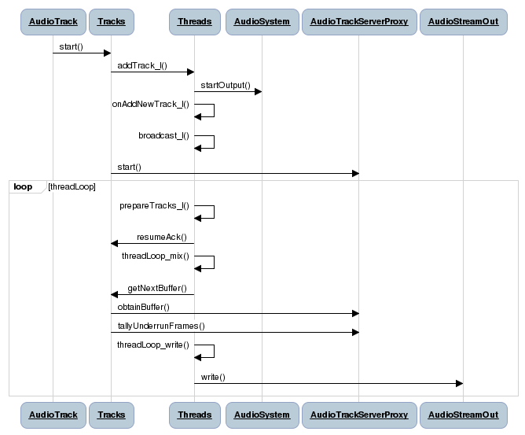

Slide 30
Key API: Seek/Skip
As seek/skip is just a sequence of a pause, flush and resume, we can refer to these cases from earlier slides.

