Slide 1






GENSPARK
8-HOUR TRAINING MODULE
Day 1 — Databricks Quality Engineering Strategy & Architecture
Databricks-Native Strategy & Architecture Patterns
Native Validation: Delta Constraints, DLT & Workflows
8 Hours | Interactive Strategy + Labs
Presented by: [Presenter Name]
[Date: MM/DD/YYYY]
Enterprise Quality Practice

Slide 2









Day 1 Agenda & Outcomes
Databricks Quality Engineering Strategy & Architecture
Duration: 8 Hours
01
08:30 – 09:00
02
09:00 – 10:15
03
10:30 – 11:45
Kickoff & Objectives
Strategy on Databricks
Architecture
Session goals, success criteria, and aligning on the day's roadmap.
QE pillars (Trust, Velocity, Compliance) and defining Lakehouse KPIs.
Reference patterns, governance with Unity Catalog, and CI/CD gates.
04
12:45 – 14:45
05
15:00 – 16:30
06
16:30 – 17:00
Module 1: Blueprint
Native Validation
Labs & Wrap-up
Deep dive: Enterprise Lakehouse Quality Engineering Blueprint & RFP Strategy.
DLT expectations, Delta constraints, and monitoring patterns.
Hands-on exercises, Q&A, and readiness checklist review.
TARGET OUTCOMES
Operating model & RACI defined
Reference architecture agreed
Native validation patterns
Day 1 Goals
Lab readiness confirmed
KPI & SLO baseline set
RFP scoring rubric mastery
Confidential — Internal Training Material
Page 2

Slide 3





Learning Objectives & Success Criteria
What we will achieve in this 8-hour strategy and architecture session
Define QE Strategy
Success Criteria
Tailor a Quality Engineering strategy specifically for the Databricks Lakehouse, moving beyond traditional warehouse QA approaches.
Documented QE operating model & RACI
Map Controls to Architecture
Reference architecture diagram agreed
Align quality gates with native components: Unity Catalog for governance, DLT for pipeline health, and Workflows for orchestration.
KPI/SLO baseline defined and tracked
Implement Native Validation
Hands-on labs completed successfully
Learn to apply Delta constraints, DLT expectations, and automated monitoring patterns for both batch and streaming workloads.
KEY DELIVERABLES
Strategy Deck
RACI Matrix
Architecture V1
Lab Notebooks
Day 1 — Databricks Quality Engineering Strategy & Architecture
Confidential & Proprietary

Slide 4




SECTION 01
Strategy — Lakehouse Quality Engineering
Defining the strategic pillars that drive trust, ensure velocity, and guarantee compliance on the Databricks Data Intelligence Platform.
Strategic Alignment Model
PILLAR 1
PILLAR 2
PILLAR 3
Trust
Velocity
Compliance
Accuracy & Consistency
Speed via Automation
Governance & Audit

Slide 5













Databricks QE Strategy — Pillars & Principles
Three foundational pillars ensuring trust, velocity, and compliance in the Lakehouse
TRUST
VELOCITY
COMPLIANCE
Accuracy & Completeness
Automation & CI/CD
Governance & Auditability
CORE PRINCIPLES
CORE PRINCIPLES
CORE PRINCIPLES
Contracts-first development
Shift-left QE in Repos/PRs
Observability by default
SLO-driven pipeline design
Self-service templates
Fine-grained access (RBAC)
Automated reconciliation
Isolated test environments
End-to-end lineage
Quarantine bad data
Automated rollback
Auto-PII classification
Metric
DQ Incident Rate
Metric
Deploy Frequency / MTTR
Metric
Audit Findings / Coverage
Tooling
DLT Expectations, Soda
Tooling
Workflows, Asset Bundles
Tooling
Unity Catalog, Monitor
OPERATING MODEL
Ingest (Bronze)
Curate (Silver)
Serve (Gold)
ALIGNMENT
Platform Eng
Domain Eng
Product Owner
2026 Databricks Quality Engineering Strategy
Day 1: Strategy + Architecture + Native Validation

Slide 6





STRATEGY
DATABRICKS QE STRATEGY & ARCHITECTURE
Operating Model & RACI
Clarifying ownership across the data lifecycle
Responsible
Accountable
Consulted
Informed
Governance Rituals
PLATFORM
DOMAIN
QE
DATA
SEC /
ACTIVITY / ROLE
ENG
ENG
OWNER
STEWARD
GOV
Design Review
Weekly
Standards & Templates
A
I
C
C
Platform & QE validate schema changes before dev begins.
Data Contracts
R
C
A
I
Release Gate
Per PR
Automated blocking on failed contract tests or PII scan.
Build Pipelines
C
R
I
Quality RCA
Post-Inc
Define Tests & SLOs
C
R
A
Blameless retrospective for any Sev1/2 data quality incident.
Monitor & Respond
I
R
C
Governance & Access
"Quality is everyone's responsibility, but without clear ownership, it becomes no one's execution."
C
I
I
C
A
Audit Evidence
I
C
R
A
Page 6

Slide 7







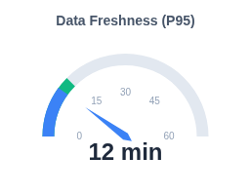
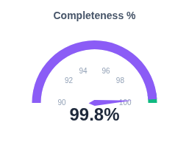
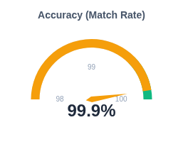



DASHBOARD
Databricks Lakehouse Quality Monitoring
Data Signals
KPIs & SLOs for Lakehouse Quality
Where metrics are sourced
System Tables
DQ INCIDENT RATE
SLA ADHERENCE
MTTR (AVG)
system.information_schema
0.4%
99.9%
18m
-12%
+0.2%
-5m
DLT Event Log
event_log (flow_progress)
TEST COVERAGE
DATA ADOPTION
AUDIT FINDINGS
85%
1.2k
0
Lakehouse Monitoring
+8%
+150
Stable
Profile Metrics & Drifts
Service Level Objectives (SLOs)
Unity Catalog
Lineage & Tags
ALERTING CHANNELS

Slide 8
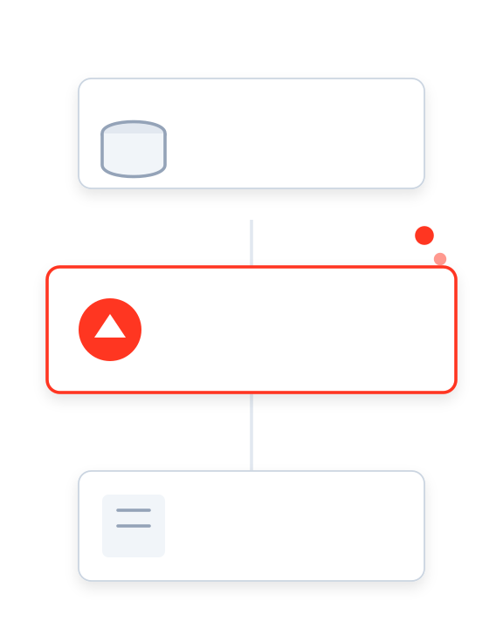
SECTION 02
Architecture — Reference Patterns
Enabling quality-by-design by integrating native Databricks components into a robust engineering framework.
1
PHASE
2
CURRENT
3
PHASE
Strategy
Architecture
Validation
Modular Component Design

Slide 9



















ARCHITECTURE PATTERN
Lakehouse QE Reference Architecture
Validations, Governance & Observability Overlays
Repos & CI/CD
Start: PR Validations & Unit Tests
Databricks Workflows
DATA PIPELINE
OBSERVABILITY
LAKEHOUSE MONITORING
Profile metrics, Drift detection, Quality scorecards
Ingest (Bronze)
Curate (Silver)
Serve (Gold)
SOURCES
Raw / Landing
Clean / Conformed
Aggregated / BI
Files (S3/ADLS)
Auto Loader
DLT / Delta
SQL Warehouse
Databases
Contracts
Schema Drift
Constraints
SLA Monitor
SYSTEM TABLES
Kafka/EventHub
Billing, Audit Logs, Lineage, Query History
PII Scan
Expectations
Delta Share
INCIDENT MGMT
Alerts to PagerDuty / Slack on Validation Failures
Unity Catalog
RBAC & Access
Data Lineage
Tags & Metadata
Row/Col Masking
Governance, Discovery & Lineage Layer
Databricks Component
QE Control / Validation

Slide 10





CI/CD for Data on Databricks
Orchestrating quality gates across Repos, Workflows, and Unity Catalog
1. DEVELOPMENT
2. TEST / STAGING
3. PRODUCTION
Databricks Repos / VS Code
PRE-MERGE GATE
Workflows & DLT (Isolated)
PRE-DEPLOY GATE
Serving & Monitoring
Unit tests (pytest) for logic Repos
Integration job runs Workflows
Blue/Green Deployment
Static analysis (SQLFluff) CI
Data-diff vs. Prod snapshot
SLO Enforcement Monitoring
Schema definition validation UC
Expectation validation DLT
Drift Alerts System Tables
Pre-commit hooks Git
Peer Review + CI Build Pass
PII & Security scan UC
Contract Check + Approval
Auto-Rollback Workflows
Databricks Advantage:
Native integration between Repos (code), Workflows (orchestration), and Unity Catalog (governance) enables automated "Quality as Code" gates at every stage.
Feedback Loop: Lakehouse Monitoring → Repos (Hotfix)
Day 1 — Databricks Quality Engineering Strategy & Architecture
10

Slide 11









Governance & Data Contracts with Unity Catalog
Unifying centralized governance policies with decentralized contract enforcement
Organization & Discovery
Contract Content & Enforcement
3-Level Namespace (Cat.Schema.Table)
Centralized Metastore
Meta-tagging & Search
Data Marketplace / Sharing
Contract Structure (YAML)
Defines schema versions, ownership, SLAs (freshness, accuracy), and privacy policies. Versions are immutable.
Security & Access Control
Fine-grained RBAC (Row/Col)
PII Classification & Masking
Storage-Level Constraints
Attribute-Based Access (ABAC)
Unified Identity Federation
Enforced via Delta Lake CHECK and NOT NULL constraints. Violations block the write transaction immediately.
Observability & Audit
Logical Expectations
Column-level Lineage
System Tables (Audit Logs)
Implemented via DLT Expectations. Allows flexible handling: WARN, DROP, or FAIL pipeline on breach.
Usage & Cost Attribution
Quality Monitor Integration
PR & CI/CD Checks
Static analysis validates contract syntax and schema compatibility (breaking changes) before code merges to main.
Day 1 — Databricks Quality Engineering Strategy & Architecture
Strategy + Architecture + Native Databricks Validation

Slide 12
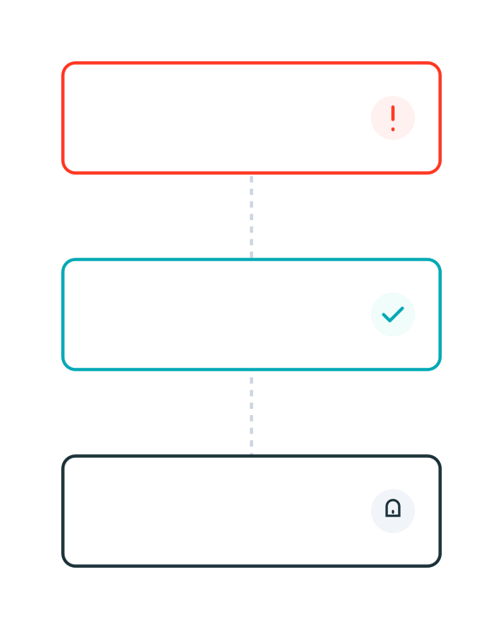



SECTION 03
Native Databricks Validation
Ensuring trust at the source with Delta constraints, DLT expectations, and comprehensive monitoring & alerting.
STORAGE
PIPELINE
OBSERVABILITY
Delta Constraints
DLT Expectations
Monitoring
Native Validation Stack

Slide 13






Delta Lake Constraints & Table Properties
Enforcing quality at the storage layer with ACID guarantees and native controls
NOT NULL & Type Enforcement
Operationalization & Workflow
Fundamental integrity check. Prevents null values in critical columns like Primary Keys, Foreign Keys, or mandatory timestamps.
ALTER TABLE silver_orders ALTER COLUMN order_id SET NOT NULL;
Manage via DDL in PRs
Do not apply constraints manually. Define them in your Infrastructure-as-Code or DDL scripts within the Git repository. CI pipelines execute ALTER TABLE commands during deployment.
CHECK Constraints
Validates row values against boolean expressions. Ideal for domain rules (e.g., price > 0, status codes) directly on the table.
Track via System Tables
Monitor enforcement actions. Query system.quality or the Delta transaction log to see when constraints blocked writes, providing auditability for data rejections.
CONSTRAINT valid_amt CHECK (amount > 0 AND status IN ('OPEN', 'CLOSED'))
Quarantine Patterns
Generated Columns
Constraints block "bad" data by default, causing transaction failure. For resilience, use logic to route invalid rows to a _quarantine table instead of failing the pipeline.
Automatically computes column values based on other columns. Ensures consistency for hash keys, date partitions, or standardizations.
GENERATED ALWAYS AS (cast(event_ts as DATE))
Best Practice
Apply structural constraints (NOT NULL) on Silver tables, but reserve complex business constraints (CHECK) for Gold to allow flexible ingestion.
Day 1 — Databricks Quality Engineering Strategy & Architecture
Confidential & Proprietary

Slide 14



















DAY 1 — DATABRICKS QE STRATEGY
DLT Expectations & Quality Gates
Native Validation Matrix
Bronze (Ingest)
Silver (Curated)
Gold (Trusted)
VALIDATION CATEGORY
Sanity & Schema
Business Rules
Integrity & SLA
Scope & Focus
Technical Sanity
Record Validity
Dataset Trust
File readability, correct format, metadata presence.
Null checks, regex patterns, numeric ranges.
Cross-table referential integrity, unique keys.
What are we validating?
DLT Operator
expect(...)
expect_or_drop(...)
expect_or_fail(...)
WARN: Record the error but allow data to flow.
DROP: Remove invalid rows from the target.
FAIL: Stop the pipeline immediately.
Action on violation
Error Handling
Rescue Clause
Quarantine Table
Incident & Rollback
Auto Loader captures schema mismatch in `_rescued_data`.
Route dropped rows to a side table for review.
Trigger PagerDuty; retain previous state.
Management of bad data
Monitoring
Ingestion Rates
Quality Score
SLO Breaches
Track rows/sec and file arrival latency.
% of rows passing expectations (from Event Log).
Alert on freshness delay or significant drift.
Signals & Alerts
NATIVE TOOLING
DLT Event Log
System Tables
Lakehouse Monitoring
Workflows
Catalog Explorer
14

Slide 15














NATIVE VALIDATION
Module 1 — Strategy & Architecture
Streaming vs. Batch QE Patterns
Comparing validation strategies
Streaming Pipeline
Batch Pipeline
CONTINUOUS / MICRO-BATCH
DISCRETE / SCHEDULED
Input Validation
Pre-flight Checks
Event Source
Schema enforcement on read (Auto Loader)
File completeness & size distribution
File Source
Micro-batch Logic
Logic Validation
Process
Check late data & watermarks
Partition checks & Business Rules
Transform
State Health
Data Diff
Sink (Delta)
Idempotency & Append-only verification
Compare vs Production / Backfill tests
Target Table
SHARED GOVERNANCE FOUNDATION
Data Contracts
Lineage
Time Travel
Alerting
Schema & SLO definitions
Unity Catalog traceability
Delta History & Rollback
PagerDuty / Slack integration
15

Slide 16










HANDS-ON LAB 1
DLT Expectations & Quality Gates
45 Mins
PREREQUISITES
Lab Walkthrough
SUCCESS CRITERIA
Databricks Workspace
Pipeline runs successfully in "Continuous" mode.
Access to create clusters/notebooks
1
Initialize Catalog & Schema
Create a dedicated schema for the lab in Unity Catalog to isolate your quality tests.
Bad data is successfully quarantined to error table.
Unity Catalog
Metastore privileges to create schema
CREATE SCHEMA IF NOT EXISTS lab_qe_v1;
Event log query returns accurate pass/fail counts.
Source Data
Sample JSON dataset mounted/available
2
Ingest with Auto Loader
Compute
Set up a streaming ingestion pipeline using cloud_files to detect new data arrival automatically.
ARTIFACTS
Single-node cluster for dev testing
lab_01_dlt.py
Python Notebook
3
Define DLT Expectations
PRO TIP
Apply quality constraints directly in the pipeline definition. Focus on completeness and domain validity.
sample_data.json
Use the "Development" mode in DLT to keep your cluster running and avoid restart overhead during debugging.
Dataset
Runbook.md
@dlt.expect_or_drop("valid_id", "id IS NOT NULL") @dlt.expect("positive_amt", "amount > 0")
Instructions
Confidential — Training Material
16
4
Configure Quarantine Logic
Route failing records to a separate error table for remediation instead of dropping them entirely.
5
Validate Alerts & Event Log
Query the DLT event log to see how many records passed vs failed expectations.

Slide 17




HANDS-ON LAB 2
Delta Constraints & Workflows Gates
45 Mins
PREREQUISITES
Lab Walkthrough
SUCCESS CRITERIA
Lab 1 Completed
Constraint violations block invalid writes (Transaction aborted).
Uses tables created previously
1
Apply Delta Constraints
Enforce strict data quality rules at the table level using SQL DDL. These constraints prevent bad data from ever being written.
Workflow gate successfully prevents bad promotion.
Databricks Workflows
Access to create job definitions
ALTER TABLE silver_users ADD CONSTRAINT valid_email CHECK (email LIKE '%@%');
Alert received upon validation failure.
SQL Warehouse
Or All-Purpose Cluster
Git Repo (Optional)
2
Create PR with DDL Changes
For versioning DDL scripts
Simulate a production change process. Commit your constraint DDL to a Git branch and open a Pull Request.
ARTIFACTS
constraints.sql
DDL Script
PRO TIP
3
Build "Data Diff" Validation Task
workflow_job.json
Use ALTER TABLE SET TBLPROPERTIES to add descriptive error messages to your constraints for better debugging.
Create a Workflow task that compares the row counts and primary key distributions between Staging and Prod before promotion.
Job Definition
diff_report.html
assert abs(stage_count - prod_count) / prod_count < 0.05, "Drift > 5%"
Validation Output
Confidential — Training Material
17
4
Configure Rollback Path
Add a "If/Else" condition in Workflows. If the validation task fails, trigger a rollback script or send a Slack alert.
5
Run End-to-End Workflow
Trigger the job manually. Verify that inserting invalid data causes the constraint to fire and the job to fail safely.

Slide 18





DAY 1 WRAP-UP
|
Session Checkpoint
Day 1 Checkpoint & Next Steps
Databricks Quality Engineering Strategy
REVIEW
REVIEW
IMMEDIATE NEXT
What We Aligned
What We Built
Module 1 Kickoff
Strategy Pillars: Confirmed Trust, Velocity, and Compliance as core tenets tailored to Lakehouse.
Reference Architecture: Mapped QE controls to Unity Catalog & DLT.
Start Module 1 Blueprint
Deep dive into Bronze/Silver/Gold controls (Slides 19–30).
Native Validation: Deployed "Quarantine" patterns and Delta constraints.
Operating Model: Ratified RACI for Platform vs. Domain ownership.
Finalize RFP Assets: Complete scoring rubric & value narrative.
Lab Artifacts: Functional pipeline with automated expectation suites.
Success Metrics: Defined baseline for Incident Rate, SLA Adherence, and MTTR.
Pilot Selection: Identify domain for initial rollout.
Launch Readiness Status
CHECKLIST
GOVERNANCE
METRICS
TOOLING
OBSERVABILITY
RACI Aligned
SLOs Defined
Templates Ready
Alerts Pending
© 2026 Enterprise Quality Engineering
Page 18

Slide 19



GENSPARK
2-HOUR TRAINING MODULE
Module 1 — Enterprise Lakehouse Quality Engineering Blueprint
QA Strategy for Bronze → Silver → Gold layers with concrete controls
Quality Engineering in Data Mesh & Domain-driven Pipelines
How QE contributes to Deal Wins & RFP Scoring
Presented by: [Presenter Name]
January 2026
Enterprise Quality Practice

Slide 20





Agenda & Outcomes
Module 1 — Enterprise Lakehouse Quality Engineering Blueprint
Duration: 2 Hours
40 MINS
40 MINS
30 MINS
01
02
03
QA Strategy
QE in Data Mesh
Commercial Impact
Bronze → Silver → Gold
Domain-driven Pipelines
Deal Wins & RFP Scoring
Deep dive into layered quality gates. How to de-risk ingestion, validation, and serving layers with specific controls.
Federated quality ownership. Defining data contracts, SLOs, and CI/CD gates for decentralized teams.
Translating technical quality into business value. How QE maturity improves win rates and RFP scores.
Standardized controls & test types per layer
Clear operating model for data domains
RFP scoring rubric & value narrative
KEY TAKEAWAYS
Learning Outcomes
CI/CD quality gate definitions
Concrete KPI set for measuring QE success
Confidential — Internal Training Material
Page 2

Slide 21
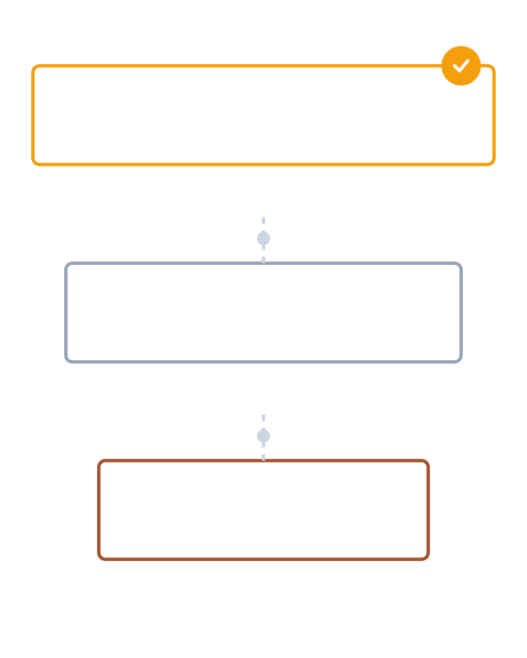
SECTION 01
QA Strategy: Bronze → Silver → Gold
How layered quality gates de-risk data ingestion, curation, and serving through a progressive maturity model.
1
LAYER 1
2
LAYER 2
3
LAYER 3
Ingestion
Curation
Serving
Quality Gate Architecture

Slide 22








Lakehouse Quality Framework
Progressive quality controls from ingestion to consumption to ensure trust at scale
Bronze Layer
Silver Layer
Gold Layer
Raw Ingestion & Landing
Cleaned & Conformed
Aggregated & Trusted
KEY CONTROLS
KEY CONTROLS
KEY CONTROLS
Land data "as-is" (immutable)
Strict schema enforcement
Business logic reconciliation
Schema capture & versioning
Null / Duplicate / Range checks
Bias & anomaly detection
PII tagging & classification
Referential integrity logic
Row-level access policies
File checksum validation
SCD Type 2 history tracking
Cross-source validation
Owner
Platform Eng
Owner
Domain Eng / QE
Owner
Product / Analytics QE
SLO Focus
Freshness / Availability
SLO Focus
Completeness / Accuracy
SLO Focus
Usability / Consistency
Primary Check
Volume & Arrival
Primary Check
Data Constraints
Primary Check
Business Rules
2026 Enterprise Quality Engineering
Module 1: Enterprise Lakehouse Quality Engineering Blueprint

Slide 23




















MODULE 1 — QUALITY ENGINEERING BLUEPRINT
Controls & Test Types by Layer
Comparison Matrix
Bronze (Raw)
Silver (Validated)
Gold (Trusted)
CONTROL CATEGORY
Ingestion & Landing
Cleaning & Integration
Aggregation & Serving
Schema & Structure
Schema Capture
Strict Enforcement
Frozen Contracts
Drift detection & enforcement
Detect new columns; allow evolution.
Fail on schema mismatch; reject bad types.
Zero tolerance for breaking changes.
Data Quality
Freshness & Volume
Nulls & Duplicates
Business Logic
File arrival SLAs; Row count ±10% vs source.
Drop/quarantine invalid PKs; Range checks.
KPI reconciliation; Cross-system alignment.
Accuracy, Completeness, Consistency
Lineage & Ops
File Checksums
Transformation Logic
Audit Trail
Traceability and operational health
Verify exact replica of source.
Job-level lineage; Error handling logs.
Full provenance; Reproducible metrics.
Privacy & Access
PII Tagging
Masking & Tokenization
RBAC & Row Security
Compliance and PII protection
Identify sensitive columns on ingestion.
Apply dynamic masking policies.
Fine-grained access control lists.
TOOLING ECOSYSTEM
Delta Constraints
Great Expectations / Deequ
dbt tests
Monte Carlo / Datadog
Airflow SLA Checks
5

Slide 24







Example Checks & Automation Patterns
Detailed breakdown of quality controls by layer vs. automation strategies
Bronze (Raw Ingestion)
Automation & CI/CD Patterns
Row counts vs source (±2% tolerance)
File checksum validation
Arrival freshness < 15 mins
PII column detection tagging
Data Contracts as Code
Define expectations in YAML/JSON at source. Ingestion pipelines auto-generate validation logic based on the contract schema.
Silver (Validated & Cleaned)
NOT NULL on business keys
Duplicate suppression (PK unique)
Valid domain sets (Ref Tables)
SCD Type-2 history continuity
PR-Validated Expectations
Run dbt test or Great Expectations suites on a staging clone during Pull Request. Block merge if new logic breaks existing constraints.
Gold (Aggregated & Trusted)
Data-Diff on Promote
Totals reconciliation vs GL
Metric drift vs 30-day baseline
Semantic consistency across marts
Strict BI contract tests
Compare row-level output of new code vs. production code on a sample dataset to catch unintended regressions before full deployment.
Canary Releases & Rollback
Deploy to a "canary" partition first. If error rate or freshness SLOs are breached, system automatically reverts to the previous version.
Module 1 — Enterprise Lakehouse Quality Engineering Blueprint
Confidential & Proprietary

Slide 25
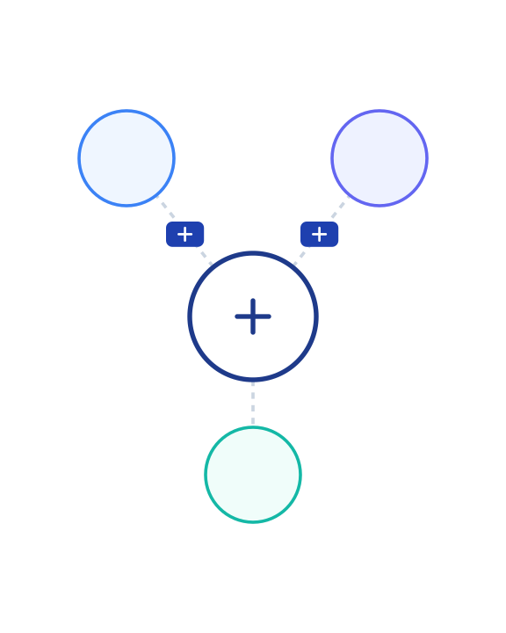
SECTION 02
QE in Data Mesh & Domain-driven Pipelines
Establishing the operating model for federated domains through clear ownership, data contracts, and automated platform guardrails.
Federated Mesh Architecture
OPERATING MODEL
INTERFACE
PLATFORM
1
2
Contracts
3
Guardrails
Ownership

Slide 26




Ownership & Data Contracts
Defining roles, responsibilities, and the structure of data contracts in a mesh architecture
Domain Product Owner
Data Contract Structure
Accountable for data product value and quality. Defines "what good looks like" from a business perspective and approves SLA breaches.
CORE SPECIFICATIONS
Schema Versioning: Explicit field types, nullability, and version (e.g., v1.2.0).
Data Engineer
Builds pipelines to meet contract specs. Implements transform logic, enforces schema, and ensures technical stability of ingestion.
SLOs (Service Level Obj): Freshness (e.g., <30m), Completeness (>99%), Accuracy (±1%).
Semantics: Field descriptions, business glossary links, and value distribution expectations.
QE Owner / Lead
Governance: PII tags, data retention policies, and authorized consumer roles.
Architects the test strategy. Defines validation rules, sets up CI/CD gates, and monitors drift/quality metrics across the lifecycle.
Change Management Policy
Data Steward
Backward compatibility required for minor updates.
Ensures compliance with governance standards (PII, retention). audits access controls and metadata completeness.
Breaking changes require a major version bump & consumer approval workflow.
Automated notifications sent 7 days prior to deprecation.
Module 1 — Enterprise Lakehouse Quality Engineering Blueprint
Confidential & Proprietary

Slide 27











MODULE 1 — QUALITY ENGINEERING BLUEPRINT
Template: canvas_one_pager
Domain Data Product Canvas (Quality-First)
Proprietary & Confidential
M1
Use Cases & Value
Inputs & Sources
Quality Contract
Primary Goal: Provide clean customer 360 view for marketing personalization.
CRM (Salesforce)
Clickstream (Kafka)
Support (Zendesk)
Guaranteed Service Levels (SLOs)
TARGET OUTCOMES
DEPENDENCIES
Daily batch dump from CRM (02:00 UTC)
FRESHNESS
Reduce churn by 5% via targeted offers.
Real-time events stream topic: `user_events`
T-1 Hour
Increase upsell conversion by 10%.
ROI HYPOTHESIS
Data available by 8:00 AM daily
$2M annual revenue lift based on pilot data.
COMPLETENESS
99.95%
Transformation Logic
Outputs & Interfaces
Non-null essential keys
Key Logic: Identity resolution across email/device_id.
Primary Interface: Delta Table `gold.cust_360`
ACCURACY
PROCESSING STEPS
Secondary Interface: REST API for real-time scoring.
+/- 0.5%
Ingest raw Bronze (append-only)
SCHEMA
Deduplicate & clean (Silver)
Variance vs Source System
cust_id (PK), segment, LTV, last_login
Aggregate session metrics (Gold)
VALIDITY
Current Health
HEALTHY
0 Critical
Last validated: Today, 09:15 AM
Consumers & Access
Governance & Owners
Blocking errors allowed
Downstream Teams: Marketing Ops, Data Science (Churn Model).
Product Owner
Data Steward
© 2026 Enterprise Quality Engineering. All rights reserved.
Sarah J.
Mike L.
9
ACCESS POLICIES
Classification
Retention
CONFIDENTIAL
3 Years
PII Masking applied for DS team.
Read-only access via `marketing_reader` role.

Slide 28





CI/CD for Data Pipelines with QE Gates
Robust automation ensuring quality from local development to production serving
1. DEVELOPMENT
2. INTEGRATION / TEST
3. PRODUCTION
Local dbt/spark unit tests
Pull Request Gate
Full integration tests
Release Gate
Canary Deployment
Static code analysis (SQLLint)
Data-diff vs. Golden Set
Live SLO monitoring
Schema contract validation
Performance/Volume tests
Drift detection alerts
Sample data profile checks
Peer review + CI Build Pass
Security & PII scanning
Sign-off + Contract Compliance
Automated rollback logic
Key Benefit:
Shifting checks left (to Dev/Test) reduces production incidents by ~40-60% and accelerates hotfix cycles.
Continuous Feedback & Observability
Module 1 — Enterprise Lakehouse Quality Engineering Blueprint
10

Slide 29
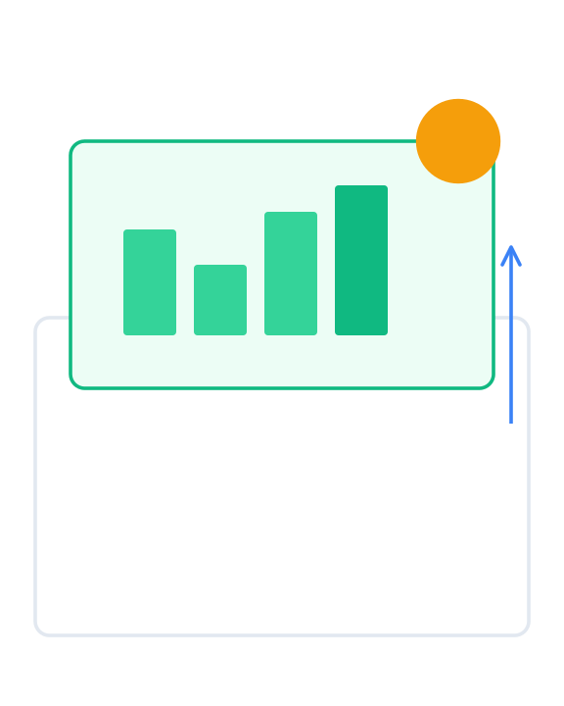



SECTION 03
QE Impact: Deal Wins & RFP Scoring
Positioning Quality Engineering as a strategic differentiator to reduce risk, assure compliance, and accelerate value delivery.
IMPACT 1
IMPACT 2
IMPACT 3
Risk Reduction
Compliance
Faster Value
Competitive Advantage Model

Slide 30


Value Narrative & RFP Scoring
Translating quality engineering capabilities into business value and deal assurance
Sample RFP Scoring Rubric Impact
Expected Business Value
Evaluation Criteria
QE Contribution Strategy
Points
40-60%
25-35%
Reduction in Data Quality Incidents
Faster Time-to-Insight (Cycle Time)
Approach & Architecture
Layered gates (Bronze/Silver/Gold) show structured risk mitigation
30
20-30%
100%
Technical Scalability
Automated Data Mesh controls demonstrate ability to scale domains
25
Lower L3 Engineering Support Cost
Compliance Audit Traceability
Quality & Testing
Comprehensive automation, contracts, and observability SLOs
25
KEY PERFORMANCE INDICATORS (KPIS)
DQ Incident Rate
SLA Adherence %
Commercials / TCO
Reduced support costs and rework lowers long-term TCO
20
Mean Time to Recovery
Test Coverage %
Data Product Adoption
Audit Findings Count
QE Maturity Ladder Positioning
1
2
3
4
Ad hoc
Managed
Automated
Predictive
High RFP scores typically require demonstrating Level 3+ capabilities
Module 1 — Enterprise Lakehouse Quality Engineering Blueprint
Confidential & Proprietary

