Slide 1






Day 3: Intermediate SQL (Part 1)
Common Table Expressions & Window Functions
Duration
Learning Outcomes
2.5 hours (including hands-on exercises)
Write readable, modular queries using CTEs
Apply window functions for ranking and analytical tasks
Prerequisites
Calculate running metrics and period-over-period changes
Day 1–2 completion:
Optimize queries for Snowflake performance
SQL basics (SELECT, WHERE)
Combine techniques to solve complex business problems
Table joins (INNER, LEFT, RIGHT)
Session Agenda
Aggregations (GROUP BY, ORDER BY)
9:00 - 10:00
CTEs: Theory & Practice
Today's Topics
10:00 - 10:30
Hands-on: Writing CTE Queries
Common Table Expressions (CTEs)
10:30 - 11:15
Window Functions
Window Functions (RANK, ROW_NUMBER, LEAD/LAG)
11:15 - 11:45
Combined Approaches
Performance Best Practices
11:45 - 12:00
Performance Best Practices
SQL & Snowflake Foundations
Day 3 of 5

Slide 2
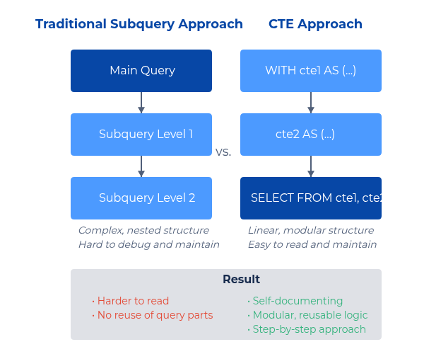
CTEs: What & Why
Definition
A CTE is a named, temporary result set defined within a query using WITH ... AS (...) that exists only for the duration of the query.
Benefits vs Subqueries
Readability: Clean, modular code structure
Reusability: Use the same result set multiple times in a query
Debugging: Easier to test and troubleshoot step by step
Maintenance: Cleaner structure for complex queries
Recursion: Enables hierarchical data processing
Basic Syntax
WITH
cte_name
AS
(
SELECT
column1, column2
FROM
table_name
WHERE
condition
)
SELECT
*
FROM
cte_name
WHERE
column1 > 100;
Quick Comparison
Subquery:
SELECT * FROM (SELECT ...) t
CTE:
WITH t AS (SELECT ...) SELECT * FROM t
SQL & Snowflake Foundations
Day 3 of 5

Slide 3
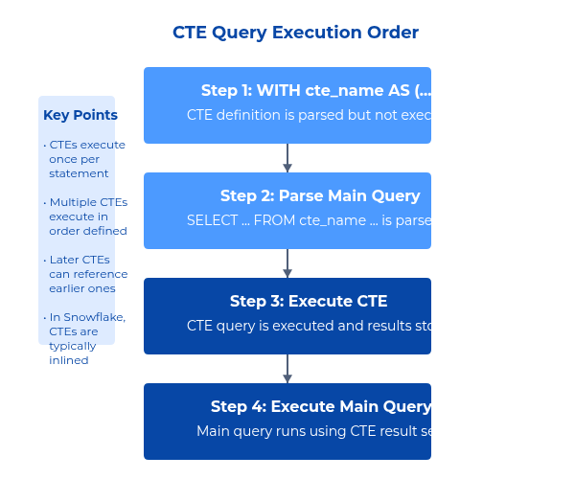
CTE Syntax & Simple Examples
Single CTE Syntax
WITH
cte_name
AS
(
SELECT
column1, column2
FROM
table_name
WHERE
condition
)
SELECT
*
FROM
cte_name;
Multiple CTEs Syntax
WITH
cte_one
AS
(
SELECT
col1, col2
FROM
table1
),
cte_two
AS
(
SELECT
col1, col3
FROM
table2
JOIN
(col1)
)
cte_one
USING
SELECT
*
FROM
cte_two;
Example 1: Total Sales per Customer
WITH
order_totals
AS
(
SELECT
customer_id,
SUM
(amount)
AS
total_amt
FROM
orders
GROUP BY
customer_id
)
SELECT
c.customer_name, o.total_amt
FROM
order_totals o
JOIN
customers
c
USING
(customer_id)
ORDER BY
o.total_amt
DESC
;
Example 2: Monthly Sales
WITH
monthly
AS
(
SELECT
DATE_TRUNC
('month', order_date)
AS
month,
SUM
(amount)
AS
revenue
FROM
orders
GROUP BY
1
)
SELECT
month, revenue
FROM
monthly
ORDER BY
month;
Note: We'll add Year-To-Date calculations using window functions later today
SQL & Snowflake Foundations
Day 3 of 5

Slide 4
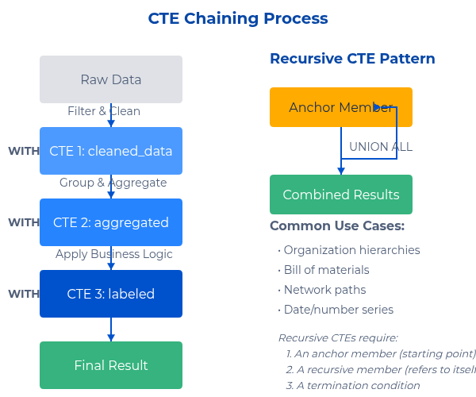
Advanced CTE Patterns
Chaining CTEs
Create multi-step data transformations with a clear, logical flow:
WITH
-- Step 1: Clean and filter raw data
cleaned_data
AS
(
SELECT
*
FROM
raw_data
WHERE
customer_id
),
status =
'active'
),
-- Step 2: Aggregate the cleaned data
aggregated
AS
(
SELECT
customer_id,
SUM
(amount)
AS
total
FROM
cleaned_data
GROUP BY
aggregated
)
-- Step 3: Add business logic/labels
labeled
AS
(
SELECT
*,
CASE WHEN
total > 10000
THEN
'VIP'
ELSE
'Standard'
END
AS
segment
FROM
SELECT
*
FROM
labeled;
Recursive CTEs
Handle hierarchies, series, and graph-like data structures:
WITH RECURSIVE
org_hierarchy
AS
(
-- Anchor member (starting point)
SELECT
id, name, manager_id, 0
AS
depth
FROM
employees
WHERE
manager_id
IS NULL
UNION ALL
-- Recursive member (references itself)
SELECT
e.id, e.name, e.manager_id, h.depth + 1
FROM
employees
e
e.manager_id = h.id
)
JOIN
org_hierarchy h
ON
SELECT
*
FROM
org_hierarchy;
High-Value Customers Example
WITH
order_items_total
AS
(
SELECT
order_id,
SUM
(quantity * price)
AS
order_total
FROM
order_items
GROUP BY
order_id
),
customer_totals
AS
(
SELECT
c.customer_id, c.name,
SUM
(oit.order_total)
AS
lifetime_value
FROM
customers
c
JOIN
orders
o
c.customer_id, c.name
)
ON
c.customer_id = o.customer_id
JOIN
order_items_total oit
ON
o.order_id = oit.order_id
GROUP BY
SELECT
*
FROM
customer_totals
WHERE
lifetime_value > 10000
ORDER BY
lifetime_value
DESC
;
Best Practices
Meaningful names: Use descriptive CTE names
Focused purpose: Each CTE should do one thing well
Depth control: Avoid excessive nesting (>3-4 levels)
Comments: Explain complex logic with inline comments
Snowflake note: CTEs are inlined by default (not materialized)
SQL & Snowflake Foundations
Day 3 of 5

Slide 5
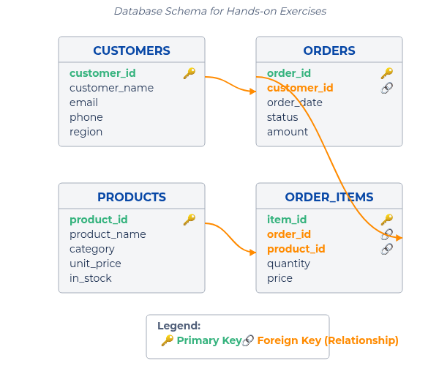
Hands-on: Write Queries Using CTEs
Dataset Description
Working with a retail sales dataset containing 4 interconnected tables:
CUSTOMERS - Customer demographic information
ORDERS - Order header data with dates and totals
ORDER_ITEMS - Line item details with quantities and prices
PRODUCTS - Product catalog with categories
Exercise 1: Products Sold in Last 30 Days
List products sold in the last 30 days with quantities and revenue
WITH
recent_orders
AS
(
SELECT
*
FROM
orders
WHERE
())
)
order_date >=
DATEADD
('day', -30,
CURRENT_DATE
SELECT
p.product_name,
SUM
(oi.quantity)
AS
units_sold,
SUM
(oi.quantity * oi.price)
AS
revenue
FROM
recent_orders ro
JOIN
order_items
oi
ON
ro.order_id = oi.order_id
JOIN
products
p
ON
oi.product_id = p.product_id
GROUP BY
p.product_name
ORDER BY
revenue
DESC
;
Exercise 2: Customer Lifetime Value
Calculate total lifetime spend for each customer
WITH
order_totals
AS
(
-- Calculate total per order
SELECT
order_id, customer_id,
SUM
(quantity * price)
AS
order_amount
FROM
orders
o
JOIN
order_items
oi
order_id, customer_id
),
customer_ltv
ON
o.order_id = oi.order_id
GROUP BY
ot.customer_id,
c.customer_name,
AS
(
-- Aggregate to customer level
SELECT
COUNT
(
DISTINCT
ot.order_id)
AS
order_count,
SUM
(ot.order_amount)
AS
lifetime_value
FROM
order_totals ot
JOIN
customers
c
ot.customer_id, c.customer_name
)
ON
ot.customer_id = c.customer_id
GROUP BY
SELECT
*
FROM
customer_ltv
ORDER BY
lifetime_value
DESC
;
Exercise 3: Monthly Revenue Growth
Calculate monthly revenue (setup for window functions)
WITH
monthly_revenue
AS
(
Dataset Structure & Relationships
SELECT
DATE_TRUNC
('month', order_date)
AS
month,
SUM
(oi.quantity * oi.price)
AS
revenue
FROM
orders
o
JOIN
order_items
oi
('month', order_date)
)
ON
o.order_id = oi.order_id
GROUP BY
DATE_TRUNC
SELECT
month, revenue
FROM
monthly_revenue
ORDER BY
month;
-- Later: Add window functions for MoM growth
Exercise 4: Top Regions by Revenue
Find top revenue-generating regions (prep for ranking)
WITH
region_sales
AS
(
SELECT
c.region,
SUM
(oi.quantity * oi.price)
AS
total_revenue
FROM
customers
c
JOIN
orders
o
ON
c.customer_id = o.customer_id
JOIN
order_items
oi
c.region
)
ON
o.order_id = oi.order_id
GROUP BY
SELECT
region, total_revenue
FROM
region_sales
ORDER BY
total_revenue
DESC
;
-- Later: Add RANK() to handle ties
SQL & Snowflake Foundations
Day 3 of 5

Slide 6

Window Functions: Concepts & OVER()
What Are Window Functions?
Functions that perform calculations across a set of table rows related to the current row without collapsing those rows like GROUP BY does.
OVER() Clause Components
PARTITION BY: Divides rows into groups (partitions)
ORDER BY: Defines the logical order of rows in each partition
Frame clause: ROWS/RANGE BETWEEN ... AND ... (optional)
Window vs. GROUP BY
GROUP BY
Collapses rows into fewer summary rows
Window
Preserves all rows while calculating aggregates
Basic Syntax
SELECT
product_category,
sale_date,
sales_amount,
sale_date
)
SUM
(sales_amount)
OVER
(
PARTITION BY
product_category
ORDER BY
AS
running_total
FROM
sales
;
Common Use Cases
Rankings (ROW_NUMBER, RANK, DENSE_RANK)
Running totals and moving averages
Period-over-period comparisons (LEAD/LAG)
Percentiles and distributions
First/last values in groups
Snowflake Tip: Use QUALIFY to filter on window function results directly
SQL & Snowflake Foundations
Day 3 of 5

Slide 7
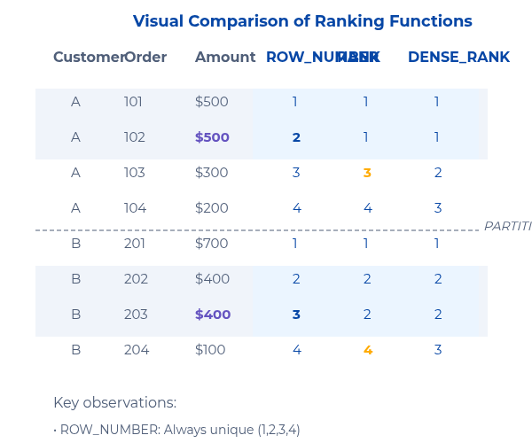
Ranking Functions: ROW_NUMBER vs RANK vs DENSE_RANK
Definitions
ROW_NUMBER(): Assigns unique sequential numbers (no ties)
RANK(): Assigns same number for ties, skips next ranks (1,1,3)
DENSE_RANK(): Assigns same number for ties, no gaps (1,1,2)
Function Comparison
Function
Ties
Gaps
Use Case
ROW_NUMBER()
No ties
No gaps
Pagination, unique ordering
RANK()
Allows ties
Gaps after ties
Traditional competitions
DENSE_RANK()
Allows ties
No gaps
Percentile bands, top-N analysis
Example: Top 3 Orders Per Customer
SELECT
customer_id, order_id, amount,
ROW_NUMBER
()
OVER
(
PARTITION BY
customer_id
ORDER BY
amount
DESC
)
AS
rn,
RANK
()
OVER
(
PARTITION BY
customer_id
ORDER BY
amount
DESC
)
AS
rnk,
DENSE_RANK
()
OVER
(
PARTITION BY
customer_id
ORDER BY
amount
DESC
)
AS
drnk
FROM
orders
QUALIFY
rnk <= 3;
Best Practices
Add tie-breakers for consistent results (e.g., ORDER BY amount DESC, order_id)
Use QUALIFY in Snowflake to filter on window results directly
Consider performance impact on large result sets
Note: Use RANK when traditional ranking (with gaps) is needed; use DENSE_RANK when you need continuous rank numbers.
SQL & Snowflake Foundations
Day 3 of 5

Slide 8
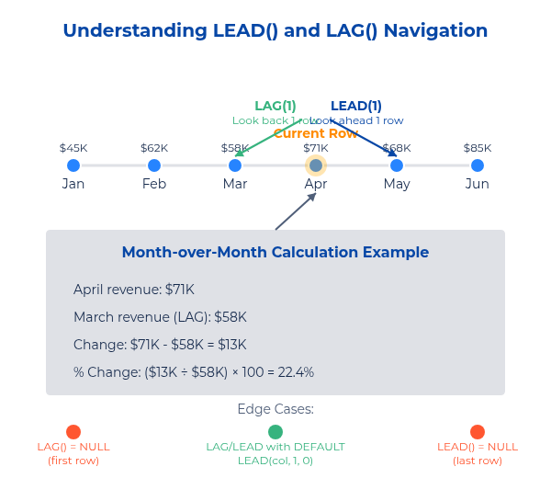
Analytical Functions: LEAD & LAG
Syntax & Purpose
Navigate to previous or future rows without joins or subqueries
LAG
(
expr
[,
offset
,
default
])
OVER
(
PARTITION BY
...
ORDER BY
...)
LEAD
(
expr
[,
offset
,
default
])
OVER
(
PARTITION BY
...
ORDER BY
...)
Month-over-Month Growth Example
WITH
monthly_sales
AS
(
SELECT
DATE_TRUNC
(
'month'
, order_date)
AS
month,
SUM
(amount)
AS
revenue
FROM
orders
GROUP BY
month,
revenue,
1
)
SELECT
prev_month,
revenue -
LAG
(revenue)
OVER
(
ORDER BY
month)
AS
LAG
(revenue)
OVER
(
ORDER BY
month)
AS
change,
ROUND
(
100
* (revenue -
LAG
(revenue)
OVER
(
ORDER BY
month)) /
NULLIF
(
LAG
(revenue)
OVER
(
ORDER BY
month),
0
),
2
)
AS
pct_change
FROM
monthly_sales
ORDER BY
month;
Additional Use Cases
Use Case
Example
Detecting changes
Status changes, price movements
Time between events
Days since last order
Gap detection
Missing dates, inventory levels
Moving averages
Trailing metrics, smoothing
Edge Cases & Tips
NULL handling: First/last rows return NULL; use DEFAULT parameter
Ties in ORDER BY: Results may be unpredictable with ties
Missing periods: LAG/LEAD only access existing rows
Performance: Window functions process after WHERE but before final ORDER BY
SQL & Snowflake Foundations
Day 3 of 5

Slide 9
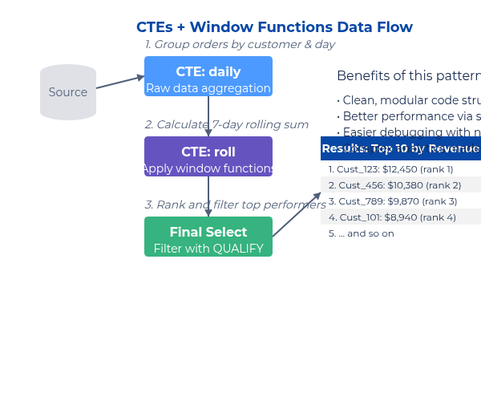
Combining CTEs & Window Functions
Pattern: Stage → Window → Filter
Powerful pattern for complex analysis:
Stage data with CTEs (clean, filter, join)
Apply window functions for analytics
Filter results with QUALIFY or outer WHERE
Example: Rolling 7-day Revenue with Ranking
WITH
daily
AS
(
SELECT
customer_id, order_date::date
AS
d,
SUM
(amount)
AS
rev
FROM
orders
GROUP BY
1, 2
),
roll
daily
)
AS
(
SELECT
customer_id, d,
SUM
(rev)
OVER
(
PARTITION BY
customer_id
ORDER BY
d
ROWS BETWEEN
6
PRECEDING AND
CURRENT ROW
)
AS
rev_7d
FROM
SELECT
*,
RANK
()
OVER
(
ORDER BY
rev_7d
DESC
)
AS
r
FROM
roll
QUALIFY
r <= 10;
-- Top 10 customers by rolling revenue
Debugging Tips
Materialize steps temporarily: CREATE TEMP TABLE...
Verify row counts at each step
Test window functions separately first
Check for NULLs in partition/order columns
Inspect Query Profile for bottlenecks
Practice Exercises
Adapt example for category-level rolling revenue
Find customers with consistently increasing monthly spend
Top 3 products per category with price comparison
SQL & Snowflake Foundations
Day 3 of 5

Slide 10





Performance & Efficiency Best Practices
CTE Usage
Query Optimization
Snowflake Specifics
CTEs are inlined by default in Snowflake (not materialized)
Filter early in the processing chain
Right-size warehouses for different workloads
Project only needed columns (avoid SELECT *)
Consider TEMP tables for large result sets reused across multiple statements
Scale up for complex window functions; suspend when idle
Add tie-breakers in ORDER BY clauses
Keep CTEs small and focused; avoid deep nesting
Use QUALIFY for filtering on window results
Leverage result caching (30-minute cache by default)
Use clear, descriptive naming conventions
Optimize window frames (ROWS vs RANGE)
Use clustering keys on large tables for partition pruning
Consider automatic clustering for frequently filtered tables
-- Prefer this approach for reusable results
CREATE
-- Filter on window functions with QUALIFY
TEMPORARY
TABLE
large_result
AS
SELECT
*
FROM
SELECT
huge_table
product_id, sales,
WHERE
complex_condition;
RANK
()
OVER
(
PARTITION BY
category
ORDER BY
sales
DESC
)
AS
rank
FROM
product_sales
QUALIFY
rank <=
5
;
-- Check query performance metrics
query_id, query_text,
execution_time, partitions_scanned
SELECT
FROM
table
(
information_schema.query_history
())
ORDER BY
start_time
DESC
LIMIT
10
;
Common Pitfalls
Coming in Day 4
Cartesian product due to missing join conditions
Overusing recursive CTEs when iterative approaches are better
Advanced window frames (ROWS vs RANGE)
Percentile and statistical functions
Improper window frame definitions causing incorrect calculations
Complex pattern matching with MATCH_RECOGNIZE
Unnecessary duplication of large CTEs
Set operations (UNION, INTERSECT, EXCEPT)
Optimizing queries at enterprise scale
Ignoring NULL handling in window functions
Forgetting tie-breakers in ranking functions
SQL & Snowflake Foundations
Day 3 of 5

