Slide 1








Introduction to
Relational Databases
& Snowflake
You will learn:
What relational databases are and why ACID matters
Snowflake's cloud-native architecture and how to access it
SQL essentials: SELECT and WHERE statements
Hands-on practice extracting simple datasets
2025 | Data Training Workshop

Slide 2
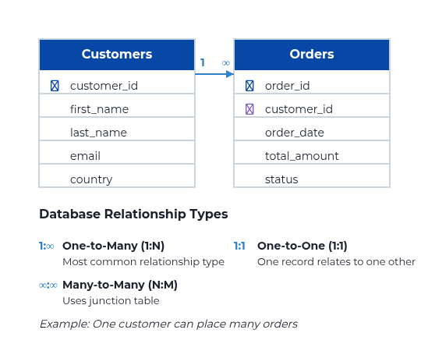




What Are Relational Databases?
Definition: Organize data into tables (rows, columns) with relationships via keys
Key concepts:
Tables, rows, columns
Data stored in tables (entities) with rows (records) and columns (attributes)
Primary keys and foreign keys
Primary keys uniquely identify records; foreign keys establish relationships
Relationships
One-to-many, many-to-many, one-to-one connections between tables
Normalization
Reduces data redundancy and improves integrity
ACID benefits:
Atomicity
Consistency
All-or-nothing transactions
Data integrity preserved
Isolation
Durability
Concurrent transactions don't interfere
Committed changes persist

Slide 3






Introduction to Snowflake
What is Snowflake? A cloud-native data platform that provides a fully managed service for data storage, processing, and analytics
Key features:
Cloud-Native Architecture
Multi-cloud support
Available on AWS, Microsoft Azure, and Google Cloud Platform
Elastic virtual warehouses
Time Travel & Zero-Copy Cloning
Pay-as-you-go compute resources that scale up/down automatically
Separation of storage and compute
Secure Data Sharing
Independent scaling allows for better resource utilization
Data type support
Micro-partitioning & Columnar Storage
Structured, semi-structured, and unstructured data handling
Automatic Query Optimization
Benefits:
No infrastructure to manage
Focus on data analytics, not hardware provisioning
Fast to start
Create an account and start analyzing data in minutes
Predictable performance
Isolated compute resources ensure consistent query performance

Slide 4
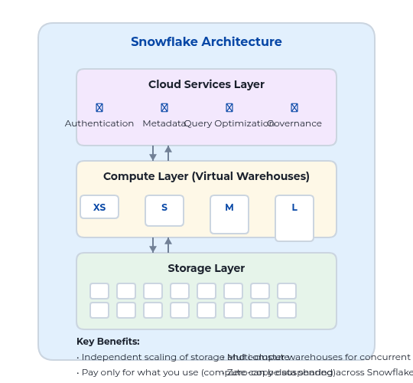

Snowflake Architecture Overview
Three layers: Snowflake's unique architecture separates functionality for performance and scalability
Storage Layer
Columnar data organized in micro-partitions
Compressed data stored in cloud object storage with metadata for efficient pruning
Compute Layer (Virtual Warehouses)
MPP clusters for SQL query execution
Independently scalable, isolated compute resources that can be suspended when not in use
Cloud Services Layer
Handles authentication, metadata, coordination
Manages query parsing, optimization, governance, and security across the platform
Hybrid design advantage:
Shared-disk + shared-nothing architecture
Combines data management simplicity of shared-disk with performance and scale-out benefits of shared-nothing approach

Slide 5




Access Setup in Snowflake
Getting started steps:
Sample commands:
1
Create account
Create a virtual warehouse:
Choose cloud provider (AWS, Azure, GCP) and region
CREATE WAREHOUSE wh_demo
Select Snowflake edition (Standard, Enterprise, Business Critical)
WITH
2
Log in via Snowsight (web UI) or CLI/driver
WAREHOUSE_SIZE = 'XSMALL'
Access using account URL: https://[account].[region].snowflakecomputing.com
AUTO_SUSPEND = 60
AUTO_RESUME = TRUE;
-- Automatically suspends after 60 seconds of inactivity
3
Create roles/users; set default warehouse/db/schema
Define organizational structure and access controls
Create a database and schema:
4
Create compute and database objects
CREATE DATABASE demo_db;
Virtual warehouses, databases, schemas, and tables
CREATE SCHEMA demo_db.raw;
Connection options:
Grant access privileges:
Snowsight (Web UI)
Snowflake CLI
GRANT USAGE ON WAREHOUSE wh_demo
TO ROLE ANALYST;
-- Allow ANALYST role to use the warehouse
JDBC/ODBC Drivers
Python/REST APIs
Set context for your session:
USE WAREHOUSE wh_demo;
USE DATABASE demo_db;
USE SCHEMA raw;

Slide 6



SQL Essentials: How Queries Are Structured
What is SQL?
Basic query pattern:
Standard Query Language
Universal language for querying and manipulating relational database data
SELECT columns to retrieve
Declarative Language
Describe what data you want, not how to get it
FROM table name(s)
ANSI Standard
Most databases support SQL with vendor-specific extensions
WHERE filter conditions
Tips for writing queries:
GROUP BY aggregate by columns
Use clear aliases
Use SELECT amount AS total_usd for readability
HAVING filter on aggregates
Qualify table names
ORDER BY sort results
Use database.schema.table in shared environments
String values in quotes
LIMIT restrict result count
WHERE country = 'USA' not 'USA'
NULL checks
Execution order differs from writing order:
Use IS NULL or IS NOT NULL, not = NULL
1. FROM → 2. WHERE → 3. GROUP BY → 4. HAVING → 5. SELECT → 6. ORDER BY → 7. LIMIT

Slide 7




SQL SELECT Statement
Purpose:
Basic syntax:
Retrieve data from database tables
SELECT column1, column2, ...
The fundamental query for reading data in SQL
FROM table_name;
Select specific columns or all columns
Allows targeted data retrieval, showing only what's needed
Example 1: Select specific columns
Filter rows with WHERE clause (optional)
SELECT first_name, last_name
Return only data that meets specific conditions
FROM customers;
-- Returns only first and last names from customers
Best practices:
Example 2: Select all columns
Prefer explicit columns over SELECT *
SELECT *
Improves performance, readability and avoids issues when schema changes
FROM customers;
-- Returns all columns for all customers
-- Use sparingly - can impact performance
Use LIMIT during exploration
Prevents accidentally returning millions of rows
Example 3: Using column aliases
Example: SELECT * FROM huge_table LIMIT 100;
SELECT
first_name AS customer_first_name,
Alias columns for readability
last_name AS customer_last_name,
Makes query output clearer, especially for expressions
order_date AS purchase_date
Example: SELECT amount * 0.1 AS tax
FROM customers
JOIN orders ON customers.id = orders.customer_id
LIMIT 10;

Slide 8
SQL WHERE Clause and Operators
Purpose:
Examples:
Filter rows that meet specified conditions, limiting results to only those records that fulfill your criteria.
Basic filtering by exact match:
SELECT *
Common operators:
FROM customers
WHERE country = 'USA';
-- Returns only customers from USA
=
Equal to
<> or !=
Not equal to
Using BETWEEN for range filtering:
SELECT *
>
Greater than
FROM orders
WHERE amount BETWEEN 100 AND 500;
>=
Greater than or equal to
-- Returns orders with amounts from $100 to $500
<
Less than
Pattern matching with LIKE:
<=
Less than or equal to
SELECT *
FROM products
LIKE
Pattern matching with wildcards
WHERE name LIKE 'Pro%';
-- Returns products whose names start with 'Pro'
IN
Match any value in a list
Combining multiple conditions:
BETWEEN
Value within a range (inclusive)
SELECT *
AND
Both conditions must be true
FROM customers
WHERE country IN ('USA', 'UK')
OR
Either condition can be true
AND age >= 21;
-- Returns customers from USA or UK who are 21 or older
IS NULL
Value is NULL / missing

Slide 9
Hands-on: Extracting Simple Datasets
Sample dataset:
Optional Snowflake setup:
customers
Set context for your session:
USE WAREHOUSE wh_demo;
id
first_name
last_name
country
USE DATABASE demo_db;
USE SCHEMA raw;
1
John
Smith
USA
2
Emma
Johnson
UK
Create customers table:
CREATE TABLE customers (
3
Carlos
Rodriguez
Mexico
id INTEGER,
first_name VARCHAR(50),
last_name VARCHAR(50),
orders
country VARCHAR(50)
);
id
customer_id
order_date
amount
Create orders table:
101
1
2024-01-15
350.00
CREATE TABLE orders (
102
2
2024-02-20
125.50
id INTEGER,
customer_id INTEGER,
103
1
2024-03-05
275.75
order_date DATE,
amount DECIMAL(10,2)
);
Objectives:
Insert sample data:
1
List all customers
INSERT INTO customers
SELECT columns FROM customers
VALUES (1, 'John', 'Smith', 'USA'),
2
Filter by country or amount
(2, 'Emma', 'Johnson', 'UK'),
Use WHERE clause with comparison operators
(3, 'Carlos', 'Rodriguez', 'Mexico');
-- Insert order data similarly
3
Combine conditions
Use AND/OR, BETWEEN operators

Slide 10








Practice Exercises & Next Steps
Exercises:
Next steps:
1
List customer first_name, last_name for all USA customers
Explore additional SQL clauses
SELECT first_name, last_name
SELECT DISTINCT, ORDER BY, LIMIT
FROM customers
WHERE country = 'USA';
Learn JOINs to combine tables
INNER, LEFT, RIGHT, FULL OUTER JOINs
2
Find orders with amount > 250 placed in 2024
Read Snowflake documentation
SELECT *
Warehouses, Time Travel, data loading techniques
FROM orders
WHERE amount > 250
Track costs and optimize resources
AND YEAR(order_date) = 2024;
Monitor warehouse usage, auto-suspend/auto-resume settings
3
Show customers with last_name LIKE 'A%'
Pro Tips
SELECT *
FROM customers
Leverage Snowflake's caching for query performance
WHERE last_name LIKE 'A%';
Use EXPLAIN to understand query execution plans
Set appropriate warehouse sizes for different workloads
4
Return orders with specific conditions
Join the Snowflake community for advanced tips
SELECT o.*, c.country
FROM orders o
JOIN customers c ON o.customer_id = c.id
WHERE amount BETWEEN 100 AND 500
AND country IN ('USA', 'CA');

