Slide 1
JS
DAY 11 OF 30
script.js
JavaScript
1
// JavaScript!
2
let name = 'Rahul';
Fundamentals & Basics
3
const age = 22;
4
5
function greet(n) {
The programming language of the web. Add logic, interactivity and power to your pages.
6
return `Hi ${n}!`;
7
}
Variables & Data Types
Operators
Functions
Arrays & Objects
8
9
const nums = [1,2,3];
6
20+
One
1
10
nums.forEach(n => {
11
console.log(n);
Core Topics
Concepts
Video
JS App
12
});
13
14
const user = {
15
name: 'Rahul',
16
age: 22 };

Slide 2
Today's Agenda
Day 11 • JavaScript Fundamentals
01
What is JavaScript?
~6 min
script tag, console.log, DevTools Console, linking JS files
02
Variables & Data Types
~9 min
var/let/const, string, number, boolean, null, undefined, typeof
03
Operators & Expressions
~8 min
arithmetic, comparison (===), logical, assignment, ternary
04
Functions
~10 min
declaration, expression, arrow functions, parameters, return, scope
05
Arrays & Objects
~10 min
array methods, objects, dot/bracket notation, destructuring, JSON

Slide 3
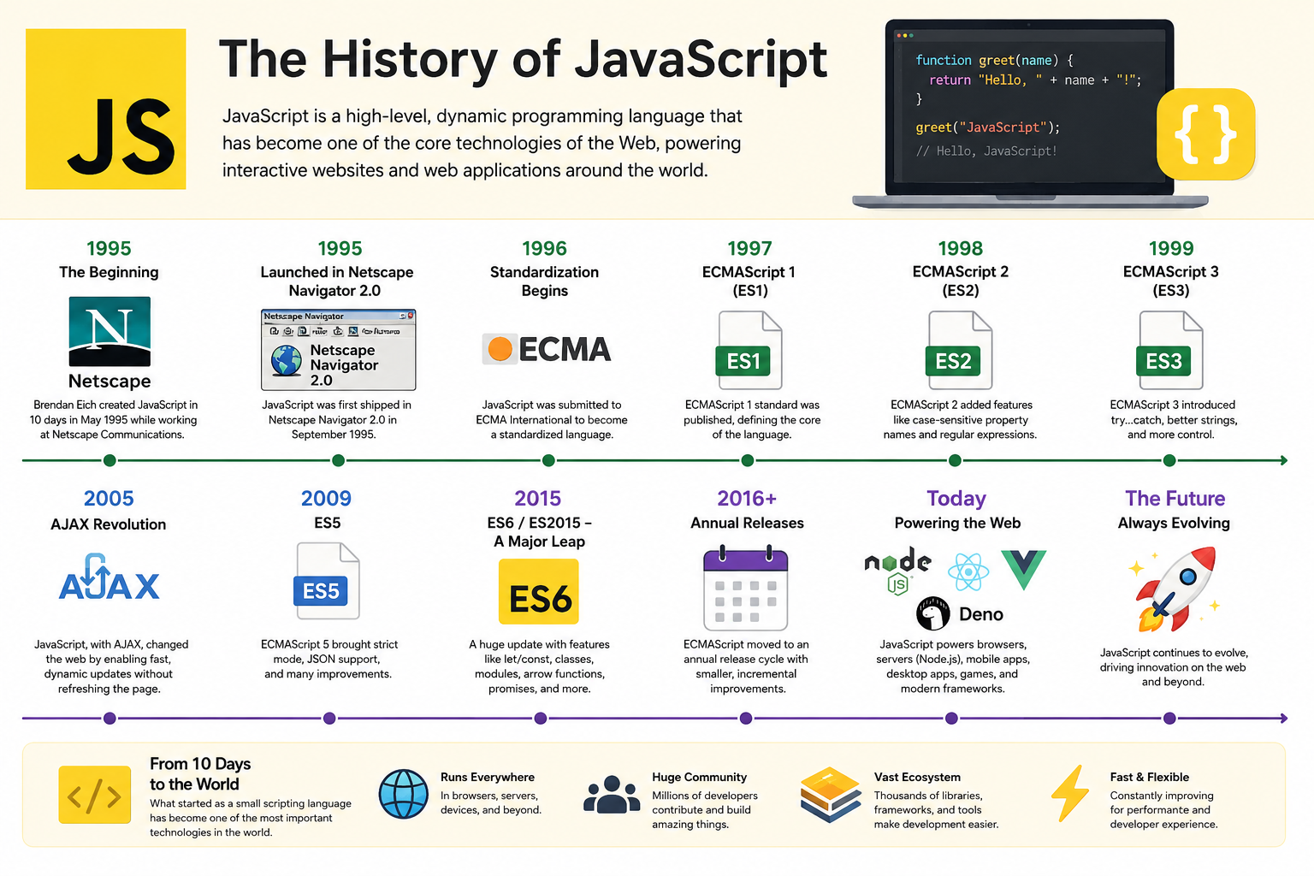

Slide 4
TOPIC 01
Variables & Data Types
Variables store data. Use const by default, let when reassigning, never var.
script.js
String
"Hello" 'World' `Hi ${name}`
1
// const — cannot reassign
Text. Backtick strings support ${expressions} inside.
2
const name = 'Rahul';
Number
42 3.14 -7 Infinity NaN
3
const PI = 3.14159;
All numbers. NaN = Not a Number (result of bad math).
4
5
// let — can reassign
Boolean
true false
6
let score = 0;
Two values only. Used in conditions and logic gates.
7
score = 100; // ✓ OK
Null
null
8
// var — avoid (legacy)
Intentional empty value. YOU set it to nothing.
9
var old = 'dont use this';
undefined
Undefined
10
const str = 'Hello World';
Declared but not yet assigned. JS sets automatically.
11
const num = 42;
12
Object
{ name: 'Rahul', age: 22 }
const bool = true;
Collection of key-value pairs. Most complex things.
13
const nul = null;
14
let undef; // undefined
Array
[1, 'two', true, null]
15
typeof str; // 'string'
Ordered list. Type of object. Index starts at 0.

Slide 5
TOPIC 02
Operators & Expressions
Operators perform actions on values. ALWAYS use === for comparison, never ==.
script.js
Assignment
Ternary
1
// Arithmetic
x = 5
// condition ? yes : no
2
5 + 3 // 8
x += 3 // x = x+3
const msg = age >= 18
3
10 - 4 // 6
x -= 2 // x = x-2
? 'Adult'
4
4 * 3 // 12
5
10 / 2 // 5
x *= 4 // x = x*4
: 'Minor';
6
10 % 3 // 1 (remainder)
x++ // x = x+1
7
2 ** 4 // 16 (power)
x-- // x = x-1
// Same as if/else, 1 line
8
// Comparison → boolean
String
Nullish ??
9
5 === 5 // true ✓ use!
10
5 !== '5' // true ✓
// Concatenation
// Returns right side if
11
5 == '5' // true ✗ avoid!
'Hi ' + name
// left is null/undefined
5 > 3 // true
// Template literal (better)
const val = x ?? 'default';
12
13
// Logical
`Hi ${name}!`
14
true && false // false
`${2+2}` // '4'
// Optional chaining
15
true || false // true
obj?.prop?.nested
18
!true // false

Slide 6
TOPIC 03
Functions
Reusable blocks of code. Define once, call many times with different inputs.
script.js
Parameters vs Arguments
1
// 1. Function Declaration
Parameters = variable names in definition (a, b). Arguments = actual values passed (3, 4).
2
function add(a, b) {
3
return a + b;
return statement
4
}
Send a value back. Code after return doesn't run. Default return value is undefined.
5
add(3, 4); // 7
6
Arrow Functions =>
7
// 2. Arrow Function (ES6)
ES6 shorthand. Single expression = implicit return. const fn = x => x*2 — super clean.
8
const square = n => n * n;
9
const greet = (name) => {
Scope
10
return `Hello ${name}!`;
Variables inside a function can't be accessed outside. Outer variables are accessible inside.
11
3. Default Parameters
};
Default Parameters
12
function hi(name='Guest') {
function greet(name='Guest') — if no arg passed, name defaults to 'Guest'. ES6 feature.
13
return `Hi ${name}`;
14
}
Callback Functions
15
hi() // 'Hi Guest'
A function passed as an argument. Used in forEach, map, filter, event listeners.
18
hi('Rahul') // 'Hi Rahul'

Slide 7
TOPIC 04
Arrays
Ordered lists. Index starts at 0. Most-used data structure in JavaScript.
script.js
push(item)
Add to END
pop()
Remove from END
1
const fruits = ['apple','banana','mango'];
2
unshift(x)
Add to START
shift()
Remove from START
3
// Access (zero-indexed)
includes(x)
true/false if exists
indexOf(x)
Index or -1
4
fruits[0] // 'apple'
5
fruits[2] // 'mango'
slice(s,e)
Copy portion
splice(i,n)
Remove/insert
6
fruits.length // 3
7
// Mutate array
map(fn)
Transform all items
filter(fn)
Keep matching items
8
fruits.push('grape');
9
fruits.pop();
find(fn)
First match
join(sep)
Array to string
10
// Iterate
sort()
Sort in place
reverse()
Reverse in place
11
fruits.forEach(f => {
12
console.log(f);
flat()
Flatten nested arrays
reduce(fn)
Accumulate to value
13
});
14
// Transform
15
const upper = fruits.map(f => f.toUpperCase());

Slide 8
TOPIC 05
Objects
Key-value pairs. Group related data and behaviours together. The heart of JS.
script.js
Properties
1
const person = {
Key-value pairs. Keys are strings (no quotes needed). Values can be any type.
2
name: 'Rahul',
3
age: 22,
Methods
4
isStudent: true,
Functions inside objects. this refers to the owning object inside a method.
5
hobbies: ['code','music'],
6
greet() {
Dot Notation
7
return `Hi, I'm ${this.name}`;
person.name — clean, preferred. Works with valid identifier keys.
8
}
9
};
Bracket Notation
// Access
10
person["key"] — works with any key, including variables.
person.name // 'Rahul'
11
person["age"] // 22
Destructuring
12
person.greet() // 'Hi...'
const {name,age} = person; — extract to variables. Clean and modern.
13
// Destructuring
14
const {name,age} = person;
Spread ...
15
const copy = {...person};
const copy={...person}; — shallow clone. {...obj1,...obj2} merges objects.

Slide 9
LIVE CODING
Build the Age & BMI Calculator
Variables, operators, functions, objects — all combined in one real app.
script.js
script.js
1
// Age Calculator
1
name: 'Rahul',
2
const birthYear = 2002;
2
birthYear: 2002,
3
const currYear = 2025;
3
weight: 70,
4
const age = currYear - birthYear;
4
height: 1.75
5
5
};
// Run calculations
6
// BMI Calculator
6
const bmi = calcBMI(
7
function calcBMI(kg, height) {
7
user.weight, user.height);
8
const bmi = kg/(height**2);
8
const cat = getBMICat(bmi);
9
return Math.round(bmi*10)/10;
9
// Output results
10
}
10
console.log(`Age: ${age}`);
11
function getBMICat(bmi) {
11
console.log(`BMI: ${bmi}`);
12
if (bmi < 18.5) return 'Underweight';
12
console.log(`Cat: ${cat}`);
13
if (bmi < 25) return 'Normal';
13
// Results array
14
if (bmi < 30) return 'Overweight';
14
const results = [age,bmi,cat];
15
return 'Obese’; } const user = {
15

Slide 10
DAY PROJECT
Interactive Calculator
Combine everything — variables, operators, functions, arrays, objects.
5
3
2
1
Data types
Functions
Objects
Results array
Build Checklist
Console Output
01 Declare const/let variables: name, birthYear, weight, height
// output:
02 Write calcAge(birthYear) — returns current age
Age: 23
BMI: 22.9
03 Write calcBMI(weight, height) — returns rounded BMI
Category: Normal
04 Write getBMICategory(bmi) — returns string category
05 Create a user object with all data as properties
Hi Rahul!
06 Add a results array and push each calc result into it
You are 23 yrs old.
07 Use template literals to format all output messages
BMI is healthy ✓
08 Print all results with console.log()
Results:
09 Test with 3 different users by changing values
[23, 22.9, 'Normal']
10 Add a getGreeting(name, age) function for a message

Slide 11
Key Takeaways
Lock in these 5 before Day 12 — Control Flow & Loops!
01
Use const by default, let when reassigning, never var. 7 data types: string, number, boolean, null, undefined, object, symbol.
Homework
Do before Day 12:
02
ALWAYS use === (strict equality), never == (loose). === checks value AND type — prevents type coercion bugs.
1
Open DevTools Console — try 5 arithmetic expressions
2
Create a 'profile' object with 5 properties
03
Arrow functions: const add = (a,b) => a+b. Single expression = implicit return. Template literals: `Hi ${name}`
3
Write a function to sum all numbers in an array
04
Arrays: zero-indexed, push/pop/map/filter. Objects: key-value pairs, dot notation or bracket notation.
Practice map() and filter() on a numbers array
4
5
Convert one function to arrow function syntax
05
console.log() everything while debugging. Use DevTools Console (F12) to run JS expressions live.
6
Share your calculator output in the comments!

Slide 12
JS
JavaScript
Unlocked!
Variables, types, operators, functions, arrays, objects — the foundation is set.
Day 11 / 30 • JS Week Started! • 36.7% complete
Up next — Day 12:
Control Flow & Loops
if/else, switch, for, while, do-while — make decisions and repeat actions in JS.
Subscribe
Comment
Share
& hit the bell
'Day 11 Done!'
with a friend

