Slide 1
Performance Evaluation in Dynamic RAN Slicing of 5G Networks
Team Number: N20
Team Members: Kushagra Tomar 01fe20bcs063
Lavanya Shahapur 01fe20bcs185
Pragathi Pujari 01fe20bcs189
Ashwini Jannu 01fe20bcs208
Ajay Kushal 01fe20bcs289
Guide : Mr.Parikshit P Hegde

Slide 2
Project Overview / Summary
Domain/Problem Space :
Fifth-generation (5G) wireless networks are projected to bring a major transformation to the current fourth-generation network to support the billions of devices that will be connected to the Internet.
Goals / Objectives :
To simulate the dynamic slicing of 5G RAN
To simulate resource allocation with tailored solutions to separate slices.
To evaluate the performance of services running on 5G RAN slicing.
Problem Definition :
To support multiple logical networks over common infrastructure and to evaluate KPI’s with respect to the different use cases. To design and customize the network slices to meet the demands of all use cases dynamically.
Technical Challenges :
Speed: There is a high demand for increased internet speed to satisfy use cases
Security: Slices abstraction and isolation is fundamental
Efficient resource allocation to slices
Finalizing Emulation Software
Choosing correct Virtual Machine and version of Ubuntu

Slide 3
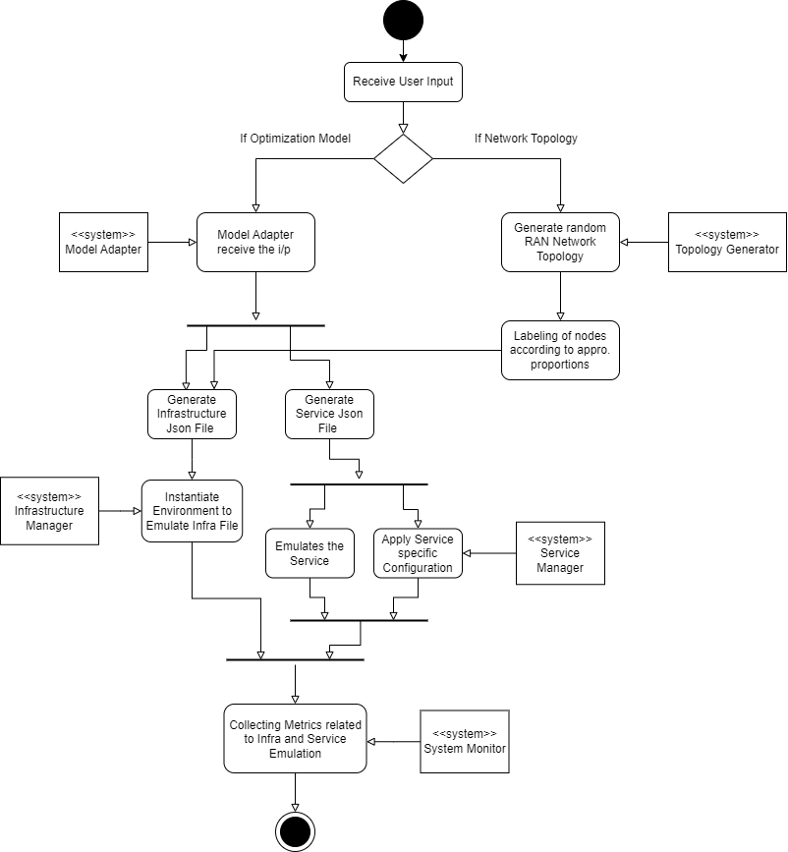
Activity Diagram

Slide 4
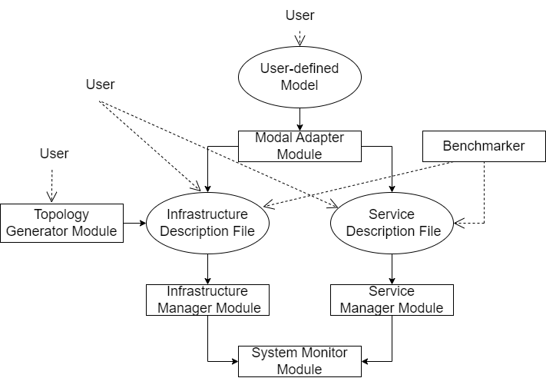
Proposed system / Solution
Block Diagram :
( block diagram / flowchart / flow of solution )
Single arrow represent mandatory flow
Dashed line represent user inputs
Dotted line represent optional flow
Rectangle represent system modules
circles represent input files

Slide 5
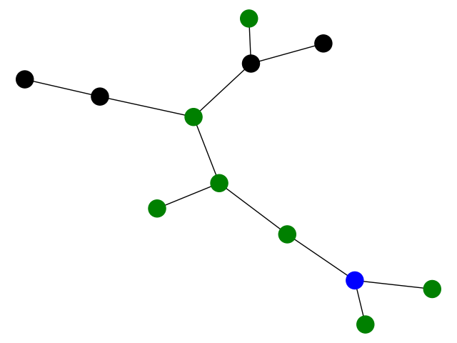
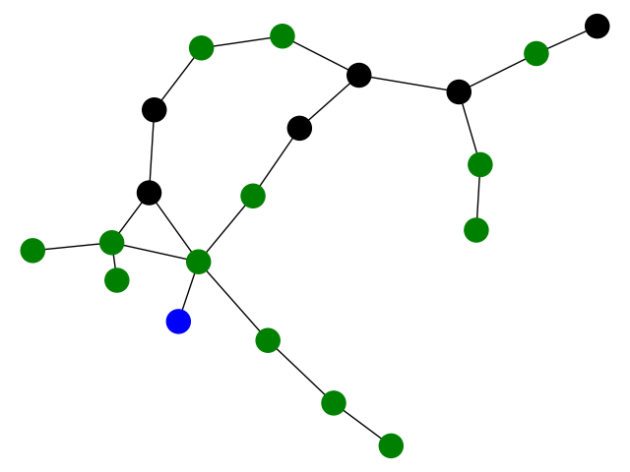
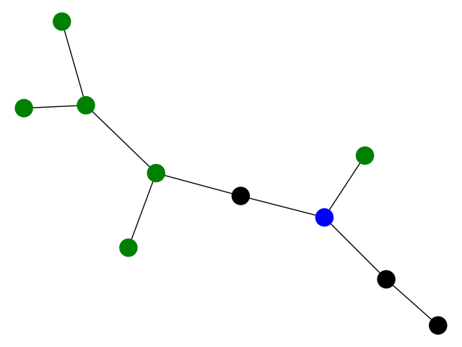
Expected Results / Measurable Outputs
Outcomes/Results :
These are some of the randomly generated topologies with
5% of the nodes are MEC Host
30% of the nodes are Base Stations
65% of the nodes are Forwarding Nodes

Slide 6
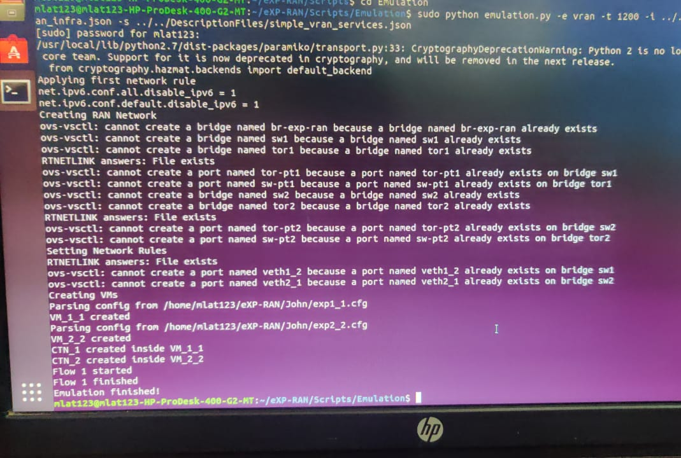
Expected Results / Measurable Outputs

Slide 7
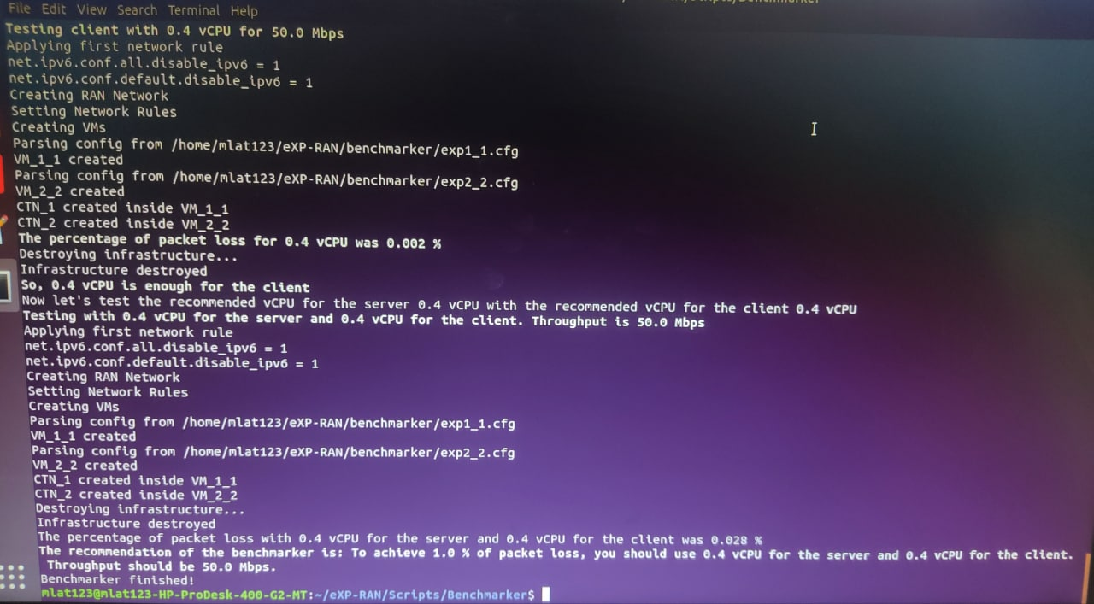
Expected Results / Measurable Outputs

Slide 8
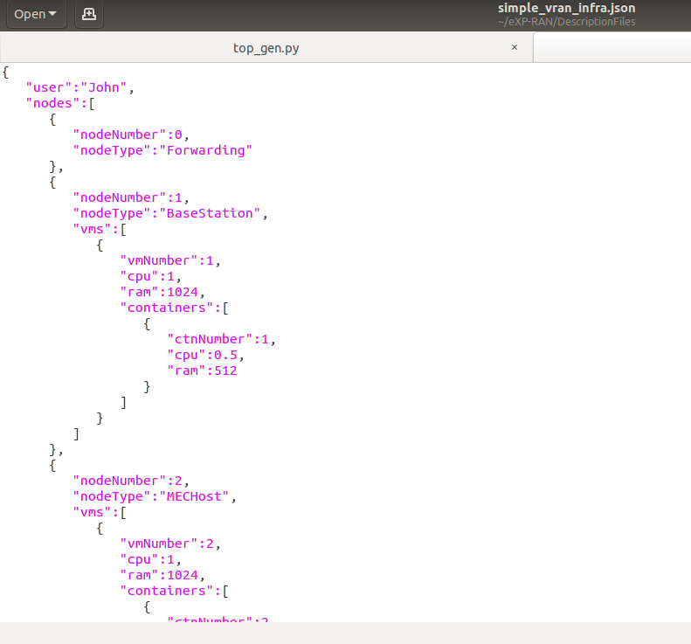
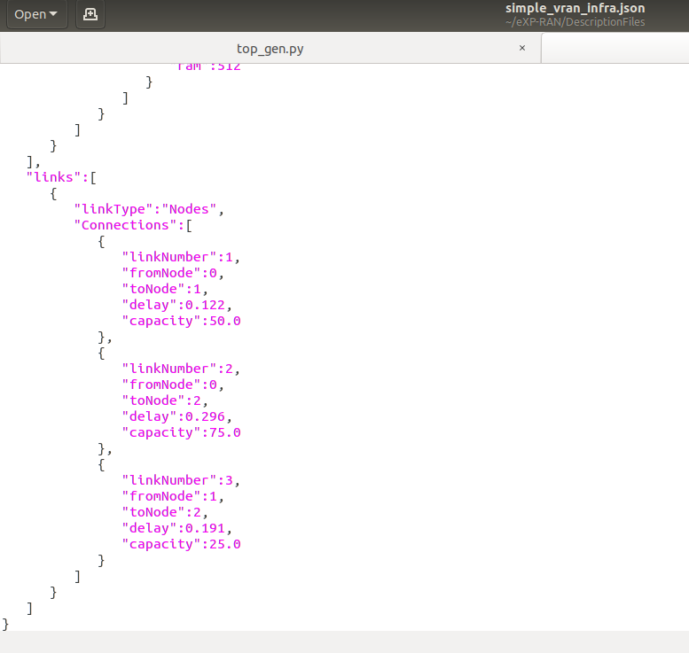
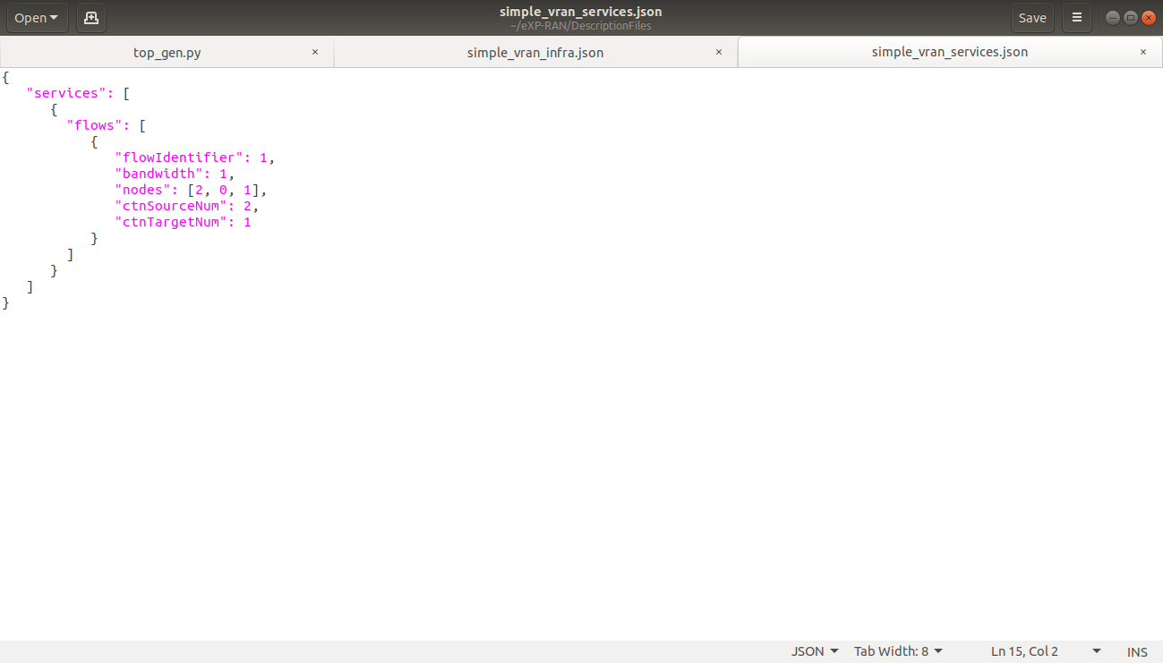
Expected Results / Measurable Outputs

Slide 9
Expected Results / Measurable Outputs
Major novelty / Observations / Conclusions :
To illustrate how eXP-RAN can emulate network slicing, with different QoS requirements.
To deduce how the Quality of Service (QoS) is affected as the workload increases.
To divide network into two slices. One slice offers video content with assured quality, while other slice should offers video content with reduced quality.

Slide 10
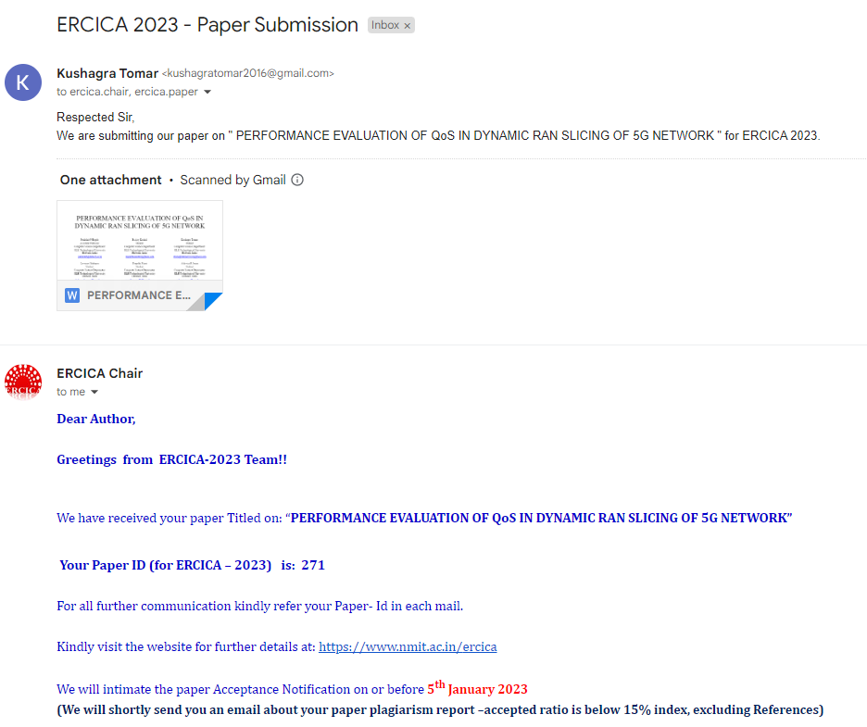
Plan to Complete Project
Final Probable Deliverables :
To emulate Video Service Deployment over the created slices.
Creating new topologies by using different number of nodes- MEC Host, Base Stations and Forwarding Nodes.
Slicing the RAN based on the bandwidth required by the model parameters.
IP Target / Plan / competitions:
Publication of Paper

Slide 11
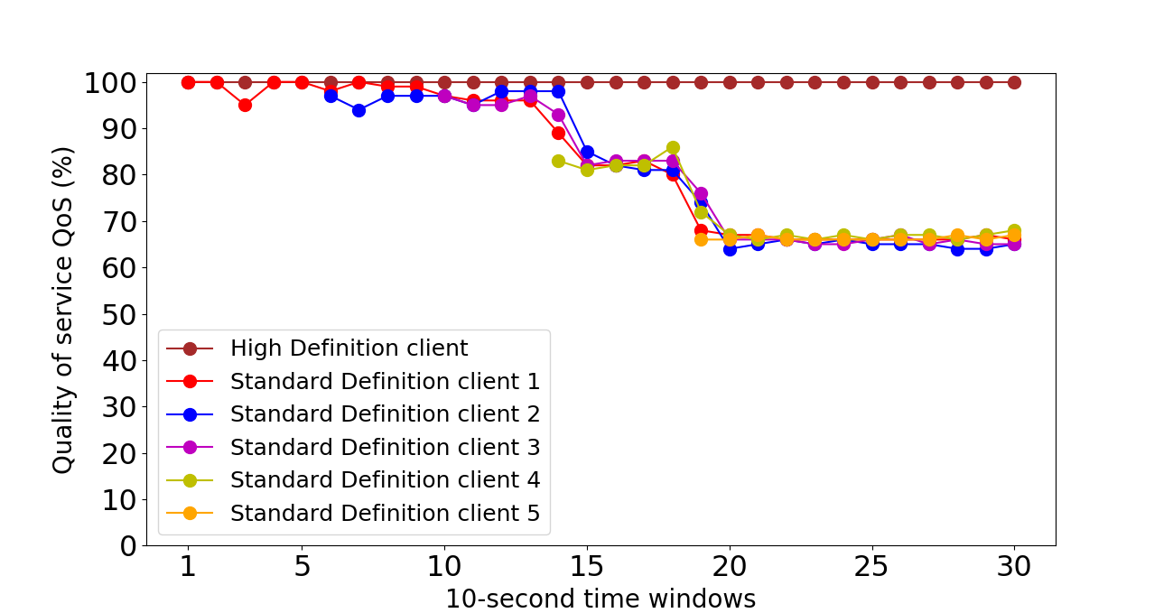
Results
The horizontal axis depicts the number of the time window, where the length of each time window is 10 seconds. Thus 1 is the first time window of 10 seconds, 10 is the tenth time window of 10 seconds, and the pattern continues. The vertical axis depicts the QoS received by each user. Quality of service (QoS) ensures stable performance of applications having very limited network capacity. Thus allowing organizations to modify their network traffic by prioritizing high-performance applications. This QoS ratio is computed every 10 seconds.

Slide 12
Conclusion
In this we illustrate how eXP-RAN can emulate two network slices, with different QoS requirements and study how the QoS is affected as the workload increases.
The network is divided into two slices. One slice is considered to be a ‘High definition’ slice and another slices as ‘Standard definition’ slice (BE).
‘High definition’ slice offers video content with assured quality, while the ‘standard definition’ slice offers video content with affected quality.
As the number of clients activity increases or as the workload increases we can observe that the QoS % of ‘High definition’ slice remains constant throughout as needed and similarly the QoS % of ‘standard definition’ slice decreases as expected.

Slide 13
Plan to Complete Project
Completion Plan :
Week 1 to 2
Solving Benchmarker error
Week 2 to 4
Creating new topologies
Week 5 to 6
Slicing RAN based on different model parameters
Week 7 to 8
Generating Emulation results graphically

Slide 14
THANK YOU

Slide 15
Problem Statement
“Performance evaluation of varied Key Performance Indicators (KPIs) in dynamic Radio Access Network(RAN) slice environment of 5G”
Supports multiple logical networks over common infrastructure.
To evaluate KPI’s with respect to the different use cases.
To design and customize the network slices to meet the demands of all use cases dynamically.

Slide 16
Motivation : 5G RAN Slicing
It is the key factor to optimise 5G network so that they efficiently address all the three use cases.
This area needs more attention and still more research is needed.
Static slicing lacks in dynamically allocating resource.
Dynamically create new slice, deploying service on pre-existing slice, and customize slices.

Slide 17
Objectives / Goals
To simulate dynamic slicing of 5G RAN to meet the needs and requirements of different use cases.
To evaluate the performance of various services in 5G RAN slicing.
To simulate resource allocation with tailored solutions to separate slices.

Slide 18
Functional and Non-Functional Requirements
Functional requirements
The network shall offer tailored solutions for each slice.
The network slices shall be completely isolated from each other.
The network shall get sliced dynamically according to requirements.
Non-Functional requirements
The network should have latency less than 10ms.
The network should allow a maximum of eight slices.
The network should be able to offer data speed more than 1000mbps

Slide 19
Architecture / Framework
The eXP-RAN architecture is divided into three layers
The Infrastructure layer
•This layer is responsible for the emulation of the four major network elements in a 5G RAN, which are: (i) edge computing resources (e.g., MEC hosts), (ii) base stations (5G/gNB), (iii) forwarding nodes, and (iv) links.
The Slicing layer manages sets of virtual resources by partitioning and isolating them.
•This layer emulates the slices created over the infrastructure, i.e., the set of virtual resources and services owned and managed by a certain tenant.
•In eXP-RAN, virtual resources are emulated by containers and links. Services are emulated by Virtualized Network Functions (VNFs) running inside the containers.
The Service layer
•This layer emulates the services being offered within the slices. Services are offered as a set of VNFs.

Slide 20
Architecture / Framework

Slide 21
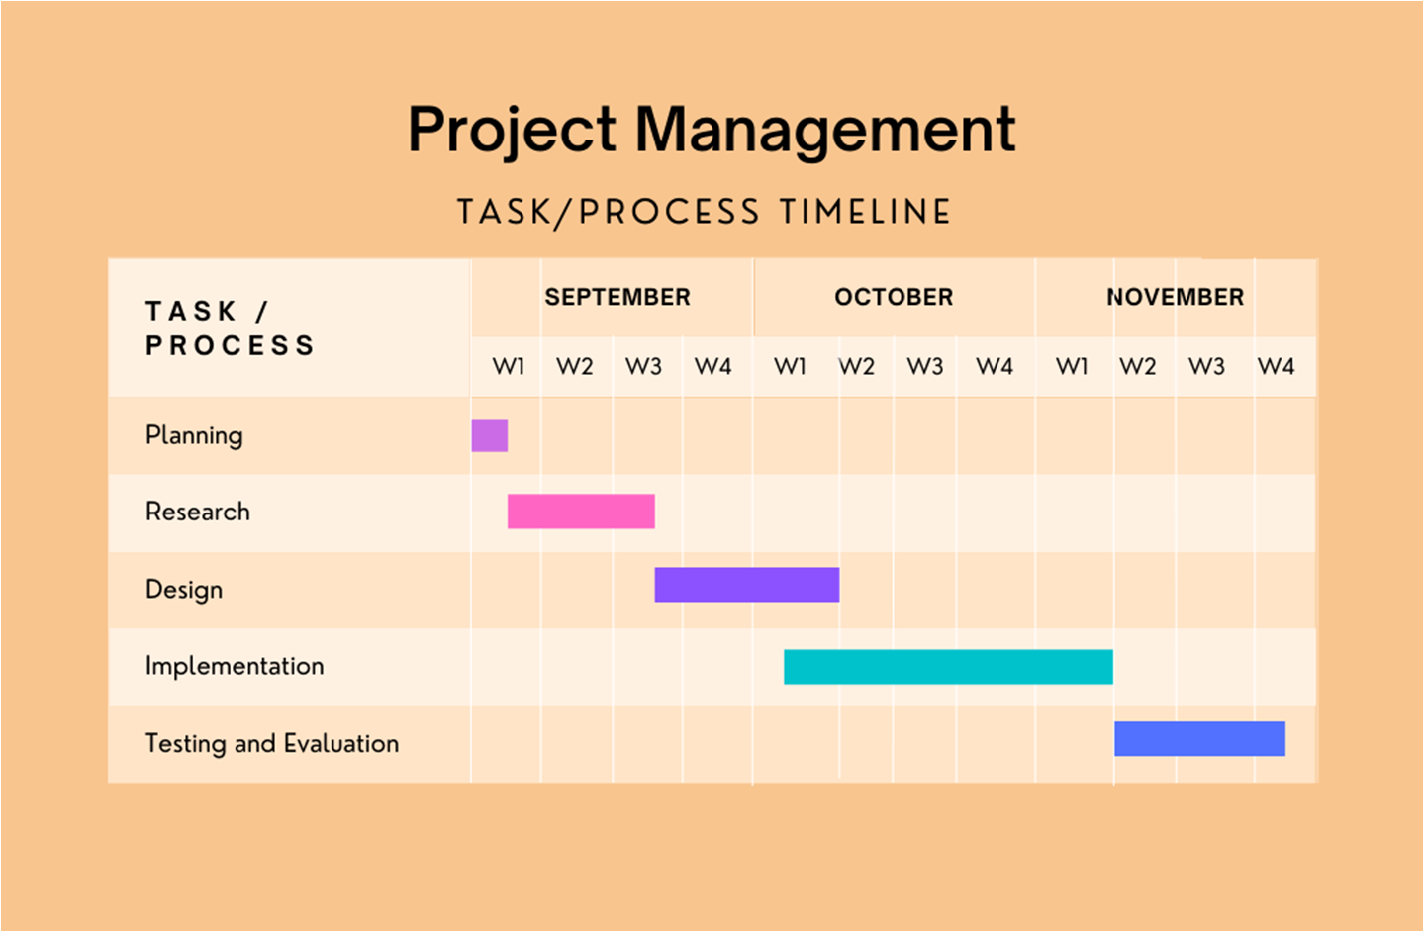
Gantt Chart (Timeline)

