Slide 1
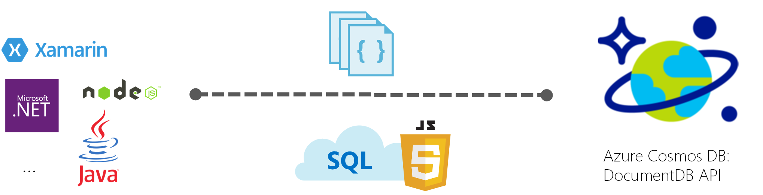
What is DocumentDB
Azure DocumentDB is a NoSQL document database service designed from the ground up to natively support JSON and JavaScript directly inside the database engine.

Slide 2
What capabilities and key features does Azure Cosmos DB offer?
Elastically scalable throughput and storage
Multi-region replication
Ad hoc queries with familiar SQL syntax
JavaScript execution within the database
Tunable consistency levels
Fully managed
Open by design
Automatic indexing

Slide 3
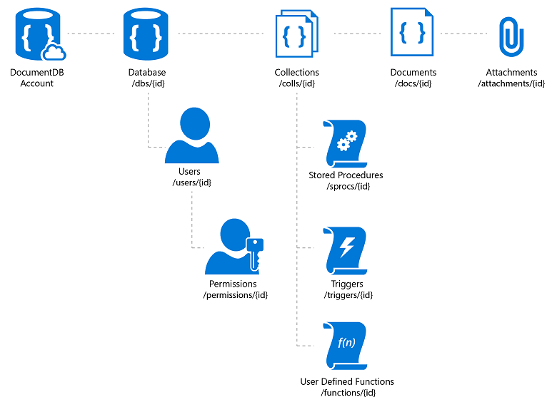
How do you manage data with the DocumentDB API?

Slide 4
.NET SDK
.NET API hosted on NuGet
Install-Package Microsoft.Azure.Documents.Client –Pre
Installs DocumentDB and JSON.NET packages

Slide 5
RESTful API:
Core interface to DocumentDB
Used by all client libraries
Standard operations against all DocumentDB resources:
CREATE, DELETE, PUT, GET, POST
Returns permanent resource URL on creation
HMAC authentication using management or resource key
DocumentDB request headers.
Notes:
REST API documentation:
http://msdn.microsoft.com/en-us/library/dn781481.aspx

Slide 6
Steps to create a DocumentDB Account:
In a new window, sign in to the Azure portal.
In the left pane, click New, click Databases, and then click Azure Cosmos DB.
On the New account blade, specify the configuration that you want for the Azure Cosmos DB account. With Azure Cosmos DB, you can choose one of four programming models: Gremlin (graph), MongoDB, SQL (DocumentDB), and Table (key-value).so choose SQL (DocumentDB) as you fill out the form.
Click Create to create the account.
On the top toolbar, click Notifications to monitor the deployment process.
When the deployment is complete, open the new account from the All Resources tile.
In the Azure portal, in the left navigation menu, click Data Explorer (Preview).On the Data Explorer (Preview) blade, click New Collection.
In Data Explorer, the new database appears in the Collections pane. Expand the Tasks database, expand the Items collection, click Documents, and then click New Documents.
Now add a few documents to the collection with the following structure, where you insert unique values for id in each document and change the other properties as you see fit. Your new documents can have any structure you want as Azure Cosmos DB doesn't impose any schema on your data.

Slide 7
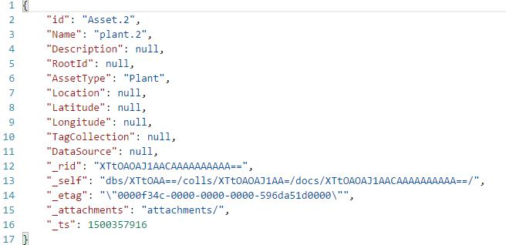
//Sample Code:
Once you've added the json to the Documents tab, click Save.
You can now use queries in Data Explorer to retrieve your data. By default, Data Explorer uses SELECT * FROM c to retrieve all documents in the collection, but you can change that to SELECT * FROM c ORDER BY c.name ASC, to return all the documents in alphabetic ascending order of the name property.

Slide 8
Document Client:
Constructed with endpoint URL and Primary key for Database account
Provides async/await methods for CRUD operations on DocumentDB resources
Manages the connection to Document DB

Slide 9
Construct Database and Document Collection if doesn’t Exist:

Slide 10
Data Model
Uses JSON.NET library for serialization
Simple class
No special base class
All public properties are serialized into JSON
Obvious mapping from.NET to JSON
IList, etc. -> Array
Int32, etc. -> Integer
Float, etc. -> Float
DateTime -> String
Byte[] -> String

Slide 11
Read all the Documents in an Collection:
Delete Document Based on Id:

Slide 12
Working on Stored Procedures, Triggers and User Defined Functions:
DocumentDB supports server-side JavaScript
Stored Procedure:
Registered at collection level
Operate on any document in the collection
Invoked inside transaction context on primary replica
Sample code: Creating the Stored Procedure in .js file:

Slide 13
Executing the Stored Procedure:

Slide 14
Create Procedure If doesn’t Exist:

Slide 15
Triggers:
Pre- or Post: create, replace or delete operations
Invoked inside transaction context on primary replica
Creating the Pre-Triggers:

Slide 16
Pre-Trigger: Creating the Pre-Trigger in .js file:

Slide 17
Execute the Pre-Trigger:

Slide 18
Create Trigger if doesn’t Exist:

Slide 19
Post-Trigger: Creating the Post-Trigger in .js file:

Slide 20
Execute the Post-Trigger:

Slide 21
User Defined Functions(UDFs):
Scalar functions invoked only inside queries
Creating the UDF in .js file:

Slide 22
Execute the UDF:

Slide 23
Create UDF if doesn’t Exist:

