Slide 1

Project Review on DESIGN AND IMPLEMENTATION OF A SOLAR-POWERED COMMUNITY CHARGING STATION FOR MOBILE PHONES IN RURAL WOMEN'S SELF-HELP GROUPS
By
M. Jaswanth Kumar (22ME1A0233)
M. Ajay (22ME1A0234)
N. Hemanth (22ME1A0238)
P. Mohan Sai Krishna (22ME1A0243)
Under The Guidance of
Mr. P. Victor Babu
Assistant Professor
Department of Electrical and Electronics Engineering
Ramachandra College of Engineering, Eluru – 534007

Slide 2
Contents
1. Abstract 2. Introduction 3. Problem Statement 4. Objective 5. Methodology 6. Block Diagram 7. Components Requirement 8. Result and Discussions 9. Conclusion 10. References

Slide 3
Abstract
This project focuses on the design and implementation of a solar-powered community charging station aimed at providing reliable and sustainable mobile phone charging facilities for rural women’s self-help groups. In many rural areas, access to electricity is limited or unreliable, which affects communication, financial inclusion, and access to digital service. The proposed system utilizes solar energy as a renewable power source, incorporating photovoltaic panels, a battery storage system, and multiple charging ports. The system is designed to be cost-effective, easy to maintain, and user-friendly. It supports community-level usage, enabling women to charge their mobile devices efficiently while promoting clean energy adoption and empowerment.

Slide 4
Introduction
Access to electricity remains a challenge in many rural regions, especially in developing areas. Mobile phones play a crucial role in communication, banking, education, and emergency services.
However, the lack of reliable charging infrastructure limits their usability. Women’s self-help groups (SHGs) are important community organizations that support financial independence and social development.
Providing them with a solar-powered charging station can enhance connectivity and productivity.
This project introduces a sustainable solution using solar energy to address power shortages and improve access to mobile charging facilities.

Slide 5
Problem Statement
Lack of Reliable Electricity
Rural areas often face irregular power supply or complete absence of grid electricity, making it difficult to charge mobile phones consistently.
Limited Access to Charging Facilities
People in remote locations must travel long distances or rely on paid charging services, which is inconvenient and time-consuming.
Challenges for Women’s Self-Help Groups
Dependence on mobile phones for communication and financial activities is hindered by lack of charging facilities.
Need for Sustainable and Affordable Solutions
Existing options are costly or polluting, highlighting the need for clean, low-cost, community-based charging systems.

Slide 6
Objective
Design a Solar Charging System
To develop a solar-powered mobile charging station for rural use.
Provide Reliable Power Supply
To ensure continuous and stable charging using renewable energy.
Support Community Usage
To enable multiple users, especially women’s self-help groups, to charge devices simultaneously.
Promote Sustainable and Affordable Solutions
To encourage clean energy adoption through a low-cost and eco-friendly system.

Slide 7
Methodology
Analyze daily charging requirements.
Design system based on load calculation.
Select appropriate components:
Solar panel.
Battery.
Charge controller.
Assemble and test the system.
Deploy in rural community setup.
Train users for operation and maintenance.

Slide 8
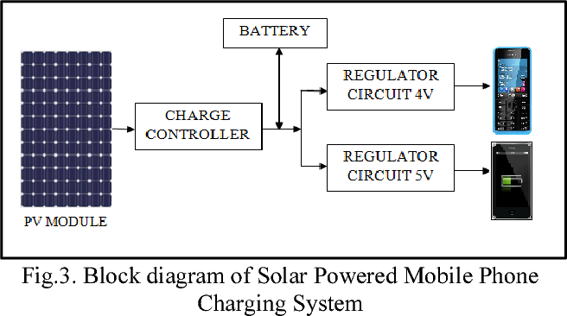

Block Diagram
Solar Panel: Converts sunlight into electricity.
Charge Controller : Regulates voltage and protects battery.
Battery: Stores energy for use anytime (day/night).
DC Distribution Unit: Safely distributes power.
USB Charging Hub: Multiple phones can charge.
Microcontroller (Optional): Tracks usage, battery level
Display: Shows status (battery, charging, faults)

Slide 9
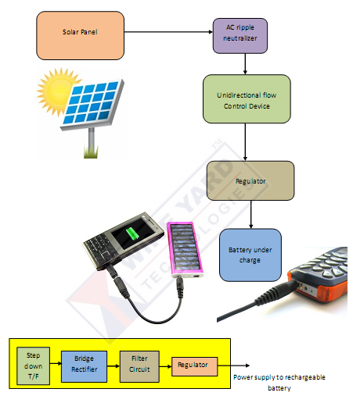
System Overview
1. Solar Power Generation
Solar panel converts sunlight into electricity.
2. Energy Storage
Battery stores power for later use.
3. Power Control
Charge controller regulates and protects system.
4. Charging Unit
USB ports used to charge mobile phones.

Slide 10
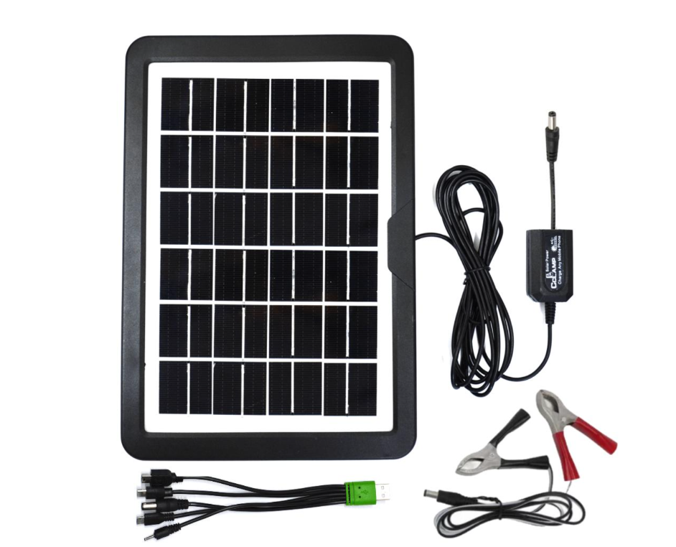
Components Requirements 1. Solar Panel
Converts sunlight into electrical energy.
Rated power: 15W Monocrystalline Solar Panel.
Produces DC power.
Operates mainly during daytime.
Reduces dependency on conventional energy sources.
Provides clean and renewable energy.

Slide 11
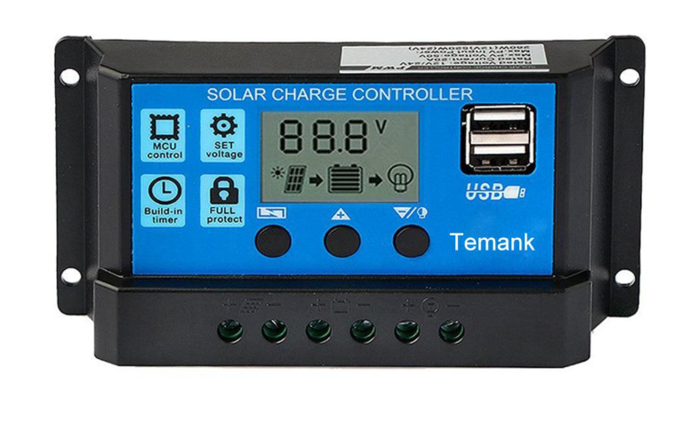
2. Charge Controller
Regulates voltage and current from the solar panel.
Prevents overcharging and deep discharge of the battery.
Improves battery life and system safety.

Slide 12
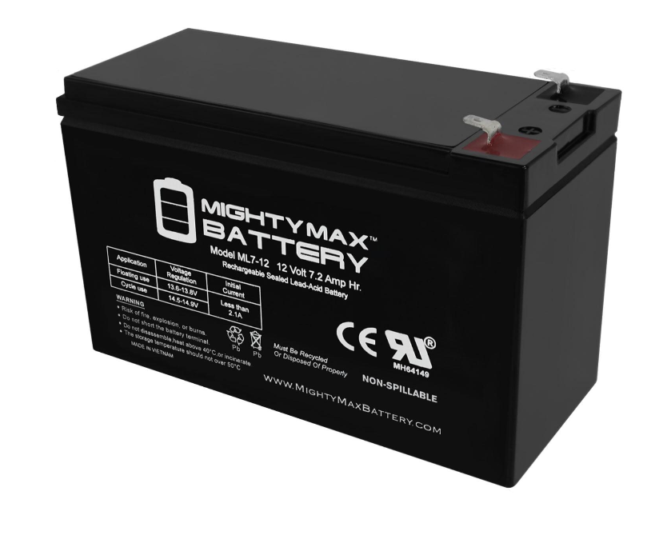
3. Battery Storage System
Battery (Lead-acid / Lithium-ion)
Stores electrical energy for use when sunlight is not available.
Lead-acid: Low cost, widely used, but heavier.
Lithium-ion: Lightweight, longer life, more efficient.

Slide 13
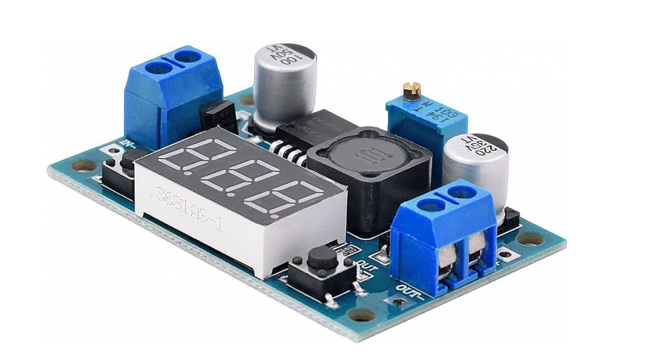
4. DC-DC Converter
Converts one DC voltage level to another.
Ensures proper voltage for charging devices (e.g., 12V to 5V).
Provides stable and efficient power output.

Slide 14
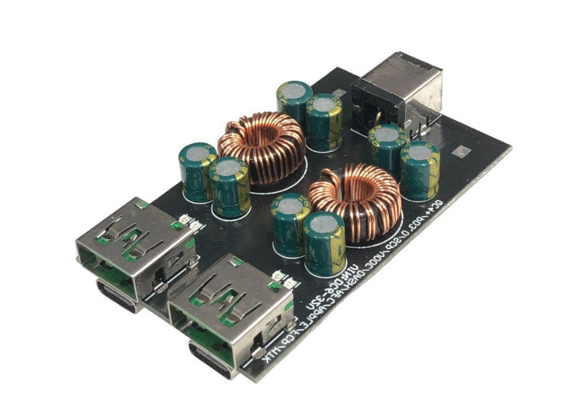
5.USB Charging Hub
Provides multiple USB ports for charging mobile phones.
Allows several users to charge simultaneously.
Designed for safe and easy access.
Durable and long-lasting components used.
Easy installation and low maintenance required.

Slide 15
Results and Discussions
The solar charging station successfully generated power using sunlight.
Battery stored sufficient energy for day and night usage.
System was able to charge multiple mobile phones simultaneously.
Stable 5V output was achieved using DC-DC converters.
Charging time was comparable to standard mobile chargers.

Slide 16
Conclusion
The solar-powered charging station was successfully designed and implemented.
It provides a reliable and eco-friendly solution for mobile charging in rural areas.
The system works efficiently using renewable solar energy.
Enables charging of multiple devices with stable output.
Reduces dependency on grid electricity and charging costs.
Supports women empowerment through Self-Help Groups (SHGs).
Overall, it is a sustainable, low-cost, and practical solution for rural communities.

Slide 17
References
Ken Butti, and John Perlin, “A Golden Thread: 2500years of solar architecture and technology,”Cheshirebooks, 1980.
Central Electricity Authority, Government of India. (2023). CO2 Baseline Database for the Indian Power Sector, Version 17.
Council on Energy, Environment and Water (CEEW). (2022). State of India's Rural Electricity Supply: Reliability, Quality, and Efficiency. New Delhi: CEEW. GSMA. (2022).
The Mobile Economy: Asia Pacific 2022. London: GSMA Intelligence. Gupta, R., Sharma, P., and Verma, K. (2019). Performance Evaluation of Solar Mobile Charging Kiosks in Rural Rajasthan. Renewable Energy, 45, 112-131.
International Energy Agency (IEA). (2023). World Energy Outlook 2023. Paris: IEA.
Krishnamurthy, A. and Rajan, S. (2020). Solar Community Charging and Women's Time Poverty:
Evidence from Tamil Nadu. Development and Change, 51(4), 1015-1038.

Slide 18

Thank You

