Slide 1

Best Buy Presentation

Slide 2



Introduction
Slow-selling SKUs need forecasts
Make up a large quantity of SKUs
Forecasts need to be accurate and efficient

Slide 3
Timeline
Analyzed and interpreted model results
Exploratory Data Analysis (EDA)
Preliminary analysis to understand data better and assist in feature engineering
Feature Engineering
Based on EDA, created features to assist with model performance
Approach Exploration
Compared baseline results of 4 different models
Approach and considerations to improve chosen models
Model Results
Model Refinement

Slide 4
Exploratory Data Analysis

Slide 5
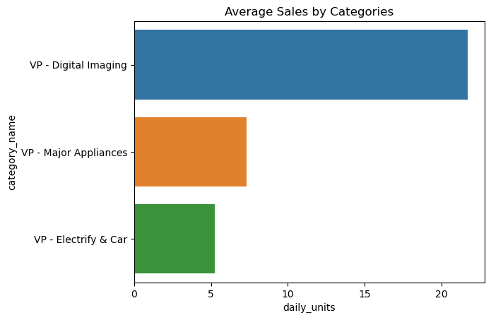
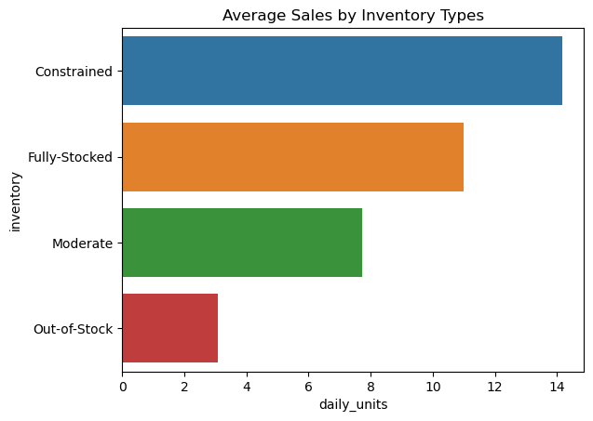
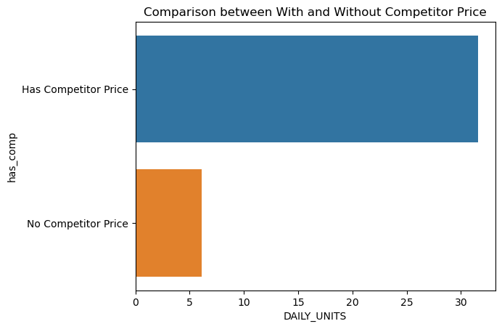

EDA
Notes:
Potential graphs: weekly trend, monthly trend, holiday

Slide 6
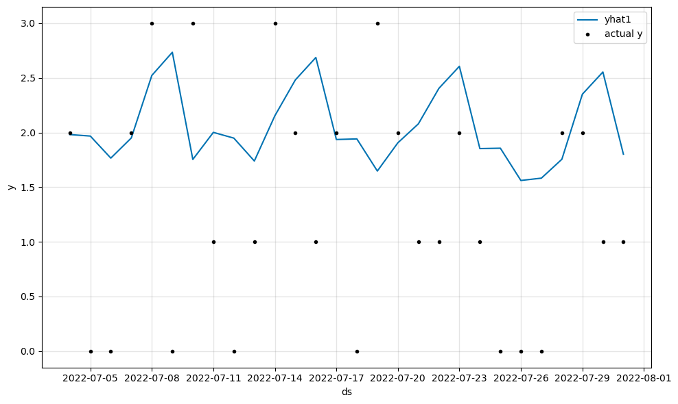
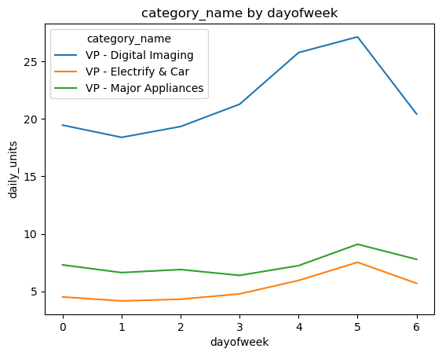
EDA continued
Time Series Fit to Real Data
Average Sales of Day of Week Grouped by Category Name

Slide 7
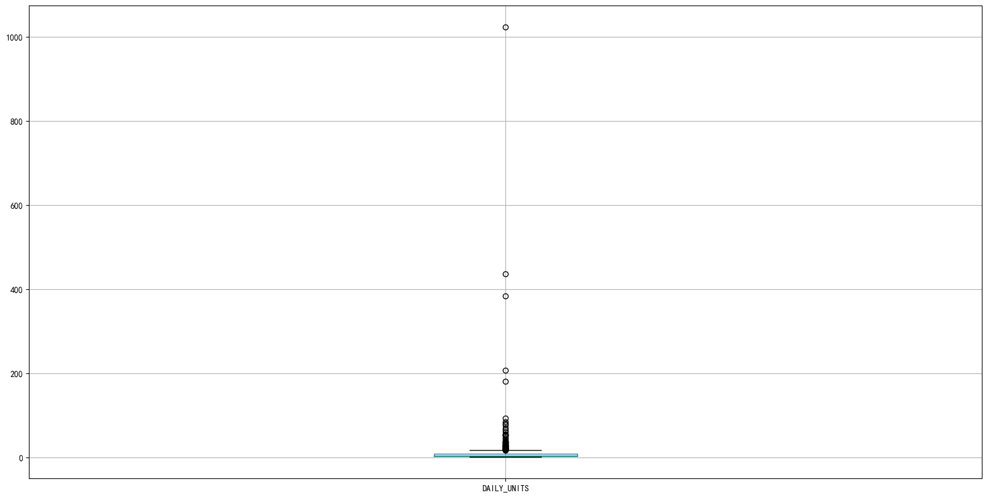
EDA Outlier Analysis
SKU_97
Encoded_SKU_ID 97 1023.159634 237 436.547715 347 207.240784 469 383.666380 557 180.306569
SKU_237
SKU_469
SKU_347
SKU_557

Slide 8
Feature Engineering

Slide 9




Feature Engineering
Category Features
Price Features
Inventory Features
Time Features
Sales vary by category
Promo prices increase sales
Sales slow when items are out-of-stock
Sales increase during holidays
Ex: Flash memory has much higher sales
Having lower price than competitors = higher sales
Sales increase when supply is limited
Sales increase during weekends

Slide 10
Approaches Exploration

Slide 11
Approaches
Time Series Approach:
Time series is traditional, but analysis shows that the sales data is too sparse and might not be appropriate.
Regression Approach:
Formulate 7 regression problems for 7 days of weeks due to the clear weekly trend.
We separated data into train (before 07-04-2022) and validation (07-04-2022 to 07-31-2022).

Slide 12
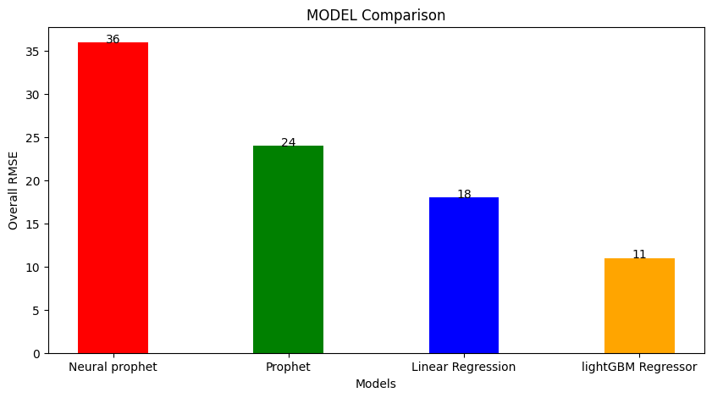
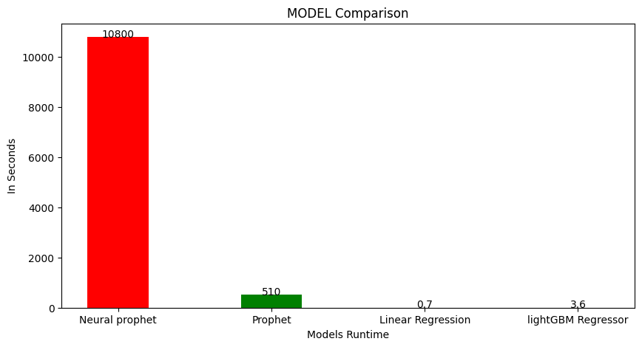
Approach Comparison
RMSE Comparison
Runtime Comparison (seconds)
Time-series approaches
Regression approaches

Slide 13
Model Refinement

Slide 14
Model Refinement
New Features
Added additional features such as: holidays, median sales same category, etc.
Outlier Removal
Analyzed models’ errors and iteratively improved performance with new features and tuning
Feature Selection
Used LASSO for feature selection
Model Tuning
Tuned models’ hyper parameters
2
4
1
3
4

Slide 15
Model Results

Slide 16
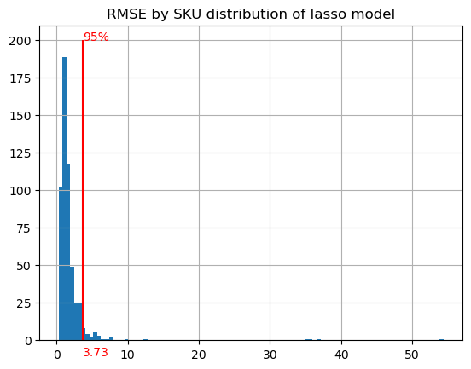
Model Results
RMSE baseline vs Final model
Distribution of RMSE by SKU for Lasso Regression

Slide 17
Summary

Slide 18
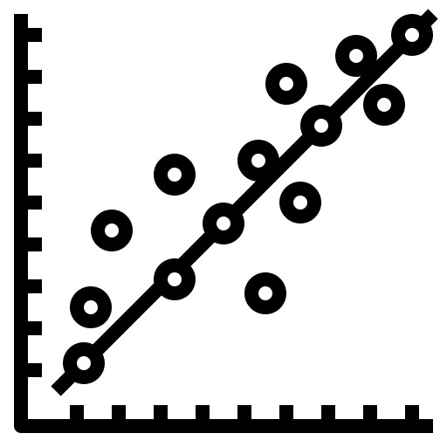


Summary
Regression approach outperformed time series approach
Improvement to 4.12 RMSE & 0.7 second run time
Can run forecast as frequently as needed

Slide 19
The goal of forecasting is not to predict the future but to tell you what you need to know to take meaningful action in the present.
Questions?
“
”
-Paul Saffo

