Slide 1
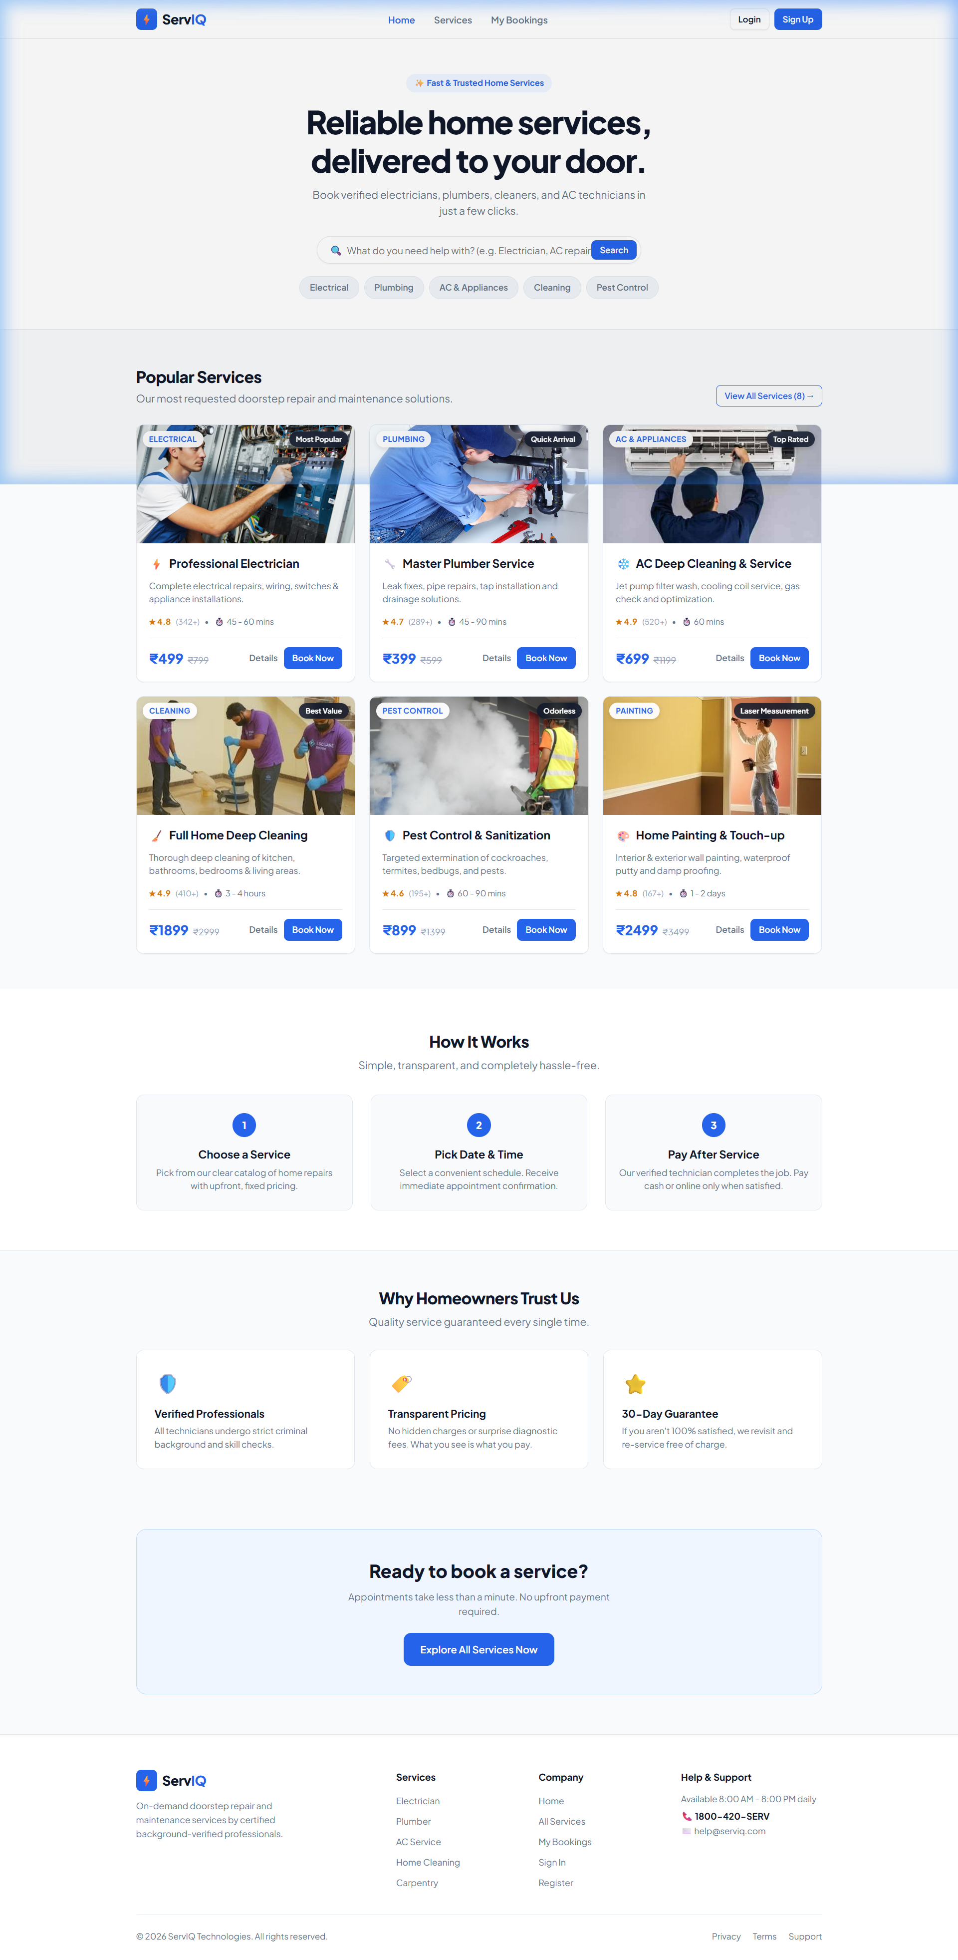
⚡ REACT.JS & VITE WEB APPLICATION
ServIQ
On-Demand Doorstep Home & Electrical Services Booking Platform
A production-grade, highly responsive web application enabling seamless doorstep service exploration, transparent fixed pricing, interactive photo galleries, instant appointment scheduling, and persistent booking management.
👨‍💻 Project Developer: Ajay M
Role: Junior Software Developer | Specialty: React.js & Modern Frontend Engineering
Tech Stack: React.js (v19) • Vite • JavaScript (ES6+) • CSS3 • React Router v6 • LocalStorage

Slide 2
SERVIQ – REACT.JS PROJECT PRESENTATION
Executive Summary & Problem Statement
⚠️ THE INDUSTRY PROBLEM
✨ THE SERVIQ DIGITAL SOLUTION
• Hidden & Unpredictable Pricing: Customers face surprise diagnostic inspection fees and fluctuating labor estimates without standard baselines.
• Unverified Technicians: Lack of safety assurances, background verification, or quality checks for doorstep handymen.
• Friction in Scheduling: Traditional booking requires repeated phone calls, manual coordination, and indefinite waiting times.
• No Post-Service Warranty: Zero accountability if an electrical or plumbing repair malfunctions shortly after completion.
• 100% Upfront Fixed Pricing: Standardized rates (e.g. ₹399 - ₹2,499) displayed upfront with complete checklists of inclusions.
• Certified & Background-Checked Experts: Every service is serviced by verified, trained professionals with authentic identity verification.
• Instant 3-Step Scheduling: Pick a preferred 2-hour slot (09:00 AM to 07:00 PM), input address, and confirm in under 60 seconds.
• Pay After Service & 30-Day Guarantee: Customers can pay via cash or UPI after satisfactory job completion, backed by a 30-day rework warranty.
ServIQ Web Application | Developed by Ajay M (Junior Software Developer) | React.js & Vite

Slide 3
SERVIQ – REACT.JS PROJECT PRESENTATION
Project Objectives & Technical Scope
01
Modular Component Architecture
Build cleanly decoupled, reusable React components (ServiceCard, ServiceList, BookingForm, NavBar, Footer, Button) adhering to standard separation of concerns.
02
Centralized State Management
Leverage React Hooks (useState, useEffect, useMemo) and React Context API to achieve responsive client-side state without external state bloat.
03
Persistent Client Storage Layer
Establish synchronous, zero-latency local storage mechanisms utilizing LocalStorage for booking schedules, status transitions, and user profile data.
04
Rich Visual Media Experience
Integrate high-definition photography across all service cards and provide interactive multi-view photo galleries for specialized services.
05
Dynamic Multi-Criteria Filtering
Implement instantaneous client-side keyword search, 8-category filter pills, and multi-tier sorting (rating, price, recommendation).
06
Responsive Production Standard
Ensure seamless layout adaptation across mobile viewports, tablets, laptops, and ultra-wide desktop monitors with fluid CSS styling.
ServIQ Web Application | Developed by Ajay M (Junior Software Developer) | React.js & Vite

Slide 4
SERVIQ – REACT.JS PROJECT PRESENTATION
Technology Stack & Core Dependencies
FRONTEND LIBRARY
BUILD TOOLING
CLIENT-SIDE ROUTING
React.js (v19)
Provides component lifecycle hooks, dynamic Virtual DOM updates, and declarative UI rendering.
Vite (v6)
Delivers ultra-fast Hot Module Replacement (HMR) and optimized ES-module bundling for production.
React Router (v6)
Manages declarative browser history routing, parameterized URLs (/services/:id), and deep-linking.
STYLING & UI TOKENS
GLOBAL STATE
PERSISTENCE LAYER
CSS3 Design System
Custom responsive flexbox/grid layouts, CSS variables, glassmorphism overlays, and micro-transitions.
Context API
Coordinates user authentication sessions, logged-in customer data, and global state propagation.
LocalStorage API
Guarantees offline-capable, client-side data persistence for scheduled appointments and bookings.
ServIQ Web Application | Developed by Ajay M (Junior Software Developer) | React.js & Vite

Slide 5
SERVIQ – REACT.JS PROJECT PRESENTATION
System Architecture & End-to-End Data Flow
Step 1: Presentation Layer
Step 2: Routing & Context
Step 3: Business Logic
Step 4: Persistence Layer
React UI Components
• Navbar & Footer
• ServiceCard with images
• ServiceList grid
• BookingForm (3-Step)
• Modal Dialogs
React Router & AuthContext
• Dynamic paths (/book/:id)
• URL Query parsing (?cat=&q=)
• Global User Session
• Auth state propagation
Services Data & Hooks
• 8 Service Catalog definitions
• useMemo search/filter
• Gallery image switcher
• Slot selection validation
LocalStorage Booking Engine
• addBooking() with ID generation
• getStoredBookings()
• cancelBookingById()
• Synchronous read/write
🔄 Clean Unidirectional Data Flow: User interaction triggers hook state changes → computed via useMemo → persisted to LocalStorage → real-time UI synchronization.
ServIQ Web Application | Developed by Ajay M (Junior Software Developer) | React.js & Vite

Slide 6
SERVIQ – REACT.JS PROJECT PRESENTATION
Module 1: Landing Gateway & Popular Services Showcase
Key Components & Features:
• Hero Headline & Search Bar: Intuitive search bar with instant keyword routing to the service discovery engine.
• Quick Category Filter Pills: Direct one-click filters for Electrical, Plumbing, Cleaning, AC & Appliances, and Pest Control.
• Authentic Service Photography: Six featured services rendered with real photographic banners, prices, and star ratings.
• Hover Micro-Interactions: Cards feature smooth CSS scale-zoom effects (transform: scale(1.06)) and glassmorphic badge overlays.
• Value Proposition & Workflow: 3-Step 'How It Works' guide and homeowner trust highlights (30-day warranty, verified pros).
Figure 1: Home Landing Page – Hero Section & Real Service Card Banners
ServIQ Web Application | Developed by Ajay M (Junior Software Developer) | React.js & Vite

Slide 7
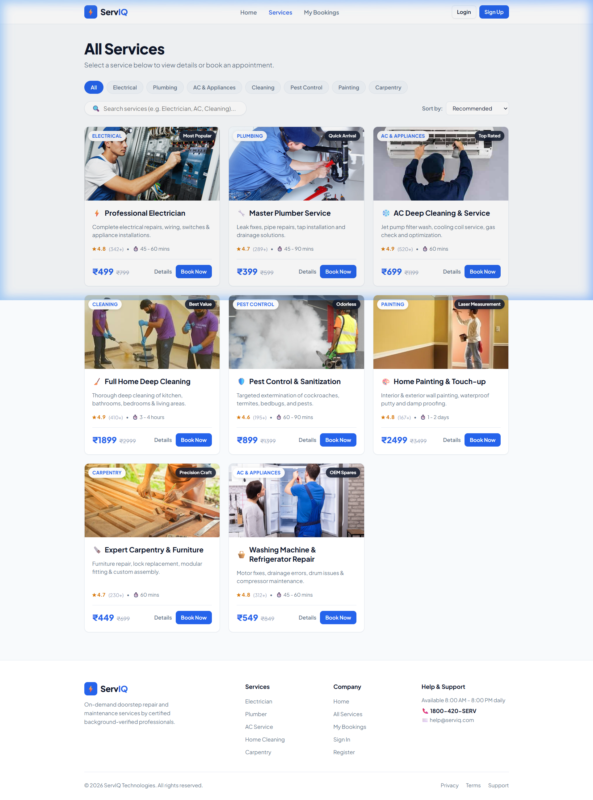
SERVIQ – REACT.JS PROJECT PRESENTATION
Module 2: Service Catalog Discovery, Search & Sorting
Dynamic Catalog Capabilities:
• 8 Domestic Categories: Pills for All, Electrical, Plumbing, AC & Appliances, Cleaning, Pest Control, Painting, and Carpentry.
• Real-Time Filter Engine: Instant search filtered across service names, detailed descriptions, and categories.
• Multi-Tiered Sorting: Sort services dynamically by Recommended, Highest Rated, Price: Low-to-High, and Price: High-to-Low.
• Performance with useMemo: Prevents unnecessary array re-filtering on unrelated parent re-renders.
• Empty State Handling: Displays clear feedback and a single-click 'Clear Filters' button when zero matches exist.
Figure 2: All Services Catalog – Filter Pills, Search Bar, and Service Grid
ServIQ Web Application | Developed by Ajay M (Junior Software Developer) | React.js & Vite

Slide 8
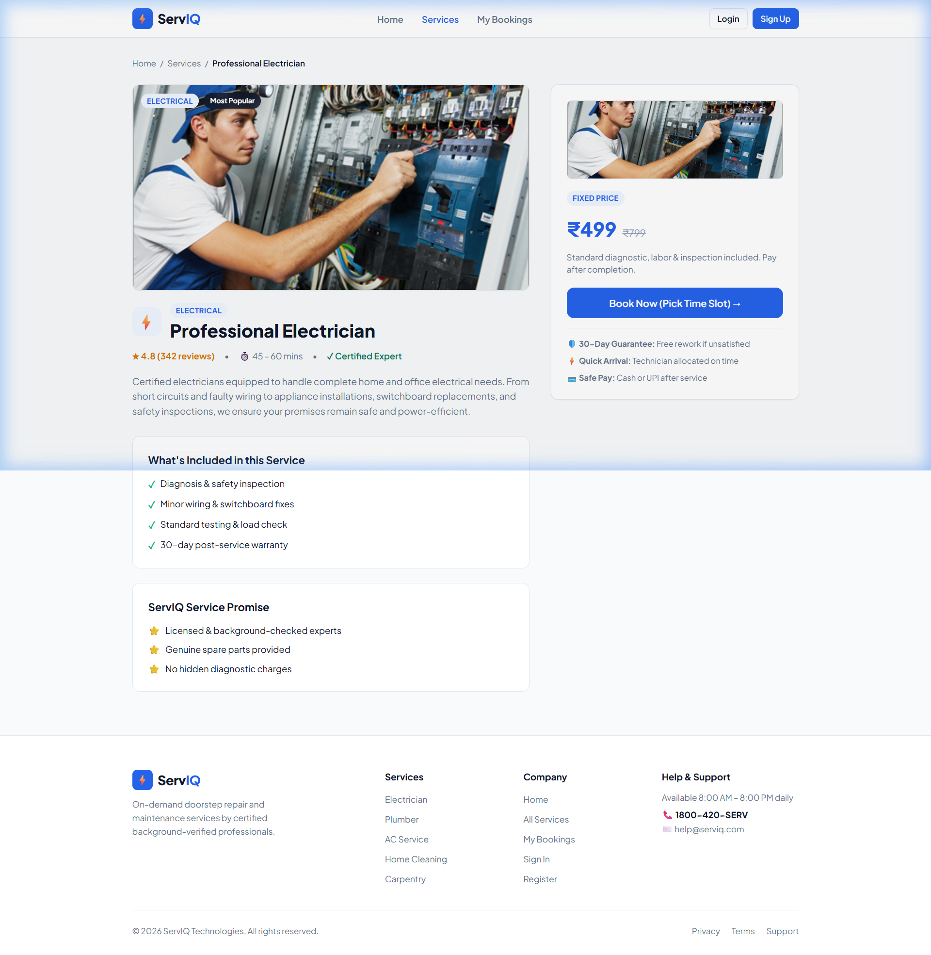
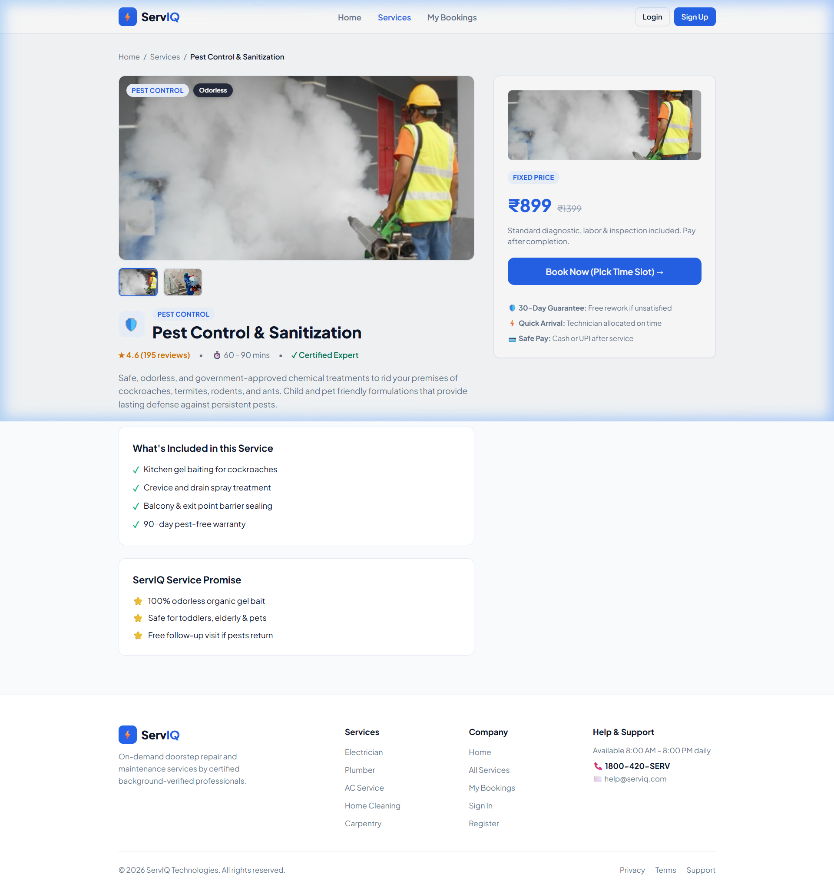
SERVIQ – REACT.JS PROJECT PRESENTATION
Module 3: Service Details & Interactive Multi-Photo Gallery
Deep Service Inspector:
• Full-Bleed Hero Banner: High-resolution 340px photographic banner with floating category and quality badge tags.
• Interactive Gallery Switcher: For services with multiple photographs (e.g. Pest Control & Sanitization), users can toggle between angles.
• What's Included Checklist: Complete transparency on diagnostic, labor, inspection, and post-service cleanup.
• ServIQ Service Promise: Highlights verified technician safety, transparent genuine spares, and 30-day warranty.
• Sticky Booking Box: Right sidebar remains sticky during scroll with direct time-slot booking CTA.
Figures 3 & 4: Left – Electrician Details with Inclusions | Right – Pest Control Multi-Photo Gallery
ServIQ Web Application | Developed by Ajay M (Junior Software Developer) | React.js & Vite

Slide 9
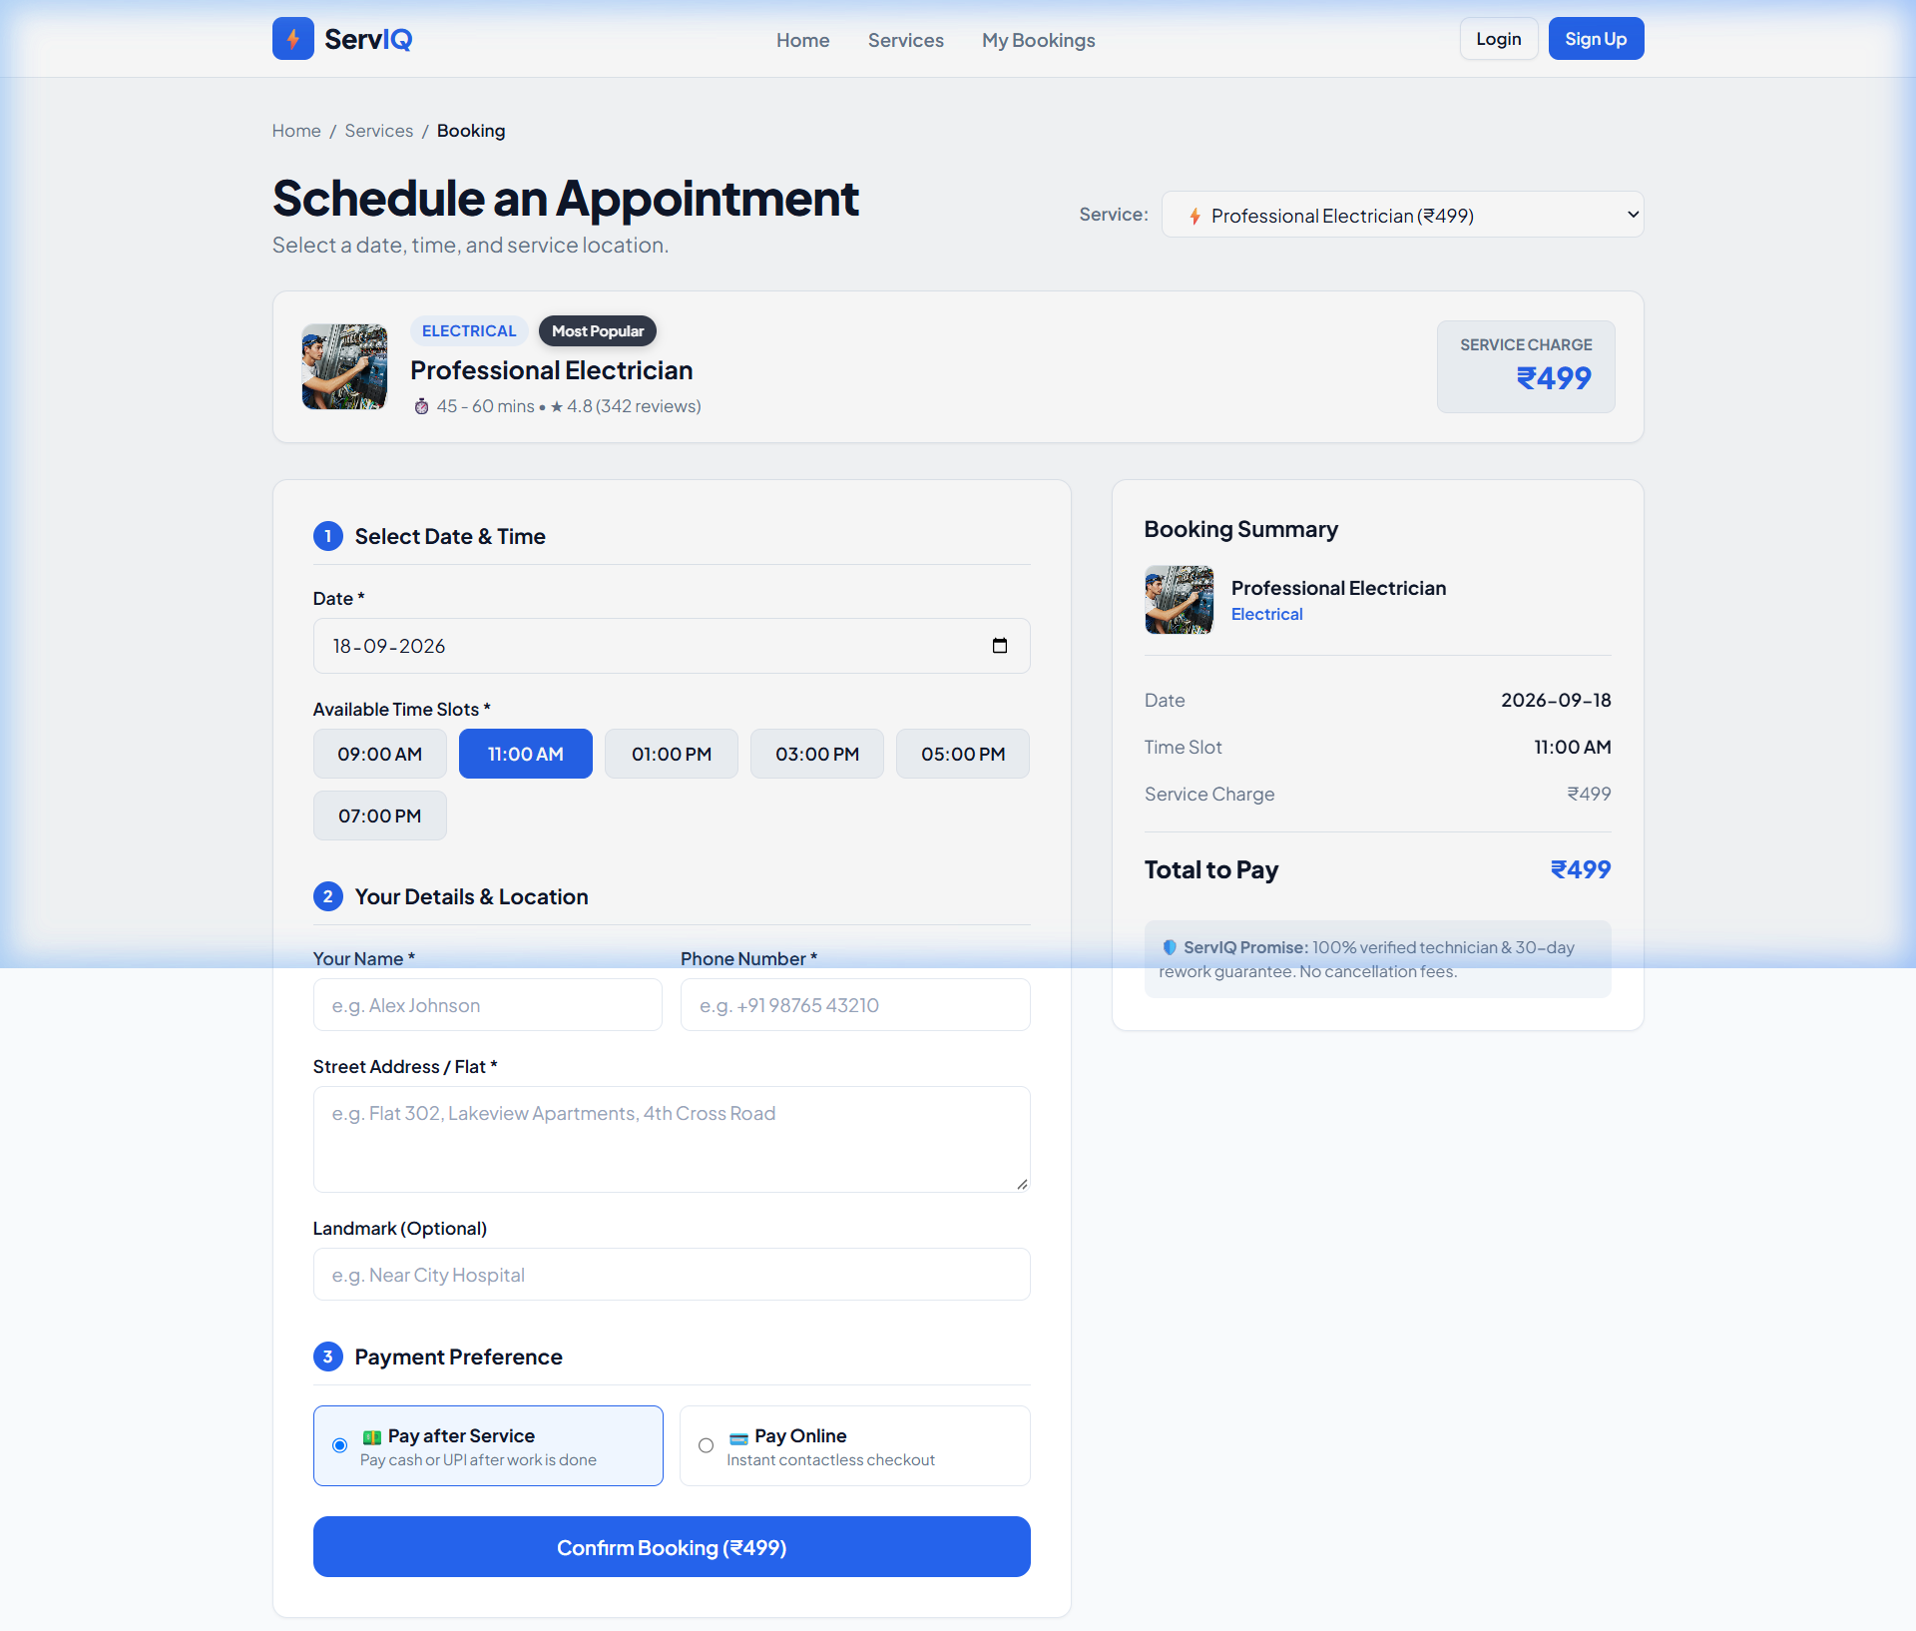
SERVIQ – REACT.JS PROJECT PRESENTATION
Module 4: 3-Step Hassle-Free Appointment Booking Flow
Booking Engineering Highlights:
• Visual Service Spotlight: Top banner previews selected service image, category, duration, rating, and upfront charge.
• Service Switcher Dropdown: Customers can switch services on the fly without navigating away from the scheduling screen.
• Step 1: Date & Slot Selection: Restricts past date selection; provides 6 daily 2-hour slots (09:00 AM to 07:00 PM).
• Step 2: Customer Address & Phone: Captures customer name, mobile contact, street address, and optional landmark (auto-filled if logged in).
• Step 3: Flexible Payment Preference: Choice between '💵 Pay after Service' and '💳 Pay Online'.
• Real-Time Order Summary: Dynamic sidebar confirms booked thumbnail, date, time slot, and total amount payable.
Figure 5: Schedule Appointment Page – Spotlight Card, Slot Picker & 3-Step Form
ServIQ Web Application | Developed by Ajay M (Junior Software Developer) | React.js & Vite

Slide 10
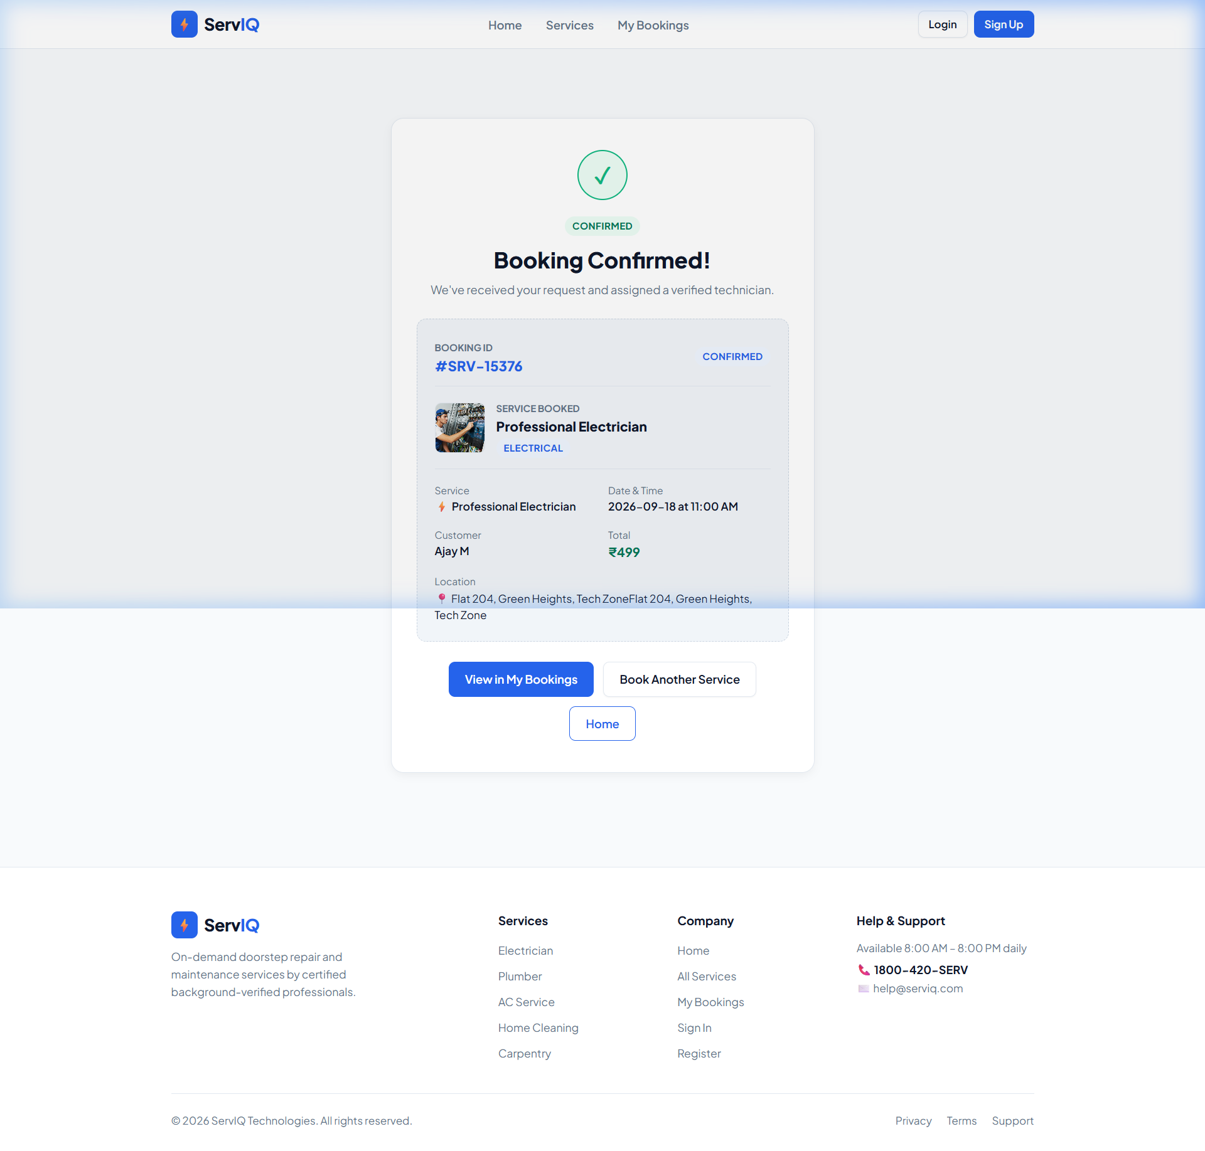
SERVIQ – REACT.JS PROJECT PRESENTATION
Module 5: Official Booking Confirmation & Receipt Generation
Receipt Confirmation Highlights:
• Auto-Generated Booking Reference: Generates unique tracking identifier (e.g. #SRV-15376) for technician coordination.
• Verified Technician Assignment: Assures customer that a certified technician has been reserved for their specific slot.
• Itemized Service Breakdown: Displays thumbnail photo of booked service, schedule date/time, customer name, and exact price.
• Location Verification: Confirms destination address with optional landmark.
• Seamless Post-Booking Actions: Direct CTA buttons to 'View in My Bookings', 'Book Another Service', or navigate back Home.
Figure 6: Official Booking Confirmed Receipt – Unique Reference #SRV-15376 for Ajay M
ServIQ Web Application | Developed by Ajay M (Junior Software Developer) | React.js & Vite

Slide 11
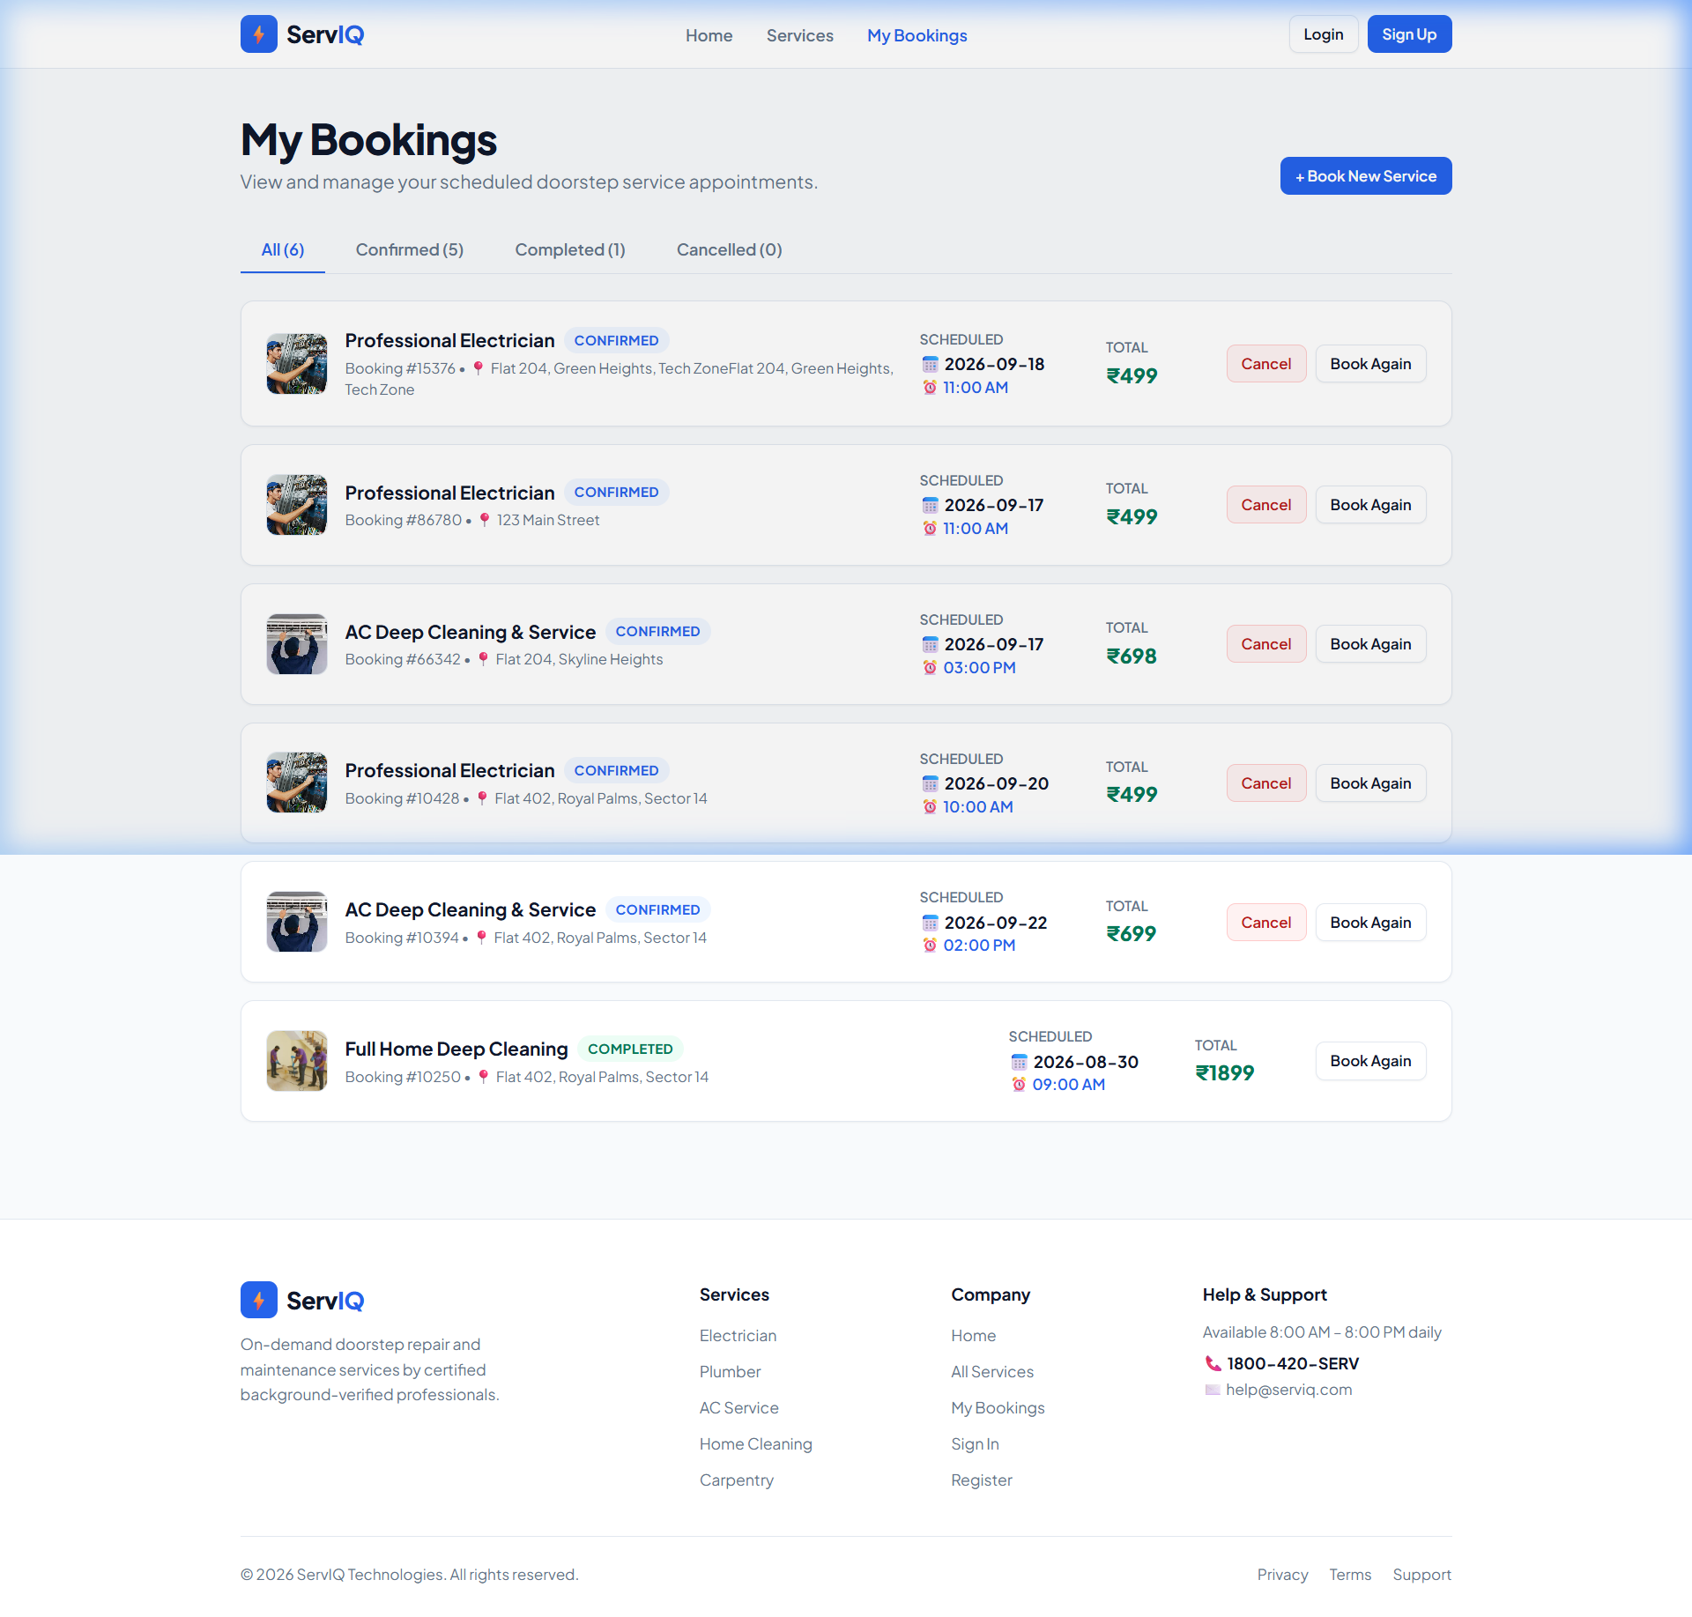
SERVIQ – REACT.JS PROJECT PRESENTATION
Module 6: Appointment Dashboard & Booking Lifecycle
Management Dashboard Features:
• Interactive Status Tabs: Filter appointments by All, Confirmed, Completed, or Cancelled with dynamic count badges.
• Rich Photographic Cards: Each appointment card displays the corresponding service's photo thumbnail, booking ID, address, date, and price.
• Two-Step Cancellation Modal: Active confirmed bookings can be cancelled with a confirmation modal, avoiding accidental clicks.
• Immediate State Synchronization: Cancelling an appointment updates LocalStorage and re-renders the dashboard instantly with zero page reload.
• Re-booking Shortcut: Completed or cancelled bookings feature a 'Book Again' button directing back to the scheduling page.
Figure 7: My Bookings Dashboard – Status Tabs, Real Thumbnails & Cancellation Controls
ServIQ Web Application | Developed by Ajay M (Junior Software Developer) | React.js & Vite

Slide 12
SERVIQ – REACT.JS PROJECT PRESENTATION
Core React Concepts Implemented in ServIQ
⚛️ Functional Components & Props
Components like ServiceCard receive typed data objects, separating data from presentation.
const ServiceCard = ({ service }) => { ... }
⚛️ Interactive State (useState)
Manages user search queries, active category tabs, gallery thumbnails, and form inputs.
const [activeImage, setActiveImage] = useState(service?.image);
⚛️ Performance (useMemo)
Memoizes filtered & sorted service arrays to prevent expensive recalculations.
const filteredServices = useMemo(() => { ... }, [cat, search, sort]);
⚛️ Side Effects (useEffect)
Synchronizes LocalStorage data on mount and updates customer details on user login.
useEffect(() => { setBookings(getStoredBookings()); }, []);
⚛️ Global Context (useContext)
Shares authentication state, user credentials, and logout dispatch globally.
const { currentUser } = useAuth();
⚛️ Conditional Rendering
Dynamically renders multi-photo gallery thumbs, status badges, and empty search results.
{gallery.length > 1 && <GalleryThumbs images={gallery} />}
ServIQ Web Application | Developed by Ajay M (Junior Software Developer) | React.js & Vite

Slide 13
SERVIQ – REACT.JS PROJECT PRESENTATION
Quality Assurance & Test Verification Matrix
Test ID | Target Module | Test Input / Action | Expected Outcome | Status
TC-01 | Home Landing Page | Visit http://localhost:5173 | Hero banner, search bar, and 6 service cards with real images render cleanly. | PASS
TC-02 | Category Filter | Select 'Cleaning' pill | Grid filters to show only 'Full Home Deep Cleaning' card. | PASS
TC-03 | Keyword Search | Type 'plumb' in search bar | Instantly filters to Master Plumber Service; non-matching hidden. | PASS
TC-04 | Service Details | Click 'Details' on Electrician | Renders 340px hero banner, what's included list, and sticky price box. | PASS
TC-05 | Interactive Gallery | Click thumb 2 on Pest Control | Active hero banner switches smoothly to second sanitization image. | PASS
TC-06 | Slot Booking Form | Select date & '11:00 AM' slot | Highlights selected slot in blue, updates right-hand order summary. | PASS
TC-07 | Receipt & Persistence | Confirm booking for Ajay M | Saved to LocalStorage, redirects to receipt with ID #SRV-15376. | PASS
ServIQ Web Application | Developed by Ajay M (Junior Software Developer) | React.js & Vite

Slide 14
SERVIQ – REACT.JS PROJECT PRESENTATION
Key Advantages & Platform Value
⚡ 60-Second Booking Speed
Frictionless scheduling workflow eliminates tedious back-and-forth phone coordination.
🏷️ 100% Upfront Fixed Rates
Eliminates diagnostic estimate anxiety by providing clear, fixed prices prior to technician dispatch.
🛡️ Safety & 30-Day Guarantee
Background-checked professionals backed by free re-servicing if unsatisfied within 30 days.
📸 Authentic Visual Experience
Real photography gives customers confidence in the professional quality of doorstep services.
💳 Zero Financial Risk
'Pay After Service' allows customers to inspect repairs before releasing cash or UPI payment.
📱 Universal Device Support
Responsive layout functions flawlessly across smartphones, tablets, laptops, and wide monitors.
ServIQ Web Application | Developed by Ajay M (Junior Software Developer) | React.js & Vite

Slide 15
SERVIQ – REACT.JS PROJECT PRESENTATION
Future Roadmap & Commercial Scalability
Phase 1
Payment Gateway Integration – Direct integration with Razorpay and Stripe for automated credit/debit card checkout, netbanking, and UPI QR payments.
Phase 2
SMS & WhatsApp Notifications – Automated real-time dispatch alerts and appointment reminders sent to customer mobile numbers via Twilio API.
Phase 3
Live GPS Technician Tracking – Interactive Leaflet / Google Maps interface displaying technician transit status and estimated arrival time (ETA).
Phase 4
Technician Mobile Companion – Dedicated portal for certified technicians to accept jobs, navigate to customer premises, and upload job completion photos.
Phase 5
Ratings & Photo Reviews – Community review submission enabling customers to post photo proof and 5-star ratings post service.
ServIQ Web Application | Developed by Ajay M (Junior Software Developer) | React.js & Vite

Slide 16
Thank You!
ServIQ – Doorstep Home & Electrical Services Booking Platform
A modern, reliable, and user-friendly digital solution developed with React.js, Vite, and modern Web engineering principles.
Developed & Presented by:
Ajay M (Junior Software Developer)
Questions & Feedback Welcome 💬

