Slide 1
Coursera Capstone
IBM Applied Data Science Capstone
Opening a Restaurant in Toronto, Canada
By: Ajay Mathew
July 2020

Slide 2
Business Problem
Location of the restaurant is one of the most important decisions that will determine whether the restaurant will be a success or a failure
Objective: To analyse and select the best locations in the city of Toronto, Canada to open a new shopping mall
Business question
In the city of Toronto, Canada, if a person is looking to open a new restaurant, where would you recommend that they open it?

Slide 3
Data
Data required
List of neighbourhoods in Toronto
Latitude and longitude coordinates of the neighbourhoods
Venue data, particularly data related to restaurants
Sources of data
Wikipedia page for neighbourhoods (https://en.wikipedia.org/wiki/List_of_postal_codes_of_Canada:_M. )
CSV file containing the geographical coordinates of neighborhoods (http://cocl.us/Geospatial_data)
Geocoder package for latitude and longitude coordinates
Foursquare API for venue data

Slide 4
Methodology
Web scraping Wikipedia page for neighbourhoods list
Get latitude and longitude coordinates using Geocoder
Use Foursquare API to get venue data
Selecting neighborhoods in only the Toronto Area
Group data by neighbourhood and taking the mean of the frequency of occurrence of each venue category
Filter venue category by Restaurant
Perform clustering on the data by using k-means clustering
Visualize the clusters in a map using Folium

Slide 5
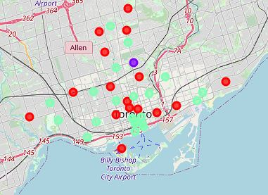
Results
Categorized the neighbourhoods into 3 clusters :
Cluster 0: Neighbourhoods with low number to no existence of restaurants
Cluster 1: Neighbourhoods with high concentration of restaurants
Cluster 2: Neighbourhoods with moderate number of restaurants

Slide 6
Discussion
Highest number in cluster 1 and moderate number in cluster 2
Cluster 0 has very low number to no restaurants in the neighbourhoods
Results are based solely on the frequency of occurrence of restaurants, to specifically select an area, we need more information.

Slide 7
Recommendations
Open new restaurants in neighbourhoods in cluster 0 with little to no competition
Can also open in neighbourhoods in cluster 2 with moderate competition if have unique selling propositions to stand out from the competition
Avoid neighbourhoods in cluster 1, already high concentration of restaurants and intense competition

Slide 8
Conclusion
Answer to business question: The neighbourhoods in cluster 0 are the most preferred locations to open a new restaurants
Findings of this project will help the relevant stakeholders to capitalize on the opportunities on high potential locations while avoiding overcrowded areas in their decisions to open a new restaurants

Slide 9

Thank you!

