Slide 1


MOBILE PRICE CLASSIFICATION
A Mentorness Project
Ajay Menon
ajaymenon17@gmail.com

Slide 2
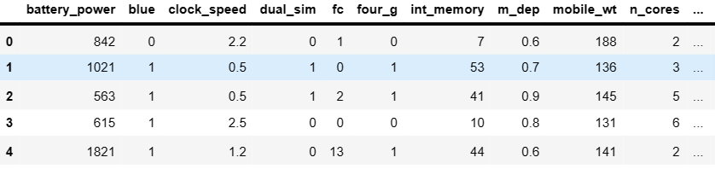
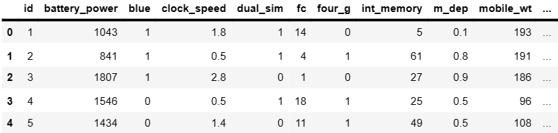

TYPES OF DATA
train.csv
This data set is used to train the machine learning model, it has features like, battery power, blue, clock _speed dual sim , fc(front camera) and price, being the target variable
test.csv
This is identical to the train.csv, with the absence of the price variable as we will feed this data into the model to correctly classify the mobile into the specific category

Slide 3
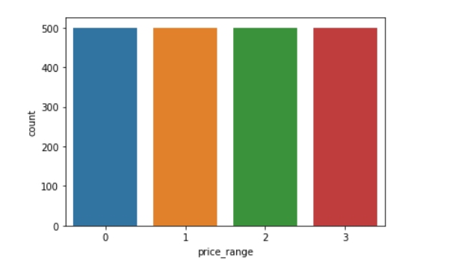
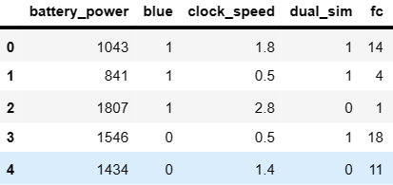

DATA PROCESSING

Slide 4
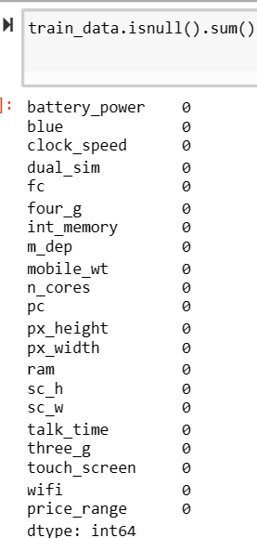
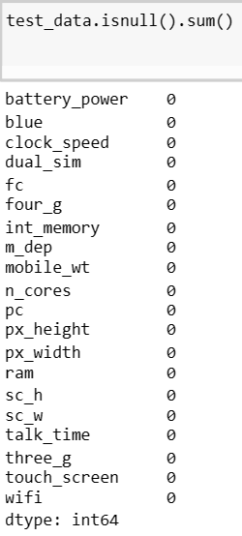
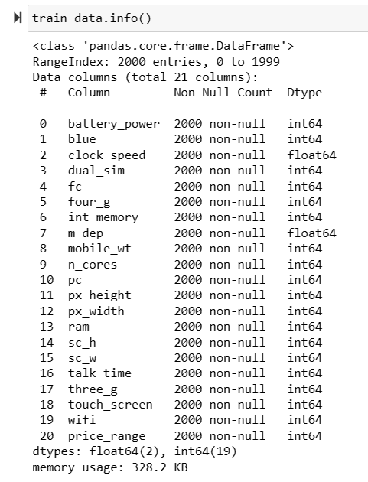
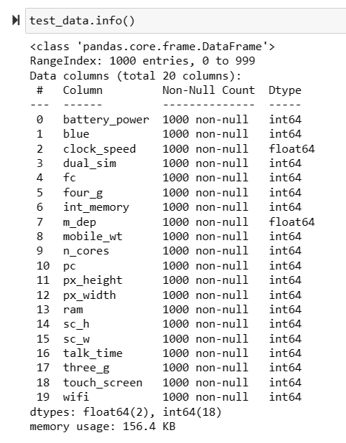
DATA PROCESSING

Slide 5
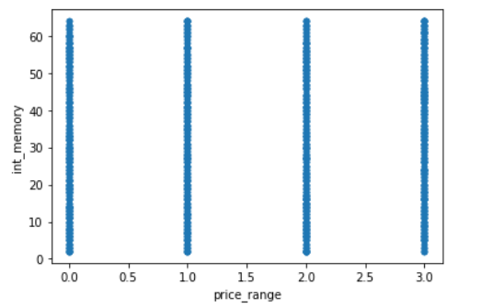
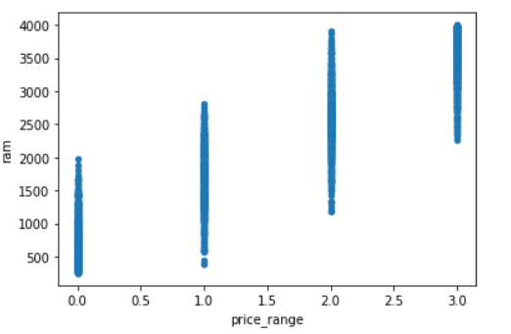
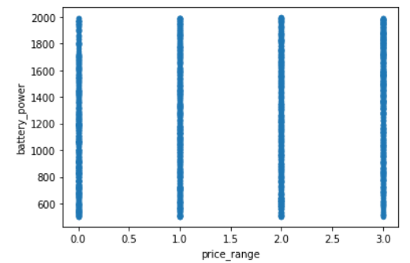
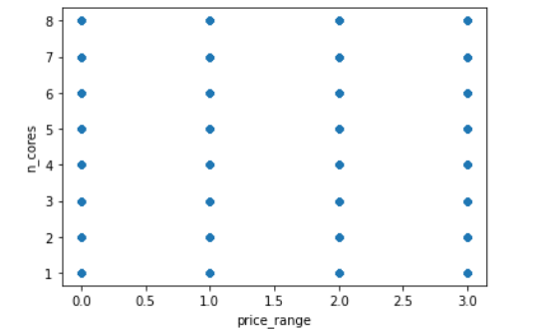

VISUALIZATIONS

Slide 6
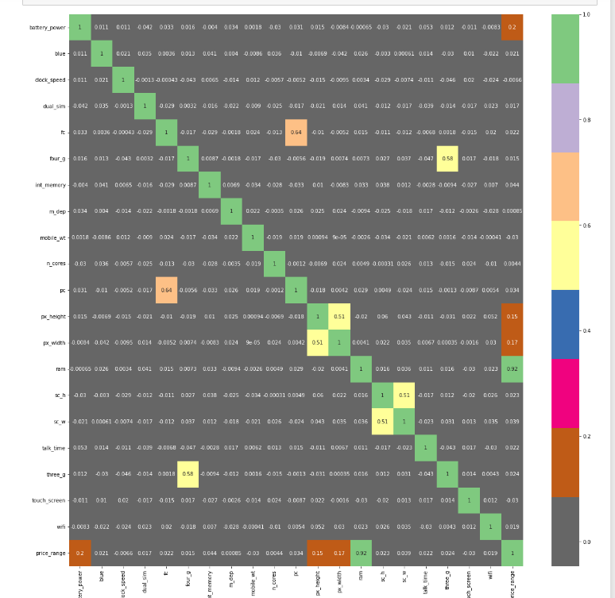

HEATMAP ANALYSIS

Slide 7

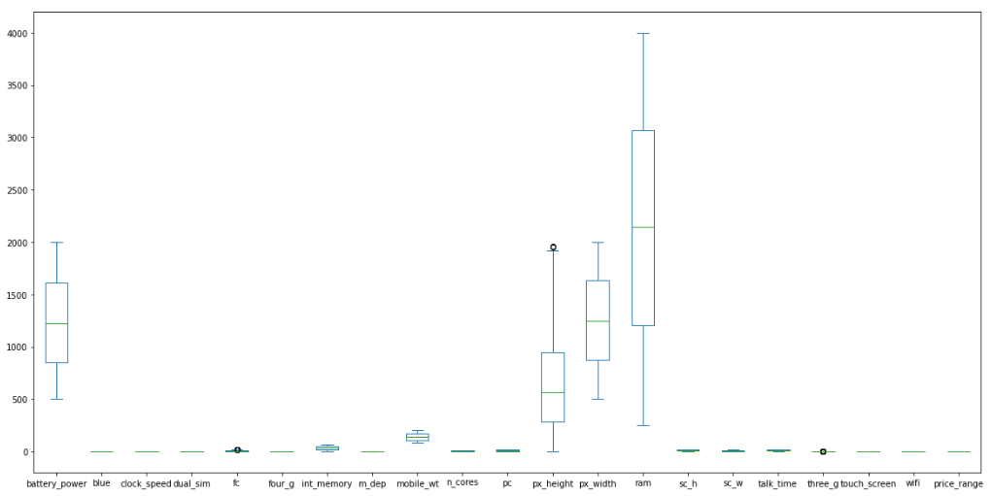
OUTLIER DETECTION

Slide 8
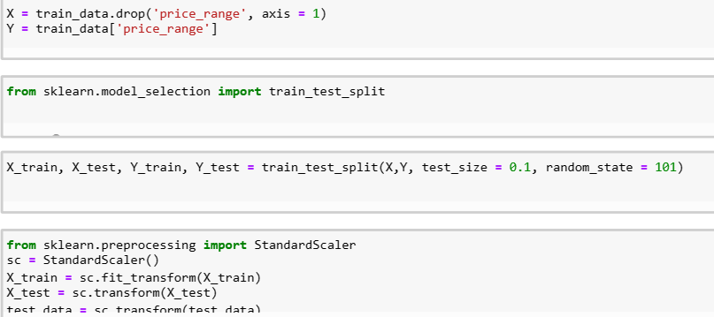
SPLITTING AND STANDARDIZATION

Slide 9
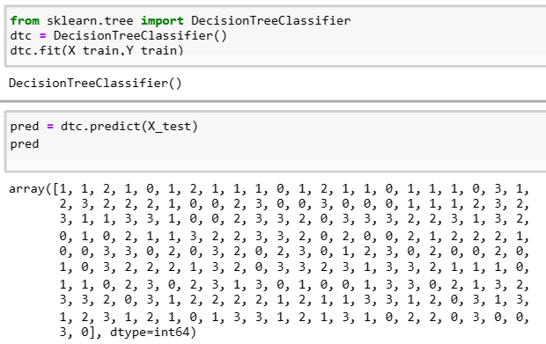
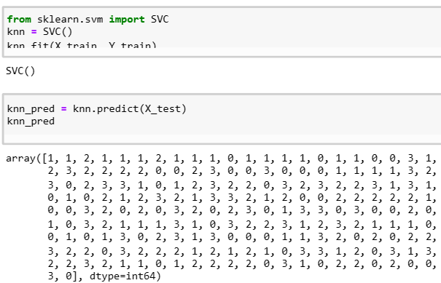
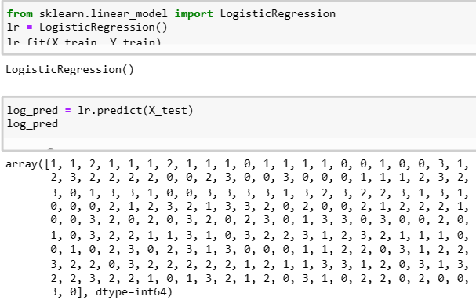
ALGORITHMS

Slide 10
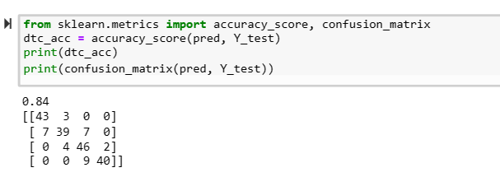
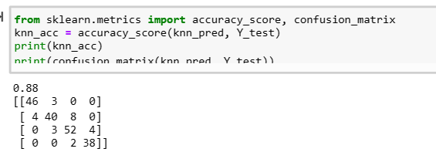
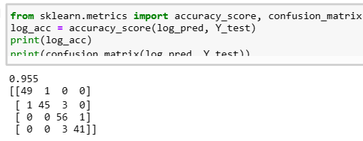
SCORES

Slide 11
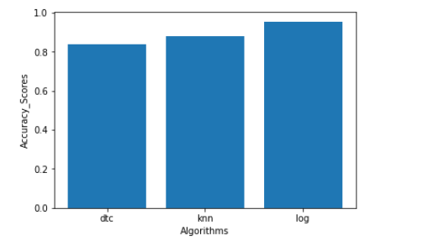
VERDICT

Slide 12
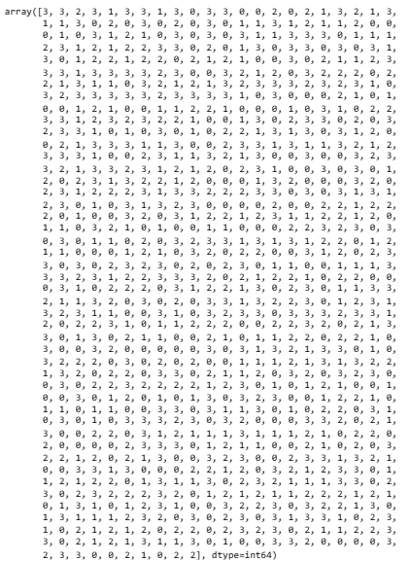


PREDICTION USING TEST DATA

