Slide 1



RNS INSTITUTE OF TECHNOLOGY
Department of Computer Science & Engineering
Major Project (BCS685)Phase-2:Review-1
ReflectAI: A Depth-Adaptive Socratic Reflection Engine for
Longitudinal AI Journaling
Student Names:
Name [USN]
Name [USN]
Name [USN]
Name [USN]
Guide Name:
Name
Designation
Dept. of CSE, RNSIT

Slide 2
AGENDA
Introduction
Literature Survey
Problem Statement
Objectives
Methodology/System Architecture
Results (showcase atleast 60-70% work)
Timeline/Plan
Future Scope
Patent/ Publication Details
References
12/03/2026

Slide 3
INTRODUCTION
Motivation. Reflective, free-form journaling is a well-evidenced tool for emotional processing and self-awareness, but adherence collapses fast without prompts, structure, or feedback — most people stop within days.
What ReflectAI is. A full-stack, AI-powered smart-journaling and digital-health platform (in-app branded “Equoria”) that pairs free-form journaling with a Socratic-style AI reflection partner, automatic mood analytics, and passive physical-health correlation.
How it works. Every entry is mood-tagged and timestamped; an LLM-driven reflection engine asks context-aware follow-up questions grounded in the user's own journal history, with a safety-checked heuristic fallback so the experience degrades gracefully instead of breaking.
Health context. A native iOS companion app streams Apple HealthKit signals (sleep, steps, heart rate, stress) to the platform, which the Retrospect module correlates against mood over time.
Engineering scope. Built on React + Vite, Node.js/Express + MongoDB, and SwiftUI/HealthKit, with production-grade security — JWT rotation, 2FA, encryption at rest, rate limiting — engineered in from the start, not bolted on later.
This review. Phase-2 demonstrates a working end-to-end system: authentication, journaling, AI-guided reflection, mood/retrospective analytics, Apple Health sync, and a fully customizable interface.
12/03/2026

Slide 4
LITERATURE SURVEY
LLM-based journaling & chatbot efficacy [1]–[7]. Multiple 2023–2026 systematic reviews and meta-analyses confirm AI conversational agents produce measurable reductions in depressive/anxiety symptoms (effect sizes g ≈ 0.27–0.82), and that LLM-driven journaling is an emerging, distinct UX pattern from static chat.
Socratic / CBT-style dialogue [10]–[12]. 2024–2025 studies show LLMs can reliably execute Socratic questioning and cognitive-restructuring protocols used in CBT, validated by mental-health professionals reviewing real transcripts — directly informs ReflectAI's follow-up-question engine.
Digital phenotyping & mood prediction [8]–[9]. Passive smartphone/wearable signals (sleep, steps, mobility) reliably classify and predict mood and depression risk, motivating ReflectAI's Health–Retrospect correlation.
Foundations of journaling itself [13]. Pennebaker-tradition expressive-writing research remains the strongest evidence base for why guided journaling improves psychological and physical health outcomes.
NLP mood/emotion classification [14]. Transformer- and LSTM-based classifiers now reach ≈90% accuracy on text mood classification, informing ReflectAI's mood-tag and theme-extraction pipeline.
Privacy & security posture [15]. 2024 CHI research found mental-health apps are frequently under-secured (1,575 vulnerabilities across just 10 audited apps) — directly motivated ReflectAI's own multi-round security-hardening pass.
Conclusion: the literature strongly supports each individual piece — journaling helps, LLMs can deliver CBT/Socratic-style support, and passive health signals predict mood — but very few systems combine all three with production-grade security. ReflectAI is designed to close exactly that gap.
12/03/2026

Slide 5
PROBLEM STATEMENT
Most journaling apps are passive notebooks with no feedback loop, while most AI mental-health chatbots are stateless, one-off conversations disconnected from a user's own writing history and physical well-being. Users are left to manually notice their own emotional patterns, with nothing connecting mood swings to sleep, activity, or workload, and no safe, always-available prompt to go deeper than a surface-level entry — resulting in shallow, inconsistent journaling and missed early signals of stress or burnout.
There is no accessible, secure, single platform that unifies guided reflective journaling, AI-driven Socratic follow-up, and objective physical-health context into one continuously learning feedback loop.
12/03/2026

Slide 6
OBJECTIVES
Build a secure, full-stack smart-journaling platform where every entry carries a mood tag and, optionally, linked physical-health context.
Design an AI reflection engine that asks context-aware, Socratic-style follow-up questions grounded in the user's own journal history, with a safe non-AI fallback so the experience never fully breaks.
Surface emotional patterns automatically — recurring themes, behavioral loops, mood-vs-health correlations — instead of requiring the user to notice them manually.
Integrate real physical-health data (steps, sleep, heart rate, stress) via a native iOS HealthKit companion app with near-real-time background sync.
Engineer the platform to a production security bar: JWT rotation, 2FA, rate limiting, encryption at rest, and a live, self-authored penetration-test harness.
Give users full control over the interface's look and feel through simple accent-color sliders, with zero code changes required.
12/03/2026

Slide 7
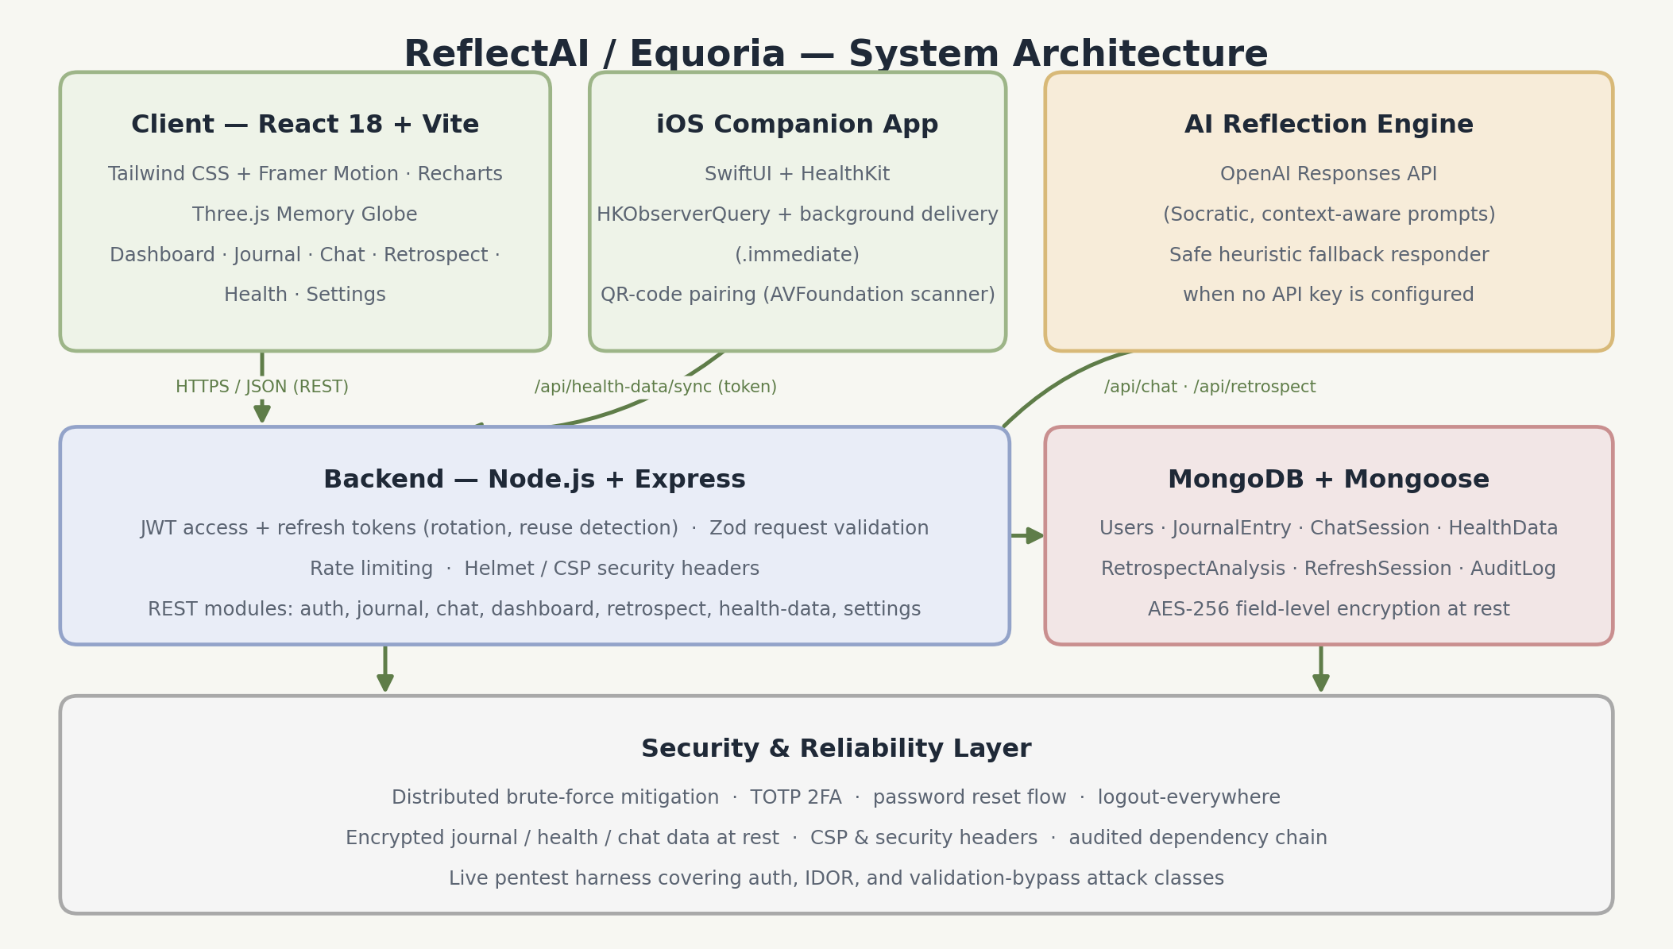
METHODOLOGY/SYSTEM ARCHITECTURE
12/03/2026

Slide 8
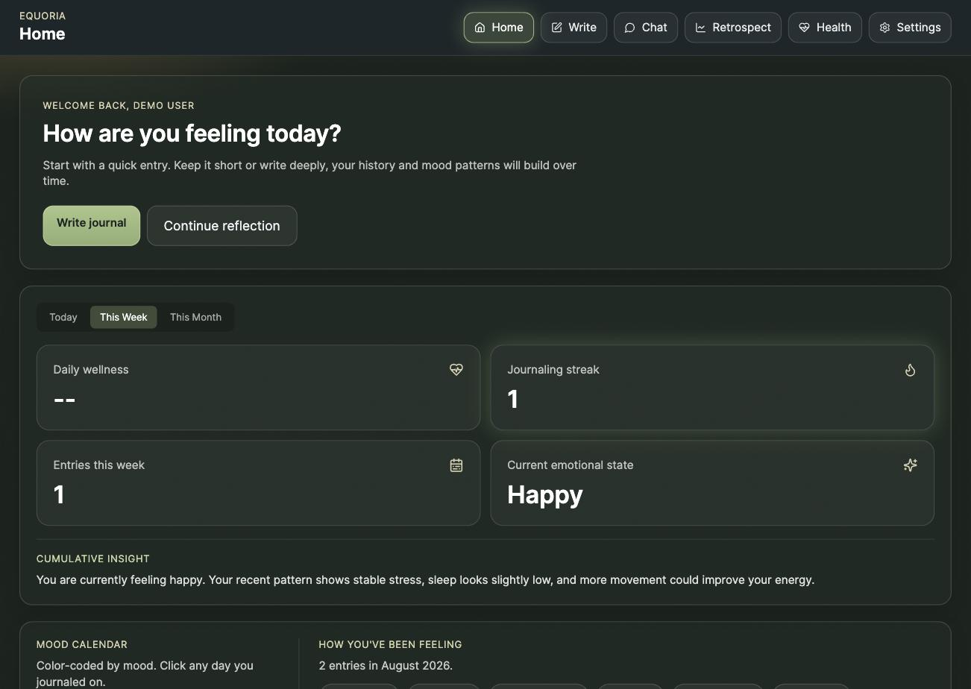
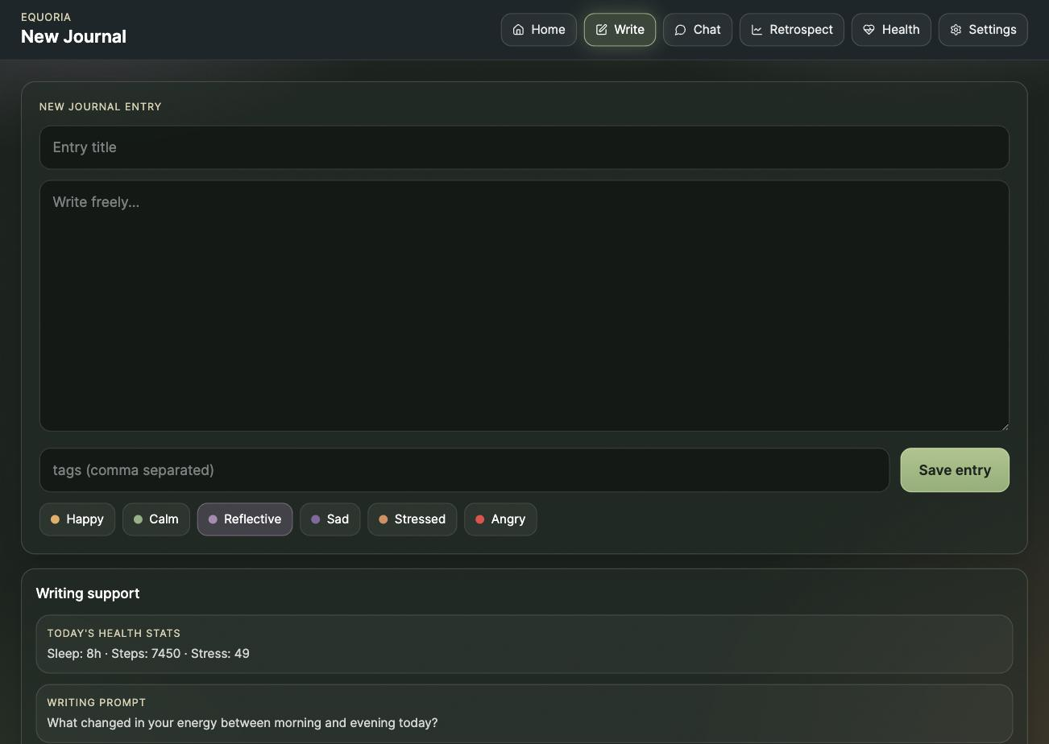
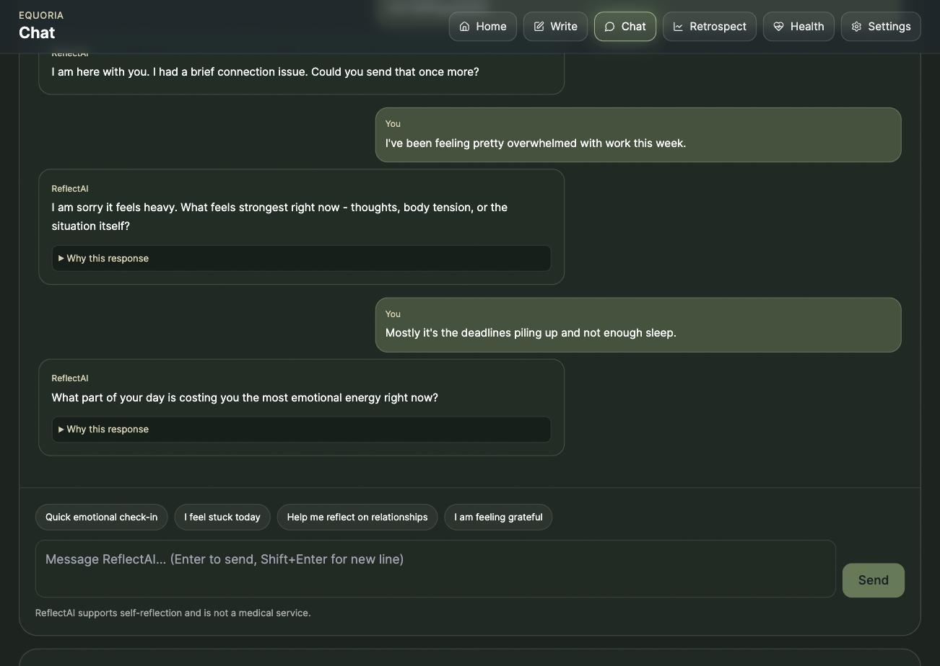
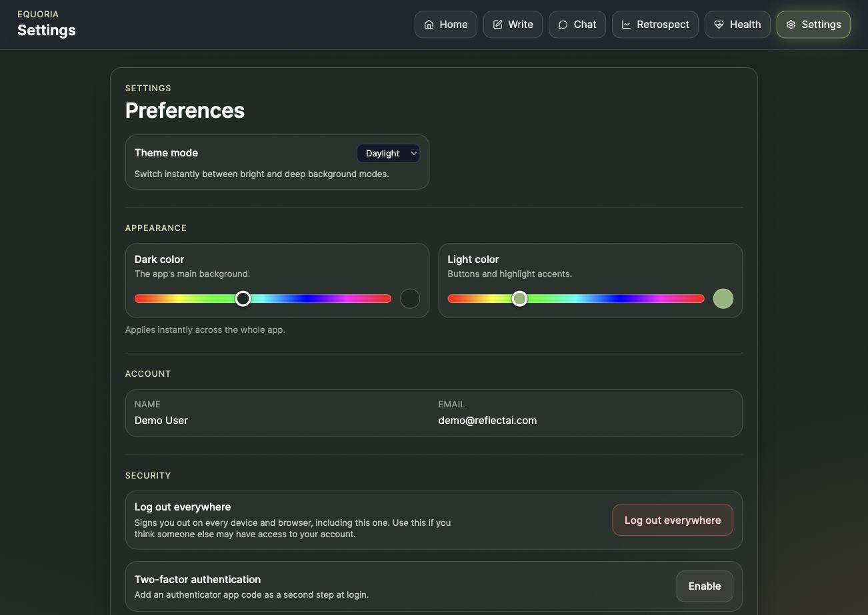
RESULTS I — JOURNALING & AI REFLECTION
Dashboard — mood calendar, streaks, cumulative insight
New Journal Entry — mood tagging + writing support
AI Reflection Chat — Socratic follow-up questioning
Settings — live dark/light accent-color sliders
12/03/2026

Slide 9
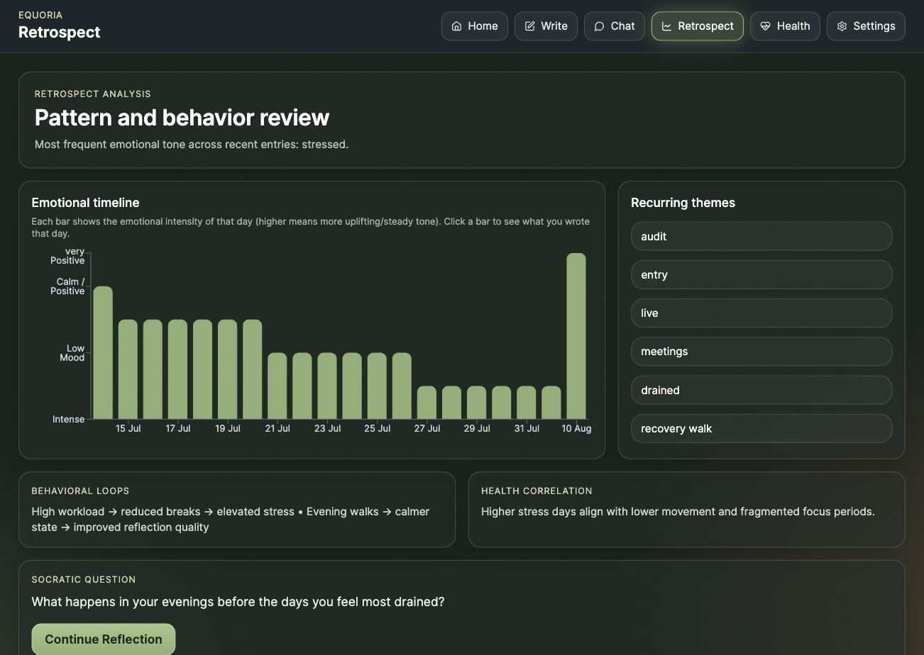
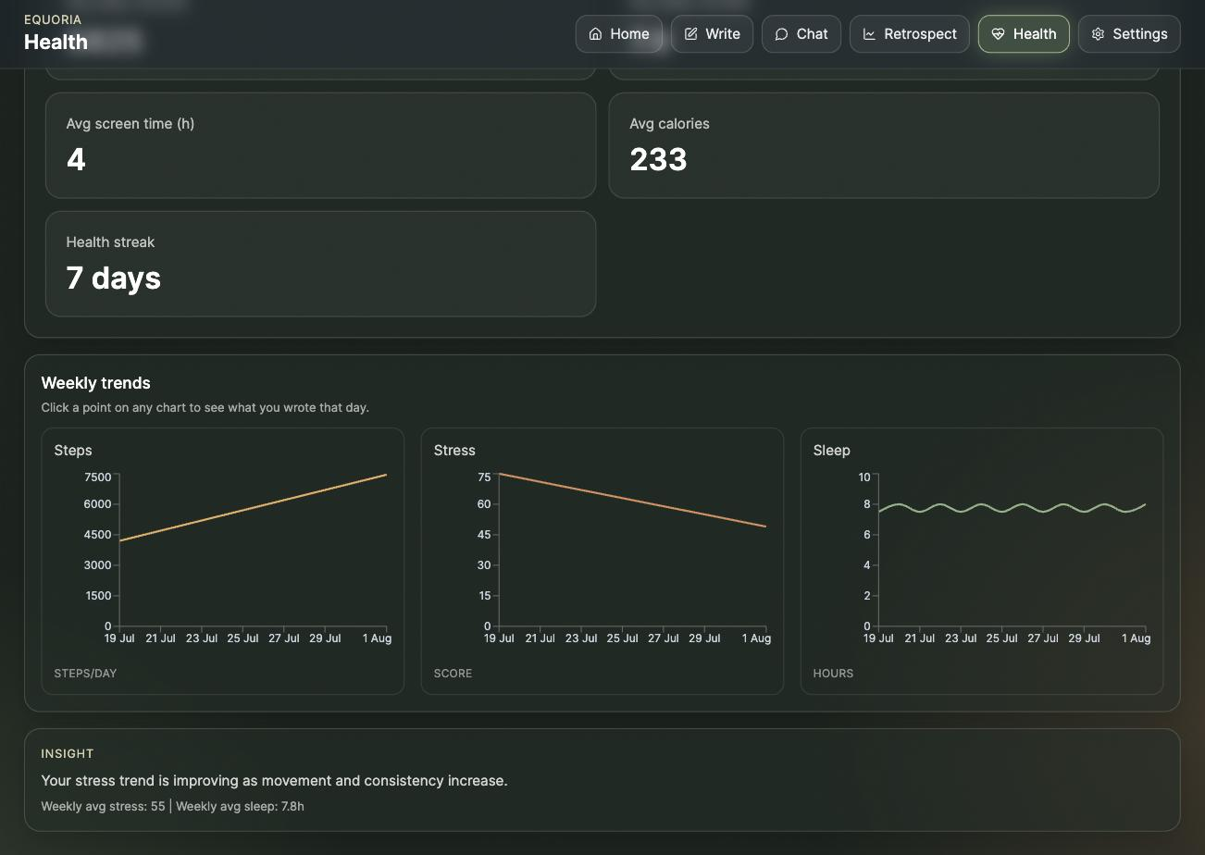
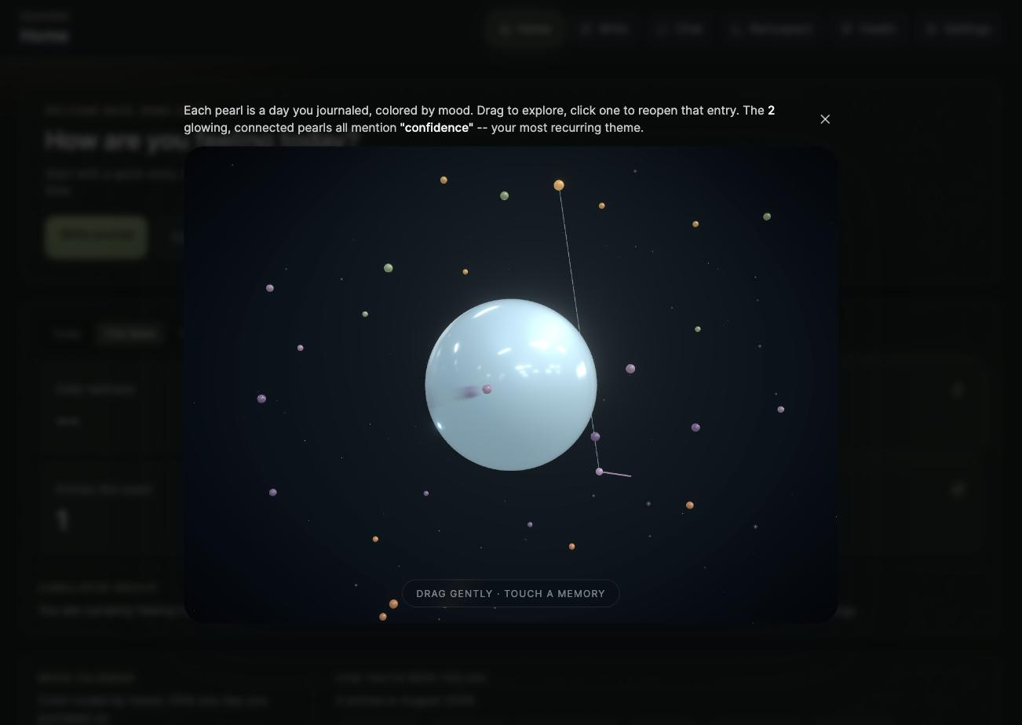
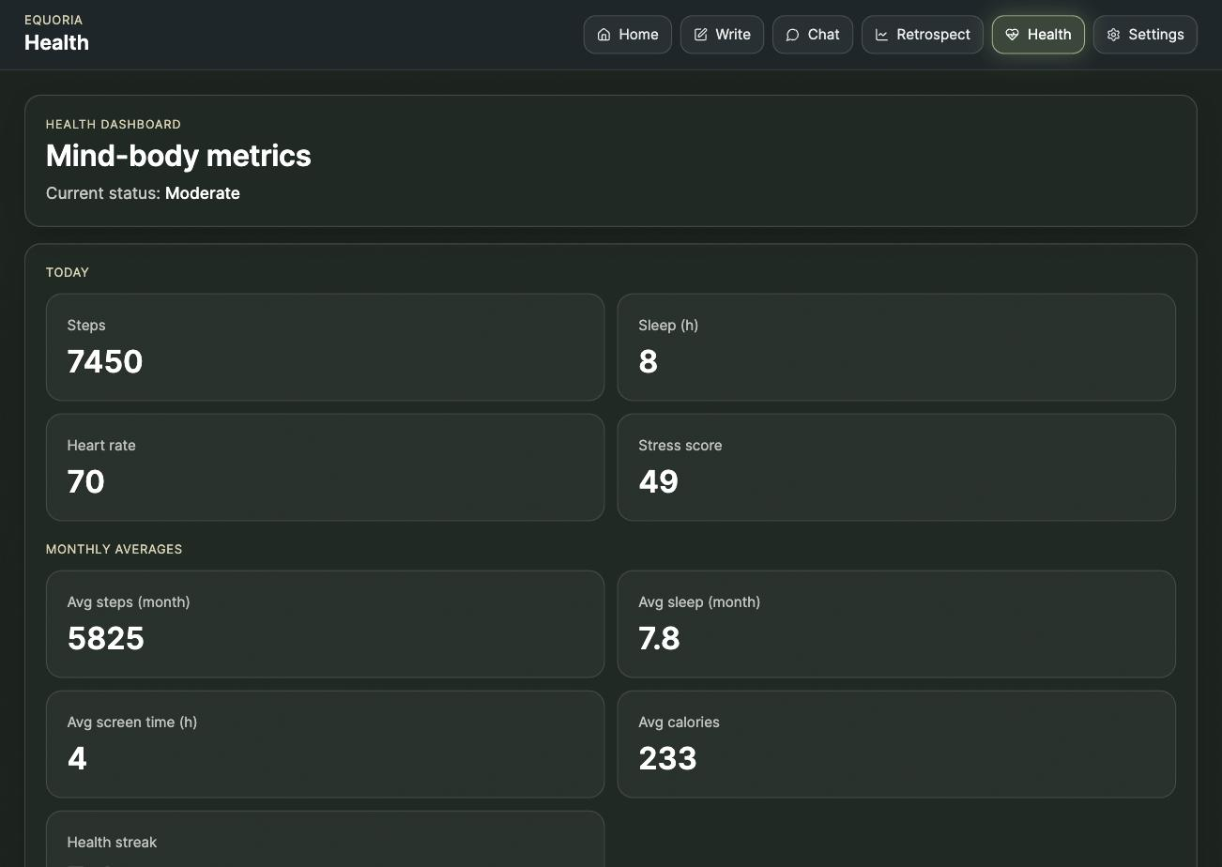
RESULTS II — ANALYTICS & HEALTH SYNC
Retrospect — emotional-timeline chart + recurring themes
Apple Health sync — weekly steps / stress / sleep trends
Memory Globe — 3D constellation of journaled days
Health dashboard — today's metrics + monthly averages
12/03/2026

Slide 10
TIMELINE/PLAN
Phase | Duration | Key Deliverables | Status
1 — Planning & Design | Weeks 1–3 | Requirement analysis, literature survey, system architecture, DB schema design | Complete
2 — Core Platform | Weeks 4–7 | JWT/2FA auth, journal CRUD, mood tagging, dashboard, MongoDB models | Complete
3 — AI Reflection Engine | Weeks 8–9 | OpenAI-integrated Socratic chat, heuristic fallback, anti-repetition logic | Complete
4 — Analytics & Health Sync | Weeks 10–11 | Retrospect analytics, theme extraction, iOS HealthKit app, QR pairing | Complete
5 — Security Hardening | Week 12 | Rate limiting, encryption at rest, pentest harness, 6 major risk fixes | Complete
6 — UI/UX Polish (current) | Week 13 (this review) | Memory Globe, custom theming, layout overhaul, live QA pass | In progress (~65%)
7 — Final Testing & Deployment | Weeks 14–16 | End-to-end test suite, deployment, extended analytics, demo prep | Planned
12/03/2026

Slide 11
FUTURE SCOPE
Nightingale Rose Chart for richer multi-dimensional mood/emotion visualization (season-over-season emotional composition) — currently in design discussion.
Android companion app to reach parity with the existing iOS HealthKit integration, via the Health Connect API.
Deeper sentiment/emotion NLP — transformer-based multi-label emotion classification — replacing the current keyword-based theme extraction.
Optional clinician/therapist-facing dashboard for supervised use cases, gated behind explicit user sharing consent.
On-device / federated personalization to reduce reliance on a hosted LLM and strengthen privacy guarantees further.
Multi-language journaling and AI reflection support.
Adaptive, data-driven habit nudges — building on the existing streak system — informed by the digital-phenotyping literature [8], [9].
12/03/2026

Slide 12
PATENT/PUBLICATION DETAILS
No patents have been filed and no publications have been made for this project at this stage of development (Phase-2 Review).
A conference/journal manuscript summarizing the Socratic-reflection engine and the mood–health correlation methodology is planned for submission after Phase-3 completion and full evaluation.
Novelty being explored for potential filing: the heuristic-fallback anti-repetition mechanism that keeps AI-guided reflection safe, contextual, and non-repetitive without requiring a live LLM connection.
12/03/2026

Slide 13
REFERENCES
[1] “Journaling with Large Language Models: A Novel UX Paradigm for AI-Driven Personal Health Management,” Frontiers in Artificial Intelligence, 2025.
[2] “The Applications of Large Language Models in Mental Health: Scoping Review,” Journal of Medical Internet Research (JMIR), 2025.
[3] “Large Language Models for Mental Health Applications: Systematic Review,” JMIR Mental Health, 2024.
[4] “Systematic Review and Meta-Analysis of Chatbots in the Management of Depressive and Anxiety Symptoms,” npj Digital Medicine, 2026.
[5] “Generative AI Mental Health Chatbots as Therapeutic Tools: Systematic Review and Meta-Analysis,” JMIR, 2025.
[6] “AI Chatbots for Mental Health: A Scoping Review of Effectiveness, Feasibility, and Applications,” Applied Sciences (MDPI), 2024.
[7] “Systematic Review and Meta-Analysis of AI-Based Conversational Agents for Promoting Mental Health and Well-Being,” npj Digital Medicine, 2023.
[8] “Personalized Mood Prediction from Patterns of Behavior Collected with Smartphones,” npj Digital Medicine, 2024.
[9] “Key Features of Digital Phenotyping for Monitoring Mental Disorders: Systematic Review,” JMIR, 2025.
[10] K. Izumi et al., “Response Generation for Cognitive Behavioral Therapy with Large Language Models: Comparative Study with Socratic Questioning,” arXiv:2401.15966, 2024.
[11] “Evaluating an LLM-Powered Chatbot for Cognitive Restructuring: Insights from Users and Mental Health Professionals,” ACM Trans. Computing for Healthcare, 2025.
[12] “A Novel CBT-Based Generative AI Tool (Socrates 2.0) to Facilitate Socratic Dialogue: Protocol for a Mixed-Methods Feasibility Study,” JMIR Research Protocols, 2024.
[13] “Efficacy of Expressive Writing Versus Positive Writing in Different Populations: Systematic Review and Meta-Analysis,” PMC, 2023.
[14] “Unveiling Emotions: NLP-Based Mood Classification and Well-Being Tracking for Enhanced Mental Health Awareness,” Math. Modelling of Engineering Problems (IIETA), 2024.
[15] “‘That's Kind of Sus(picious)’: The Comprehensiveness of Mental Health Application Users' Privacy and Security Concerns,” Proc. 2024 CHI Conf. Human Factors in Computing Systems (ACM), 2024.
12/03/2026

