Slide 1
UNITED STATES FARMER’S MARKET
BY
Ajay Mohandas
Gurjot Kaur
Harsh Shah

Slide 2
INTRODUCTION
Public markets are almost as old as history. Across the world, you will find flourishing marketplaces which are centuries old and vestiges of former ways of doing business. In the United States, these markets began to decline after World War II with the advent of the supermarket and convenience shopping.
A farmers market is a place where farmers come together to sell produce directly to consumers, usually off the back of their trucks.
Demerits of traditional Farmer’s Market model are as follows:
A) Unless labeled organic, there is no way of knowing if the farmer used pesticides or fertilizers.
B) The distribution and storage cost of raw materials and end produce has to be considered by the farmers and in turn they are unable to turn the revenue to profits

Slide 3
NEED FOR USFM
Farmers can sell their produce at market price to our office and we will take care of the rest process by reaching out to customers as per their demand
This will help farmers in saving their distribution and storage cost since the crops will be stored in warehouse under supervision.
When in need of any raw materials or pesticides for growing crops, farmers just have to place an order and rest will be taken care by us.
Our application will also notify farmers of current weather information so that they can take necessary precaution to save their crops.

Slide 4
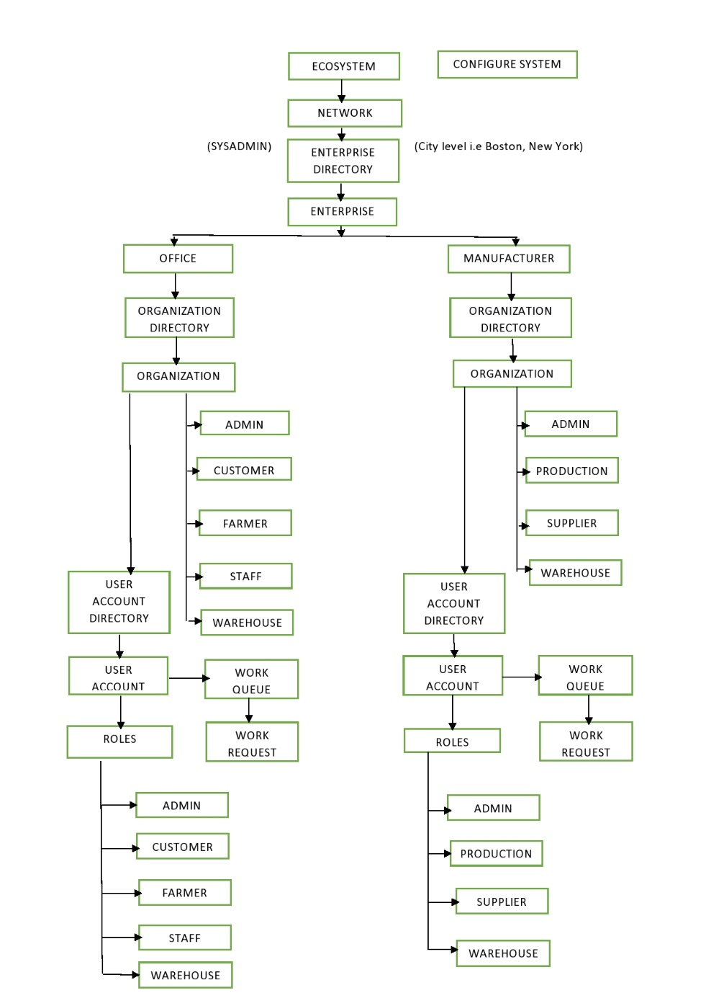
Object Model

Slide 5
FUNCTIONALITY
1) Weather API
2) Graphs
3) Produce and Raw Material Reviews

Slide 6
SCREENSHOTS

Slide 7
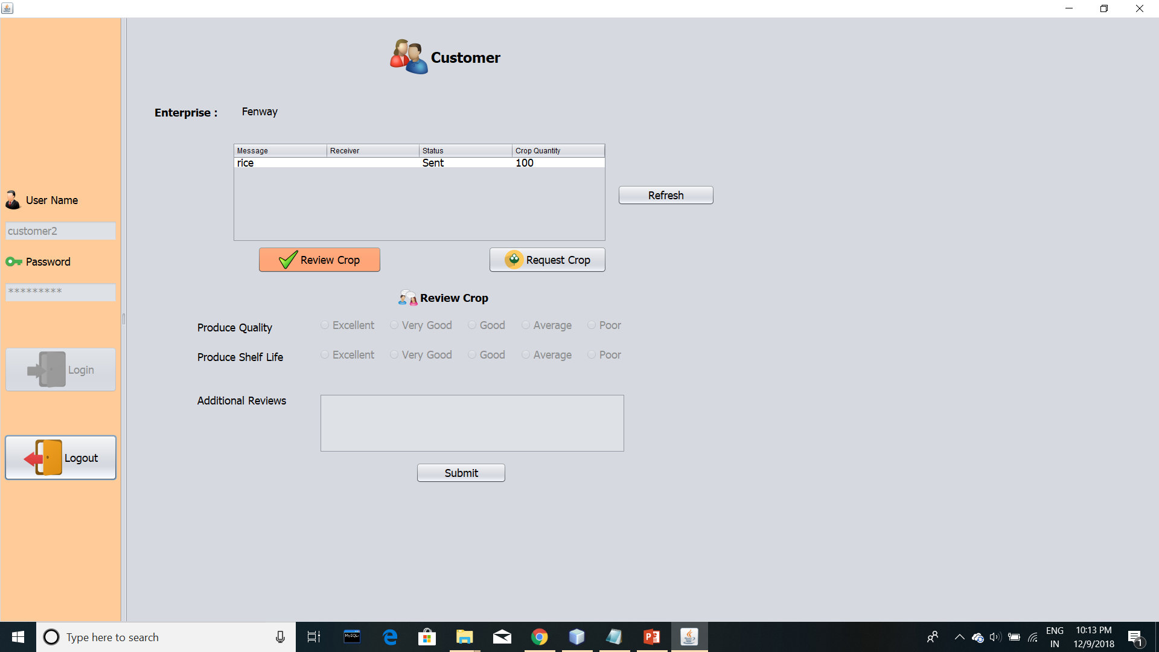

Slide 8
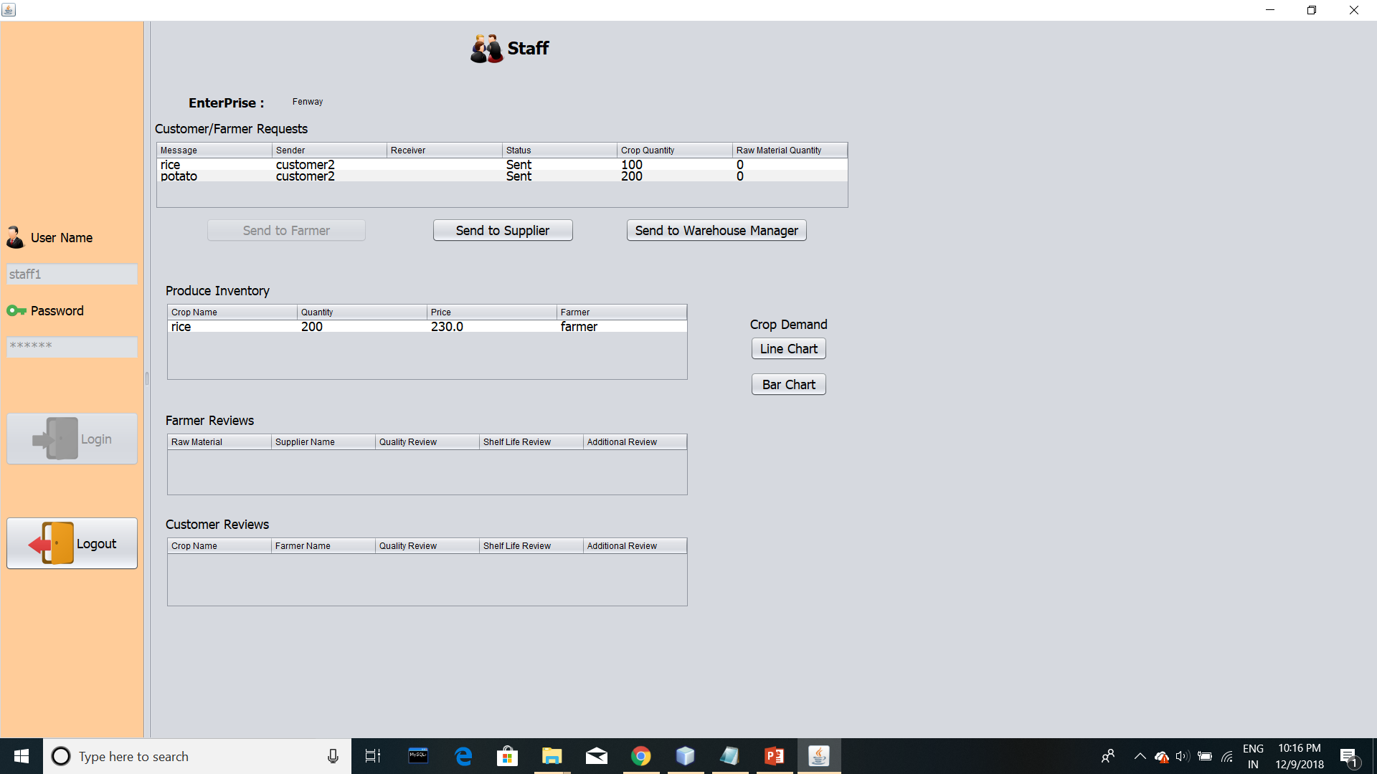

Slide 9
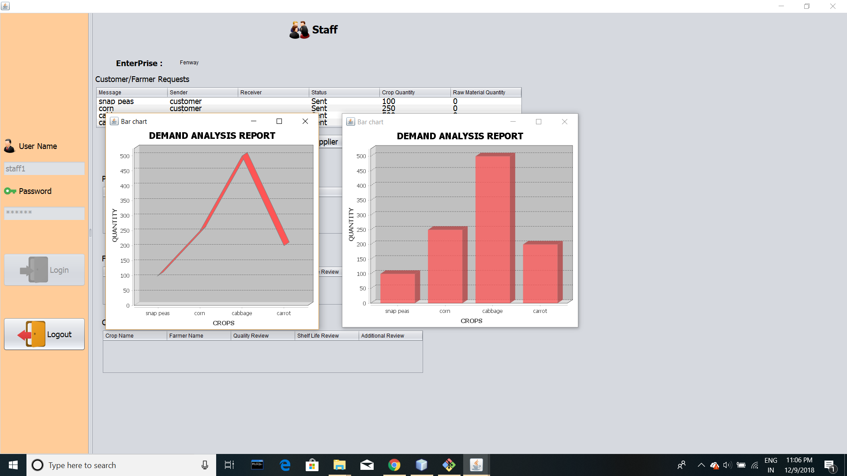

Slide 10
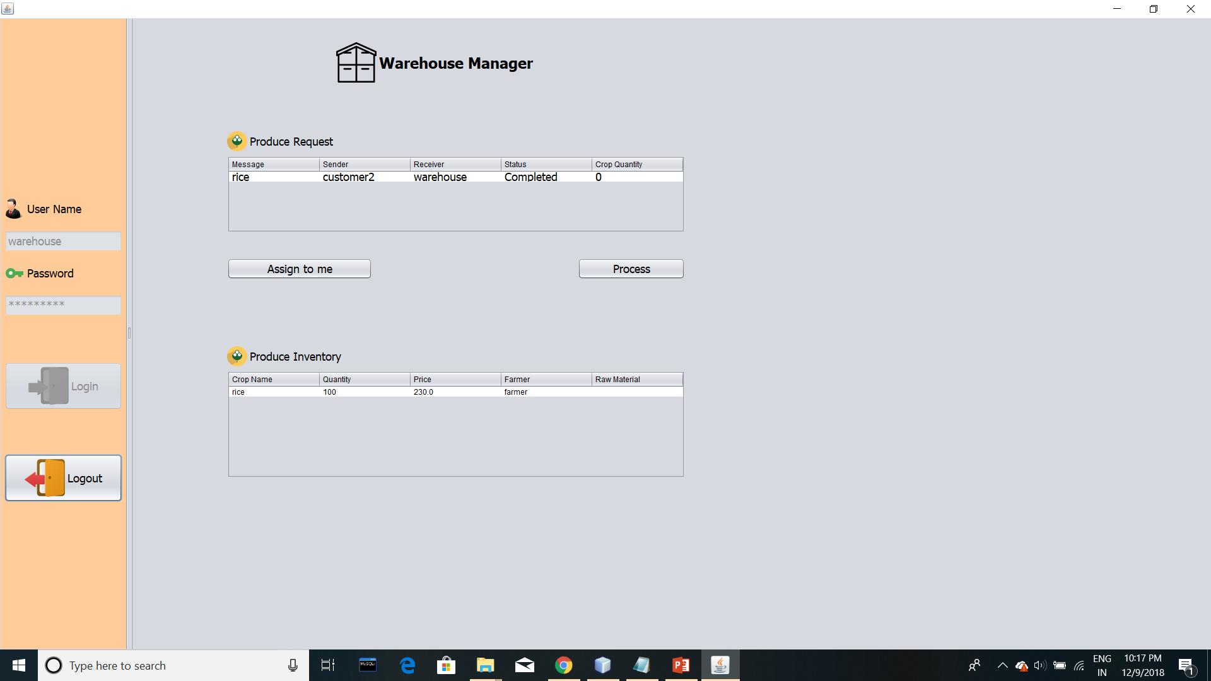

Slide 11
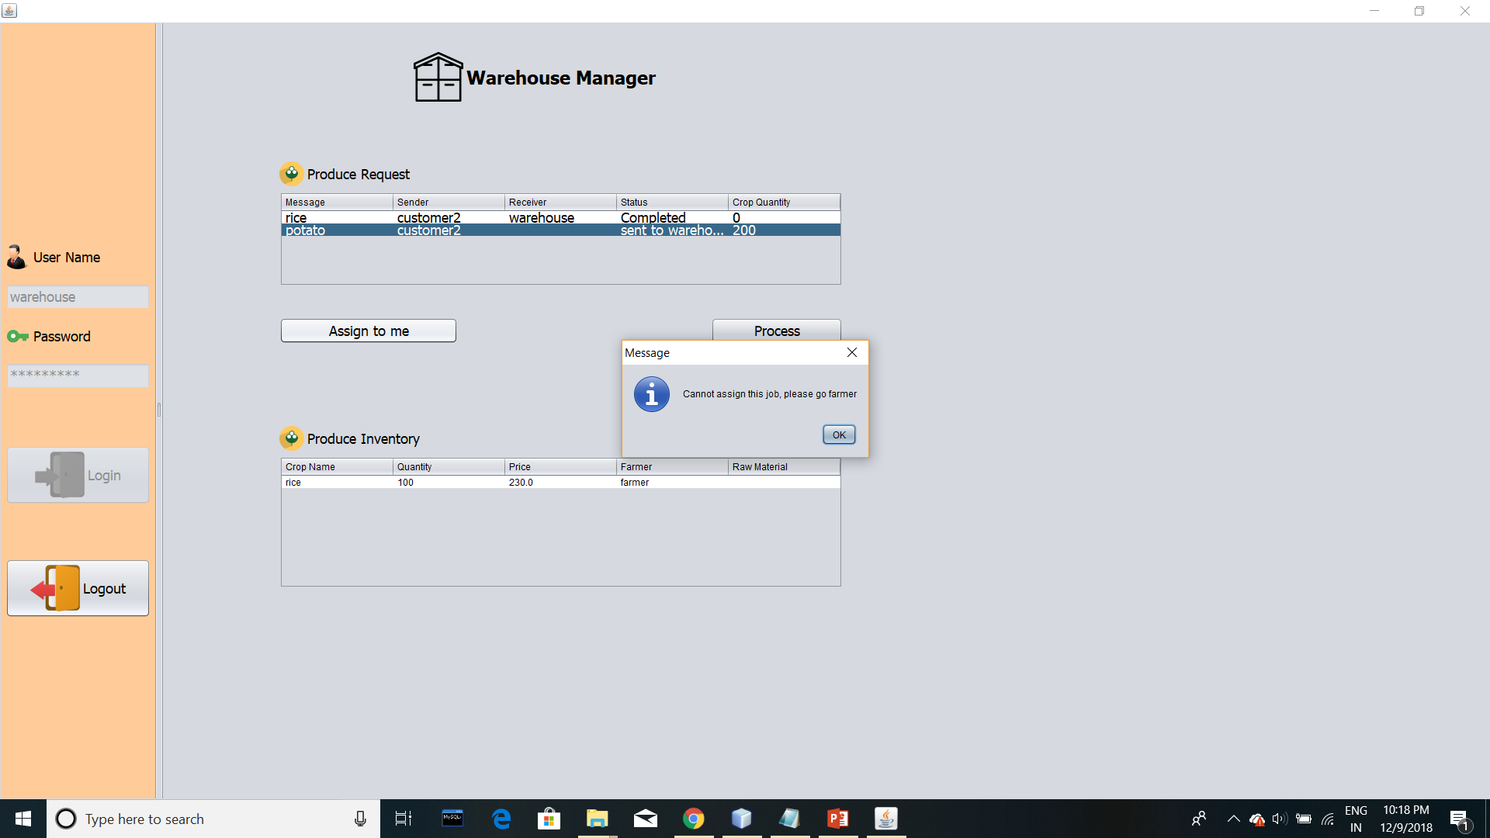

Slide 12


Slide 13
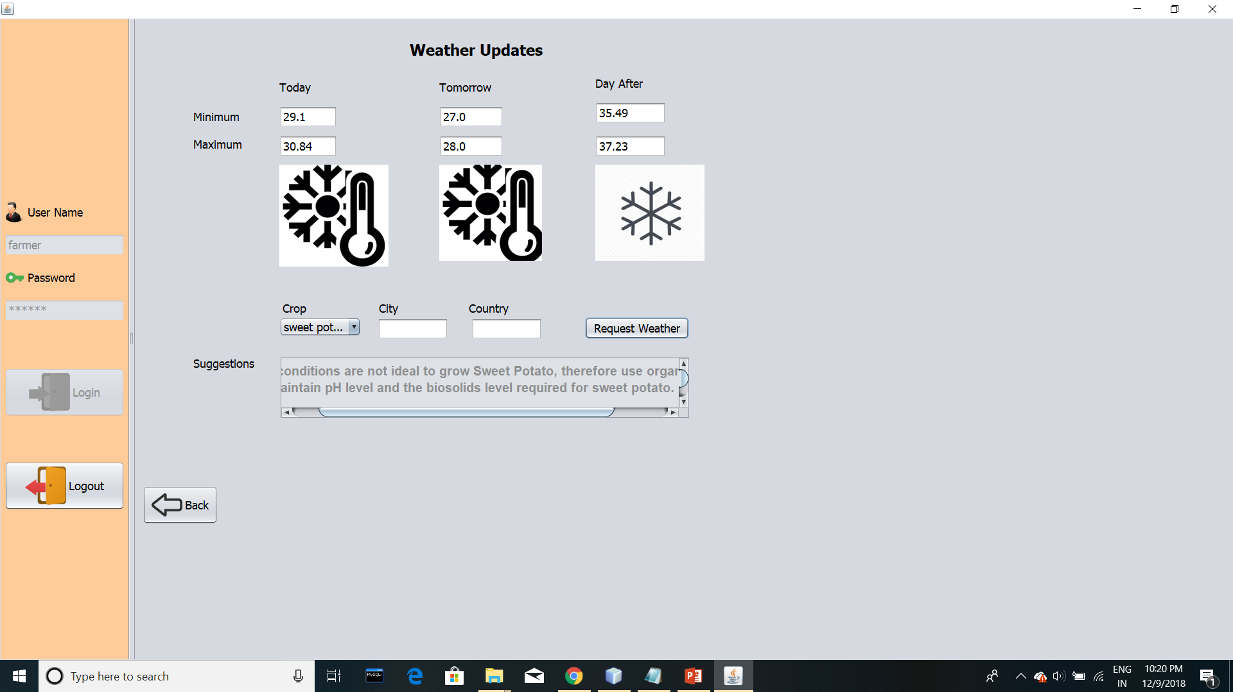

Slide 14
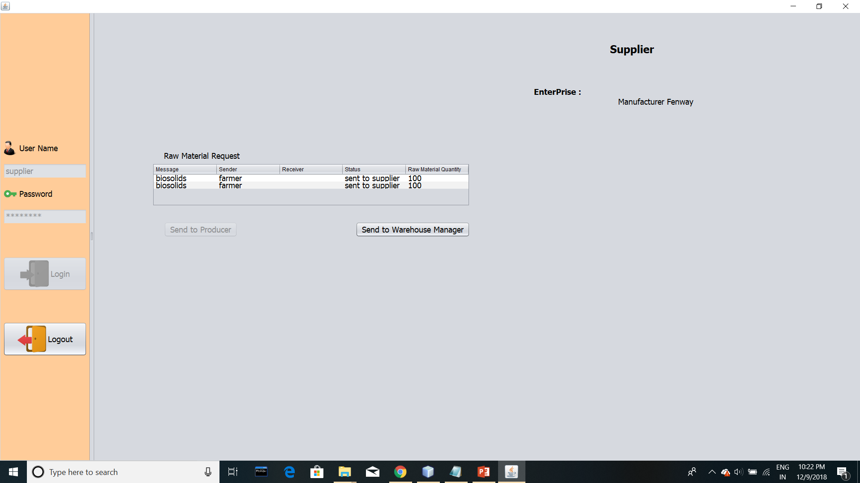

Slide 15
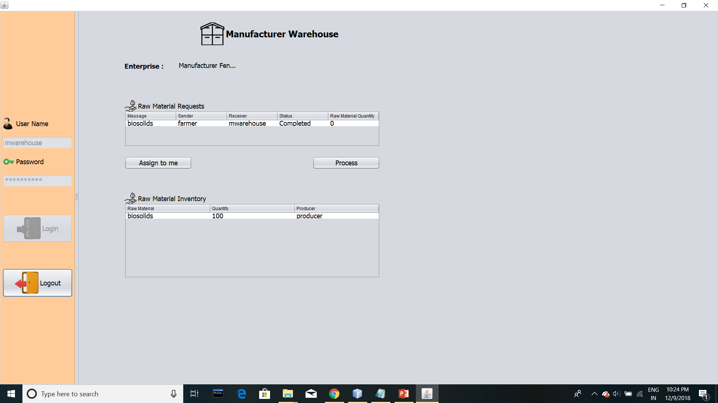

Slide 16
ANY QUESTIONS?

Slide 17
THANK YOU

