Slide 1
Stanford's Distantly Supervised
Slot Filling System
Mihai Surdeanu, Sonal Gupta, John Bauer, David McClosky, Angel X. Chang, Valentin I. Spitkovsky, Christopher D. Manning. Stanford's Distantly-Supervised Slot-Filling System. Proceedings of the TAC-KBP 2011 Workshop, 2011.
Mihai Surdeanu, David McClosky, Julie Tibshirani, John Bauer, Angel X. Chang, Valentin I. Spitkovsky, Christopher D. Manning. A Simple Distant Supervision Approach for the TAC-KBP Slot Filling Task. Proceedings of the TAC-KBP 2010 Workshop, 2010
http://nlp.stanford.edu/software/mimlre.shtml

Slide 2
KBP task definition
Input : name of entity, type(PER/ORG)
  e.g.: Albert Einstein, PER
Output : Attributes of this slot
  e.g.: per:alternate_names: Prof. Einstein, per:date_of_birth: 14 March 1879, per:city_of_birth: Ulm, per:country_of_birth: Germany ….
Slot name
Slot value

Slide 3
Wikipedia info-boxes
<entity wiki_title="Mack_McLarty" type="PER" id="E0004232" name="Mack McLarty">
<facts class="Infobox US Cabinet official">
<fact name="name">Thomas F. "Mack" McLarty III</fact>
<fact name="order">17 th</fact>
<fact name="title"><link>White House Chief of Staff</link></fact>
<fact name="term_start"><link>1993</link></fact>
<fact name="term_end">January, <link>1994</link></fact>
<fact name="predecessor"><link entity_id="E0214786">James Baker</link></fact>
<fact name="successor"><link entity_id="E0076158">Leon Panetta</link></fact>
<fact name="president"><link entity_id="E0100324">Bill Clinton</link></fact>
<fact name="birth_date">June 14, 1946 (1946-06-14) (age 62)</fact>
<fact name="birth_place"><link entity_id="E0600134">Hope</link>, <link entity_id="E0240539">Arkansas</link></fact>
<fact name="party"><link>Democratic</link></fact>
</facts>
<wiki_text><![CDATA[Mack McLarty
Thomas F. "Mack" McLarty III (born June 14, 1946) is a prominent Arkansas
business and political leader and former White House Chief of Staff for US
President Bill Clinton. He is the President of McLarty Associates (his
Washington-based consulting company - see www.maglobal.com), as well as Chief
Executive Officer of the McLarty Companies.
…....................
….....................
]]></wiki_text>
</entity>

Slide 4
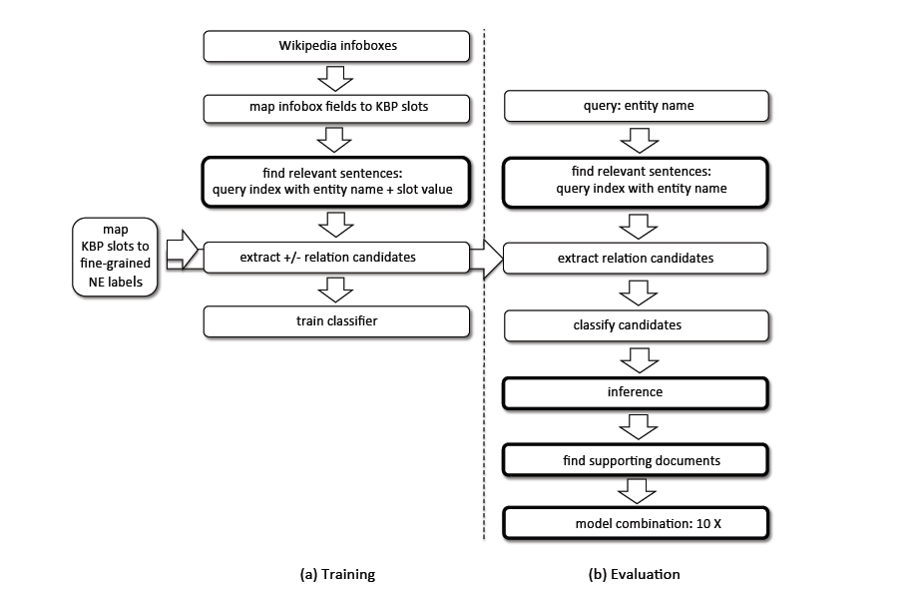
System Architecture

Slide 5
Features
KB file
<entity wiki_title="Asha_Puthli" type="UKN" id="E0007544" name="Asha Puthli">
<facts class="Infobox musical artist">
<fact name="Name">Asha Puthli</fact>
<fact name="Background">solo_singer</fact>
<fact name="Origin"><link>Bombay</link>, <link entity_id="E0031352">India</link></fact>
<fact name="Genre"><link>Jazz</link>,
<link>soul</link>, <link entity_id="E0783192">funk</link>,
<link entity_id="E0668346">pop</link>,
<link entity_id="E0390417">ambient music</link>,
<link entity_id="E0539140">electronica</link>, <link>Indian music</link></fact>
<fact name="Years_active">1970—present</fact>
<fact name="Label">CBS / Sony, Polygram, TK Records, Autobahn Records, Top of the World</fact>
Relation Features used with examples:
  arg_type : arg1type=ENT:PERSON_and_arg2type=COUNTRY
  arg_order :
  full_tree_path : NNP_<-_NP_<-_S_<-_VP_<-_NP_->_NP_->_NNP
  surface_distance_binary : surface_distance_6
  surface_distance_bins : surface_distance_bin_lt10
  adjacent_words : leftarg0-diva rightarg0-, leftarg1-featuring rightarg1--
  entities_between_args : entity_between_args:_MODIFIER
  entity_counts_binary : entity_counts_COUNTRY:_1.0, entity_counts_ENT:PERSON:_1.0, entity_counts_MODIFIER:_1.0, entity_counts_NUMBER:_1.0
  entity_counts_bins : entity_counts_bin1 entity_counts_bin1 entity_counts_bin1 entity_counts_bin1
  span_words_unigrams : span_word:jazz span_word:diva
  dependency_path_lowlevel : _dep->_partmod->_
  dependency_path_words : word_in_dependency_path:bear
Datum file

Slide 6
Implementation details
Sentences are stored in an inverted index which are queried using “entity_name + slot value”
The code to create index file is part of the package
  Input: corpus of documents
  Output: Lucene inverted index of the sentences
The index file is read along with the KB file (slot information) to create datum files
  Pre-processed training data files used as input to the classifiers

