Slide 1
DESIGN PROJECT
TOPIC : PHISHING SITE DETECTION CHROME EXTENSION
Guided By : Miss. Aswathi
Team Members :
Vishnu Prasad A
Devaprasad V
Ajay Prakash Nair

Slide 2

INTRODUCTION
Phishing refers to the act that the attacker lure users to visit a fake website by developing a look alike website, and stealthily get users personal information such as username, password, financial details, account details, national security ID, etc.
The frequently used attack method is to send e-mails, messages, which can cause theft of data or personal information.
For eg. user leak their passwords if an attacker asked them to update via http link sent by them.

Slide 3
WORKS THAT ARE SIMILAR
Use of Machine Learning in Detection of Phishing Websites (March 2019)
Authors : Dr. L.M.R.J. Lobo; Shrinidhi Tapadiya; Sukanya Kondapure; Sachita Navadgi; Shivani Yambal; Rupali Naitam; Pratibha Basate
Web Phishing Detection Using a Deep Learning Framework (2018)
Authors : Ping Yi, Yuxiang Guan, Futai Zou, Yao Yao, Wei Wang, and Ting Zhu
Detection of phishing websites using an efficient feature-based machine learning framework (2018)
Authors : Routhu Srinivasa Rao, Alwyn Roshan Pais

Slide 4

PROPOSED SYSTEM
A browser plugin that aims to detect phishing websites and warn the user.

Slide 5
ISSUES THAT WE SOLVE
Implemented for day to day usage
Browser plugin with ML prediction mechanism
Real time and rapid detection

Slide 6
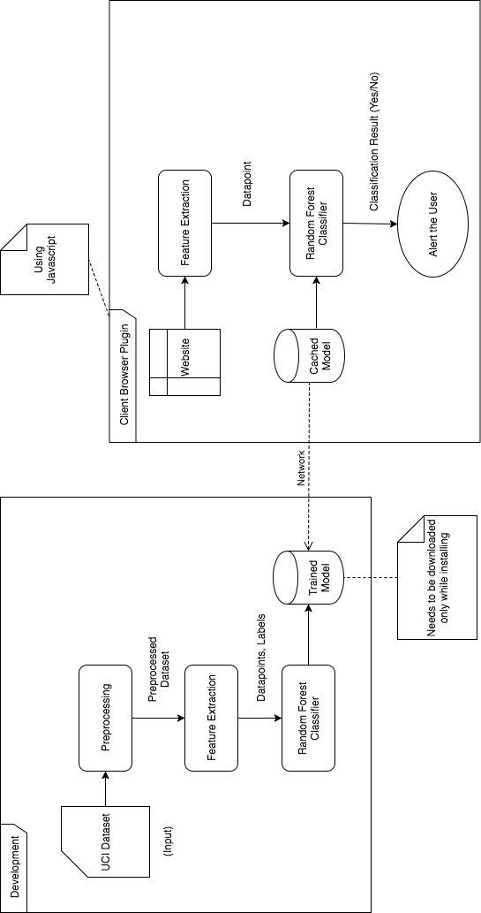
Figure : System Architecture

Slide 7

PREPROCESSING
INPUT : Dataset in arff format (attribute relation ﬁle format)
OUTPUT : Training and testing data in npy format (numpy)
PSEUDOCODE
Start
load dataset into numpy array examine dataset
characteristics split training and test set export to npy file
end

Slide 8
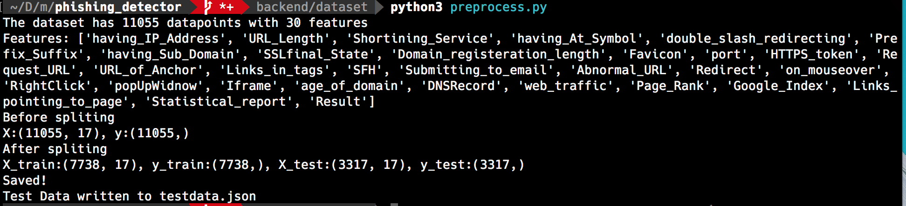
OUTPUT

Slide 9
TRAINING
INPUT : Training and testing data npy format (numpy)
OUTPUT : Trained random forest classiﬁer model
PSEUDOCODE
start
load training set from file calculate cross validation score
train random forest classifier load testing set from file
Calculate f1 score on testing set
end

Slide 10
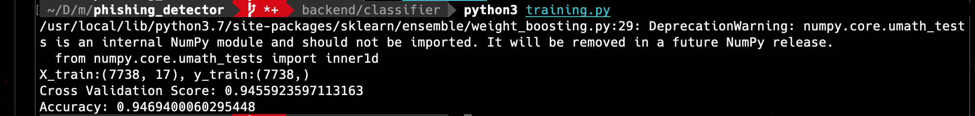
OUTPUT

Slide 11

PLUGIN
INPUT : Website viewed by the user
OUTPUT : Alert/Popup to the user

Slide 12
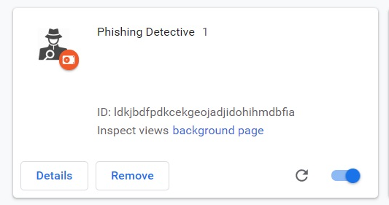
OUTPUT

Slide 13
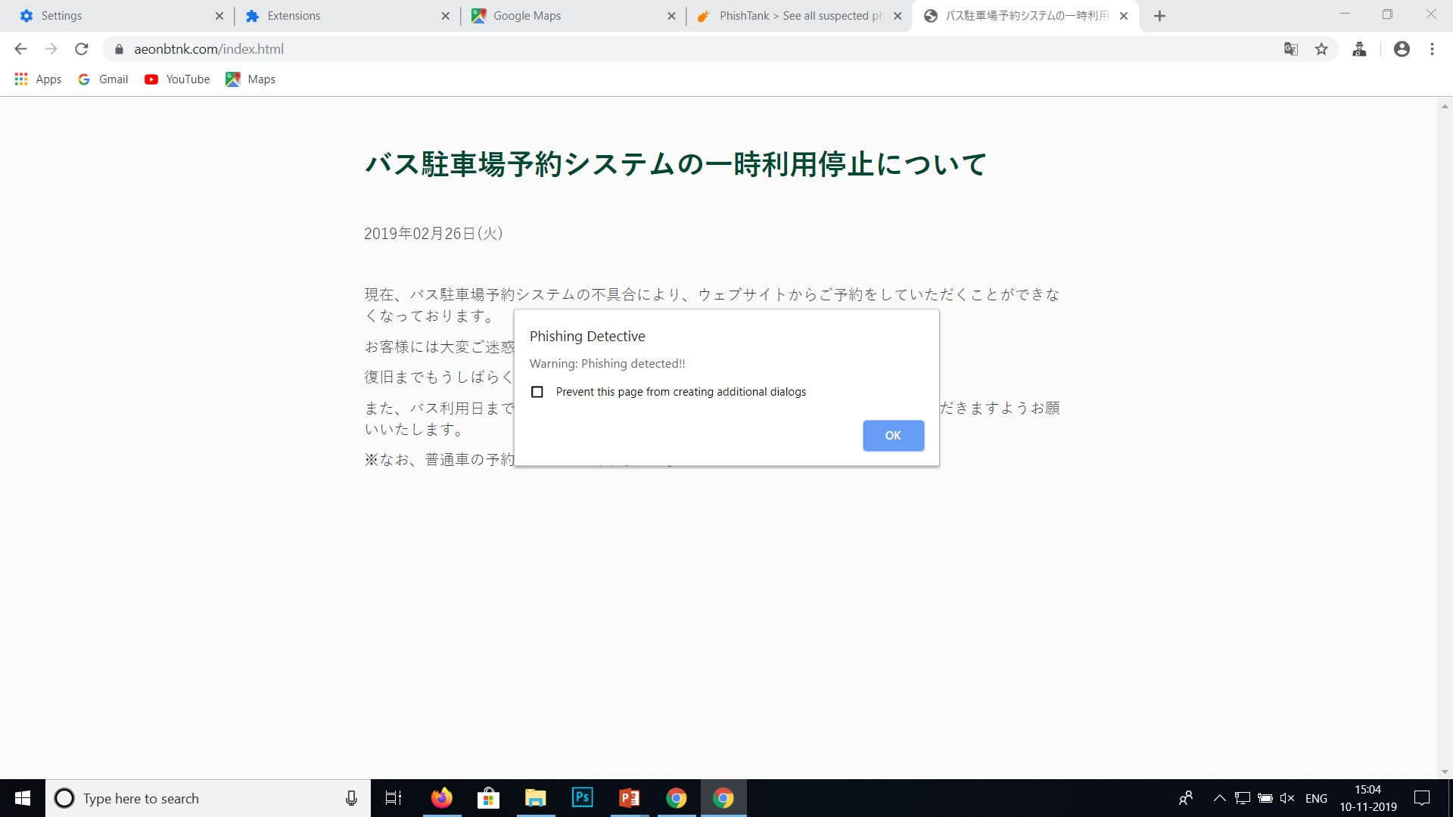

Slide 14
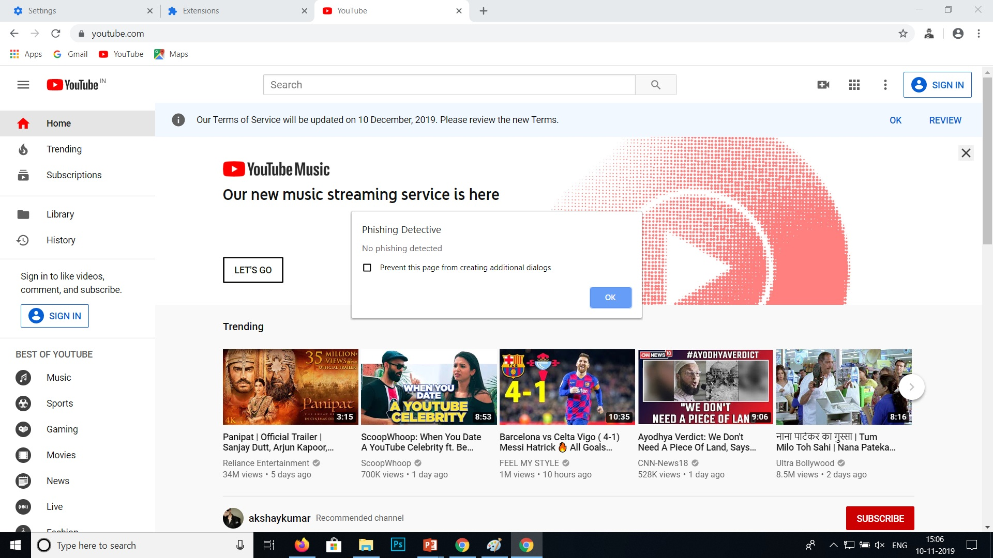

Slide 15
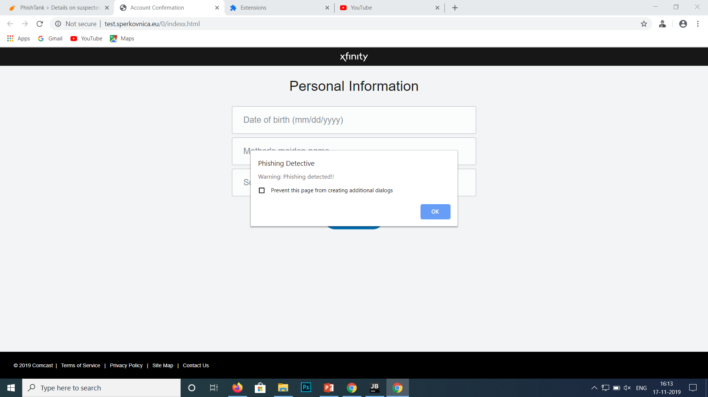

Slide 16
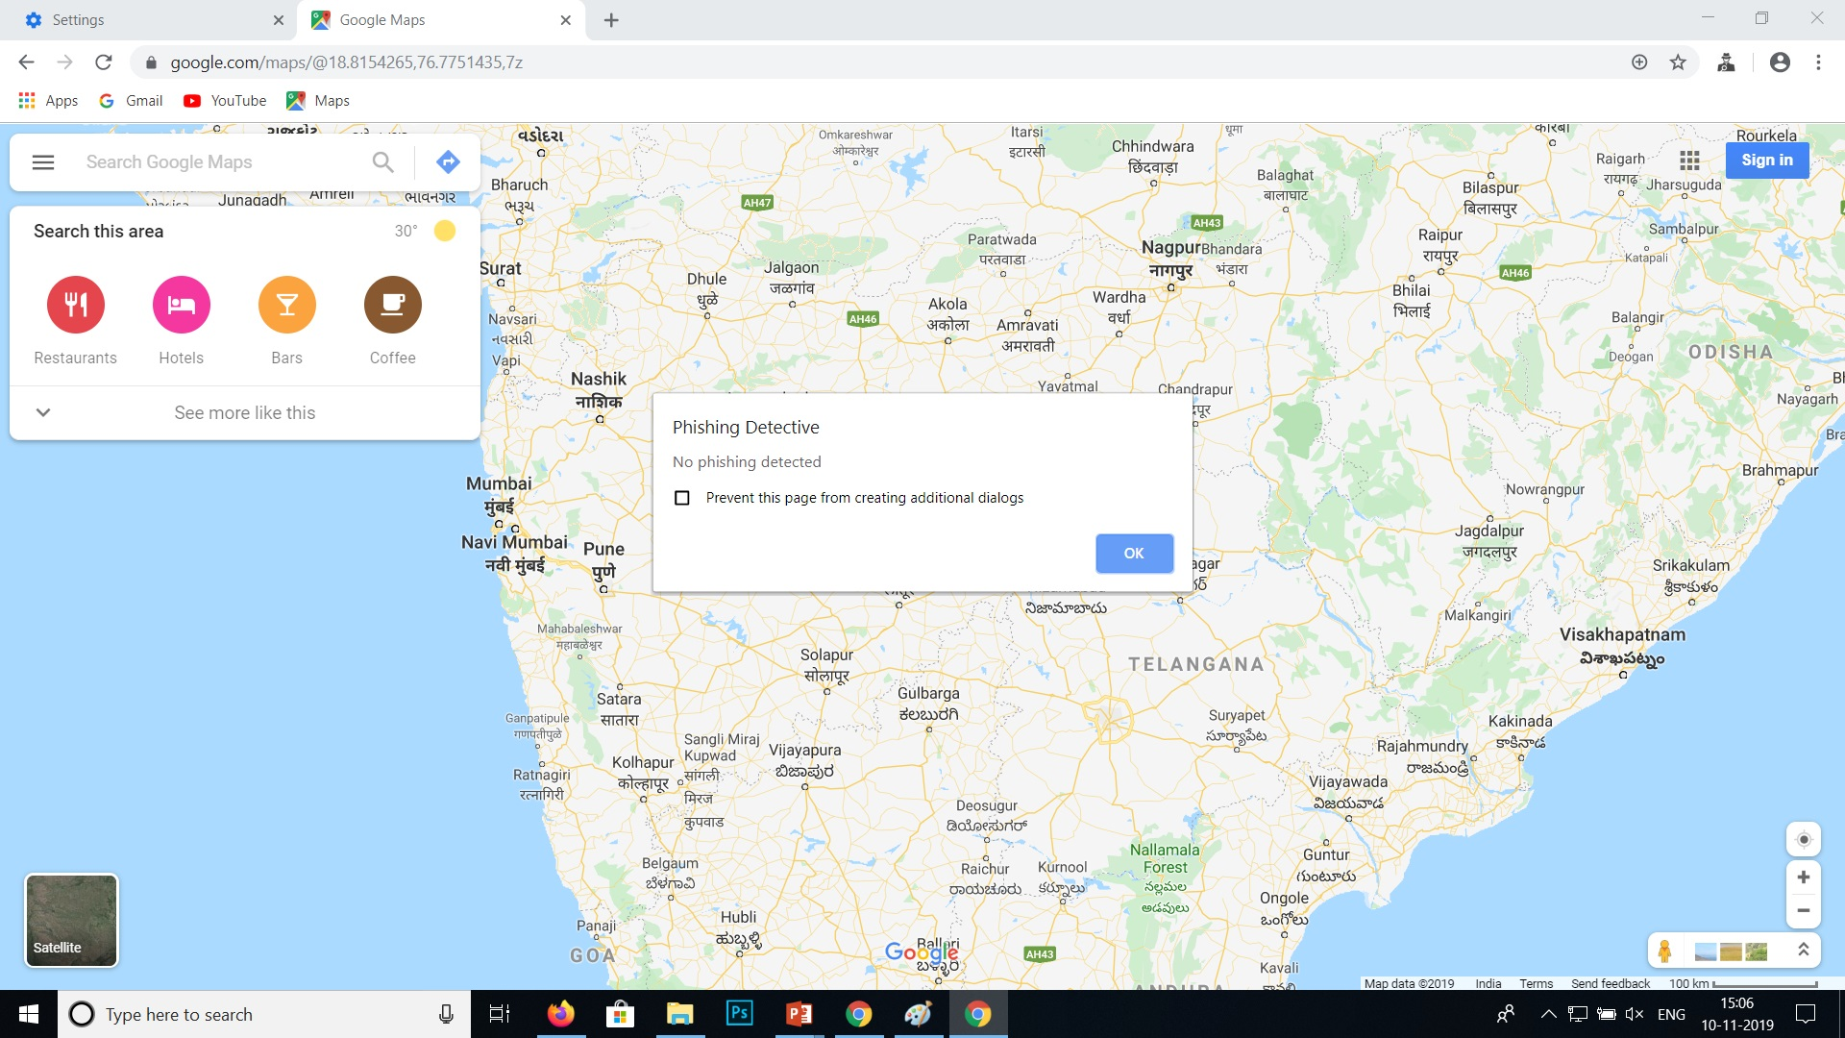

Slide 17
THANK YOU!

