Slide 1
CSE 530 Assignment#1
Hands-on tutorial

Slide 2
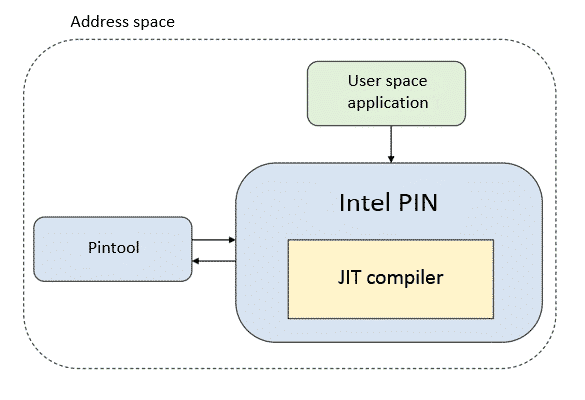
Intel Pin tool
Intel Pin is a dynamic binary instrumentation (DBI) framework that enables the creation of dynamic program analysis tools to perform code analysis of the userspace applications.
The tools created using Pin API are called Pintools. For Pintools development, Intel provides Pin kits that include the source codes for many tools.

Slide 3
Simulator
Init Stage
Parse YAML file passed as input from user
Sanity Check and Memory hierarchy creation
Rd
Wr
Parse Addr
Check if exist in current level
If not available, in current level issue rd to the next level. If available, then read and exist from method.
Write response to the current level
Repeat step ii-iv till you find the data or done walking over all level of cache
Parse Addr
Check if block exist
If block exist, then write in cache. If not, then check if space available and create corresponding block.
If space not available, then evict oldest from the cache and try creating block again.

Slide 4
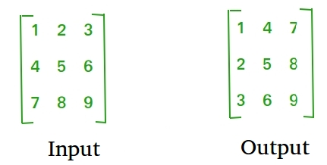
Transpose

Slide 5
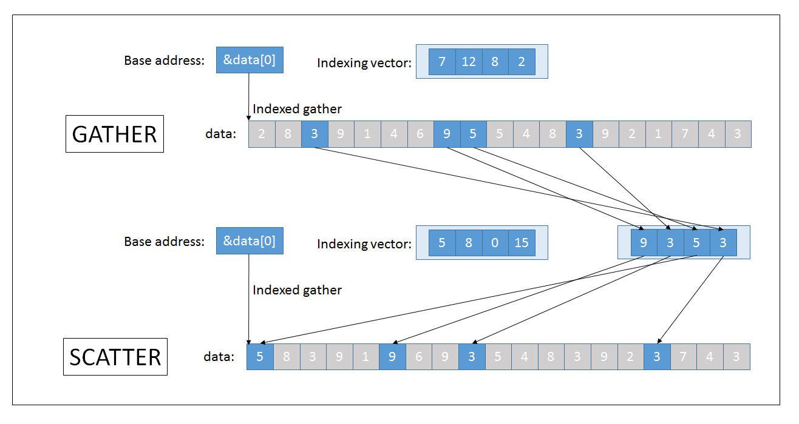
Gather and Scatter operations
Gather – Read data randomly from src tensor
Scatter- Write data in randomly in dst tensor

Slide 6
Reference
https://software.intel.com/content/www/us/en/develop/articles/pin-a-dynamic-binary-instrumentation-tool.html
https://github.com/abhishekk06/CachePerformanceOnMatMul
https://www-users.cs.umn.edu/~hanxx023/dmclass/scatter.pdf

