Slide 1
Airbnb NYC 2019 Data Storytelling & Statistical Validation
ApexPlanet Internship – Task 4
AJAY NATH

Slide 2
Project Objective
• Analyze Airbnb NYC 2019 listings.
• Identify pricing and availability patterns.
• Understand room type distribution.
• Generate business insights through data analysis.

Slide 3
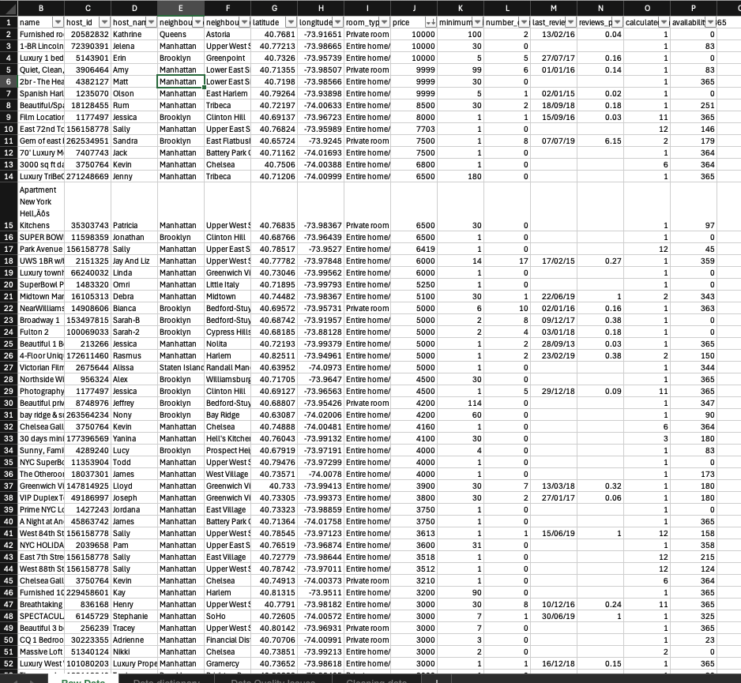
Data Cleaning & Preparation
• Missing values identified and handled.
• Duplicate records checked.
• Outliers analyzed and treated.
• New categories created:
- Price Category
- Availability Category
- Review ActivityTry

Slide 4
Exploratory Data Analysis
Insert:
Listings by Borough chart
Room Type Distribution chart
Key Findings
Manhattan has the highest number of listings.
Entire Home/Apt is the most common room type.

Slide 5
Business Intelligence Analysis
Insert:
Average Price by Room Type
Average Availability by Borough
Key Findings
• Entire Home/Apt has the highest average price.
• Availability varies across boroughs.

Slide 6
Correlation Analysis
Price vs Availability Analysis.
Finding
A weak relationship exists between price and availability.

Slide 7
Deep Dive Analysis
FINDING Segmentation reveals different listing patterns and customer engagement levels.
Notes:
In Slide Show mode, select the arrows to visit links.

Slide 8
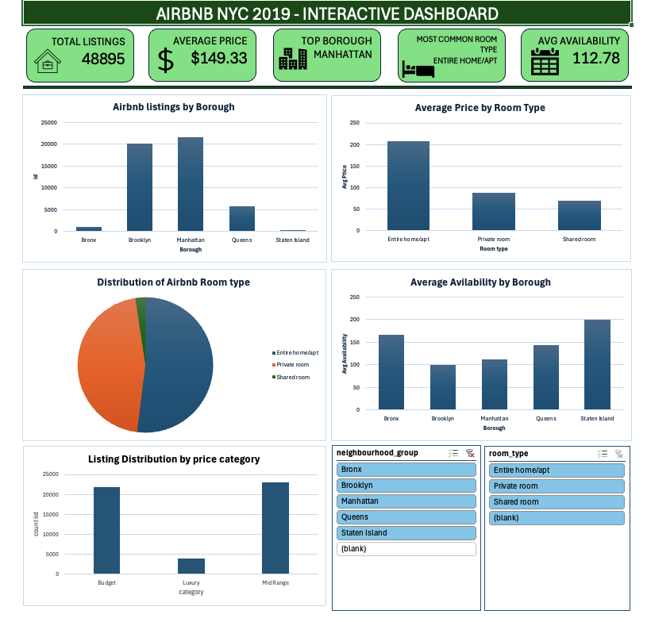
Interactive Dashboard

Slide 9
Hypothesis Testing
H₀ (Null Hypothesis): Average price is the same across all room types.
H₁ (Alternative Hypothesis): Average price differs across room types.
Conclusion
The average price differs significantly across room types. Therefore, room type influences listing price.
Room Type | Average Price
Entire Home/Apt | 207.73
Private Room | 86.28
Shared Room | 70.13

Slide 10
Recommendations & Conclusion
Recommendations
• Focus on high-performing boroughs.
• Optimize pricing based on room type.
• Improve occupancy strategies.
• Use segmentation for targeted decisions.
Conclusion
The project demonstrates how data cleaning, EDA, dashboarding, and segmentation can support data-driven business decisions.

