Slide 1

Automated Requirement Classification
From Technical Specifications
EECE5644: Machine Learning and Pattern Recognition
Final Project
Chittela Ajayanath
ajayanath.c@northeastern.edu

Slide 2
Problem Statement
Technical specs (NVMe, PCIe, CXL) encode a different obligation level in almost every sentence.
MANDATORY ("shall"), PROHIBITED ("shall not"), RECOMMENDED ("should"), OPTIONAL ("may"), INFORMATIVE (prose).
Engineers must separate and type requirements by hand before writing validation tests slow and error-prone.
Goal: automatically (1) extract requirement sentences and (2) classify each by normative modality.
This is the requirement-understanding stage of a larger document-to-code agent.

Slide 3
Pipeline Architecture
End-to-end, reproducible pipeline:
parse → segment → filter → weakly label → split → train → evaluate.
Stage 1: Document understanding: Docling → structured Markdown/JSON with section headers, page provenance, and block type.
Stage 2: Requirement classification: two model families trained and evaluated on identical stratified splits and metrics.
One command regenerates every metric and figure; nothing between the raw PDF and the reported numbers is hand-edited.
Modular design mirrors a larger “document-to-code” agent; this project delivers its first two stages.

Slide 4
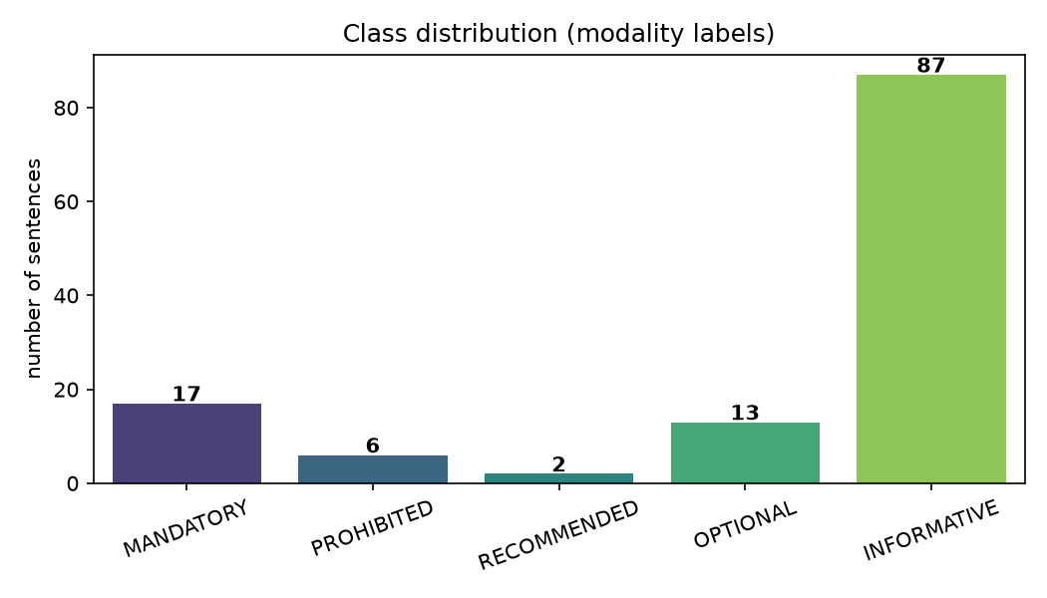
Dataset & Weak Labelling
Source: NVM Express Base Spec, Rev 2.3.
Parsed with Docling sentence records with page & section.
125 labeled sentences.
No gold labels weak supervision from modal keywords.
Realistic, heavy imbalance: INFORMATIVE dominates; RECOMMENDED/PROHIBITED rare.
Stratified train / val / test split.

Slide 5
Weak Supervision Labels Without Gold Data
Specs carry no gold labels → labels come from the document’s own modal language (config.MODALITY_RULES).
Curated, longest-match-first lexicon with explicit precedence:
“shall not” / “may not” matched before “shall” / “may”; word-boundary regex so “may” never fires inside “maybe.”
A standard weak-supervision approach in requirements-engineering NLP scalable, transparent, annotation-free.
Trade-off: some irreducible label noise “may” as permission vs. possibility can be mislabeled.

Slide 6
Data Cleaning & Preprocessing
Keep only Docling body prose (text / paragraph / list_item); drop tables, figures, headers.
Regex sentence segmentation that protects spec abbreviations (e.g., i.e., Fig., No., vol.).
Drop fragments < 15 chars or with no letters (removes numbers & cross-ref debris).
Remove exact-text duplicates before labeling.
Word-boundary label matching: "shall not" before "shall"; "may" doesn't fire inside "maybe".

Slide 7
Feature Engineering
Classical models TF-IDF: sublinear TF, 1–2 grams (captures "shall not", "may not"), accent stripping.
DistilBERT: WordPiece tokenization (max length 128), fine-tuned contextual embeddings.
Interpretable engineered features for EDA:
length, avg word length, digit & acronym counts, negation / cross-ref / modal-cue flags.
Class imbalance handled with class weights (both model families).

Slide 8
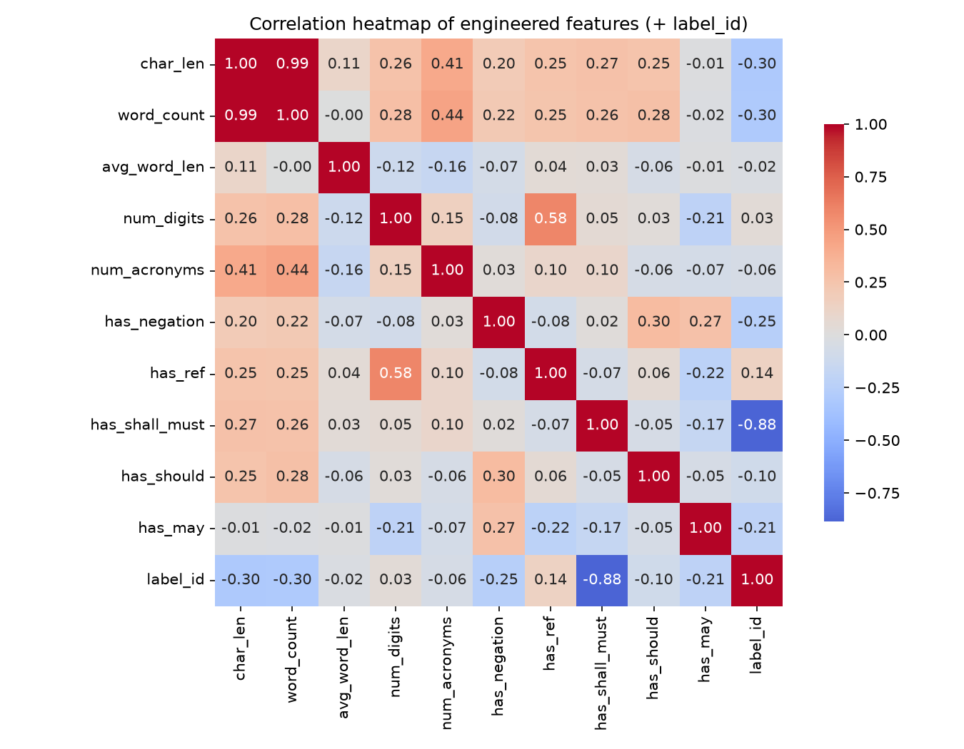
Exploratory Data Analysis
No single surface feature strongly correlates with the label.
Modal-cue flags carry the most signal.
Sentence length distributions overlap across classes.
The class boundary lives in word choice & context, not simple statistics.

Slide 9
Machine Learning Models
Multinomial Naive Bayes generative MAP baseline over TF-IDF counts.
Logistic Regression (TF-IDF) discriminative, balanced, interpretable coefficients.
Linear SVM (TF-IDF) max-margin in high-dimensional sparse space.
DistilBERT 6-layer distilled BERT + linear head, class-weighted cross-entropy loss.
Classical model selected by stratified k-fold CV (macro-F1); DistilBERT by val macro-F1.

Slide 10
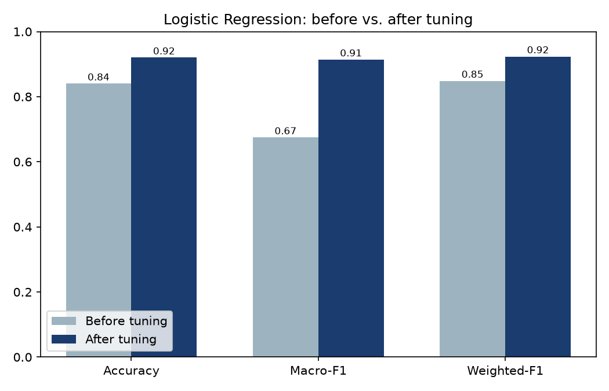
Hyperparameter Tuning
Grid search: 24 combos × 2-fold CV (macro-F1).
Tuned ngram_range, min_df, sublinear_tf, C.
Best: bigrams, min_df=2, sublinear TF, C=1.0.
Test macro-F1 0.67 - 0.91 (+0.24).
Biggest gains: bigrams + sublinear TF scaling.

Slide 11
Evaluation Protocol & Metric Choice
Stratified 80 / val / 20 split (seed 5644); test set (n = 25) is never seen during training or model selection.
Classical models selected by stratified k-fold CV on macro-F1; DistilBERT by best-validation-checkpoint macro-F1.
Headline metric = macro-F1: a majority-only classifier already scores ≈ 0.70 accuracy, so accuracy alone is misleading.
Macro-F1 averages per-class F1 equally → it rewards getting the rare, high-value modalities right.
ROC / PR (one-vs-rest): AUC ≈ 1.0 for well-represented classes; PROHIBITED is low purely from 1-sample support.

Slide 12
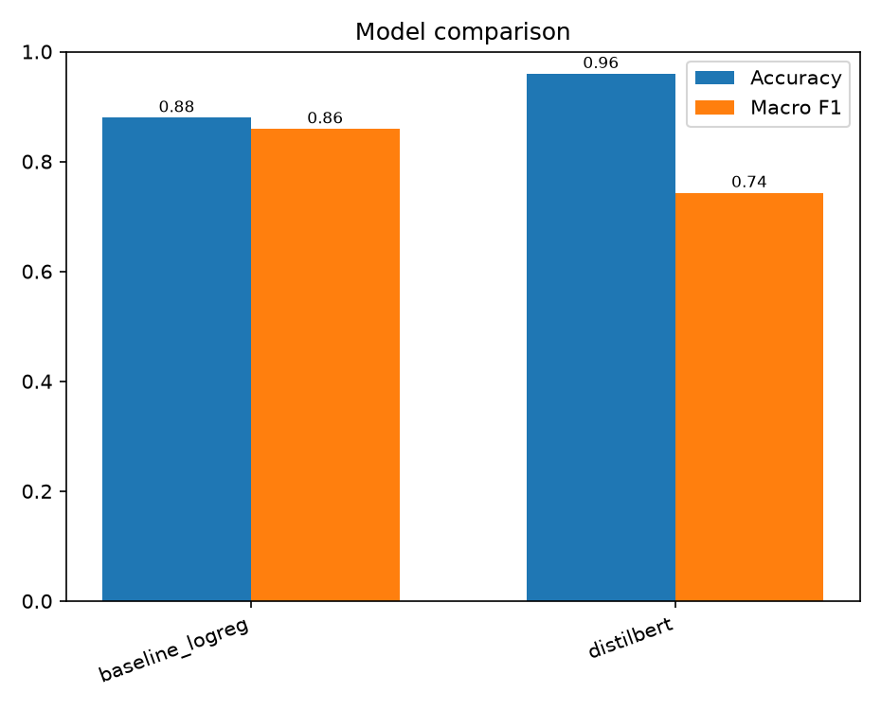
Results Model Comparison
DistilBERT: accuracy 0.96, weighted-F1 0.94.
Tuned LogReg: best macro-F1 0.91.
Majority baseline accuracy ≈ 0.70.
Macro-F1 is the headline metric under imbalance.
Linear model rivals the Transformer on this task.

Slide 13
Why a Linear Model Rivals the Transformer
DistilBERT wins accuracy (0.96) & weighted-F1 (0.94); tuned LogReg wins macro-F1 (0.91) the imbalance metric.
The signal is largely lexical: modal cues (“shall”, “may not”) are near-linearly separable in TF-IDF space.
DistilBERT’s lower macro-F1 (0.74) comes almost entirely from the 1-sample PROHIBITED class variance, not capacity.
Masking ablation: both stay above the 0.70 baseline with the trigger hidden → real context use, not keyword lookup.
Practical read: prefer the interpretable linear model here; revisit the Transformer as rare-class data grows.

Slide 14
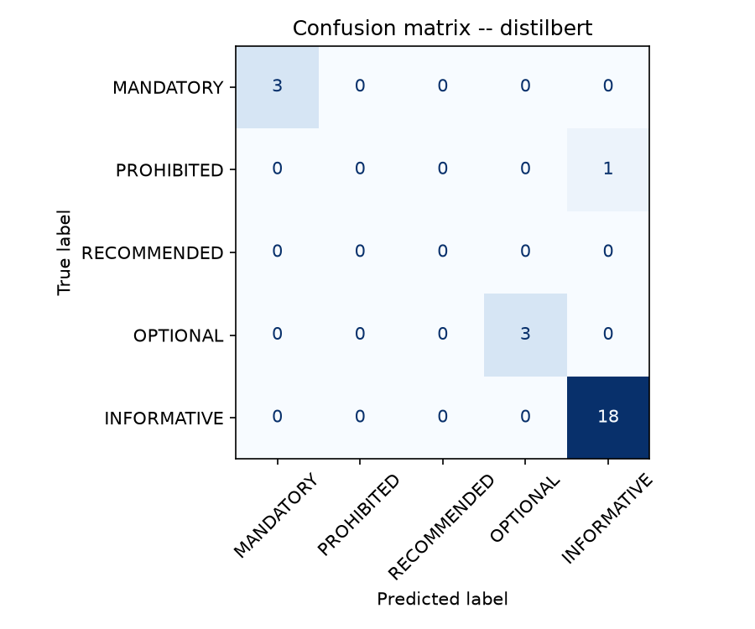
Results Error Analysis
Perfect on MANDATORY & OPTIONAL (P=R=1.00).
INFORMATIVE F1 ≈ 0.97.
Errors sit in PROHIBITED (1 test sample) & RECOMMENDED (0).
Data-scarcity artifact, not a systematic weakness.
Critical error (dropping a real requirement) is minimized: MANDATORY recall = 1.00.

Slide 15
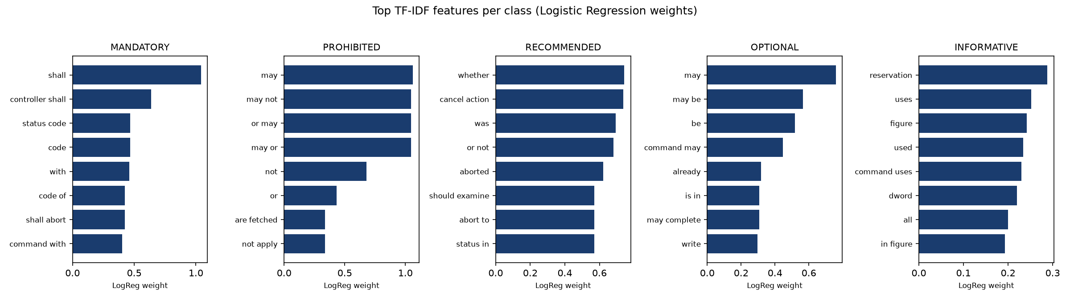
Feature Importance & Learning Curve
Top terms per class are intuitive:
MANDATORY: "shall", "controller shall".
OPTIONAL/PROHIBITED: "may", "may not".
Generic nouns & "figure"/"section" ≈ zero weight.
Learning curve still rising - more data would help.

Slide 16
Do the Models Learn Meaning, or Just Keywords
Ablation: blank the modal trigger word and re-evaluate.
Logistic Regression accuracy: 0.88 (full) - 0.80 (masked).
DistilBERT accuracy: 0.96 (full) - 0.80 (masked).
Both stay above the 0.70 majority baseline with the keyword hidden.
The models use sentence context, not a keyword lookup.

Slide 17
Challenges & Lessons Learned
Extreme class imbalance with only 0–2 samples for the rarest classes on the test set.
Weak labels are noisy "may" as permission vs. possibility can be mislabeled.
Tiny test set makes macro-F1 high-variance.
Lesson: a well-tuned linear model can match a Transformer on small, imbalanced text.
Lesson: data volume for rare classes not model capacity is the real bottleneck.

Slide 18
Real-World Use & Future Work
Use: feed a document-to-code agent typed requirements → test plans, traceability, coverage.
Beneficiaries: firmware/hardware validation, compliance, and technical-writing teams.
Future: expand corpus & add more standards (learning curve still climbing).
Future: build a human-verified gold test set to remove weak-label noise.
Future: add downstream requirement - test-case generation; confidence calibration for human-in-the-loop.

Slide 19
Thank You
https://github.com/ajaynathch/requirement_doc_parser

