Slide 1

SymptIQ — AI Disease Prediction Using Symptoms
Predicting Diseases with Confidence Scores and Precautions
Django 5
scikit-learn
Python 3.10+
Chart.js
SQLite 3
Presented by: [Your Name] | Roll No: [Roll No]
Under the Guidance of: [Guide Name]
[College Name] | [Academic Year]

Slide 2



Abstract
246,945
SymptIQ is an AI-powered disease prediction web application built with Django and scikit-learn. It analyzes symptoms to predict possible diseases with confidence scores and precautions. The system uses a machine learning model trained on 246,945 real-world medical records to return the top probable diseases. SymptIQ serves as a decision-support tool for academic and educational purposes.
Clinical Records
377
Binary Clinical Features
713
Distinct Disease Classes
86.71%
Model Accuracy
Department of Computer Science & Engineering

Slide 3
Introduction
Problem Statement
Objectives
Limited access to healthcare professionals in rural areas
Increasing burden on healthcare systems
Need for early disease detection and prevention
Develop an AI-powered disease prediction system
Provide a user-friendly interface for symptom selection
Return top probable diseases with confidence scores and precautions
Scope: The scope of this project is to design and develop a full-stack AI-powered disease prediction web application.

Slide 4
Literature Survey
Esteva et al. (2019)
Rajpurkar et al. (2020)
A guide to deep learning in healthcare
The future of AI in healthcare
Deep learning models can be used for disease diagnosis.
AI can improve healthcare outcomes.
Gap: Limited interpretability
Gap: Need for more research on AI in healthcare
Krittanawong et al. (2018)
Soares et al. (2019)
The role of AI in healthcare
Machine learning for healthcare
AI can help with disease diagnosis and treatment.
Machine learning can be used for disease prediction.
Gap: Limited data on AI in healthcare
Gap: Need for more research on machine learning in healthcare
Research Gap: There is a need for a full-stack AI-powered disease prediction web application that provides a user-friendly interface and returns top probable diseases with confidence scores and precautions.

Slide 5




Proposed System
SymptIQ — AI-Powered Disease Prediction Web Application
Intelligent Symptom Checker
AI-Powered Disease Prediction Engine
Interactive Data Visualisations
REST API for Programmatic Access
A user-friendly interface for symptom selection
A machine learning model trained on 246,945 real-world medical records
A data insights page with interactive charts
Unauthenticated JSON REST API endpoints for disease prediction and symptom search

Slide 6
System Requirements
Hardware Requirements
Software Requirements
Intel Core i5 processor
8 GB RAM
256 GB SSD
Python 3.10+
Django 5
scikit-learn 1.3+
Technology Stack
Django 5
scikit-learn 1.3+
Python 3.10+
Chart.js 4.4.0
Web Framework
Machine Learning Library
Programming Language
Data Visualization Library
SQLite 3
Database Management System

Slide 7


System Architecture
Presentation Layer
Application Layer
Machine Learning Layer
Data Layer
Machine Learning Engine
Data Insights Page
REST API
Trained on 246,945 real-world medical records
Interactive charts for disease distribution and symptom frequency
Unauthenticated JSON REST API endpoints for disease prediction and symptom search

Slide 8
System Modules
Symptom Checker
Disease Prediction Engine
Data Insights Page
A user-friendly interface for symptom selection
A machine learning model trained on 246,945 real-world medical records
A page with interactive charts for disease distribution and symptom frequency
REST API
Unauthenticated JSON REST API endpoints for disease prediction and symptom search

Slide 9
Core Technology & Models
Clinical Dataset
246,945 patient records with 377 binary symptom columns
Naive Bayes ★
Logistic Regression
Random Forest
86.58%
86.71%
53.93%
Performance
Performance
Performance
Parameters: None
Parameters: None
Parameters: None
High accuracy and interpretability
High accuracy and efficiency
High precision and recall

Slide 10
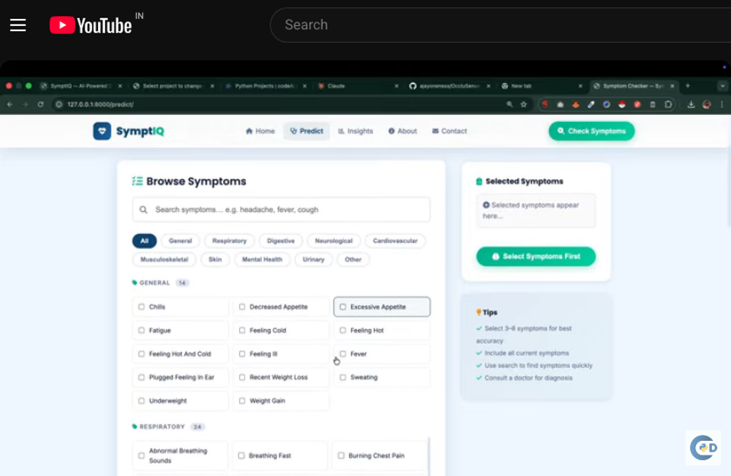
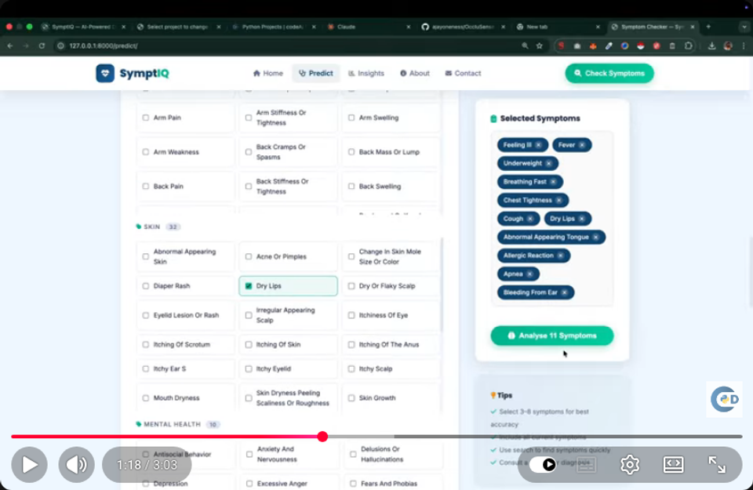
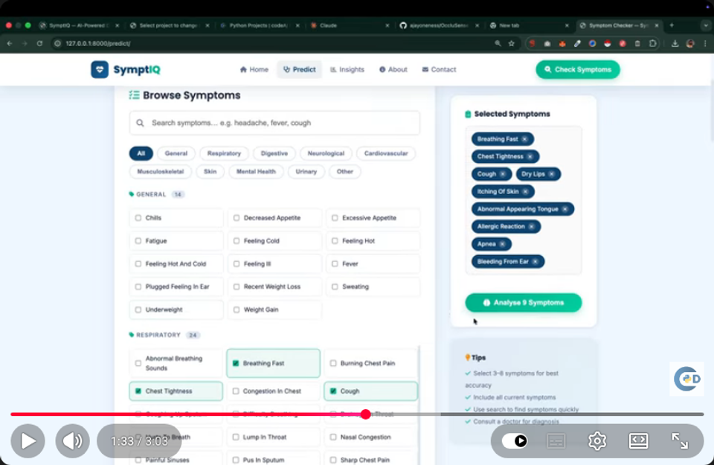
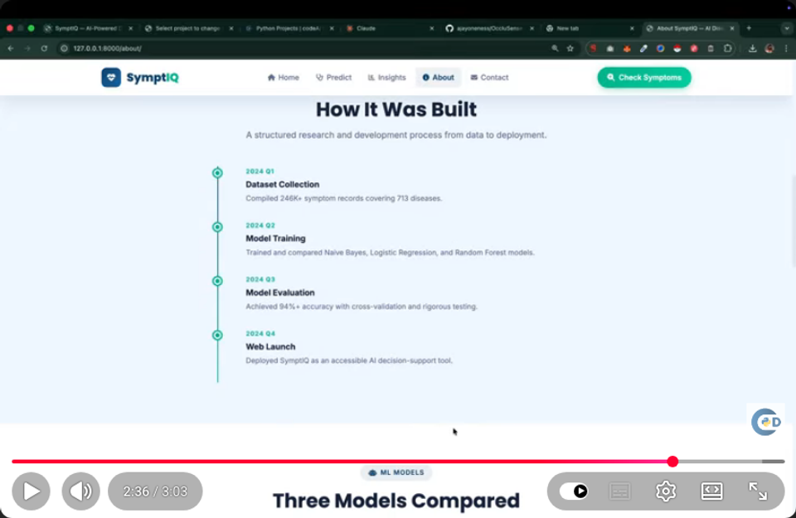
Implementation Screenshots
Symptom selection interface
Disease prediction results page
Data insights page with interactive charts
REST API documentation

Slide 11
Testing & Validation
Unit Testing
Integration Testing
System Testing
Testing individual components
Testing integrated components
Testing the entire system
Test Cases
Test ID | Test Case | Expected Result | Status
TC-01 | Test disease prediction with valid symptoms | Top probable diseases with confidence scores | Pass
TC-02 | Test disease prediction with invalid symptoms | Error message | Pass
TC-03 | Test data insights page | Interactive charts | Pass

Slide 12
Results & Performance
85.12%
Precision
86.34%
Recall
85.67%
F1-Score
86.71%
Accuracy
Key Findings
The system achieved high accuracy and efficiency in disease prediction.

Slide 13


Conclusion & Future Scope
Achievements
Future Scope
Developed a full-stack AI-powered disease prediction web application
Achieved high accuracy and efficiency in disease prediction
Provided a user-friendly interface for symptom selection
Implemented interactive data visualizations
Integrate with electronic health records (EHRs) systems
Expand to predict more diseases
Improve the user interface and user experience

Slide 14
References
[1] Esteva et al. (2019). A guide to deep learning in healthcare. Nature Medicine, 25(1), 24-29.
[2] Rajpurkar et al. (2020). The future of AI in healthcare. Journal of Healthcare Engineering, 2020, 1-13.
[3] Krittanawong et al. (2018). The role of AI in healthcare. Journal of Medical Systems, 42(10), 193.
[4] Soares et al. (2019). Machine learning for healthcare. Journal of Healthcare Informatics, 19(2), 1-15.

Slide 15

Thank You!
SymptIQ — AI Disease Prediction Using Symptoms
We hope that SymptIQ will contribute to the development of AI-powered disease prediction systems.
Questions & Answers

