Slide 1
AI/ML Challenge @ Algorithms Summit 2024

Slide 2
Outline
What is this Challenge about?
Rakino Case Study
Logistics to Get Started
Baseline Walkthrough
Evaluation Criteria
Deliverables

Slide 3
What is this Challenge about?
Majority of ASIC development time is spent in Design Verification (DV)
DV Engineers spend majority (35% - 45%) of their time debugging failures
Debugging is mostly a manual process today
Makes quantifying DV effort and planning future projects very difficult
Anything we can do to optimize debugging effort is a huge win!
Source: https://blogs.sw.siemens.com/verificationhorizons/2022/12/12/part-8-the-2022-wilson-research-group-functional-verification-study/

Slide 4
Typical DV Debug Process
Regression failures
Manual simulation log (VIP logs, tool logs, CPU traces, etc.) analysis
Best guess high ROI failure(s)
Waveform analysis, HW/SW co-debug
Design and TB code commits
Arrive at root cause of failure (could be design or testbench)
Validate findings
100s/1000s of failures in a regression – where to start?
Manual effort intensive, iterative and interactive process
Multiple data sources, potentially big log (text) files, waveforms, data management/revision control information, etc.
Comparison with known good simulations or regression differential
Design and testbench environment peculiarities

Slide 5
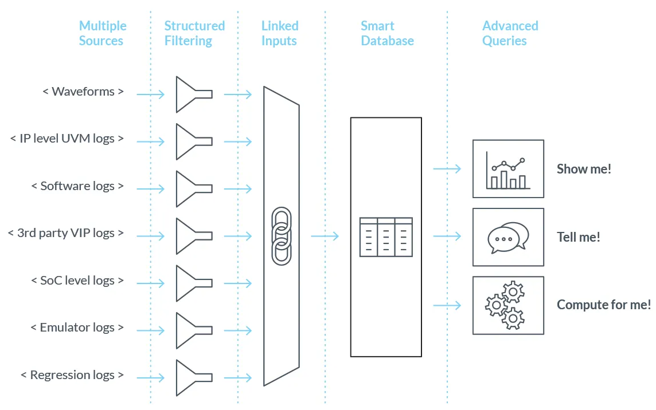

What can AI/ML aided DV Debug Triaging look like?
Automate efficient & simultaneous analysis of multiple, multi-modal input sources (regression outputs)
First step is to provide “intelligent” failure binning
Minimize manual intervention, allow DV engineer to focus on more important tasks
Can we build a smart database from various sources that the DV engineer can query?
Source: vtool Cogita Pro | https://www.thevtool.com/product/
Focus of this challenge:
Binning/clustering large log files

Slide 6
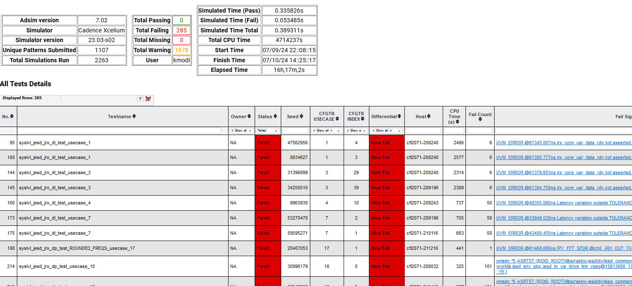
Rakino Case Study | Regressions
The Rakino design verification has tests with randomized design configuration objects.
Every night, these tests are run multiple times with randomization to result in regression runs with 1000+ sims.
Here’s one regression report with 1978 simulations, out of which 285 failed.
A DV engineer’s challenge is to weed through the log files, rerun the failing simulations with waves for debug, and root-cause the failure.
Such regressions generate thousands of log files daily with a mix of passing and failing simulations.

Slide 7
Rakino Case Study | Log files
Each log file could be about 30,000 lines or even more.
If the log file has “CKRSLT Info - Fail” towards the end, the test failed, otherwise the test passed.
The simulation logs have a lot of noise/text not relevant to the test’s passing or failing. The challenge participant will need to figure out what’s considered as noise.
Tip: Lines that begin with a white-space directly followed by “INFO”, “WARNING”, or “ERROR” can be ignored.
Here’s the general structure of a log file:
The simulation command used to run that test; begins with “xrun”.
Debug prints from scripts that set up forces on different parts of the design.
Simulation starts at the “xcelium> run” point.
From there, messages from the test will be of the format “<whitespace> UVM_xxxx @ <time stamp> <message>”. The <message> could be single-line, multi-line or even a table.
Simulation ends at the “--- UVM Report Summary ---” point.

Slide 8


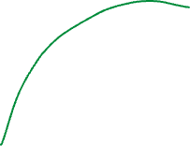

Big Picture
Parsing
Clustering
mlchallenge_labels.csv
fname | label | Pass/ Fail
a.log | 1 | Pass
b.log | 2 | Pass
c.log | 1 | Fail
m
Recall: If the log file has “CKRSLT Info - Fail” towards the end, the test failed, otherwise the test passed.
Parsing
Clustering
your_submission.csv

Slide 9
Logistics to Get Started
Please refer to the repository README to:
Install python dependencies
Download data
Go through a simple baseline for the challenge
Participating in teams of 2 or 3 people is highly encouraged
Many open questions to address
Parsing/chunking/embedding
Labeling feedback

Slide 10
On the Baseline
Check scripts/embed_mlchallenge_data.py
Check notebooks/simple_baseline.ipynb
Parsing
Clustering
your_submission.csv

Slide 11
On the Baseline
The baseline implements the following steps to bin/cluster the log files:
Embed log files into an embedding space (see here for more details on embeddings). Each log file is represented by a list of floating-point numbers.
Use/learn/Design a similarity metric/function that quantifies how similar two log files are, given their embeddings (e.g., Euclidean distance).
Employ the similarity values obtained from (2.) to cluster (e.g., using spectral clustering) the log files into clusters that ideally would correspond to common root causes
There are several ways to go about (1.) either because of its technical challenges or the nature of the text to be embedded (see here for more details embedding textual data)

Slide 12
Evaluation Criteria
This year’s challenge fits unsupervised learning framework
There are no ground truth clustering labels
Except for a set of noisy labels obtained by clustering structured SW log files.
By noisy, we mean the clustering is deemed OK by the DV engineer but it is not perfect.
We are releasing a subset of these labels to help participants get some feedback on their clustering.
We will use the full set of noisy labels to evaluate and grade the submissions quantitatively
Besides obtaining acceptable clustering metrics values w.r.t the noisy labels, we strongly encourage submissions that exhibit:
Explainability: a framework that explains the clustering decisions it makes. E.g., pointing to the chunk of text that makes two log files have the same cluster (the main root cause of failure)
Reusability: a framework that is general and can be applied to another set of log files with minimal changes/tuning.
Scalability: a framework that scales gracefully as data grows (ie., beyond the 700 log files that we consider for this challenge).
Interactivity: framework that improves as DV engineers provide feedback on which log files should be binned together, which shouldn’t. Participants can simulate this concept with the provided noisy labels (i.e., start with clustering log files without any initialization of labels, then provide a subset of noisy labels iteratively to see if the framework converges to the full set of noisy labels)

Slide 13
Deliverables
A CSV file (labels for each log file)
A link to the code repository
A document describing the proposed solution
Format: PPT, short recording
Accuracy is the not the only criterion
Explainability
Interactivity
Scalability
Interactivity

