Slide 1
CS –673 Mid Term Project
Analyzing New York City Data Instructor: Anthony Escalona
Team Members
AJAY PODENDLA
DEEPIKA DHANAVEL
PAVANKALYAN SUDAGANI
GNANA PRASUNA

Slide 2
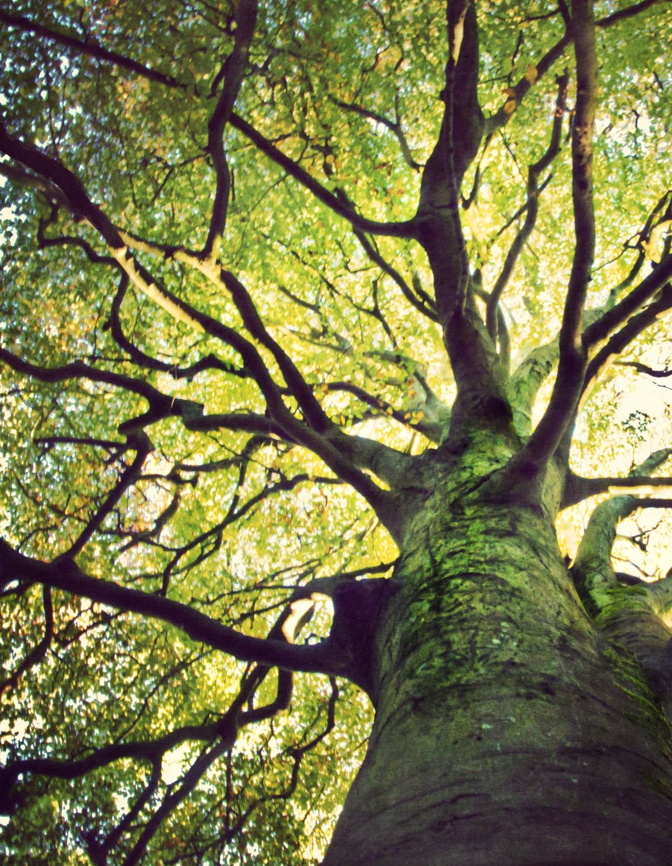
Objective of the project
Our objective of this project is to find the top 10 tree species in Newyork and their health status
We also provide a geographical view of these trees health with the help of their locations(latitude and longitude)

Slide 3
Data processing
We took 2005 and 2015 trees data set from new york
We also took nyyb to find location of these trees for graphical representation
We used pandas mostly for processing and cleaning the data

Slide 4
We first filter the data by removing the unwanted data and changing the status of tree to dead if its not alive and changing the common species name to title.
Then we only took 7 columns which are helpful to us('tree_dbh', 'status', 'health', 'spc_common', 'boroname', 'Latitude', 'longitude')

Slide 5
 | species | proportion
0 | London Planetree | 0.133423
1 | Honeylocust | 0.098539
2 | Callery Pear | 0.090362
3 | Pin Oak | 0.081551
4 | Norway Maple | 0.052424
5 | Littleleaf Linden | 0.045605
6 | Cherry | 0.044895
7 | Japanese Zelkova | 0.044863
8 | Ginkgo | 0.032237
9 | Sophora | 0.029652
We normalize the data and took top 10 tree species and there proportion

Slide 6
species | proportion
0 | LONDON PLANETREE | 0.151136
1 | MAPLE, NORWAY | 0.126139
2 | PEAR, CALLERY | 0.107353
3 | HONEYLOCUST | 0.088105
4 | OAK, PIN | 0.074100
5 | LINDEN, LITTLE LEAF | 0.046700
6 | ASH, GREEN | 0.034816
7 | MAPLE, RED | 0.03419
We did the same thing to the other data set from 2005 and we got these results
If we compare both of these you can see that from 2005 to 2015 the proportion of trees had been decreasing day by day

Slide 7
 | THE_GEOM | BOROCODE e | BORONAME | SHAPE_LENG | SHAPE_AREA
0 | MULTIPOLYGON (((-74.05050806403247 40.56642203... | 5 | Staten Island | 325917.353950 | 1.623621e+09
1 | MULTIPOLYGON (((-73.89680883223778 40.79580844... | 2 | Bronx | 463179.772813 | 1.187175e+09
2 | MULTIPOLYGON (((-73.82644661516991 40.59052744... | 4 | Queens | 888199.730955 | 3.041419e+09
3 | MULTIPOLYGON (((-74.01092841268026 40.68449147... | 1 | Manhattan | 357713.308660 | 6.365205e+08
4 | MULTIPOLYGON (((-73.86327471071958 40.58387684... | 3 | Brooklyn | 728148.532410 | 1.934138e+09
We took the nybb dataset and see the proportion of the tree rate is new york in different places and these are the results.
We define them by colors by which one could easily understand.
These are the results
{'Staten Island': 'red', 'Bronx': 'green', 'Queens': 'orange', 'Manhattan': 'blue', 'Brooklyn': 'pink'}

Slide 8
Problems occurred during the project:
For cleaning the data it took a lot of time as the dataset are huge and fixing every column and filtering the data is problematic
During the visualizing subplot we use different techniques like enumerate for displaying the plots
Inserting the data with python to postgres is a bit problematic as some values are missing and some special characters.
The main problem occurred during the project is type casting during the context of latitude and longitude .

Slide 9
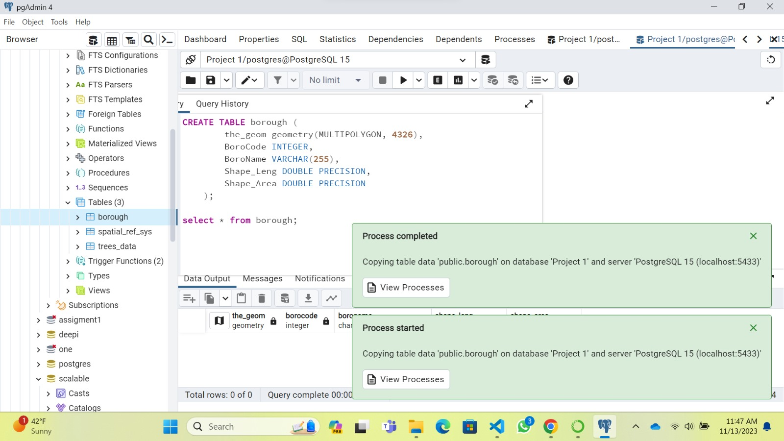

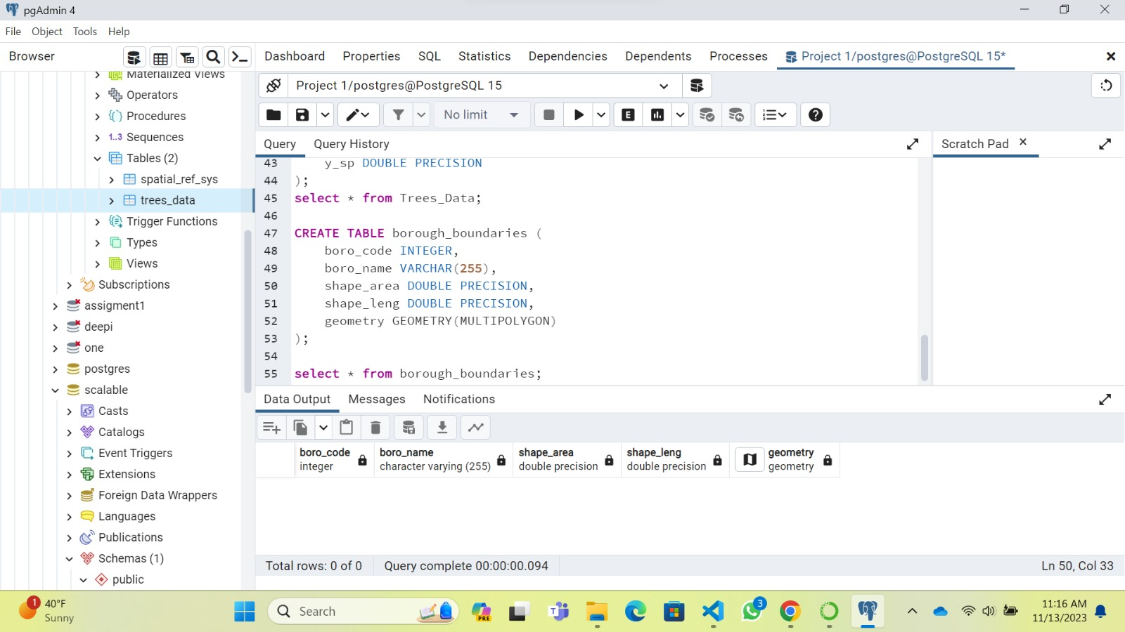
We need to connect to Postgres so that if we want to change anything in Postgres we can do it in python it automatically changes.

Slide 10

Creating the table
First we need to Aggregate data from the trees_data table to count the total number of trees for each borough (boroname)
We use join operation for joining the tree_data and borough
Output:
(datetime.date(2015, 9, 29), 268373, 206050, '010100000016D64DEB407F52C0C860CC91634E4440', 33, 3, 'Brooklyn', 728148.53241,1934138258.43) (datetime.date(2015, 9, 29), 268373, 206050, '010100000016D64DEB407F52C0C860CC91634E4440', 33, 3, 'Brooklyn', 728148.53241, 1934138258.43)
The SQL query is aggregating data from the trees_2005 table to count the total number of trees for each assembly district (st_assem).

Slide 11
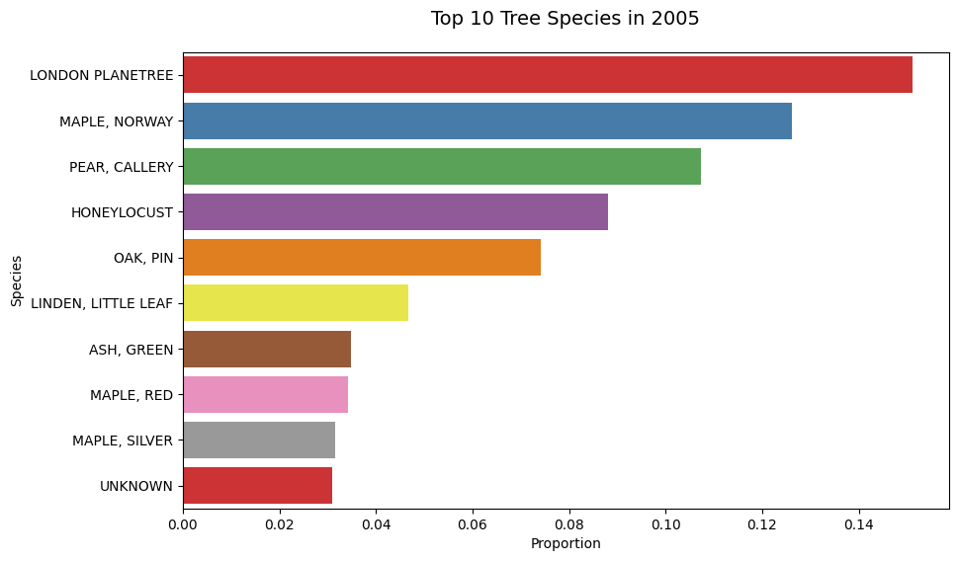
For data visualization we used bar charts and used species and how much portion it covered

Slide 12
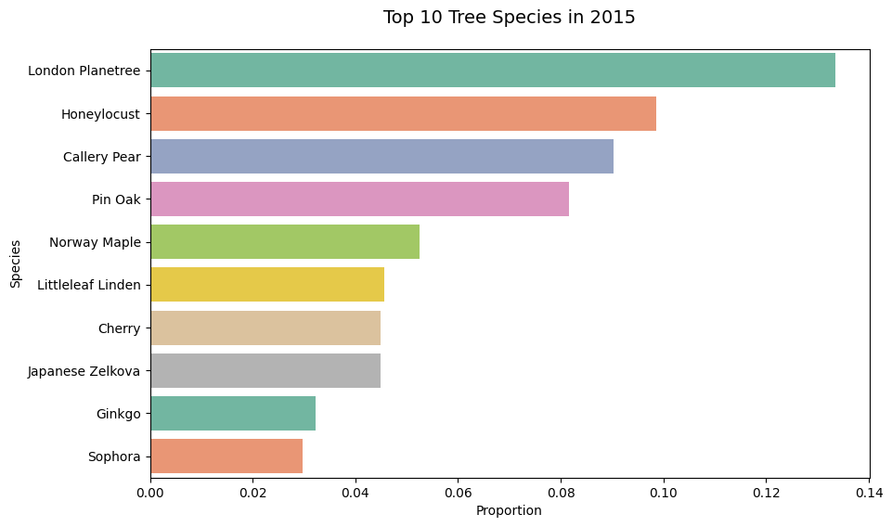
This is the visualization for species in 2015

Slide 13
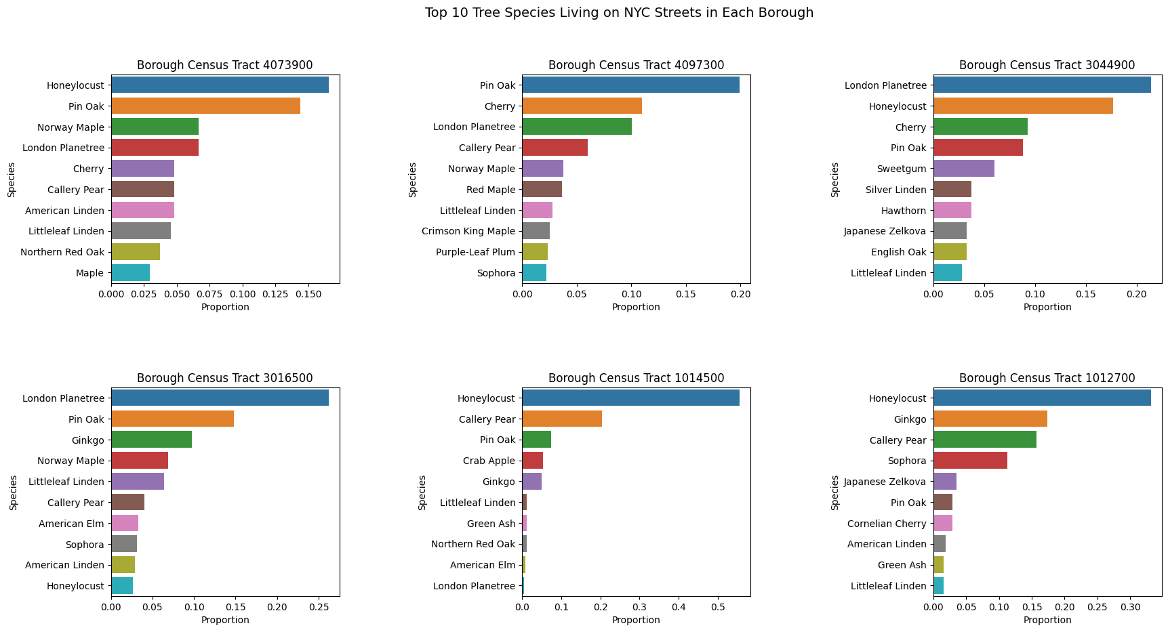
We created the subplots for top species living in new York for each borough

Slide 14
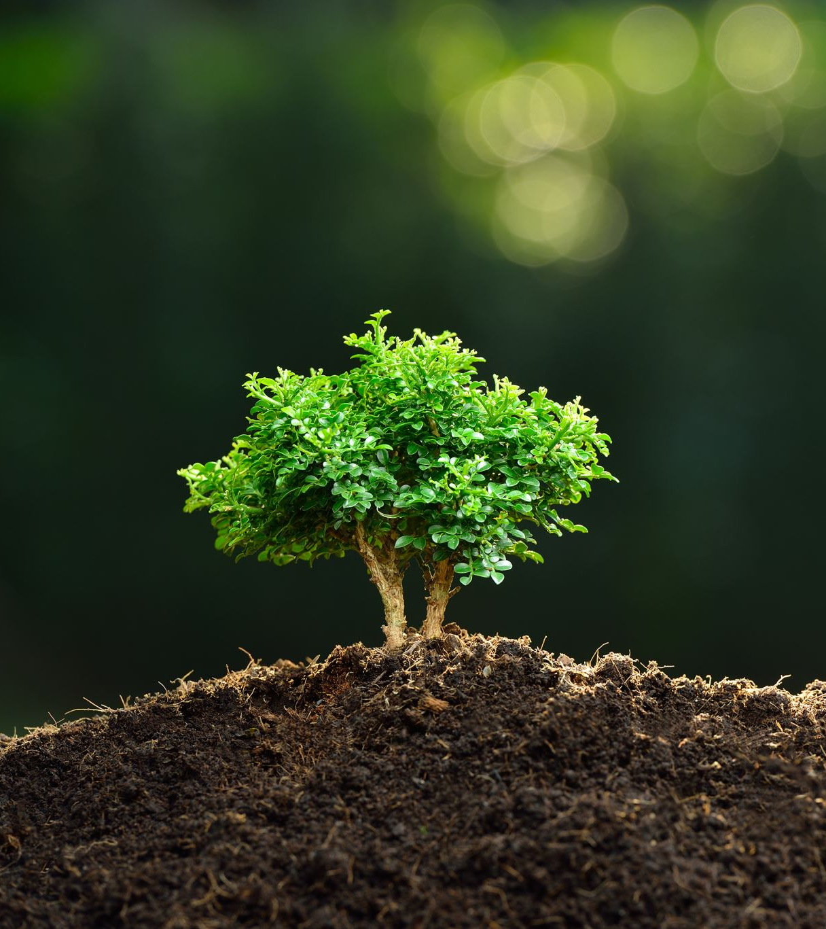
Then we analyze the data and came to a conclusion that there are around 169 different tree species in New York
In these 169 species around 72.5% are the top ten tree species remaining 159 are only 27.5%
Overall, the most common species of tree is the LONDON PLANETREE. 15.11% of all NYC street trees are LONDON PLANETREE. 12.61% are MAPLE, NORWAY 10.74% are PEAR, CALLERY 8.81% are HONEYLOCUST 7.41% are OAK, PIN 4.67% are LINDEN, LITTLE LEAF 3.48% are ASH, GREEN 3.42% are MAPLE, RED 3.15% are MAPLE, SILVER 3.1% are UNKNOWN

Slide 15
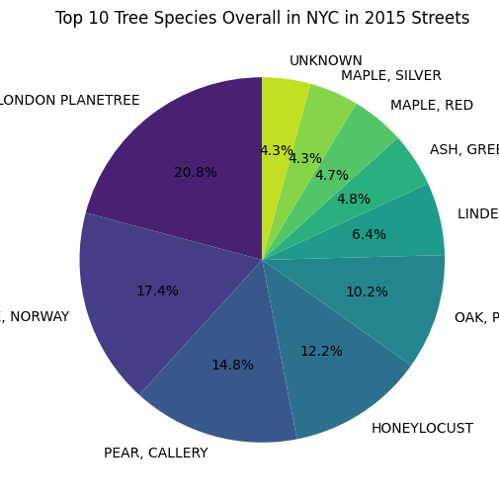
The pie chart visualization of top tree in nyc

Slide 16


The status of the trees in nyc are
Alive 0.953765 Stump 0.025818 Dead 0.020417

Slide 17
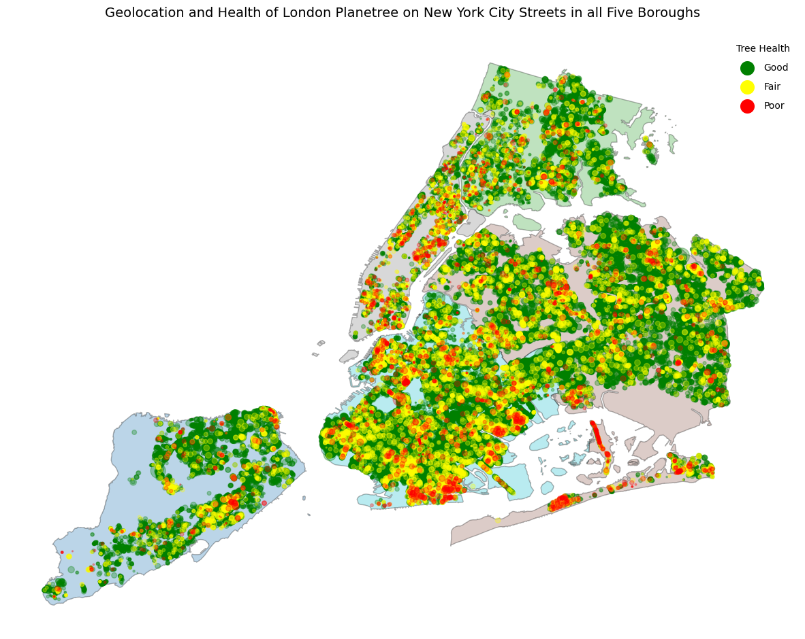

Slide 18

At last I would like to conclude by saying that saving trees is not only about safe guarding the environment but also securing the future.
Individually we all can contribute by planting trees and Rasing awareness in people

