Slide 1
Design Patterns

Slide 2
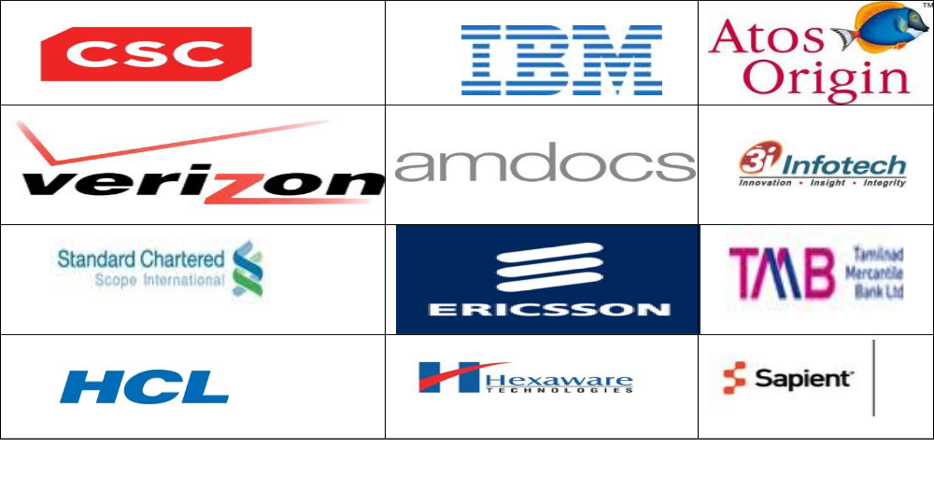
K.Srivatsan
IT Trainer Since 1991
Conducting Java Training Since 2004
About 40+ Corporate Clients

Slide 3
Topics
Day-1 –Session -1
Introduction
  Dynamic and Component Programming
Object Oriented Programming and Practice
  Revisiting basic OOP concepts.
  Objects, Classes and Sub-classes
  Essence of OOP - Abstraction
  PIE of OOP - Polymorphism, Inheritance and Aggregation
  Aggregation and Composition
  Polymorphism
Object Modeling
  Quick Introduction to UML
  Identifying Objects in a system
  Object Domains
  Quality of Design
  Coupling and Cohesion
  Intrinsic and Extrinsic Object

Slide 4
Topics
Day-1 –Session -2
Object Oriented Design Principles
  SOLID Principle
  Acyclic Dependency , Common Closure Common Re-use
Design Pattern Introduction
  Introduction to Patterns
  Intent & Classification
  Relationship with design principles
Creational Patterns
  Factory, Prototype, Builder
Day-2 –Session -1
Creational Patterns
  Singletton
  Day-2 –Session -2
Structural Pattern
  Adapter, Façade,Proxy Bridge,Composite,Decorator

Slide 5
Topics
Day-3 –Session -1
Behavioral
  Strategy Pattern Iterator Pattern State Pattern Visitor
  Day-3 –Session -2
  Behavioral
  Chain of Responsibility Command Observer
Beyond GOF and Anti – Patterns
  Patterns Beyond GoF

Slide 6
INTRODUCTION

Slide 7
Object Oriented Concepts
A Customer Friendly Programmer
  Great software always does what the customer wants it to.
  Even if the customer wants a change it doesn't break or give them unexpected result
A Object Oriented Programmer
  Great software is code that is Object Oriented, so there’s not bunch of duplicate code, and each object is in control of its own behavior.
  Its also easy to extend because design is really solid and flexible
A design Guru Programmer
  Great Software is when you use tried-and-true design patterns and principles. You’ve kept your objects loosely coupled, and your code open for extension but closed for modification. That makes the code reusable.

Slide 8
Dynamic Programming
Dynamic programming proceeds by solving small problems, then combining them to find the solution to larger problems
DP reduces computation by
  Solving subproblems in a bottom-up fashion.
  Storing solution to a subproblem the first time it is solved.
  Looking up the solution when subproblem is encountered again.
Key: determine structure of optimal solutions

Slide 9
Comparison with divide-and-conquer
Divide-and-conquer split a problem into separate subproblems,
Solve the subproblems, and combine the results for a solution to the original problem
  Example: Quicksort
  Example: Mergesort
  Example: Binary search
Divide-and-conquer algorithms can be thought of as top-down algorithms

Slide 10
Component based programming
“A software component is a unit of composition with contractually specified interfaces and explicit context dependencies only.
A software component can be deployed independently and is subject to composition by third parties.”
Unit of composition
  combine components to build systems
Contractually specified interfaces
  mechanism for interface definition, such as Interface Definition Language
Independent production
  separation of concerns
Deployed and composed by third parties
  reusable units assembled like parts supplied by manufacturers
OO programming is component-based programming
  classes are components
.NET programming is component-based programming
  DLLs are components

Slide 11
Need for component based approach
Components off the shelf < --- > Custom-made
Advantages of Components of the shelf
  Cost efficiency & flexibility
  Reuse, productivity
  Scalability
  Application of engineering techniques

Slide 12
Costs of components
It takes significant effort to create a software component that is effectively reusable.
The component needs:
  to be fully documented;
  more thorough testing;
  robust input validity checking;
  to pass back useful error messages as appropriate;
  to be built with an awareness that it will be put to unforeseen uses
Microsoft: COM, DCOM and ActiveX
Java : JavaBeans, EJB and JEE other components

Slide 13
Components and Software Architecture
Classes vs. components:
  class hierarchies + object collaboration = detailed design
  components + collaboration = architecture
Class vs. JavaBean:
  Class == a brick, a piece of wood, a nail
  Javabean = a wall element, a roof, a room
  Client application == a building
  An architecture does not concentrate on nails and bricks!

Slide 14
OBJECT ORIENTED PROGRAMMING AND PRACTICES

Slide 15
Topics
Revisiting basic OOP concepts.
Objects, Classes and Sub-classes
Essence of OOP - Abstraction
PIE of OOP - Polymorphism, Inheritance and Aggregation
Aggregation and Composition
Polymorphism

Slide 16
Classes
A class is a template, Blueprint, or contract that defines what an object’s data fields and methods will be.
An object is an instance of a class.
Can create many instances of a class.
A Java class uses variables to define data fields and methods to define actions

Slide 17
Class and Object
Objects are made up of attributes and methods.
Attributes are the characteristics that define an object; the values contained in attributes differentiate objects of the same class from one another.
Example:
  Mobile as object.
  Mobile has characteristics like model, manufacturer, cost, operating system etc.
  A “Samsung” mobile object and “IPhone” mobile object we can distinguish them from characteristics.
  The values of the attributes of an object are also referred to as the object’s state

Slide 18
OOP Concepts
Encapsulation - Enforces Modularity
  Encapsulating the data and behavior into a single object is of primary importance in OO development. A single object contains both its data and behaviors and can hide what it wants from other objects.
Inheritance -Passes "Knowledge" Down
  A class can inherit from another class and take advantage of the attributes and methods defined by the superclass.
Polymorphism -Takes any Shape
  Polymorphism means that similar objects can respond to the same message in different manners.
PIE , the three main features of OOPS.

Slide 19
Encapsulation
It is the ability of an object to place a boundary around its properties (data, methods).
It seals the data and methods safely inside the 'capsule' of a class, where it can be accessed only by trusted users (ie methods of the class).
    While driving a car, user don't have to know the details of cylinders, ignition etc.
  No need to know implementation details of a component to use it.
  Implementation can change without effecting any calling code.
Advantage
  Provides Modularity, Code quality, ease of maintenance

Slide 20
Need for Encapsulation
Reuse the object anywhere.
Upgrade component, by providing a more efficient implementation, or fix bugs—all without having to touch the other objects in your program.
The users of your object automatically benefit from any changes that you make.
Using an encapsulated object won’t cause unexpected side effects between the object and the rest of the program. Since the object is self-contained,
Interaction restricted to its interface.

Slide 21
Inheritance
Inheritance is unique to OO
  not there in function-oriented languages/models
Inheritance by class B from class A is the facility by which B implicitly gets the attributes and operations of A as part of itself
Attributes and methods of A are reused by B
When B inherits from A, B is the subclass or derived class and A is the base class or superclass

Slide 22
Inheritance..
A subclass B generally has a derived part (inherited from A) and an incremental part (is new)
Hence, B needs to define only the incremental part
Creates an “is-a” relationship
  objects of type B are also objects of type A

Slide 23
Polymorphism
Polymorphism = Poly + morphos
Poly = many + morphos = forms.
It describes the feature of languages that allows the same word to be interpreted correctly in different situations based on the context.
Polymorphism is classified into Two types
Static Polymorphism
Dynamic Polymorphism

Slide 24
Static Polymorphism
Static Polymorphism(compile time polymorphism)
  The ability to execute different method implementations by altering the argument used with the method name is known as method overloading.
If an exact signature match is not possible, the one that is closest via “widening” of the values is used
  “Widening” means that values of “smaller” types are cast into values of “larger” types
    Ex: int to long int to float float to double
  Fewer widening provides a "closer" match
If two or more versions of the method are possible with the same amount of “widening”, the call is ambiguous, and a compilation error will result

Slide 25
Dynamic Binding
Subclassing Polymorphism
  Sometimes called “true polymorphism”
  Consists basically of two ideas:
  Method overriding
    A method defined in a superclass is redefined in a subclass with an identical method signature
    Since the signatures are identical, rather than overloading the method, it is instead overriding the method
      For subclass objects, the definition in the subclass replaces the version in the superclass

Slide 26
Dynamic Binding
  Dynamic (or late) binding
    The code executed for a method call is associated with the call during run-time
    The actual method executed is determined by the type of the object, not the type of the reference
  Allows superclass and subclass objects to be accessed in a regular, consistent way
    Array or collection of superclass references can be used to access a mixture of superclass and subclass objects
    This is very useful if we want access collections of mixed data types (ex: draw different graphical objects using the same draw() method call for each)

Slide 27
Abstraction
Its the ability to focus on the important features of an object when trying to work with large amounts of information.
Example,
  if we are trying to design a floor plan for a kitchen, we can focus on the shapes and relative sizes of the appliances and ignore attributes such as color, style, and manufacturer.
The objects we design in our Java programs will be abstractions in this sense because they ignore many of the attributes that characterize the real objects and focus only on those attributes that are essential for solving a particular problem.

Slide 28
Effective Abstraction
Address the general case, not the specific case.
When confronting a number of different problems, search for commonality.
Try to see a concept, not a specific case.
Abstraction might not be readily apparent.
Abstraction might not jump out at you the first, second, or third time you solve a problem that is subject to being abstracted.
Prepare for failure. It is almost impossible to write an abstraction that will work in every situation.

Slide 29
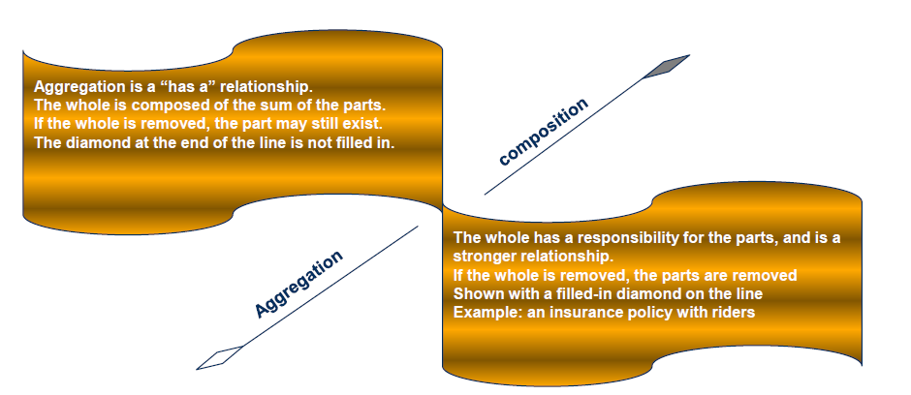
Aggregation & Composition

Slide 30
OBJECT MODELING

Slide 31
Topics
Quick Introduction to UML
Identifying Objects in a system
Object Domains
Quality of Design
Coupling and Cohesion
Intrinsic and Extrinsic Object

Slide 32
Object Modeling
  Identifying Object Classes
  Preparing a Data Dictionary for Classes
  Identifying Associations
  Identifying Attributes
  Refining with Inheritance
  Grouping Classes into Modules

Slide 33
Modeling
Modeling involves:
  representation or simplification of reality
  providing a blueprint of a system
Used for better understanding of the system
Describe the structure or behaviour of the system
Experiment by exploring multiple solutions
Document the design decisions
Visualize the system “as-is” and ”to-be”
Provide a template for constructing a system

Slide 34
Modeling Principles
The choice of models affects how a problem is tackled
Every model may be expressed at different levels of abstraction
Effective models are connected to reality
No single model is sufficient to describe non-trivial systems
Objects can be Modeled as Domain Object or Anemic Mdole
Domain Objects
  They have logic and may be related to the database structure.
  anemic data model
  They only have fields (state).
  They are used when transferring data from one layer/subsystem to another
  Example : DTO’s

Slide 35
What is UML?
UML = Unified Modelling Language
A language for visualizing, specifying, constructing and documenting artifacts of software-intensive systems.
Examples of artifacts: requirements, architecture, design,source code, test cases, prototypes, etc.
UML is suitable for modelling various kinds of systems:
  enterprise information systems,
  distributed web-based,
  real-time embedded system, etc.

Slide 36
UML – Specification Language
Provides views for development and deployment.
UML is process-independent.
UML is recommended for use with the processes that are:
  use-case driven
  architecture-centric
  Iterative
  incremental

Slide 37
Goals of UML
Provide modelers with an expressive, visual modelling language to develop and exchange meaningful models
Provide extensibility and specialization mechanisms to extend core concepts
Support specifications that are independent of particular programming languages and development processes
Provide a basis for understanding specification languages
Encourage the growth of the object tools market
Supports higher level of development with concepts such as components frameworks or patterns

Slide 38
UML Building Blocks
Three basic building blocks:
  elements: main “citizens” of the model
  relationships: relationships that tie elements together
  diagrams: mechanisms to group interesting collections of elements and relationships
Used to represent complex structures

Slide 39
Applications of UML
UML is currently used for applications other than just drawing designs
Forward engineering
  UML model used to generate actual source code
Reverse engineering
  UML models are generated from source code to re document or recover design of program

Slide 40
Conceptual Elements
static part of the model to represent conceptual elements
“nouns” of the model
Class
Interface
Collaboration
use case
active class
Component
node

Slide 41
Diagram
A diagram is a graph presentation of a set of elements and relationships where:
  nodes are elements
  edges are relationships
Can visualize a system from various perspective, thus is a projection of a system.

Slide 42
Diagram Types
UML is characterized by nine major diagrams:
class
object
use case
sequence
collaboration
State chart
activity
Component
deployment

Slide 43
A Class
A class is:
a description of a set of objects that share the same
  attributes,
  operations,
  relationships and
  semantics
a software unit that implements one or more interfaces

Slide 44
Class Diagrams
the most widely used diagram of UML
models the static design view of a system
also useful in modelling business objects
used to specify the structure, interfaces and relationships between classes that underlie the system architecture.
primary diagram for generating codes from UML models

Slide 45
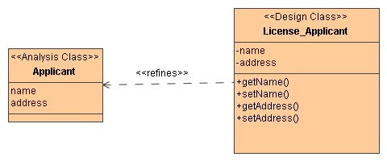
Class Notation
Basic notation: a solid-outline rectangle with three compartments separated by horizontal lines.
Three compartments:
  top compartment holds the class name and other general properties of the class
  middle compartment holds a list of attributes
  bottom compartment holds a list of operations

Slide 46
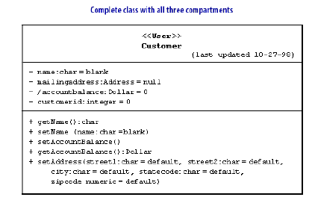
Class Diagram

Slide 47
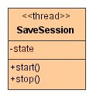
Stereotypes for Classes
Attribute or operation lists in a class may be organized into groups with stereotypes.
A number of stereotypes of classes and data types:
thread
event
entity
process
utility
Metaclass
Powerclass
enumeration, etc.

Slide 48
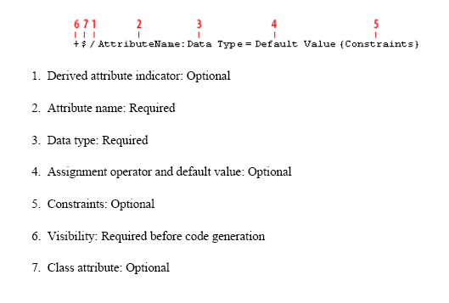
Attribute Syntax

Slide 49
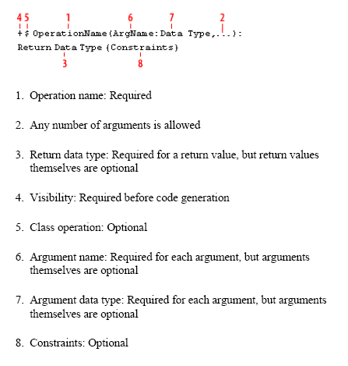
Operations Syntax

Slide 50
Adding Visibility
scope of access allowed to a member of a class
applies to attributes and operations
UML visibility maps to OO visibilities:
  private scope: within a class (-)
  package scope: within a package (~)
  public scope: within a system (+)
  protected scope: within an inheritance tree (#)

Slide 51
Identifying Classes
Disparate Attributes and operations on a class :
  Split class so that each is part is coherent
Difficulty in generalizing cleanly :
  one class may be playing two roles, spilt it up and page par may then fit cleanly
Duplication associations with same and purpose :
  generalize to create the missing super class that unites them
Missing Access Path:
  Add New Associations so that you can answer the queries
Lack of attributes ,operations and associations on a class

Slide 52
Candidates for classes
Tangible things referred to by common nouns in requirements spec
  I.e., cookie, factory, triangle
Events with associated information (i.e., flight, game).
Abstract data stores (i.e., buffer, tree, hash table)
Note: verbs can also be classes!
  Parsing -> Parser, Scanner as a subclass of String
Can anything be a class? What isn't a class?
  Proper nouns are instances of classes, not classes
  Classes have content: store state information and perform operations
  If it doesn’t store state and perform multiple operations, keep it simple
  Classes with just one or two routines (probably not worth classifying)
  Redundant classes: merge synonyms, reuse classes in libraries

Slide 53
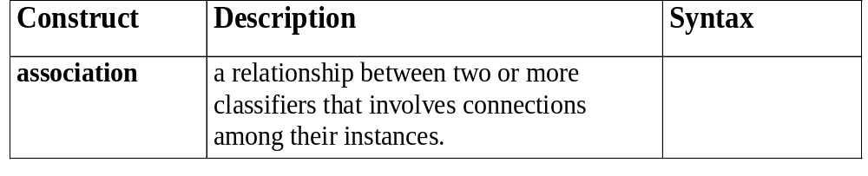
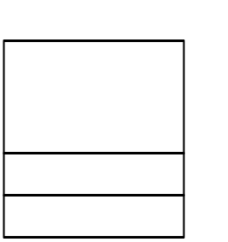
Association
Focus on those associations for which knowledge of the relationship needs to be preserved for some duration (“need-to-know”)
It is more important to identify classes than to identify associations
Too many associations can be confusing
Classes may have association with themselves
person
*
1
manages

Slide 54
Multiplicity
Description | Syntax
An A is always associated with one B
An A is always associate with one or more B
An A is associated with zero or one B
An A is associated with zero, one or more B
1
1..*
0..1
0..*

Slide 55
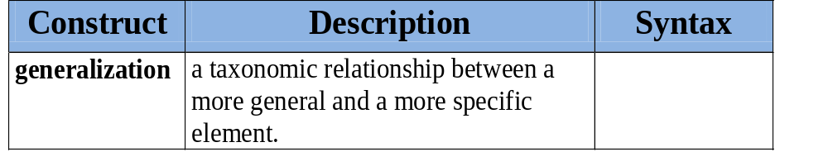
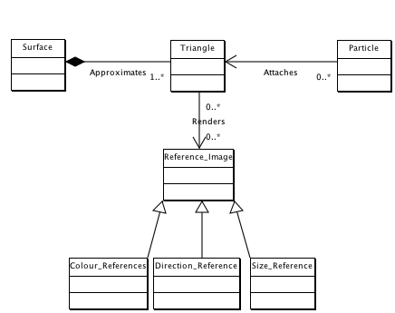
Generalization
Generalization: identifying commonality among classes and defining supertype and subtype relationships

Slide 56
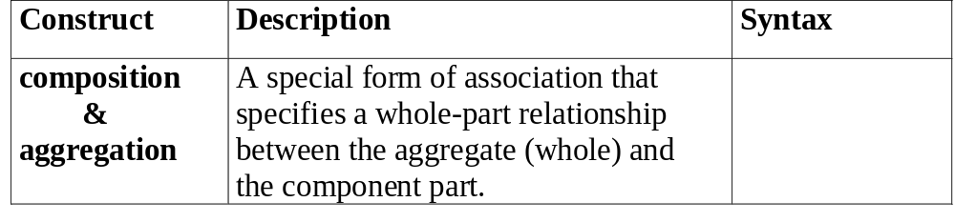
Aggregation
Composition (filled diamond):
  Strong ownership of one class (the part) by another (the whole)
  Exclusive relationship
Aggregation (hollow diamond):
  Loose informal relationship. Indicates that the whole is more important than the part
  Non-exclusive. The part may participate in other aggregations

Slide 57
Use Case Diagrams
describe or capture functional requirements
represent the desired behaviour of the system
identify users (actors) of the system and associated processes
are the basic building blocks of use case diagrams
tie requirements phase to other development phases

Slide 58
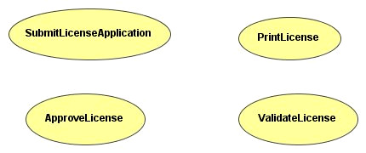
Use Case Diagrams

Slide 59
Use Case Definition
A use case:
  is a collection of task-related activities describing a discrete chunk of a system
  describes a set of actions sequences that a system performs to present an observable result to an actor
describes a system from an external usage viewpoint
Key attributes of a use case:
  description
  action sequence
  includes variants
  produces observable results

Slide 60
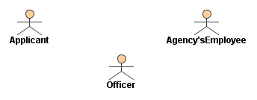
Actor
Definition
  Actor is anyone or anything that interacts with the system causing it to respond to events
An actor:
  is something or somebody that stimulates the system to react or respond to its request
  is something we do not have control over
  represents a coherent set of roles that the external entities to the system can play
  represents any type of a system’s user

Slide 61
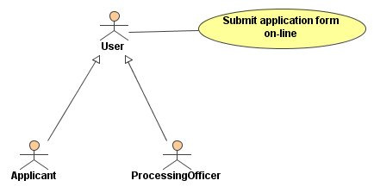
Types of Actors
Initiator versus participant:
  When there is more than one actor in a use case, the one that generates the stimulus is called the initiator and the others are participants.
Primary versus secondary:
  The actor that directly interacts with the system is called the primary actor, others are called secondary actors.

Slide 62
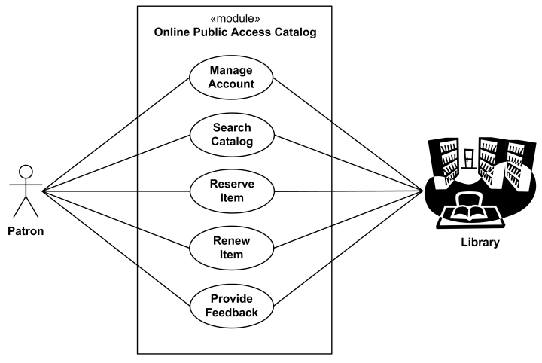
E-Library – Use Case

Slide 63
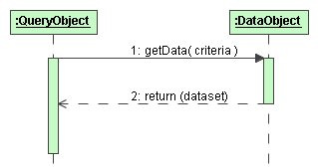
Sequence Diagram
A sequence diagram shows interactions between objects.
Components of sequence diagrams:
1) object lifelines
  object
  timeline
2) messages
  message, stimulus
  signal, exception
  operations, returns
  identification
3) message syntax

Slide 64
Lifeline & Timeline
The timeline is a line that runs:
  from the beginning of a scenario at the top of the diagram
  to the end of the scenario at the bottom of the diagram.
An object lifeline consists of:
  an object
  a timeline
If an object is created and destroyed during the message sequence,
the lifeline represents its whole lifecycle

Slide 65
Message
Definition
  Message is a description of some type of communication between objects.
A unit of communication between objects.
The sender object may:
  invoke an operation,
  raise a signal or
  cause the creation or destruction of the target object.

Slide 66
Object Model
Steps to develop an object model
Identify the classes and their associations as they affect the overall problem structure and approach.
Prepare a data dictionary.
  Identify associations between objects.
  Identify attributes of objects and links.
  Organise and simplify object classes using inheritances
Verify that access paths exist for likely queries
Iterate and refine the model
Group classes into modules.

Slide 67
Coupling
Coupling is an inter-module concept, captures the strength of interconnection between modules
More tightly coupled the modules, the more they depend on each other, more difficult to modify one
Low coupling is desirable for making systems understandable and modifiable
In OO, three types of coupling exists – interaction, component, and inheritance

Slide 68
Coupling…
Interaction coupling occurs due to methods of a class invoking methods of other classes
  Like calling of functions
  Worst form if methods directly access internal parts of other methods
  Still bad if methods directly manipulate variables of other classes
  Passing information through temporary variables is also bad

Slide 69
Coupling…
Least interaction coupling if methods communicate directly with parameters
  With least number of parameters
  With least amount of information being passed
  With only data being passed
I.e. methods should pass the least amount of data, with least number of parameters

Slide 70
Cohesion
Cohesion is an intra-module concept
Focuses on why elements are together
  Only elements tightly related should exist together in a module
  This gives a module clear abstraction and makes it easier to understand
Higher cohesion leads to lower coupling – many interacting elements are in the module
Goal is to have higher cohesion in modules
Three types of cohesion in OO – method, class, and inheritance

Slide 71
Cohesion…
Method cohesion – why different code elements are together in a method (like cohesion in functional modules)
  Highest form is if each method implements a clearly defined function with all elements contributing to implementing this function
  Should be able to state what the module does by a simple statement

Slide 72
Cohesion…
Class cohesion – why different attributes and methods are together in a class
  A class should represent a single concept with all elements contributing towards it
  Whenever multiple concepts encapsulated, cohesion is not as high
  A symptom of multiple concepts – different groups of methods accessing different subsets of attributes
OO Design

Slide 73
Cohesion…
Inheritance cohesion – focuses on why classes are together in a hierarchy
  Two reasons for subclassing
    generalization-specialization
    reuse
  Cohesion is higher if the hierarchy is for providing generalization-specialization
OO Design

Slide 74
Intrinsic and Extrinsic
An intrinsic object ,is one whose state naturally belong to the Object and should be permanent or immutable or context free
Example :
  Request, Response, and Session
An extrinsic Object ,is one whose state belong to the context of the object
Example :
Collections.sort(alist);
Collections.sort(alist,new MyComparator());
The Comparable approach is intrinsic, the Comparator extrinsic; the former case rigid, the latter adaptable to the required context

Slide 75
OBJECT ORIENTED DESIGN PRINCIPLES

Slide 76
Topics
Object Oriented Design Principles
Open-Close Principle
Single Responsibility
Interface Segregation Principle
Liskov's Substitution Principle
Dependency Inversion Principle
Acyclic Dependency Principle
Common Closure Principle
Common Re-use principle
Stable Dependency Principle

Slide 77
SOLID Design Principle
S ->Single Responsibility Principle
  One class should have one and only one responsibility“
O -> Open Close Principle
  "Software components should be open for extension, but closed for modification“
L-> Liskov Substitution Principle
  "Derived types must be completely substitutable for their base types"
I ->Interface Segregation Principle
  "Clients should not be forced to implement unnecessary methods which they will not use“
D->Dependency Inversion Principle
  "Depend on abstractions, not on concretions"

Slide 78
Single Responsibility Principle (SRP)
There should not be more than one reason for a class to change, or a class should always handle single functionality.
This principle states that if we have 2 reasons to change for a class, we have to split the functionality in two classes.
Each class will handle only one responsibility and on future if we need to make one change we are going to make it in the class which handle it.
When we need to make a change in a class having more responsibilities the change might affect the other functionality of the classes.

Slide 79
Single Responsibility Principle (SRP)
  interface IEmail {
  public void setSender(String sender);
  public void setReceiver(String receiver);
  public void setContent(String content);
  }
  class Email implements IEmail {
  public void setSender(String sender) {// set sender; }
  public void setReceiver(String receiver) {// set receiver; }
  public void setContent(String content) {// set content; }
  }
Adding a new protocol will create the need to add code for parsing and serializing the content for each type of field.
Adding a new content type (like html) make us to add code for each protocol implemented.

Slide 80
Single Responsibility Principle (SRP)
interface IEmail {
public void setSender(String sender);
public void setReceiver(String receiver);
public void setContent(IContent content);
}
interface IContent {
public String getAsString(); // used for serialization
}
class Email implements IEmail {
public void setSender(String sender) {// set sender; }
public void setReceiver(String receiver) {// set receiver; }
public void setContent(IContent content) {// set content; }
}

Slide 81
Open Closed Design Principle
Classes, methods or functions should be Open for extension (new functionality) and Closed for modification.
This prevents some-one from changing already tried and tested code.
Ideally if you are adding new functionality only than your code should be tested and that's the goal of Open Closed Design principle.
Add new functionality by adding new subclasses or methods, or by reusing existing code through delegation

Slide 82
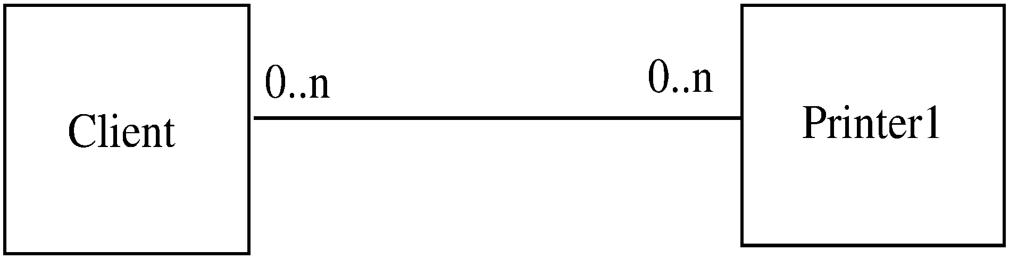
Example

Slide 83
Example..
Client directly calls methods on Printer1
If another printer is to be allowed
  A new class Printer2 will be created
  But the client will have to be changed if it wants to use Printer 2
Alternative approach
  Have Printer1 a subclass of a general Printer
  For modification, add another subclass Printer 2
  Client does not need to be changed

Slide 84
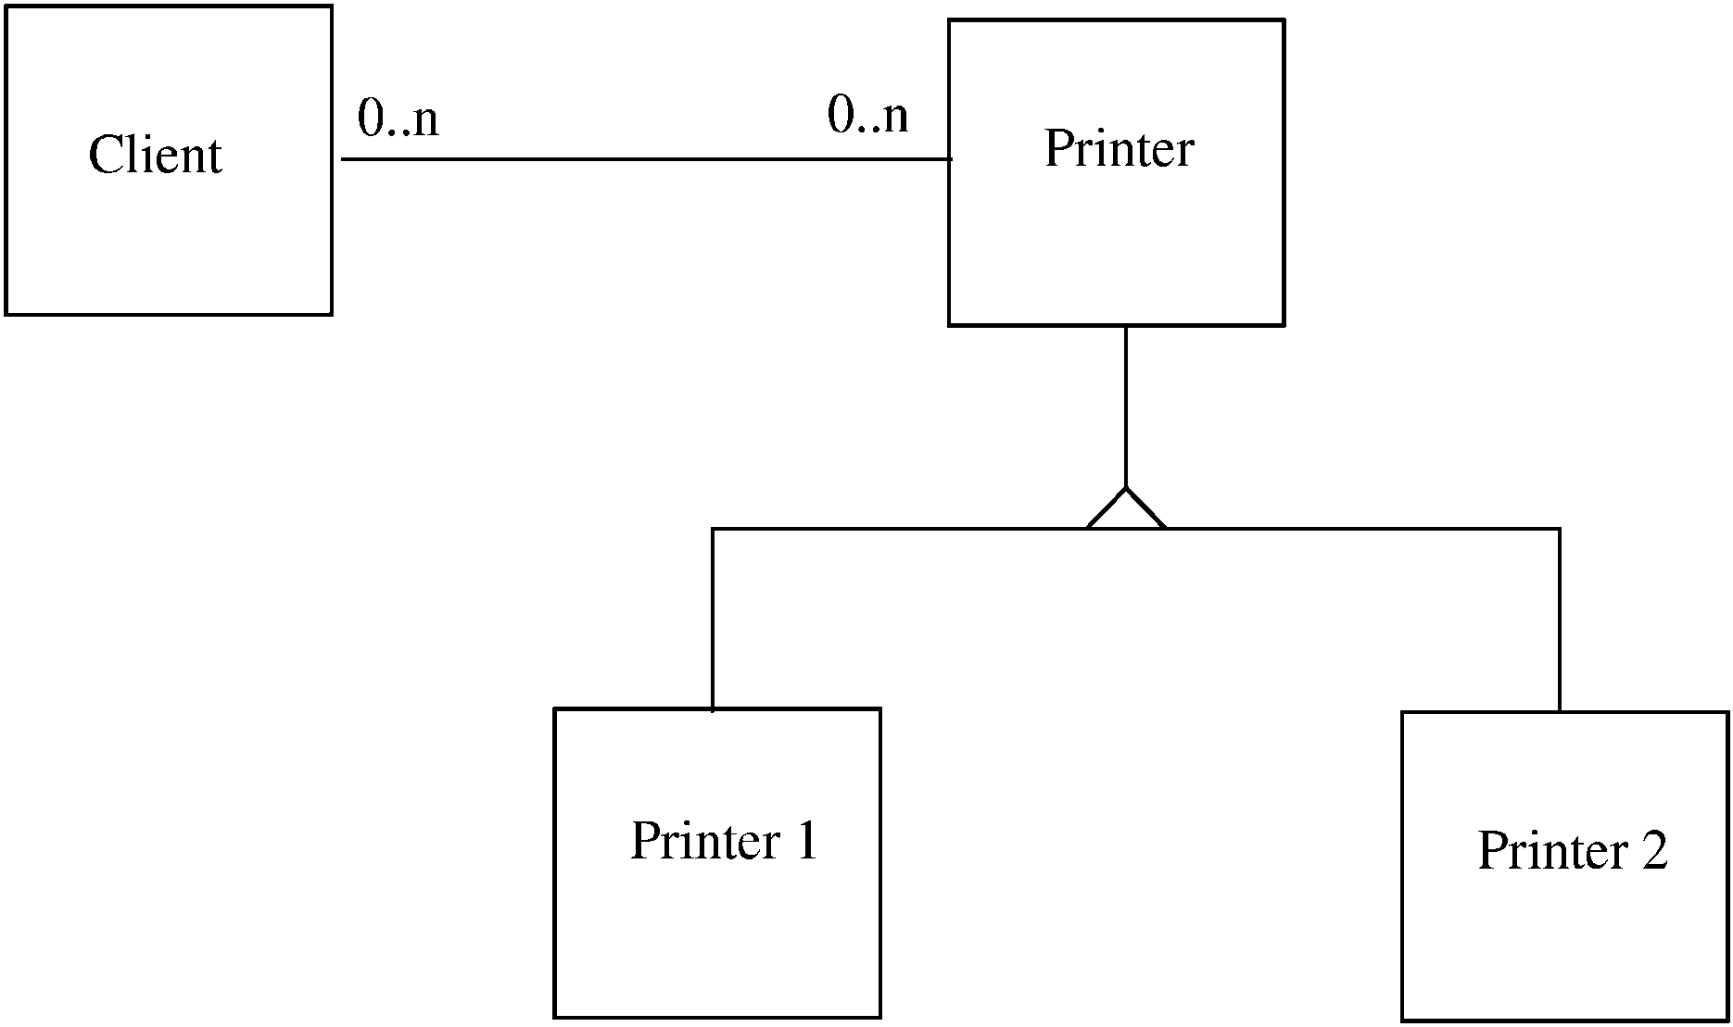
Example…

Slide 85
Liskov Substitution Principle (LSP)
If a program module is using a Base class, then the reference to the Base class can be replaced with a Derived class without affecting the functionality of the program module.
Classes are created in some class hierarchies, we extend some classes creating some derived classes.
Need to ensure that the new derived classes just extend without replacing the functionality of old classes.
Otherwise the new classes can produce undesired effects when they are used in existing program modules.

Slide 86
Liskov Substitution Principle (LSP)
  class Rectangle { }
  class Square extends Rectangle { }
  class LspTest {
  private static Rectangle getNewRectangle() {
  return new Square();
  }
  public static void main (String args[]) {
  Rectangle r = LspTest.getNewRectangle();
  r.setWidth(5);
  r.setHeight(10);
  System.out.println(r.getArea());
  } rea is 100 instead of 50.

Slide 87
Interface Segregation principle (ISP)
Interface Segregation Principle stats that, a client should not implement an interface, if it doesn't use that.
Instead of one fat interface many small interfaces are preferred based on groups of methods, each one serving one submodule.
This happens mostly when one interface contains more than one functionality, and client only need one functionality and not other.
Another benefit of this design principle in Java is, interface has disadvantage to implement all method before any class can use it so having single functionality means less method to implement.

Slide 88
Interface Segregation principle (ISP)
interface IWorker {
public void work();
public void eat(); }
class Worker implements IWorker{
public void work() { // ....working }
public void eat() { // ...... eating in lunch break }
}
class SuperWorker implements IWorker{
public void work() { //.... working much more }
public void eat() { //.... eating in lunch break }
}
class Manager {
IWorker worker;
public void setWorker(IWorker w) {
worker=w;
}
public void manage() {
worker.work();
} }
What Happens when a new Robot worker is introduced

Slide 89
Interface Segregation principle (ISP)
interface IWorkable { public void work(); }
interface IFeedable{ public void eat(); }
interface IWorker extends IFeedable, IWorkable {
}
class Worker implements IWorkable, IFeedable{
public void work() { // ....working }
public void eat() { //.... eating in launch break }
}
class Robot implements IWorkable{
public void work() {
// ....working
}
}

Slide 90
Dependency Injection or Inversion principle
High-level modules should not depend on low-level modules. Both should depend on abstractions.
Abstractions should not depend on details. Details should depend on abstractions.
Don't ask for dependency it will be provided to you by framework.
This has been very well implemented in Spring framework,
Any class which is injected by DI framework is easy to test with mock object and easier to maintain because object creation code is centralized in framework and client code is not littered with that.

Slide 91
Dependency Injection or Inversion principle
class Worker {
public void work() { // ....working }
}
class Manager {
Worker worker;
public void setWorker(Worker w) {
worker = w;
}
public void manage() {
worker.work();
}
}
class SuperWorker {
public void work() {
//.... working much more
}
}

Slide 92
Dependency Injection or Inversion principle
interface IWorker {
public void work();
}
class Worker implements IWorker{
public void work() { // ....working }
}
class SuperWorker implements IWorker{
public void work() { //.... working much more }
}
class Manager {
IWorker worker;
public void setWorker(IWorker w) {
worker = w;
}
public void manage() {
worker.work();
} }

Slide 93
DRY (Don't repeat yourself)
Don't write duplicate code:
Use Abstraction to abstract common things in one place.
If you have block of code in more than two place consider making it a separate method, or if you use a hard-coded value more than one time make them public final constant.
Benefit of this Object oriented design principle is in maintenance.
  Copying and pasting blocks of code from one method, function or block of code to another, then you are in violation of DRY.
If you have places in your codebase where you clearly have very similar code (even with minor variations) then you should be looking to refactor that code to make it DRY.
"Don't repeat yourself!" == "Don't write the same code repeatedly"

Slide 94
Encapsulate What Changes
Only one thing is constant in software field and that is "Change",
  Encapsulate the code you expect or suspect to be changed in future.
Benefit of this OOPS Design principle is that Its easy to test and maintain proper encapsulated code.
If you are coding in Java then follow principle of making variable and methods private by default and increasing access step by step e.g. from private to protected and not public.
Several of design pattern in Java uses Encapsulation,
Factory design pattern is one example of Encapsulation which encapsulate object creation code and provides flexibility to introduce new product later with no impact on existing code.

Slide 95
Favor Composition over Inheritance
Always favor composition over inheritance ,if possible.
Some of you may argue this, but I found that Composition is lot more flexible than Inheritance.
Composition allows to change behavior of a class at runtime by setting property during runtime and by using Interfaces to compose a class
we use polymorphism which provides flexibility of to replace with better implementation any time.
Even Effective Java advise to favor composition over inheritance.

Slide 96
Programming for Interface not implementation
Always program for interface and not for implementation this will lead to flexible code which can work with any new implementation of interface.
So use interface type on variables, return types of method or argument type of methods in Java.

Slide 97
Delegation principle
Don't do all stuff by yourself, delegate it to respective class.
Classical example of delegation design principle is equals() and hashCode() method in Java.
In order to compare two object for equality we ask class itself to do comparison instead of Client class doing that check.
Benefit of this design principle is no duplication of code and pretty easy to modify behavior.

Slide 98
Overview of Patterns
Is a proven solution to a problem in a given context.
Is first verified several times in the real-world systems to be actually called a pattern.
Promotes reuse of software concepts and technologies, which make you work faster and efficiently.
Establishes common terminology for problems.
Describes the circumstances, influences, and the resolution of a solution.
Facilitates design modifications, documentation, and understandability of a software system.

Slide 99
Selecting a Design Pattern
Patterns are Created by
    Identifying components and their internal structure and relationship among various component
    Determining and analyzing the level of communication among the components.
    Defining the architecture of the presentation layer that is robust
The guidelines for selecting a design pattern
    Identifying the type of problem that a design pattern solves and helps in narrowing the list of suitable design patterns that are applied to the given problem.

Slide 100
GoF’s Design Patterns
The four elements of GoF’s design patterns are:
      Pattern name: Identifies a pattern.
      Problem: Describes when to apply a pattern and the context in which to apply the pattern.
      Solution: Describes a pattern as a template, which can be applied to different contexts.
      Consequences: Describes the pros and cons in applying the pattern in a certain context.

Slide 101
Types of GoF’s Design Patterns
The three types of design patterns are:
Creational design patterns:
  Provide techniques for creating objects
Structural design patterns:
  Describe the composition of objects and their organization.
Behavioral design patterns:
  Provide guidelines for enabling communication among objects of a given system.

Slide 102
CREATIONAL DESIGN PATTERN

Slide 103
Topics
Limitation of Constructor
Static Factory Pattern
Factory Method Pattern
Singleton Pattern
Prototype
Abstract Factory
Dependency Injection
Builder Pattern

Slide 104
Limitation of Constructor
The constructor has many parameters
  Constructors with many parameters can lead to poor readability, and better alternatives exist.
  Here's a quote from Effective Java 2nd Edition, Item 2: Consider a builder pattern when faced with many constructor parameters:
The constructor does a lot of work that costs time
  If the work must be done at construction time, then doing it in the constructor or in a helper method doesn't really make too much of a difference. When a constructor delegates work to a helper method, however, make sure that it's not overridable, because that could lead to a lot of problems.

Slide 105
Limitation of Constructor
The constructor does a lot of work that can be deferred
  The construction of an object can be made faster when some work is deferred to when it's actually needed; this is called lazy initialization.
  As an example, when a String is constructed, it does not actually compute its hash code.
  It only does it when the hash code is first required, and then it will cache it (since strings are immutable, this value will not change).

Slide 106
Creational Design Patterns
Deal with object creation mechanisms, trying to create objects in a manner suitable to the situation.
The basic form of object creation could result in design problems or added complexity to the design.
Creational design patterns solve this problem by somehow controlling this object creation.
Allows instances of classes to be created, without the need to identify the class type by having the subclass of the class create the objects.

Slide 107
Classification of Creational Pattern
Class-creation patterns:
  use inheritance effectively in the instantiation process
  deal with the relationships between the parent class and subclasses.
  Inheritance plays a big role in these patterns.
  Example :Factory Patterns
Object-creation patterns:
  use delegation effectively to get the job done
  deal with the relationship between objects and is usually created during runtime.
  Example :Builder, Prototype

Slide 108
Creational Patterns
Factory Method Pattern
  Define an interface for creating an object, but let subclasses decide which class to instantiate.
Abstract Factory Pattern
  Provide an interface for creating families of related or dependent
  objects without specifying their concrete classes.
Prototype Pattern
  Specify the kinds of objects to create using a prototypical instance, and create new objects by copying this prototype.
Builder Pattern
  Separate the construction of a complex object from its representation so that the same construction process can create different representations

Slide 109
Factory Method Pattern
Factory Method
  Helps to model an interface for creating an objects
  Subclasses decide which class to instantiate
Applicability:
  A class can’t anticipate the class of objects it must create
  A class wants its subclasses to specify the objects it creates

Slide 110
Benefits of Factory Method Pattern
Factory Method pattern
  provides approach to code for interface rather than implementation.
  Removes the instantiation of actual implementation classes from client code, making it more robust, less coupled and easy to extend.
  Provides abstraction between implementation and client classes through inheritance.

Slide 111
Factory Method Usage
Usage
  Used when we have a super class with multiple subclasses
  Responsibility of instantiation of a class from client program to the factory class.
  Examples in JDK
  java.util.Calendar,
  ResourceBundle and NumberFormat getInstance() methods
  valueOf() method in wrapper classes like Boolean, Integer etc.

Slide 112
Factory Method
Super Class
  can be an interface, abstract class or a normal java class.
Sub Classes
  Let’s say we have two sub-classes PC and Server with below implementation
Factory class.
  can be a Singleton or we can keep the method that returns the subclass as static.
  Based on the input parameter, different subclass is created and returned.

Slide 113
The Parts Class
  public class Parts {
  public String specification;
  public Parts(String specification)
  {
  this.specification = specification;
  }
  public String getSpecification()
  {
  return specification;
  }
  }

Slide 114
The Super Class
  public abstract class Computer {
  public abstract Parts getRAM();
  public abstract Parts getProcessor();
  public abstract Parts getMonitor();
  }

Slide 115
Sub Classes
  public class PersonalComputer extends Computer {
    public Parts getMonitor() {
    return new Parts("Samtron");
    }
    public Parts getProcessor() {
    return new Parts("Intel");
    }
    public Parts getRAM() {
    return new Parts("1GB");
    }

Slide 116
Sub Classes
  public class Workstation extends Computer {
  public Parts getMonitor() {
  return new Parts("Samsung");
  }
  public Parts getProcessor() {
  return new Parts("Intel Dual Core");
  }
  public Parts getRAM() {
  return new Parts("4GB");
  }
  }

Slide 117
Class with Static Factory Method
public class ComputerFactory {
private Computer comp;
public static Computer getComputer(String ch) {
if (cd.equals("PC"))
comp = new PersonalComputer();
else if(cd.equals("Workstation"))
comp = new Workstation();
return comp;
}
}

Slide 118
Client Application
public static void main(String[] args) {
Computer computer = ComputerFactory.getComputer("PC");
System.out.println("Monitor: "+computer.getMonitor().getSpecification());
System.out.println("RAM: "+computer.getRAM().getSpecification());
System.out.println("Processor: "+computer.getProcessor().getSpecification());
}}

Slide 119
Abstract Factory Pattern
Intent:
  provide an interface for creating families of related or dependent objects without specifying their concrete classes
  A hierarchy that encapsulates:
Applicability
  A system should be independent of how its products are created, composed, and represented.
  If you want to provide a class library and you want to reveal just their interfaces , not their implementations

Slide 120
Abstract Factory Pattern
Similar to Factory Pattern except the fact that it’s more like factory of factories.
  Code for interface rather than implementation.
  “factory of factories” and can be easily extended to accommodate
  if-else block is removed
  A factory class for each sub-class

Slide 121
Factory and Abstract Factory
Enforces Encapsulation and result is loosely coupled and highly cohesive system.
Any change e.g. a new product from Factory requires almost no change in existing clients.
Abstract Factory allows you to use different Factory implementation for different purpose.
Abstract Factory pattern can be implemented using Factory method and Singleton design pattern in Java.
One of the best example of Abstract Factory and Factory pattern in Java is DocumentBuilderFactory and DocumentBuilder javax.xml.parsers package.

Slide 122
Abstract Factory Pattern
public abstract class Computer {
public abstract String getRAM();
public abstract String getProcessor();
public abstract String getMonitor();
@Override
public String toString() {
return "RAM :="+this.getRAM() +"Processor:="+this.getProcessor()+"Monitor:="+this.getMonitor();
}

Slide 123
Abstract Factory Pattern
  public class PersonalComputer extends Computer {
  private String monitor;
  private String processor;
  private String rAM;
  @Override
  public String getMonitor() {
  return this.monitor;
  }
  // Other Methods and Constructors
  }
  }

Slide 124
Abstract Factory Pattern
  public class Workstation extends Computer {
  private String monitor;
  private String processor;
  private String rAM;
  @Override
  public String getMonitor() {
  return this.monitor;
  }
  // Other Methods and Constructors
  }

Slide 125
Abstract Factory Pattern
  public interface ComputerAbstractFactory {
  public Computer createComputer();
  }
  public class MyComputerFactory {
  public static Computer getComputer(ComputerAbstractFactory factory){
  return factory.createComputer();
  }
  }

Slide 126
Abstract Factory Pattern
  public class PCFactory implements ComputerAbstractFactory
  {
  private String monitor;
  private String processor;
  private String rAM;
  public String getMonitor() {
  return this.monitor;
  }
  // Constructor and other set/get Methods
  public Computer createComputer() {
  return new PersonalComputer(monitor, processor, rAM);
  }
  }

Slide 127
Abstract Factory Pattern
  public static void main(String[] args) {
  ComputerAbstractFactory factory=new PCFactory("samsung", "i5", "16gb");
  Computer comp=MyComputerFactory.getComputer(factory);
  System.out.println(comp);
  ComputerAbstractFactory factory2=new WorkshopFactory("IBM", "i5", "216gb");
  Computer comp2=MyComputerFactory.getComputer(factory2);
  System.out.println(comp2);
  }
  }

Slide 128
Prototype Pattern
Provides a mechanism of object creation.
Used
  when the Object creation is a costly affair
  requires a lot of time and resources
  similar object already existing.
To copy the original object to a new object and then modify it according to our needs.
Pattern mandates that the Object which is copied should provide the copying feature.
It should not be done by any other class.
Usage of shallow or deep copy depends on the requirements and it’s a design decision.

Slide 129
Prototype
  public class Book implements Cloneable{
  private int bookNumber;
  private String bookName;
  @Override
  public String toString() {
  return "Book [bookNumber=" + bookNumber + ", bookName=" + bookName
  + "]";
  }
  @Override
  protected Object clone() throws CloneNotSupportedException {
  return super.clone();
  }
  }

Slide 130
Prototype
  public class BookList {
  private List<Book> bkList;
  public BookList(List<Book> bkList) {
  public void loadData(){
  bkList.add(new Book(101,"java"));
  bkList.add(new Book(102,"jee"));
  }
  @Override
  public Object clone() throws CloneNotSupportedException{
  List<Book> temp = new ArrayList<Book>();
  for(Book b : this.getBkList()){
  temp.add(b);
  }
  return temp;
  }
  }

Slide 131
Prototype
  BookList bk =new BookList();
  bk.loadData();
  try {
  List<Book> bkList=(List<Book>) bk.clone();
  System.out.println(bkList);
  } catch (Exception e) {
  e.printStackTrace();
  }

Slide 132
Builder
Definition:
  codifies the construction process outside of the actual steps that carries out the construction
  construction process itself to be reused.
Applicability
  Builder patterns fits when different variations of an object may need to be created and the inheritance into those objects is well-defined

Slide 133
Builder Pattern
Advantages:
  more maintainable if number of fields required to create object is more than 4 or 5.
  less error-prone as user will know what they are passing because of explicit method call.
  more robust as only fully constructed object will be available to client.
Disadvantages:
  verbose and code duplication as Builder needs to copy all fields from Original

Slide 134
Builder Pattern
The participants classes in this pattern are:
Builder
  abstract interface for creating parts of a Product object.
ConcreteBuilder
  constructs and puts together parts of the product by implementing the Builder interface.
  It defines and keeps track of the representation it creates and provides an interface for saving the product.
Director
  class constructs the complex object using the Builder interface.
Product
  represents the complex object that is being built.

Slide 135
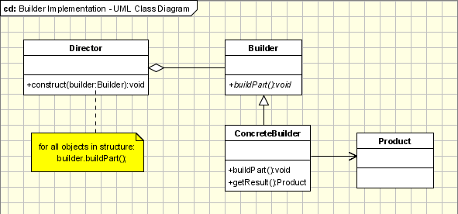
Builder Pattern

Slide 136
Product
  public class BloodTest {
  private String patientName;
  private String test1;
  private String test2;
  //Constructor and Set/GET Method
  }

Slide 137
Abstract Builder
  public abstract class BloodTestBuilder {
  protected BloodTest bldTest;
  public BloodTest getBldTest() {
  return bldTest;
  }
  public void createNewTest() {
  bldTest = new BloodTest();
  }
  public abstract void buildTest1();
  public abstract void buildTest2();
    }

Slide 138
concrete builder
  public class SugarTestBuilder extends BloodTestBuilder {
  @Override
  public void buildTest1() {
  bldTest.setTest1("H!B!C");
  }
  @Override
  public void buildTest2() {
  bldTest.setTest2("PP");
  }
  }

Slide 139
Director
  public class LabTechnician {
  private BloodTestBuilder builder;
  public void setBuilder(BloodTestBuilder builder) {
  this.builder = builder;
  }
  public BloodTest getBloodTest(){
  return builder.getBldTest();
  }
  public void constructTest1() {
  builder.createNewTest();
  builder.buildTest1();
  builder.buildTest2(); }
  public void constructTest2() {
  builder.createNewTest();
  builder.buildTest2();
  } }

Slide 140
The Client
  LabTechnician tech= new LabTechnician();
  BloodTestBuilder builder = new SugarTestBuilder();
  tech.setBuilder(builder);
  tech.constructTest1();
  BloodTest test =tech.getBloodTest();
  System.out.println(test.getTest1());
  System.out.println(test.getTest2());
  tech.constructTest2();
  BloodTest test2 =tech.getBloodTest();
  System.out.println(test2.getTest2());

Slide 141
Builder Pattern
  public class BloodTest {
  private String patientName;
  private String patientId;
  private boolean isH1bAEnabled;
  private boolean isCholostralEnabled;
  public BloodTest(BloodTestBuilder builder)
  {
  this.patientName=builder.patientName;
  this.patientId=builder.patientId;
  this.isCholostralEnabled=builder.isCholostralEnabled;
  this.isH1bAEnabled=builder.isH1bAEnabled;
  }
  }

Slide 142
Builder Pattern
  public static class BloodTestBuilder {
  private String patientName;
  private String patientId;
  private boolean isH1bAEnabled;
  private boolean isCholostralEnabled;
  public BloodTestBuilder setH1bAEnabled(boolean isH1bAEnabled) {
  this.isH1bAEnabled = isH1bAEnabled;
  return this;
  }
  public BloodTestBuilder setCholostralEnabled(boolean isCholostralEnabled) {
  this.isCholostralEnabled = isCholostralEnabled;
  return this;
  }

Slide 143
Builder Pattern
  public BloodTestBuilder(String patientName, String patientId) {
  this.patientName=patientName;
  this.patientId=patientId;
  }
  public BloodTest build(){
  return new BloodTest(this);
  }
  }

Slide 144
Builder-Application
BloodTest test1=new BloodTest.BloodTestBuilder("Ramesh","10203").setCholostralEnabled(true).build();
BloodTest test2=new BloodTest.BloodTestBuilder("Suresh","20203").setCholostralEnabled(true).setH1bAEnabled(true).build();
System.out.println(test1.getPatientId());
System.out.println(test2.getPatientName());

Slide 145
Builder and Abstract Factory
In the case of the Abstract Factory, the client uses the factory�s methods to create its own objects.
In the Builder�s case, the Builder class is instructed on how to create the object and then it is asked for it
The Way that the class is put together is up to the Builder class

Slide 146
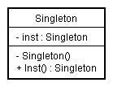
Singleton
Intent
  Ensure a class has only one instance, and provide a global point of access to it.
  Encapsulated "just-in-time initialization" or "initialization on first use".
  Ensures all the objects that use the instance of the class use the same instance.
Problem
  Application needs one, and only one, instance of an object.
  Additionally, lazy initialization and global access are necessary.

Slide 147
Singleton Pattern
Has Multiple Approach to implement
Use Cases
  Used for logging, driver objects, caching and thread pool.
  Used in other design patterns like Abstract Factory, Builder, Prototype, Facade etc.
  Singleton design pattern is used in core java classes
  java.lang.Runtime, java.awt.Desktop.
Common concept of different approaches of this Pattern
  private constructor to restrict instantiation from other classes.
  private static variable of the same class that is the only instance of the class.
  public static method that returns the instance of the class, this is the global access point for outer world

Slide 148
Eager Initialization
Pros
  The instance is created at the time of class loading
  easiest method to create a singleton class
  When the class is not using a lot of resources
Cons
  Instance is created even though client application might not be using it.
  Also this method doesn’t provide any options for exception handling.

Slide 149
Eager Initialization
  public class Singleton {
  private static final Singleton instance = new Singleton();
  private Singleton() { }
  public static getInstance(){
  return instance;
  }
  }

Slide 150
Lazy Initialization
Creates the instance in the global access method.
More suitable in single threaded environment
In a multithreaded systems
  If multiple threads are inside the if loop at the same time.
  It will destroy the singleton pattern and both threads will get the different instances of singleton class.

Slide 151
Lazy Initialization
  public class Singleton {
  private static Singleton instance;
  Private Singleton() { }
  public static Singleton getInstance(){
  if(instance == null){
  instance = new Singleton();
  }
  return instance;
  }
  }

Slide 152
Static block initialization
Similar to eager initialization
  Instance is created in the static block
  Static block has option for exception handling
  the instance is created even before it’s being used
  Not the best practice to use.

Slide 153
Static block initialization
  public class StaticBlockSingleton {
  private static StaticBlockSingleton instance;
  private StaticBlockSingleton(){}
  static{
  try{
  instance = new StaticBlockSingleton();
  }catch(Exception e){
  throw new RuntimeException("Exception occured in creating
  singleton instance");
  }
  }
  public static StaticBlockSingleton getInstance(){
  return instance;
  }
  }

Slide 154
Thread Safe Singleton
A thread-safe singleton class is created by making the global access method synchronized
  it reduces the performance because of cost associated with the synchronized method, although we need it only for the first few threads who might create the separate instances
To avoid this extra overhead every time, double checked locking principle is used.
In this approach, the synchronized block is used inside if condition with an additional check to ensure that only one instance of singleton class is created.

Slide 155
Thread Safe Singleton
  public class ThreadSafeSingleton {
  private static ThreadSafeSingleton instance;
  private ThreadSafeSingleton(){}
  public static synchronized ThreadSafeSingleton getInstance(){
  if(instance == null){
  instance = new ThreadSafeSingleton();
  }
  return instance;
  }
  }

Slide 156
Double checked locking
  public static ThreadSafeSingleton getInstanceUsingDoubleLocking(){
  if(instance == null){
  synchronized (ThreadSafeSingleton.class) {
  if(instance == null){
  instance = new ThreadSafeSingleton();
  }
  }
  }
  return instance;
  }

Slide 157
Serialization and Singleton
The Serializable interface in Singleton class
Destroys the singleton pattern
Can be Avoided by Providing the implementation of readResolve()
protected Object readResolve() {
return getInstance();
}
readResolve() is invoked on the new instance just created by the serialization.

Slide 158
Serialization and Singleton
  public class Singleton implements Serializable {
  private static Singleton instance = new Singleton();
  private int i;
  private Singleton() { }
  public static Singleton getInstance() { return instance; }
  private void readObject(ObjectInputStream ois) throws IOException, ClassNotFoundException {
  ois.defaultReadObject(); instance = this;
  }
  private Object readResolve() {
  return instance;
  }

Slide 159
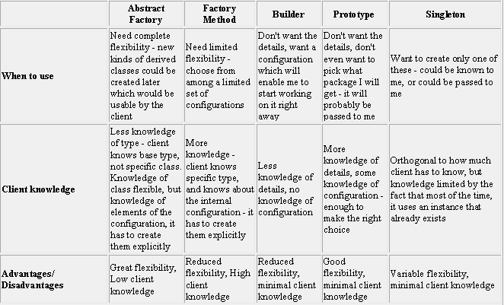
Comparison of Creational Pattern

Slide 160
STRUCTURAL PATTERN

Slide 161
Structural pattern
Adapter Pattern
  Match interfaces of different classes
Façade
  A single class that represents an entire subsystem
Proxy Pattern
  An object representing another object
Bridge
  Separates an object’s interface from its implementation
Composite
  A tree structure of simple and composite objects
Decorator
  Add responsibilities to objects dynamically

Slide 162
Adapter Pattern
Convert the programming interface of one class into that of another.
Used when two unrelated interfaces can work together.
The object that joins these unrelated interface is called an Adapter
by inheritance, - Class Adapters
  A new class is derived from the nonconforming one and added the methods to make the new derived class match the desired interface.
  Class adapters can be implemented in languages allowing multiple inheritance
Object composition. – Object Adapters
  Include the original class inside the new one and create the methods to translate calls within the new class.
  Uses the composition, the Adapter delegates the calls to Adaptee

Slide 163
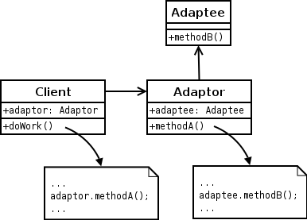
Object Adapter Implementation
objects participating in adapter pattern:
  Target - defines the domain-specific interface that Client uses.
  Adapter - adapts the interface Adaptee to the Target interface.
  Adaptee - defines an existing interface that needs adapting.
  Client - collaborates with objects conforming to the Target interface

Slide 164
Examples in JDK
java.util.Arrays#asList()
java.io.InputStreamReader(InputStream) (returns a Reader)
java.io.OutputStreamWriter(OutputStream) (returns a Writer)

Slide 165
Target Class
  public class BankAccount {
  public double calcualte(double principle)
  {
  System.out.println("Calculate Interest");
  return principle * 0.10d;
  }
  }

Slide 166
The Adoptee Class
  public class LifeInsurance {
  public double calcualtePremium(double principle)
  {
  System.out.println(“Preimium Calculation");
  return principle * 0.05d;
  }
  }

Slide 167
The Adapter Class
  public class AdapterClass extends BankAccount {
  LifeInsurance life;
  public AdapterClass(LifeInsurance life) {
  this.life = life;
  }
  public double calcualte(double principle) {
  return life.calcualtePremium(principle);
  }
  }

Slide 168
Test Adapter
  public class TestAdapater {
  public static void main(String[] args) {
  AdapterClass adapter = new AdapterClass(life);
  adapter.calcualte(6000);
  }
  }

Slide 169
Decorator Pattern
This pattern attaches additional responsibilities to an object dynamically .
Decorators provide a flexible alternatives to sub classing for extending functionality
Decorators have the same super type as the objects they decorate
More than one Decorators can be used to wrap an object
Decorator has the same super type as the object they decorate , they can be passed around where original object is expected
The decorators adds its own behavior either before and/or after delegating to the object it decorates to do the rest of the job.

Slide 170
Decorator Pattern
Decorator pattern is used a lot in Java IO classes, such as FileReader, bufferedReader etc.
Elements of Decorator Pattern
Component - Interface for objects that can have responsibilities added to them dynamically.
ConcreteComponent - Defines an object to which additional responsibilities can be added.
Decorator - Maintains a reference to a Component object and defines an interface that conforms to Component's interface.
Concrete Decorators - Concrete Decorators extend the functionality of the component by adding state or adding behavior.

Slide 171
Related Patterns
Adapter Pattern - A decorator is different from an adapter in that a decorator changes object's responsibilities, while an adapter changes an object interface.
Composite Pattern - A decorator can be viewed as a degenerate composite with only one component. However, a decorator adds additional responsibilities.

Slide 172
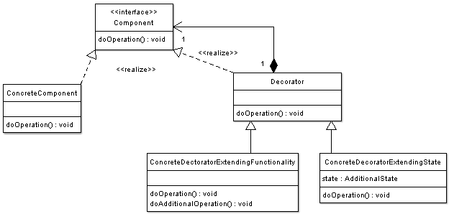
Decorator

Slide 173
Decorator Pattern
  The Component- They can be used on its own or wrapped wth Decorator
  public abstract class BankAccount {
  public String description="unknownAccount";
  public String getDescription()
  {
  return this.description;
  }
  public abstract double balanceToMaintain();
  }

Slide 174
Decorator Pattern
  The Concrete Component is the object ,to which new behavior is going to added to dynamically, It extends component
  public class SavingsAccount extends BankAccount {
  public SavingsAccount() {
  description = "Savings Account";
  }
  public double balanceToMaintain() {
  return 5000.00d;
  }
  }

Slide 175
The Decorator
Each decorator Has-A wrapped component, the decorator has an instance variable that hold a reference to the component
Decorators implement the same interface or abstract class as the component they are going to decorator
  public abstract class FeatureDecorator extends BankAccount {
  BankAccount bk;
  public FeatureDecorator(BankAccount bk) {
  if(bk!=null)
  {
  bk.balanceToMaintain();
  }
  }
  public abstract double balanceToMaintain();
  }

Slide 176
Decorators
  public class MultiCity extends FeatureDecorator {
  BankAccount bkaccObj;
  public MultiCity(BankAccount bkaccObj) {
  super(bkaccObj);
  this.bkaccObj = bkaccObj;
  }

Slide 177
Decorator
  public class OnlineBanking extends FeatureDecorator {
  public BankAccount bkObj;
  public OnlineBanking(BankAccount bkObj) {
  super(bkObj);
  this.bkObj = bkObj;
  }
  public double balanceToMaintain() {
  return bkObj.balanceToMaintain()+6000;
  }
  public String getDescription() {
  return bkObj.getDescription() + "Has Online Banking";
  }

Slide 178
Test Decorators
  public static void main(String[] args) {
  BankAccount bkObj = new SavingsAccount();
  System.out.println("Both Multicity and Online Facility");
  BankAccount bkObj =
  new OnlineBanking(new MultiCity(bkObj));
  System.out.println(bkObj2.balanceToMaintain());
  }
  }

Slide 179
Façade Pattern
Makes a complex system simpler by providing a unified or general interface, which is a higher layer to these subsystems.
Where to use & benefits
  To reduce complexities of a system.
  Decouple subsystems , reduce its dependency, and improve portability.
  Make an entry point subsystems.
  Minimize the communication and dependency between subsystems.
JDBC design is a good example of Façade pattern.
JDBC is used to connect the database and manipulate data without exposing details to the clients.

Slide 180
Façade Pattern
Like a helper for client applications, it doesn’t hide subsystem interfaces from the client.
Whether to use Facade or not is completely dependent on client code.
Can be applied at any point of development, usually when the number of interfaces grow and system gets complex.
Subsystem interfaces are not aware of Facade and they shouldn’t have any reference of the Facade interface.

Slide 181
Façade Pattern
Applied for similar kind of interfaces
Provide a single interface rather than multiple interfaces that does the similar kind of jobs.
Can use Factory pattern with Facade to provide better interface to client systems

Slide 182
Component and Its Implementation
public interface Store {
public String getGoods();
}
public class ElectronicStore implements Store {
public String getGoods() {
return "DVD,TV,IPod";
}
}
public class FurnitureStore implements Store {
public String getGoods() {
return "Computer Table,Dinining Table";
}
}

Slide 183
The Façade Class
  public class StoresFacade {
  public ElectronicStore getElectronics()
  {
  ElectronicStore eStore = new ElectronicStore();
  return eStore;
  }
  public FurnitureStore getFurnitures()
  {
  FurnitureStore fStore = new FurnitureStore();
  return fStore;
  }

Slide 184
Test the Facade
public static void main(String[] args) {
StoresFacade sf = new StoresFacade();
System.out.println(sf.getElectronics().getGoods());
System.out.println(sf.getFurnitures().getGoods());
}

Slide 185
Proxy Pattern
  proxy pattern is used when we want to provide controlled access of a functionality.
used to represent a complex with a simpler one.
If creation of object is expensive, its creation can be postponed till the very need arises and till then, a simple object can represent it.
This simple object is called the “Proxy” for the complex object
The Proxy holds reference to the RealObject ,Clients interact with the realObject through the proxy .
Because both the proxy and RealObject implement the same interface .
The Proxy can be substituted where Subject can be requested

Slide 186
Proxy Pattern
The participants classes in the proxy pattern are:
Subject
  Interface implemented by the RealSubject and representing its services.
  The interface must be implemented by the proxy as well so that the proxy can be used in any location where the RealSubject can be used.
Proxy
  Maintains a reference that allows the Proxy to access the RealSubject.
  Implements the same interface implemented by the RealSubject so that the Proxy can be substituted for the RealSubject.
  Controls access to the RealSubject and may be responsible for its creation and deletion.
  Other responsibilities depend on the kind of proxy.
RealSubject - the real object that the proxy represents.

Slide 187
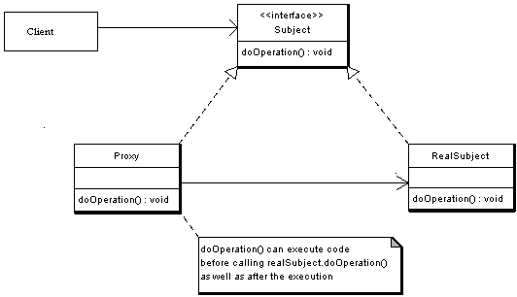

Slide 188
Proxy Pattern
public interface Subject {
public void request();
}
public class RealSubject implements Subject {
public void request() {
System.out.println("Hello From Real Subject");
}

Slide 189
The Proxy Class
  public class ProxySubject implements Subject {
  Subject sub;
  public void request() {
  sub = new RealSubject();
  sub.request();
  }
  }

Slide 190
Test the Proxy
  public class TestProxy {
  public void callProxy(Subject sub)
  {
  sub.request();
  }
  public static void main(String[] args) {
  ProxySubject pxySub = new ProxySubject();
  TestProxy tpxy = new TestProxy();
  tpxy.callProxy(pxySub);
  }

Slide 191
Composite Pattern
Used to represent a part of whole hierarchy.
When there is a need to create a structure in a way that the objects in the structure has to be treated the same way
Should be applied when the group of objects should behave as the single object.
Used to create a tree like structure.
What makes the Composite pattern one of the most beautiful is the power of recursion.

Slide 192
Composite Pattern
Composite Pattern consists of following objects.
Base Component
  Its the interface for all objects in the composition,
  client program use to work with the objects in the composition.
  Can be Java interface or an abstract class with some methods common to all the objects.
Leaf
  Defines the behavior for the elements in the composition.
  It is the building block for the composition and implements base
  component.
  It doesn’t have references to other Components.
Composite
  It consists of leaf elements and implements the operations in base component.

Slide 193
Composite Pattern
Composite Pattern in JDK
java.awt.Container#add(Component) is a great example of Composite pattern in java and used a lot in Swing.
java.util.Map#putAll(Map)
java.util.List#addAll(Collection)
java.util.Set#addAll(Collection)
java.nio.ByteBuffer#put(ByteBuffer) (also on CharBuffer, ShortBuffer, IntBuffer, LongBuffer, FloatBuffer and DoubleBuffer)

Slide 194
Composite Pattern
Client use the component class interface to interact with objects in the composition structure.
if recipient is a leaf then request is handled directly.
If recipient is a composite,then it usually forwards request to its child components,
possibly performing additional operations before and after forwarding.

Slide 195


Slide 196
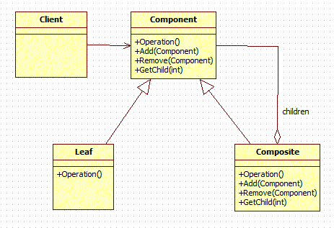

Slide 197
Base Component
public abstract class Employee {
public abstract void showEmployeeDetails();
}

Slide 198
The Leaf
  public class Accountant extends Employee {
  private String name;
  private double salary;
  public void showEmployeeDetails() {
  System.out.println("Name :="+name+"Salary:="+salary);
  }
  }

Slide 199
Another Leaf
  public class Engineer extends Employee {
  private String name;
  private double salary;
  public void showEmployeeDetails() {
  System.out.println("Name :="+name +"Salary :="+salary);
  }
  }

Slide 200
Composite
  public class GenralManager extends Employee {
  private List<Employee> employeeList = new ArrayList<Employee>();
  public void addEmployee(Employee e)
  {
  employeeList.add(e);
  }
  public void showEmployeeDetails() {
  for(Employee emp:employeeList){
  emp.showEmployeeDetails();
  }
  }
  }

Slide 201
Composite Client
  public static void main(String[] args) {
  Engineer eng1 = new Engineer("Nataraj", 4500.00);
  Engineer eng2 = new Engineer("Ravi", 560.00);
  GenralManager mgr=new GenralManager();
  mgr.addEmployee(eng1);
  mgr.addEmployee(eng2);
  Accountant acc1 = new Accountant("Gopi", 6700.00);
  Accountant acc2 = new Accountant(“Gopal",1700.00);
  mgr.addEmployee(acc1);
  mgr.addEmployee(acc2);
  mgr.showEmployeeDetails();
  }

Slide 202
Bridge Design Pattern
Decouple an abstraction from its implementation so that the two can vary independently”
Bridge design pattern is a modified version of the notion of “prefer composition over inheritance”.
Creates two different hierarchies. One for abstraction and another for implementation.
Avoids permanent binding by removing the dependency between abstraction and implementation.
We create a bridge that coordinates between abstraction and implementation.

Slide 203
Bridge Pattern
Abstraction and implementation can be extended separately.
Should be used when we have need to switch implementation at runtime.
Client should not be impacted if there is modification in implementation of abstraction.
Best used when you have multiple implementations.

Slide 204
Elements of Bridge Design Pattern
Abstraction – core of the bridge design pattern and defines the crux. Contains a reference to the implementer.
Refined Abstraction – Extends the abstraction takes the finer detail one level below. Hides the finer elements from implemetors.
Implementer – This interface is the higer level than abstraction. Just defines the basic operations.
Concrete Implementation – Implements the above implementer by providing concrete implementation.

Slide 205
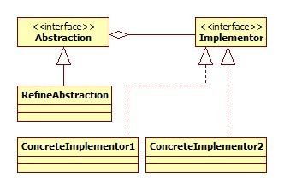
Bridge Pattern

Slide 206
Abstraction – core of the bridge design pattern and defines the crux. Contains a reference to the implementer.
Refined Abstraction – Extends the abstraction takes the finer detail one level below. Hides the finer elements from implemetors.
Implementer – This interface is the higer level than abstraction. Just defines the basic operations.
Concrete Implementation – Implements the above implementer by providing concrete implementation

Slide 207
Abstraction
public interface Workshop {
abstract public void work();
}

Slide 208
Implementer
public class Assemble implements Workshop {
public void work() {
System.out.println(" Assembled.");
}

Slide 209
Refined Abstraction
  public class Car extends Vehicle {
  public Car(Workshop workShop1, Workshop workShop2) {
  super(workShop1, workShop2);
  }
  @Override
  public void manufacture() {
  System.out.print("Car ");
  workShop1.work();
  workShop2.work();
  }
  }

Slide 210
Concrete Implementation
public class Produce implements Workshop {
public void work() {
System.out.print("Produced");
}
}

Slide 211
public abstract class Vehicle {
protected Workshop workShop1;
protected Workshop workShop2;
protected Vehicle(Workshop workShop1, Workshop workShop2) {
this.workShop1 = workShop1;
this.workShop2 = workShop2;
}
abstract public void manufacture();
}

Slide 212
public class BridgePatternClient {
public static void main(String[] args) {
Vehicle vehicle1 = new Car(new Produce(), new Assemble());
vehicle1.manufacture();
Vehicle vehicle2 = new Bike(new Produce(), new Assemble());
vehicle2.manufacture();
}
}

Slide 213
Bridge Vs Adapter Design Pattern
The adapter design pattern helps it two incompatible classes to work together.
But, bridge design pattern decouples the abstraction and implementation by creating two different hierarchies.

Slide 214


Wishing You All the Best
&
Thank You!
K.Srivatsan
vatsank@gmail.com

