Slide 1
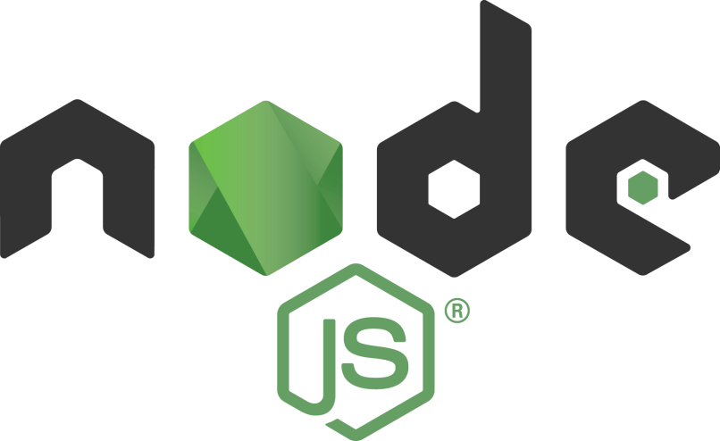
Node.js Security Tips
Tamar Twena-Stern

Slide 2
Eval Function
Eval – a function in JavaScript which is used for evaluate code.
You can put an expression in your eval function
Eval will evaluate your code
You will get the result of the evaluation

Slide 3
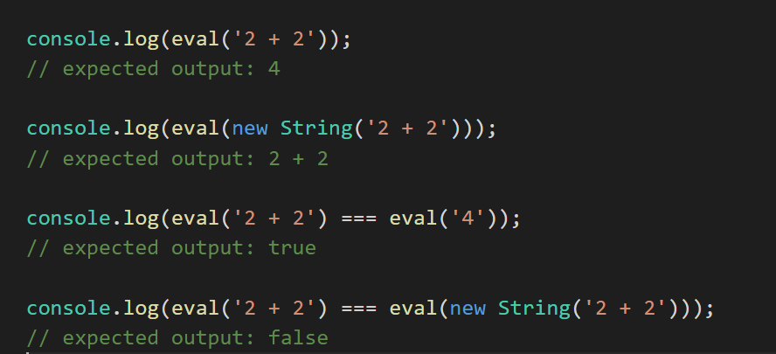
Eval Code Sample

Slide 4
Injection Attack - Definition
Specific class of software attacks
Allows the attacker to supply untrusted input to a program
The input will get processed as part of the execution of the software
The input can cause damage to the software
Example :
SQL injection
Command injection

Slide 5
Don’t use eval
Eval can open your application to injection attacks.
If the expression that eval is handling are coming from the input that you get you application will be exposed ti injection attacks
Make sure that if you do use eval:
The expression is not come from the user input
You will use escaping techniques on the expression or balcklist

Slide 6
Functions That Use Eval
The following functions use eval in their implementation :
setInterval
setTimeout
New Function(string)
Make sure that you control the input that they get

Slide 7
Use Strict
new feature in ECMAScript 5
allows you to place a program, or a function, in a "strict" operating context.
Strict context prevents certain actions from being taken and throws more exceptions.
It catches some common coding bloopers, throwing exceptions.
It prevents, or throws errors, when relatively "unsafe" actions are taken (such as gaining access to the global object).
It disables features that are confusing or poorly thought out.

Slide 8
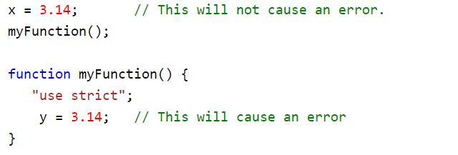
Use strict – What’s not allowed
Working with undeclared variables:
Another example – use strict in a function scope

Slide 9

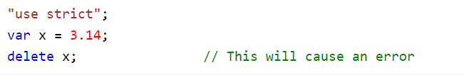
Use strict – What’s not allowed
Working with undeclared objects:
Delete a variable or a function:

Slide 10

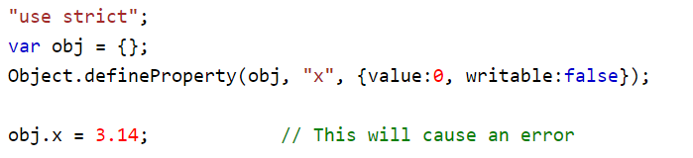
Use strict – What’s not allowed
Duplicate a parameter name :
Writing to a read only variable

Slide 11
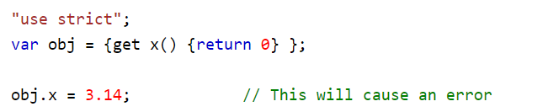

Use strict – What’s not allowed
Writing to a get-only property is not allowed:
Deleting an undeletable property

Slide 12
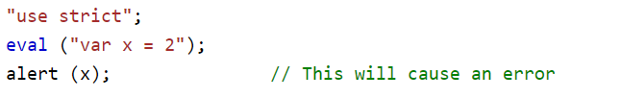

Use strict – What’s not allowed
For security reasons, eval() is not allowed to create variables in the scope from which it was called:
Use the variable name eval is not allowed

Slide 13
Why Use Strict Modd
eval in strict mode does not introduce new variables, which helps control its output
In strict mode, any assignment to the following throw an error:
non-writable property
getter-only property
non-existing property
non-existing variable
non-existing object

Slide 14
Why Use Strict Mode - Continue
Strict mode makes it easier to write “secure” JavaScript.
As you saw in the examples, things that an attacker can reasonably do, will be blocked in strict mode.

Slide 15
Handle Errors Carefully
Stack traces can reveal information that can be interesting to an attacker.
Providing debugging information as a result of operations that generate errors is considered a bad practice.
Always log the stack trace, but never show it to the users.

Slide 16
Don’t Run Your Node.js Process With Super-User Rights
If the process has super user rights, the attacker can harm your system in a much severe way
For Example – a super user will not have any problem to perform injection attacks
If the process does not have super user rights, some of the injection attacks can be blocked in the process level

Slide 17
Set Up The Following HTTP Headers
Strict-Transport-Security enforces secure (HTTP over SSL/TLS) connections to the server
X-Frame-Options provides clickjacking protection
X-XSS-Protection enables the Cross-site scripting (XSS) filter built into most recent web browsers
X-Content-Type-Options prevents browsers from MIME-sniffing a response away from the declared content-type
Content-Security-Policy prevents a wide range of attacks, including Cross-site scripting and other cross-site injections

Slide 18
Disable X-Powered-By Header
In your request, this header will have the value express
Attackers will use this header to perform specific related express attacks
Best practice is to disable this header
Helmet will take care of this out of the box.

Slide 19
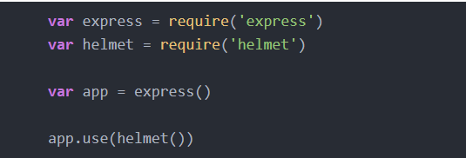
To Set Up The Headers Automatically – Use Helmet Module

Slide 20
Put The Following Flags In Each Cookie
secure - Only send the cookie if the request is being sent over HTTPS.
HttpOnly - Help prevent attacks such as cross-site scripting since it does not allow the cookie to be accessed via JavaScript.

Slide 21
Put The Following Flags In Each Cookie To verify The Cookie Scope
domain - indicates the domain of the cookie; use it to compare against the domain of the server in which the URL is being requested. If they match, then check the path attribute next.
path - indicates the path of the cookie; use it to compare against the request path. If this and domain match, then send the cookie in the request.
expires - use to set expiration date for persistent cookies.

Slide 22
Use Retire Module To Find Vulnerabilities In Your Npm Modules
The goal of Retire.js is to help you detect the use of module versions with known vulnerabilities.
Npm install –g Retire
After that, running it with the retire command will look for vulnerabilities in your node_modules directory.

Slide 23
Questions ?

