Slide 1

Advanced Techniques For GNSS
Weighted Least squares estimation
Student: Ajay Ragh
Guide: Ansgar Dreier

Slide 2
Aim?

Slide 3
Improve SPP
Improve the accuracy of SPP by using Weighting Techniques.
Techniques Explored:
C/N0 Weighting
Elevation Weighting
Combined SNR and Elevation weighting

Slide 4
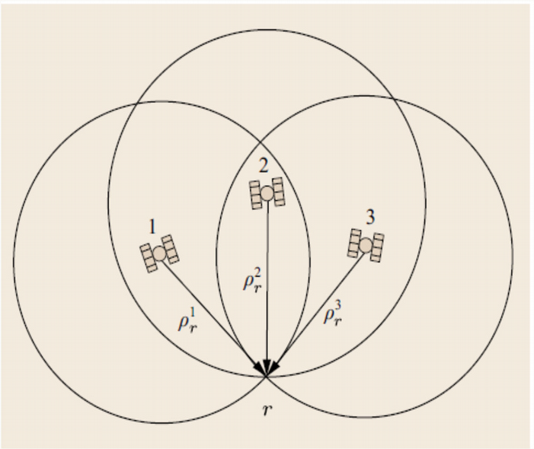
Single Point Positioning (SPP)

Slide 5
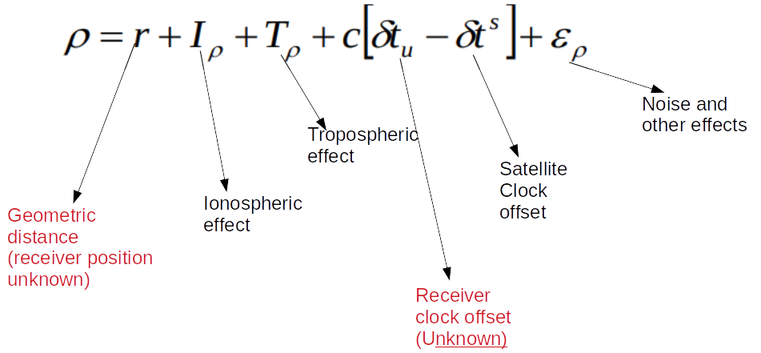

Single Point Positioning
The Geometry Consist of one receiver antenna and at least 4 satellites.
Estimate the receiver position via Least Squares(LS) estimation.
The Unknowns are receiver position (X,Y,Z) and receiver clock offset
The measurement model is given by:
The uncertainty of measurement is:

Slide 6
How?

Slide 7
Weighting Techniques
The idea is to decide varying weightages for each measurement based on some parameter.
The higher weight means more reliable measurement and vice versa.
Commonly weighting is done based on the C/No (Carrier-Noise ratio), satellite elevation angle or a combination of both.
These two parameters are good indicators of the measurement quality.

Slide 8
Satellite Elevation Weighting (1/2)
The measurement quality improves as elevation angle moves towards zenith (90º )
Traditionally we use elevation masks to remove satellites elevation near horizon (less than 10º-5º)
In this technique we instead of removing the measurements we assign a weight depending on its elevation angle.

Slide 9
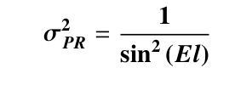
Satellite Elevation Weighting (2/2)
We calculate the uncertainty of measurement from the elevation angle by:
The stochastic model showing the uncertainty of measurement in the LS estimation :

Slide 10
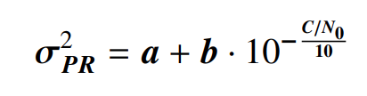
C/No Weighting
Like elevation weighting, here we estimate the uncertainty of measurement using the C/No as quality indicator.
The uncertainty is calculated by the model from Kuusniemi et al. (2007)
The values a and b are model parameters whose values were estimated in Kuusniemi, (2005)

Slide 11
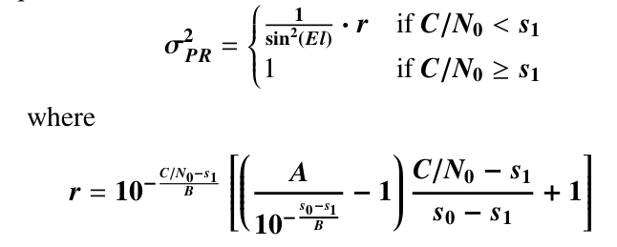
Combined Elevation & C/No Weighting
A technique that calculates an uncertainty value based on the elevation angle and C/No of the received signal proposed in Realini and Reguzzoni(2013).
Here s1 is the threshold value for C/No.
The other parameter values are s0 = 10,
A=B=30 (Angrisano et al., 2018)

Slide 12

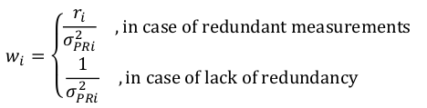
Redundancy Matrix
Redundancy Matrix (R) is used to understand the contribution towards the total redundancy of the system.
The diagonal elements r_{i} redundancy number (values between 0-1).
Low r_{i} is leverage measurement (lack redundancy).

Slide 13
Implementation

Slide 14
Data
Approximately 24 hour GNSS raw measurements as a RINEX file (9841 epochs).
A smaller data sequence of 75 epochs.
From the larger data we extracted two smaller data sequences based on satellite visibility.
High satellite visibility sequence
Low satellite visibility sequence

Slide 15
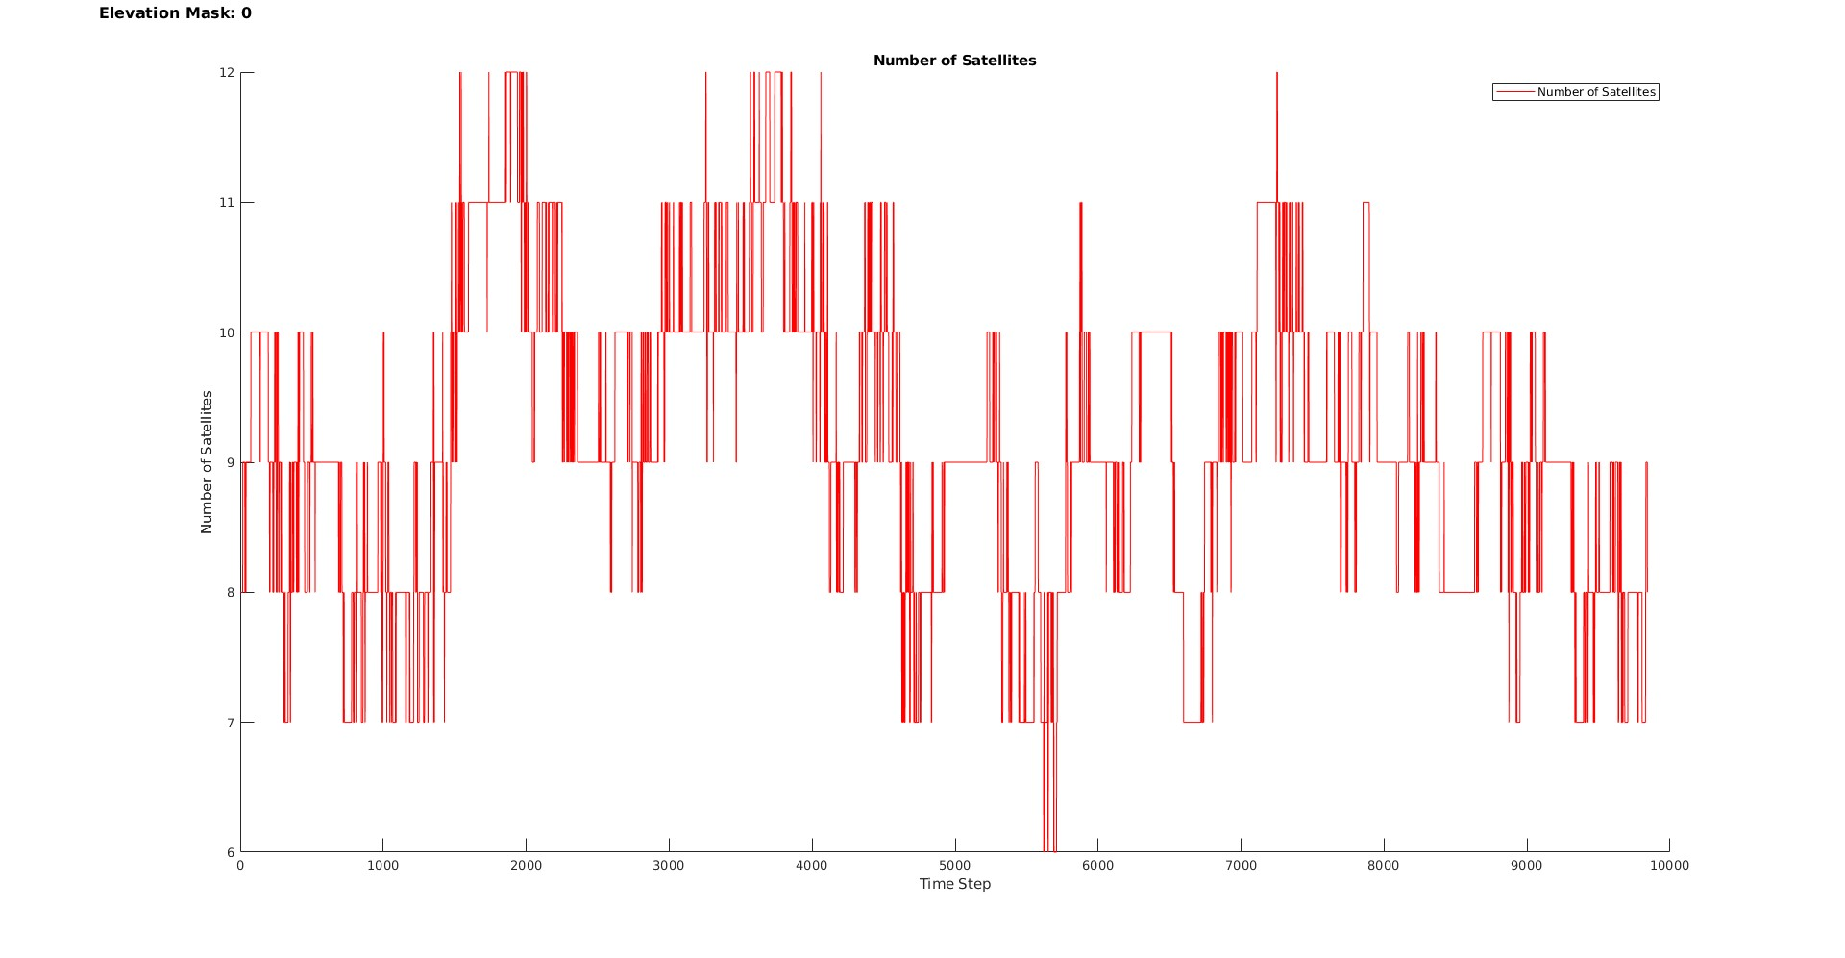
Satellite Visibility Plot Of Large Sequence

Slide 16
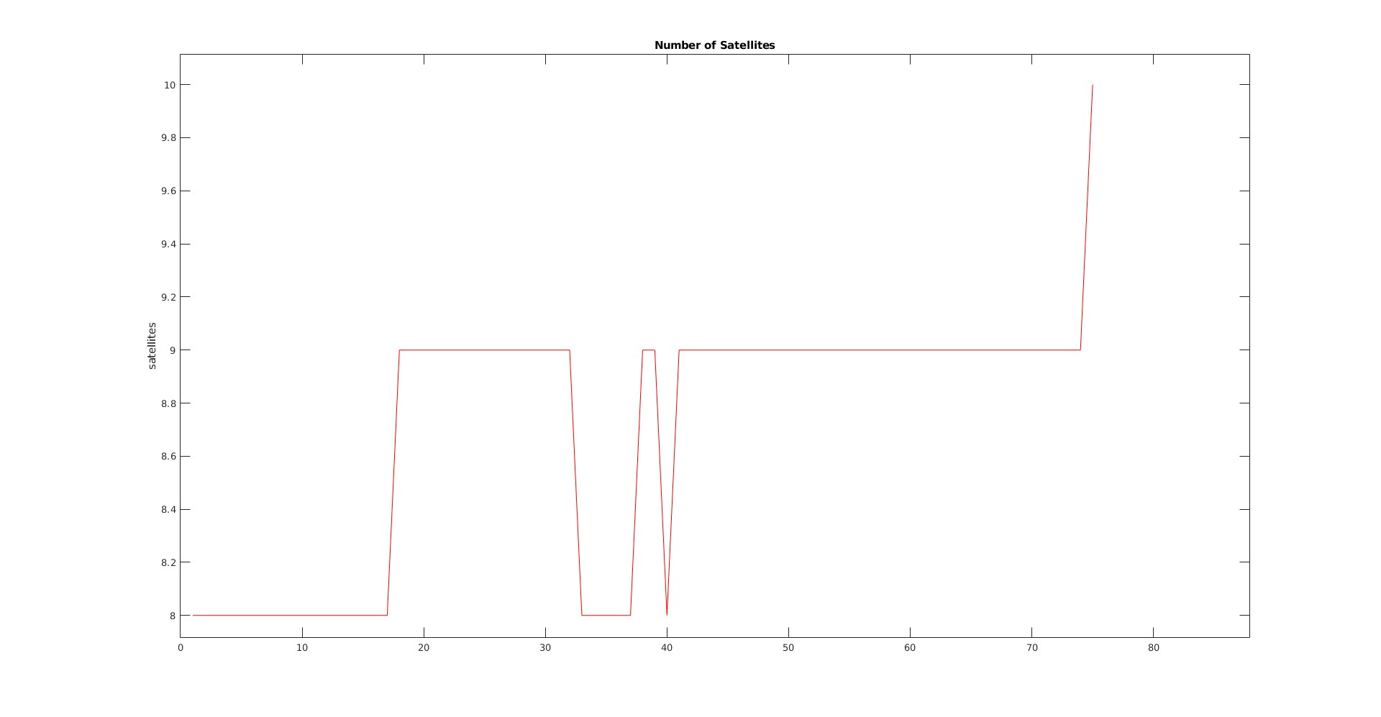
Satellite Visibility Plot Of Small Sequence

Slide 17
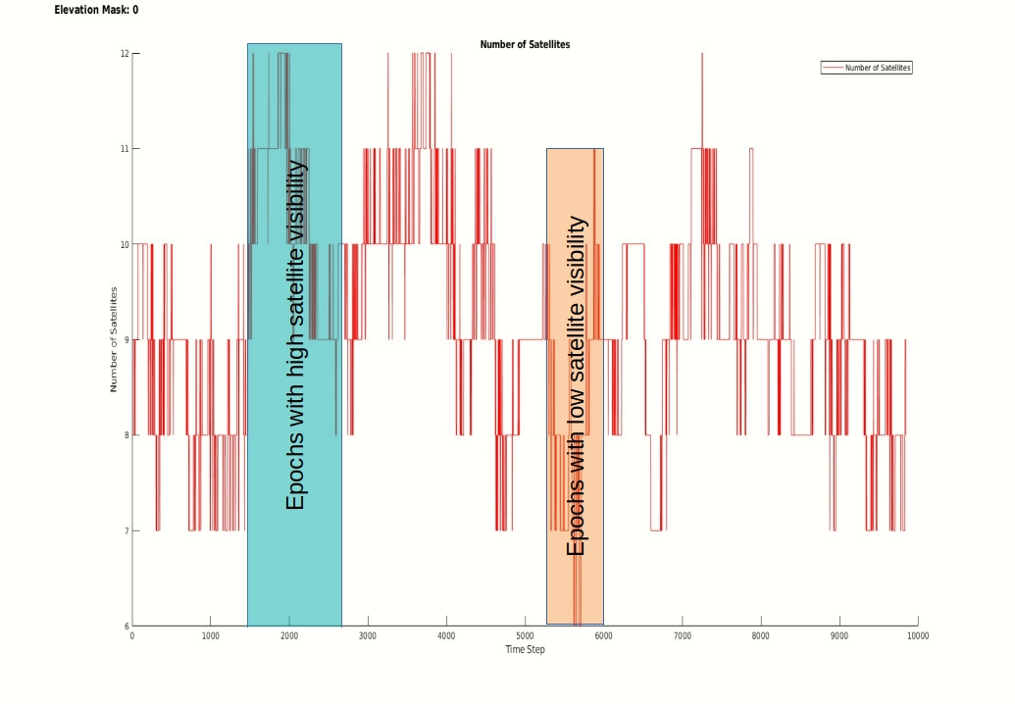
High and Low satellite Visibility data sequence regions

Slide 18
Plots (PDOP)

Slide 19
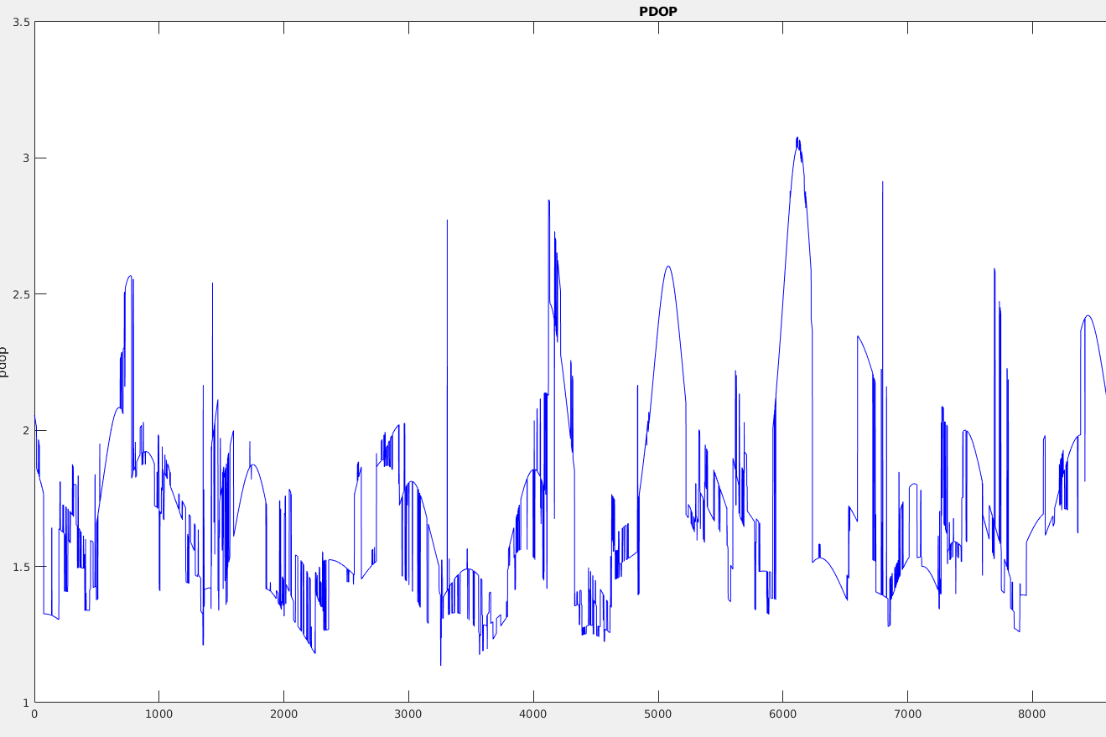
EQW
Data sequence: Large
Plot: PDOP
Variation:
1.13 to 3.07

Slide 20
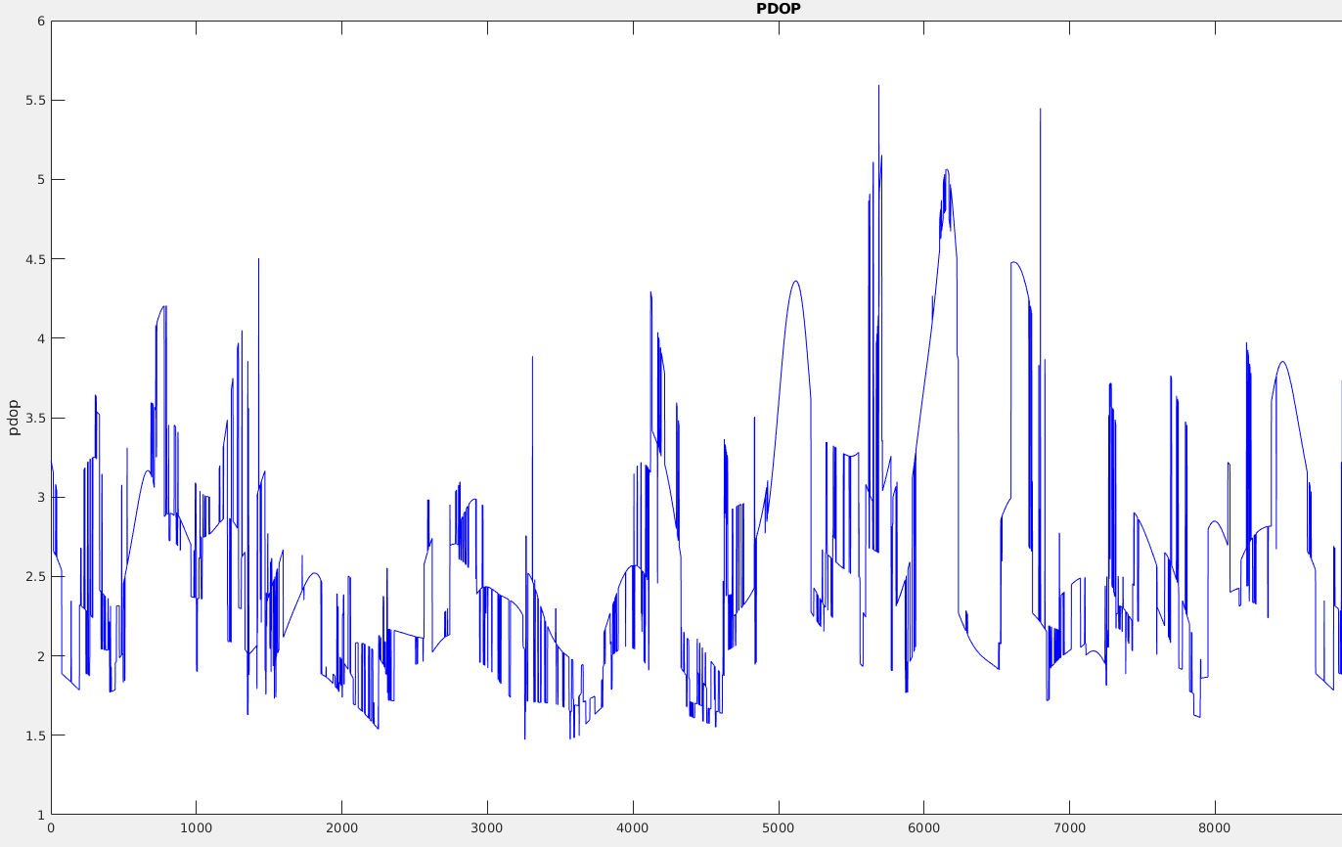
EQW+RDM
Data sequence: Large
Plot: PDOP
Variation:
1.47 to 5.59

Slide 21
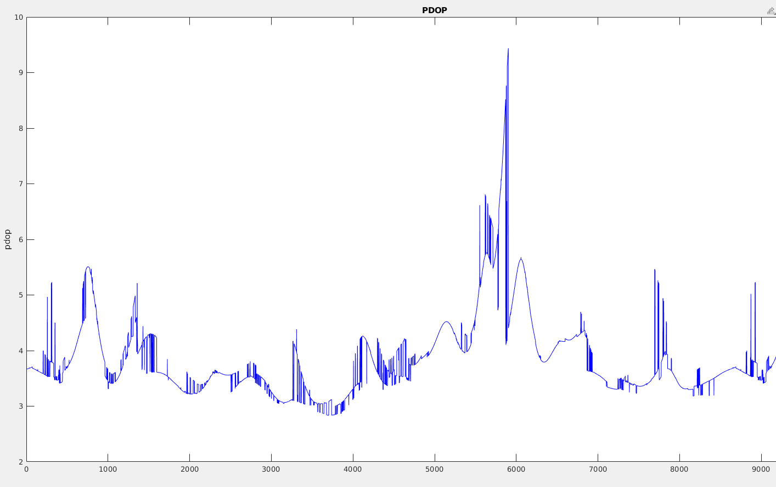
ELV
Data sequence: Large
Plot: PDOP
Variation:
2.83 to 9.41

Slide 22
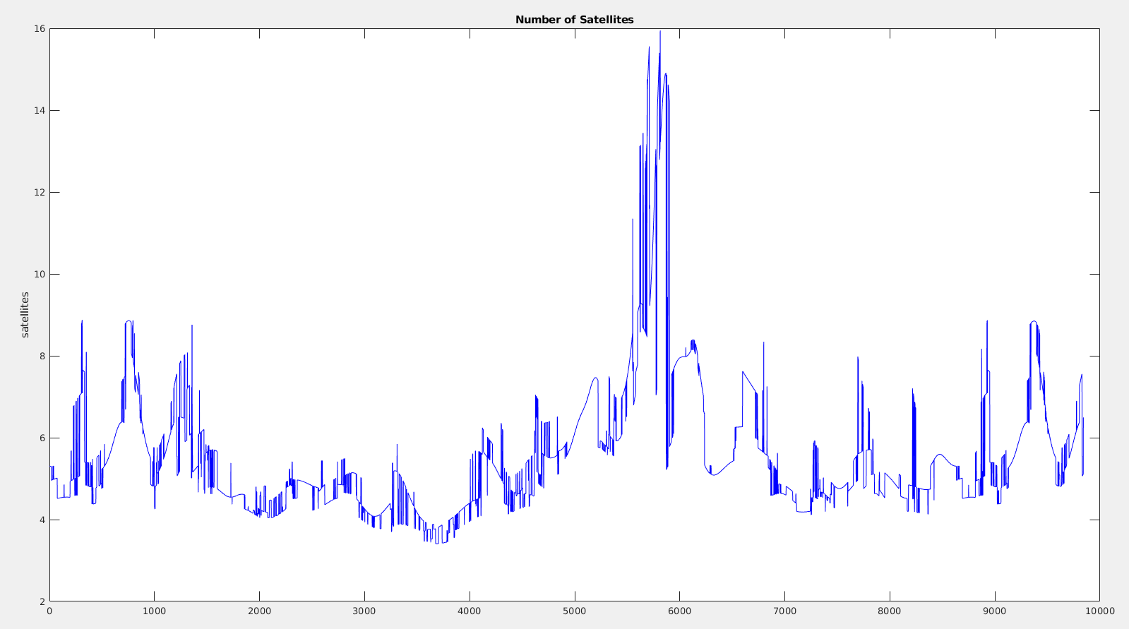
ELV+RDM
Data sequence: Large
Plot: PDOP
Variation:
3.41 to 15.94

Slide 23
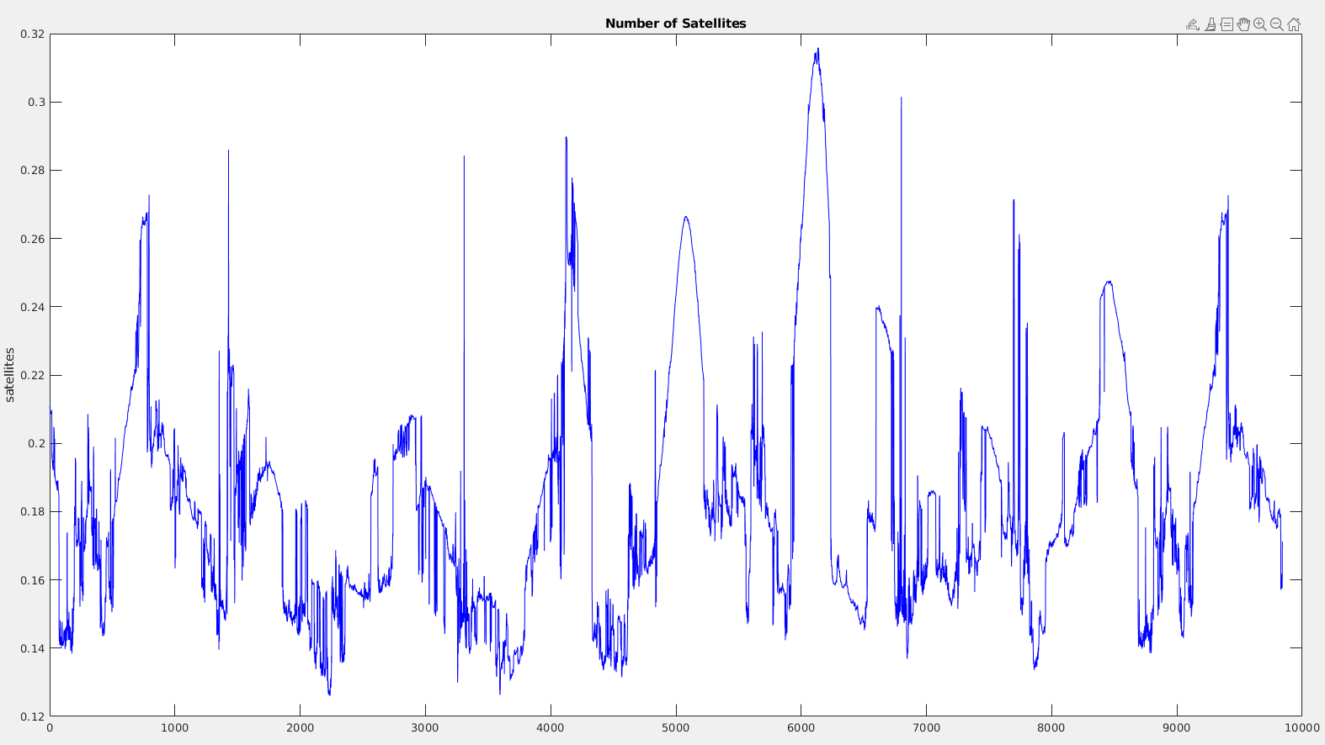
CN
Data sequence: Large
Plot: PDOP
Degradation: Light
Params: a = 0.01, b= 25
Variation:
0.12 to 0.31

Slide 24
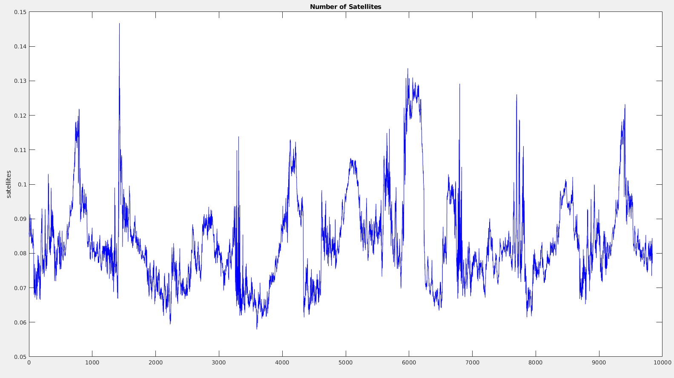
CN
Data sequence: Large
Plot: PDOP
Degradation: Heavy
Params: a = 0.001, b= 40
Variation:
0.057 to 0.14

Slide 25
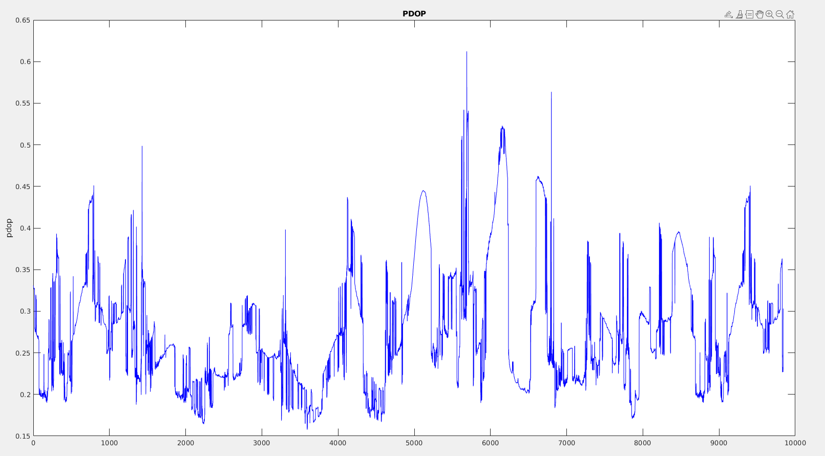
CN+RDM
Data sequence: Large
Plot: PDOP
Degradation: Light
Params: a = 0.01, b= 25
Variation:
0.15 to 0.61

Slide 26
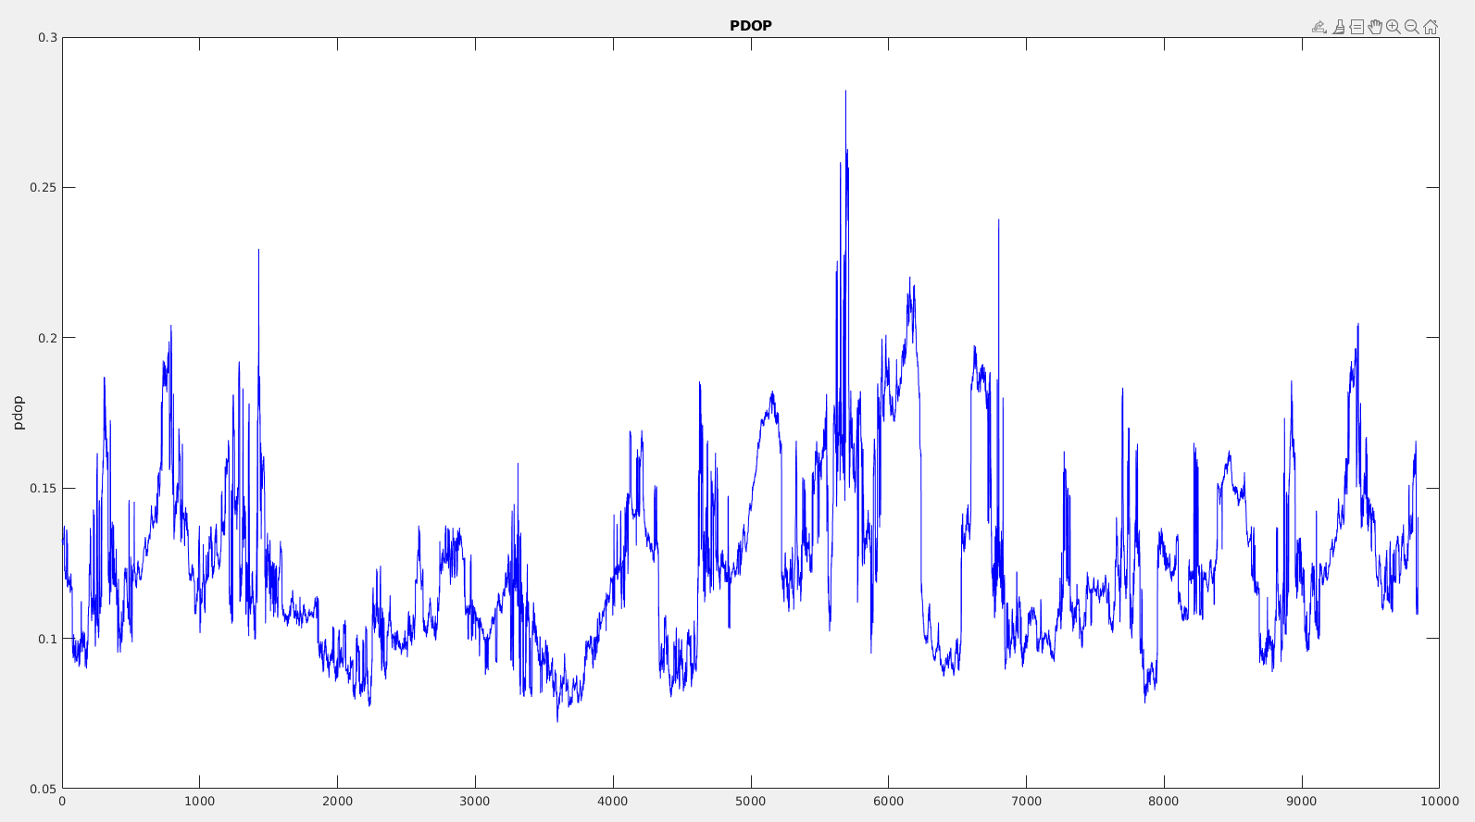
CN+RDM
Data sequence: Large
Plot: PDOP
Degradation: Heavy
Params: a = 0.001, b= 40
Variation:
0.07 to 0.28

Slide 27
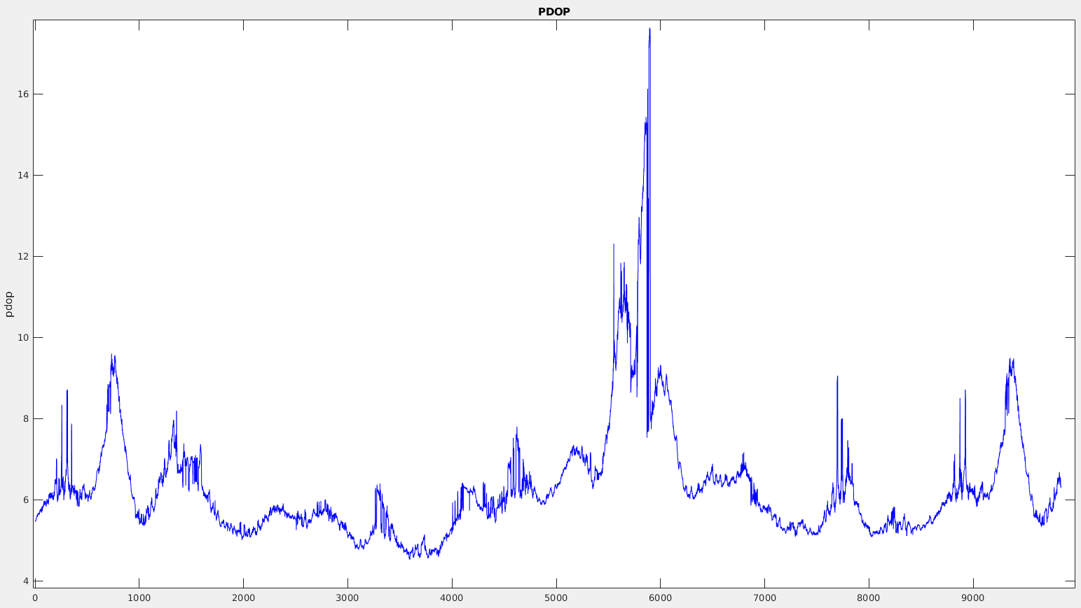
ELVCN
Data sequence: Large
Plot: PDOP
Threshold: 60
Variation:
4.51 to 17.62

Slide 28
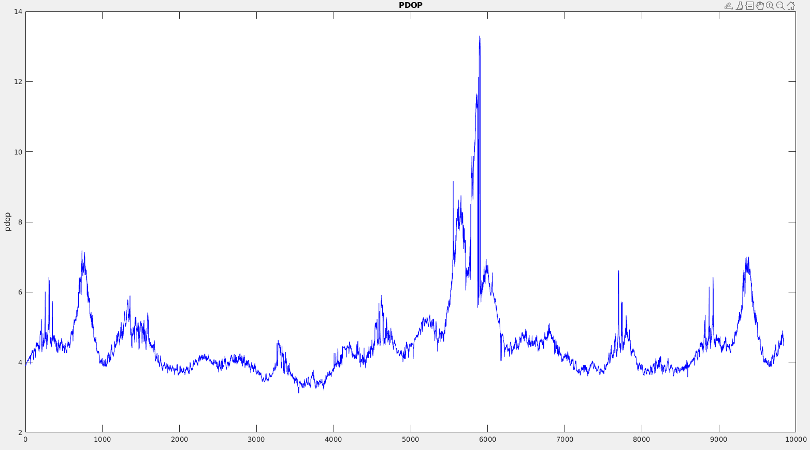
ELVCN
Data sequence: Large
Plot: PDOP
Threshold: 50
Variation:
3.12 to 13.27

Slide 29
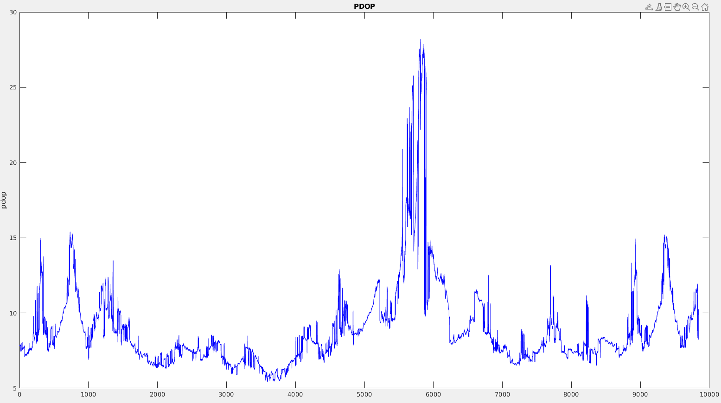
ELVCN+RDM
Data sequence: Large
Plot: PDOP
Threshold: 60
Variation:
5.49 to 28.19

Slide 30
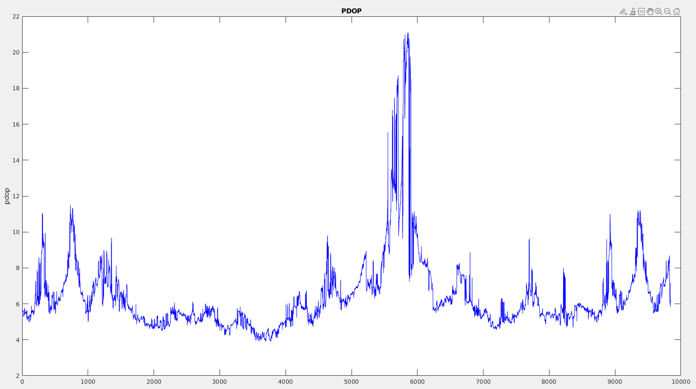
ELVCN+RDM
Data sequence: Large
Plot: PDOP
Threshold: 50
Variation:
3.90 to 21.07

Slide 31
Plots (RMS Error)

Slide 32
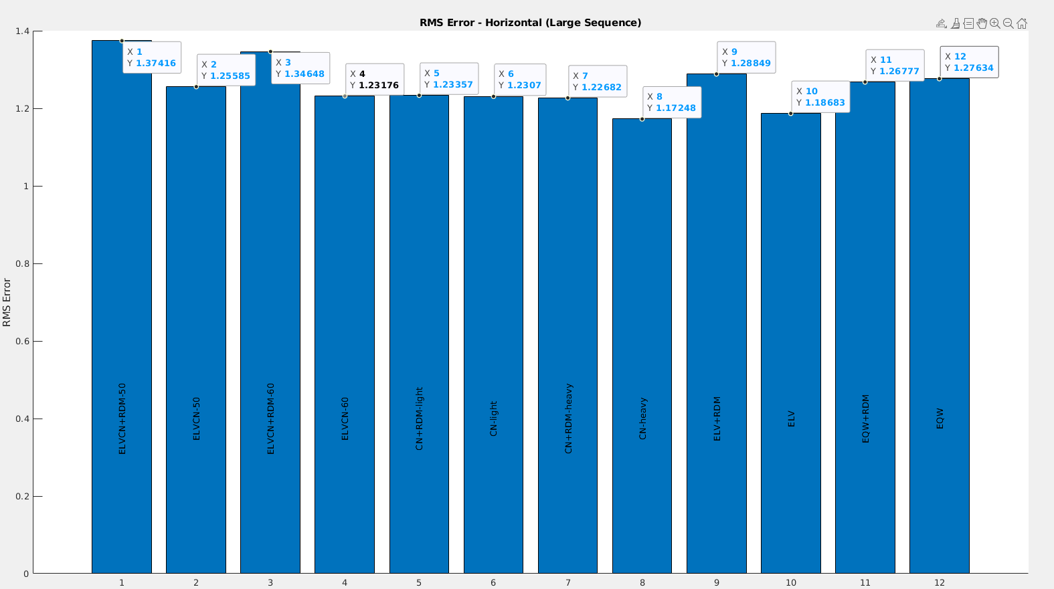
Large - Horizontal
Best technique:
CN Heavy (1.17248)
ELV (1.18683)

Slide 33
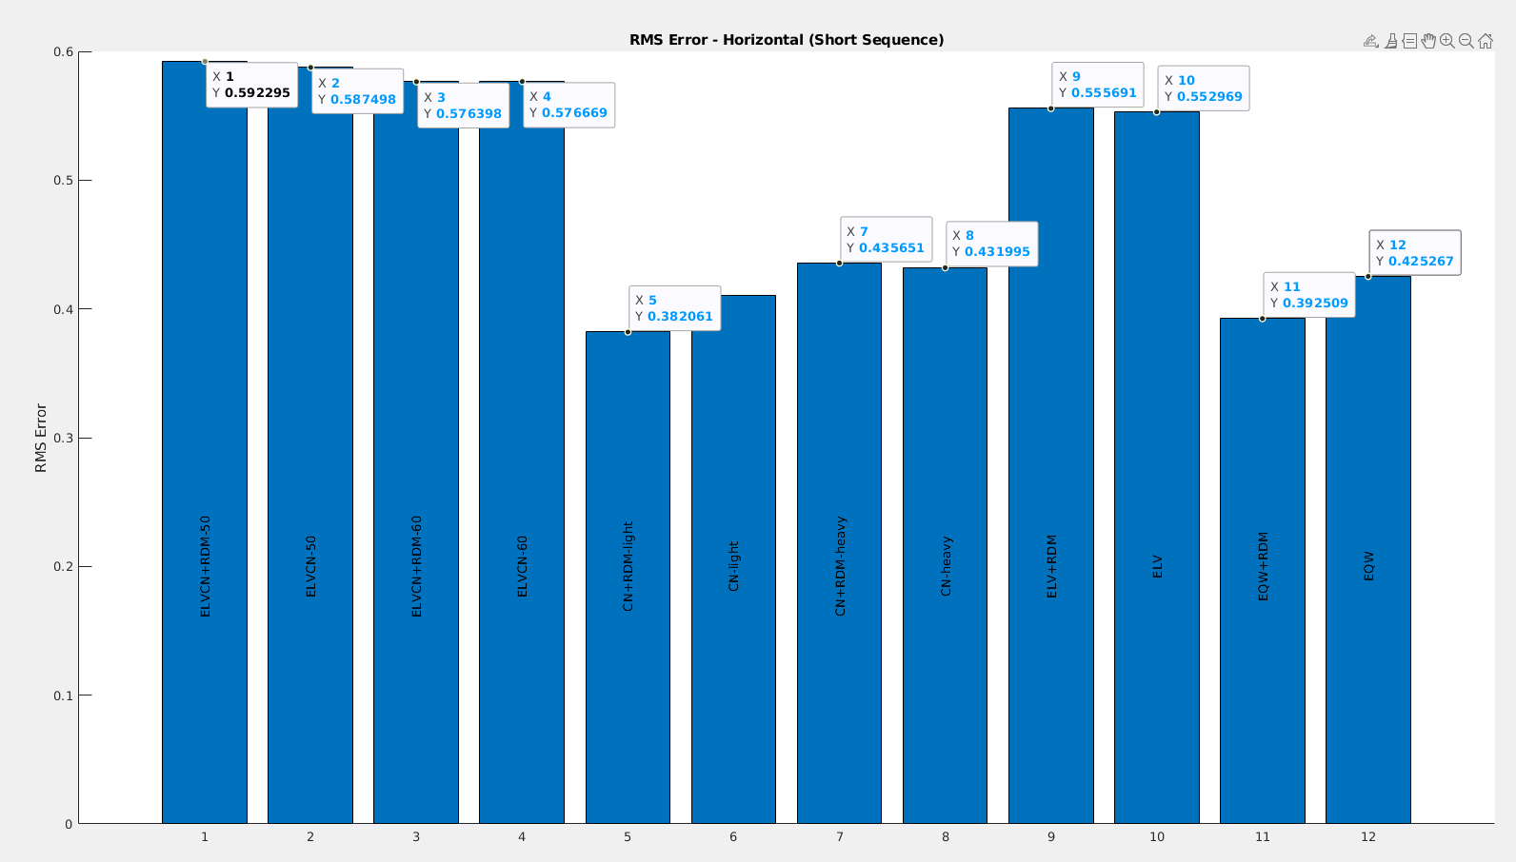
Short - Horizontal
Best technique:
CN+RDM Light (0.38206)
EQW+RDM (0.392509)

Slide 34
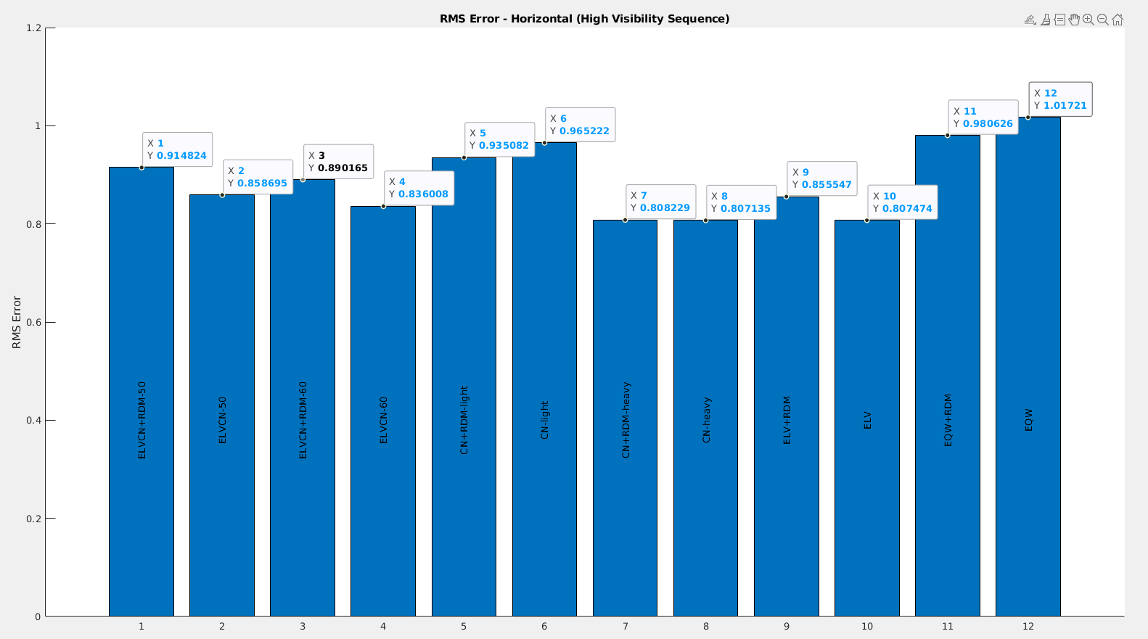
High Visibility- Horizontal
Best technique:
CN Heavy (0.8071)
ELV (0.8074)

Slide 35
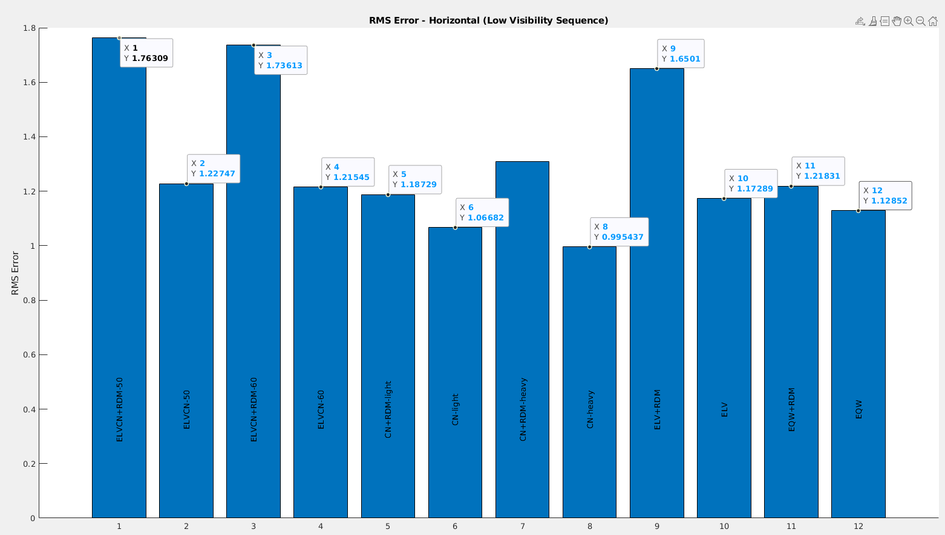
Low Visibility - Horizontal
Best technique:
CN Heavy (0.9954)
CN Light (1.0668)

Slide 36
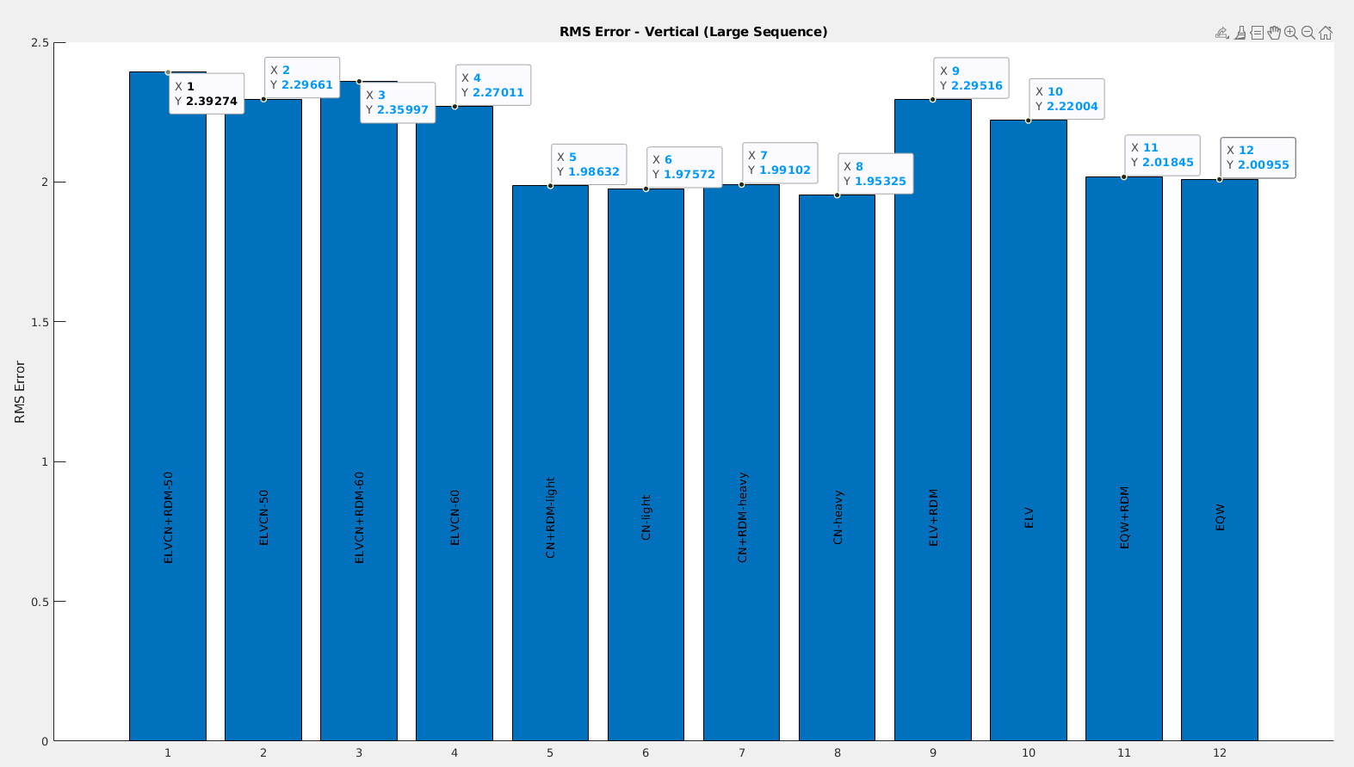
Large - Vertical
Best technique:
CN Heavy (1.95325)
CN Light (1.97572)

Slide 37
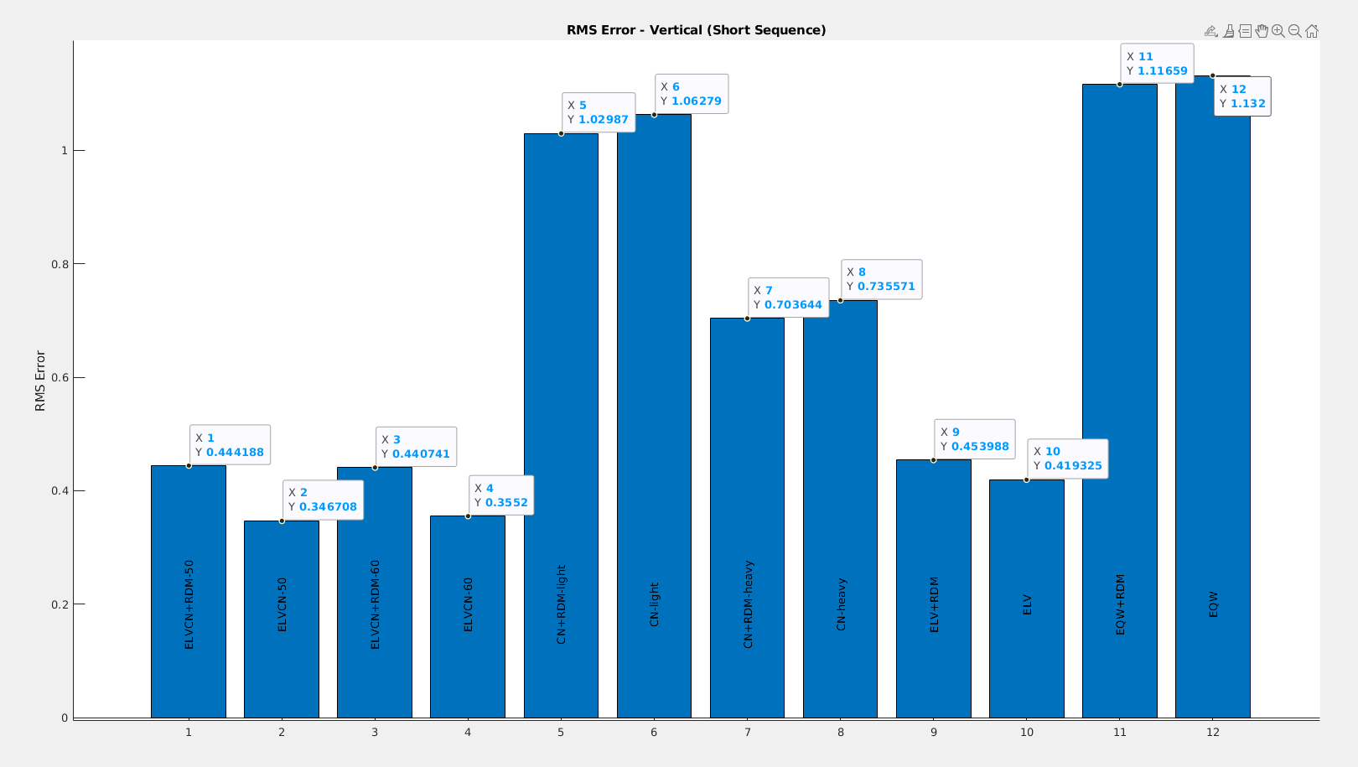
Short - Vertical
Best technique:
ELVCN-50 (0.3467)
ELVCN-60 (0.3552)

Slide 38
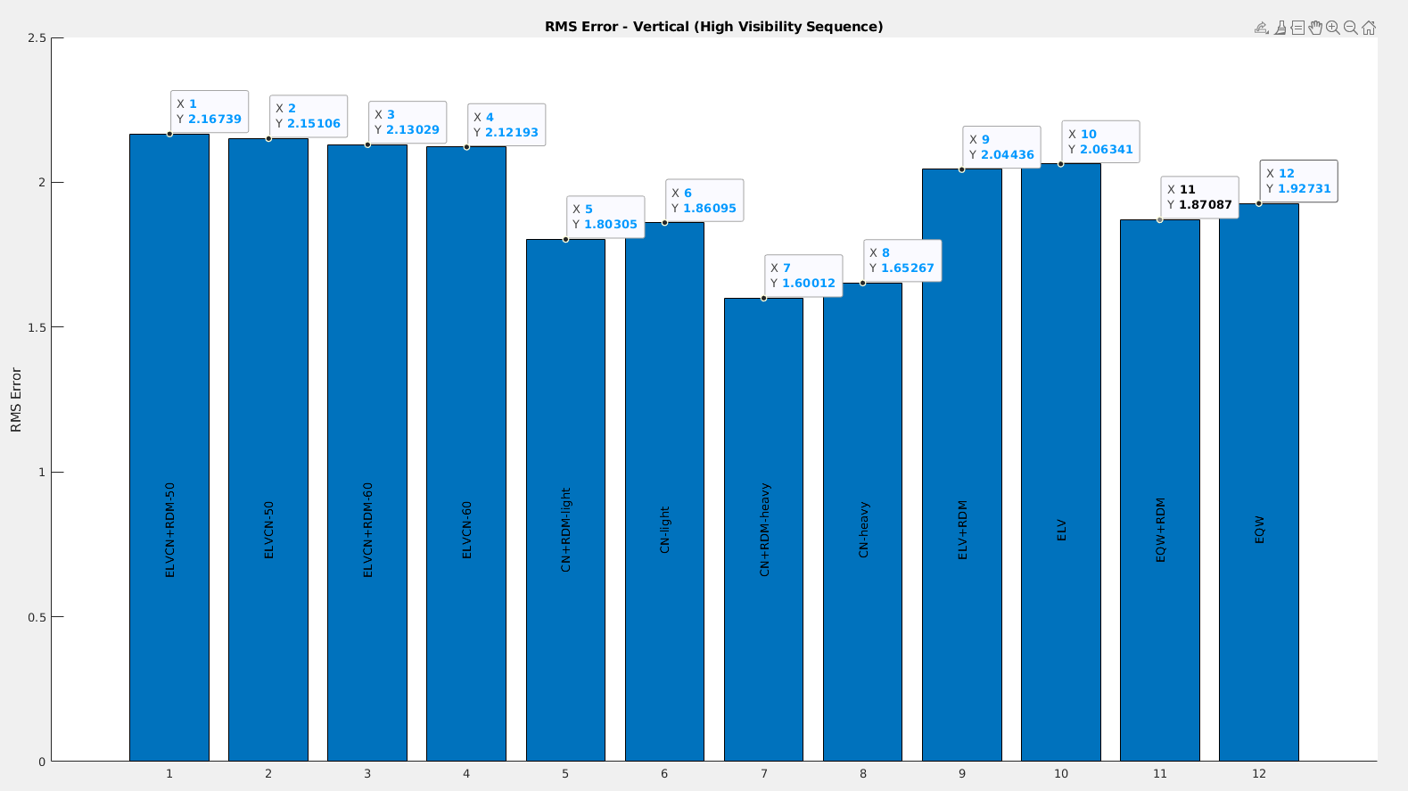
High Visibility- Vertical
Best technique:
CN+RDM Heavy(1.60012)
CN Heavy (1.65267)

Slide 39
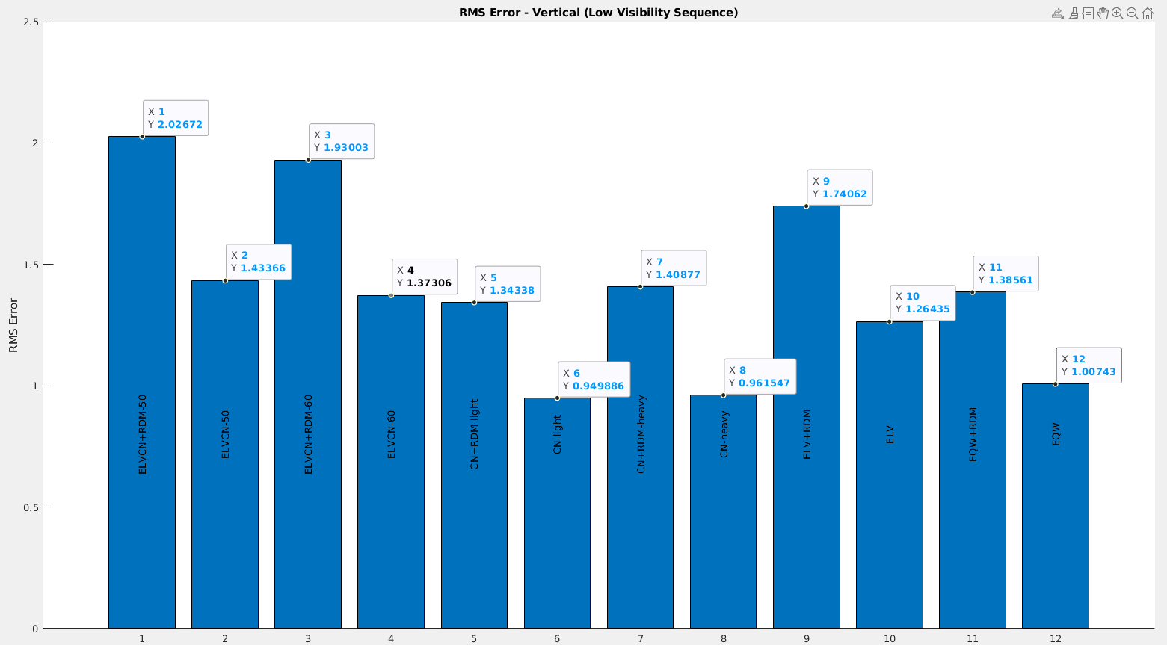
Low Visibility - Vertical
Best technique:
CN Light (0.949886)
CN Heavy (0.961547)

Slide 40
Conclusion

Slide 41
Best Performing Techniques
Data | Max Error | Mean Error | RMS Error
Short | CN+RDM(Light) | CN+RDM(Light) | CN+RDM(Light)
Large | CN (Heavy) | ELV | CN (Heavy)
Low Sat Visibility | CN (Heavy) | CN (Heavy) | CN (Heavy)
High Sat Visibility | ELVCN60 | CN (Heavy) | CN (Heavy)
Data | Max Error | Mean Error | RMS Error
Short | ELVCN50 | ELVCN50 | ELVCN50
Large | CN (Heavy) | CN (Heavy) | CN (Heavy)
Low Sat Visibility | CN (Light) | CN (Light) | CN (Light)
High Sat Visibility | CN +RDM (Heavy) | CN +RDM (Heavy) | CN +RDM (Heavy)
Horizontal Component
Vertical Component

Slide 42
Observations
Weighting techniques improved the error in measurement.
Redundancy matrix gave mixed results, but we have observed some cases especially in data sequences with high visibility where redundancy matrices gave slightly better or similar results.
We found that C/No based techniques performed the best in majority of the experiments.
The best performing techniques :
CN (Heavy) : best in 10 cases
CN (Light), CN+RDM(Light), CN+RDM(Heavy), ELVCN50 all these techniques came best in 3 cases each.

Slide 43
Thank You

