Slide 1

Gradle
Date : Nov 14, 2016
GOPAL REDDY

Slide 2

Agenda
What is Gradle
advantages of Gradle
Installation of Gradle
Build script of gradle
Dependency Management
Gradle plugins
Gradle commands
Build a java project
Running test cases
Build multiple projects
Deployment
Profile management
Gradle scopes
Eclipse integration

Slide 3
What is Gradle
Gradle is an open source, advanced automation build management tool. It is built on ANT, Maven, and lvy repositories. It supports Groovy based Domain Specific Language (DSL) over XML.
It replaces XML based on build scripts with an internal DSL that is based on the Groovy programming language.
Gradle is a multi-language, multi-platform, multi-project and multi-channel build and automation software.
It has Ant’s power and flexibility with Maven’s life-cycle and ease of use.
The end result is a tool that was released in 2012 and gained a lot of attention in a short period of time. For example, Google adopted Gradle as the default build tool for the Android OS.

Slide 4
advantages of Gradle
Drawbacks of Maven :
Maven follows some pre-defined Build and Automation life cycle. Sometimes it may not fit to our project needs.
Even though we can write custom Maven life cycle methods, but it is bit tough and verbose.
It’s build scripts are bit tough to maintain for very complex projects.
Advantages of Gradle :
Gradle is available with separate Domain Specific Language (DSL) based on Groovy language. Gradle provides declarative language elements. The elements also provide build-by-convention support for Java.
Like Maven, Gradle is also an expressive, declarative, and maintainable build Tool.
Like Maven, Gradle also supports Dependency Management.
It provides very scalable and high-performance builds.
It provides Standardized project layout and life-cycle, but full flexibility and the option to fully configure the defaults.
It is very easy-to-use Gradle tool and very flexible to implement our own Project required custom logics.
It supports for project structures that consist of more than one project to build deliverable.
It is very easy to integrate existing Ant/Maven with Gradle.
It is very easy to migrate from existing Ant/Maven to Gradle.
Gradle combines most of the popular build tools into a single build tool.

Slide 5
Installation of Gradle
Gradle requires JDK version 6 or later to be installed in your system.
Download the latest version of Gradle from the below link.
https://gradle.org/gradle-download/
Extract the downloaded zip file and set up PATH and GRADLE_HOME in Environmental variables.
Verify the Gradle installation by using the below in command prompt.
> gradle –v
For Installation more in detail visit below links.
http://www.journaldev.com/7971/introduction-to-gradle
https://www.tutorialspoint.com/gradle/gradle_installation.htm
https://www.javacodegeeks.com/2013/04/how-to-install-gradle-2.html
http://www.java2novice.com/gradle/installation/
https://rominirani.com/gradle-tutorial-part-1-installation-setup-2ea77729fc8c
http://www.bryanlor.com/blog/gradle-tutorial-how-install-gradle-windows

Slide 6
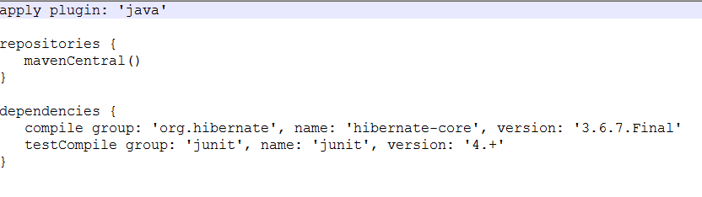
Build script of Gradle
Gradle builds a script file for handling two things one is projects and another one is tasks.
Every Gradle build represents one or more projects. A project represents a library JAR or a WAR.
A task means a piece of work which a build performs. A task might be compiling some classes, creating a JAR, generating Javadoc, or publishing some archives to a repository.
Gradle provides a Domain Specific Language (DSL), for describing builds. This uses the Groovy language to make it easier to describe a build. Build script of Gradle named as build.gradle.
We can run task by using below Gradle command.
> gradle <task name>
Example build scripting file given below.

Slide 7


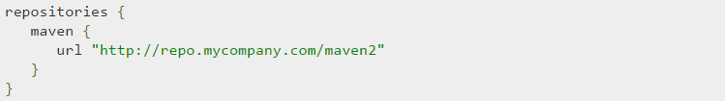
Gradle Dependency Management
Gradle follows some special syntax to define dependencies like below.
Gradle providing different standard Dependency configurations.
1. Compile
2. Runtime
3. Test Compile
4. Test Runtime
While adding external dependencies. Gradle looks for them in a repository. A repository is just a collection of files, organized by group, name and version.
By default, Gradle does not define any repositories. We have to define at least one repository explicitly.
There are two types of repositories, one is maven repository and another one is remote maven define like below.

Slide 8
Gradle plugins
A plugin is nothing but a set of tasks, almost all useful tasks such as compiling tasks, setting domain objects, setting up source files, etc. are handled by plugins.
There are two types of plugins in Gradle.
1. Script plugins
2. Binary plugins.
Script plugins is an additional build script that gives a declarative approach to manipulating the build.
Binary plugins are the classes that implement the plugin interface and adopt a programmatic approach to manipulating the build.

Slide 9
Gradle Commands
Gradle command | Description
gradle build | run Gradle on the gradle build script located in the same directory
gradle init --type <library name> | to create a project.
gradle compileCode | compile the Code in the build script located in the same directory
gradle clean build | first execute the task named clean and then the task named build.
gradle build -x test | this will exclude the test task from execution.
gradle tasks | it will show the all tasks found in the build script located in the directory in which you run .
gradle tasks –all | If you use the --all flag you will get more information about each task.
gradle jar | It will generate jar.
gradle –gui | It will build the UI content.
gradle –h | It shows a list of the gradle command's options by passing the -h flag.
gradle dependencies | It will show all dependencies.
gradle eclipse | it will convert the project into eclipse structure.
gradle <task name> -P<option> | it is used for run specified task in build script.

Slide 10
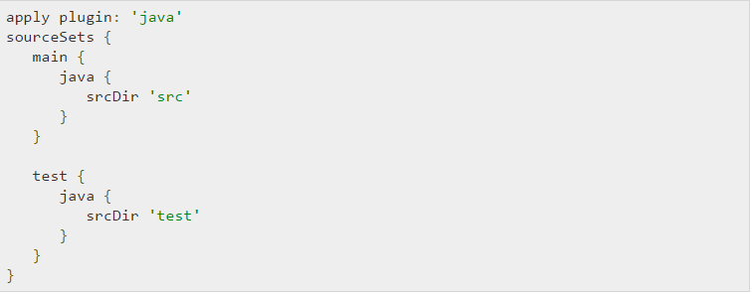
Build a java project
Gradle comes with a "Java plugin" which provides a set of tasks commonly used when building Java projects.
By using the Gradle Java plugin can save you a lot of time when writing your Gradle build script, because you don't have to write all the needed tasks yourself.
SourceSets can be used to specify a different project structure. For example, the sources are stored in a src folder rather than in src/main/java.
Finally run the below command for project build.
> gradle build

Slide 11
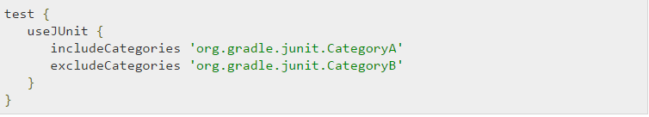
Running test cases
The test task automatically detects and executes all unit tests in the test source set. It also generates a report once test execution is complete. JUnit and TestNG are the supported APIs.
Test class has an include and exclude method. These methods can be used to specify, which tests should actually be run.
It will run only the included test cases.
It will skip test cases.

Slide 12
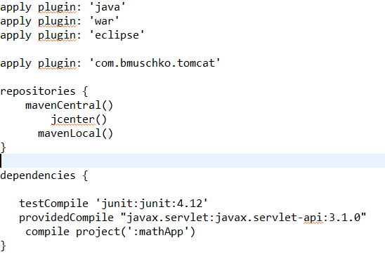
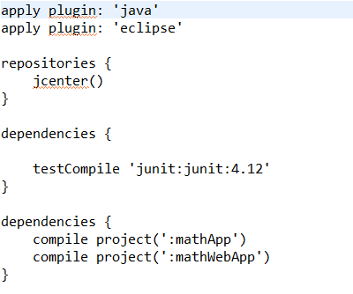
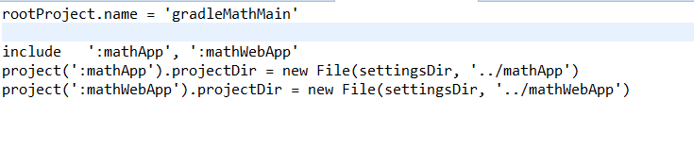
Build multiple projects
Gradle can handle smallest and largest projects easily. Small projects have a single build file and a source tree.
It is very easy to understand a project that has been split into smaller, inter-dependent modules. Gradle perfectly supports this scenario that is multi-project build.
Here ‘mathApp’ and ‘mathWebApp’ are two subprojects.Both projects combining into single ‘gradleMathMain’.

Slide 13
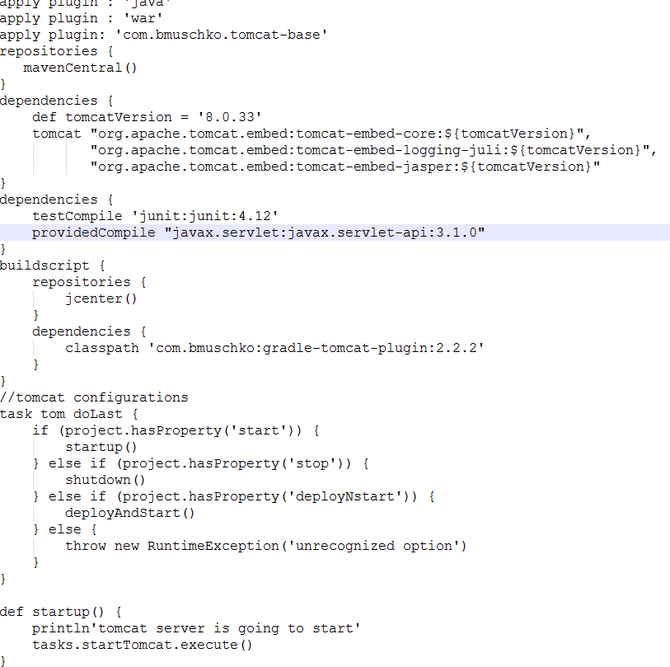
Deployment
Gradle offers several ways to deploy build artifacts repositories. When deploying signatures for your artifacts to a Maven repository, you will also want to sign the published POM file.
Gradle provides maven-publish plugin by default. It is used to publish the gradle script.

Slide 14
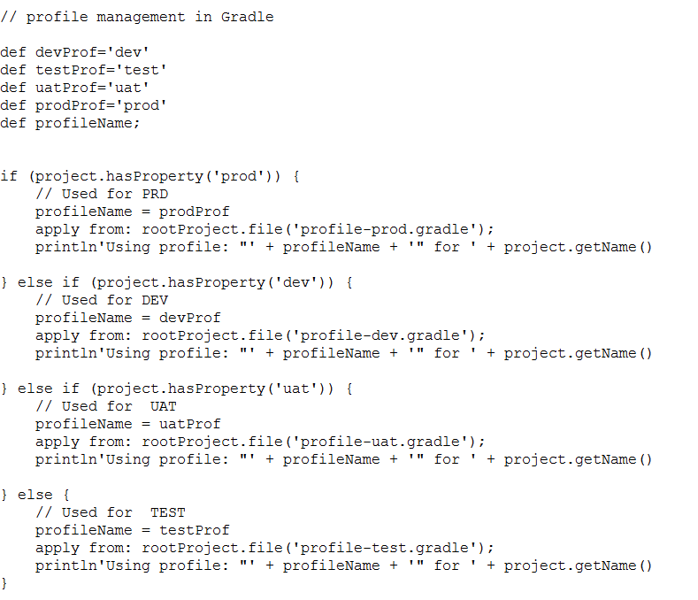
Profile Management
Profile Management concept that allows applications to be loaded in different configuration states. This feature can be used to set environment-specific dependencies and properties across each sub-project. Below script for profile management
We can run by using below command for specific environment
> gradle –P<state name>

Slide 15
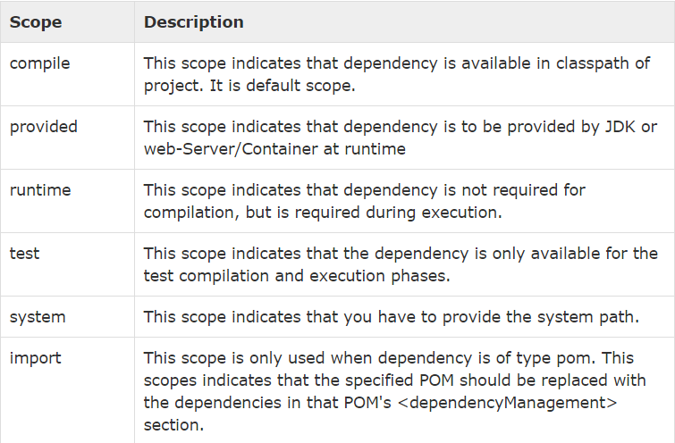
Gradle scope
Scope is used to limit the transitivity of a dependency, and also to affect the classpath used for various build tasks. Maven scopes are given below.
Gradle Scopes:
Compile: The dependencies required to compile the production source of the project.
Runtime: The dependencies required by the production classes at runtime. By default, also includes the compile time dependencies.
testCompile: The dependencies required to compile the test source of the project. By default, also includes the compiled production classes and the compile time dependencies.
testRuntime: The dependencies required to run the tests. By default, also includes the compile, runtime and test compile dependencies.

Slide 16
Eclipse Integration
Open Eclipse IDE → go to Help menu → select eclipse Marketplace.
In Eclipse Marketplace wizard find search box and type buildship and press enter.
It will show all gradle plugins and choose and install “Buildship Gradle Integration 1.0”.
Confirm and accept the license agreement after it will take some time to install.
After installation you verify go to file → click New → click Other projects and select Gradle Project and click Next.

Slide 17
Thank you

