Slide 1

JDBC
18/01/2017
Venkatesh Sami – Crew Pay

Slide 2

Agenda
Why use JDBC
Types of Drivers
DriverManager class
Connection Interface
Statement Interface
Result Set Interface
Prepared Statement Interface
Callable Statement
Datatypes
Store & Retrieve image or files in database
Transaction Management
Batch Processing
Exception Handling
Rowset

Slide 3
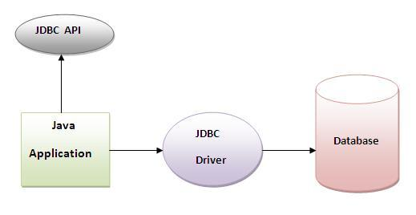
Why use JDBC…?
Before JDBC, ODBC API was the database , API to connect and execute query with the database. But, ODBC API uses ODBC driver which is written in C language (i.e. platform dependent and unsecured). That is why Java has defined its own API (JDBC API) that uses JDBC drivers (written in Java language).
Java JDBC is a java API to connect and execute query with the database. JDBC API uses JDBC drivers to connect with the database.
Java JDBC(Java DataBase Connectivity)
API
API (Application programming interface) is a document that contains description of all the features of a product or software. It represents classes and interfaces that software programs can follow to communicate with each other. An API can be created for applications, libraries, operating systems, etc….

Slide 4
JDBC Driver
JDBC Driver is a software component that enables java application to interact with the database , There are 4 types of JDBC drivers
JDBC-ODBC bridge driver
Native-API driver (partially java driver)
Network Protocol driver (fully java driver)
Thin driver (fully java driver)
JDBC-ODBC bridge driver
The JDBC-ODBC bridge driver uses ODBC(Open DataBase Connectivity) driver to connect to the database. The JDBC-ODBC bridge driver converts JDBC method calls into the ODBC function calls. This is now discouraged because of thin driver.

Slide 5
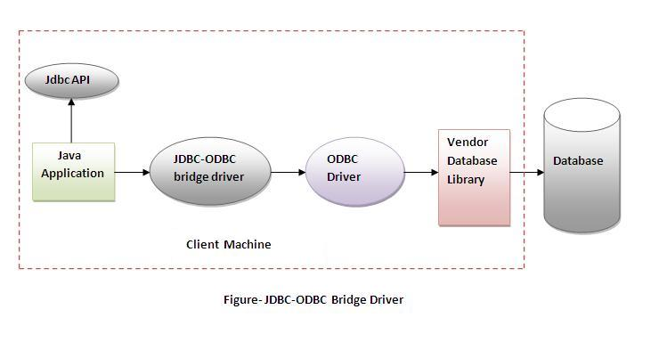
Advantages:
easy to use.
can be easily connected to any database.
Disadvantages:
Performance degraded because JDBC method call is converted into the ODBC function calls.
The ODBC driver needs to be installed on the client machine.

Slide 6
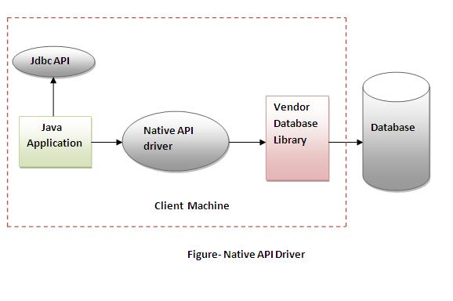
NATIVE-API DRIVER
The Native API driver uses the client-side libraries of the database. The driver converts JDBC method calls into native calls of the database API. It is not written entirely in java.
Advantage:
performance upgraded than JDBC-ODBC bridge driver.
Disadvantage:
The Native driver needs to be installed on the each client machine.
The Vendor client library needs to be installed on client machine.

Slide 7
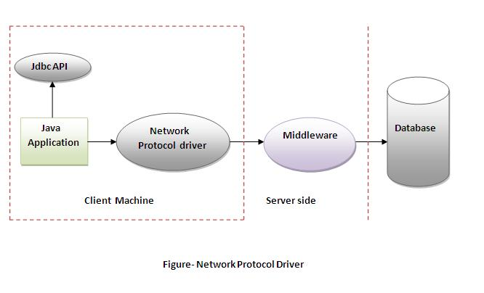
NETWORK PROTOCOL DRIVER
The Network Protocol driver uses middleware (server) that converts JDBC calls directly or indirectly into the vendor-specific database protocol. It is fully written in java.
Advantage:
No client side library is required because of application server that can perform many tasks like auditing, load balancing, logging etc.
Disadvantages:
Network support is required on client machine.
Requires database-specific coding to be done in the middle tier.
Maintenance of Network Protocol driver becomes costly because it requires database-specific coding to be done in the middle tier.

Slide 8
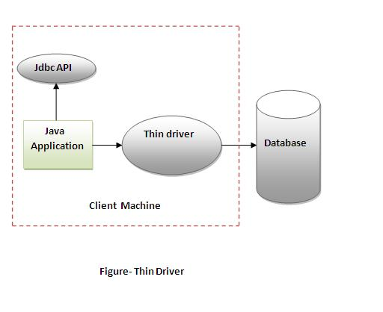
THIN DRIVER
The thin driver converts JDBC calls directly into the vendor-specific database protocol. That is why it is known as thin driver. It is fully written in Java language
Advantage:
Better performance than all other drivers.
No software is required at client side or server side.
Disadvantage:
Drivers depends on the Database.

Slide 9
There are 5 steps to connect any java application with the database in java using JDBC. ,They are as follows
REGISTER THE DRIVER CLASS
The forName() method of Class , class is used to register the driver class. This method is used to dynamically load the driver class.
Class.forName("com.mysql.jdbc.Driver”);
CREATING CONNECTION
The getConnection() method of DriverManager class is used to establish connection with the database
Connection con=DriverManager.getConnection( "jdbc:mysql://localhost:3306:employee",“root",“sam.nani-14");
CREATING STATEMENT
The createStatement() method of Connection interface is used to create statement. The object of statement is responsible to execute queries with the database.
Statement stmt=con.createStatement();
EXECUTING QUERIES
The executeQuery() method of Statement interface is used to execute queries to the database. This method returns the object of ResultSet that can be used to get all the records of a table.
ResultSet rs=stmt.executeQuery("select * from emp");
CLOSING CONNECTION
By closing connection object statement and ResultSet will be closed automatically. The close() method of Connection interface is used to close the connection.
con.close();

Slide 10
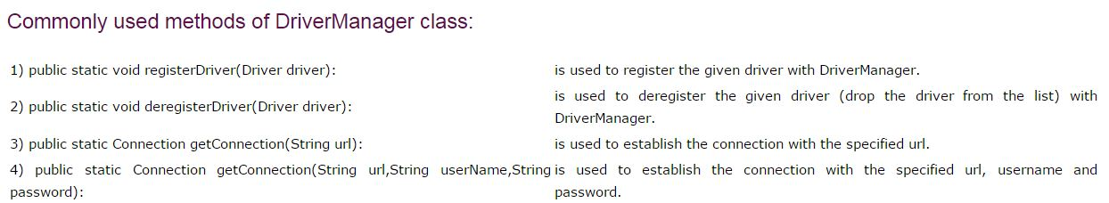
DRIVERMANAGER CLASS
The DriverManager class acts as an interface between user and drivers
It is used for translating purpose
It obtains a reference to class object with FQCN(Fully Qualified Class Name)
It keeps track of the drivers that are available and handles establishing a connection between a database and the appropriate driver
The DriverManager class maintains a list of Driver classes that have registered themselves by calling the method DriverManager.registerDriver().

Slide 11
CONNECTION INTERFACE
A Connection is the session between java application and database
The Connection interface is a factory of Statement, PreparedStatement, and CallableStatement.
The Connection interface provide many methods for transaction management like commit(), rollback() etc
Import JDBC Packages : The Import statements tell the Java compiler where to find the classes
Register JDBC Driver : Registering the driver is the process by which the sql driver's class file is loaded into the memory, so it can be utilized as an implementation of the JDBC interfaces
Class.forName() method, to dynamically load the driver's class file into memory, which automatically registers it.
Class.forName("com.mysql.jdbc.Driver");
DriverManager.registerDriver() method should use the registerDriver() method
Driver myDriver = new oracle.jdbc.driver.OracleDriver();
DriverManager.registerDriver( myDriver );

Slide 12
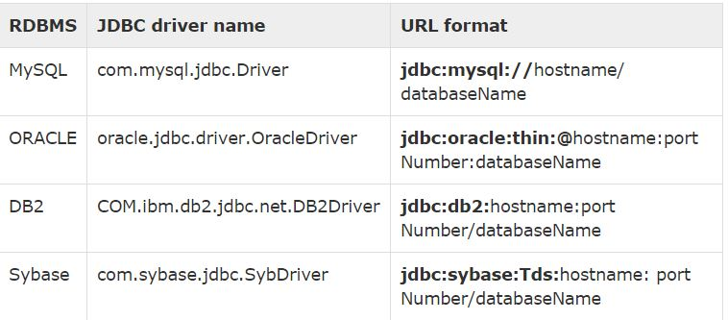
Database URL Formulation
After you've loaded the driver, you can establish a connection using the DriverManager.getConnection() method
getConnection(String url)
getConnection(String url, Properties prop)
getConnection(String url, String user, String password)

Slide 13
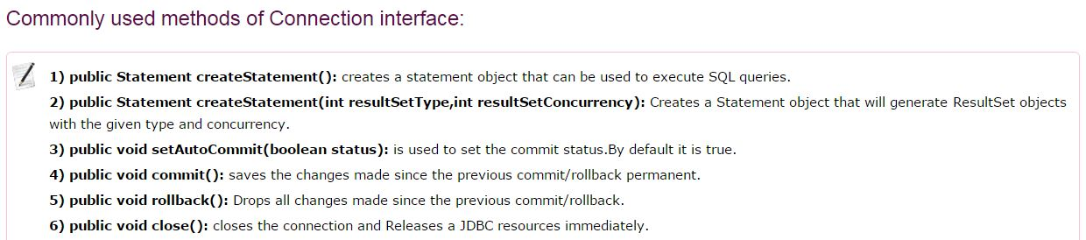
Create Connection Object
DriverManager.getConnection() method to create a connection object.
Closing JDBC Connections
At the end of your JDBC program, it is required explicitly to close all the connections to the database to end each database session. However, if you forget, Java's garbage collector will close the connection when it cleans up stale objects. con.close();

Slide 14
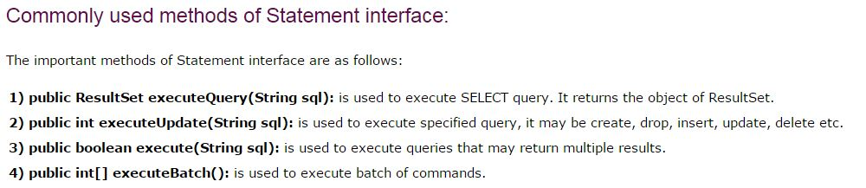
STATEMENT INTERFACE
Once a connection is obtained we can interact with the database, The Statement interface provides methods to execute queries with the database.
The JDBC Statement , CallableStatement, and PreparedStatement interfaces define the methods and properties that enable you to send SQL or PL/SQL commands and receive data from your database.
Statement used for general-purpose access to your database. Useful when you are using static SQL statements at runtime. The Statement interface cannot accept parameters.
PreparedStatement uses when you plan to use the SQL statements many times. The PreparedStatement interface accepts input parameters at runtime.
CallableStatement when you want to access the database stored procedures. The CallableStatement interface can also accept runtime input parameters.

Slide 15
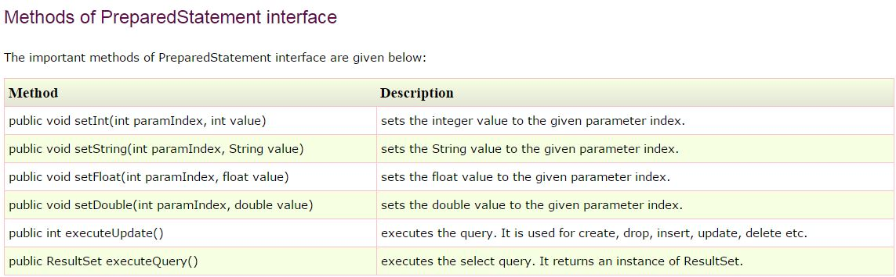
PREPAREDSTATEMENT INTERFACE
The PreparedStatement interface is a subinterface of Statement. It is used to execute parameterized query.
Let's see the example of parameterized query:
String sql="insert into emp values(?,?,?)";
Improves performance: The performance of the application will be faster if you use PreparedStatement interface because query is compiled only once.

Slide 16
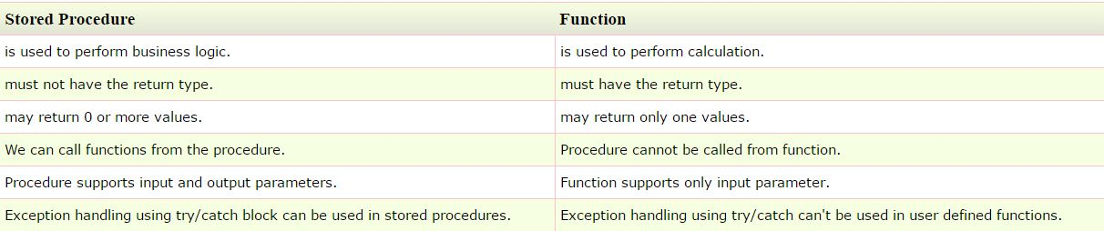
CALLABLESTATEMENT INTERFACE
Connection object creates the CallableStatement object, which would be used to execute a call to a database stored procedures and Functions
We can have business logic on the database by the use of stored procedures and functions that will make the performance better because these are precompiled.
The prepareCall() method of Connection interface returns the instance of CallableStatement.
public CallableStatement prepareCall("{ call procedurename(?,?...?)}");
CallableStatement stmt=con.prepareCall("{call myprocedure(?,?)}");

Slide 17
RESULTSET INTERFACE
The SQL statements that read data from a database query, return the data in a result set. The SELECT statement is the standard way to select rows from a database and view them in a result set.
A ResultSet object maintains a cursor that points to the current row in the result set.
The term "result set" refers to the row and column data contained in a ResultSet object.
METHODS
Navigational methods: Used to move the cursor around.
Get methods: Used to view the data in the columns of the current row being pointed by the cursor.
Update methods: Used to update the data in the columns of the current row. The updates can then be updated in the underlying database as well.
JDBC provides the following connection methods to create statements with desired ResultSet −
createStatement(int RSType, int RSConcurrency);
prepareStatement(String SQL, int RSType, int RSConcurrency);
prepareCall(String sql, int RSType, int RSConcurrency);

Slide 18
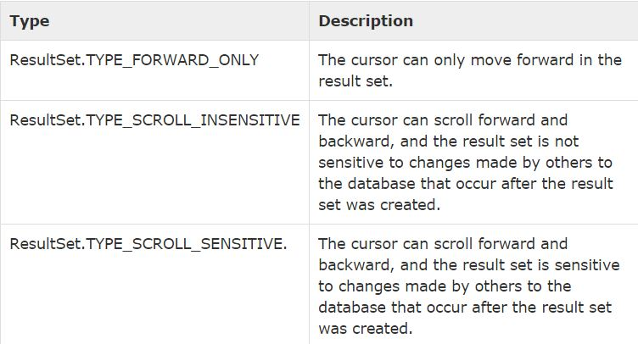
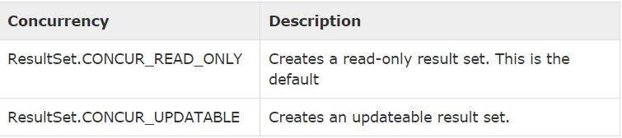
Type of ResultSet
The possible RSType are given below. If you do not specify any ResultSet type, you will automatically get one that is TYPE_FORWARD_ONLY.
Concurrency of ResultSet
The possible RSConcurrency are given below. If you do not specify any Concurrency type, you will automatically get one that is CONCUR_READ_ONLY.

Slide 19
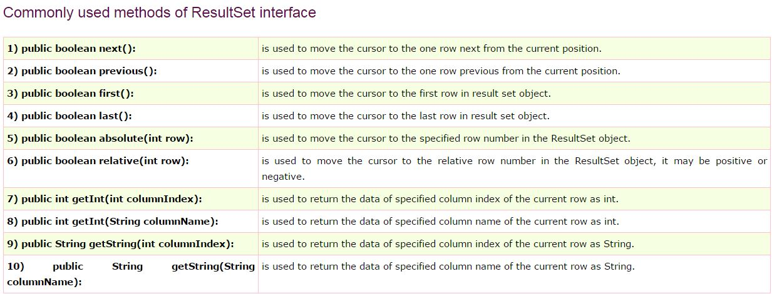
Navigational Methods
Updating a Result Set
public void updateString(int columnIndex, String s)
throws SQLException
public void updateString(String columnName, String s)
throws SQLException
public void updateRow()
public void deleteRow()
public void refreshRow()
public void cancelRowUpdates()
public void insertRow()

Slide 20
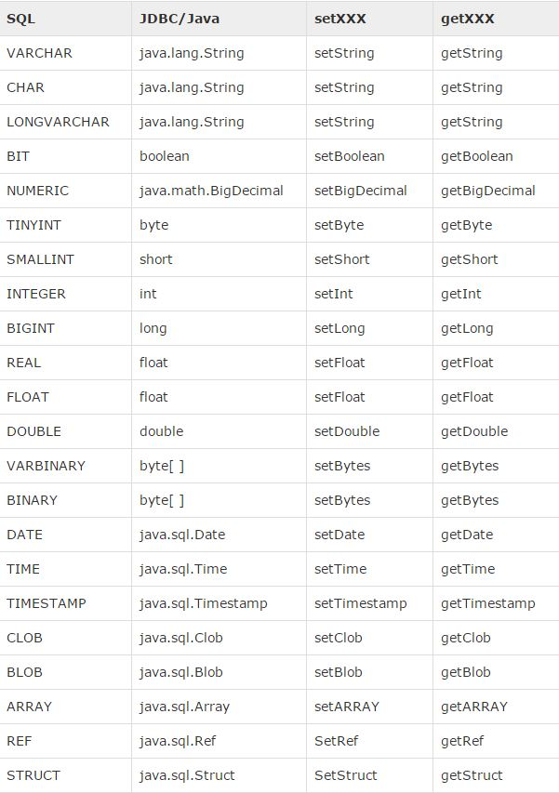
Date & Time Data Types
Get standard date and time
java.util.Date javaDate = new java.util.Date();
long javaTime = javaDate.getTime();
Get and display SQL DATE
java.sql.Date sqlDate = new java.sql.Date(javaTime);
Get and display SQL TIME
java.sql.Time sqlTime = new java.sql.Time(javaTime);
Get and display SQL TIMESTAMP
java.sql.Timestamp sqlTimestamp = newjava.sql.Timestamp(javaTime);

Slide 21
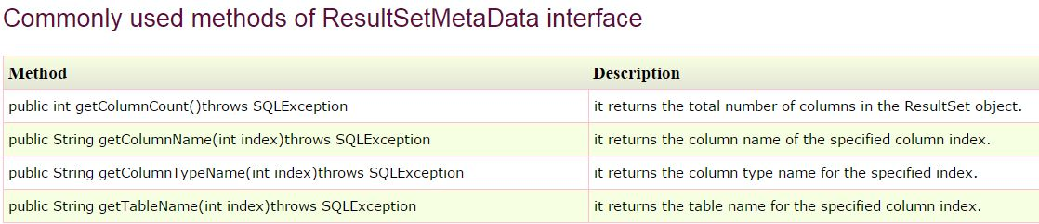
JAVA RESULTSETMETADATA INTERFACE
The metadata means data about data i.e. we can get further information from the data.
If you have to get metadata of a table like total number of column, column name, column type etc. , ResultSetMetaData interface is useful because it provides methods to get metadata from the ResultSet object
JAVA DATABASEMETADATA INTERFACE
DatabaseMetaData interface provides methods to get meta data of a database such as database product name, database product version, driver name, name of total number of tables, name of total number of views etc.

Slide 22
STORE IMAGE or FILES IN DATABASE
You can store images and Files in the database in java by the help of PreparedStatement interface.
The setBinaryStream() method of PreparedStatement is used to set Binary information into the parameterIndex.
RETRIEVE IMAGE FROM DATABASE
By the help of PreparedStatement we can retrieve and store the image in the database.
The getBlob() method of PreparedStatement is used to get Binary information, it returns the instance of Blob. After calling the getBytes() method on the blob object, we can get the array of binary information that can be written into the image file.

Slide 23
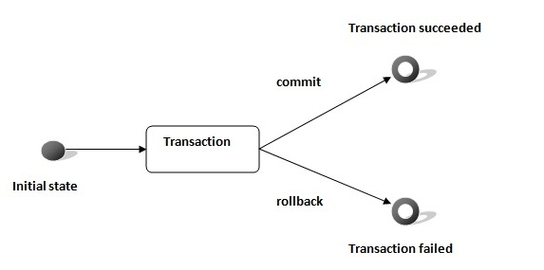
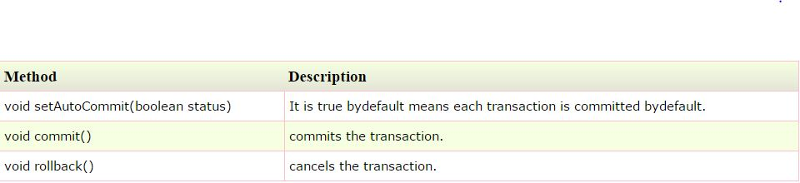
TRANSACTION MANAGEMENT IN JDBC
Transaction represents a single unit of work.
The ACID properties describes the transaction management well. ACID stands for Atomicity, Consistency, isolation and durability.
Atomicity means either all successful or none.
Consistency ensures bringing the database from one consistent(Standard) state to another consistent state.
Isolation ensures that transaction is separated from other transaction.
Durability means once a transaction has been committed, it will remain so, even in the event of errors, power loss etc.
Advantage : Fast performance It makes the performance fast because database is hit at the time of commit.

Slide 24
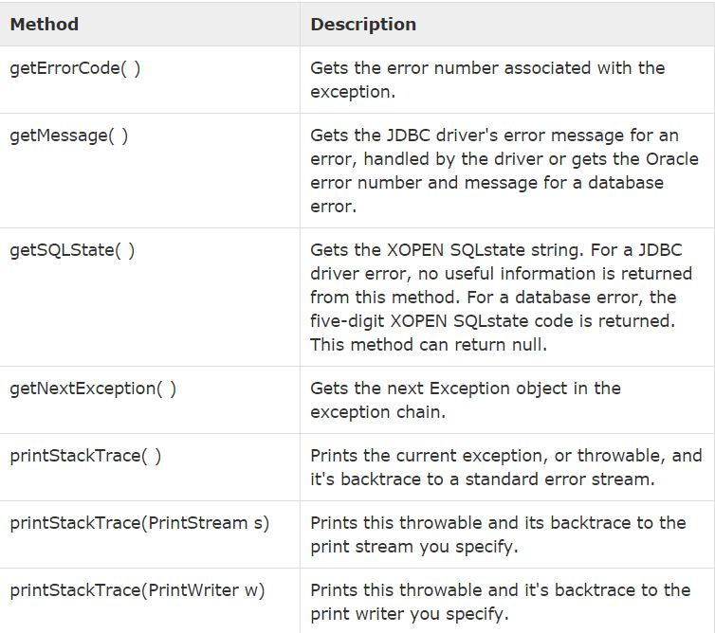
EXCEPTION HANDLING allows you to handle exceptional conditions such as program-defined errors in a controlled fashion.
When an exception condition occurs, an exception is thrown. The term thrown means that current program execution stops, and the control is redirected to the nearest applicable catch clause. If no applicable catch clause exists, then the program's execution ends.
SQLException Methods

Slide 25
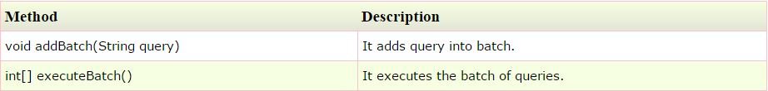

BATCH PROCESSING IN JDBC
Instead of executing a single query, we can execute a batch (group) of queries. It makes the performance fast.
The java.sql.Statement and java.sql.PreparedStatement interfaces provide methods for batch processing.
Advantage :Fast Performance
STEPS:
Load the driver class
Create Connection
Create Statement
Add query in the batch
Execute Batch
Close Connection

Slide 26
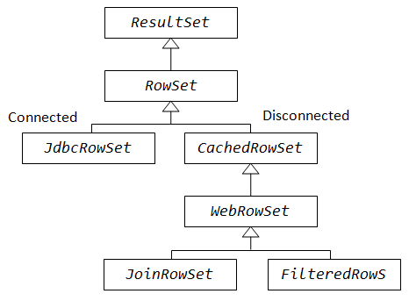
ROWSET
A RowSet is an object that encapsulates a set of rows from either java Database Connectivity (JDBC) result sets or tabular data sources
The implementation classes of RowSet interface are as follows:
JdbcRowSet, CachedRowSet, JoinRowSet, FilteredRowSet
The advantages of using RowSet are given below:
It is easy and flexible to use
It is Scrollable(Allow to retrieve data in Forward and Backward
direction) and Updatable bydefault

Slide 27
JDBC ROWSET
It is the wrapper of ResultSet. It holds tabular data like ResultSet but it is easy and flexible to use.
CACHED ROWSET
A CachedRowSet object is a container for rows of data that caches its rows in memory, which makes it possible to operate without always being connected to its data source
Further, it is a JavaBeans component and is scrollable, updatable, and serializable
JOIN ROWSET
A JoinRowSet implementation lets you create a SQL JOIN(it combines rows of that tables in one table and one can retrieve the information by a SELECT statement) between RowSet objects when they are not connected to a data source
FILTERED ROWSET
It lets you filter the number of rows that are visible in a RowSetobject so that you can work with only the relevant data that you need.

Slide 28
Thank you

