Slide 1

Junit-4
Date : Nov 17, 2016)
Ajay Singh Madan – Crew Pay

Slide 2

Agenda
-What is Testing and Unit Testing -JUnit - Plug with Eclipse
-What is junit Testing - Difference between Junit3 and junit4 -Environment Setup - Ignore Test
-Features of Junit - Exception Test
-JUnit API -Parameterized Test
-Assert Class -Error and Failure
-Test Case Class -Disadvantages of junit
-TestSuite Class
-Annotation
-JUnit - Suite Test
-

Slide 3
What is Testing and Unit Testing
Testing is the process of checking the functionality of an application to ensure it runs as per requirements.
Unit testing means testing the smaller units of your application, like classes and methods.
Unit tests are typically automated, meaning once they are implemented, you can run them again and again
Type of testing
Manual Testing | Automated Testing
Executing a test cases manually without any tool support is known as manual testing. | Taking tool support and executing the test cases by using an automation tool is known as automation testing.
Time-consuming and tedious − Since test cases are executed by human resources, it is very slow and tedious. | Fast − Automation runs test cases significantly faster than human resources.
Huge investment in human resources − As test cases need to be executed manually, more testers are required in manual testing. | Less investment in human resources − Test cases are executed using automation tools, so less number of testers are required in automation testing.
Less reliable − Manual testing is less reliable, as it has to account for human errors. | More reliable − Automation tests are precise and reliable.

Slide 4
What is Junit Testing
Kent Beck developed the first xUnit automated test tool for Smalltalk in mid-90’s
Kent Beck, Erich Gamma, David Saff, Mike Clark
JUnit is a unit testing framework for Java programming language.
JUnit has been important in the development of test-driven development,
and is one of a family of unit testing frameworks

Slide 5
Environment Setup
JUnit is a framework for Java, so the very first requirement is to have JDK installed in your machine.
System Requirement
JDK | 1.5 or above.
Memory | No minimum requirement.
Disk Space | No minimum requirement.
Operating System | No minimum requirement.

Slide 6
Download the latest version of JUnit jar file from http://www.junit.org
Set the JUNIT_HOME environment variable to point to the base directory location where JUNIT jar is stored on your machine
Set the CLASSPATH environment variable to point to the JUNIT jar location.

Slide 7
Features of JUnit
JUnit is an open source framework, which is used for writing and running tests.
Provides annotations to identify test methods.
Provides assertions for testing expected results.
Provides test runners for running tests.
JUnit tests allow you to write codes faster, which increases quality.
JUnit is elegantly simple. It is less complex and takes less time.
JUnit tests can be run automatically and they check their own results and provide immediate feedback. There's no need to manually comb through a report of test results.

Slide 8
JUnit - API
The most important package in JUnit is junit.framework, which contains all the core classes. Some of the important classes are as follows −
Sr.No. | Class Name | Functionality
1 | Assert | A set of assert methods.
2 | TestCase | A test case defines the fixture to run multiple tests.
3 | TestSuite | A TestSuite is a composite of tests.

Slide 9
Assert Class
Assert class has following methods-
Sr.No. | Methods & Description
1 | void assertEquals(boolean expected, boolean actual) Checks that two primitives/objects are equal.
2 | void assertFalse(boolean condition) Checks that a condition is false.
3 | void assertNotNull(Object object) Checks that an object isn't null.
4 | void assertNull(Object object) Checks that an object is null.
5 | void assertTrue(boolean condition) Checks that a condition is true.

Slide 10
Test Case Class
Testcase class present in org.junit package
A test case defines the fixture to run multiple tests. Some of the important methods of TestCase class are as follows −
Sr.No. | Methods & Description
1 | int countTestCases() Counts the number of test cases executed by run(TestResult result).
2 | TestResult createResult() Creates a default TestResult object.
3 | String getName() Gets the name of a TestCase.
4 | TestResult run() A convenience method to run this test, collecting the results with a default TestResult object.
5 | void run(TestResult result) Runs the test case and collects the results in TestResult.

Slide 11
TestSuite Class
This class present in org.junit package
A TestSuite is a Composite of tests. It runs a collection of test cases. Some of the important methods of TestSuite class are as follows −
Sr.No. | Methods & Description
1 | void addTest(Test test) Adds a test to the suite.
2 | void addTestSuite(Class<? extends TestCase> testClass) Adds the tests from the given class to the suite.
3 | int countTestCases() Counts the number of test cases that will be run by this test.
4 | String getName() Returns the name of the suite.
5 | void run(TestResult result) Runs the tests and collects their result in a TestResult.

Slide 12
Annotation
Annotations are like meta-tags that you can add to your code, and apply them to methods or in class. It information about test methods or class like
which methods are going to run before and after test methods.which methods run before and after all the methods, and.which methods or classes will be ignored during the execution.
Sr.No. | Annotation & Description
1 | @Test The Test annotation tells JUnit that the public void method to which it is attached can be run as a test case.
2 | @Before Several tests need similar objects created before they can run. Annotating a public void method with @Before causes that method to be run before each Test method.
3 | @After If you allocate external resources in a Before method, you need to release them after the test runs. Annotating a public void method with @After causes that method to be run after the Test method.
4 | @BeforeClass Annotating a public static void method with @BeforeClass causes it to be run once before any of the test methods in the class.
5 | @AfterClass This will perform the method after all tests have finished. This can be used to perform clean-up activities.

Slide 13
JUnit - Suite Test
Test suite is used to bundle a few unit test cases and run them together. In JUnit, both @RunWith and @Suite annotations are used to run the suite tests.
JUnit - Time Test
JUnit provides a handy option of Timeout. If a test case takes more time than the specified number of milliseconds, then JUnit will automatically mark it as failed. The timeout parameter is used along with @Test annotation and @Test(timeout)

Slide 14
JUnit - Plug with Eclipse
To set up JUnit with eclipse, follow the steps given below.
Step 1: Download JUnit Archive
Step 2: Set Eclipse Environment
Open eclipse → right click on project and click on property > Build Path > Configure Build Path and add the junit-4.10.jar in the libraries using the button Add External Jar.

Slide 15
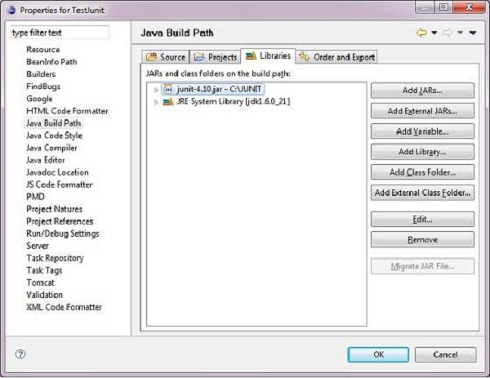

Slide 16
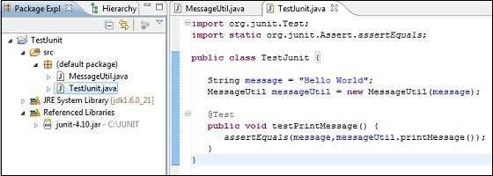
Step 3: Verify JUnit installation in Eclipse
Create a project TestJunit in Eclipse . Then create a class MessageUtil to test in the project.
Following should be the project structure −

Slide 17
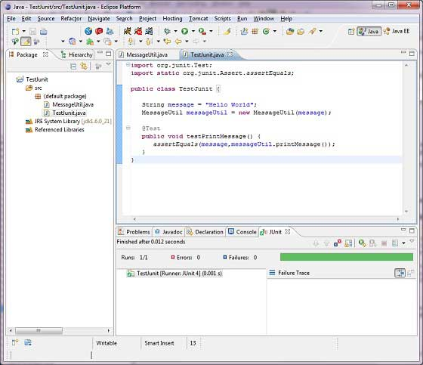
right click the program and run as JUnit to verify the output of the program.

Slide 18
Difference between Junit3 and junit4
Junit 3 Junit 3 require jdk 1.2 or any latest version Every test class in junit3 need to extend junit.framework.TestCase Junit 3 does not support annotations Junit 3 supports Swing Abstract Window Toolkit(AWT) Junit 3 does not have timeout factor | Junit 4 Junit 4 require jdk 5 or any latest version In Junit 4 no need to extend junit.framework.TestCase Junit 4 supports annotations Junit 4 does not support Swing Abstract Window Toolkit(AWT) Junit 4 have timeoutfactor @Test(timeout=1000)

Slide 19
Ignore Test-
Sometimes it so happens that our code is not completely ready while running a test case. As a result, the test case fails.
The @Ignore annotation helps in this scenario.
A test method annotated with @Ignore will not be executed.
If a test class is annotated with @Ignore, then none of its test methods will be executed.

Slide 20
Exceptions Test
JUnit provides an option of tracing the exception handling of code.
You can test whether the code throws a desired exception or not.
The expected parameter is used along with @Test annotation.
@Test(expected = ArithmeticException.class)

Slide 21
Parameterized Test
JUnit 4 has introduced a new feature called parameterized tests. Parameterized tests allow a developer to run the same test over and over again using different values. There are some steps that you need to follow to create a parameterized test.
.
Annotate test class with @RunWith(Parameterized.class).
Create a public static method annotated with @Parameters that returns a Collection of Objects (as Array) as test data set.
The number of elements in each array provided by the method annotated with
@Parametersmust correspond to the number of parameters in the constructor of the
class

Slide 22
Error and Failure
Errors - mean that while your test was running, there were some unhandled exceptions , and hence, your test case basically crashed without executing fully.
Failures - mean that your test completed successfully, but the test condition of your test criteria has failed(not what you expected it to be).

Slide 23
Disadvantages of junit
Test prioritization, Parallel testing is not supported by Junit
@BeforeTest, @AfterTest, @BeforeSuite, @AfterSuite, @BeforeGroups, @AfterGroups which are not supported in JUnit.
configure dependency test. Dependency test configuration for software web application is not possible in JUnit.
group test it is not supported in JUnit.

Slide 24
Thank you

