Slide 1

Spring Framework
Nov 22, 2016
Neha Varshney – Crew Pay

Slide 2

Agenda
Spring Core
Spring Introduction
Spring Modules
Dependency Injection or Inversion of control
Spring IoC Container
Spring Configuration Metadata
Beans Definition
Bean autowiring
Annotation Based Configuration
Java Based Configuration
Spring AOP
AOP terminologies
Spring MVC
Request processing workflow

Slide 3
Spring Introduction
Spring Framework is an open source Java platform which provides a light-weight solution for developing enterprise applications.
Any Java application can be benefitted from Spring in terms of simplicity, testability & loose coupling.
Spring provides elegant integration points with standard and defacto-standard interfaces: Hibernate, EJB, RMI, WebServies, Struts, JMS, JNDI etc.

Slide 4

Spring Framework History
Started in 2002 by Rod Johnson and Juergen Hoeller.
Started as a framework developed around Rod Johnson’s book “Expert One-on-One J2EE Design and Development”.
The first milestone release, 1.0, was released in March 2004.
Current Version of Spring is 4.3.4.

Slide 5
Characteristics
LightWeight
Loose Coupling
Aspect Oriented
Container
Notes:
Lightweight :-
Spring framework is lightweight in its size and overhead.
The entire Spring Framework can be spread in a single JAR file that weighs in at just over 2.5MB.
And the processing overhead required by Spring is minor.
Loose Coupling:—
Spring enables loose coupling through a method known as dependency injection (DI).
Here when DI happens the spring objects are passively given their dependencies as an alternative of creating or looking for dependent objects for themselves.
Aspect-oriented: —
This enables consistent development by separating application business logic from the supporting system services (such as auditing and transaction management).
Spring Container: —
It contains and manages the lifecycle and configuration of application objects.
In Spring framework , you can state how each of your application objects should be produced,
how they should be configured, and how they should be coupled with each other.
Framework : —
Spring allows to configure and compose complex applications from simpler components.
Here application objects are composed declaratively, typically through XML file.
Spring also provides good infrastructure functionality (transaction management, persistence framework integration, etc.), leaving the development of application logic to you.

Slide 6
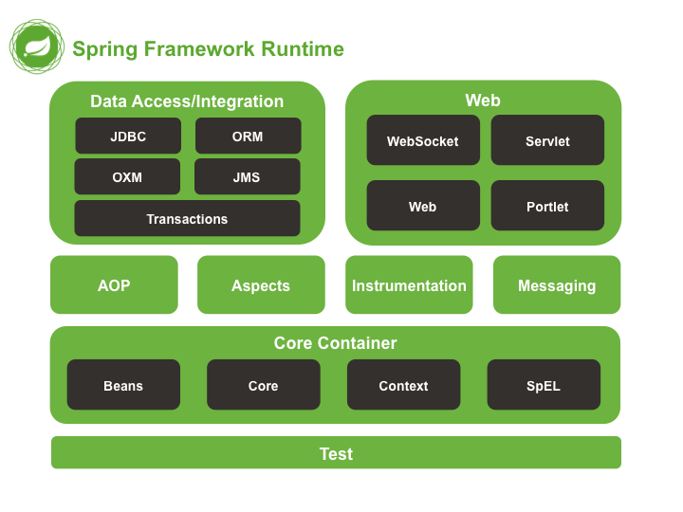
Spring Modules
The Spring Framework consists of features organized into about 20 modules.
These modules are grouped into Core Container, Data Access/Integration, Web, AOP
(Aspect Oriented Programming),
Instrumentation, Messaging,
and Test, as shown in the diagram.

Slide 7
Core Container
The Core Container consists of the spring-core, spring-beans, spring-context, spring-context-support, and spring-expression (Spring Expression Language) modules.
Spring-core and spring-beans : modules provide the fundamental parts of the framework, including the IoC and Dependency Injection features. It contains the ‘Bean Factory’ ,which is an implementation of the Factory pattern.
Context (spring-context) : module builds on the solid base provided by the Core and Beans modules. The Context module inherits its features from the Beans module and adds support for internationalization, resource loading etc. The ApplicationContext interface is the focal point of the Context module.
Spring-expression : module provides a powerful Expression Language for querying and manipulating an object graph at runtime.

Slide 8
AOP & Instrumentation
Spring-aop : module provides an AOP Alliance-compliant aspect-oriented programming implementation allowing you to define, for example, method interceptors and pointcuts to cleanly decouple code that implements functionality that should be separated.
Spring-aspects : module provides integration with AspectJ.
Spring-instrument : module provides class instrumentation support and classloader implementations to be used in certain application servers. The spring-instrument-tomcat module contains Spring’s instrumentation agent for Tomcat.
Messaging
Spring Framework 4 includes a spring-messaging module with key abstractions from the Spring Integration project such as Message, MessageChannel, MessageHandler, and others to serve as a foundation for messaging-based applications.

Slide 9
Data Access/Integration
Spring-jdbc : module provides a JDBC-abstraction layer that removes the need to do tedious JDBC coding and parsing of database-vendor specific error codes.
Spring-tx : module supports programmatic and declarative transaction management for classes that implement special interfaces and for all your POJOs (Plain Old Java Objects).
Spring-orm : module provides integration layers for popular object-relational mapping APIs, including JPA, JDO, and Hibernate. Using the spring-orm module you can use all of these O/R-mapping frameworks in combination with all of the other features Spring offers.
Spring-oxm : module provides an abstraction layer that supports Object/XML mapping implementations such as JAXB, Castor, XMLBeans, JiBX and XStream.
Spring-jms : module (Java Messaging Service) contains features for producing and consuming messages. Since Spring Framework 4.1, it provides integration with the spring-messaging module.

Slide 10
Web
The Web layer consists of the spring-web, spring-webmvc, spring-websocket, and spring-webmvc-portlet modules.
spring-web: module provides basic web-oriented integration features such as multipart file upload functionality and the initialization of the IoC container using Servlet listeners and a web-oriented application context. It also contains an HTTP client and the web-related parts of Spring’s remoting support.
spring-webmvc: module (also known as the Web-Servlet module) contains Spring’s model-view-controller (MVC) and REST Web Services implementation for web applications. Spring’s MVC framework provides a clean separation between domain model code and web forms and integrates with all of the other features of the Spring Framework.
spring-webmvc-portlet module (also known as the Web-Portlet module) provides the MVC implementation to be used in a Portlet environment and mirrors the functionality of the spring-webmvc module.

Slide 11
Dependency Injection or Inversion of Control
A Java application — a loose term that runs the gamut from constrained, embedded applications to n-tier, server-side enterprise applications — typically consists of objects that collaborate to form the application proper. Thus the objects in an application have dependencies on each other.
The Spring Framework Inversion of Control (IoC) component addresses this concern by providing a formalized means of composing disparate components into a fully working application ready for use.
The basic concept of the Inversion of Control pattern or dependency injection is that you do not create your objects but describe how they should be created. A configuration file is used to describe the services needed by a component . In the Spring framework, the IOC container is responsible for looking it all up.

Slide 12
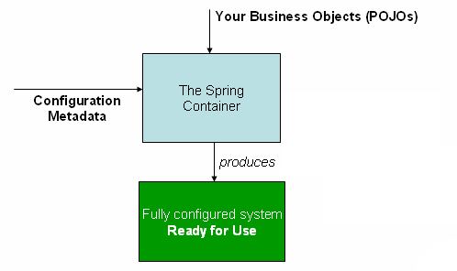
IoC Container
Features of DI
Eliminates lookup code from your application.
Promotes good OO design.
Better reuse of existing code.
Makes the application extremely
testable.

Slide 13
Spring IoC Container
Spring provides following two distinct types of containers:
BeanFactory Container :
This is the simplest container providing basic support for DI and defined by the org.springframework.beans.factory.BeanFactory interface.
ApplicationContext Container :
This container adds more enterprise-specific functionality such as the ability to resolve textual messages from a properties file and the ability to publish application events to interested event listeners. This container is defined by the org.springframework.context.ApplicationContext interface.
Note:
The ApplicationContext container includes all functionality of the BeanFactory container, so it is generally recommended over the BeanFactory. BeanFactory can still be used for light weight applications like mobile devices or applet based applications where data volume and speed is significant.

Slide 14
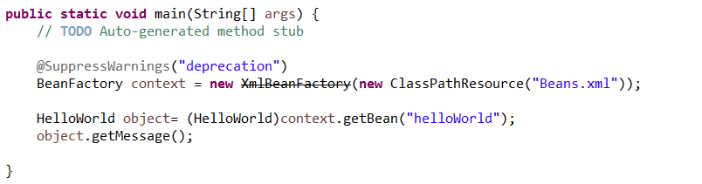
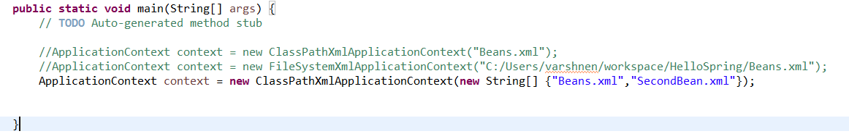
BeanFactory Container
ApplicationContext Container

Slide 15
Spring Configuration metadata
Spring IoC container is totally decoupled from the format in which this configuration metadata is actually written. There are following three important methods to provide configuration metadata to the Spring Container:
XML based configuration file
Annotation-based configuration
Java-based configuration

Slide 16
Dependency Injection
There are two ways to inject the dependencies:
Constructor Based : Constructor-based DI is accomplished when the container invokes a class constructor with any number of arguments, each representing a dependency on other class.
Setter Based: Setter-based DI is accomplished by the container calling setter methods on your beans after invoking a no-argument constructor or no-argument static factory method to instantiate your bean.

Slide 17
Bean Definition
The objects that form the backbone of your application and that are managed by the Spring IoC container are called beans.
A bean is an object that is instantiated, assembled, and otherwise managed by a Spring IoC container. These beans are created with the configuration metadata that you supply to the container.
The bean definition contains the information called configuration metadata which is needed for the container to know the followings:
How to create a bean
Bean's lifecycle details
Bean's dependencies

Slide 18
Bean Definition continued
class : This attribute is mandatory and specify the bean class to be used to create the bean.
name : This attribute specifies the bean identifier uniquely. In XML-based configuration metadata, you use the id and/or name attributes to specify the bean identifier(s).
scope : This attribute specifies the scope of the objects created from a particular bean.
initialization method: A callback to be called just after all necessary properties on the bean have been set by the container.
destruction method: A callback to be used when the container containing the bean is destroyed.
Properties: This is used to inject the dependencies.

Slide 19
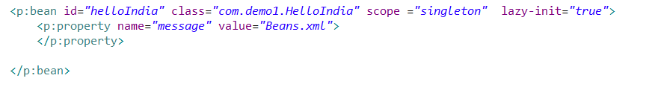
Bean Definition continued
constructor-arg : This is used to inject the dependencies.
autowiring mode: This is used to inject the dependencies.
lazy-initialization mode : A lazy-initialized bean tells the IoC container to create a bean instance when it is first requested, rather than at startup.

Slide 20
Beans Autowiring
There are following autowiring modes which can be used to instruct Spring container to use autowiring for dependency injection.
No: This is default setting which means no autowiring and you should use explicit bean reference for wiring. You have nothing to do special for this wiring.
byName : Autowiring by property name. Spring container looks at the properties of the beans on which autowire attribute is set to byName in the XML configuration file. It then tries to match and wire its properties with the beans defined by the same names in the configuration file.
byType: Autowiring by property datatype. Spring container looks at the properties of the beans on which autowire attribute is set to byType in the XML configuration file. It then tries to match and wire a property if its type matches with exactly one of the beans name in configuration file. If more than one such beans exists, a fatal exception is thrown.
Constructor: Similar to byType, but type applies to constructor arguments. If there is not exactly one bean of the constructor argument type in the container, a fatal error is raised.
Autodetect: Spring first tries to wire using autowire by constructor, if it does not work, Spring tries to autowire by byType.

Slide 21
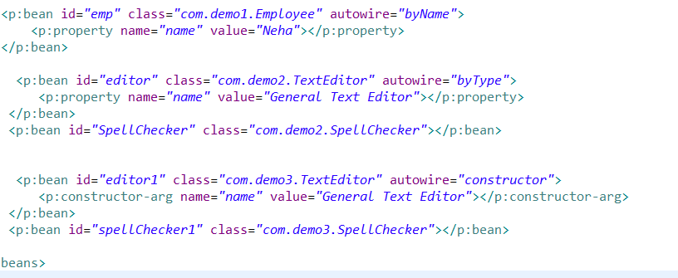
Beans Autowiring

Slide 22
Injecting Collections
We have seen how to configure primitive data type using value attribute and object references using ref attribute of the <property> tag in our Bean configuration file. Both the cases deal with passing singular value to a bean.
Now what about if we want to pass plural values like Java Collection types List, Set, Map, and Properties. To handle the situation, Spring offers four types of collection configuration elements which are as follows:
<list> This helps in wiring ie injecting a list of values, allowing duplicates.
<set> This helps in wiring a set of values but without any duplicates.
<map> This can be used to inject a collection of name-value pairs where name and value can be of any type.
<props> This can be used to inject a collection of name-value pairs where the name and value are both Strings.

Slide 23
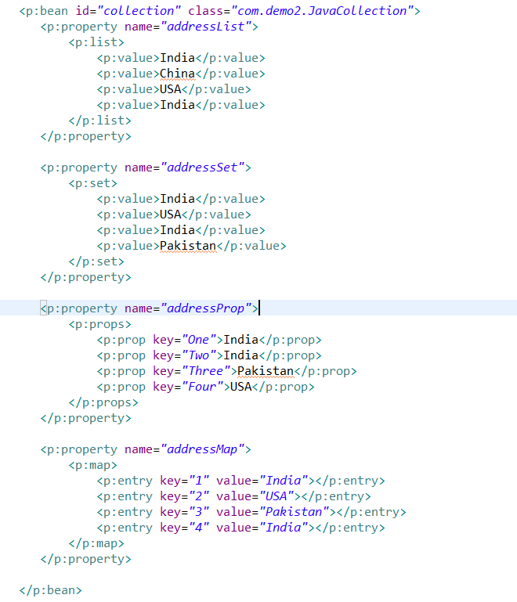
Injecting Collections

Slide 24
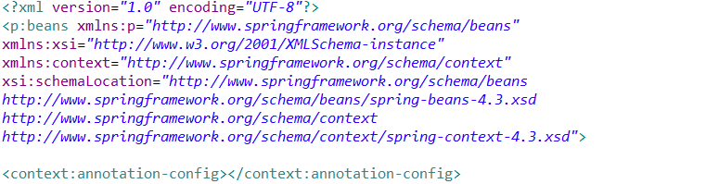
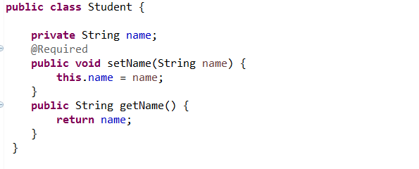
Annotation Based Configuration
Starting from Spring 2.5 it became possible to configure the dependency injection using annotations. So instead of using XML to describe a bean wiring, you can move the bean configuration into the component class itself by using annotations on the relevant class, method, or field declaration.
Annotation injection is performed before XML injection, thus the latter configuration will override the former for properties wired through both approaches.
Annotation wiring is not turned on in the Spring container by default. So, before we can use annotation-based wiring, we will need to enable it in our Spring configuration file.
Once <context:annotation-config/> is configured, you can start annotating your code to indicate that Spring should automatically wire values into properties, methods, and constructor.
@Required : The @Required annotation applies to bean
property setter methods.

Slide 25
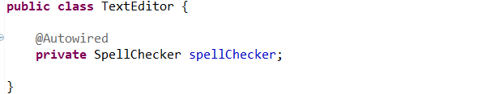
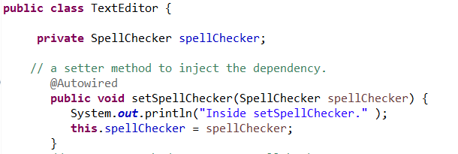
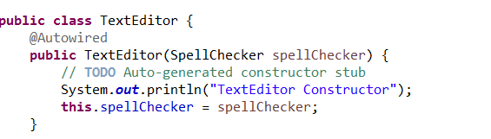

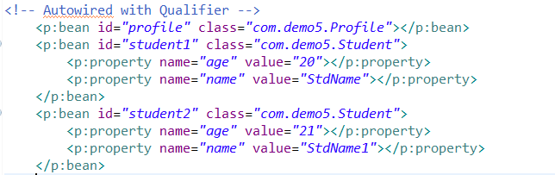
Annotation Based Configuration
@Autowired : The @Autowired annotation can apply to bean property setter methods, non-setter methods, constructor and properties.
@Qualifier: The @Qualifier annotation along with @Autowired can be used to remove the confusion by specifying which exact bean will be wired.

Slide 26
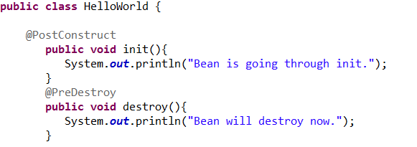
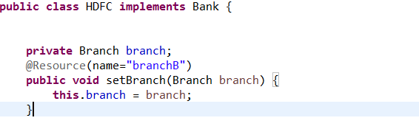
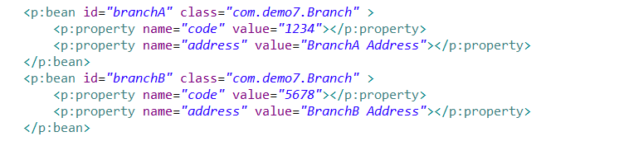
Annotation Based Configuration
JSR-250 Annotations: Spring supports JSR-250 based annotations which include @Resource, @PostConstruct and @PreDestroy annotations.
@Resource is same as @Qualifier annotation. It check first “byname” and then “byType” in case name attribute does not have any value. @Qualifier annotation first checks with “byType” and then “byName”. This is the only conceptual difference between these two annotations.

Slide 27
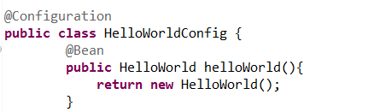
Java Based Configuration
Java based configuration option enables you to write most of your Spring configuration without XML but with the help of few Java-based annotations explained below.
Annotating a class with the @Configuration indicates that the class can be used by the Spring IoC container as a source of bean definitions.
The @Bean annotation tells Spring that a method annotated with @Bean will return an object that should be registered as a bean in the Spring application context.
The @Import annotation allows for loading @Bean definitions from another configuration class.
The default scope is singleton, but you can override this with the @Scope annotation.
The @Bean annotation supports specifying arbitrary initialization and destruction callback methods, much like Spring XML's init-method and destroy-method attributes on the bean element.

Slide 28
Spring AOP (Aspect Oriented Programming)
Spring provides a new way of implementing the cross cutting concerns by using AOP.
In OOP, key unit of modularity is a class but in AOP , key unit is aspect.
Aspects: are the cross cutting concerns that cut across multiple classes. For eg. Security, Authentication, Logging etc.

Slide 29
AOP terminologies
Aspects: These are the cross cutting concerns that cut across multiple classes. For eg. Logging etc.
Join point: The possible program execution points where the aspects are applied. In Spring framework AOP, a join point always represents a method execution.
Advice: This represents the action taken by an aspect at a particular join point. There are different types of advices:
Before Advice: it executes before a join point.
After Returning Advice: it executes after a joint point returns successfully without any exception.
After Throwing Advice: it executes if method exits by throwing an exception.
After Advice: it executes after a join point regardless of join point exit whether normally or exceptional return. This is similar to finally block in exception handling.
Around Advice: contains logics which get executed before method invocation and after the method returns successfully.
Notes:
Before Advice:
A system should make security check before allowing any user to access the resources.
In such a case, we can have a before advice that contains code which implements the user authentication logic.
After Advice:
It is common in application to delete the session data and the various information pertaining to a user, after he has logged out from the application.
Note : afterReturning() will be method that will be called once the method returns normal execution. If some exception happens in the method execution the
afterReturning() method will never be called.
Points to remember:
Before advice can stop the execution of a join point only by throwing exception.
After advice can ‘t change the return value from the join point.
Aspect can not be the target of another aspect.
Around advice is very powerful as
it can change the return value.
It can change the arguments that needs to be passed to the method.
It can control the method execution.

Slide 30
AOP terminologies
Pointcut: Advice is associated with a pointcut expression and runs at any join point matched by the pointcut (for the execution of a method with a specific name).
Introduction: Declaration of additional methods or fields on behalf of a type. Spring AOP allows you to introduce new interfaces to any advised object.
Interceptor: It is an aspect that contains only one advice.
Spring AOP heavily uses proxy. At runtime, the proxies are being created for Business objects with the aspects linked. This process is called Weaving. The object created is called AOP proxy or Target object.

Slide 31
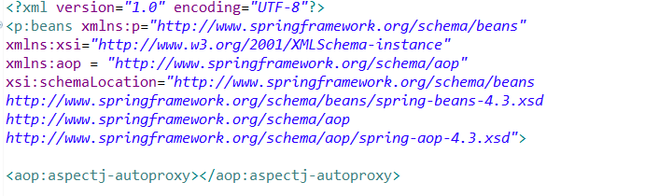
AOP Implementation
Spring AOP can be implemented in the below mentioned ways:
Schema Based approach
AspectJ annotation based
<aop: aspectj-autoproxy/> , This definition in Spring configuration file will enable AspectJ support.
Libraries required: aspectj.jar, aspectweaver.jar, aspectjrt.jar

Slide 32
Pointcut Declaration
It has two parts:
Signature with pointcut designator(commonly used one is execution)
Expression part- matches a method execution
Parameters Part
() represents method with no argument
(..) represents method with zero or more arguments
(*) represents method with one argument which is of any type
(*,int) represents method with two arguments. First is of any type but second one is of int type.
Notes:
Understanding Pointcut Expressions
Let's try the understand the pointcut expressions by the examples given below:
@Pointcut("execution(public * *(..))")
It will be applied on all the public methods.
@Pointcut("execution(public Operation.*(..))")
It will be applied on all the public methods of Operation class.
@Pointcut("execution(* Operation.*(..))")
It will be applied on all the methods of Operation class.
@Pointcut("execution(public Employee.set*(..))")
It will be applied on all the public setter methods of Employee class.
@Pointcut("execution(int Operation.*(..))")
It will be applied on all the methods of Operation class that returns int value.

Slide 33
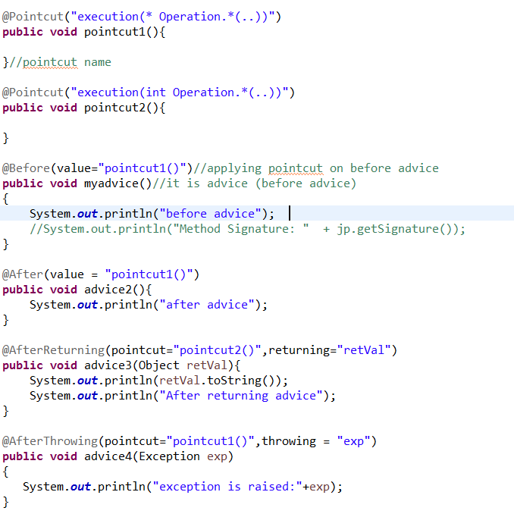
Pointcut Declaration
Notes:
Understanding Pointcut Expressions
Let's try the understand the pointcut expressions by the examples given below:
@Pointcut("execution(public * *(..))")
It will be applied on all the public methods.
@Pointcut("execution(public Operation.*(..))")
It will be applied on all the public methods of Operation class.
@Pointcut("execution(* Operation.*(..))")
It will be applied on all the methods of Operation class.
@Pointcut("execution(public Employee.set*(..))")
It will be applied on all the public setter methods of Employee class.
@Pointcut("execution(int Operation.*(..))")
It will be applied on all the methods of Operation class that returns int value.

Slide 34
Spring MVC
The Spring Web model-view-controller (MVC) framework is designed around a DispatcherServlet that dispatches requests to handlers, with configurable handler mappings, view resolution, locale, time zone and theme resolution as well as support for uploading files.
Full featured MVC implementation for building web applications.
It is part of Spring web package.
The Model encapsulates the application data and in general they will consist of POJO.
The View is responsible for rendering the model data and in general it generates HTML output that the client's browser can interpret.
The Controller is responsible for processing user requests and building appropriate model and passes it to the view for rendering.

Slide 35
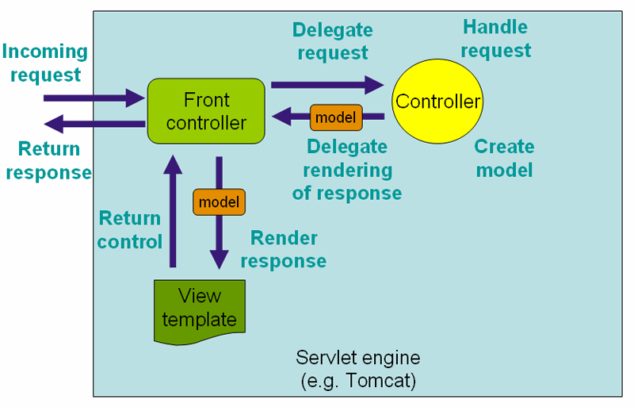
Request Processing Workflow in Spring MVC(High level)
Front Controller:- DispatcherServlet
It intercepts the incoming requests and determines which Controller will handle the request.
Spring controller returns a
ModelAndView class from their
handling methods.
The ModelAndView instance holds
a reference to a view and a model.
The dispatcher servlet dispatches
the request to the view object
indicated by the Model and View
object.
The view object is responsible for
rendering a response back to the
client.

Slide 36
Life Cycle of a Request in Spring MVC
The client requests for a web resource in the web application.
The DispatcherServlet acting as the front controller, intercepts the request and tries to find out the appropriate HandlerMappings.
The HandlerMappings maps a client request to its controller object by looking up the various controllers defined in the configuration file.
Once the controller object is identified, the DispatcherServlet will dispatch the request to the controller with the help of Handler Adapter.
The client request is processed by the Controller a ModelandView object representing a Model and View is returned back to DispatcherServlet.
Then DispatcherServlet will try to resolve the actual view through ViewResolver object.
Then Selected view is finally rendered back to the client.

Slide 37
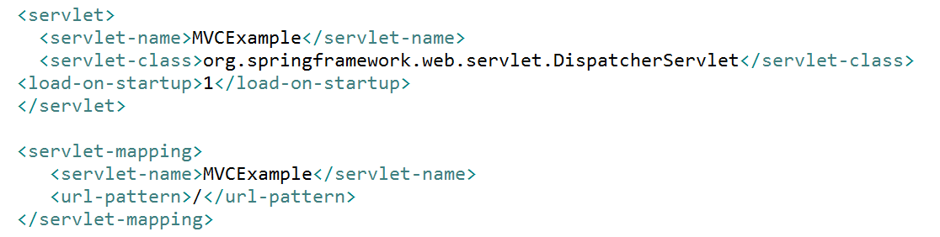
Dispatcher Servlet
The Dispatcher Servlet handles all the requests of the application.
So all the requests to the application has to be forwarded to Dispatcher Servlet.
How to do this?
Once DispatcherServlet is initialized, the framework will look for a configuration file with the name [Servlet-name]-servlet.xml in WEB-INF directory and creates beans in it.

Slide 38
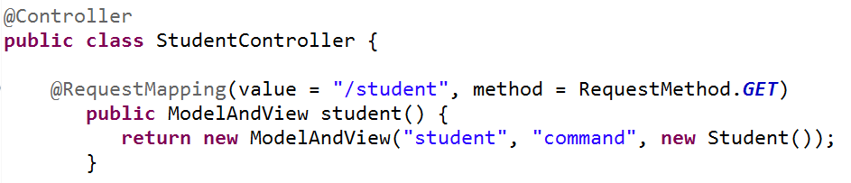
Spring Controller
Spring controllers provide access to application logic that has to be executed to handle the request.
Controllers take the user input and convert the input into a wise model which will be indicated to the user by view.
Controllers handle the request delegated to them by the DispatcherServlet.
Any class with @Controller annotation can act as a controller class.
@Controller facilitates auto detection of controllers which eliminates the need for configuring the controllers in DispatcherServlet’s Configuration file.
For enabling auto-detection of annotated controllers component-scan has to be added in the config file.
@RequestMapping annotation maps requests to the appropriate handler method.

Slide 39
Handler Mapping
Once the client request is intercepted by the DispatcherServlet, it has to be mapped with a handling object.
In order to do this , the DispatcherServlet identifies the appropriate HandlerMapping object.
DispatcherServlet will make use of DefaultAnnotationHandlerMapping which maps the requests to the handler methods using @RequestMapping annotation.
BeanNameUrlHandlerMapping : Maps Controllers' to URLs that are based on the controllers bean name
SimpleUrlHandlerMapping : Maps controllers to URLs using property collection defined in the context configuration file.
ControllerClassNameHandlerMapping : maps controllers to URLs by using the controller’s class name as the basis for the URL.
CommonsPathMapHandlerMapping : maps Controllers to URLs using source-level metadata placed in the controller code.

Slide 40
Handler Adapter
Once the DispatcherServlet identifies the appropriate Handler Mapping, the request is delegated to the controller via Handler Adapter .
There are various types of Handler Adapters which are as follows:
SimpleControllerHandlerAdapter
ThrowawayControllerHandlerAdapter
SimpleServletHandlerAdapter

Slide 41

ModelAndView
After processing the request the controller returns a ModelAndView object back to the Dispatchersrevlet.
This class is a container class for holding Model and View information.

Slide 42
View
In Spring, the views are addressed by a Name and the views are determined by a View Resolver.
Spring uses two interfaces to handle the views.
View : addresses the groundwork of the request and hands the request over to one of the view.
ViewResolver: gives a mapping between view names and actual views. There are many ViewResolver available in Spring.

Slide 43
References
www.springsource.org
http://www.tutorialspoint.com/spring/
http://www.javatpoint.com/spring-tutorial

Slide 44
Thank you

