Slide 1

TestNG Testing code as you write it
Date : Nov 14, 2016
Chandra Vir Singh – Crew Pay

Slide 2

Agenda
Introduction to TestNG
Installation Guide for Eclipse
Features
A comparison to Junit
Benefits of TestNG
Basic Annotations
testNg.xml
TestNG Reports
More on Annotations
Code Demo

Slide 3
What is TestNG
TestNG is a testing framework for the Java programming language created by Cédric Beust and inspired by JUnit .
TestNG is an open source Automated testing framework where NG stands for Next Generation designed to be better than JUnit, especially when testing integrated classes.
The design goal of TestNG is to cover a wider range of test categories: unit, functional, end-to-end, integration, etc., with more powerful and easy-to-use functionalities.
Unit testing (testing a class in isolation of the others)
Integration testing (testing entire systems made of several classes, several packages and even several external frameworks, such as application servers).

Slide 4
Installing in eclipse
The latest version of TestNG can be downloaded from http://search.maven.org/
In Eclipse, Select Help / Software updates / Find and Install.
Search for new features to install.
New remote site.
For Eclipse 3.4 and above, enter http://beust.com/eclipse.
For Eclipse 3.3 and below, enter http://beust.com/eclipse1.
Make sure the check box next to URL is checked and click Next.
Eclipse will then guide you through the process and restart eclipse.

Slide 5
Basic Three steps for Writing Test Case
Write the business logic of your test and insert TestNG Annotations in your code.
Add the information about your test (e.g. the class name, the groups you wish to run, etc...) in a testng.xml file.
Run TestNG.

Slide 6
Additional features over JUnit
Support for parameters.
Supports dependent methods testing.
Test configuration flexible.
TestNG has a more elegant way of handling parameterized tests with the data-provider concept.
For the same test class TestNG support for multiple instances.
Extendibility of using different Tools and plug-ins like Eclipse, Maven, IDEA etc.
Default JDK functions for runtime and logging (no dependencies).
Supported different Annotations like @BeforeSuite, @AfterSuite, @BeforeClass, @AfterClass, @BeforeTest, @AfterTest, @BeforeGroups, @AfterGroups, @BeforeMethod, @AfterMethod, @DataProvider, @Factory, @Parameters, @Test.

Slide 7
A Comparison..
JUnit vs TestNG
Feature | JUnit 4 | TestNG
Test annotation | @Test | @Test
Run before all tests in this suite have run | — | @BeforeSuite
Run after all tests in this suite have run | — | @AfterSuite
Run before the test | — | @BeforeTest
Run after the test | — | @AfterTest
Run before the first test method that belongs to any of these groups is invoked | — | @BeforeGroups
Run after the last test method that belongs to any of these groups is invoked | — | @AfterGroups
Run before the first test method in the current class is invoked | @BeforeClass | @BeforeClass
Run after all the test methods in the current class have been run | @AfterClass | @AfterClass
Run before each test method | @Before | @BeforeMethod
Run after each test method | @After | @AfterMethod
ignore test | @ignore | @Test(enbale=false)
Expected exception | @Test(expected = ArithmeticException.class) | @Test(expectedExceptions = ArithmeticException.class)
Timeout | @Test(timeout = 1000) | @Test(timeout = 1000)

Slide 8
Advantages over JUnit
In TestNG Annotations are easy to understand over JUnit.
In TestNG there is no constraint like you have to declare @BeforeClass and @AfterClass, which is present in JUnit.
As method name constraint is present in JUnit, such method name constraint is not present in TestNG and you can specify any test method names.
In TestNG enable you to grouping of test cases easily which is not possible in JUnit.
TestNG supports following three 3 additional setUp/tearDown level: @Before/AfterSuite, @Before/AfterTest and @Before/AfterGroup.
TestNG allows us to define the dependent test cases each test case is independent to other test case.
TestNG allows us to execute of test cases based on group. Let’s take a scenario where we have created two set of groups “Regression” & “Sanity”. If we want to execute the test cases under Sanity group then it is possible in TestNG framework.
Parallel execution of Selenium test cases is possible in TestNG.

Slide 9
TestNG execution hierarchy
@BeforeSuite
@BeforeTest
@BeforeClass
@BeforeMethod
@Test
@AfterMethod
@AfterClass
@AfterTest
@AfterSuite

Slide 10
Annotations
@Test: The annotated method is a part of a test case
@BeforeSuite: The annotated method will be run before all tests in this suite have run.
@AfterSuite: The annotated method will be run after all tests in this suite have run.
@BeforeTest: The annotated method will be run before any test method belonging to the classes inside the tag is run.
@AfterTest: The annotated method will be run after all the test methods belonging to the classes inside the tag have run.
@BeforeGroups: The list of groups that this configuration method will run before. This method is guaranteed to run shortly before the first test method that belongs to any of these groups is invoked.
@AfterGroups: The list of groups that this configuration method will run after. This method is guaranteed to run shortly after the last test method that belongs to any of these groups is invoked.
@BeforeClass: The annotated method will be run before the first test method in the current class is invoked.
@AfterClass: The annotated method will be run after all the test methods in the current class have been run.
@BeforeMethod: The annotated method will be run before each test method.
@AfterMethod: The annotated method will be run after each test method.
@DataProvider: Create parameters to pass to your test methods
@Parameters : Create your own test objects at runtime.
@Factory: Create your own test objects at runtime.

Slide 11
Inside @Test
@Test
Groups
The groups this method belongs to
DependsOnGroups
The list of groups this test method depends on. TestNG guarantees that all the methods belong to these groups will be run before your method
Enable or disable tests
@Test(enabled = false)
Add to a group which is excluded
Exclude in other ways in testng.xml
TimeOut
@Test(timeOut = 1000)
testng.xml <suite|test> time-out attribute
The test case will be failed if time period is exceeded

Slide 12
testng.xml
Where all the runtime information goes:
The test methods, classes, packages
Which groups should be run (include-groups)
Which groups should not be run (exclude-groups)
Define additional groups (“groups of groups”)
Whether the tests should be run in parallel
Parameters

Slide 13

Example testng.xml
<suite name="Suite">
<test name="Test">
<parameter name="name" value ="chandravirsingh"></parameter>
<!-- <groups>
<run>
<exclude name ="grp1"></exclude>
<include name="grp2"></include>
</run>
</groups> -->
<classes>
<class name="learningTestNg.Factory"/>
<class name="learningTestNg.TestNgAnnotation_1"/>
<class name="learningTestNg.DataProvider"/>
<class name="learningTestNg.TestNgAnnotation_2"/>
</classes>
</test> <!-- Test -->
</suite> <!-- Suite -->

Slide 14
configurations in testng.xml file
A suite is represented by one XML file. It can contain one or more tests and is defined by the <suite> tag.
Class names
Package names ( will execute all test classes)
Groups and methods (include/exclude)
run the tests in parallel, how many threads to use
TestNG will run your tests in the order they are found in the XML file. If you want the classes and methods listed in this file to be run in an unpredictable order, set the preserve-order attribute to false

Slide 15
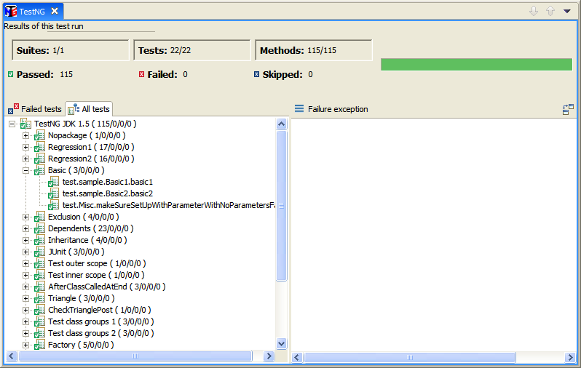
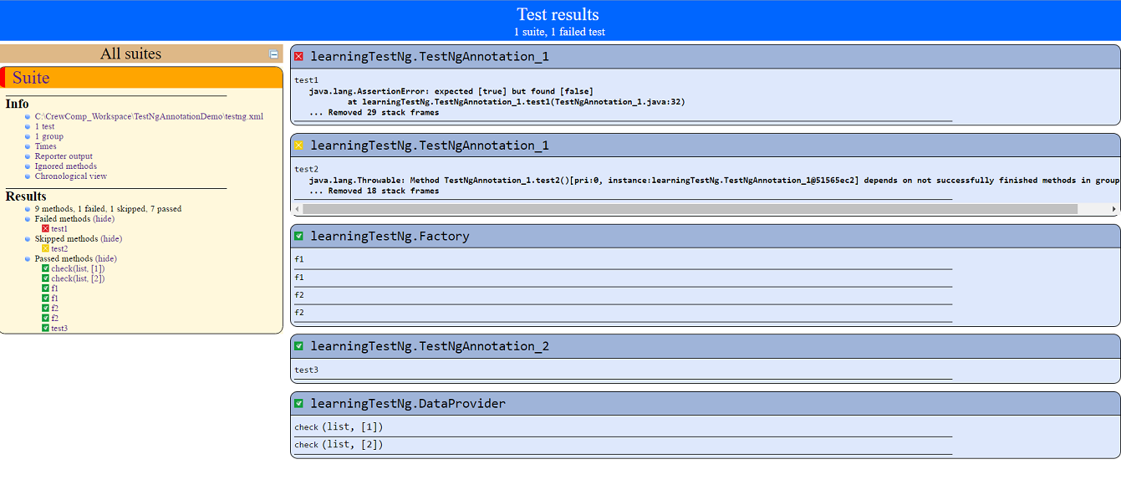
TestNG Report

Slide 16

Rerunning failed tests
Most of our work is fixing tests that fail
TestNG knows what tests failed in a particular run and makes it to rerun just these tests
➔ testng-failed.xml
Typical session:
$ java org.testng.TestNG testng.xml
$ java org.testng.TestNG testng-failed.xml

Slide 17
Groups
Each test method is tagged with any number of groups.
@Test // no groups
@Test (groups = “group1”)
@Test (groups = { “g1”, “g2”, ... })
A group therefore contains any number of test methods.
Groups can span classes.
Groups can also be externally defined (TestNG xml configuration file).
A group is identified by a unique string (don’t use white space).
There are no pre-defined group names.
E.g., “slow”, “fast”, “gui”, “check-in”, “week-end” “unit”,“regression”,“integration”,“broken.unknownReason”

Slide 18

Including/Excluding groups
Sometimes, tests break and you can’t fix them just now
With JUnit: comment out the broken tests and hope you won’t forget to turn them back on before you ship
With TestNG: define a “broken” group and have it excluded of all your runs. Move any test method that fails into this group
Later: just look for all the tests in the “broken” group, fix them and remove them from this group
<test name=“DBTest">
<groups>
<run>
<exclude name=“broken.*" />
<include name=“functional.*” />
</run>
</groups>

Slide 19

Dependent methods
Problem: certain test methods depend on the successful prior run of other test methods.
Example: testing a web server:
One test method that launches the server (launch())
One test method that pings the server (ping())
Twenty methods that test various functionalities of the server (test1() … test20())
Problem: server is launched but ping() fails
Scenario tricky to achieve with JUnit
Result: 1 PASSED and 21 FAILURES
➔ Onshore team freaks out and calls you on a Saturday night during your club party.

Slide 20
Dependent methods
Back to the Web server testing example:
Dependencies: launch → init → tests
@Test(groups = “launch”)
public void launchServer() {…}
@Test(groups = “init”,
dependsOnGroups = { “launch” })
public void ping() { …}
@Test(dependsOnGroups = { “init” })
public void test1() { … }
Outcome: 1 SUCCESS, 1 FAIL, 20 SKIPS

Slide 21
Parameterized Tests
Parameterized tests are very simple with TestNG.
You can have as many data providers in one class as you wish. You can reuse them (call them from other classes), and you can make them "lazy", so each set of parameters is created when required.
@BeforeMethod
@Parameters("name")
public void beforeMethod(String name){
System.out.println(name);}
<parameter name="name" value ="chandravirsingh"></parameter>

Slide 22
Data Providers
TestNG supports Data-Driven Testing
DataProviders allow you to separate data from the logic of your tests
Data can come from Java, flat file, database, network, etc…
You can have as many DataProviders as you want (e.g. “good-strings-provider”, “bad-strings-provider”, etc…)
Example: returning HTTP error codes for browser user agent strings
@Test
public void verifyUserAgentSupport() {
assertEquals(200, getReturnCodeFor(MSIE);
assertEquals(200, getReturnCodeFor(FireFox));
assertEquals(301, getReturnCodeFor(Safari);
assertEquals(-1, getReturnCodeFor(WAP));
}

Slide 23
DataProviders
@DataProvider(name = “user-agents")
public Object[][] createUserAgents() {
return new Object[][] {
new Object[] { “MSIE”, 200}, new Object[] { “FireFox”, 200}; new Object[] { “Safari”, 301}; new Object[] { “WAP”, -1}; }
}
@Test(dataProvider = “user-agents”)
public void verifyUserAgent(String s, int code) {
assert getReturnCodeFor(s) == code;
}

Slide 24
References
http://testng.org/doc/index.html
http://testng.org/doc/documentation-main.html
http://testng.org/testng-1.0.dtd.php
http://testng.org/javadoc/

Slide 25
Thank you

