Slide 1


Slide 2
Agenda
Introduction to AngularJS
Single Page Application (SPA)
Downloading AngularJS and Understanding API
Directives, Filters and Data Binding
  Using Directives and Data Binding
  Data-Binding Example using AngularJS Directives
  Iterating with the ng-repeat Directive
  Using Filters
MVC with Angular JS
  Views, Controllers and Scope
  Creating a View and Controller

Slide 3
Agenda
Modules, Routes and Factories
  Creating a Module.
  Creating a Controller in a Module.
  The Role of Routes
  Defining Routes
Using Factories and Services
  The Role of the Factory
  Creating Factory

Slide 4
Single Page Application
HTML is a great declarative language for static documents.
  It does not contain much in the way of creating applications,
One "real" HTML page whose content can be changed in Javascript without having to download a new page.
  The new content is created programmatically using templates.
  performances is better since not downloading a new HTML page each time while navigating
No server-side page rendering

Slide 5
Characteristics Single Page Application:
Chunking
  the web page is constructed by loading chunks of HTML fragments and JSON data instead of receiving full HTML from a web server on every request.
Controllers
  JavaScript code that handles complex DOM and data manipulations, application logic and AJAX calls is replaced by controllers that separate views and models using MVC or MVVM patterns.
Templating
  coding of UI and DOM manipulations are replaced by declarative binding of data to HTML templates.

Slide 6
Characteristics Single Page Application:
Routing
  selection of views and navigation (without page reloads) that preserves page state, elements and data
Real-time communication
  two-way communication of a client application and web server replaces one-way requests from a browser
Local storage
  capabilities of storing data on a browser for performance and offline access replace cookies and intensive data loads from web server

Slide 7
Model View Controller
View
Passes Calls to
Controller
Fires Event
Model
Modifies

Slide 8
Model View Presenter
View
Passes Calls to
Updates
Presenter
Fires Event
Model
Modifies

Slide 9
Model View ViewModel
View
Modifies
Fires Event
View Model
Fires Event
Modifies
Model

Slide 10
What is AngularJS
A JavaScript Library and also a framework to make the development of web apps easier and faster
HTML with a native Model-View-Controller (MVC) capabilities.
  extends HTML attributes with Directives, and binds data to HTML with Expressions
Uses HTML as template language and extend HTML's syntax to express application's components clearly and succinctly.
Has data binding and dependency injection within the browser,

Slide 11
Downloading AngularJS
Can be download from http://angularjs.org/
Added to a web page with a script tag.
  <script src="Scripts/angular.js"></script>
Can also be added through latest CDN link
  <head>
  <title>Learning AngularJS</title>
  <script src=https://ajax.googleapis.com/ajax/libs/angularjs/1.0.7/angular.min.js ></script>
  </head>
There are two types of angular script URLs we can point to,
angular.js
  This is the human-readable, non-minified version, suitable for web development.
angular.min.js
  This is the minified version, usually used in production.

Slide 12
Building Blocks AngularJS
View Component
  what the user sees (the DOM)
Directives
  extend HTML with custom attributes and elements
Controllers Component
  the business logic behind views
Model Component
  the data shown to the user in the view and with which the user interacts
Filters
  formats the value of an expression for display to the user
Services
  reusable business logic independent of views
Dependency Injection
  Creates and wires objects and functions

Slide 13
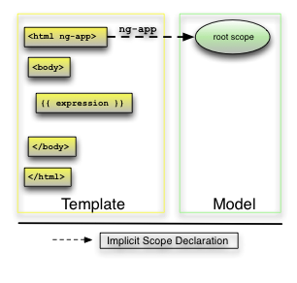
View And Templates
view is a projection of the model through the HTML template
  Pure static HTML page is turned into a template to display result with any set of data.
  View is the Structure of the web page before it's processed by AngularJS.
  Its scanned for directives and template commands, and compiled to a application.

Slide 14
A Simple View (Template)
  <!DOCTYPE html>
  <html>
  <head>
  <title>First Example</title>
  <script src="Scripts/angular.js"></script>
  </head>
  <body ng-app>
  {{"Hello" + "World"}}
  </body>
  </html>
Directive
Expression

Slide 15
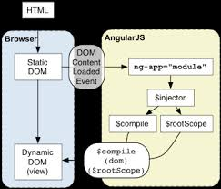
Angular Automatic Initialization

Slide 16
Angular Manual Initialization
<script>
angular.module('myApp', [])
.controller('MyController', ['$scope', function ($scope) {
$scope.greetMe = 'Manual Initialization';
}]);
angular.element(document).ready(function () {
angular.bootstrap(document, ['myApp']);
});
</script>
<div ng-controller="MyController">
Hello {{greetMe}}!
</div>

Slide 17
Angular Automatic Initialization
It initializes automatically upon DOMContentLoaded event or when the angular.js script is evaluated
It looks for the ng-app directive which designates application root.
If the ng-app directive is found then Angular will:
  load the module associated with the directive.
  create the application injector
  compile the DOM treating the ng-app directive as the root of the compilation.
  This is to treat only a portion of the DOM as an Angular application.

Slide 18
Directives
Used to extend HTML ,understandable to AngularJS.
Directives are HTML attributes with an ng prefix.
  Can use data-ng- to make it HTML5 compliant
ng-App.
  Best Practice is to put to the parent tag <html>
  Indicate the AngularJS compiler that this part of the page is an angular module/application.
  defines the root element of an AngularJS application.
  Will automatically initialize the application when page is loaded.

Slide 19
Directives
ng-bind
  binds the innerHTML of the element to the application variable .
  Uses one way data Binding ($scope->view)
  Has shortcult {{ }} do display scope value
ng-model
  binds the value of HTML controls to application data.
  Provide CSS classes for HTML elements.
  Has two-way data binding
  ($scope --> view and view --> $scope)
  Bind HTML elements.
  <input ng-model="val"/>.

Slide 20
Directives- Example-I
  <!DOCTYPE html>
  <html xmlns="http://www.w3.org/1999/xhtml">
  <head>
  <title>Directive Example-One</title>
  <script src="Scripts/angular.js"></script>
  </head>
  <body>
  <div ng-app="">
  <label>First Name</label>
  <input type="text" ng-model="name">
  <p ng-bind="name"></p>
  </div>
  </body>
  </html>
Model
Data Binding
View

Slide 21
Angular vs. JavaScript Expressions
Context:
  JavaScript expressions are evaluated against the global window.
  In Angular, expressions are evaluated against a scopeobject.
Forgiving:
  In JavaScript, trying to evaluate undefined properties generates ReferenceError or TypeError.
  In Angular, expression evaluation is forgiving to undefined and null.
No Control Flow Statements:
  In Angular cannot use the conditionals, loops, or exceptions.
Filters:
  Filters can be used within expressions to format data before displaying it.
  Instead of using eval() use the $eval() method.

Slide 22
Data Binding Expressions
Binds data to HTML using Expressions {{ expression }}.
  Expressions are written inside double braces:
  Same way as the ng-bind directive.
They can contain literals, operators, and variables.
Will "output" data exactly where the expression is written.
  <div ng-app="">
  <label>First Name</label>
  <input type="text" ng-model="name">
  {{name}}
  </div>

Slide 23
Models
Model
Any data that is reachable as a property of an angular Scope object.
This property reference can be created explicitly or implicitly.

Slide 24
Explicit Model
Created by explicitly creating scope properties referencing JavaScript objects in the following ways:
In Controllers
Make a direct property assignment to the scope object in JavaScript code; this most commonly occurs in controllers:
In Templates
Use an angular expression with an assignment operator in templates:
Use ngInit directive in templates
The ngModel directive binds an input,select, textarea (or custom form control) to a property on the scope using NgModelController, which is created and exposed by this directive.

Slide 25
Explicit Models
Angular creates models implicitly (by creating a scope property and assigning it a suitable value) when processing the following template constructs: Form input, select, textarea and other form elements: The code above creates a model called "query" on the current scope with the value set to "fluffy cloud
An iterator declaration in ngRepeater:
The code above creates one child scope for each item in the "phones" array and creates a "phone" object (model) on each of these scopes with its value set to the value of "phone" in the array

Slide 26
Data-binding framework
In traditional server-side HTML programming, model interact within a server process to produce new HTML views.
Angular provides Automatic data binding
  ability to consider the view to be a projection of the model state.
Any time the model is changed in the client-side model, the view reflects these changes without writing any custom code.
Views created are live templates
  Individual components of the views are dynamically interpolated .
  Pages are generated without any interaction with a server.

Slide 27
One Way Data Binding
Data Binding is a process that links UI and business logic, changes done to either of them will reflect in both.
one way data binding
  model values are automatically assigned to the HTML placeholder elements specified through the data binding notation,
  but the HTML elements don't change the values in the model .
Specified in two different ways:
  with curly braces: {{expression}}
  ng-bind
    ng-bind="varName“
    ($scope --> view).
    $scope.val inserted into html where val is a variable name.

Slide 28

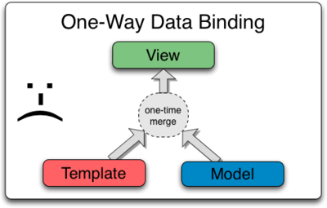
One Way Data Binding

Slide 29
One Way Data Binding -MVC
MVC design pattern can be seen in AngularJS,
Model: Model is nothing but data.
View: View represents this data.
Controller: Controller mediates between the two.
In MVC if we make any change in the view it doesn’t gets updated in model

Slide 30
One Way Data Binding -MVC
  <script src="Scripts/angular.js"></script>
  <script>
  function TextController($scope) {
  $scope.sampleText = 'This is MVC demo!';
  }
  </script>
  </head>
  <body ng-app="" ng-controller="TextController">
  <p>{{sampleText}}</p>
  </body>

Slide 31
Directives
  The ng-show and ng-hide directives are used to conditionally display HTML DOM elements based on variables, Expressions or functions
  <img src="Images/orderedList1.png" ng-show="true" />
  Used to display DOM elements like an error message
Both the directives require a boolean value to evaluate the visible state of the element on which they are defined.
They can be used as attributes in an element
ng-click
  own HTML events directives.
  defines an AngularJS click event.

Slide 32
Directive Statement-Example-II
  <div ng-app="">
  <div id="left">
  <img src="Images/orderedList1.png" ng-show="true" />
  </div>
  <div id="right" >
  <img src="Images/orderedList2.png" ng-show="false"/>
  </div>
  <label>First Name</label>
  <input type="text" ng-model="name">
  <p ng-bind="name"></p>
  </div>

Slide 33
Directives
ng-init
  directive initialize application variables.
<div ng-app="" ng-init="firstName=‘Ramesh'">
<p>The name is <span ng-bind="firstName"></span></p>
</div>
  <div ng-app="" ng-init="person={userName:‘Ramesh',email:‘ram@abc.cm'}">
  <p>The name is <span ng-bind="person.userName"></span></p>
  </div>
Common use case is for aliasing special properties of ngRepeat.
Use controllers is preferred rather than ngInit to initialize values

Slide 34
Directives
The ng-repeat directive used on an array of objects, it repeats an HTML element:
Used for displaying data in a tables.
Can be Used to iterate over a Array of Values
  <div ng-app="" ng-init=" nameList=['Jagan','Hari','Kumar']">
  <table>
  <tr ng-repeat="name in nameList">
  <td>{{ name }}</td>
  </tr>
  </table>
  </div>

Slide 35
Directive Statement-Example-V
<div ng-app=""
ng-init="items=[ {itemCode:101,itemName:'laptop'},
        {itemCode:102,itemName:'smaartphone'}]">
<ul>
<li ng-repeat="x in items">
{{ x.itemCode + ', ' + x.itemName}}
</li>
</ul>
</div>

Slide 36
Directive
ng-disabled
  binds application data to the disabled attribute of HTML elements
  Click me to toggle:
  <input type="checkbox" ng-model="checked">
  <button ng-disabled="checked">Button</button>
ng-include
Fetches, compiles and includes an external HTML fragment.
  <div class="container">
  <div ng-include="'myUsers_List.htm'"></div>
  <div ng-include="'myUsers_Form.htm'"></div>
  </div>

Slide 37
ngClass
Used to dynamically set CSS classes on an HTML element
  Data binding an expression that represents all classes to be added.
The directive operates based on the expression
  evaluates to a string,
  the string should be one or more space-delimited class names.
.bold {
font-size:1.2em;
}
  <body ng-app="" ng-init="clsName='bold'">
<h1 ng-class="clsName">CSS Styling</h1>

Slide 38
Directive Processing
Directives life begins and ends within the AngularJS bootstrapping process, before the page is rendered.
Directive processes the element depends directive definition object.
It can define a compile function, a link function or both.
  Link function can be defined as a pre-link function and a post-link function
compile
  The directive to manipulate the DOM before it is compiled and linked
  Allowing to add/remove/change directives,
  Allowing to add/remove/change other DOM elements.

Slide 39
Directive Processing
The pre-link
  function allows for private $scope manipulation before the post-link process begins.
The post-link
  The primary workhorse method of the directive.
  DOM manipulation takes place,
  event handlers are configured,
  watches are configured

Slide 40
CONTROLLERS

Slide 41
Controllers
Functions used to initialize the model objects,
  A new Controller object is instantiated , using the specified Controller's constructor function.
  A new child scope will be available as an injectable parameter to the Controller's constructor function as $scope.
Use controllers to:
  Set up the initial state of the $scope object.
  Add behavior to the $scope object.
  Controllers should contain only business logic.

Slide 42
Controllers
ng-controller
  directive defines the controller.
  Gets executed when the page loads.
  attribute on a DOM element says that all of the elements inside of it belong to the controller.
  The value should also be the name of the function .
  They have special parameters with fixed names like $scope.
NameSpace
  Created by Placing it in a module and then creating within the module.

Slide 43
Globally Defined Controller
  Global Function can be used as a Controller to Initialize the model
  <script>
  function itemController($scope) {
  $scope.itemName = 'Computer';
  $scope.ratePerUnit = 45000;
  }
  </script>
  <div ng-app="" ng-controller="itemController">
  Item Name : <input ng-model="itemName" type="text" />
  RatePerUnit :<input ng-model="ratePerUnit" type="text" />
  </div>

Slide 44
Example
  <div ng-app="" ng-controller="showHideController">
  <div id="left">
  <img src="Images/orderedList1.png" ng-show="status" />
  </div>
  <label>First Name</label>
  <input type="text" ng-model="name">
  <p ng-bind="name"></p>
  <button ng-click="show()">Hide Image</button>
  </div>
  <script>
  function showHideController($scope) {
  $scope.status = true;
  $scope.show = function () {
  $scope.status = false;
  } }
  </script>.

Slide 45
External Controller
ItemController.js
  function itemController($scope) {
  $scope.itemName = 'Ipad';
  $scope.ratePerUnit = 35000;
  }
<script src="../Scripts/ItemController.js"></script>
  <div ng-app="" ng-controller="itemController">
  Item Name : <input ng-model="itemName" type="text" />
  RatePerUnit :<input ng-model="ratePerUnit" type="text" />
  </div>

Slide 46
Multiple Controller
Can define multiple controllers in the same HTML template
  each one manages its own $scope object.
Properties resides in its own $scope thus avoiding any conflict
Nested Controller
  To share model and functions through an inheritance tree.
  Done by assigning a controller to a DOM element that is inside another one
  Nesting happens in scopes.
The $scope passed to a nested controller prototypically inherits from its parent controller’s $scope.

Slide 47
Multiple Controller-Example II
  var firstController = function ($scope) {
  $scope.firstName = "John";
  $scope.lastName = "Doe";
  $scope.getFullName = function () {
  return $scope.firstName + " " + $scope.lastName;
  }; };
      var secondController = function ($scope) {
      $scope.firstName = "Bob";
      $scope.middleName = "Al";
      $scope.lastName = "Smith";
      $scope.getFullName = function ()
      {
      return $scope.firstName + " " + $scope.middleName + " " + $scope.lastName;
      }; };

Slide 48
Nested Controllers-Example-III
Binding the ChildController under the ParentController in our view,
Can reference the property on the parent scope on ChildController:
  <script>
  function BankConroller($scope) {
  $scope.productName = 'BankAccount';
  }
  function DepController($scope) {
  $scope.PersonalType1 = 'SavingsAccount';
  $scope.PersonalType2 = 'RecurringDeposit';
  }
  </script>

Slide 49
Nested Controller-Example-III
  <div ng-controller="BankConroller">
  <div ng-controller="DepController">
  Product SubTypes {{ productName }}
  <ol>
  <li>{{ PersonalType1 }}</li>
  <li>{{ PersonalType2 }}</li>
  </ol>
  </div>
  </div>

Slide 50
Controller Within a Module
This is the Best Practise in Angular for defining controller
  var app = angular.module("ctrlExample1", []);
  app.controller("booksController", function ($scope) {
  $scope.books = [
  {
  bookNo:'101',bookName:'java'
  } ,
  {
  bookNo: '202', bookName: 'jQuery'
  }
  ]
  });
  </script>

Slide 51
Controller Within a Module
  <div ng-app="ctrlExample1" ng-controller="booksController">
  <ul>
  <li ng-repeat=“bk in books">
  {{ bk.bookNo + ', ' + bk.bookName }}
  </li>
  </ul>
  </div>

Slide 52
DATA BINDING

Slide 53
Two Way Data Binding
Its the ability to bind changes to an object’s properties to changes in the UI, and vice-versa.
  Can have more than one HTML element bound to the same variable.
ng-model
  has two-way data binding
  Variable it will be bound to the scope.
  Scope for the variable will be available in UI as well as model.
  model –> view and view –> model.
When the page is loaded, the value of the input elements are initialized to those of the respective model variables
  whenever the user types something in an input, the value of the model variable is modified as well

Slide 54
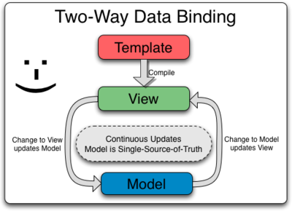
Two Way data-Binding
Handling Value Changes
  If the view changes the value, the model observes the change through dirty checking,
  If the model changes the value, the view updates with the change.
Any update on model will be immediately reflected in view without the need for any DOM manipulation or event handling

Slide 55
MVVM Design Pattern
Two-way binding enables MVVM design pattern.
Model
View
View Model
Controller is replaced by View Model
View Model is a JavaScript function like a controller and is responsible for maintaining relationship between view and model,
Difference
  If we update anything in view, it gets updated in model,
  change anything in model, it shows up in view

Slide 56
Two Way Data Binding
  <script src="Scripts/angular.js"></script>
  </head>
  <body>
  <form ng-app="" ng-controller="CurrencyController">
  <label>Indian Rupees:</label>
  <input name="inr" ng-change=“convert()" ng- model="data.inr">
  <label>Indian Rupees entered by User :</label> {{data.inr}}
  <label>Converstion Rate :</label> {{data.convRate}}
  <label>Result :</label> {{data.result}}
  </form>

Slide 57
Two Way Data Binding
  <script>
  function CurrencyController($scope) {
  $scope.data = { inr: 0, convRate: 50, result: 0 };
  $scope.convert = function () {
  $scope.data.result = $scope.data.inr * $scope.data.convRate;
  }
  }
  </script>
  </body>
  </html>

Slide 58
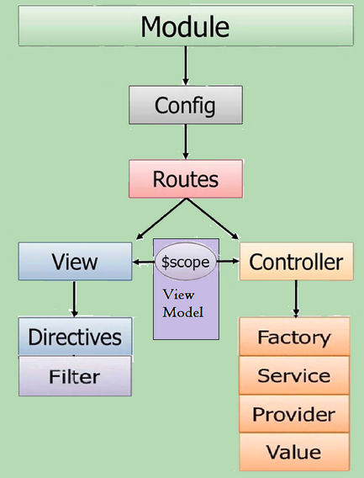
$SCOPE
  glues the View with Controller.
  uses two-way data binding to bind model data to view
  application object -owns application variables and functions.
  Can be used to set the initial state
  added as a parameter to the controller function.

Slide 59
$scope
Inline injection used to explicitly specify $scope to Controller
Properties found on the scope automatically accessible
  with {{ }} in View/HTML/
  with Directive into a DOM component
  With user input validation controls

Slide 60
Example
<script>
function ListCtrl($scope) {
$scope.department = 'Training';
$scope.names = ['Jagan', 'Hari', 'Kumar'];
}
</script>
  <div ng-app="" ng-controller="ListCtrl">
  <p>Name is <span ng-bind="department"></span> </p>
  <ol>
  <li ng-repeat="name in names">{{name}} from {{department}}</li>
  </ol>
  /div>

Slide 61
Adding Behavior to a Scope Object
Can attach methods to the $scope object.
Made available from the template/view.
Can be invoked via angular expressions
Can also be invoked with event handler directives like ngClick
  var myApp = angular.module('myApp',[]);
  myApp.controller('DoubleController', ['$scope', function($scope)
  {
  $scope.double = function(value) { return value * 2; };
  }
  ]);
<div ng-controller="DoubleController">
Two times <input ng-model="num"> equals {{ double(num) }} </div>

Slide 62
$scope Life Cycle
Linking
  When the $scope is linked to the view, all directives that create $scopes will register their watches on the parent scope.
  These watches watch for and propagate model changes from the view to the directive.
Updating
  During the $digest cycle, which executes on the $rootScope, all of the children scopes will perform dirty digest checking.
  All of the watching expressions are checked for any changes, and the scope calls the listener callback when they are changed.
Destruction
  When a $scope is no longer needed, the child scope creator will need to callscope.$destroy() to clean up the child scope.
  Note that when a scope is destroyed, the$destroy event will be broadcasted.

Slide 63
$scope.$watch
$scope.$watch
  Used to watch when a variable changes,
$scope.$watch( watchExp, listener, objectEquality );
  what to watch (watchExp),
  what to do when it's updated (listener),
  and whether or not you're checking on a variable or on an object.
  As we are checking a variable, we can ommit this when we call the function.
Angular will register watcher function in the $scope.

Slide 64
Two Way Binding with Watch
<script>
var myapp = angular.module("twoway", []);
myapp.controller('twoWayController', function ($scope) {
$scope.firstName = "Ramesh";
$scope.lastName = "kumar";
$scope.$watch(function () {
return $scope.firstName;
}, function (newValue, oldValue) {
console.log('$scope.firstName was updated!');
});
}
);
</script>

Slide 65
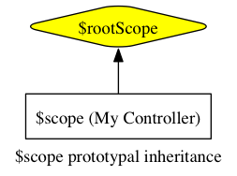
$rootScope
The $rootScope is the top level scope for the application.
Can be accessed anywhere in the view
scopes are created with prototypal inheritance
How it works
  If property is not found on a local scope,
  It crawl up to the containing (parent) scope and look for the property or method there.
  If is not found there it will walk to that scope's parent and so on and so forth until it reaches the $rootScope.
  If it doesn't find it on the $rootScope, then it moves on and is unable to update the view.
Isolate Scope
  scope created inside of a directive

Slide 66
$rootScope
  <p>Favourite Color {{ color }}.</p>
  <div ng-controller="myController">
  <p>My Favourite Color is {{ color }}.</p>
  </div>
  <div ng-controller="yourController">
  <p>Your Favourite Color is {{ color }}.</p>
  </div>
  <script type="text/javascript">
  var app = angular.module('myApp', []).run(function ($rootScope) {
  $rootScope.color = 'yellow';
  });
  app.controller('myController', function ($scope) {
  $scope.color = 'blue';
  });
  app.controller('yourController', function ($scope) {
  });
  </script>
Favourite Color yellow.
My Favourite Color is blue.
Your Favourite Color yellow.

Slide 67
Dependency Injection
Component can get a hold of its dependencies:
  can create the dependency, using the new operator.
  can look up the dependency, by referring to a global variable.
  can have the dependency passed to it where it is needed.
Issues with First Two Options
  Dependency is hard coded in to the component.
  Difficult, to modify the dependencies.
  Problematic in tests, where it is often desirable to provide mock dependencies for test isolation.

Slide 68
Dependency Injection
Can use the third way where injector subsystem creates components,
  resolving their dependencies,
  The dependency is simply handed to the component.
  providing them to other components as requested.
  function SomeClass(greeter) {
  this.greeter = greeter;
  }
  SomeClass.prototype.doSomething = function(name) { this.greeter.greet(name); }
This is desirable, but it puts the responsibility of getting hold of the dependency on the code that constructs SomeClass.

Slide 69
Dependency Injection
When Angular compiles the HTML, it processes the ng-ontroller directive,
  Then Using the injector creates an instance of the controller and its dependencies.
  injector.instantiate(MyController);
It will Inject all the dependecy without the controller ever knowing about the injector.
The application code declares the dependencies it needs, without having to deal with the injector.

Slide 70
Dependency Injection
General Syntax for Creating Controllers
  use array based dependencies approach.
module.controller('ControllerName',['dependency1','dependency2', function(dependency1, dependency2){
//logic
}
myApp.controller('TodoController',['$scope','$http',function($scope,
  $http){ //logic }]);
  AngularJS injects the dependencies by name
  JavaScript code are minified with tools to reduce the size.
  Which rename your variables to short variable names.
  $scope and $http may become $s and $h and eventually it will fail.

Slide 71
Dependency Injection
  myApp.controller('TodoController',function($scope,$http){
  //logic
  });
While Minifying the code turns into
  myApp.controller('TodoController',function($s,$h){
  //logic
  });
  Here $s represents $scope and $h represents $http services
  myApp.controller('TodoController',['$scope','$http',function($s,$h){
  }]);
Now Even after JavaScript minifies the function argument names, string literals remains same and right services are injected.

Slide 72
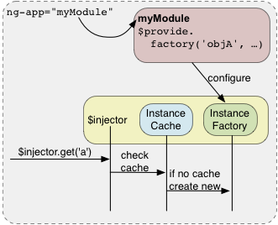
Dependency Injection

Slide 73
Logging in AngularJS
$log
  Simple service for logging.
  writes the message into the browser's console
  function FirstController($scope,$log) {
  $log.info("Controller Initialized");
  $scope.firstName = "Ramesh";
  $scope.fullName = function () {
  $log.info("full Name Method Invoked");
  return $scope.firstName + ":" + $scope.lastName;
  }
  }

Slide 74
$logProvider
Logging can be Controlled
Logging is Enabled by injecting the $log object
  Using $log.debug() send logs to the console.
Logging is disabled by calling
  $logProvider.debugEnabled(false);
  angular.module('app', []) .config( ['$logProvider',
  function($logProvider) {
  $logProvider.debugEnabled(false);
  }
  ])

Slide 75
FILTERS

Slide 76
Filters
Used for transforming the data for display used along with expressions.
  Can also be added to directives using a pipe (|) character
  multiple filters can be used by using two or more pipes.
To use the uppercase filter,
  <p>The Firstname is {{ firstName | uppercase }}</p>
We can also use filters from within JavaScript by using the $filter service.
  app.controller('DemoController', ['$scope', '$filter',
  function ($scope, $filter) {
  $scope.name = $filter('lowercase')(‘Ramesh');
  }
  ]);

Slide 77
Filters
Currency
  Format a number to a currency format.
Select
  a subset of items from an array.
Lowercase
    Format a string to lower case.
orderBy
    Orders an array by an expression.
Uppercase
    Format a string to upper case.

Slide 78
Currency Filters
currency filter accepts the symbol for the currency and the default is $.
Use the (:) symbol to pass parameter to a filter as follows.
{{ 123.456789 | number:2 }} <!-- Displays: 123.46 -->
<div>{{ 12345.67 | currency }}</div>
  <body ng-app>
  <div>{{ "12345.67" | currency:"USD" }}</div>
  </body>
  Date Filter
  <div>{{ 1288323623006 | date }}</div>

Slide 79
Filtering Input
An input filter can be added to a directive with a pipe character (|) and filter followed by a colon and a model name.
The filter filter selects a subset of an array:
<div ng-app="" ng-controller="namesController">
<p><input type="text" ng-model="test"></p>
<ul>
<li ng-repeat="x in names | filter:test | orderBy:'country'">
{{ (x.name | uppercase) + ', ' + x.country }}
</li>
</ul>
</div>

Slide 80
orderBy filter
Display with orderBy Filter
To sort the table, add an orderBy filter:
<div ng-app="" ng-controller="namesController">
<table>
<tr ng-repeat="x in names | orderBy : 'Country'">
<td>{{ x.Name }}</td>
<td>{{ x.Country }}</td>
</tr>
</table
</div>

Slide 81
Filters
  function ShoppingCartCtrl($scope) {
  $scope.items = [
  { Name: "Soap", Price: "25", Quantity: "10" },
  { Name: "Shaving cream", Price: "50", Quantity: "15" },
  { Name: "Shampoo", Price: "100", Quantity: "5" }
  ];
  $scope.mySortFunction = function (item) {
  if (isNaN(item[$scope.sortExpression]))
  return item[$scope.sortExpression];
  return parseInt(item[$scope.sortExpression]);
  }
  }

Slide 82
Filters
<table border="1">
<thead>
<tr>
<th>Name</th>
<th>Price</th>
<th>Quantity</th>
</tr>
</thead>
<tbody>
<tr ng-repeat="item in items | orderBy:mySortFunction | filter:search">
<td>{{item.Name}}</td>
<td>{{item.Price | currency}}</td>
<td>{{item.Quantity}}</td>
</tr>
</tbody>
</table>

Slide 83
Custom Filters
.filter() method
  Method is used for creating custom filters
  app.filter('', function () {
  return function () {
  return; }; });
The returned function gets invoked each time Angular calls the filter, which means two-way binding for our filters.
The user makes a change, the filter runs again and updates as necessary.
The name of filter used for reference it inside Angular bindings.

Slide 84
Custom Filters
app.filter( 'makeUppercase', function () {
return function (item) {
return item.toUpperCase(); };
});
  <div ng-app="app">
  <div ng-controller="PersonCtrl as person">
  <p> {{ person.username | makeUppercase }} </p>
  </div>
  </div>

Slide 85
MODULES

Slide 86
Modules
Building blocks of well structured application.
Used to nicely organize code into modules to avoid declaring objects and variables in the global namespace.
Defined by calling the angular.module function,
The angular.module function accepts two parameters:
  the name of the module
  an array of dependencies on other modules.
The angular.module returns a module instance
  Can define a controller directly on that instance through the controller function.
  controller's constructor function out of the global scope.

Slide 87
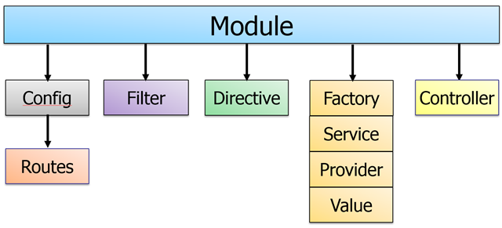
Modules

Slide 88
Benefits of Modules
Advantages of modules include:
  Keeping the global namespace clean
  Making tests easier to write and keeping them clean so as to more easily target isolated functionality
  Making it easy to share code between applications
  Allowing the application to load different parts of the code in any order
  They create services, values, and constants

Slide 89
Module Example -I
  <script>
  var app = angular.module("ctrlExample1", []);
  app.controller("booksController", function ($scope) {
  $scope.bookList = [
  { bookNo:'101',bookName:'java‘ } ,
  { bookNo: '202', bookName: 'jQuery’ }
  ]
  });
  </script>

Slide 90
Module Example -I
  <div ng-app="ctrlExample1" ng-controller="booksController">
  <ul>
  <li ng-repeat="bk in bookList">
  {{ bk.bookNo + ', ' + bk.bookName }}
  </li>
  </ul>
  </div>

Slide 91
Modularization with Value
Value can be a number, string or JavaScript object.
Injected into factories, services or controllers.
Defined using the value() function on the module.
app.value("invoiceNumber", 102);
  The first parameter is the name of the value
  Second parameter is the value
  app.controller("MyController", function ($scope, invoiceNumber) {
  $scope.invNumber = invoiceNumber;
  console.log(invoiceNumber);
  });

Slide 92
Module Example -II
  <script>
  var app = angular.module("valExample", []);
  app.value("items", { item1: 'laptop', item2: "pc" });
  app.controller("MyController", function ($scope, items) {
  $scope.items = items;
  });
  </script>

Slide 93
Module Example -II
<div ng-app="valExample" ng-controller="MyController">
<ul>
<li>Invoice Number{{invNumber}}</li>
<li>Item {{items.item1}}</li>
</ul>
</div>

Slide 94
Custom Directives
In Angular we can create custom directives .
The commonly implemented custom directives:
Element directives
  activated when a matching HTML element in the HTML template.
Attribute directives
  activated when a matching HTML element attribute.

Slide 95
Custom Directive
Directive are registered with the module using directive() function
  myapp= angular.module('custDirective', []);
  myapp.directive('mydirctive', function () {} );
  First Parameter is a function takes is the name of the directive to register, used in HTML templates to activate the directive.
  The second parameter is a factory function that returns a directive definition when invoked.
  Factory function returns a JavaScript object which has two properties:
    A restrict field and a template field.

Slide 96
Custom Directive
The restrict field
  By setting restrict to E directive should be activated by a matching HTML element
  By setting restrict to A directive should be activated by matching HTML attributes
  Can also use a value of AE which will match both HTML element names and attribute names.
The template field
  HTML template that will be used instead of the matched div element.
  The HTML template replaces the matched HTML element.

Slide 97
Custom Directive
  <script>
  myapp = angular.module('custDirective', []);
  myapp.directive('mydirctive', function () {
  return {
  restrict: 'AE',
  replace: 'true',
  template: '<h3>Hello World!!</h3>'
  };
  });
  </script>
  <div ng-app="custDirective">
  <div mydirctive></div>
  </div>

Slide 98
Custom Directive
  angular.module('custDirective', [])
  .controller('Controller', ['$scope', function($scope) {
  $scope.customer = {
  name: 'Ramesh',
  address: 'Chennai-117'
  };
  }])
  .directive('myCustomer', function() {
  return {
  template: 'Name: {{customer.name}} Address: {{customer.address}}'
  };
<div ng-app="custDirective" ng-controller="Controller">
<div myCustomer></div>
</div>

Slide 99
AJAX CALL WITH ANGULAR

Slide 100
$.http
The Most common way to send AJAX requests
  Using $http service.
  REST type calls.
$http
  service for reading data from remote servers.
  Can read a JSON File
  angular.module("myapp", [])
  .controller("MyController", function ($scope, $http)

Slide 101
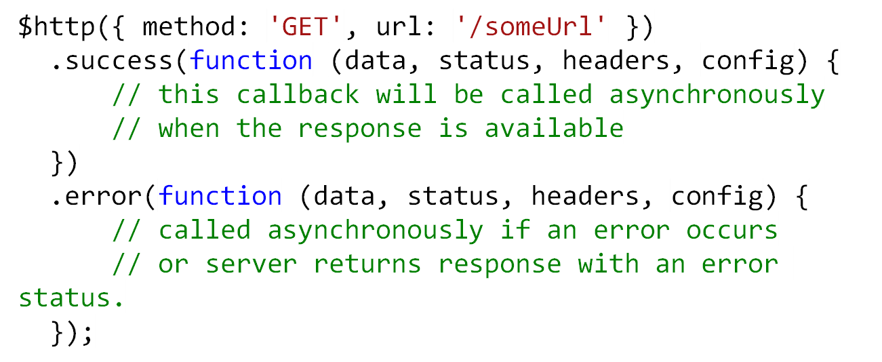
$http Service
The AngularJS XHR API follows what is commonly known as the Promise interface.
  Use the then method to register callbacks, and these callbacks will receive a single argument – an object representing the response.

Slide 102
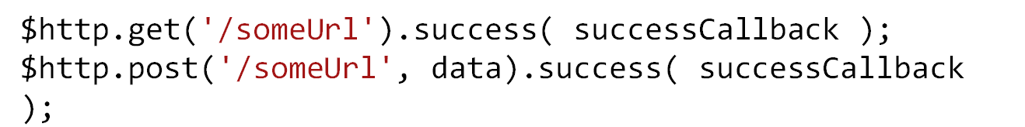
$http Functions
  $http.get
  $http.head
  $http.post
  $http.put
  $http.delete
  $http.jsonp
POST and PUT can take the data to be sent to the server.
The data parameter will be converted to a JSON string and included in the HTTP Request

Slide 103
Functions of The Promise Object
$http.get()
  returns a "promise" object.
Functions in $http service return a promise object.
This promise object has two functions called success() and error().
  They take a callback function as parameter.
  Used to set appropriate values on the $scope object.
  Can Update the $scope object with data,
  AngularJS will trigger the HTML template rendering so the data can be made visible to the user.

Slide 104
The config Parameter
Config parameter passed to the $http functions controls the HTTP request sent to the server.
  A JavaScript object which can contain the following properties:
    method
    url
    params
    headers
    timeout
    cache
    transformRequest
    transformResponse

Slide 105
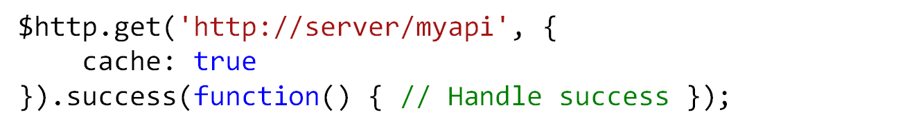
The config Parameter
Method
  used to set the HTTP method for pthe request.
  The method is one of either GET, POST, PUT, DELETE or HEAD.
  This property is normally set implicitly via the function you choose to call
url
  used to set the URL of the AJAX call.
  This is already provided to the various $http functions,
params
  used to set any additional request parameters to be appended to the URL query string.
  The params property is a JavaScript object with one property per request parameter to add.
cache
  used to enable XHR GET request caching.

Slide 106
The config Parameter
headers
  used to set any additional HTTP headers you want sent to the server.
  The headers property is a JavaScript object with one property per header.
timeout
  used to set the timeout for the AJAX call.
  When the timeout limit is reached, the AJAX call is aborted.
  The timeout is specified in milliseconds.
transformRequest
  used to set a function which can transform the request object before it is sent to the server.
transformResponse
  used to set a function which can transform the response sent back from the server, before it is passed to your application.

Slide 107
Functions of The Promise Object
Both Success and Error functions take the following parameters:
Data
  is the JSON object returned by the server. The $http service assumes that your server sends back JSON.
status
  parameter is the HTTP status code returned by the server along with the response.
headers
  used to obtain any HTTP response headers
  returns a JavaScript object with one key, value pair for each header,
config
  configuration object that was used to create the given HTTP request
  Its passed as parameter to the $http

Slide 108
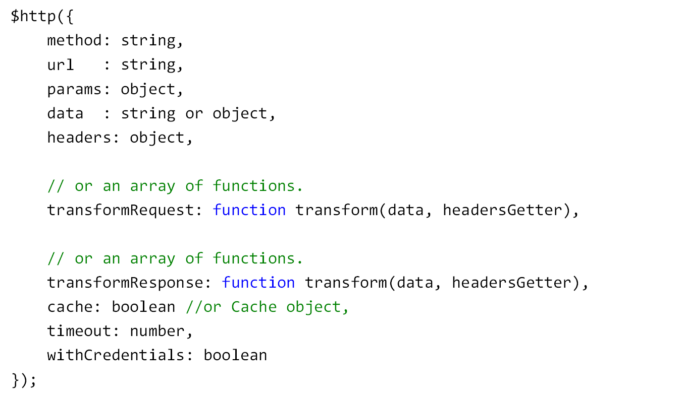
Configuring Request

Slide 109
Steps to Consume the REST Service
Define an angular module
Create a Controller
In Controller use $http service to call the web service
Set result to $scope in success callback.

Slide 110
$http –Example -I
  angular.module("myapp", []) .controller("MyController", function ($scope, $http)
  {
  $scope.myData = {};
  $scope.myData.doClick = function (item, event) {
  var responsePromise = $http.get("/Home/greet");
  responsePromise.success(function (data, status, headers, config) {
  $scope.myData.fromServer = data;
  });
  responsePromise.error(function (data, status, headers, config) {
  alert("AJAX failed!");
  });
  }
  });

Slide 111
$http –GET- Example -I
  <div ng-app="myapp" ng-controller="MyController">
  <button ng-click="myData.doClick(item, $event)">
  Send AJAX Request
  </button>
  Data from server: {{myData.fromServer}}
  </div>

Slide 112
$http –GET- Example -I
  namespace AngularShowCase.Controllers
  {
  public class HomeController : Controller
  {
  public string greet()
  {
  return "Hello From Controller";
  }
  }
  }

Slide 113
$http –POST-Example -II
  angular.module("myapp", []).controller("MyController", function ($scope, $http) {
  $scope.myForm = {};
  $scope.myForm.name = "";
  $scope.myForm.car = "";
  $scope.myForm.submitTheForm = function (item, event) {
  var dataObject = {
  name: $scope.myForm.name,
  car: $scope.myForm.car
  };
  var responsePromise = $http.post("../Home/handleForm", dataObject, {});
  responsePromise.success(function (dataFromServer, status, headers, config) {
  console.log(dataFromServer);
  });

Slide 114
$http –POST-Example -II
  namespace AngularShowCase.Controllers
  {
  public class HomeController : Controller
  {
  [HttpPost]
  public String handleForm(String name,String car)
  {
  return "Received One Request: "+name + car;
  }
  }
  }

Slide 115
$resource Service in ngResource
A factory which creates a resource object that lets you interact with RESTful server-side data sources.
Installation:
  angular-resource.js
  angular.module('app', ['ngResource']);
$resource( url [, paramDefaults] [, actions] );

Slide 116
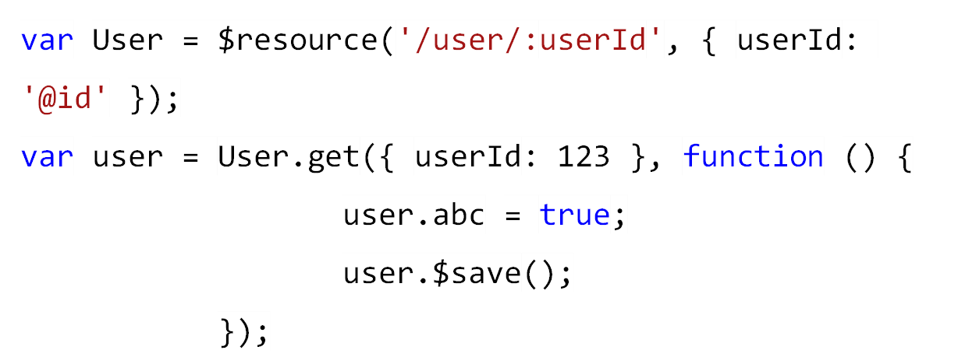
Create a Resource
$resource( url [, paramDefaults] [, actions] );
Resource
Constructor
Resource Factory
Resource
Instance
Success
callback
Prototype
method

Slide 117
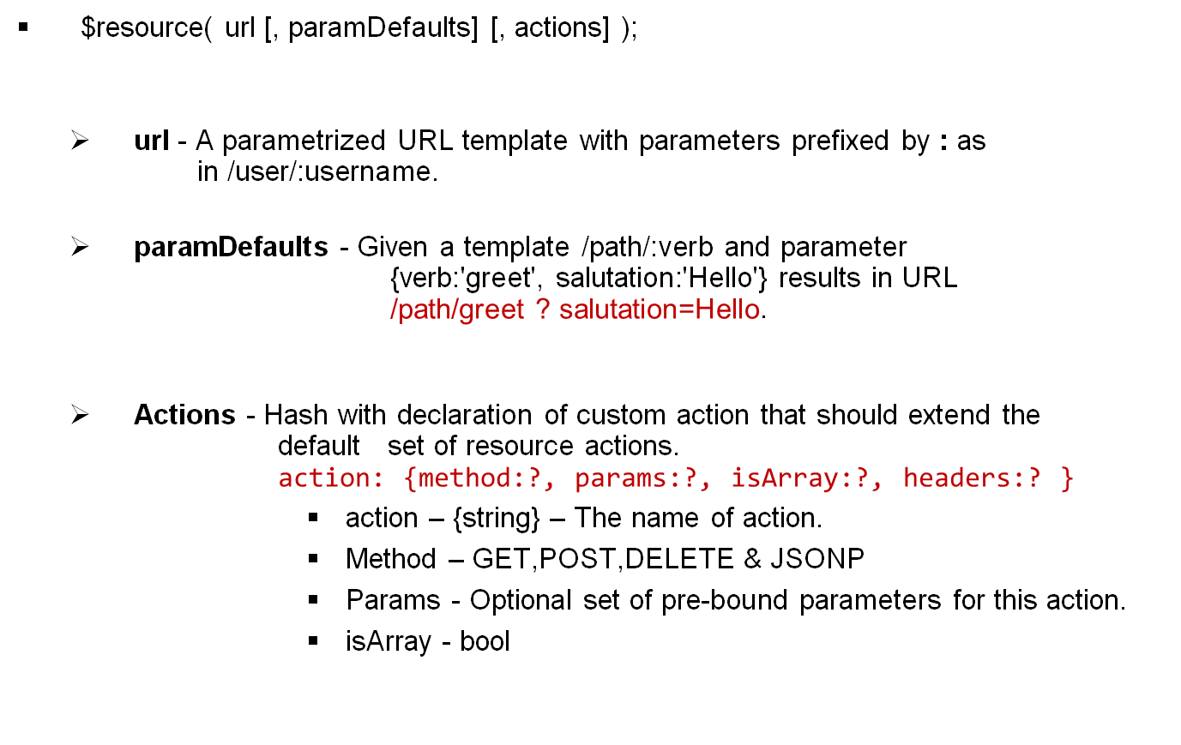
Resource Factory

Slide 118
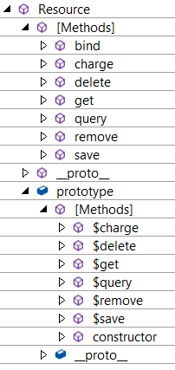
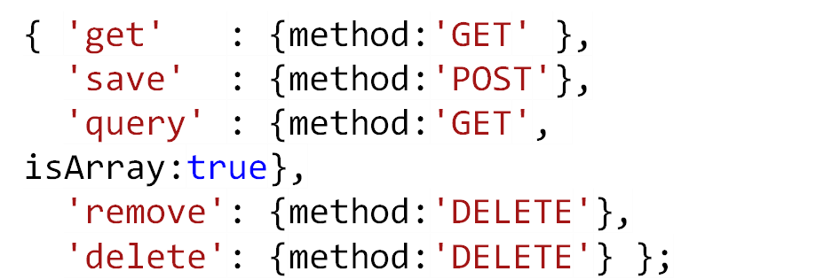
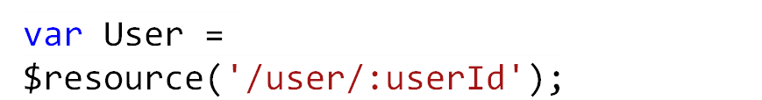
Resource Constructor
The default set of resource actions optionally extended with custom actions.
Default actions:
Resource Constructor
Resource
Constructor
Resource Factory

Slide 119
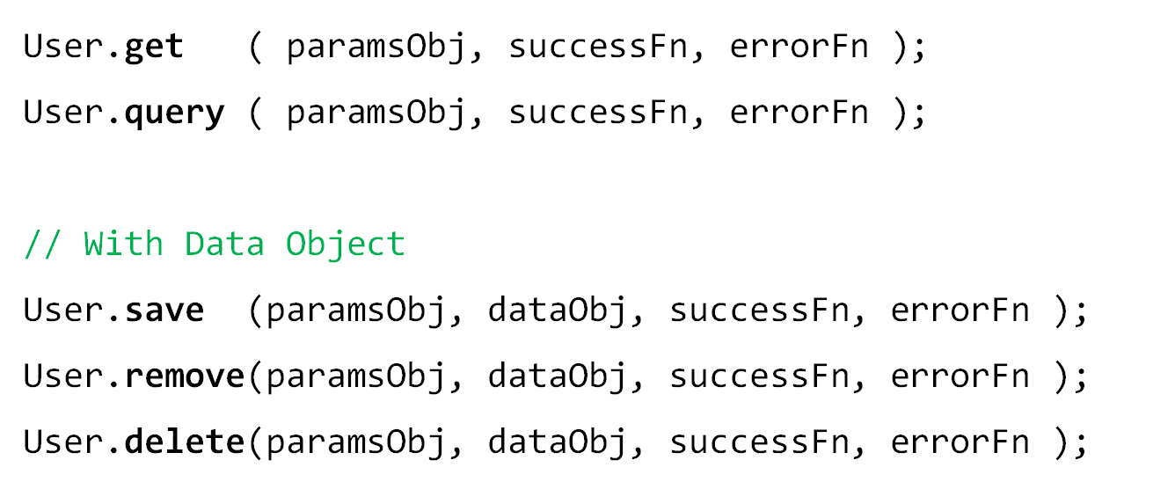
Resource Constructor Methods
Expected up to 4 arguments params object, data object, success function, error function.

Slide 120
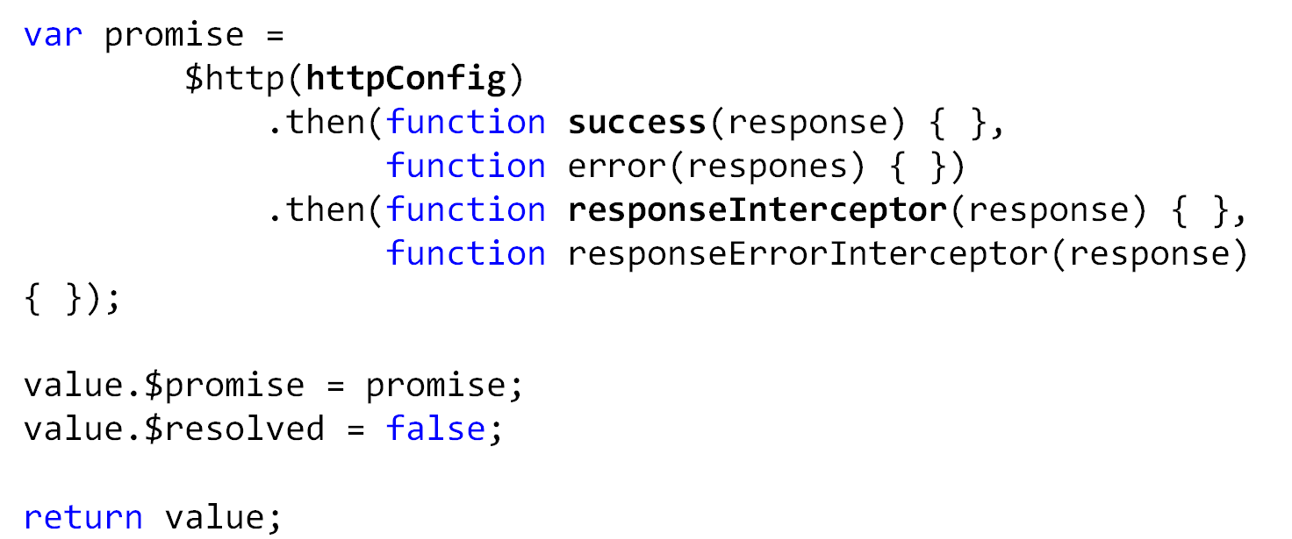
Resource Execution (Angular Code)
Resource functions return object with two properties: $promise and $resolved.
The two “then” function insert the response to the value object.
The request details
Resource
Instance

Slide 121
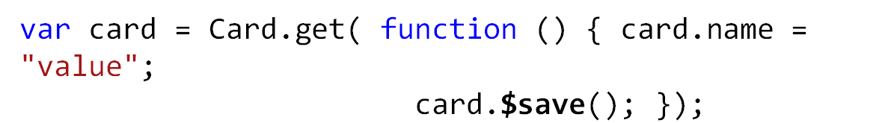
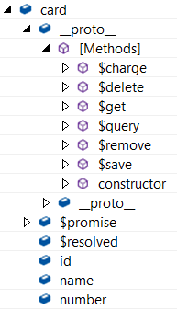
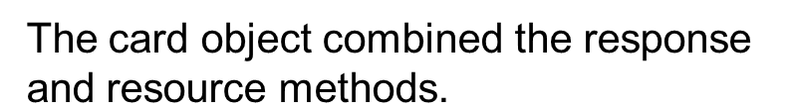

Resource Instance Structure

Slide 122
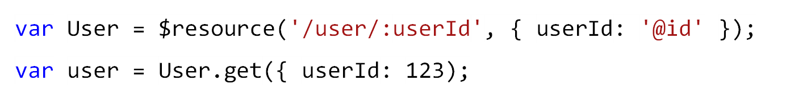
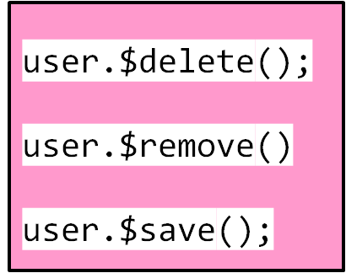
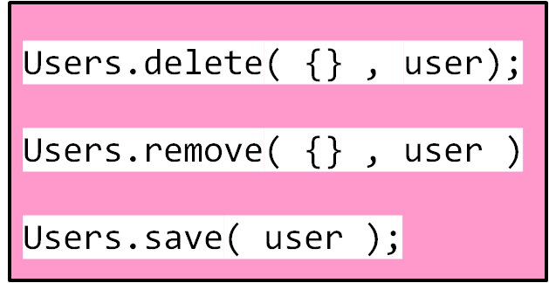
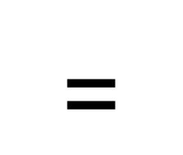
Instance vs. Constructor
The instance level-methods are prefixed with the $ character.
Both the methods have the equivalent functionality.

Slide 123
AngularJS Forms
Easier to work with forms by binding data of HTML form input fields to the model object ($scope).
Can leverage the two-way Binding of Angular
ng-model
  Directive is used to bind an input field to a model property
<input type="text" id=“userName" ng-model=“form1.userName">

Slide 124
Binding HTML Elements
Binding Checkboxes
  The model property will be set to true if the checkbox is checked, and false if not.
Can Set other than boolean Values
  ng-true-value and ng-false-value
<input type="checkbox" ng-model="myForm.wantNewsletter" ng-true-value="yes" ng-false-value="no" >

Slide 125
Binding HTML Elements
Binding Select Boxes
ng-options
  Can create option elements based on data from the $scopeobject.
  ng-options directive is used inside the select element.
  div ng-controller="MyController" >
  <form>
    <select ng-model="myForm.items"
    ng-options="obj.id as obj.name for obj in myForm.options">
    </select>
    </form>
    </div>

Slide 126
Binding HTML Elements
    angular.module("myapp", []) .
    controller("MyController", function($scope) {
    $scope.myForm = {};
    $scope.myForm.items = “phone";
    $scope.myForm.options = [
    { id : “phone", name: "Nokia" } ,
    { id : "tv", name: “LG" } ,
    { id : “pc" , name: “Lenova" } ];
    } );

Slide 127
Field Validation State
Form elements are to the $scope object as a property with form Name.
Angular form creates an instance of FormController.
  It has methods and properties
The State can be pristine, dirty, valid, invalid.
Can use these properties to set a matching CSS class on the input fields.

Slide 128
CSS classes
ng-valid
  is set if the form is valid.
ng-invalid
  is set if the form is invalid.
ng-pristine
  is set if the form is pristine.
ng-dirty
  is set if the form is dirty.
ng-submitted
  is set if the form was submitted.

Slide 129
Form Properties
Can use the validation properties to show or hide validation messages.
$pristine
  True => if the form or form fields has NOT been CHANGED
  false => if form fields or form HAVE been CHANGED.
$dirty - reverse of $pristine
  true => if the form has CHANGED .
  false => if the form has NOT been CHANGED
$valid
  True => if the form field or the whole form is VALID.
  False=> if the form field or the whole form is NOT VALID.
$invalid-reverse of the $valid
  true => if the field or a single field in the for is NOT VALID.
  false => if the field or all fields in the form is VALID,

Slide 130
Form Properties-Example
<input type="email" name="email" ng-model="email" required>
<span style="color:red" ng-show="myForm.email.$pristine && myForm.email.$invalid“> * </span>
  <input type="email" name="email" ng-model="email" required>
  <span style="color:red" ng-show="myForm.email.$dirty && myForm.email.$invalid">
  <span ng-show="myForm.email.$error.required">Email is required.</span>
  <span ng-show="myForm.email.$error.email">Invalid email address.</span>
  </span>

Slide 131
Submitting Forms
Forms can be submitted in two ways:
  Using a button element with an ng-click attribute.
  Using an ng-submit attribute (directive) on the form element.
In both cases a JavaScript function is called on the $scope object.
Function Can send the data from the form to your server via AJAX

Slide 132
Form Validation
Validation is done on fields before copying their value into the $scope
If a form field is invalid, its value is not copied into the$scope property
  Instead the corresponding $scope property is cleared.
  That is done to prevent the$scope properties from containing invalid values.
This example sets the ng-minglength to 5 and ng-maxlength to 12.
That means that if the text in the input field is less than 5 or more than 12 characters long, the value from the input field will not be copied into the$scope.myForm.name property.

Slide 133
Form Validation & Submission
  <script>
  var validationApp = angular.module('validationApp', []);
  validationApp.controller('mainController', function ($scope) {
  $scope.submitForm = function (isValid) {
  if (isValid) {
  alert('Angular Forms are amazing');
  }
  };
  });
  </script>

Slide 134
Form Validation & Submission
  <body ng-app="validationApp" ng-controller="mainController">
  <div class="page-header"><h1>AngularJS Form Validation</h1></div>
  <form name="userForm" ng-submit="submitForm(userForm.$valid)" novalidate>
  <div>
  <label>Name</label>
  <input type="text" name="name" class="form-control"
  ng-model="name" required>
  <p ng-show="userForm.name.$invalid && !userForm.name.$pristine">
  Name is required.</p>
  </div>

Slide 135
Form Validation & Submission
  <div>
  <label>Username</label>
  <input type="text" name="username" ng-model="user.username"
  ng-minlength="3" ng-maxlength="8">
  <p ng-show="userForm.username.$error.minlength" >Too short.</p>
  <p ng-show="userForm.username.$error.maxlength" >Too long.</p>
  </div>

Slide 136
Form Validation & Submission
  <div >
  <label>Email</label>
  <input type="email" name="email" class="form-control"
  ng-model="email">
  <p ng-show="userForm.email.$invalid && !userForm.email.$pristine">Enter a valid email.</p>
  </div>
  <button type="submit"
  ng-disabled="userForm.$invalid">Submit</button>
  </form>

Slide 137
FACTORY AND SERVICES

Slide 138
AngularJS Services
Services are stateless singleton objects or functions that carry out specific tasks.
Used hold some business logic.
Service are injected by Its Name
Example for Service
  The business logic or logic to call HTTP url to fetch data from server can be put within a service object.
Putting business and other logic within services has following advantages.
  fulfills the principle of separation of concern or segregation of duties.
  Each component is responsible for its own work making application more manageable.

Slide 139
AngularJS internal services
AngularJS internally provides many services that we can use in our application.
  Internal services starts with $ sign
  $http ,$route,$window, $location are other services
Services can be used within any Controller using dependencies.
The Most popular was of defining services are.
  module.service.
  module.factory

Slide 140
Services –Example I
  var app = angular.module("usingServices", []);
  app.service("gs", function () {
  this.sayHello = function (text) {
  return "Service says \"Hello " + text + "\"";
  };
  });
  app.controller('greetController', function invoke($scope, gs) {
  $scope.fromService = gs.sayHello("World");
  });
  <div ng-app="usingServices" ng-controller="greetController">
  {{fromService}}
  </div>

Slide 141
Services-Example-II
  angular.module('myApp‘).service('UserService', ['$http',function($http) {
  var service = this;
  this.user = {};
  this.login = function(email, pwd) {
  $http.get('/auth',{ username: email, password: pwd}).success(function(data){
  service.user = data;
  });
  };
  this.register = function(newuser) {
  return $http.post('/users', newuser);
  };
  }]);

Slide 142
Factories
Functionality can be encapsulated into services, factories, and providers.
The Object returned by factory can be used to work with data, validate business rules, or perform a variety of other tasks.
They are singletons by default so the object returned by a factory is re-used by the application.
  angular.module(‘YourModule"’).factory()

Slide 143
Factory
  angular.module('myApp‘).factory('UserService', ['$http',function($http) {
  var service = {
  user: {},
  login: function(email, pwd) {
  $http.get('/auth',{ username: email, password: pwd}).success(function(data){
  service.user = data;
  });
  },
  register: function(newuser) {
  return $http.post('/users', newuser);
  }
  };
  return service;
  }]);

Slide 144
AngularJS Service vs Factory
Services are application wide singleton objects.
  once created can be used within any other services or controllers etc.
When declaring serviceName as an injectable argument you will be provided with an instance of the function.
  In other words new Function You PassedToService().
  This object instance becomes the service object that AngularJS registers and injects later to other services / controllers if required.
When declaring factoryName as an injectable argument you will be provided with the value that is returned by invoking the function reference passed to module.factory.

Slide 145
ROUTING

Slide 146
Routing
Routes enable us to create different URLs for different content
A route is specified in the URL after the # sign.
Routes create different URLs for different content in your application.
Each such bookmarkable URL is called a route.
Routes enables to show different content depending on what route is chosen.

Slide 147
Routing
http://myangularjsapp.com/index.html#books http://myangularjsapp.com/index.html#albums http://myangularjsapp.com/index.html#games http://myangularjsapp.com/index.html#apps
When the browser loads these links, the same AngularJS application will be loaded
  located http://myangularjsapp.com/index.html
AngularJS will look at the route (the part of the URL after the #) and decide which HTML template to show.

Slide 148
Routing
Different URL's all point to the same AngularJS application, but each point to different routes:
Use different views for different URL fragments
Makes use of template partials
  Templates that are not a whole web page (i.e. part of a page)
  Used in conjunction with the ng-view directive

Slide 149
ng-view
  determines where the partial will be placed
  Can only have one ng-view per page
  Render different templates on particular view depending upon the router.
  For example, if user hits example.com/about then route will tell to load particular template for this route.

Slide 150
Adding Routing
Including the AngularJS Route Module
  Route module is contained in its own JavaScript file.
  Need to add to the AngularJS application
    <script src="Scripts/angular.js"></script>
    <script src="Scripts/angular-route.js"></script>
Declaring Routing as a Dependency
  Its declared as a dependency in the application Module
    var module = angular.module("sampleApp", ['ngRoute']);

Slide 151
Routing
ngView Directive : <div ng-view></div>
  Inside the HTML template specific to the given route will be displayed.
  Used as a container to switch between views.
  Will look to the route provider to find which template needs to be rendered
  Config function is Injected with $routeProvider and not $route.
    myApp = angular.module(‘myApp’, [‘ngRoute’]);
    myApp.config([‘$routeProvider’, function($routeProvider) { … }]);

Slide 152
RouteProvider
$routeProvider provides methods like when() and otherwise()
  use to define the routing for application.
when()
  Routes are configured by using this function
  $routeProvider.when(<path>, {<route>});
    Path:
      A String matched to a url pattern of the a view
      Path matched against $location.path.
    Route
      An Object with two typical properties
    controller = The name of the controller that should be used
    templateUrl = A path to the template partial that should be used
otherwise()
  To render a view when there is no match to a url pattern.

Slide 153
Routing
URL parameters
  $routeParams service
    To access the parameters in the URL,
    will have a field with the same name as the parameter
  $routeProvider
    will match the route against /:message,
    value of :message can be injected into the controller as $routeParams,
    retrieved with a key of the same name.
#/route1/12345
The value 12345 will be extracted as parameter.

Slide 154
Route Parameters
Controller functions can get access to route parameters
  module.controller("RouteController", function($scope, $routeParams) {
  $scope.param = $routeParams.param;
  })
Views can get access to it, or you can use it in AJAX calls etc.

Slide 155
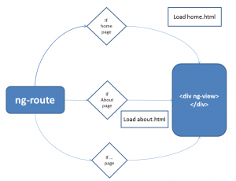
Routing Flow

Slide 156
Example
index.html ( Starting page)
---- about.html ( template )
---- module.html ( template )
---- cntrl.html ( template )
---- script.js ( Angular code )

Slide 157
Index.html
  <body ng-app="single-page-app">
  <div ng-controller="cfgController">
  <div>
  <nav >
  <ul>
  <li><a href="#/">AngularJS</a></li>
  <li><a href="#/cntrl">Conrollers</a></li>
  <li><a href="#/module">Modules</a></li>
  </ul>
  </nav>
  </div>
  <div ng-view ></div>

Slide 158
Scripts.js
  var app=angular.module('single-page-app',['ngRoute']);
  app.config(function($routeProvider){
  $routeProvider
  .when('/',{
  templateUrl: 'about.html'
  }).
  when('/module', {
  templateUrl: 'module.html'
  })
  .when('/cntrl',{
  templateUrl: 'cntrls.html'
  });
  });

Slide 159
Routing with Parameters
<body ng-app="sampleApp">
<a href="#ShowOrder/1234">show details</a>
<a href="#ShowOrder/5412">show details</a>
<a href="#ShowOrder/9874">show details</a>
<div ng-view></div>

Slide 160
Routing Configuration
  var sampleApp = angular.module('sampleApp', ['ngRoute']);
  sampleApp.config(['$routeProvider',
  function ($routeProvider) {
  $routeProvider.
  when('/ShowOrder/:orderId', {
  templateUrl: 'show_orders1.html',
  controller: 'ShowOrderController'
  });
  }]);

Slide 161
'show_orders1.html
<body>
<h2>Order #{{order_id}}</h2>
Here are the details for order <b>#{{order_id}}</b>.
</body>

