Slide 1

Interactive Keyword-Based News Retrieval: Enhancing Content Discovery with NLP and Real-Time Data Processing
Presenters: Ajay Raj Singh, Venkat Akhil Mettu, Dr. Gulhan Bizel
Affiliation: Saint Peter's University, Data Science Institute, Jersey City, NJ, USA

Slide 2
Introduction
The Information Overload Challenge
Digital news consumption has exploded
Average user encounters 100+ headlines daily
Too much content, too little time
Difficulty identifying relevant information
Traditional news interfaces fail to prioritize effectively

Slide 3
Problem Statement
Why This Matters
Underserved populations struggle with news accessibility
Language barriers limit information access
Visual learning surpassing traditional reading
Need for real-time awareness of current events
Information retention improved through visualization
Decision-making depends on efficient news consumption

Slide 4
Objective
Research Aims
Our research aims to address the need for accessible news tools by:
Developing an interactive word cloud dashboard for daily news trends
Creating a streamlined process for capturing news content
Designing a visually engaging interface for complex data
Reducing information overload through visual summarization
Improving accessibility for underserved populations
Enhancing user engagement with current events

Slide 5
Proposed Solution
The Trending Topics Explorer
An interactive dashboard that:
Transforms news articles into dynamic word clouds
Highlights important keywords based on frequency and significance
Integrates Google Trends data for real-world relevance
Provides one-click access to related content
Offers both textual and video content options
Updates in real-time as news develops

Slide 6
Data Source
Primary News Collection
New York Times API
High-quality journalism source
Comprehensive article metadata
Structured API with robust documentation
Customizable query parameters:
Date range specification
Topic filtering
Keyword searching
JSON response format for efficient processing

Slide 7
Keyword Extraction Strategy
From Articles to Keywords
Preprocessing Pipeline:
Text normalization (lowercase, whitespace)
Special character removal
Stop word elimination
Tokenization
Keyword Selection Criteria:
Term frequency in corpus
Contextual significance
Named entity recognition
Pre-filtered facet categories
No base score filtering - adaptive threshold approach

Slide 8
Trend Integration
Adding Real-World Context
Google Trends Integration:
Keywords are queried against Google Trends API
Real-time search volume data retrieved
Normalized trend scores (0-100 scale)
Geographic targeting for relevance
Time-window adjustment for recency

Slide 9
Formula Design
Keyword Significance Calculation
Final Score = α * Base Score + β * Trend Score
Where:
Base Score = Term frequency in news corpus
Trend Score = Normalized Google Trends value
α = Weight for news source importance (0.4)
β = Weight for public interest (0.6)

Slide 10
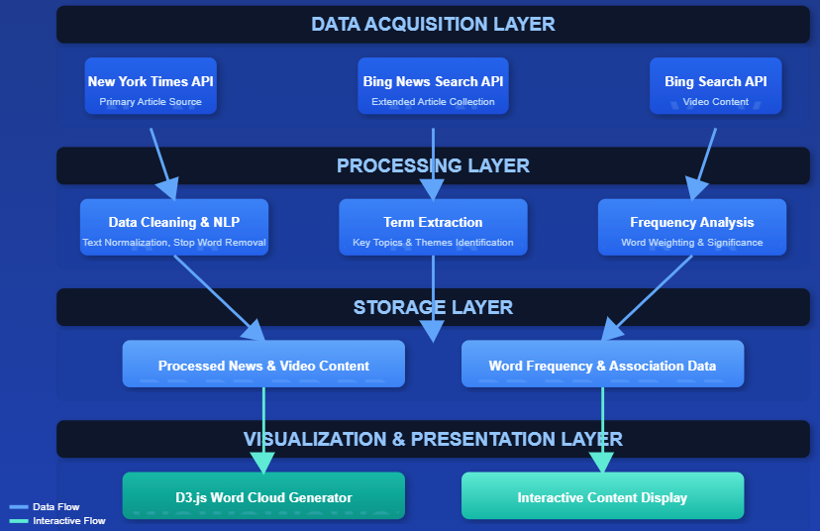
System Architecture

Slide 11
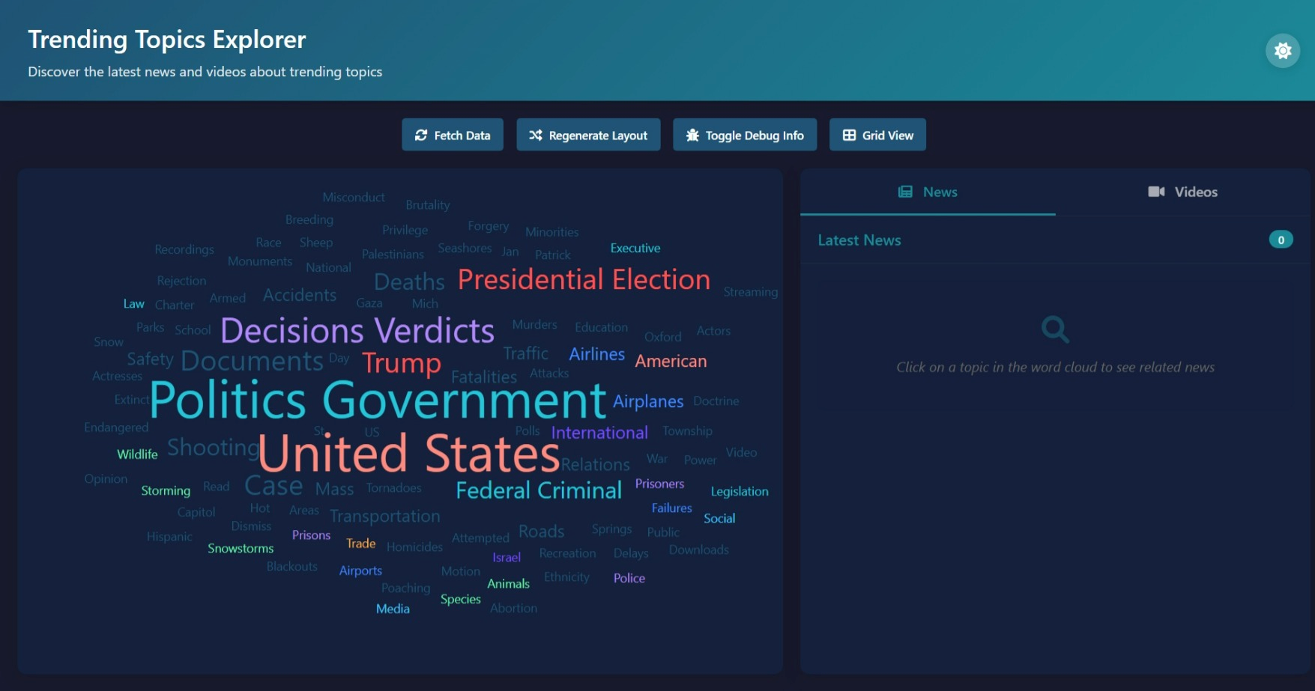
Prototype

Slide 12
Conclusion
Impact and Significance
Key Contributions: | Benefits for Users:
Novel visual approach to news aggregation Integrated data pipeline combining multiple sources Enhanced accessibility for diverse populations Real-time tracking of emerging themes | Reduced information overload Increased engagement with current events More efficient discovery of relevant content Improved accessibility for underserved groups

Slide 13
References
Bostock, M., Ogievetsky, V., & Heer, J. (2011). D3: Data-Driven Documents. IEEE Transactions on Visualization and Computer Graphics, 17(12), 2301–2309. https://doi.org/10.1109/TVCG.2011.185
Duggan, M. (2024). The Digital Landscape: A Shift in News Consumption. Journal of Communication, 68(1), 50-67. https://doi.org/10.1111/jcom.12532
Neuman, W. R., & Guggenheim, L. (2011). The Evolution of Media Effects Theory: A Six-Stage Model of Cumulative Research. Communication Theory, 21(2), 169–196. https://doi.org/10.1111/j.1468-2885.2011.01381.x
Huang, Y., Wang, Y., & Ye, F. (2019). A Study of the Application of Word Cloud Visualization in College English Teaching. International Journal of Information and Education Technology, 9(2), 119–122. https://doi.org/10.18178/ijiet.2019.9.2.1185
Lohmann, S., Ziegler, J., & Tetzlaff, L. (2015). Visualizing Text Document Corpus with Multiple Word Clouds. IEEE Symposium on Information Visualization, 34–41. https://doi.org/10.1109/INFOVIS.2015.21

Slide 14

Thank You
Ajay Raj Singh
asingh6@saintpeters.edu
Venkat Akhil Mettu
makhil@saintpeters.edu
Dr. Gulhan Bizel
gbizel@saintpeters.edu
Question ?
Live Demo

