Slide 1
CRICKET

Slide 2
Team F
Members:
1. Vaishnavi Peddiraj Z1979763
2. Ajay Rama Raju Z1979893
3. Dinesh Alluru Z1975913
4. Rishitha Chowdary Z1982982

Slide 3
Description
Cricket is a sport with a rich history and a passionate global following. In order to manage the many facets of this complex game, organizations have turned to databases to keep track of players, teams, matches, and other critical information. In a cricket database, each team can have multiple players, but a player can only belong to one team.
Matches take place at specific venues, and a venue can host multiple matches. Matches are officiated by umpires, with live commentary and analysis provided by commentators. Player performance is tracked using batting stats, bowling stats, and fielding stats, which are stored in the database alongside information about the matches played, and awards earned.

Slide 4
Description
Coaches use this data to identify performance trends and make data-driven decisions that lead to success on the field. Captains develop strategies and make tactical decisions during matches. Physiotherapists work with individual teams to help them in recovering players from injuries and stay in peak physical condition.
Ground Staff are responsible for ensuring that the playing surface at each venue is in top condition, while umpires ensure that matches are played according to the rules. A team competes in one or more matches that take place at a specific venue, and a match is officiated by one or more umpires.

Slide 5
Entities
Player
Fielding_stats
Bowling_stats
Batting_stats
Award
Team
Coach
Physiotherapist
Captain
Match
Venue
Umpire
Venue
Ground Staff
Commentator

Slide 6
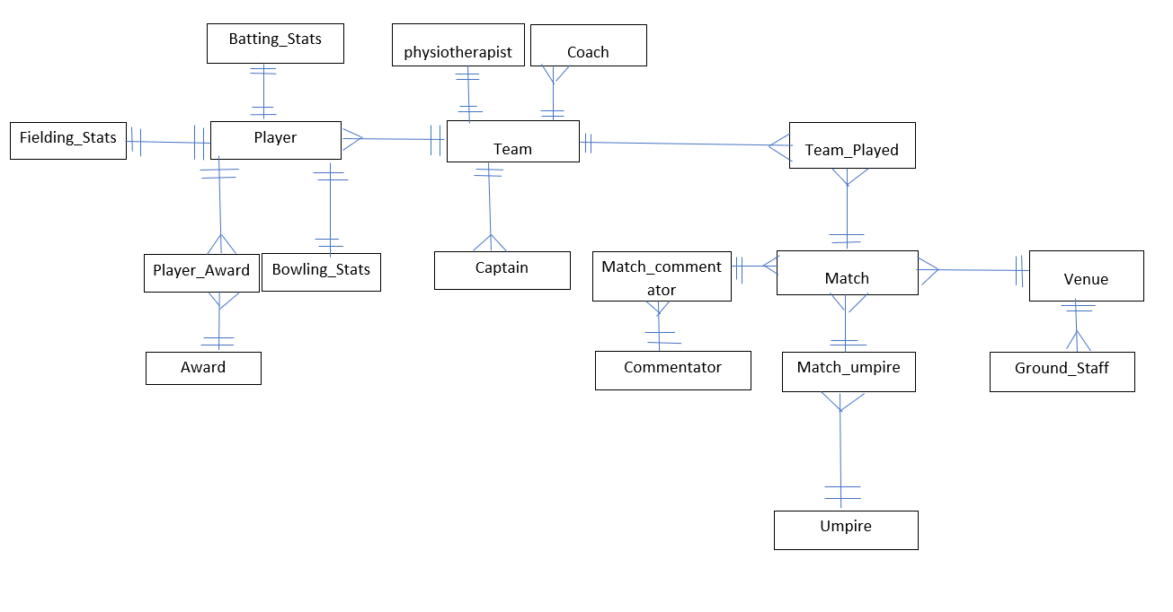
Entity Relationship Diagram

Slide 7
Assumptions
A player can have many batting, bowling, and fielding stats records associated with them, and a single record can be associated with only one player and one match.
Player_award is a bridging entity, which will contain information about each award presented to a player.
Match_commentator is a bridging entity, which will contain information about each commentator participated in each match.
Match_Umpire is a bridging entity, which will contain information about each umpire participated in each match.

Slide 8
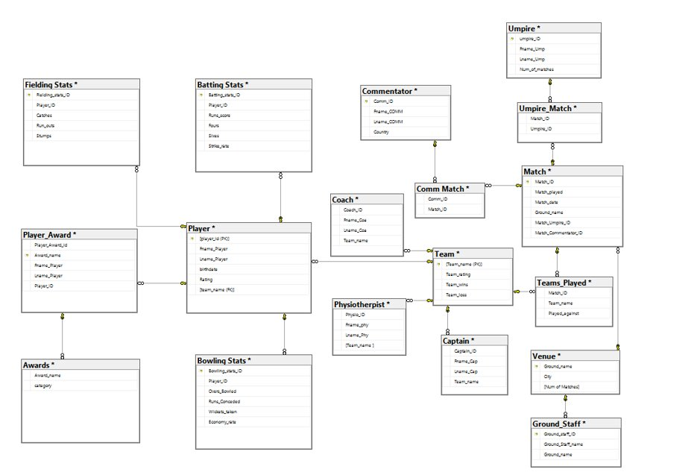
Database Diagram

Slide 9
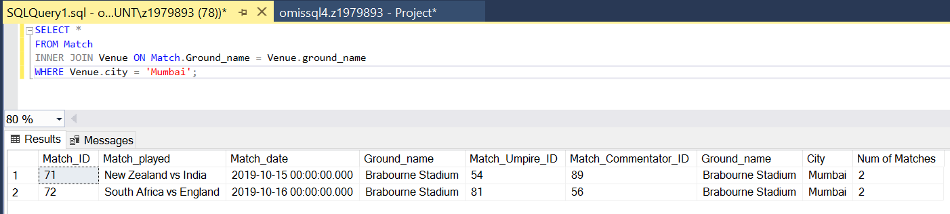
LET’S PLAY ! With the Queries
Show the details of all the matches played in the Mumbai city:

Slide 10
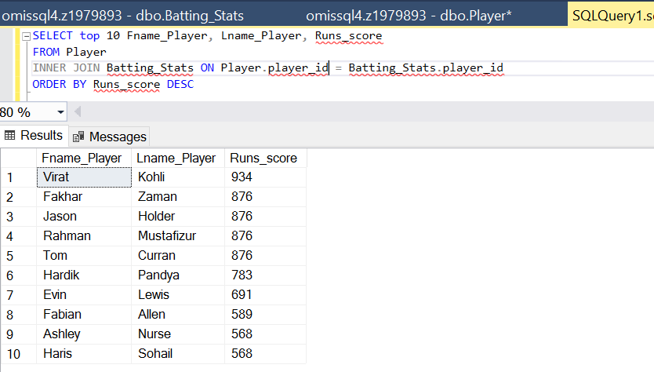
List the top 10 batsmen with First and Last name and in terms of the number of runs scored:

Slide 11
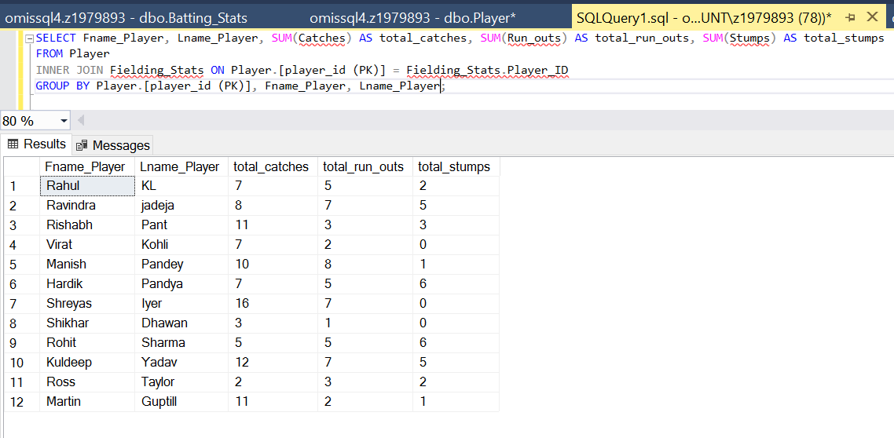
Find the total number of catches, run outs, and stumpings for each fielder with their First name and Last name

Slide 12
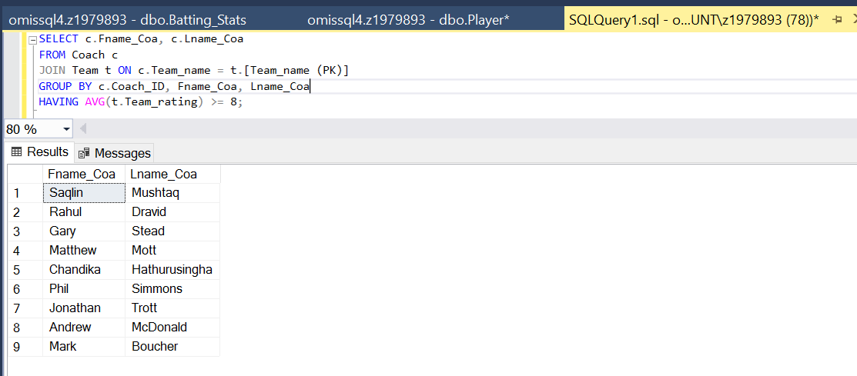
List the names of coaches who have coached teams with an average rating of at least 8

Slide 13
THANK YOU

