Slide 1






DESIGN THINKING AND INNOVATION PROJECT
OD Tracking Application
Submit request
Faculty / HOD review
A Digital On-Duty Request, Approval & Certificate Tracking System
Approve / reject
Department of Computer Science and Design
Rajalakshmi Engineering College
Email notification
TEAM
SHARJIN JINO S.A
NAVEEN.S
AJAY RAM IYYAPPAN
Certificate verification
Reg. No. 241701052
Reg. No. 241701038
Reg. No. 241701004
Notes:
Introduce the project and the team. This is a Design Thinking and Innovation project: a web application that digitizes On-Duty (OD) management.

Slide 2




Abstract
Overview
Process at a glance
Digitizes the manual On-Duty approval process. Students submit OD requests with an approval letter; Faculty or HOD approve or reject. Approved requests trigger email notifications, and after the event students upload certificates for verification.
Purpose: replace paper-based, delay-prone OD handling with a transparent digital workflow.
Submit request
Faculty review
Approval decision
Expected outcomes
Email notification
Reduced paperwork
Transparent status tracking
Upload certificate
Centralized records
Simplified certificate verification
Notes:
The application digitizes the full OD lifecycle. Walk through the five-step flow on the right, then the expected outcomes.

Slide 3






Introduction
What is an OD request?
Traditional process
MANUAL
On-Duty (OD) is a request for approved absence to attend an event, backed by an approval letter and signed off by Faculty / HOD.
Physical OD letter
Manual approval
Event attended
Offline certificate check
Who is involved
Students
Proposed digital solution
DIGITAL
Faculty members
Online submission
Faculty / HOD review
Email notification
Certificate upload & verification
Head of Department
Notes:
Explain what an OD request is, how it works traditionally, and how the application changes it.

Slide 4




Problem Statement
Paper-based submissions
Lost or misplaced forms
Delayed approvals
Physical OD letters are handed in manually.
Physical documents can go missing.
Manual approvals introduce delays.
Hard-to-search records
Offline certificate checks
Follow-up overhead
Paper records are difficult to search or audit.
Verification is handled offline and inconsistently.
Students and faculty chase status manually.
Result: slow, opaque OD management with no reliable status or central record.
Notes:
These are the issues documented in the existing manual process.

Slide 5

Objectives
01
Digital OD submission
02
Role-based approval workflow
Submit requests with approval letter online.
Faculty / HOD approve or reject with remarks.
03
Status tracking
04
Email notifications
Students follow each request's status.
Automatic updates on approval decisions.
05
Certificate upload & verification
06
Centralized record management
Proof uploaded; Faculty / HOD verify.
Searchable, auditable OD history.
Notes:
Six goals the application is built to meet; each maps to a module shown later.

Slide 6

Existing System vs Proposed System
Aspect | Existing System | Proposed System
Submission | Physical OD letter submission | Digital submission with approval letter
Approval | Manual approvals cause delays | Faculty / HOD approve or reject online
Status tracking | Repeated follow-ups between students and faculty | Clear status updates for students
Notification | Communication through manual follow-up | Email notification on decisions
Certificates | Offline, inconsistent verification | Upload and verification inside the system
Records | Paper records, hard to search | Centralized, searchable, auditable records
Notes:
Row-by-row comparison of the manual process and the OD Tracking Application.

Slide 7






Technology Stack
UI / UX DESIGN
FRONTEND
BACKEND
DATABASE
Figma
HTML5 · CSS3 · JavaScript
Python + Flask
Azure SQL
Wireframes, UI design, interactive prototype
Student, Faculty and HOD interfaces
Authentication, workflows, notifications
Users, requests, approvals, certificates, logs
FILE STORAGE
EMAIL
DEV TOOLS
DEPLOYMENT
Local file system
SMTP email service
VS Code · Git · GitHub
Local deployment
Approval letters and certificates
Approval and status notifications
Development and code hosting
Free, open-source stack
DEVELOPMENT FLOW
Figma
HTML / CSS / JS
Flask
Azure SQL
Notes:
All components are free, local or open-source; no paid cloud services. Flow: Figma to HTML/CSS/JS to Flask to MySQL/SQLite.

Slide 8



System Architecture
USERS
PRESENTATION LAYER
APPLICATION LAYER
DATA LAYER
Role-based access
Frontend
Backend
Database
UI designed in Figma
Python Flask Application
Azure SQL
Student
Web Interface
HTML · CSS · JavaScript
User Management
OD Request
Approval
Users
Submit request & upload certificate
Email
Certificate
Report
OD Requests
Login / Register
Authentication & Authorization
Session-based · Role-based access control
Approvals
Faculty
Dashboard
Review, approve / reject, verify
Certificates
OD Request Form
Status Tracking
Email Logs
File Storage
Email Service
HOD
Notifications
Approve & monitor OD activity
Local system: letters & certificates
SMTP notifications to users
Activity Logs
Upload Certificate
Notes:
Four-layer architecture: users, presentation, application (Flask) and data layers, plus local file storage and an SMTP email service. Arrows show request / response flow.

Slide 9



System Modules
Student Module
Faculty Module
HOD Module
Submit requests with approval letter
Track request status
Upload certificates
View OD history
Approve or reject requests
Add remarks
Verify certificates
Maintain student OD records
Department-level approvals
Monitor requests
Review records
Generate reports
BACKEND MODULES (FLASK)
User Management
OD Request
Approval
Email
Certificate
Report
Register · Login · Roles
Submit with letter · View status
Approve / reject (Faculty, HOD)
Approval & status updates
Upload · View
OD history · Reports · Export
Notes:
Top row: what each role can do. Bottom row: the six Flask backend modules that support those roles. The source documents Student, Faculty and HOD roles.

Slide 10

OD Request Workflow
Approved?
1
2
DB
3
DB
Student Login
Submit OD Request
Faculty / HOD Review
No
Rejected
Access the portal
Attach approval letter
Review, add remarks
Remarks added, student notified
Yes
8
DB
7
6
DB
5
DB
Final Status
Verify Certificate
Upload Certificate
Approval Recorded
OD completed, stored
Faculty / HOD verify
Student submits proof
Email notification sent
DB
Record created / updated in the central database
Order of steps
Certificate upload is possible only after approval.
1
Notes:
Follow the numbered steps. Row one is the request and decision; the Yes branch continues right to left through certificate upload and verification. Every terminal state updates the central record.

Slide 11

Database Design
decides
N
APPROVALS
N
Faculty / HOD decisions
1
reviewed by
USERS
OD REQUESTS
1
CERTIFICATES
1
submits
N
1
N
Student · Faculty · HOD roles
Request with approval letter
has proof
Uploaded proof & verification
1
1
performs
triggers
EMAIL LOGS
N
N
ACTIVITY LOGS
Notification records
How to read
Request history & audit trail
1 — N : one-to-many relationship
Entity-level view. Table fields are not shown; they are not specified in the project material.
Notes:
Entity-level ER diagram built from the six tables in the architecture (MySQL / SQLite). Attribute-level fields are not shown because they are not specified in the source material.

Slide 12

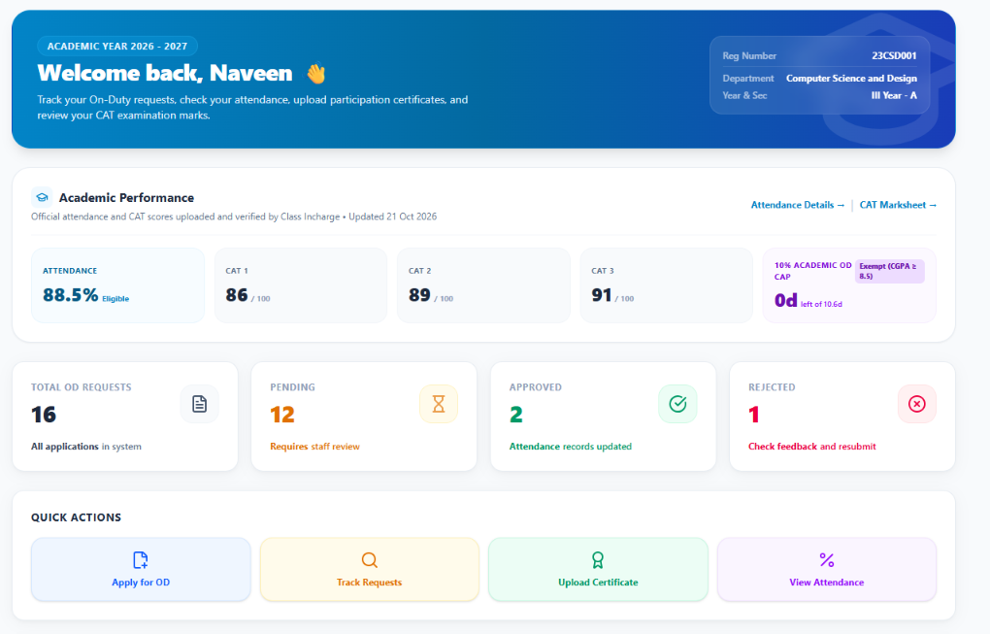
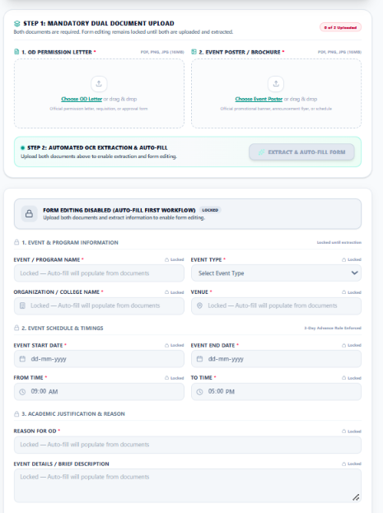
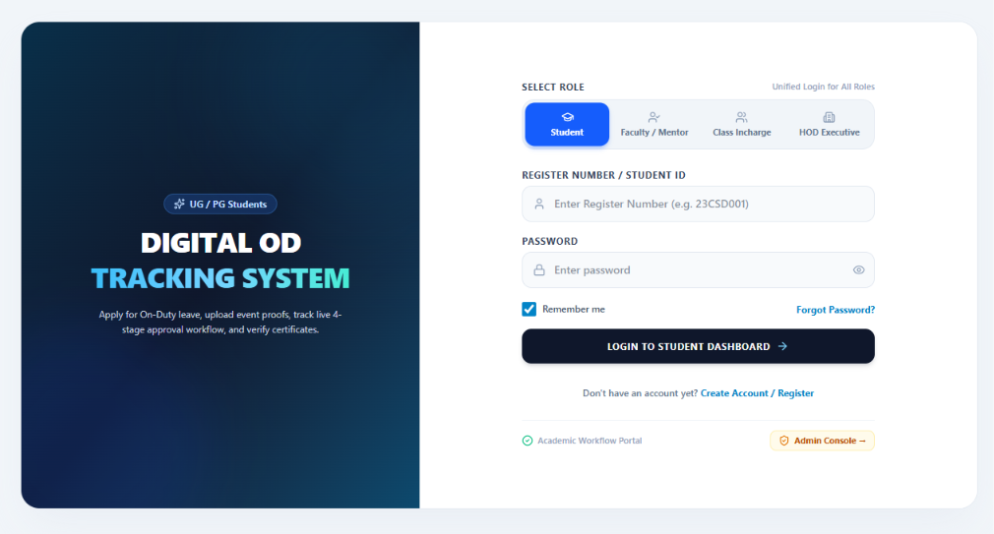
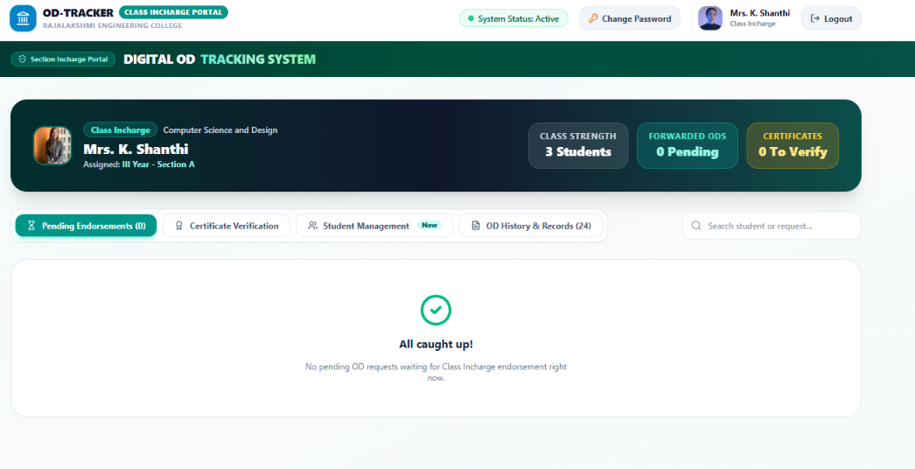
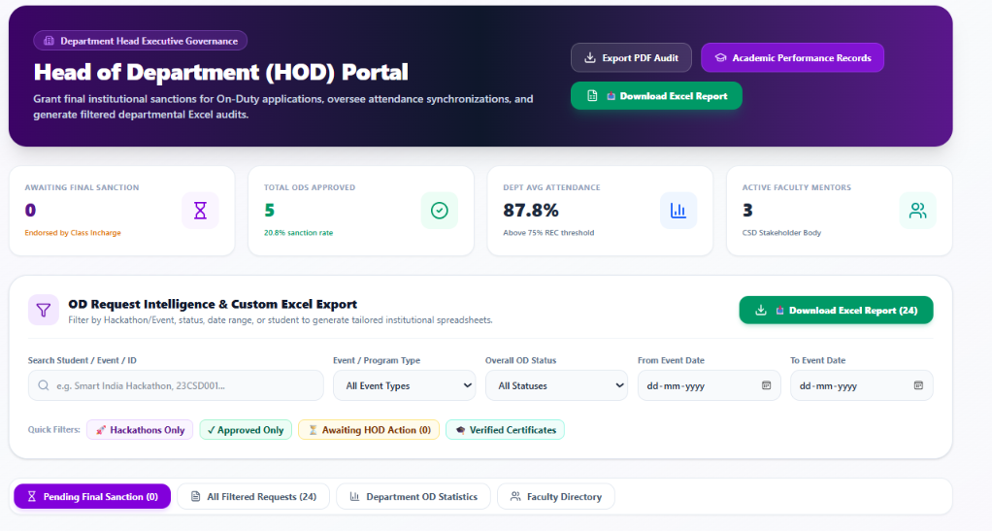
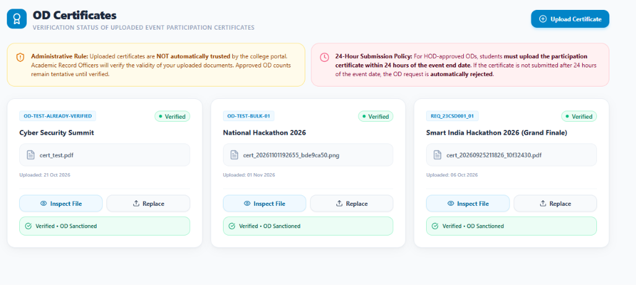
User Interface
Login / Register
Student Dashboard
OD Request Form
Faculty Dashboard
HOD Dashboard
Certificate Upload & Verification
Notes:
Source materials contain no screenshots of the running application. These frames are labelled placeholders: right-click a frame, choose Format Shape > Fill > Picture, and insert the real screenshot.

Slide 13




Security and Notifications
Authentication & Access Control
Email Notifications
Login / Register
Approval / status update
Email module (Flask)
SMTP email service
User signs in to the portal
Session management
Students are notified of decisions; the Email Logs table keeps a record.
Session-based authentication
Role-based access control
Document & Record Handling
Access depends on user role
Letters & certificates in local file storage
Student
Faculty
HOD
OD records centralized in the database
Access is granted according to user role
Activity & email logs keep a trail
Notes:
Only features documented in the project architecture are listed: session-based authentication, role-based access control, local file storage, SMTP email notifications and activity / email logs.

Slide 14







Advantages, Future Scope & Conclusion
Advantages
IMPLEMENTED
Future Scope
PROPOSED, NOT IMPLEMENTED
Reduced paperwork
Mobile application (Android / iOS)
Faster approval tracking
QR-based event verification & attendance
Centralized, searchable records
Automated reminders & email scheduling
Improved transparency & accountability
Advanced analytics: department-wise reports
Simplified certificate verification
Digital certificate validation & export
CONCLUSION
Digitizes the full OD lifecycle: submission, approval, notification, certificate verification and archival. From manual OD management to a simple, transparent digital workflow.
Notes:
Left: benefits delivered by the current implementation. Right: proposed future work, which is NOT implemented. Close with the conclusion statement.

Slide 15

THANK YOU
Questions & Discussion
OD Tracking Application
A Digital On-Duty Request, Approval & Certificate Tracking System
SHARJIN JINO S.A · NAVEEN.S · AJAY RAM IYYAPPAN
Department of Computer Science and Design · Rajalakshmi Engineering College
Notes:
Close and invite questions from the panel.

