Slide 1
Monthly Gasoline Demand
ECON 5337-001 Group 2
Ajay Singh Rathore
Amal Dev Thomas
Anurag Patil
Arjit Sakhuja
Varun Srinivasa

Slide 2
Overview
Dataset is the Monthly Gasoline Demand in Ontario between years 1960 and 1975 in million gallons
The Dataset was obtained from datamarket
Link: https://datamarket.com/data/set/22of/monthly-gasoline-demand
Able to predict gasoline demand and peak times
Holdout period: 1960-01-01 to 1975-08-01
Deterministic Variable not present

Slide 3
Benefits of Forecasting
Estimate Demand, Quantity, Transportation facility to avoid delay
Gasoline prices become volatile as a result of shortage and uncertainty in world market- Formulate policy
Make use of Strategic Petroleum Reserves(SPR) to reduce cost
Impose taxes as part of pollution reduction monthly plan/cap and trade program.

Slide 4
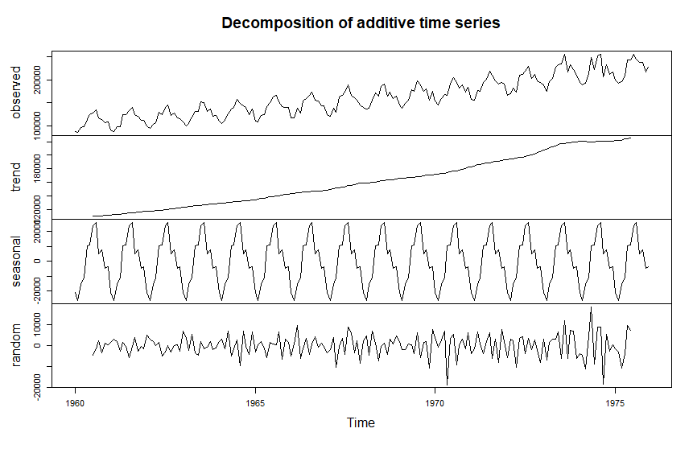
plot(decompose(gasoline))

Slide 5
Seasonality, Deterministic trends and Stochastic variation exists in the time series data
Higher sale in the month of June and July of every year is observed
Increasing trend is observed
Stochastic variation

Slide 6
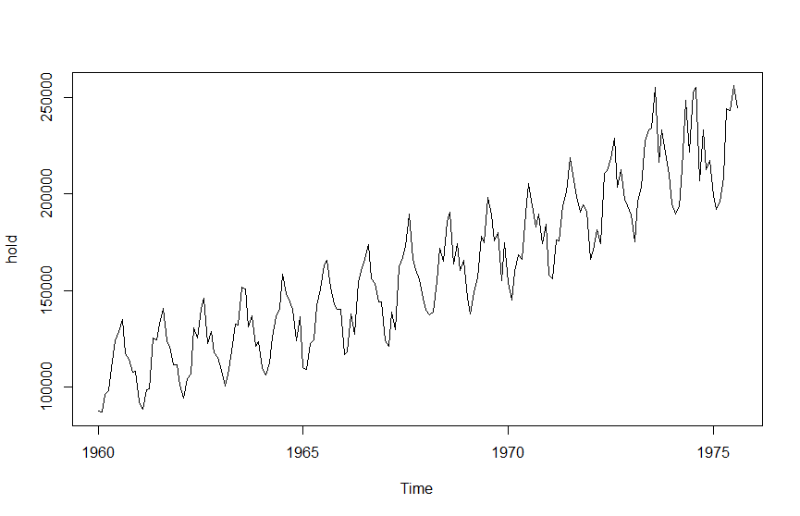
Snapshot of hold of the timeseries data
hold=ts(temp[,2],start=c(1960,1),end=c(1975,8),frequency = 12)

Slide 7
covariance stationary model Check
Augmented Dickery-Fuller unit root test-
To determine if the data is stationary of nonstationary based on that we will decide if the transformation is required or not.

Slide 8
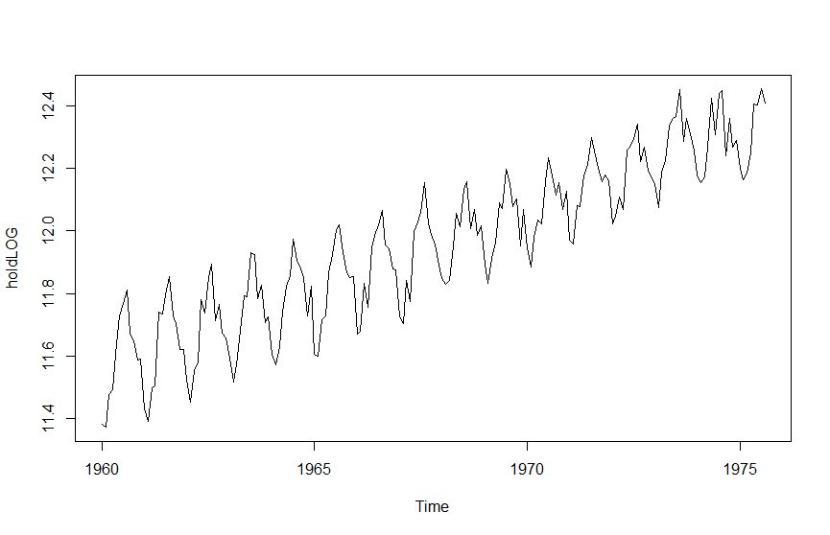
Applied Log to get the data to Stationary
holdLOG=log(hold) plot(holdLOG)

Slide 9
Result for the Unit Root Test for the Log(hold)
Test regression drift
Call:
lm(formula = z.diff ~ z.lag.1 + 1 + z.diff.lag) With 14 Lags
Residuals:
Min 1Q Median 3Q Max
-0.105521 -0.020534 -0.000466 0.021170 0.090045
Residual standard error: 0.03375 on 151 degrees of freedom
Multiple R-squared: 0.8698, Adjusted R-squared: 0.8569
F-statistic: 67.27 on 15 and 151 DF, p-value: < 2.2e-16
Value of test-statistic is: -0.6383 7.0535
Critical values for test statistics:
1pct 5pct 10pct
tau2 -3.46 -2.88 -2.57
phi1 6.52 4.63 3.81

Slide 10
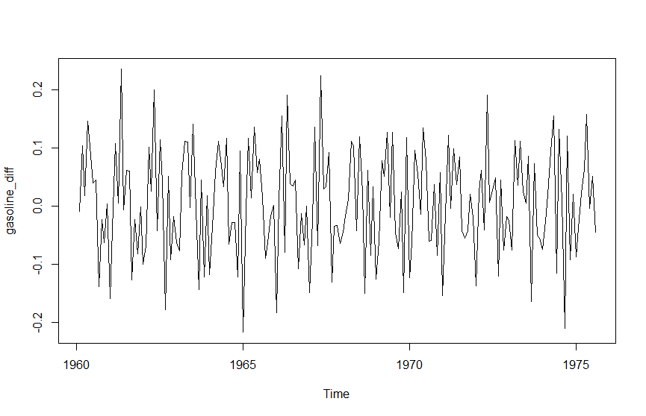
Snapshot of time series after applying the difference to log (hold)
gasoline_diff = diff(log(hold))
plot(gasoline_diff)

Slide 11
Unit root test result for the gasoline_diff = diff(log(hold))
Test regression drift
Call:
lm(formula = z.diff ~ z.lag.1 + 1 + z.diff.lag) with 13 Lags
Residuals:
Min 1Q Median 3Q Max
-0.105919 -0.019893 0.001225 0.021093 0.089988
Residual standard error: 0.0338 on 151 degrees of freedom
Multiple R-squared: 0.9422, Adjusted R-squared: 0.9368
F-statistic: 175.8 on 14 and 151 DF, p-value: < 2.2e-16
Value of test-statistic is: -4.1517 8.6422
Critical values for test statistics:
1pct 5pct 10pct
tau2 -3.46 -2.88 -2.57
Phi1 6.52 4.63 3.81

Slide 12
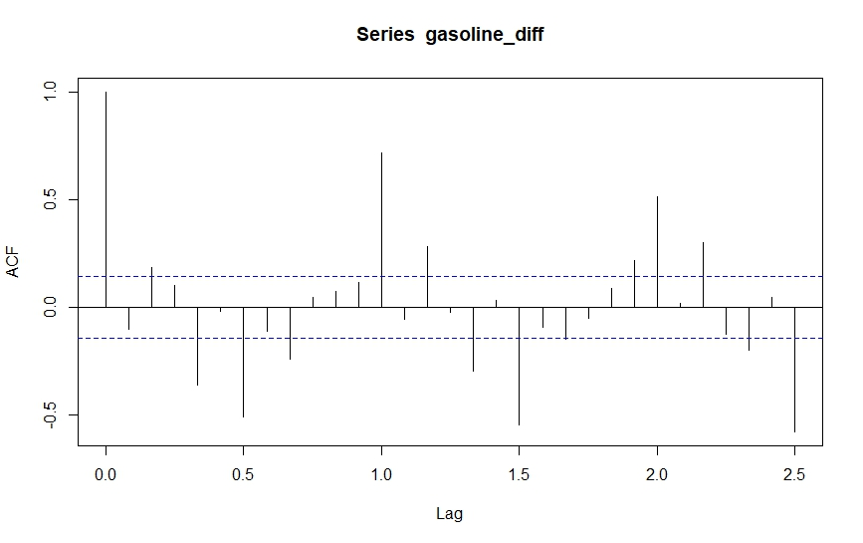
Model Selection

Slide 13
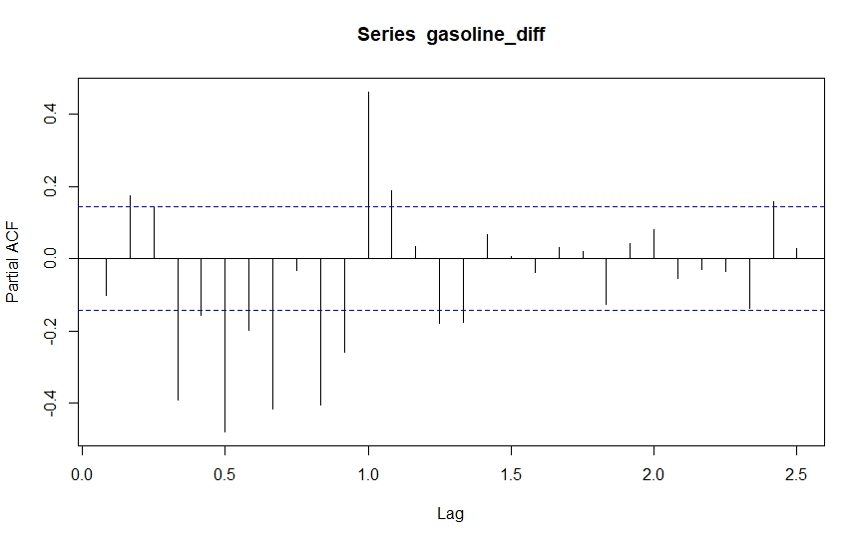
Both ACF and PACF plots show the presence of seasonal effects.
ACF shows the presence of an auto-regressive component
PACF plot shows that it is statistically significant at several lags,
denoting the presence of a moving average component.

Slide 14
Estimated Models:
Arima(holdLOG,order=c(1,1,1),seasonal=c(0,0,1)) #BIC=-455.29
Arima(holdLOG,order=c(1,1,1),seasonal=c(1,0,1)) #BIC=-633.72
Arima(holdLOG,order=c(2,1,1),seasonal=c(1,0,1)) #BIC=-662.90
Arima(holdLOG,order=c(2,1,2),seasonal=c(1,0,1)) #BIC=-657.73
Arima(holdLOG,order=c(3,1,2),seasonal=c(1,0,1)) #BIC=-653.45
Arima(holdLOG,order=c(4,1,1),seasonal=c(1,0,1)) #BIC=-653.06
Arima(holdLOG,order=c(2,1,1),seasonal=c(2,0,1)) #BIC=-660
Arima(holdLOG,order=c(2,1,1),seasonal=c(2,0,2)) #BIC=-654.94
Arima(holdLOG,order=c(2,1,1),seasonal=c(1,1,1)) #BIC=-651.28
Arima(holdLOG,order=c(4,0,2),seasonal=c(0,1,1),include.drift = TRUE) #BIC=-660.97
Arima(holdLOG,order=c(3,1,5),seasonal=c(3,0,1)) #AIC=-705.03 #BIC=-663.16

Slide 15
Shortlisted Models:
model1=Arima(holdLOG,order=c(2,1,1),seasonal=c(1,0,1)) #BIC=-662.90
model2=Arima(holdLOG,order=c(3,1,5),seasonal=c(3,0,1)) #BIC=-663.16

Slide 16
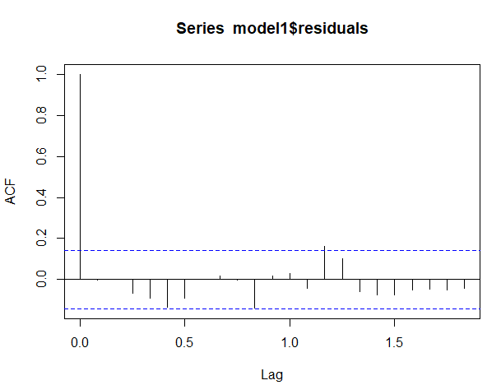
Diagnostic Checks on Residuals
Arima(holdLOG,order=c(2,1,1),seasonal=c(1,0,1))
We have 20 Auto-correlation coefficients and all of them are well within our 95% confidence band except one coefficient which is marginally outside our confidence band.
The coefficient which is marginally outside is not significant enough with Ljung Box test p-value of 0.254.
Ljung Box test generated a p-value of 0.28 which implies that we fail to reject that our first 20 auto correlation coefficients are jointly zero.
We do not have enough evidence to show these residuals have correlation.

Slide 17
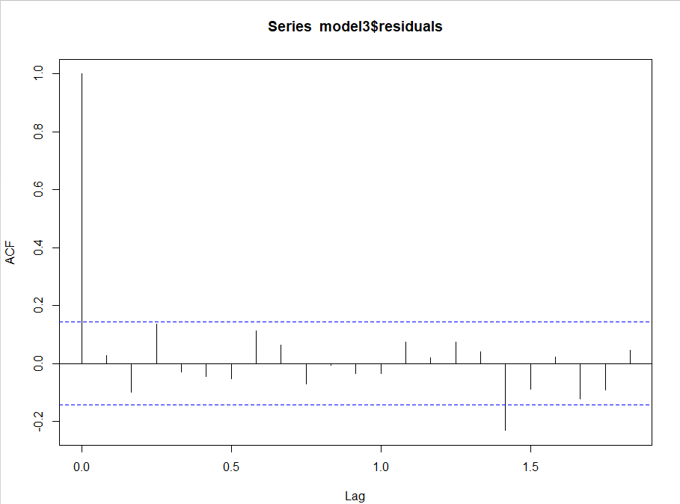
Diagnostic Checks on Residuals
Arima(holdLOG,order=c(3,1,5),seasonal=c(3,0,1))
We have 20 Auto-correlation coefficients and all of them are well within our 95% confidence band except one coefficient which is marginally outside our confidence band.
This plot looks more cleaner as compared to model1.
Ljung Box test generated a p-value of 0.1666 which implies that we fail to reject that our first 20 auto correlation coefficients are jointly zero.
The coefficient which is marginally outside is not significant enough with Ljung Box test p-value of 0.20.
We do not have enough evidence to show these residuals have correlation.
We choose this model to proceed ahead with forecasting.

Slide 18
Forecast
fore2 = forecast(model2,h=4,lambda = 0,biasadj = TRUE)
Four Point ahead forecast
Forecast and the actual values have a marginal difference.
 | Point Forecast | Actual
Sep-75 | 228145.7 | 237579
Oct-75 | 241728.8 | 237579
Nov-75 | 217539.7 | 217775
Dec-75 | 228520.8 | 227621

Slide 19
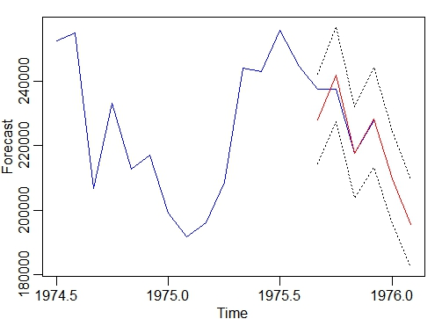
Forecast
fore2 = forecast(model2,h=4,lambda = 0,biasadj = TRUE)
If management/government has such an accurate estimate of gasoline demand they could make arrangement of supply beforehand.
Make use of Strategic Petroleum Reserves(SPR) to reduce cost
To solve supply demand problem efficiently.

Slide 20


Model Comparison
ARIMA(3,1,5)(3,0,1)₁₂
_{Accuracy}
ETS
_{Accuracy}

Slide 21

Comparison of Actual Values and Forecasted Values
ORIGINAL DATA
ARIMA FORECAST
ETS FORECAST

Slide 22
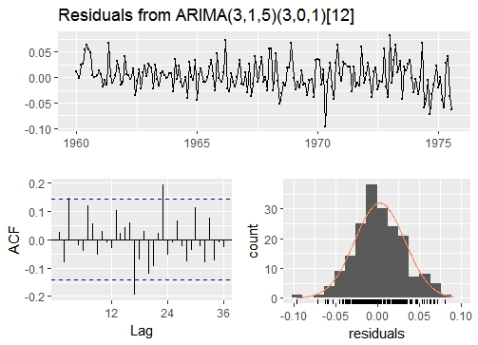
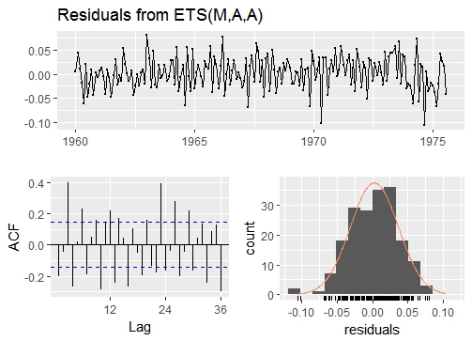
Residual Analysis
ARIMA(3,1,5)(3,0,1)₁₂ ETS

Slide 23


Diagnostic Check on Residuals
ARIMA(3,1,5)(3,0,1)₁₂
ETS

Slide 24
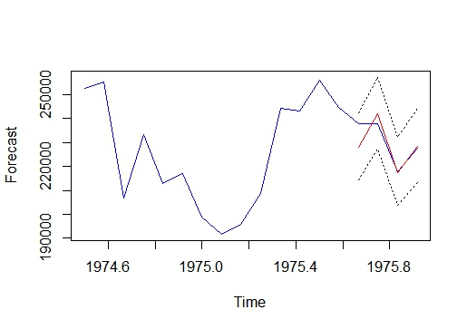
Forecast on Hold Out Data

Slide 25
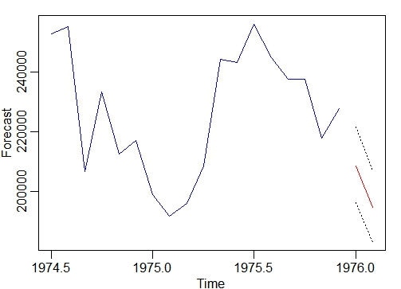
Two Months Ahead forecast

Slide 26
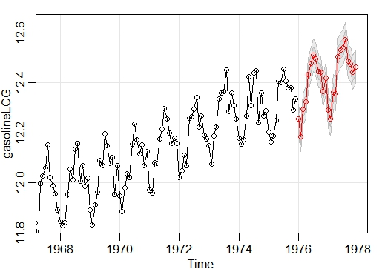
Two Years Ahead forecast

Slide 27
Effects of Forecasting on Interested Parties
Efficient Supply Chain Scheduling
Better Labor Management
Adequate Cash Flow
More Accurate Budgeting

Slide 28
THANK YOU!!!!

