Slide 1
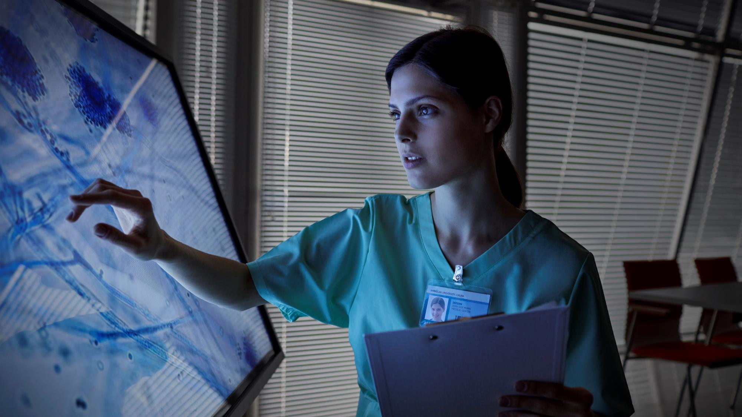

Slide 2
LUNG Cancer detection SYStem

Slide 3
Health-C ML Assistants Parth Ajay Anish Nitin

Slide 4
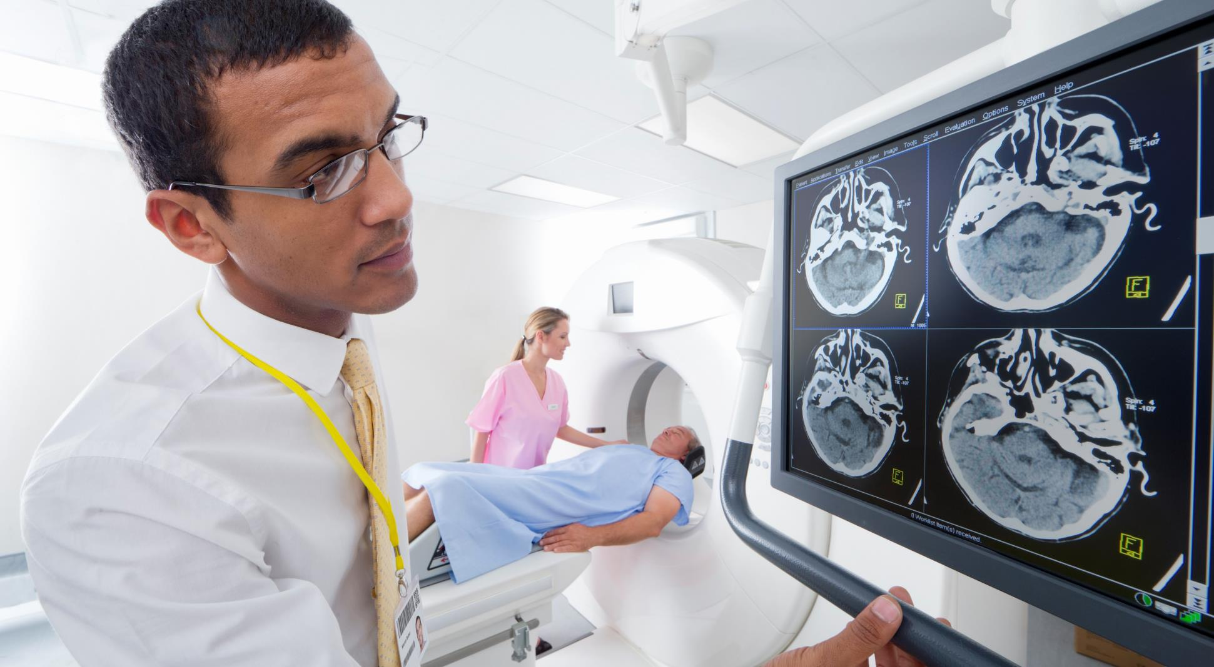
Tech Stack
HTML
CSS
Django
Python
Numpy
Pandas
Keras
TensorFlow
SciKitLearn
Matplotlib
Convolutional Neural Networks

Slide 5
LIVE DEMO

Slide 6

Thank you

