Slide 1



IMDB WEB PROJECT
Submitted by
Ajay Saradhi Reddy Chilukuri
Sri Datta Harshini Singu
Jhansi Alugubelly
Nagarjuna Sriramaneni

Slide 2
CONTENTS
PLATFORMS USED
DESIGN OF DATABASE
MVC DESIGN
DESIGN OF QUERIES
EXTRA FEATURES

Slide 3
PLATFORMS USED
We used below platforms for creating the IMDB Project.
On Database Side we used Microsoft SQL Server and SSMS to maintain and for storing IMDB datsets.
On Front End i.e Application platform End we used Java and JSP for to view an data.
We followed MVC Design Model.

Slide 4







DATABASE DESIGN
We Designed the database through the IMDB datasets from https://datasets.imdbws.com/
The Datasets are in the TSV format. We converted TSV to CSV by using python Code and imported to the database.
We have updated the “/N” values to Null Values through the SQL query.

Slide 5
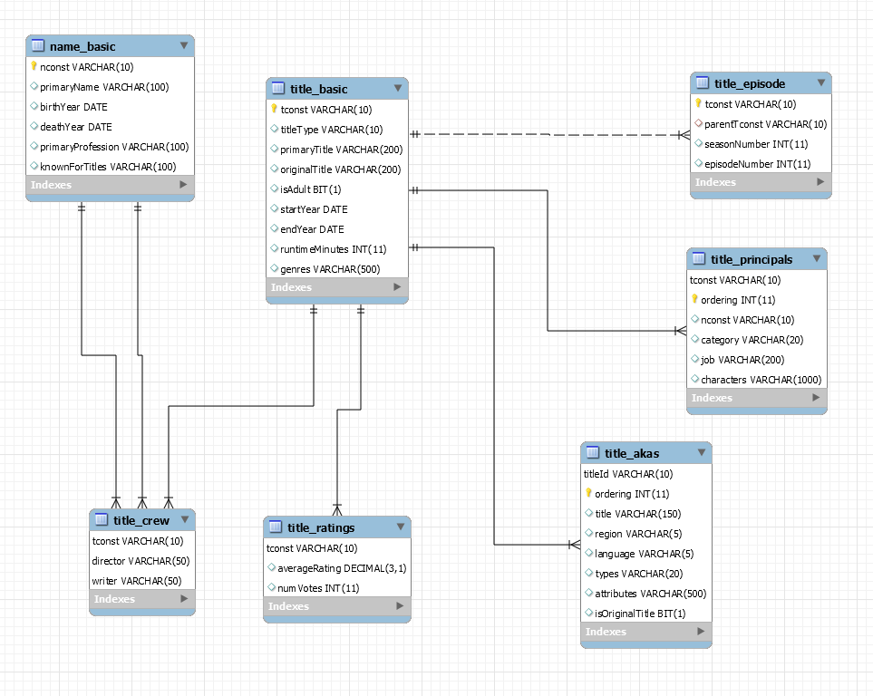
ER DIAGRAM

Slide 6
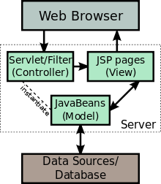
MVC DESIGN
MODEL: In our project we created separate java file for each table in the database for declaring the columns. Below are those.
Akas.java
Basic.java
Crew.java
Episode.java
Principal.java
Rating.java
TitleBasic.java

Slide 7
MVC DESIGN
VIEW: We used Java Server Pages (JSP) that we can create the dynamic web content to the user.
CONTROLLER: We used the Servlets which collect input from users through web page forms, present records from a database, and create web pages dynamically.

Slide 8
DESIGN OF QUERIES
We designed the queries for our project using below clauses and operators
Views
Group By & Order By
Set Operations
Nested Queries
JOIN operations

Slide 9
DESIGN OF QUERIES
VIEW:
Views are nothing but virtual tables which are used to fetch records from one or more tables
GROUP BY :
The GROUP BY clause is a SQL command that Is used to group rows that have same values.
ORDER BY :
The ORDER BY keyword is used to sort the result set in
ascending or descending order.

Slide 10
DESIGN OF QUERIES
SET OPERATORS :
Set operations allow the results of multiple queries to be
combined into a single result set.
They Include UNION, INTERSECT and EXCEPT.
NESTED QUERY:
A nested query or inner query or sub query is a query within another SQL query and embedded within the WHERE clause.

Slide 11
SAMPLE QUERIES
Show the information of movies (Title, Region, Language, Year, Rating, Votes) which have average rating greater than 7 and number of votes greater than 1000.
STATEMENT:
CREATE VIEW Movies_Details
AS
SELECT b.primaryTitle as Title,a.region as Region,a.language as 'Language',b.startYear as 'Year', r.averageRating as Rating,r.numVotes as Votes
FROM Title.akas a
INNER JOIN Title.basic b ON b.tconst=a.titleId
INNER JOIN Title.ratings r ON r.tconst=b.tconst
WHERE r.averageRating>7 AND r.numVotes>1000;

Slide 12
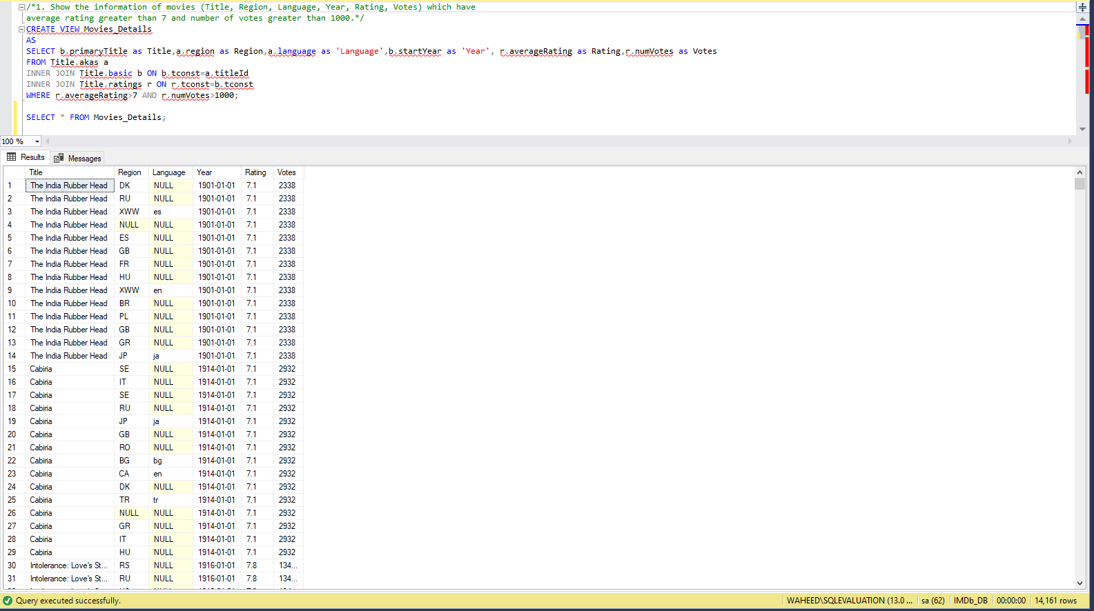

Slide 13
SAMPLE QUERIES
Show the names of persons who have directed more than 10 movies.
STATEMENT:
SELECT b.primaryName AS [Director Name]
FROM (SELECT DISTINCT directors
FROM Title.crew AS c
GROUP BY directors
HAVING (COUNT(tconst) > 10)) AS out1 INNER JOIN
Name.basic AS b ON b.nconst = out1.directors

Slide 14
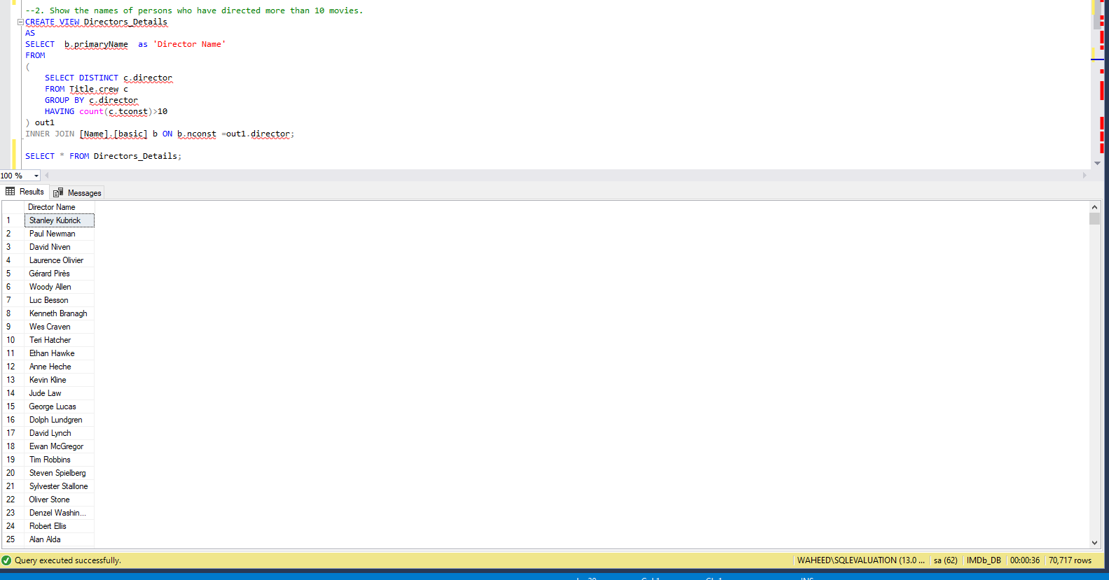

Slide 15
EXTRA FEATURES
In our project we used below extra features.
Apache tomcat
JSP Pages
Designed the queries using Views.

Slide 16
Thanks!
Any questions?

