Slide 1
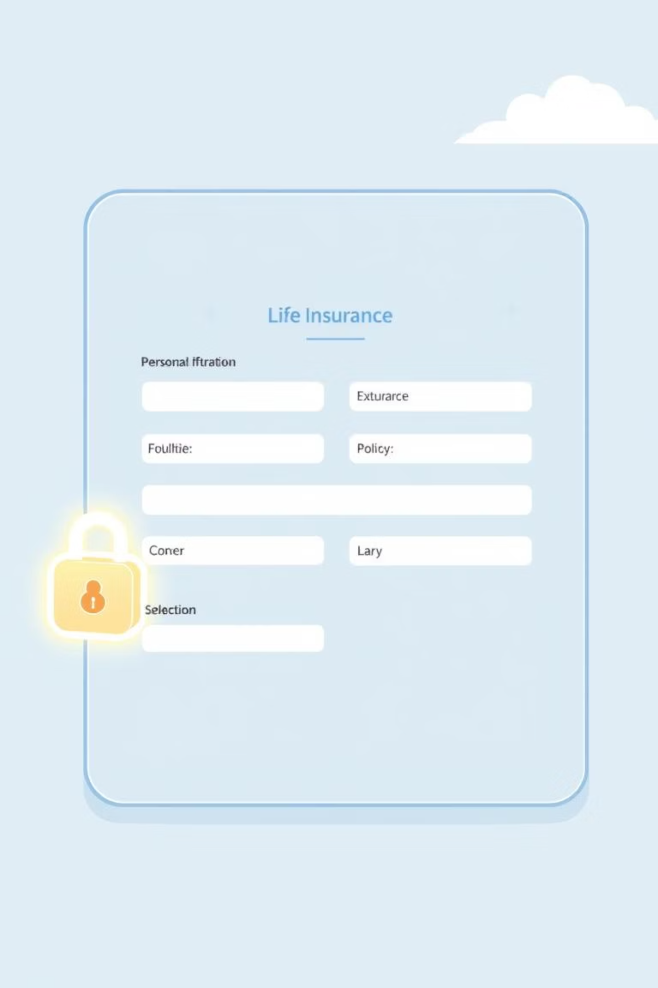
Insurance Application Use Case

Slide 2
Use Case Name
Apply for Life Insurance Coverage
Use Case Description
This use case describes the process by which an applicant selects and applies for life insurance coverage through an online system. The applicant provides personal information, selects a plan based on age, chooses optional coverages, answers health screening questions, provides billing information, and submits the application. The system validates inputs, displays eligible plans, and saves the applicant's preferences.

Slide 3
Actors
Preconditions
Primary Actor: Applicant (the user applying for life insurance)
The applicant has access to the insurance company's online portal.
Secondary Actor: Insurance System (processes the application and stores preferences)
The system is operational and connected to the database.

Slide 4
Postconditions
The applicant's information and preferences are saved in the system.
The application is submitted for review, or an error message is displayed if criteria are not met.

Slide 5
Primary Flow
The applicant accesses the insurance company's online portal and initiates the application process for life insurance.
The system prompts the applicant to enter personal information, including:
Full name
Date of birth (to calculate age)
Contact information (email, phone number, address)
Gender
The applicant enters the type of insurance desired (life insurance).
The system prompts the applicant to provide medical history, including:
Pre-existing conditions
Current medications
Smoking status
Family medical history
The system displays health screening questions (e.g., recent hospitalizations, chronic illnesses) and the applicant provides answers.
The system prompts the applicant to select billing information, including:
Payment method (credit card, bank transfer, etc.)
Billing frequency (monthly, quarterly, annually)
The system calculates the applicant's age based on the provided date of birth and determines eligible term options:
If the applicant is 50 to 60 years old (inclusive):
Display options for 10-year term and 20-year term.
If the applicant is less than 50 years old or exactly 60 years old:
Display only the 10-year term option.
If the applicant is 65 years or older:
Display an error message: "Sorry, you do not meet the eligibility criteria for life insurance due to age restrictions."
Terminate the application process.
If eligible, the system displays coverage amounts based on the selected term:
For a 20-year term:
$2,300
$5,000
$1,000,000
For a 10-year term:
$2,500
$5,000
$7,500
$1,000,000
$1,200,000
$1,500,000
$1,750,000
$2,000,000
The applicant selects a coverage amount from the displayed options.
The system displays optional coverages:
Dependent Child Coverage: Available if the applicant is not an existing customer of the insurance company or is an existing customer of XYZ Insurance Company but has not already selected this option in another policy.
Disability Distribution Coverage: Available if the applicant is less than 60 years old.
Accidental Death and Dismemberment Coverage: Always displayed.
The applicant selects any desired optional coverages.
The system prompts the applicant to review all entered information, including personal details, medical history, billing information, selected term, coverage amount, and optional coverages.
The applicant confirms the information and submits the application.
The system validates all inputs and saves the applicant's preferences to the database.
The system displays a confirmation message: "Your application has been successfully submitted for review."
The use case ends.

Slide 6
Alternate Flows
A1: Applicant Edits Information Before Submission
A2: Applicant Cancels Application
A3: Existing Customer with Dependent Child Coverage
At any point before step 13, the applicant chooses to cancel the application.
At step 10, if the applicant is an existing customer of XYZ Insurance Company and has already selected Dependent Child Coverage in another policy:
At step 12 of the primary flow, the applicant chooses to edit one or more pieces of information (e.g., personal details, coverage amount, or optional coverages).
The system prompts for confirmation: "Are you sure you want to cancel your application?"
The system does not display Dependent Child Coverage as an option.
The system returns to the relevant step (e.g., step 2 for personal information, step 9 for coverage amount, or step 11 for optional coverages).
If confirmed, the system discards all entered data and terminates the session.
The flow continues to step 11 with the remaining optional coverages.
The use case ends.
The applicant updates the information and proceeds to step 12 to review and submit.

Slide 7
Exceptional Flows
1
2
3
E1: Invalid Personal Information
E2: Incomplete Medical History or Health Screening
E3: Invalid Billing Information
At step 2, if the applicant enters invalid personal information (e.g., invalid email format, missing required fields):
At step 6, if the applicant enters invalid billing information (e.g., incorrect credit card number, unsupported payment method):
At step 4 or 5, if the applicant fails to provide complete medical history or answer all health screening questions:
The system displays an error message: "Please provide valid personal information (e.g., correct email format, all required fields)."
The system displays an error message: "Please provide valid billing information."
The system displays an error message: "Please complete all medical history and health screening questions."
The applicant is returned to step 6 to correct the billing details.
The applicant is returned to step 2 to correct the information.
The applicant is returned to the relevant step to complete the information.
4
5
E4: Age Eligibility Check Failure
E5: System Error During Submission
At step 7, if the applicant is 65 years or older:
At step 14, if the system encounters an error while saving the applicant's preferences (e.g., database connectivity issue):
The system displays an error message: "Sorry, you do not meet the eligibility criteria for life insurance due to age restrictions."
The system displays an error message: "An error occurred while submitting your application. Please try again later."
The application process terminates, and no further steps are executed.
The use case ends.
The applicant is returned to step 12 to review and resubmit.
If the error persists, the system logs the issue for technical support and informs the applicant: "We are experiencing technical difficulties. Please contact support at support@xyzinsurance.com."

Slide 8
Assumptions
The system can accurately calculate the applicant's age based on the provided date of birth.
The system has access to the applicant's existing customer status and policy details (if applicable).
All monetary amounts are in USD and represent annual premiums.
The system supports real-time validation of inputs (e.g., email format, credit card details).
The database is available and capable of storing applicant preferences.

Slide 9
Notes
The system ensures that all required fields are completed before allowing submission.
Optional coverages are only displayed based on eligibility criteria (e.g., age, existing customer status).

Slide 10
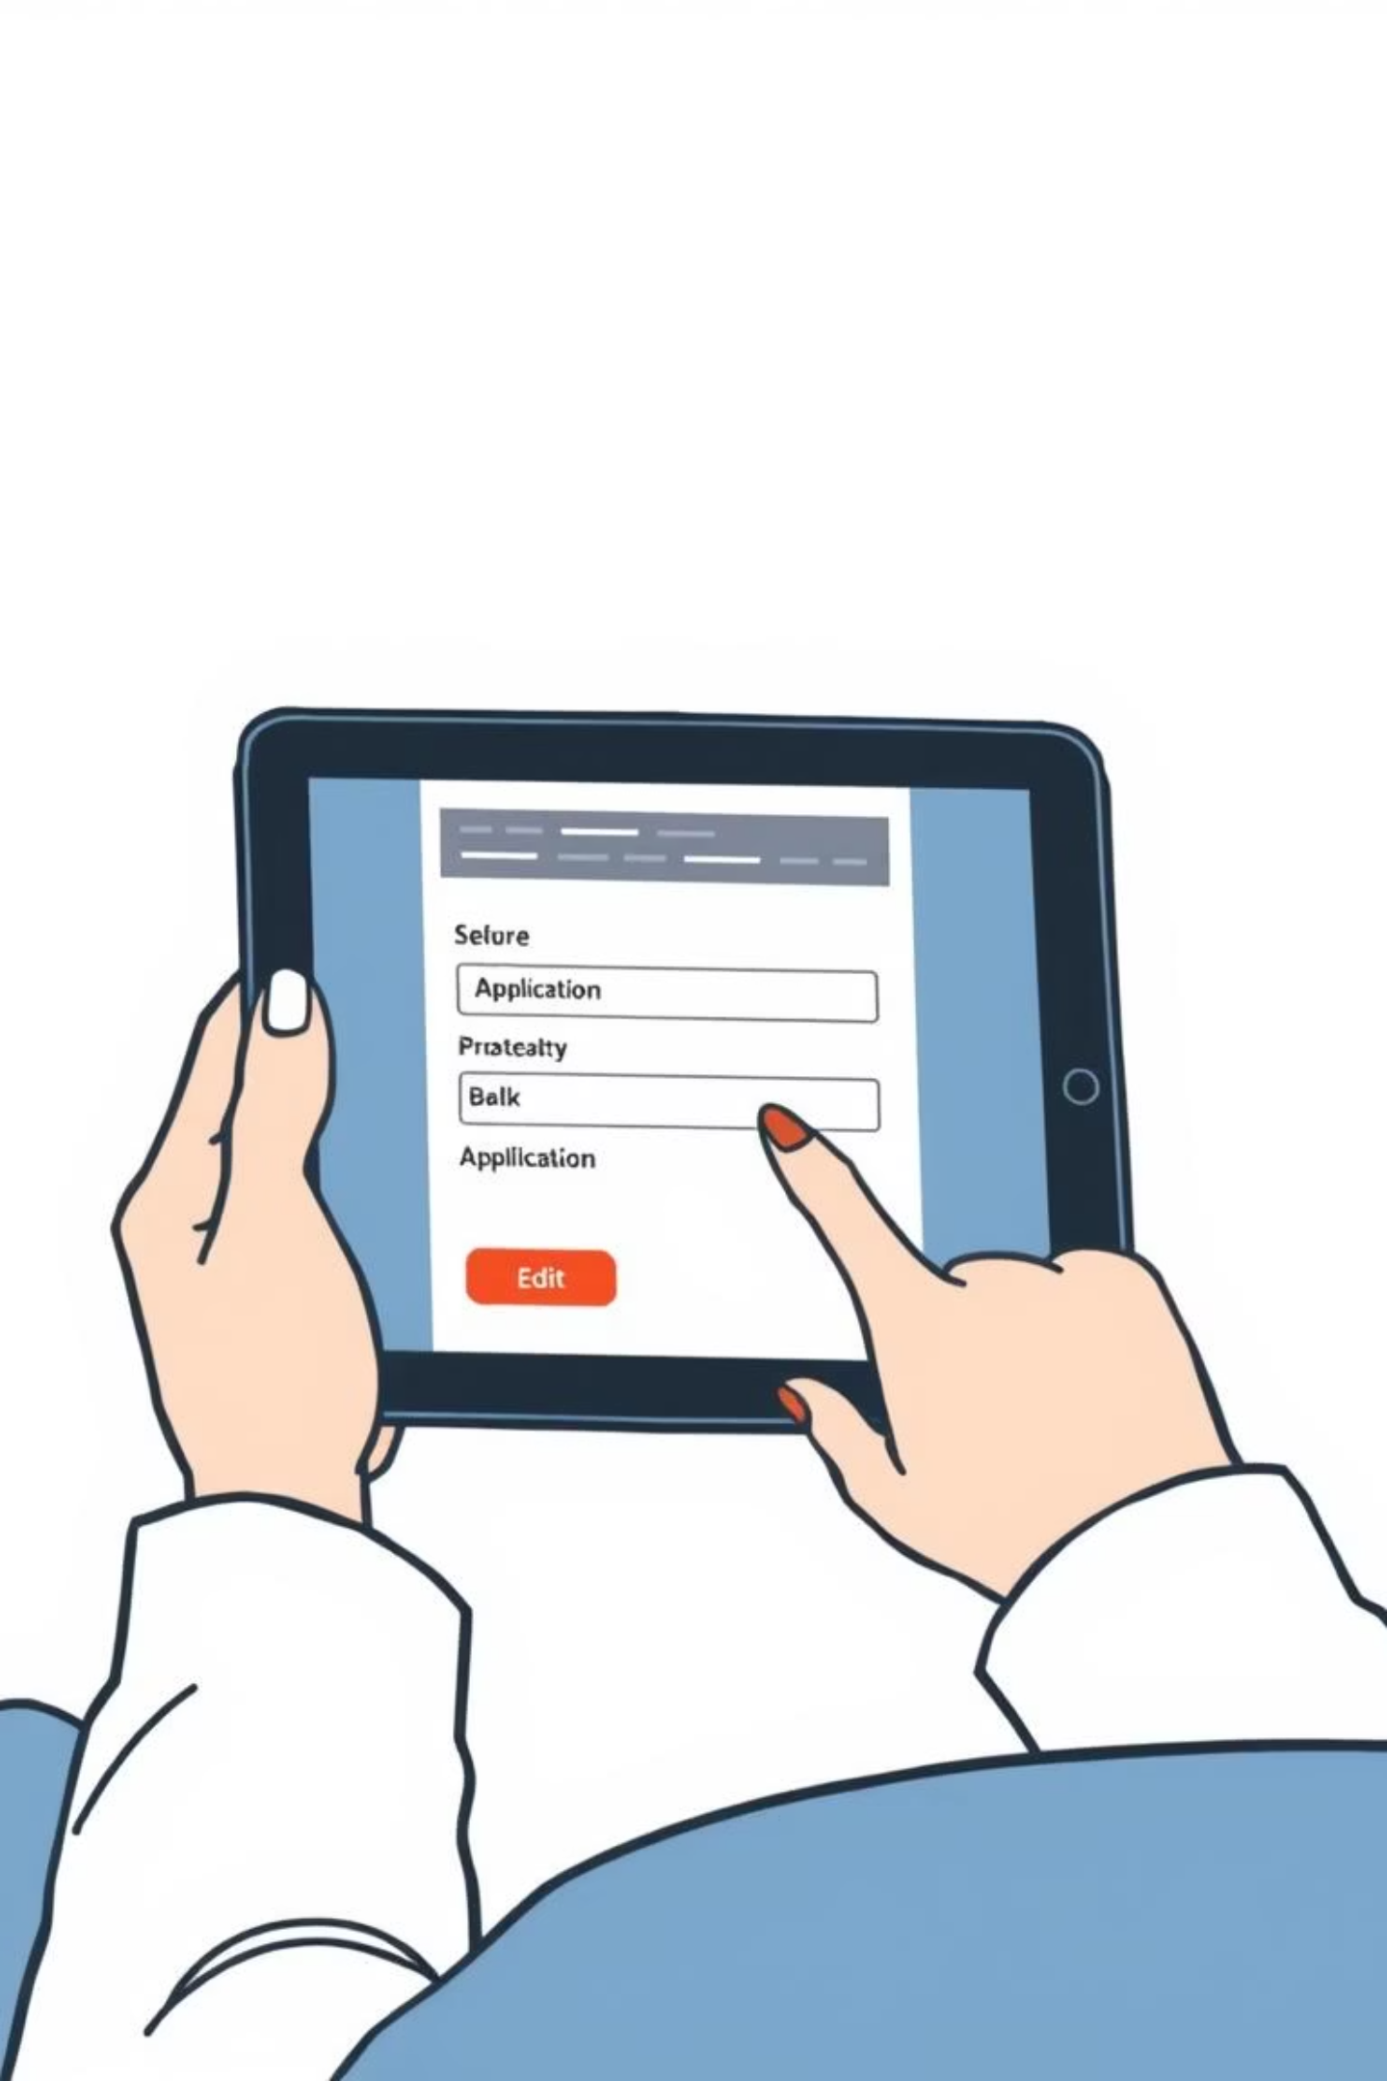
The applicant can navigate back to previous steps to correct or update information before submission.

