Slide 1
PRODUCT INTELLIGENCE AI
AI-Powered Product Intelligence
for Industrial Commerce
UniHack Submission
Team name: IntelliForge AI
Team leader: Ajay Sah

Slide 2
OVERVIEW
Brief about your solution
Product Intelligence AI is a multi-agent system that turns minimal product data — just a manufacturer part number, a short description, and brand fields — into a fully enriched, 252-column product catalog record matching an enterprise PIM delivery format.
A LangGraph-orchestrated Supervisor routes each product to four specialized agents (Website, Catalog, Tech Doc, Digital Asset). Each independently searches the web, fetches real source documents through a custom MCP (Model Context Protocol) server, extracts and OCRs their content, retrieves the most relevant information via Hybrid RAG, and proposes structured data with a confidence score.
Results from all four agents are merged, cross-checked against previously approved products for conflicts, and presented to a human reviewer for editing and approval before anything is written to the permanent catalog — built to process large datasets concurrently, not one row at a time.
PRODUCT INTELLIGENCE AI · UNIHACK
2

Slide 3
QUESTION 1
How does your solution enrich minimal product information?
Transforming a part number + brand + short description into rich product intelligence
1
Supervisor routing (LangGraph)
Given just a part number, brand, and short description, the Supervisor activates up to four specialized sub-agents in parallel — Website, Catalog, Tech Doc, Digital Asset.
2
Plan → Search/Fetch → Extract
Each agent formulates a source-specific query, searches the web when no URL is known, and fetches real pages/documents via custom MCP tools — then converts PDFs, DOCX, HTML, spreadsheets, and images (via OCR) into clean text.
3
Hybrid RAG → Normalize
Vector search + BM25 + Reciprocal Rank Fusion + cross-encoder reranking surface the most relevant content; an LLM Normalize step extracts title, specs, features, dimensions, identifiers, warranty, price, and category.
4
Confidence-weighted merge
The four agents' outputs are merged, turning a six-field input row into a fully populated 252-column output record.
PRODUCT INTELLIGENCE AI · UNIHACK
3

Slide 4
QUESTION 2
How does your solution ensure accuracy and trust?
Validation strategy: confidence scoring, multi-source verification, human review, and more
1
Confidence scoring
Every field carries a score derived from retrieval quality (the cross-encoder reranker), visible per-field in the review UI.
2
Multi-source verification
Up to four independent agents research the same product from different angles; agreement strengthens confidence, disagreement is surfaced explicitly.
3
Validation / conflict detection
New data is automatically checked against previously approved data; contradictions are flagged as explicit conflicts, never silently overwritten.
4
Human-in-the-loop + full provenance
Nothing reaches the catalog without explicit approval; every field is editable, and a Sources panel shows exactly which URL each agent used — full auditability, not a black box.
PRODUCT INTELLIGENCE AI · UNIHACK
4

Slide 5
QUESTION 3
What makes your solution scalable for enterprise catalogs?
Handling large catalogs, new manufacturers, document formats, and continuous updates
1
Concurrent batch processing
Products are processed in parallel across a worker pool sized to leave headroom for the OS — built specifically for datasets with thousands of rows, not one row at a time.
2
New manufacturers, zero configuration
The pipeline discovers manufacturer identity and sourcing dynamically per product via live web search — no pre-configuration needed for a new brand.
3
Broad document format support
PDF, DOCX, TXT, HTML, CSV, XLSX, and images (with OCR) are already supported; the MCP-tool architecture makes adding new source types straightforward.
4
Compounding data quality
Approved products remain as a permanent, growing knowledge base — every new run cross-references and validates against everything approved before it.
PRODUCT INTELLIGENCE AI · UNIHACK
5

Slide 6
OPPORTUNITIES
Differentiation & USP
✦
✦
✦
How is it different?
How does it solve the brief?
USP
Most product-enrichment tools are a single LLM call against a static prompt. This is a genuine multi-agent system — four independently-reasoning agents with real web search, real document fetching, and real OCR — coordinated by an explicit Supervisor graph, with results merged and cross-validated rather than trusted blindly.
It directly automates the three required pillars — Creation (net-new products), Enrichment (filling gaps), and Validation (catching disagreements between sources) — using one unified pipeline, driven by whether a Main DB match already exists.
Full source transparency: every generated field shows exactly which URL it came from and how it was found. Combined with per-field confidence scoring and explicit conflict flagging, the output is auditable — critical for enterprise trust in AI-generated catalog data.
PRODUCT INTELLIGENCE AI · UNIHACK
6

Slide 7
CAPABILITIES
List of features offered
✓
Three input modes: free text, file upload, bulk CSV import
✓
Four specialized, independently-toggleable retrieval agents
✓
Real web search + real document fetching via custom MCP server
✓
Full extraction pipeline: PDF, DOCX, HTML, CSV, XLSX, OCR
✓
Hybrid RAG: vector search + BM25 + RRF + cross-encoder reranking
✓
LLM-based structured extraction with heuristic fallback
✓
Per-field confidence scoring
✓
Automated conflict / validation detection vs. approved data
✓
Full source-provenance panel (URL, discovery method, stats)
✓
Editable human review interface before approval
✓
Transactional approval flow — all-or-nothing writes
✓
Concurrent batch processing (CPU/GPU aware)
✓
252-column CSV export — single product or full bulk export
✓
Fully containerized (Docker Compose) deployment
PRODUCT INTELLIGENCE AI · UNIHACK
7

Slide 8
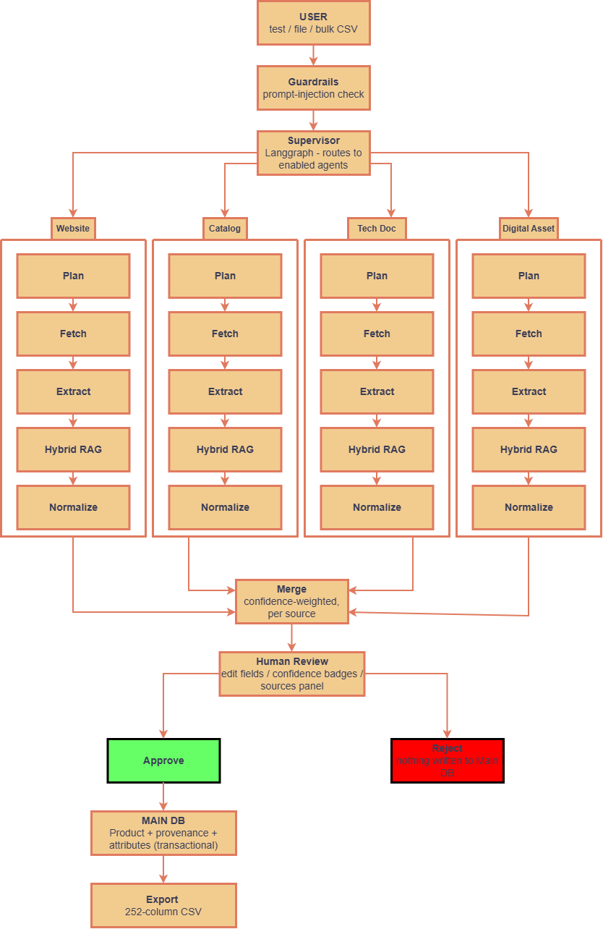
PROCESS FLOW
How a product moves through the system
PRODUCT INTELLIGENCE AI · UNIHACK
8

Slide 9
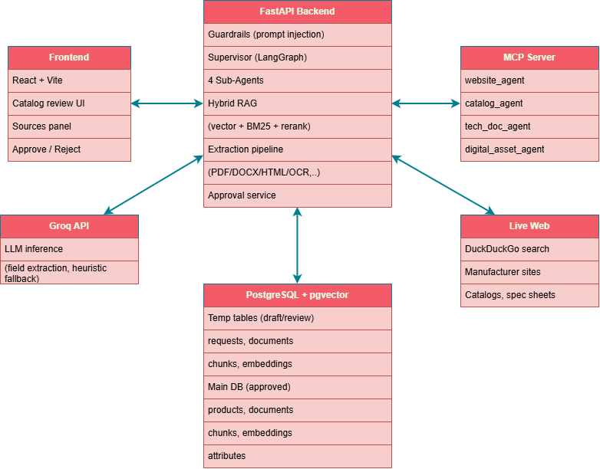
ARCHITECTURE
System architecture of the proposed solution
PRODUCT INTELLIGENCE AI · UNIHACK
10

Slide 10
TECH STACK
Technologies used in the solution
Backend
AI / Orchestration
Python · FastAPI · SQLAlchemy · PostgreSQL + pgvector
LangGraph (Supervisor) · LangChain-Groq (LLM inference)
Retrieval
Document Processing
sentence-transformers (embeddings + reranker) · BM25 · RRF · custom MCP server/client
PyMuPDF · python-docx · BeautifulSoup · openpyxl · EasyOCR
Frontend
Infrastructure
React · Vite
Docker · Docker Compose · ThreadPoolExecutor concurrency (CPU/GPU aware)
PRODUCT INTELLIGENCE AI · UNIHACK
11

Slide 11
COST (OPTIONAL)
Estimated implementation cost
Built entirely on open-source components except LLM inference, which runs on Groq's API (free tier available; low per-token cost at scale). No proprietary licensing costs. Primary ongoing cost at production scale would be LLM API usage and hosting/compute for the database and backend services.
PRODUCT INTELLIGENCE AI · UNIHACK
12

Slide 12
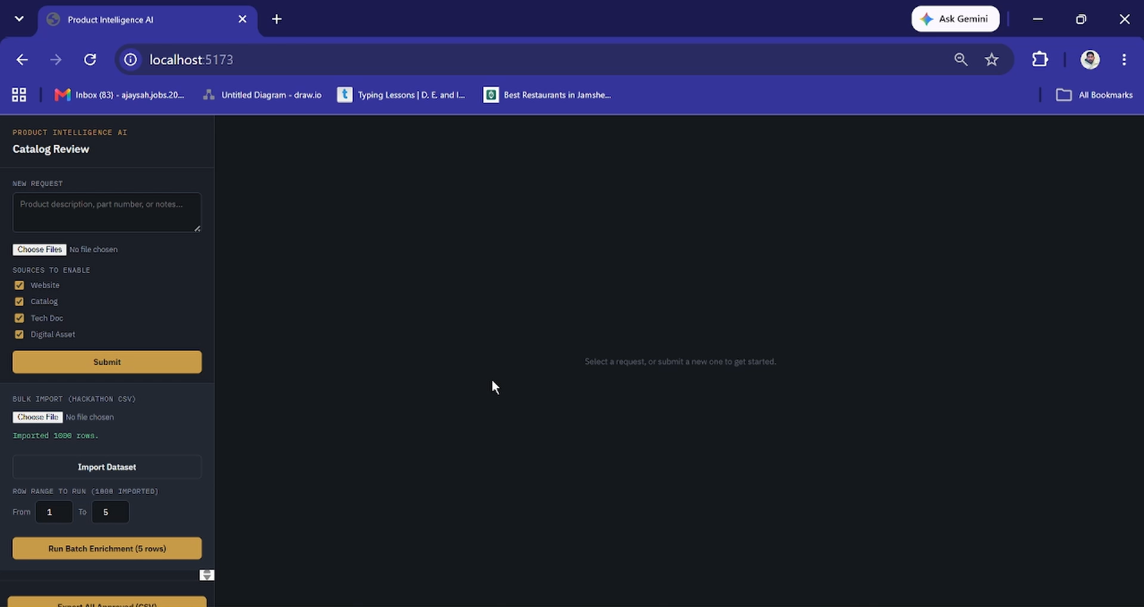
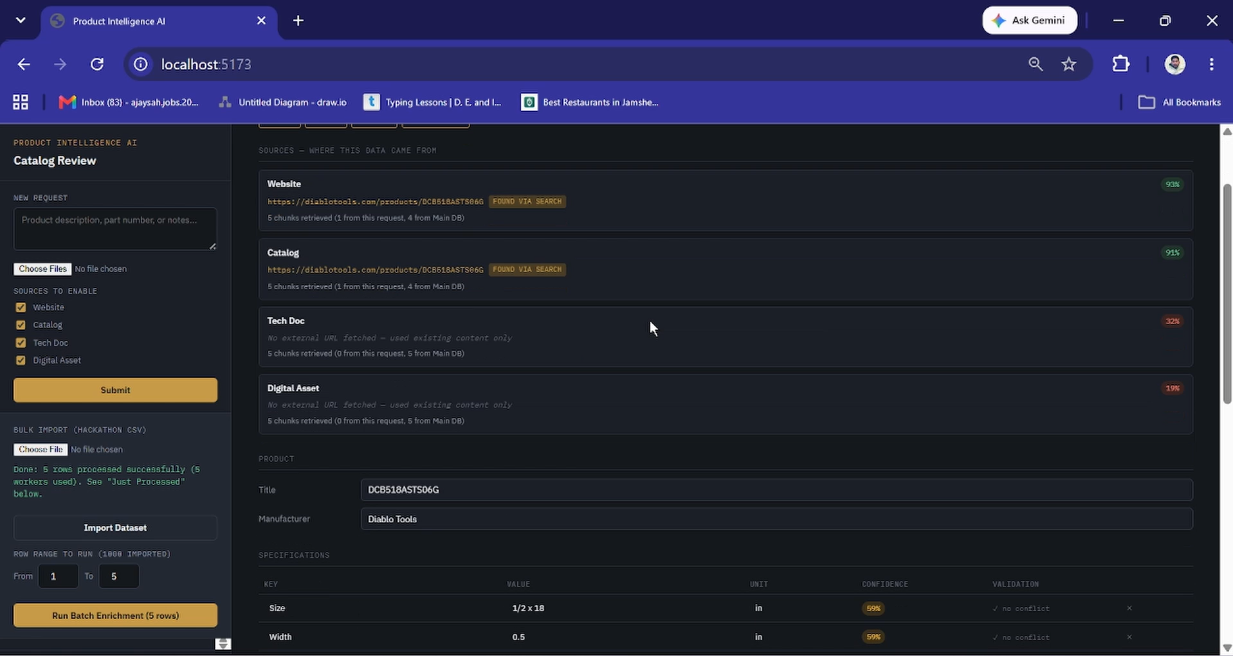
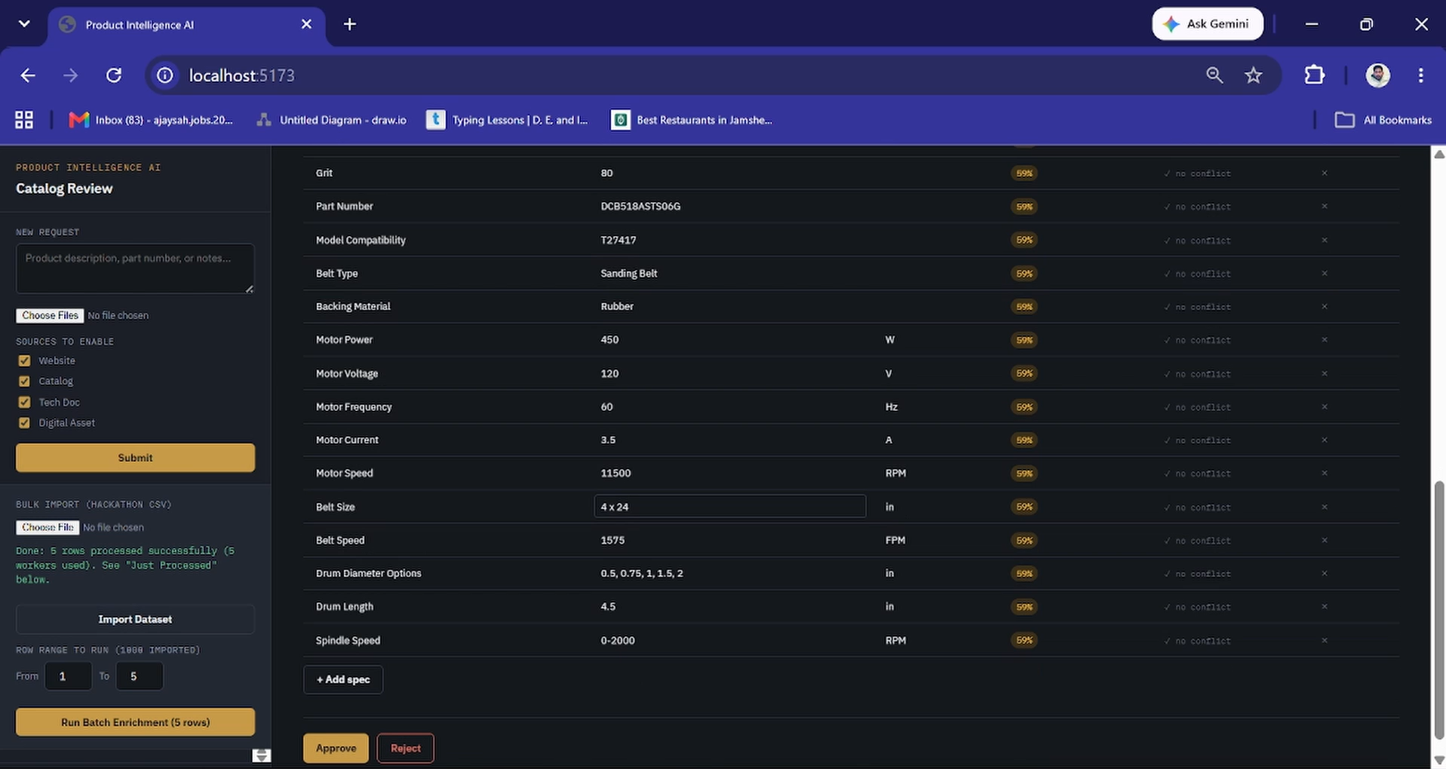
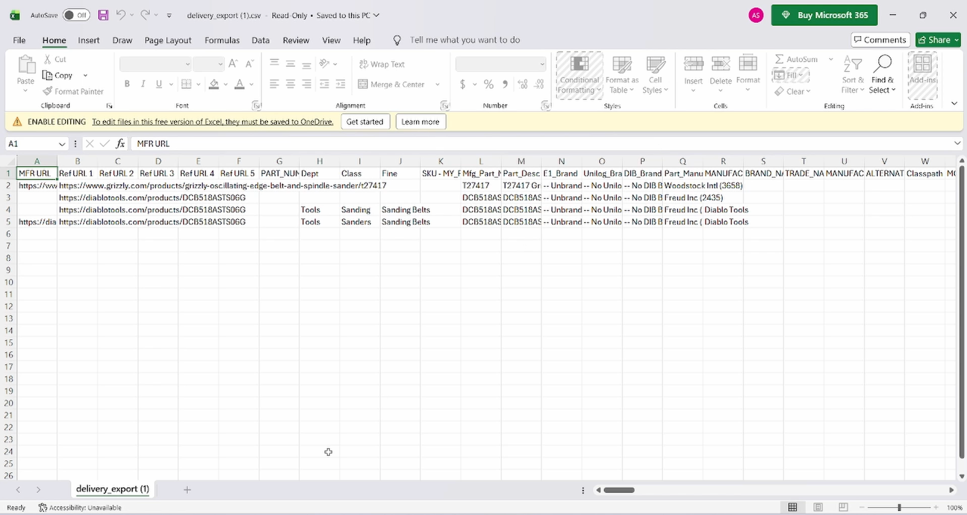
DEMO
Snapshots of the MVP
[
[ Insert screenshot ]
[ Insert screenshot ]
[ Insert screenshot ]
PRODUCT INTELLIGENCE AI · UNIHACK
13

Slide 13
ROADMAP
Additional details / future development
In-place enrichment: update an existing product record rather than creating a new one on re-enrichment
1
Background job queue with progress polling, for batch runs at full dataset scale (1,000+ rows)
2
Richer automatic category (Department / Class / Fine) classification
3
Title-cleaning pass to avoid raw scraped breadcrumb/HTML-title artifacts
4
PRODUCT INTELLIGENCE AI · UNIHACK
14

Slide 14
LINKS
Provide links to your submission
GitHub Public Repository
1
https://github.com/ajaysah-ai/Product-Intelligence-AI
Demo Video Link (3 Minutes)
2
Video is also available on GitHub.
PRODUCT INTELLIGENCE AI · UNIHACK
15

Slide 15
PRODUCT INTELLIGENCE AI
Thank You
AI-Powered Product Intelligence for Industrial Commerce

