Slide 2


Slide 3
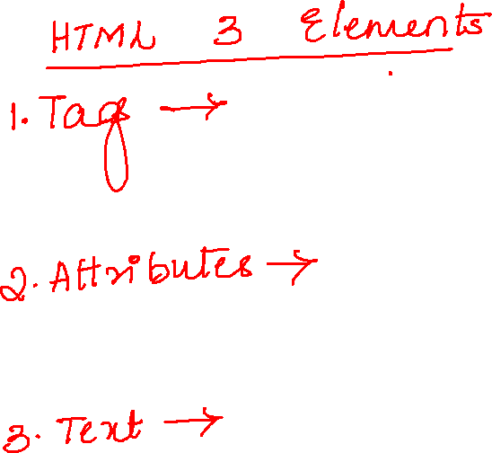

Slide 4
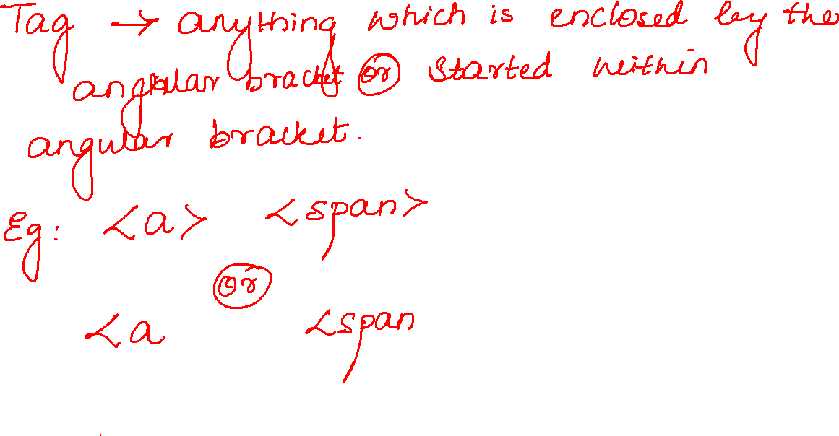

Slide 5
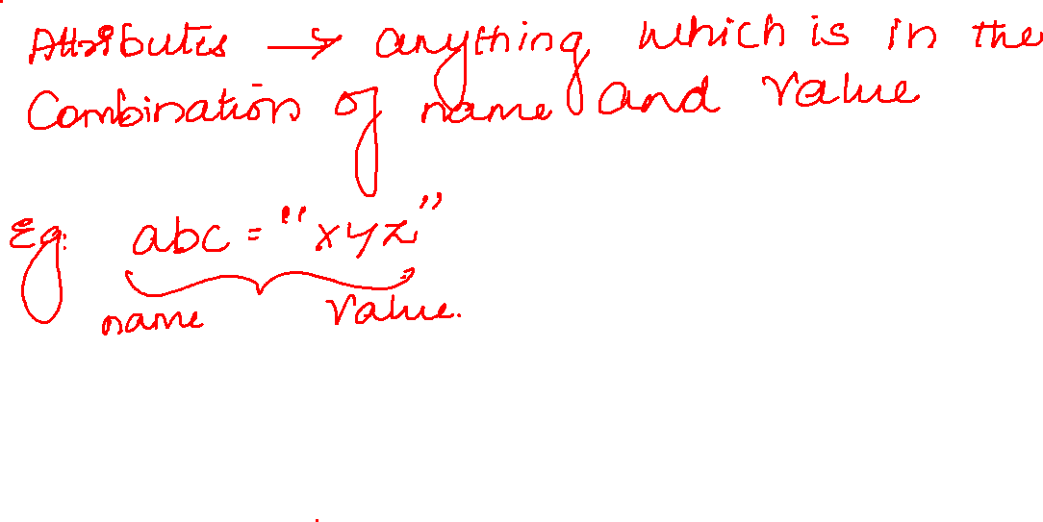

Slide 6
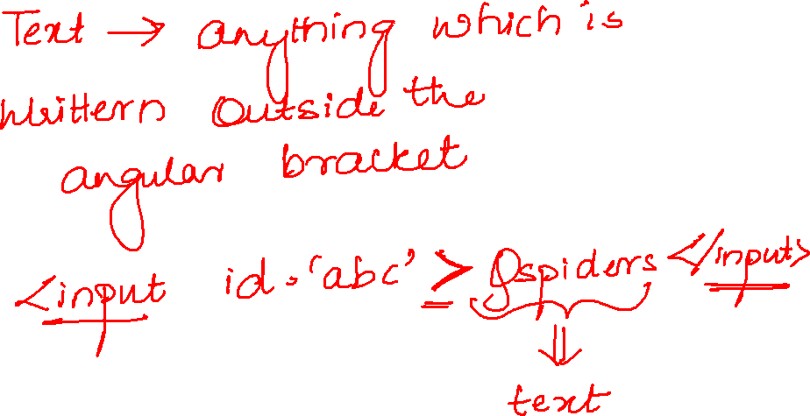

Slide 7
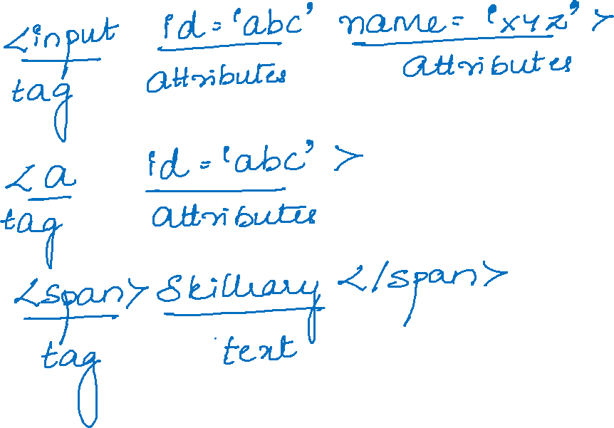

Slide 8
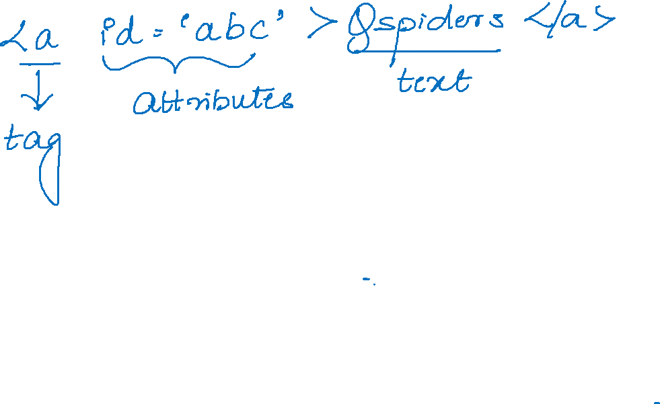

Slide 9
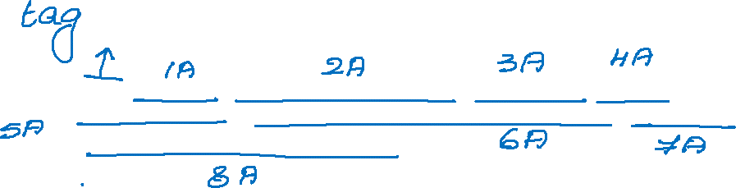
<input type="text" class="inputtext _55r1 _6luy" name="email" id="email" data-testid="royal_email" placeholder="Email address or phone number" autofocus="1" aria-label="Email address or phone number">

Slide 10
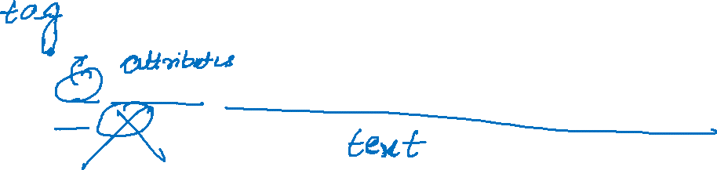
<h2 class="_8eso">Facebook helps you connect and share with the people in your life.</h2>

Slide 11
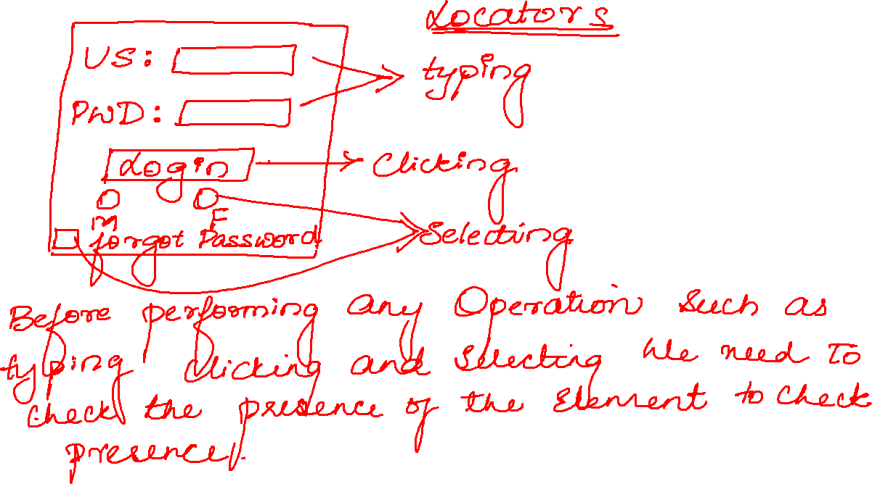

Slide 12
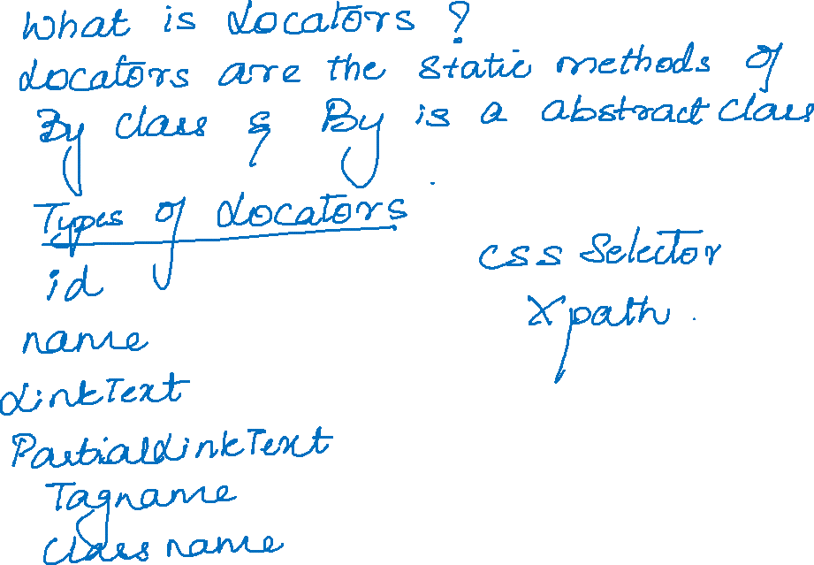

Slide 13
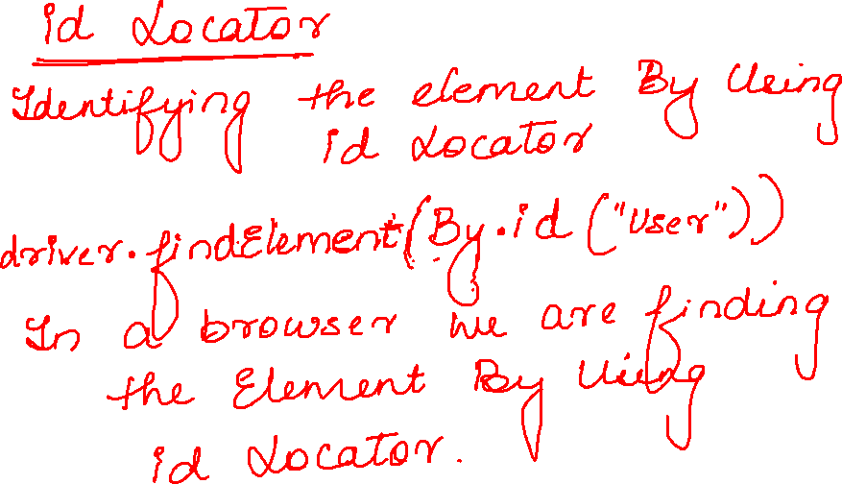

Slide 14

