Slide 1
Scan, Pay and Go Ajay Saini

Slide 2
Introduction
Scan, Pay and Go is a mobile app for customers for retail stores.
Helping customers at retail stores to avoid queues during check out.
Simple operations, shorter queues.

Slide 3

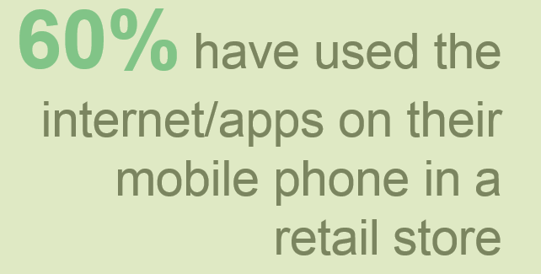

Slide 4
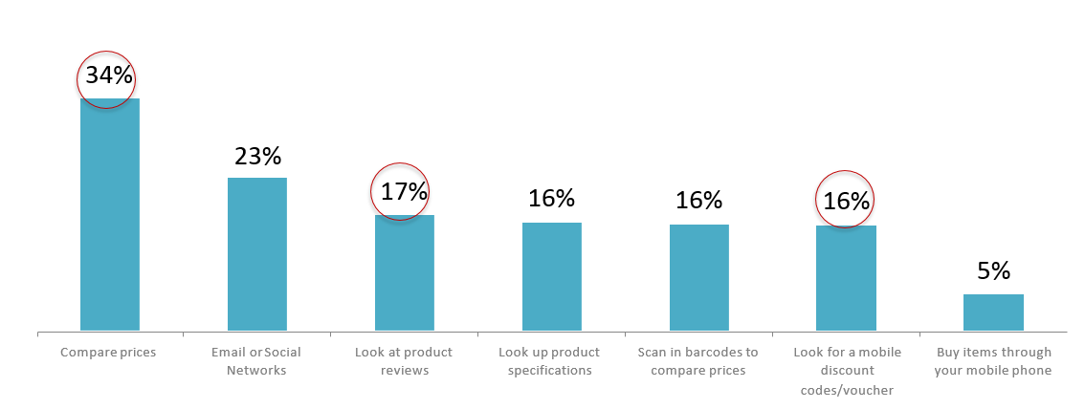
In store, customers are most likely to use their mobile internet to compare prices, look for discounts & reviews.

Slide 5
ICICI Bank APIs and Tech Stack
Technology – Android, Google Vision API, MVVM, Dagger, Firebase
ICICI Bank APIs – Authentication, Bill Payment

Slide 6
Features
Simplify check out process to avoid long queues.
Compare prices and look products reviews.
Offering best deals to customers & cashback on check out with mobile app.

Slide 7
Summary
60% have used the internet on their mobile phone whilst in a retail store and they’re most likely use it to compare prices, look for discounts & read product reviews.
The majority would be happy for retailers to send them a text/e-mail with promotional offers whilst they’re in- store using the free Wi-Fi service, which opens up new communication methods for retailers.
Popularity of using discount vouchers will continue and mobile is the preferred future method of redeeming.

Slide 8
References
https://ondeviceresearch.com/blog/can-mobile-save-high-street-from-online-competition
https://econsultancy.com/blog/8919-why-retailers-need-to-embrace-mobile-internet-in-stores/

