Slide 1
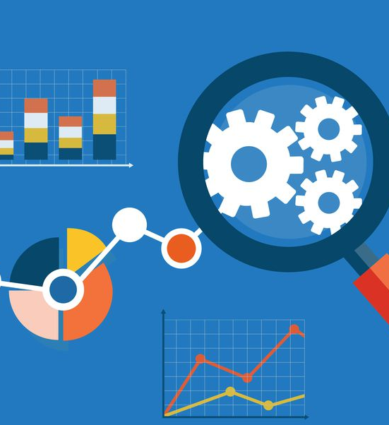
HR ANALYTICS
KPI no-3
This Photo by Unknown Author is licensed under CC BY-ND

Slide 2
HR ANALYTICS KPI CHART

Slide 3
Observations
Consistency Across Departments:
The average Total Working Years is relatively consistent across all departments, ranging from 20.32 to 20.67 years. This indicates a balanced distribution of experience levels among employees.
High Experience Levels:
Across the board, employees in different departments demonstrate a substantial average Total Working Years, suggesting a seasoned workforce. This can positively impact productivity and efficiency.
Potential Skill Set Variation:
While the average years of experience are similar, it's crucial to explore the specific skill sets within each department. Assess whether there are specialized skills or areas of expertise unique to certain departments.

Slide 4
Suggestions
Succession Planning:
Develop a robust succession planning strategy to mitigate the risk associated with an aging workforce. Identify and groom potential leaders from within to ensure a smooth transition of knowledge and responsibilities.
Skill Diversification:
Encourage cross-functional training and development programs to diversify the skill sets within each department. This can enhance the overall flexibility of the workforce and prepare employees for evolving roles.
Knowledge Transfer Programs:
Implement knowledge transfer programs to capture and share the wealth of experience within the organization. This can involve mentorship initiatives, documentation of best practices, and regular knowledge-sharing sessions.

