Slide 1
INFOSYS SPRINGBOARD INTERNSHIP
Milstone-1
Project Title : EcoPackAI – AI-Powered Sustainable Packaging Recommendation System

Slide 2
Outline
Dataset
Dataset Integration
Data Preprocessing
Feature Engineering

Slide 3
Dataset
Dataset Contains:(material)
Material_Type
Strength_PSI
Weight_Capacity_KG
Biodegradability_%
CO2_Emission_Score_%
Recyclability_%
Cost_per_KG_USD
Dataset Contains:(products)
Product Name
Category
Product_Weight_kg
Fragility_Level

Slide 4

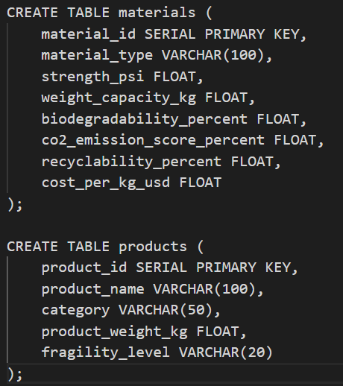
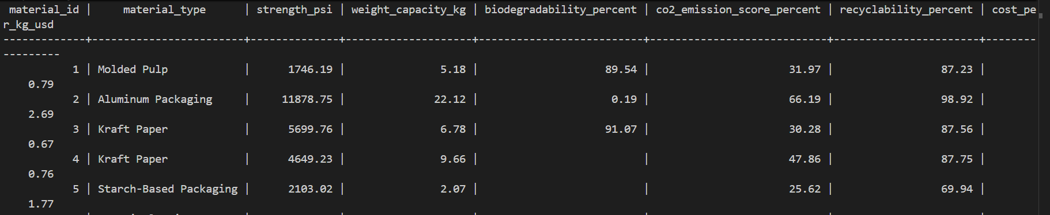
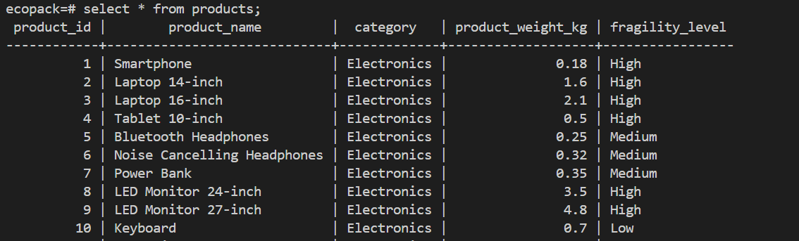
Dataset Integration

Slide 5
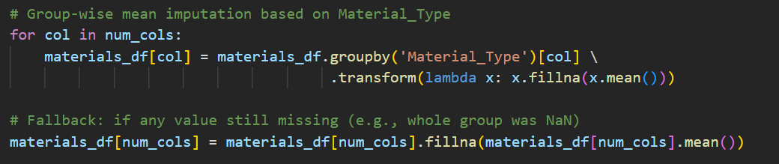
Data Preprocessing
Missing Value Handling
Instead of global mean imputation:
We applied group-wise mean imputation:
Missing values filled based on Material_Type
Example:
Kraft Paper → mean of Kraft Paper only
Molded Pulp → mean of Molded Pulp only

Slide 6
Feature Engineering
CO2 Impact Index:
Logic Used:
Lower CO2 emission → Better
Higher recyclability → Better
Applied Min-Max normalization for CO2
Inverted CO2 since lower emission is desirable
Formula Used:
CO2_Impact_Index = 0.7 × (1 - normalized_CO2) + 0.3 × (Recyclability Score)
Higher value → More sustainable material
Cost Efficiency Index:
Factors Considered:
Weight Capacity
Strength
Low CO2 Emission
Formula Used:
Cost_Efficiency_Index = 0.4 × Weight Capacity (normalized) + 0.4 × Strength (normalized) + 0.2 × Low CO2 Score
Higher value → Better performance-cost balance

Slide 7
Feature Engineering
Material Suitability Score:
Factors Included:
Strength
Biodegradability
Recyclability
Low CO2 Emission
Formula Used:
Material_Suitability_Score = 0.3 × Strength + 0.2 × Biodegradability + 0.2 × Recyclability + 0.3 × (1-CO2 Score)
Higher value → More suitable for sustainable packaging

Slide 8
Thank You

