Slide 1
INFOSYS SPRINGBOARD INTERNSHIP
Milstone-2
Machine Learning Dataset Preparation & AI Recommendation Model
Project Title : EcoPackAI – AI-Powered Sustainable Packaging Recommendation System

Slide 2
Outline
Feature Selection & Target Variable Generation
Train-Test Split
Data Pipeline & Preprocessing
Cost Prediction Model
CO₂ Prediction Model
Scoring Formula

Slide 3
Feature Selection & Target Variable Generation
Selected the following features:
Material_Type (Categorical)
Strength_PSI
Weight_Capacity_KG
Biodegradability_%
Recyclability_%
These features influence:
Cost
Environmental Impact
Performance
Created two ML prediction tasks:
1️⃣ Cost Prediction Target → Cost_per_KG_USD
2️⃣ CO₂ Impact Prediction Target → CO2_Emission_Score_%

Slide 4
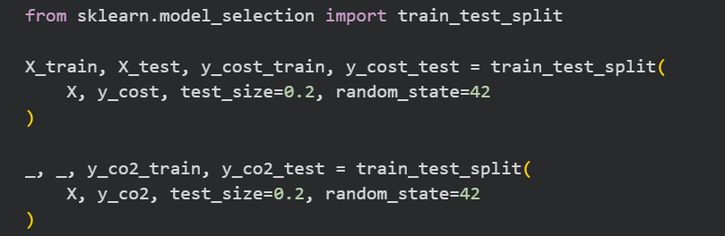
Train-Test Split
Data Splitting Strategy
80% → Training Data
20% → Testing Data
Random State = 42 (Reproducibility)
Purpose:
Train model on unseen data
Evaluate generalization performance

Slide 5
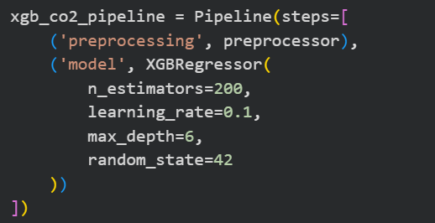
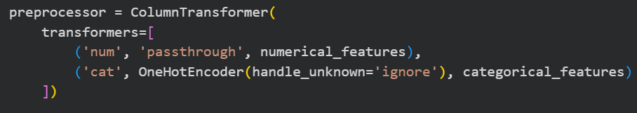
Data Pipeline & Preprocessing
Used:
Preprocessor:
Encoding (Material_Type)
Scaling (Numerical Features)
Integrated using Pipeline
Why Pipeline?
Prevents data leakage
Ensures consistent preprocessing
Cleaner and scalable architecture

Slide 6
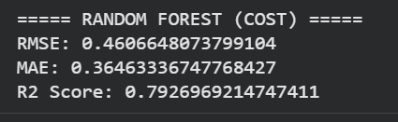
Cost Prediction Model
Model Used:RandomForestRegressor
Parameters:
n_estimators = 200
max_depth = 10
Why Random Forest?
Handles non-linear relationships
Robust to overfitting
Works well on mixed features
Evaluation Metrics:

Slide 7
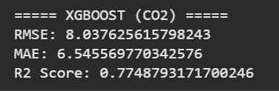
CO₂ Prediction Model
Model Used:XGBRegressor
Parameters:
n_estimators = 200
learning_rate = 0.1
max_depth = 6
Why XGBoost?
High performance
Gradient boosting optimization
Handles complex environmental patterns
Evaluation Metrics:

Slide 8
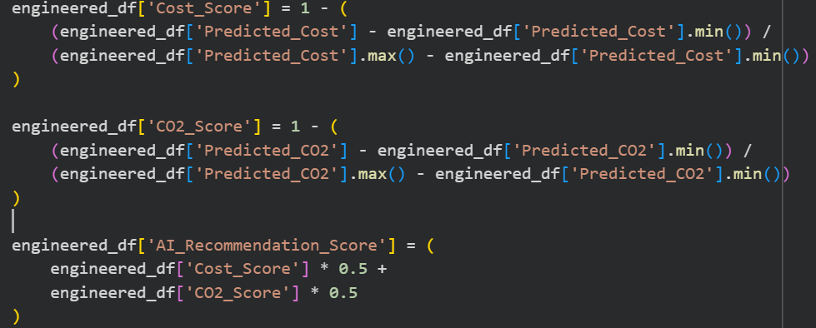
Scoring Formula
Final Recommendation Formula:
Cost Score: 1 − Normalized(Predicted_Cost)
CO₂ Score:1 − Normalized(Predicted_CO2)
Final AI Score:
AI_Recommendation_Score = (0.5 × Cost_Score) + (0.5 × CO2_Score)
Equal weight given to:
Economic factor
Environmental factor

Slide 9
Thank You

