Slide 1
INFOSYS SPRINGBOARD INTERNSHIP
Milstone-3
Project Title : EcoPackAI – AI-Powered Sustainable Packaging Recommendation System

Slide 2
Outline
System Architecture
Backend Architecture
Flask REST API Endpoints
Environmental Score Computation
AI Material Recommendation
UI
Recommendation Output UI

Slide 3
System Architecture
Diagram
User ↓ Frontend UI (HTML + Bootstrap) ↓ Flask Backend API ↓ Machine Learning Models ↓ PostgreSQL Database

Slide 4
Backend Architecture
Flask application provides REST APIs for:
Product Input Handling
Environmental Score Calculation
AI Material Recommendation
Backend responsibilities:
Process user inputs
Load trained ML models
Query material dataset
Rank materials
Return JSON response

Slide 5
Flask REST API Endpoints
Health Check:
GET /api/health
Checks:
database connection
models loaded
dataset availability
Product Input API:
Stores product data in database.
Example JSON:
{
"product_name":"Glass Bottle",
"category":"food",
"product_weight_kg":1.5,
"fragility_level":"High"
}

Slide 6
Environmental Score Computation
POST /api/environment-score
Input cost_values
co2_values Formula:
Cost Score = normalized(cost)
CO₂ Score = normalized(co2)
Final AI Score:
AI Score =
0.5 * Cost Score +
0.5 * CO2 Score
Purpose: Evaluate environmental sustainability of materials

Slide 7
AI Material Recommendation
POST /api/recommend-materials
Input:
{
"product_weight_kg":5,
"fragility_level":"Medium",
"top_n":5
}
Steps
Filter materials based on
weight capacity
strength requirement
Predict values using ML models
Cost prediction → Random Forest
CO₂ prediction → XGBoost
Calculate environmental scores
Rank materials by AI score

Slide 8
Frontend UI Development
Technologies
HTML
CSS
Bootstrap
Flask Templates
Features
Product input form
Fragility selection
Display recommendation result

Slide 9
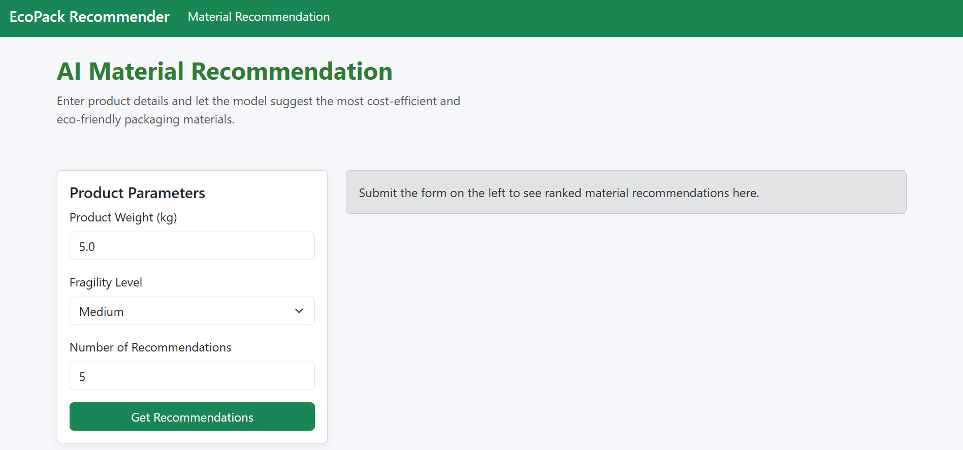
UI

Slide 10
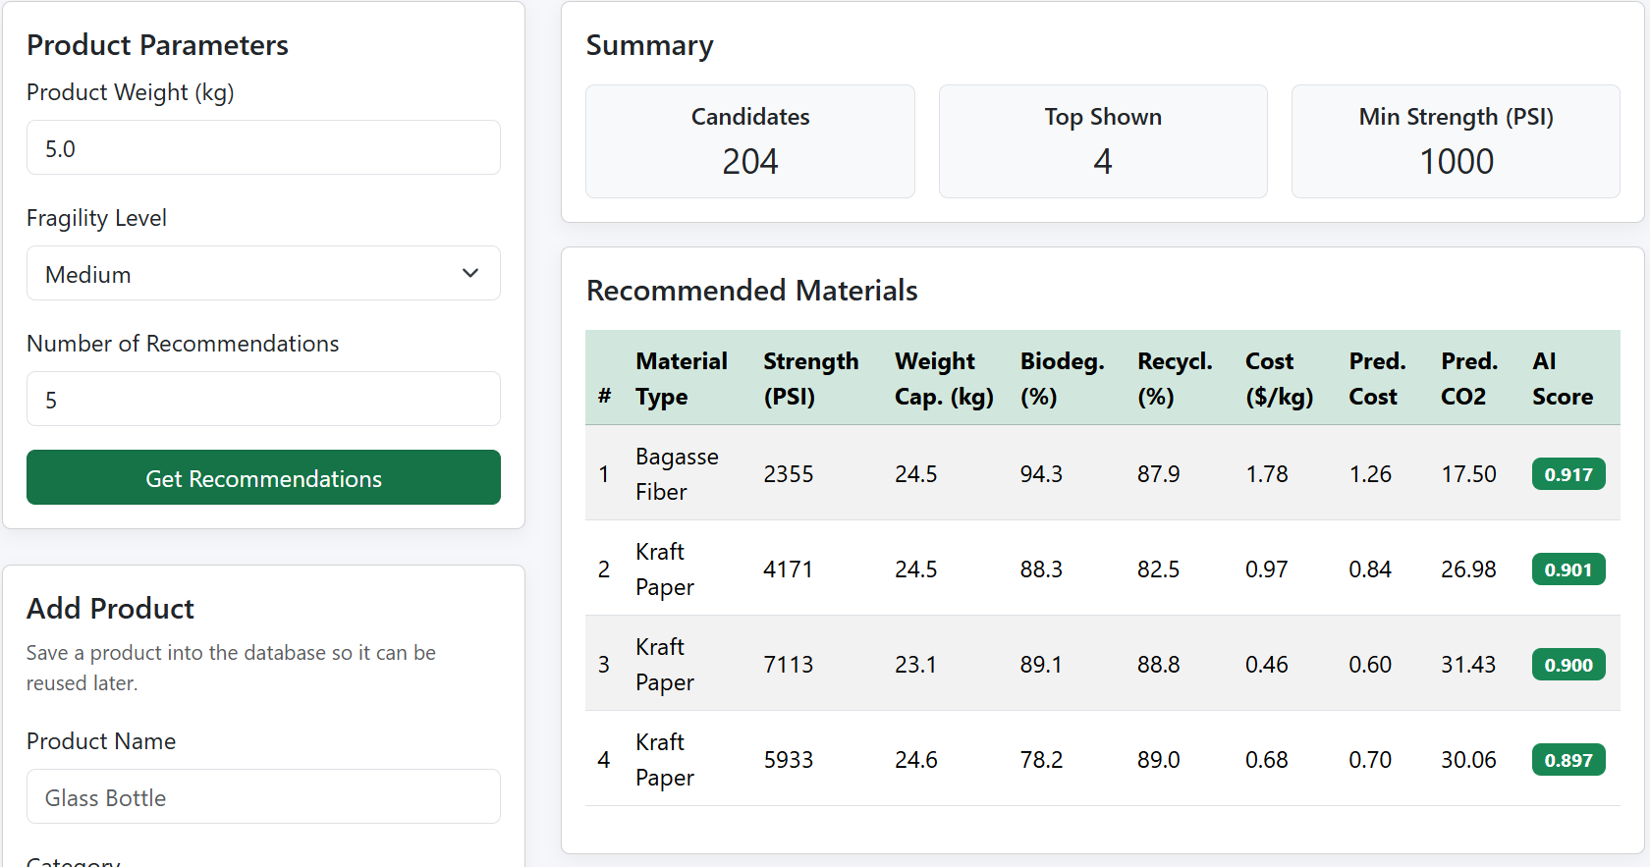
Recommendation Output UI

Slide 11
Thank You

