Slide 1







IAM + KEYCLOAK
What Is
Keycloak?
Realms, clients, users, roles and groups — and how authentication, authorization, OAuth 2.0 and OpenID Connect fit together, using one banking example you can rebuild locally.
1. The problem before Keycloak
LOGIN
Account, Payment and Customer services each build their own login form and password storage.
Before: every service owns identity
Account
Payment
Customer
ROLES
Each service keeps its own role rules, so “who may see a balance?” gets three different answers.
Login form
Login form
Login form
Passwords
Passwords
Passwords
Roles
Roles
Roles
SESSIONS
Sessions, tokens and logout are re-implemented per service and drift apart over time.
Sessions
Sessions
Sessions
3 logins · 3 password stores · 3 role models
Notes:
Keep this slide about the problem only. The three services are the same banking services used across the series (Account, Payment, Customer, Notification). No stat is quoted on purpose.

Slide 2

2. What we will learn — and build
Every concept in this post is shown on one small example you can reproduce on your own machine with a local Keycloak.
What Keycloak is and why teams use it
The working example
Realm, client, user, role and group
Realm · bank-demo
Authentication vs authorization
Client bank-app requests tokens
OAuth 2.0 vs OpenID Connect
Realm role customer views own accounts
Where each concept lives in the Admin Console
Group retail-customers → customer
Run Keycloak locally with Docker
User ajay in retail-customers
Get a real token for a real user
Verify roles inside the token
User akash no group, no role
One realm, one client, one role, one group, two users. ajay should be allowed; akash should not.
Notes:
All names (bank-demo, bank-app, customer, retail-customers, ajay, akash) are the planned values for the local build. If you rename anything while building in Keycloak, update the deck to match before publishing.

Slide 3








3. What is Keycloak?
Keycloak is an open-source Identity and Access Management (IAM) server. Applications hand login over to it and receive standard, signed tokens back.
In one line
A separate server that owns “who are you?” and issues tokens your apps can trust.
In our example
Keycloak runs on localhost:8080 and owns login for the bank-demo realm. The banking services never see a password.
What it is not
Not a library inside your app. Your app still has to validate the token it receives.
License
Apache License 2.0
Authentication
Identity store
Login forms, passwords, MFA
Users, groups, attributes
Tokens
Single sign-on
Signed JWT access & ID tokens
Log in once, use many apps
Authorization data
Open standards
Realm & client roles in tokens
OIDC · OAuth 2.0 · SAML 2.0
Notes:
Keep the definition short. SAML 2.0 is listed as a supported standard but is not covered in this series post. Capabilities map: tokens and roles are demonstrated on slides 11-12.

Slide 4

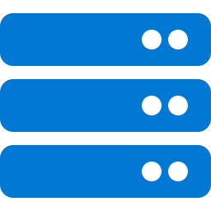
4. High-level architecture
Keycloak sits beside your applications. The user logs in at Keycloak; the application only ever sees a token.
1 Login
ajay sends credentials to Keycloak, never to the API.
2 Tokens
Keycloak verifies him and returns signed tokens.
3 Call the API
The client sends Authorization: Bearer <token>.
4 Verify
The API checks the token signature with Keycloak’s public keys, then decides.
Keycloak
realm: bank-demo
1
2
ajay
(browser / curl)
4
3
Application / API
account-service (Post 03)
In this post we stop at step 2 and inspect the token. The API side is built in Post 03.
Notes:
Step 4 (JWKS / public key verification) is only introduced here; implementation belongs to Post 03.

Slide 5
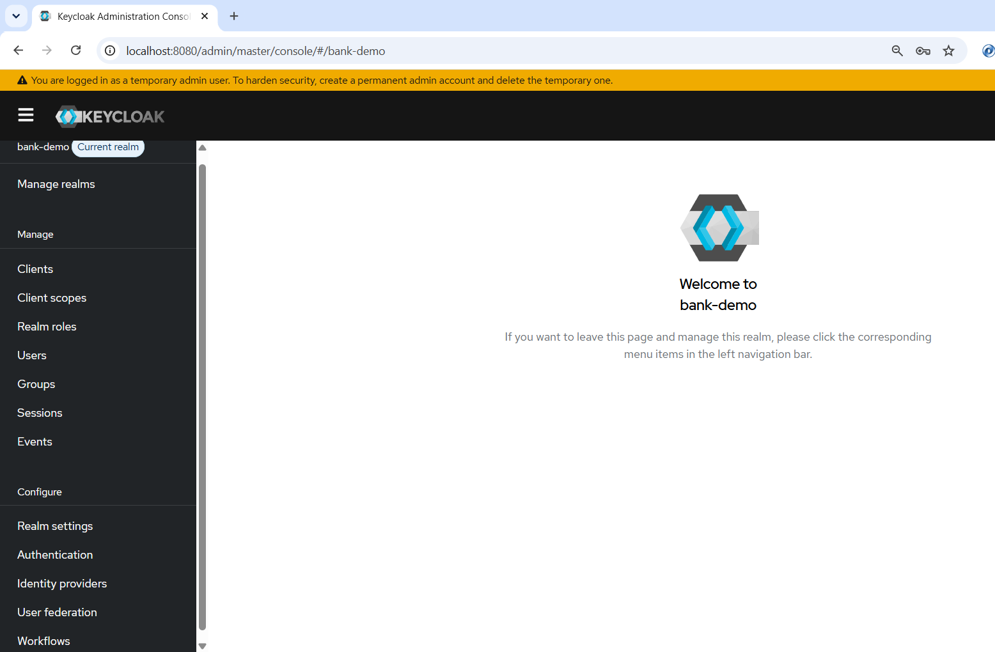
5. Where everything lives in the Admin Console
Open http://localhost:8080/admin and switch from the master realm to your own realm first. Every concept below lives inside that realm.
Realm
Realm dropdown → Create realm; settings in Realm settings
Client
Clients
User
Users (password in the Credentials tab)
Role
Realm roles (client roles: Clients › Roles)
Group
Groups
Authentication
Authentication (login flows)
Token preview
Clients › bank-app › Client scopes › Evaluate
Highlighted items are the ones used in this post. The Current realm (top-left) decides which realm you are editing.
Notes:
Menu labels are from the Keycloak 26.x admin console (Manage / Configure sections). Confirm against your local version when capturing 00-admin-console.png.

Slide 6
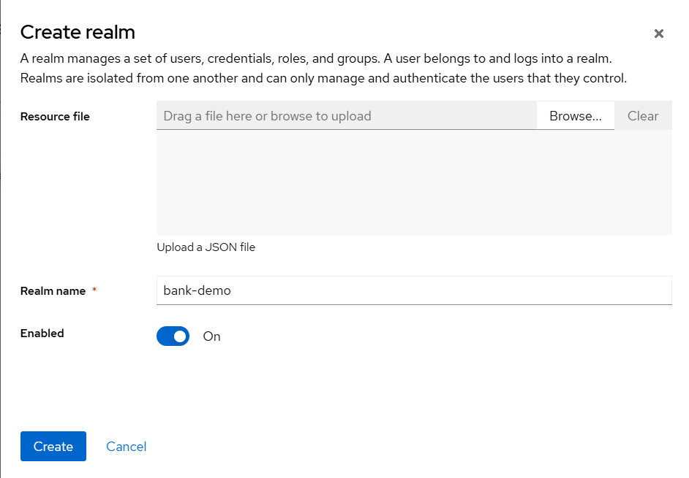
6. Realm — the isolated identity space
A realm owns its own users, clients, roles, groups and login settings. Nothing is shared between realms.
Why it exists
Separates tenants or environments. The built-in master realm is only for administering Keycloak.
Working example
Realm bank-demo holds everything for our banking services.
Expected result
Token issuer becomes localhost:8080/realms/bank-demo
Takeaway
Never create application users in master.
Open the Manage realms , choose Create realm, enter bank-demo and click Create.
Notes:
Capture 01-realm-create.png: Create realm form with bank-demo typed in, before clicking Create.

Slide 7
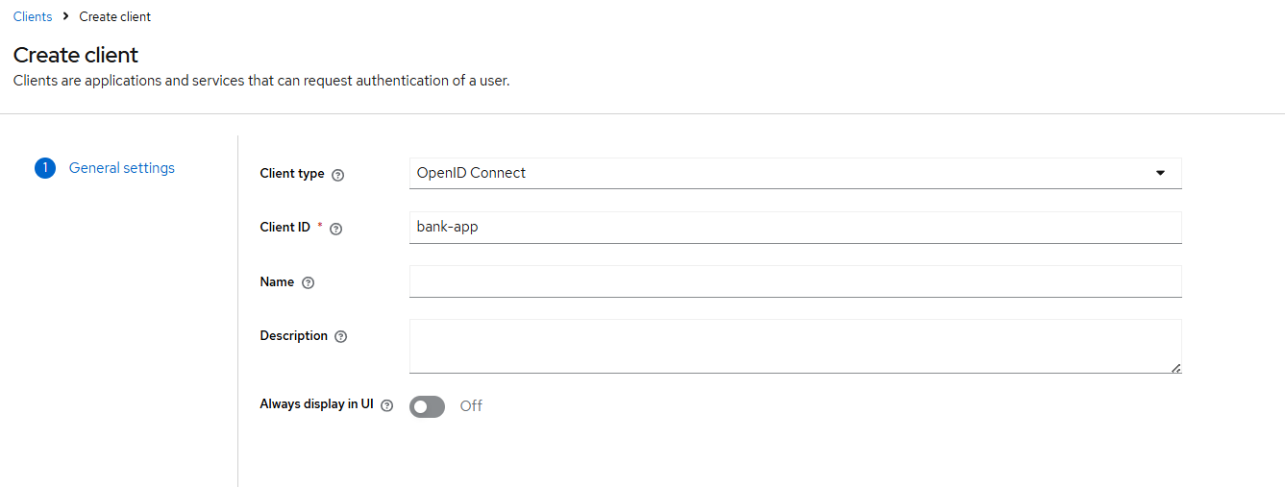
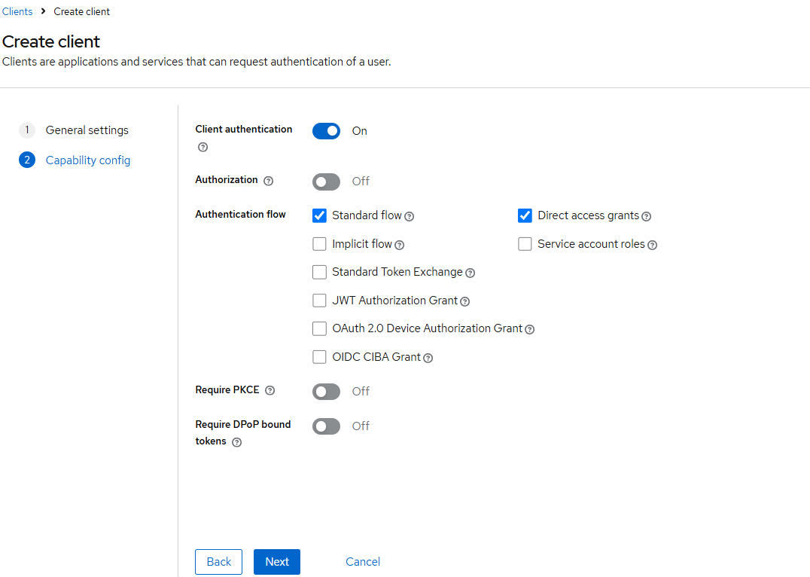
7. Client — an application Keycloak knows
A client is an application or service that asks Keycloak to log users in or to issue tokens.
Create client · Capability config
Why it exists
Keycloak only issues tokens to registered apps — each has its own ID, secret and allowed flows.
Working example
bank-app: OpenID Connect, confidential, Direct access grants on so we can test with curl.
Expected result
A client secret appears under bank-app › Credentials.
Takeaway
Realm = the space. Client = one app inside it.
Clients → Create client. Step 1 sets the Client ID; step 2 turns on Client authentication and the flows.
Notes:
Capture 02-client-capability.png on step 2 (Capability config). Also capture 03-client-credentials.png: bank-app > Credentials tab showing (blurred) client secret. Direct access grants is enabled only so the demo can call the token endpoint with curl; real apps use Authorization Code + PKCE.

Slide 8
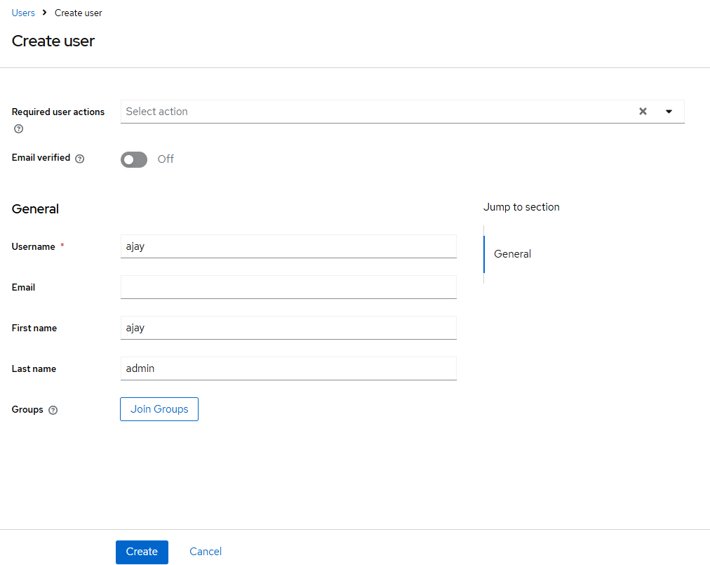
8. User — an identity that can log in
A user is a person or account in the realm: a username, profile attributes and credentials Keycloak verifies.
Create user
Why it exists
Keycloak stores and checks passwords, so the banking services never handle them.
Working example
ajay and akash, each with a non-temporary password.
Expected result
Both users can log in. Neither has any banking permission yet.
Takeaway
A user proves identity, not permission.
Users → Add user, enter ajay fill in details and click Create, then Credentials tab→ Click Set password with Temporary off save password.
Repeat for akash.
Notes:
Capture 04-user-create.png (Create user form for ajay) and optionally 05-user-credentials.png (Set password dialog, Temporary off). Do not show real passwords.

Slide 9
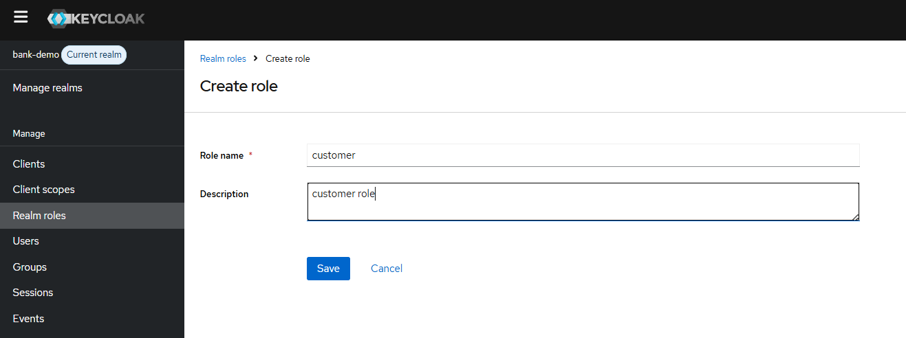
9. Role — a named permission
A role is a permission label such as customer. Keycloak puts a user’s roles into the access token.
Why it exists
Apps check roles instead of hard-coding usernames.
Working example
Realm role customer — may view own accounts.
Expected result
The role exists but nobody has it yet. ajay gets it through a group on the next slide.
Takeaway
Realm roles are shared by all clients. Client roles belong to one app — covered in a later topic.
Realm roles → Create role, name it customer. The default-roles-bank-demo composite is given to every user.
Notes:
Capture 06-realm-role.png: Realm roles list after creating customer.

Slide 10
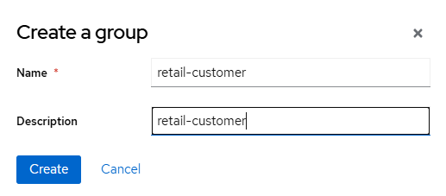
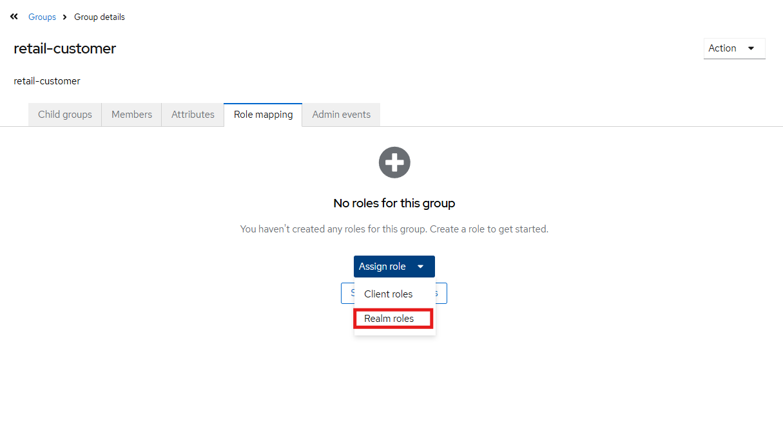
10. Group — hand out roles in bulk
A group is a set of users who share the same roles and attributes.
Why it exists
Assign roles once to the group instead of user by user.
Working example
retail-customers → role customer. ajay joins; akash does not.
Expected result
Ajay’s effective roles include customer; akash do not.
Takeaway
Roles grant permission; groups are how you assign them at scale.
Groups → Create group, then Role mapping → Assign role → customer.
Add ajay via Users › ajay › Groups → Join Group.
Notes:
Capture 07-group-role-mapping.png (group Role mapping tab) and 08-user-groups.png (ajay > Groups tab showing retail-customers).

Slide 11
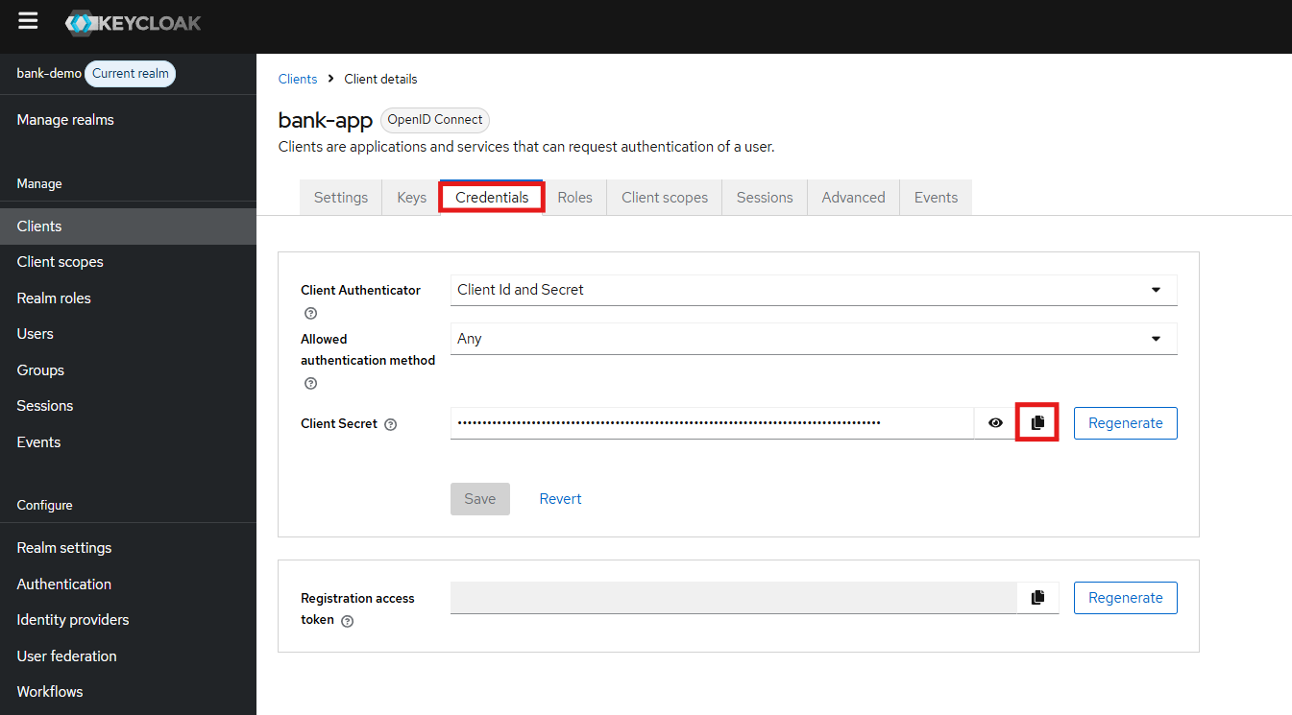
11. Client authentication — the client secret
Refer below screenshot to get client_secret for the client bank-app
What is client_secret used for
It is used to authenticate the client(app) for which token is being issued.
Wrong client_secret
If client_secret is incorrect then we get HTTP 401 with unauthorized_client — no token is issued.
Notes:
After running locally: paste the real (truncated) response into the second card and capture 09-token-response.png if you want a terminal screenshot. The 300-second value is Keycloak's default access token lifespan; confirm in Realm settings > Tokens.

Slide 12
12. Authentication — prove who you are
Authentication answers “who are you?”. Here ajay proves his identity to Keycloak and receives tokens from the realm’s token endpoint.
What Keycloak does
Finds ajay in bank-demo, checks the client secret and his password, then issues tokens.
Wrong password
HTTP 401 with invalid_grant — no token is issued.
“Account is not fully set up”
Also invalid_grant: the user still has a required action or missing profile fields (email, first/last name). Complete them or clear Required user actions in Users › ajay.
Request (bash / Git Bash — in PowerShell use curl.exe)
curl --location \
'http://localhost:8080/realms/bank-demo/protocol/openid-connect/token' \
--header 'Content-Type: application/x-www-form-urlencoded' \
--data-urlencode 'client_id=bank-app' \
--data-urlencode 'grant_type=password' \
--data-urlencode 'username=ajay' \
--data-urlencode 'password=<ajay-password>' \
--data-urlencode 'client_secret=<client-secret>' \
--data-urlencode 'scope=openid'
Your real response (tokens truncated) — id_token: see slide 15
{
"access_token": "eyJhbGciOiJSUzI1NiIs…",
"expires_in": 300, // default 5 min
"refresh_expires_in": 1800, // default 30 min
"refresh_token": "eyJhbGciOiJIUzUxMiIs…",
"token_type": "Bearer",
"session_state": "TKklYjfn…",
"scope": "email profile"
}
Run it for ajay, then for akash — both succeed. Authentication does not look at roles.
Notes:
Your curl, with the closing quote fixed and scope=openid added. The response card is from your real run, which was sent WITHOUT scope=openid — slide 15 compares both. Re-run with scope=openid and, if you like, capture 09-token-response.png.

Slide 13


13. Authorization — decide what you may do
Authorization answers “what may you do?”. Keycloak puts ajay’s roles in his access token; the API reads them and decides.
ajay’s access token — from your run (excerpt)
Rule in the API (built in Post 03)
{
"iss": "http://localhost:8080/realms/bank-demo",
"aud": "account",
"azp": "bank-app",
"preferred_username": "ajay",
"realm_access": { "roles": [
"offline_access", "default-roles-bank-demo",
"uma_authorization", "customer" ] },
"resource_access": { "account": { "roles": [
"manage-account", "manage-account-links",
"view-profile" ] } },
"scope": "email profile"
}
GET /accounts requires role customer
roles include customer
ajay
200 OK
no customer role
akash
403 Forbidden
Keycloak supplies the facts (roles in a signed token). The API makes the decision.
Notes:
Claims are from your real token (signature/other claims omitted). aud "account" and resource_access.account come from Keycloak's built-in account client via default roles — not something you configured. Capture 10-evaluate-ajay.png and 11-evaluate-akash.png from Clients > bank-app > Client scopes > Evaluate > Generated access token.

Slide 14


14. OAuth 2.0 vs OpenID Connect
They are related but not the same. OAuth 2.0 is about access; OpenID Connect adds identity on top of it.
OAuth 2.0
OpenID Connect
Authorization framework · RFC 6749
Identity layer on OAuth 2.0 · OIDC Core
Lets a client obtain an access token to call an API
Adds the ID token: who logged in, and when
Scopes say what the client may access
Adds /userinfo and discovery metadata
Does not define who the user is
Triggered by scope=openid
In our example: access_token from /token
In our example: id_token only when scope=openid is sent
OAuth 2.0 on its own is not a login protocol. Using it to “log users in” is a common mistake.
Try: /realms/bank-demo/.well-known/openid-configuration lists every OIDC endpoint.
Notes:
Confirmed by Ajay's run: without scope=openid the response had no id_token ("scope": "email profile"). Slide 15 shows both. Optional screenshot 12-openid-configuration.png: the discovery JSON in the browser.

Slide 15
15. Same request — with and without openid
OAuth 2.0 gives you the access token. Add one OIDC scope — openid — and Keycloak also returns an ID token.
What changed
One parameter: scope=openid
access_token — OAuth 2.0
Sent to APIs. Carries roles in realm_access.
id_token — OpenID Connect
For the client app: who logged in. aud is bank-app. Never send it to an API.
Check it yourself
Decode both tokens and compare typ: Bearer vs ID.
Without scope=openid — your real response
{
"access_token": "eyJhbGciOiJSUzI1NiIs…",
"expires_in": 300,
"refresh_token": "eyJhbGciOiJIUzUxMiIs…",
"token_type": "Bearer",
"scope": "email profile" // no openid → no id_token
}
With 'scope=openid' — expected; re-run to confirm
{
"access_token": "eyJ…",
"expires_in": 300,
"refresh_token": "eyJ…",
"token_type": "Bearer",
"id_token": "eyJ…", // OIDC: who logged in
"scope": "openid email profile"
}
Your first run said "scope": "email profile" — that is why no id_token came back.

Slide 16
16. What happens inside Keycloak
From one token request to an allow/deny decision — the full path for ajay.
Authentication
Steps 1–2. Only identity is checked here.
Authorization data
Steps 3–4. Group → role mapping is resolved when the token is built.
Trust
Step 5. The API trusts the token because it can verify the signature with /protocol/openid-connect/certs.
Decision
Step 7 happens in your code, not in Keycloak.
1
bank-app sends ajay’s credentials client → Keycloak
2
Check client secret, then ajay’s password bank-demo
3
Resolve effective roles retail-customers → customer
4
Build claims sub, preferred_username, realm_access
5
Sign the JWT with the realm key RS256 by default
6
Return access, refresh and ID tokens Keycloak → client
7
API verifies signature, checks role Post 03
Notes:
Step 7 is shown dashed because it is implemented in Post 03. RS256 is the realm default signature algorithm; confirm under Realm settings > Tokens and Realm settings > Keys.

Slide 17
17. Hands-on: build it in 10 steps
Everything below runs on your machine. Each step points to the slide that shows it.
1
Start Keycloak (command on the right)
Start Keycloak (dev mode)
2
Log in at localhost:8080/admin as admin
docker run -p 8080:8080 \
-e KC_BOOTSTRAP_ADMIN_USERNAME=admin \
-e KC_BOOTSTRAP_ADMIN_PASSWORD=admin \
quay.io/keycloak/keycloak:26.7 start-dev
3
Create realm bank-demo · slide 6
4
Create client bank-app · slide 7
NOTE: Data disappears when the container is removed. To keep the realm, users and roles across restarts, use docker-compose.yml (Keycloak + PostgreSQL) from the repo folder 01-keycloak-basics.)
5
Create users ajay and akash · slide 8
6
Create realm role customer · slide 9
Verification checklist
Create group retail-customers + map customer
Keycloak starts on :8080
Realm bank-demo exists
7
8
Add ajay to retail-customers · slide 10
Client bank-app has a secret
ajay & akash can log in
9
Request tokens with curl · slide 12
ajay is in retail-customers
Token request returns 200
10
Compare ajay vs akash in Evaluate · slide 13
ajay’s token has customer
akash’s token does not
start-dev and admin/admin are for your laptop only — see slide 19.
Notes:
Image tag 26.7 matches the current Keycloak release line as of Sept 2026 (26.7.x). Pin the exact tag you actually used when building locally. KC_BOOTSTRAP_ADMIN_* is the 26.x variable name (older KEYCLOAK_ADMIN is deprecated).

Slide 18




18. Common mistakes
Most beginner problems come from mixing up “who are you?” with “what may you do?” — or expecting Keycloak to do the API’s job.
App users in the master realm
Confusing realm and client
Treating OAuth 2.0 as login
Create your own realm; keep master for admins.
Realm = the space. Client = one app inside it.
Identity comes from OIDC and the ID token.
Expecting group names in the token
Direct access grants in production
“Keycloak protects my API”
Group roles are included; group names need a Group Membership mapper.
Demo only. Real apps use Authorization Code + PKCE.
Only if the API validates the token — Post 03.
Check yourself: akash can log in (authentication OK) but has no customer role (authorization denied). Both are correct.
Notes:
Mistakes limited to this topic. Group Membership mapper is configured via Client scopes; covered in a later topic.

Slide 19
19. From local demo to production
The concepts stay the same as systems grow. What changes is how Keycloak is run and which flows apps use.
Local demo
Production
Enterprise IAM
later topic
start-dev
start with hostname + TLS
API gateway
later topic
Built-in dev database
PostgreSQL or other supported DB
Microservices
later topic
admin / admin
Strong, temporary bootstrap admin
Multiple APIs
later topic
Direct access grants
Authorization Code + PKCE
Single API
Post 03
http://localhost:8080
HTTPS behind a proxy / LB
Local demo
this post
Manual console setup
Realm export / config as code
Each rung is a later post. This post stays on the first one.
Realms, clients, users, roles and groups do not change between the two columns.
Notes:
Production items are named, not explained — each gets its own post later in the series.

Slide 20

20. Key takeaways
Keycloak is a separate IAM server — apps delegate login to it and trust its signed tokens.
Where this fits in the series
Post 01
Why IAM matters
Realm → client → user → role → group is the whole model you built today in bank-demo.
Authentication ≠ authorization. akash logs in fine; he just lacks the customer role.
Post 02
What is Keycloak? (you are here)
OAuth 2.0 gives access; OIDC adds identity — the ID token is the OIDC part.
Post 03
Secure a Spring Boot REST API
Repository: https://github.com/ajayshinde01/keycloak
Topic folder: 01-keycloak-basics
Presentation → Concept → Keycloak configuration → Working code → Hands-on demo
Get the code: https://github.com/ajayshinde01/keycloak/tree/main/01-keycloak-basics
Next: Post 03 — secure a Spring Boot API
Sources: Keycloak Server Administration Guide — keycloak.org/docs/latest/server_admin
Keycloak Getting Started (Docker) — keycloak.org/getting-started/getting-started-docker · Keycloak 26.7 release line
OpenID Connect Core 1.0 — openid.net/specs/openid-connect-core-1_0.html · OAuth 2.0, RFC 6749 — datatracker.ietf.org/doc/html/rfc6749
Notes:
Replace [REPO URL] before publishing. Topic folder name 01-keycloak-basics assumed from the earlier Post 02 README plan — confirm it matches the repo.

