Slide 1





IAM + KEYCLOAK + SPRING BOOT · POST 3 OF 20 · TOPIC 03
Secure a Spring Boot
API with Keycloak
The first real vertical slice: Keycloak issues a signed JWT, Spring Boot validates it and answers 200, 401 or 403. Every result in this deck was run locally with Postman.
1. Where Post 02 stopped
POST 02
Keycloak already issues signed access tokens for ajay and admin in the demo realm.
Postman / curl
client
Keycloak
realm demo
THE GAP
An API with no security setup cannot tell a real token from a forged or expired one.
token
Bearer token
Account API
:8081
?
POST 03
Make the API a Resource Server: no valid token, no access. Roles decide what you can do.
Valid? Whose? Allowed?
Notes:
Post 02 ended with a token from Keycloak. This post closes the loop: the Spring Boot API validates that token and makes an access decision.

Slide 2

2. What we will learn — and build
Six concepts, one working example. Each concept is shown on the same API, the same realm and the same two users.
Resource Server
the API accepts tokens, not passwords
The working example
Issuer URI
one property that points Spring at the realm
Realm
demo
issuer …:8080/realms/demo
JWT validation
signature, issuer and timestamps on every call
Client
spring-boot-api
public · direct access grants (demo only)
User
ajay
realm role USER
Protected endpoints
URL rules plus @PreAuthorize
User
admin
realm roles USER, ADMIN
401 vs 403 vs 200
three answers, three different meanings
API
:8081
Spring Boot 3.5.16 · Java 21
Token expiry
how Spring knows a token is too old
IdP
:8080
Keycloak 26.7.4 (start-dev, Docker)
Realm, client, users and roles were explained in Post 02. Here we only use them.
Everything is created by scripts/provision-users.sh (or .ps1) against a running Keycloak, so the setup is repeatable.

Slide 3
3. The vertical slice — end to end
Keycloak authenticates the user and signs the token. Spring Boot never sees a password; it only checks the token and the roles inside it.
1 Get a token
POST /realms/demo/protocol/openid-connect/token with ajay's credentials (password grant, demo only).
2 Call the API
Send Authorization: Bearer <access_token>.
3 Read the token
No header on a protected URL → 401.
4 Validate the JWT
Key from Keycloak's JWKS, then signature, iss, exp. Any failure → 401.
5 Map roles
Keycloak roles become Spring authorities ROLE_USER, ROLE_ADMIN.
6 Decide
Role missing → 403. Role present → controller → 200.
Postman / curl
ajay or admin
1
Keycloak :8080
realm demo
JWT
2
JWKS (public keys)
Spring Boot API :8081
3
Bearer token filter
reads Authorization header
401
no / invalid / expired token
4
JwtDecoder
signature · iss · exp / nbf
5
Role converter
realm_access.roles → ROLE_*
403
valid token, missing role
6
@PreAuthorize
hasRole / hasAnyRole
200
controller runs

Slide 4
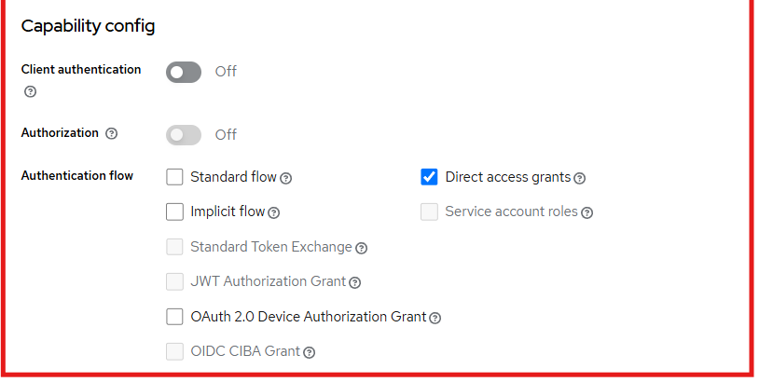
4. Resource Server — the API trusts tokens, not passwords
In OAuth 2.0 terms Keycloak is the authorization server that issues tokens; our API is the resource server that accepts them. One starter and one SecurityConfig turn it on.
pom.xml + SecurityConfig.java
<artifactId>
spring-boot-starter-oauth2-resource-server
</artifactId>
@EnableMethodSecurity
SecurityFilterChain securityFilterChain(
HttpSecurity http) {
http.csrf(csrf -> csrf.disable())
.authorizeHttpRequests(auth -> auth
.requestMatchers("/actuator/health",
"/api/public")
.permitAll()
.anyRequest().authenticated())
.oauth2ResourceServer(oauth -> oauth
.jwt(jwt -> jwt
.jwtAuthenticationConverter(
keycloakJwtAuthenticationConverter())));
return http.build();
}
Keycloak side
Clients → spring-boot-api → Capability config: Client authentication Off (public client), Direct access grants on so Postman can use the password grant.
Expected result
The API holds no client secret and no passwords. It only needs to know which issuer to trust (next slide).
oauth2ResourceServer().jwt() makes Spring read a Bearer JWT on every request. Everything not listed as permitAll() needs a valid token.

Slide 5
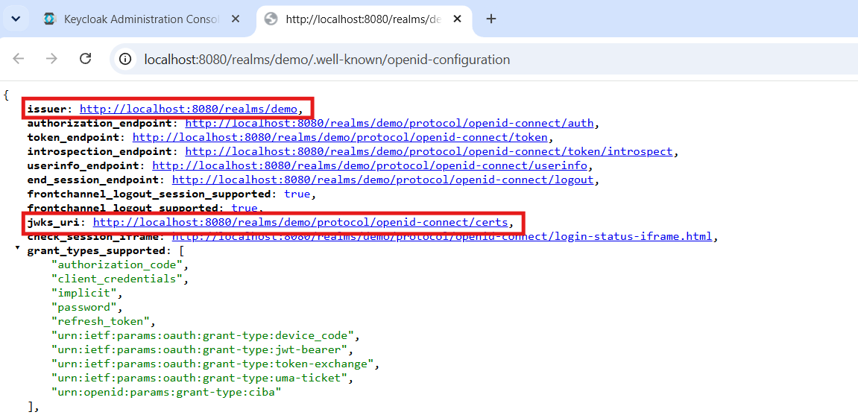
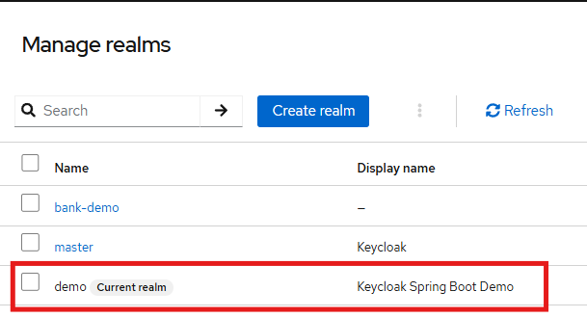
5. Issuer URI — one property points Spring at the realm
The issuer is the realm's identity: Keycloak URL + /realms/<realm>. Spring uses it to discover the realm's keys and to check every token's iss claim.
src/main/resources/application.yml
spring:
security:
oauth2:
resourceserver:
jwt:
issuer-uri: http://localhost:8080/realms/demo
What Spring does with it
On the first request that carries a JWT, Spring calls /realms/demo/.well-known/openid-configuration, reads jwks_uri, and from then on requires iss to equal issuer.
Takeaway
The API is not coupled to Keycloak at startup, but the issuer string must match exactly: scheme, host, port and realm.
Manage realms: realm demo is the one in the URL. A typo in the realm name means every token fails the issuer check → 401.

Slide 6
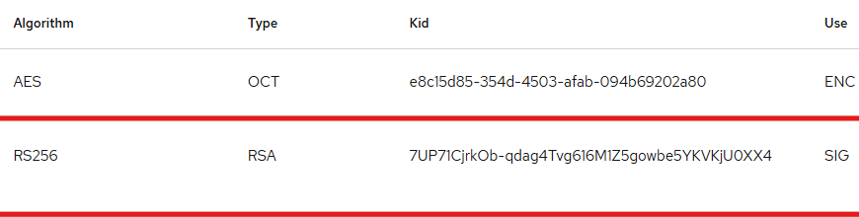






6. JWT validation — what Spring checks on every call
Validation happens locally inside the API with Keycloak's public key. Any failed check stops the request with 401 before controller code runs.
Read the Bearer token
401
missing on a protected URL
Find the key by kid
401
JWKS from jwks_uri, cached 5 min
Keycloak UI
Realm settings → Keys: the active RS256 key (Use SIG). Its Kid 7UP71Cjrk…U0XX4 is the same kid found in our tokens' header.
Why it matters
Only Keycloak has the private key. If one byte of the token changes, the signature check fails.
Not checked by default
aud. Our tokens carry "aud": "account". Spring checks it only if you set jwt.audiences (covered in a later topic).
Verify RS256 signature
401
token changed or forged
Check iss = issuer-uri
401
other realm or host
Check exp / nbf (60 s skew)
401
token expired
Build the Authentication
to @PreAuthorize

Slide 7
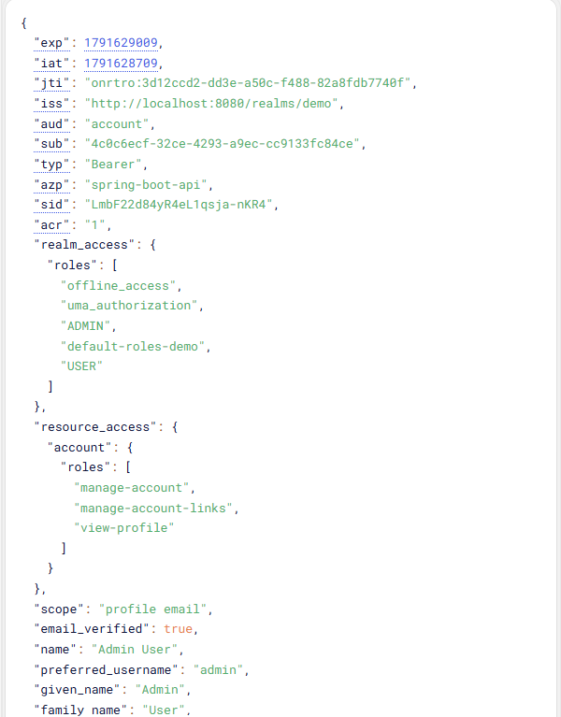
7. Inside the token — the claims the API reads
A real admin access token decoded on jwt.io. Each claim on the right has a job in the request you just saw.
Claim | Value in this token | Used for
iss | http://localhost:8080/realms/demo | must equal issuer-uri → else 401
exp | 1791629009 | expiry check → 401 when past
iat | 1791628709 | issued at; exp − iat = 300 s
preferred_username | admin | principal name (our converter)
realm_access.roles | ADMIN, USER, … | mapped to ROLE_ADMIN, ROLE_USER
azp | spring-boot-api | client that asked for the token
aud | account | not validated by default
Header (not shown): "alg": "RS256", "kid": "7UP71Cjrk…U0XX4" — the key from slide 6.
Decoded payload of the admin token (local demo token, already expired).

Slide 8
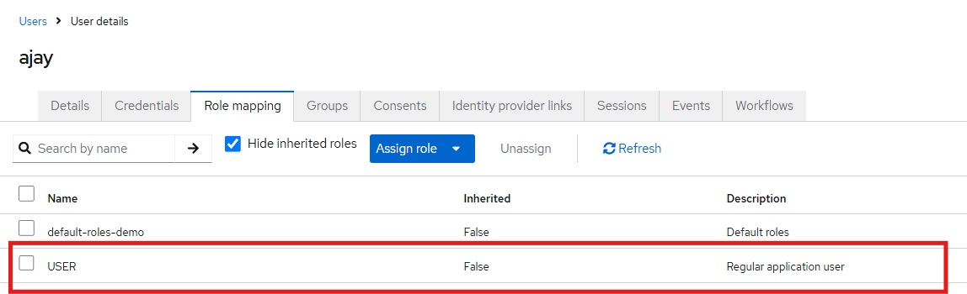
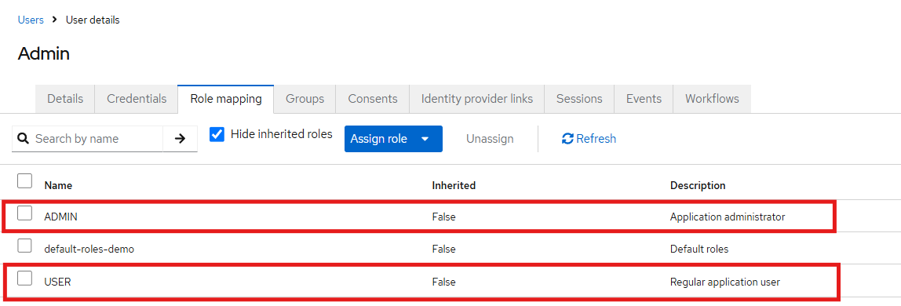
8. From Keycloak roles to Spring authorities
Keycloak puts realm roles in realm_access.roles. Spring only maps scope by default (SCOPE_profile, SCOPE_email), so a small converter turns roles into ROLE_*.
Users → ajay → Role mapping: realm role USER.
Users → admin → Role mapping: ADMIN and USER.
SecurityConfig.keycloakJwtAuthenticationConverter()
Why the ROLE_ prefix
hasRole('ADMIN') looks for the authority ROLE_ADMIN. Without this converter even admin gets 403.
Client roles too
Roles under resource_access.spring-boot-api.roles are mapped the same way. This demo only uses realm roles.
// realm_access.roles + resource_access.spring-boot-api.roles
Stream.concat(extractRealmRoles(jwt).stream(),
extractClientRoles(jwt).stream())
.map(role -> new SimpleGrantedAuthority("ROLE_" + role))
.toList();
return new JwtAuthenticationToken(jwt, authorities,
jwt.getClaimAsString("preferred_username"));
// GET /api/me with ajay's token returns:
{"username":"ajay","authorities":[
"ROLE_offline_access","ROLE_uma_authorization",
"ROLE_default-roles-demo","ROLE_USER"]}

Slide 9
9. Protected endpoints — the rules in code
Two layers: the filter chain decides who must be authenticated; @PreAuthorize on each method decides which role is required.
SecureController.java
Endpoint | Rule | No token | ajay | admin
GET /api/public | public | 200 | 200 | 200
GET /api/me | authenticated | 401 | 200 | 200
GET /api/accounts | USER or ADMIN | 401 | 200 | 200
POST /api/accounts | ADMIN | 401 | 403 | 200
DELETE /api/accounts/{id} | ADMIN | 401 | 403 | 200
@GetMapping("/api/public")
// permitAll() in SecurityConfig
@GetMapping("/api/me")
// any valid token
@GetMapping("/api/accounts")
@PreAuthorize("hasAnyRole('USER', 'ADMIN')")
@PostMapping("/api/accounts")
@PreAuthorize("hasRole('ADMIN')")
@DeleteMapping("/api/accounts/{id}")
@PreAuthorize("hasRole('ADMIN')")
@PreAuthorize only works because SecurityConfig has @EnableMethodSecurity.
Expected results from the project README; the highlighted cases are proven with Postman on the next slide.

Slide 10
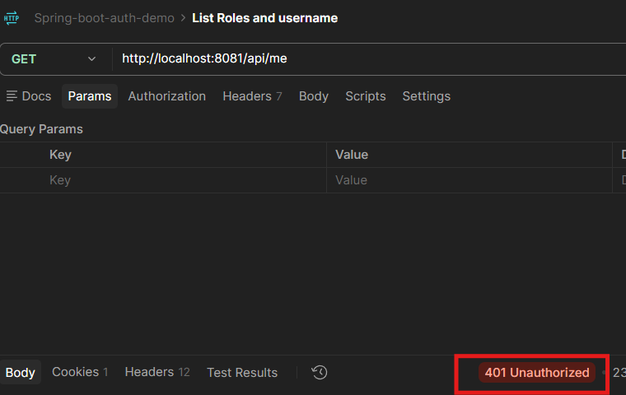
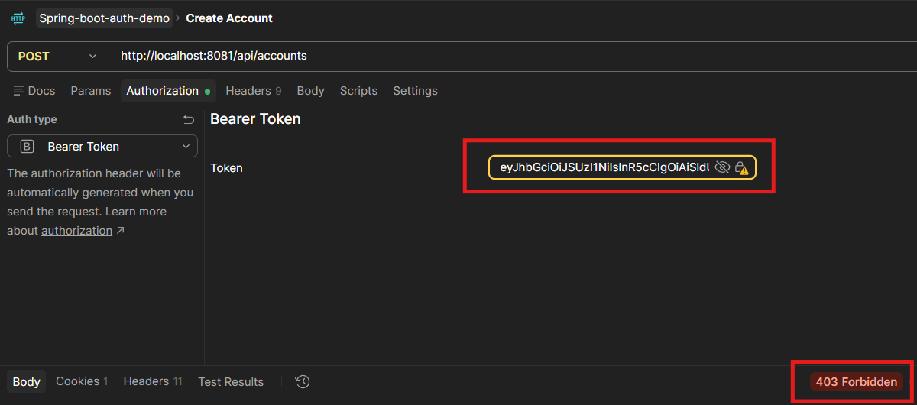
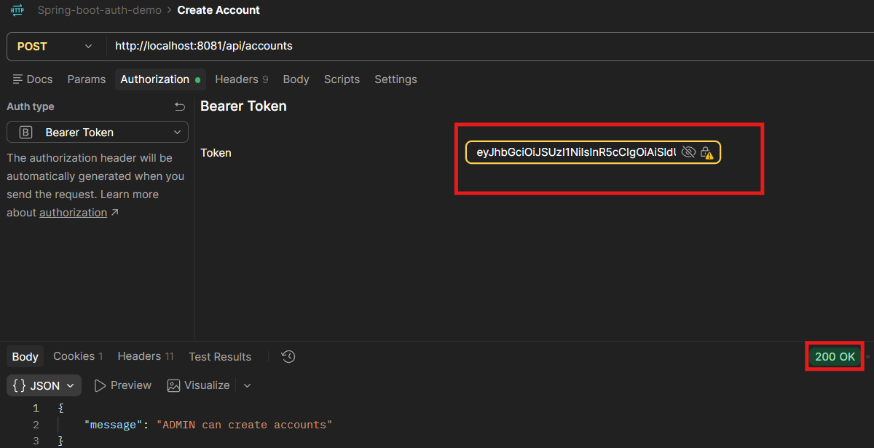
10. 401 vs 403 vs 200 — three different answers
The status code tells you which layer said no. Same API, same Postman collection, three requests.
401 Unauthorized
403 Forbidden
200 OK
GET /api/me — no token
POST /api/accounts — ajay
POST /api/accounts — admin
Spring does not know who you are. The filter rejects the call; no controller code runs.
Token is valid, ajay is known, but he has USER, and the method needs ADMIN.
Valid token and ROLE_ADMIN → {"message":"ADMIN can create accounts"}.
401 = authentication failed (missing, invalid or expired token) → fix the token. 403 = authenticated but not allowed → fix the role.

Slide 11
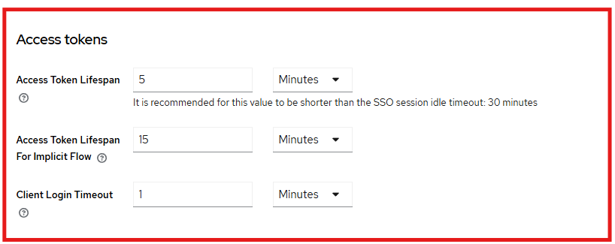
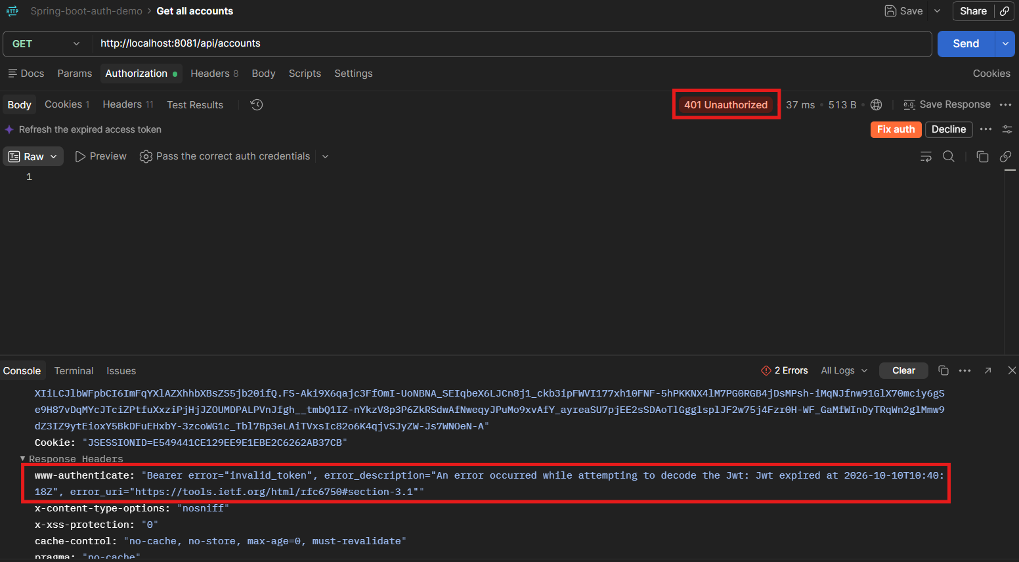
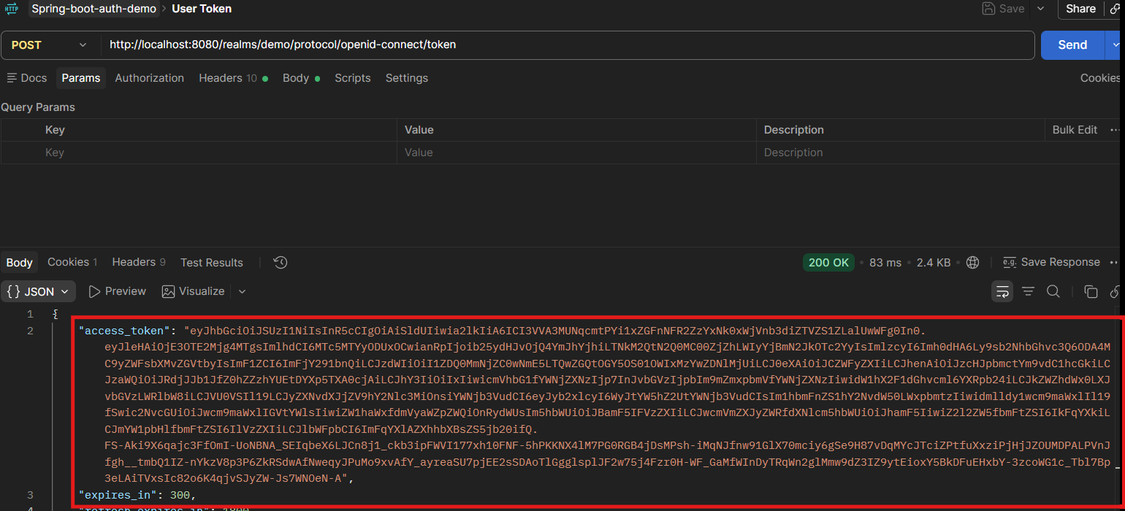
11. Token expiry — how the API knows a token is too old
Keycloak writes the deadline into the token as exp. The API compares it with its own clock, with no call to Keycloak needed.
Realm settings → Tokens: Access Token Lifespan 5 minutes.
Same request after 5 minutes: 401 and WWW-Authenticate: Bearer error="invalid_token" … "Jwt expired at 2026-10-10T10:40:18Z".
iat
exp = iat + 300 s
+60 s skew → 401
Token response: "expires_in": 300 seconds.
1791628709
1791629009
Values from the admin token on slide 7. A new token without a new login needs refresh tokens (later topic).

Slide 12
12. Hands-on — reproduce it in 10 steps
Everything runs on your machine: Docker for Keycloak, Java 21 + Maven for the API, Postman or curl for the calls.
1
docker compose up -d Keycloak 26.7.4 on :8080
Step 7 — token for ajay (README)
2
./scripts/provision-users.sh or .ps1
curl -X POST "http://localhost:8080/realms/demo/
protocol/openid-connect/token"
-H "Content-Type: application/
x-www-form-urlencoded"
-d "client_id=spring-boot-api"
-d "grant_type=password"
-d "username=ajay" -d "password=ajay123"
3
Open realm demo in the Admin Console slide 5
4
mvn spring-boot:run API on :8081
5
GET /api/public without a token → 200
6
GET /api/me without a token → 401 · slide 10
Verification checklist
Request a token for ajay expires_in: 300 · slide 11
Keycloak starts on :8080
Realm demo provisioned
7
API starts on :8081
No token → 401
8
GET /api/accounts as ajay → 200
ajay token → GET 200
ajay → POST 403
9
POST /api/accounts: ajay, then admin → 403, 200
admin → POST 200
Expired token → 401
10
Wait 5 min, repeat any call → 401 "Jwt expired" · slide 11
Postman: import Spring-boot-auth-demo.postman_collection.json, then paste a fresh token into each request's Bearer field.

Slide 13


13. Common mistakes
Most problems in this step show up as an unexpected 401 or 403. The code tells you where to look.
Issuer mismatch
401
Roles never mapped
403
Missing ROLE_ prefix
403
Token fetched from 127.0.0.1 or another realm, so iss ≠ issuer-uri. Use exactly the same URL everywhere.
Without the converter Spring only sees SCOPE_*, so even admin is forbidden.
hasRole('ADMIN') looks for ROLE_ADMIN. Prefix in the converter, not in the annotation.
Reusing an old token
401
Assuming aud is checked
Password grant in production
Tokens live 5 minutes. Read WWW-Authenticate and request a new one, rather than raising the lifespan.
Our token has aud: "account". Add jwt.audiences when many APIs share a realm (later topic).
Used here only to demo with curl. Real apps use Authorization Code + PKCE (later topic).

Slide 14

14. Key takeaways
The API is a Resource Server: it validates Keycloak's JWT and never handles passwords.
From local demo to production
In this demo | In a real system
http://localhost:8080 | HTTPS hostname of the IdP
start-dev, in-container data | production mode + database
password grant via curl | Authorization Code + PKCE
aud not checked | audiences set per API
re-login every 5 min | refresh tokens
one API | many services, gateway
issuer-uri is the single link to Keycloak: keys come from its JWKS and iss must match it.
401 = fix the token (missing, forged, wrong issuer, expired). 403 = fix the role.
Expiry is read from exp inside the token. Here tokens live 5 minutes, with 60 s clock skew.
Everything in the right column is covered in a later topic.
Get the code: github.com/ajayshinde01/keycloak/tree/main/02-spring-boot-keycloak
Run it: README.md in that folder · Postman collection included
Spring Security Reference, OAuth 2.0 Resource Server JWT: docs.spring.io/spring-security/reference/servlet/oauth2/resource-server/jwt.html · RFC 6750 §3.1 Bearer token errors · RFC 7519 JWT
Keycloak 26 Server Administration Guide: keycloak.org/docs/latest/server_admin · Screenshots and tokens: local demo run, 10 Oct 2026 (Keycloak 26.7.4, Spring Boot 3.5.16)

