Slide 1
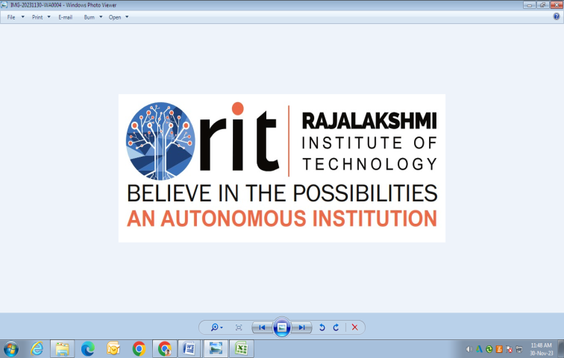
DEPARTMENT OF ARTIFICIAL INTELLIGENCE AND DATA SCIENCE ACADEMIC YEAR 2025 - 2026 SEMESTER III ARTIFICIAL INTELLIGENCE LABORATORY MINI PROJECT REVIEW DIABETES PREDICTION USING NAIVE BAYES ALGORITM
REGISTER NUMBER | 2117240070012
NAME | AJAY SINGH R J
YEAR | II AI & DS
SECTION | A
FACULTY IN-CHARGE | Mrs. M. Divya

Slide 2
PROBLEM STATEMENT
Artificial Intelligence (AI) allows systems to learn patterns from data and make decisions automatically
This project applies Machine Learning techniques to predict whether a person is diabetic or non-diabetic using medical details such as glucose level, blood pressure, BMI, insulin, and age.
The goal is to create a simple, accurate, and efficient model that can assist in early diabetes detection and awareness.

Slide 3
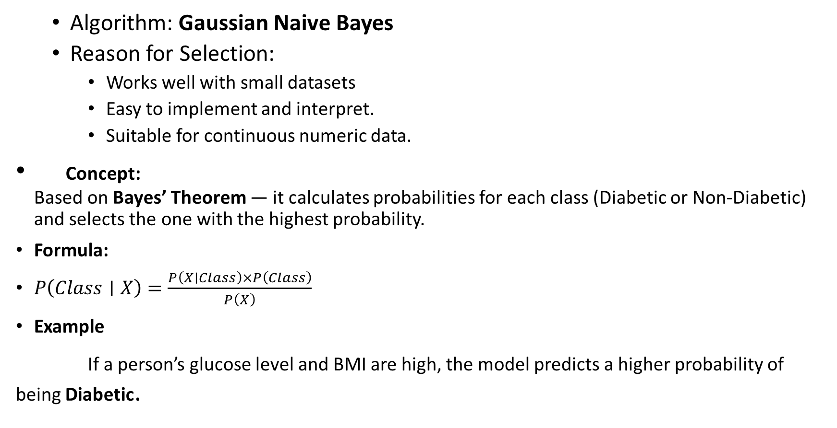
THEORETICAL BACKGROUND
Algorithm: Gaussian Naive Bayes
Reason for Selection:
Works well with small datasets
Easy to implement and interpret.
Suitable for continuous numeric data.
Concept: Based on Bayes’ Theorem — it calculates probabilities for each class (Diabetic or Non-Diabetic) and selects the one with the highest probability.
Formula:
$P\left(Class∣X\right)=\frac{P\left(X∣Class\right)×P\left(Class\right)}{P\left(X\right)}$
Example
If a person’s glucose level and BMI are high, the model predicts a higher probability of being Diabetic.

Slide 4
IMPLEMENTATION AND CODE
Link to code in Git-hub Repository
List | Git-hub Repository Links
Implementation of Code Link | Link
Word Document Report Link | Link
PPT Link | Link

Slide 5
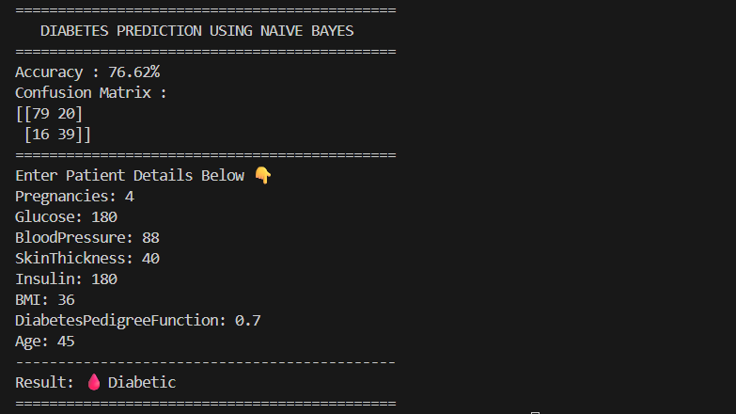
OUTPUT AND RESULTS
OUTPUT:
OUTPUT EXPLANATION:
The model was trained and tested using the Pima Indians Diabetes dataset.
It achieved an accuracy of 76.62%, showing good prediction performance.
The confusion matrix indicates correct and wrong classifications for diabetic and non-diabetic cases.
After entering patient details (e.g., Glucose = 180, BMI = 36, Age = 45),the model predicted the result as 🩸 Diabetic.
High glucose and BMI values influenced the diabetic prediction

Slide 6
OUTPUT AND RESULTS
Future Enhancements:
Use advanced models.
Create a GUI or web app for easier user input.
Add more data for higher accuracy.

Slide 7
REFERENCES
Brownlee, J. — Pima Indians Diabetes Dataset, UCI Machine Learning Repository.
Russell, S. & Norvig, P. — Artificial Intelligence: A Modern Approach, Pearson Education.
GeeksforGeeks — “Naive Bayes Classifier in Machine Learning.”
Scikit-Learn Documentation — “GaussianNB Classifier.”
Towards Data Science — “Building a Diabetes Prediction Model Using Python.”

